Slide 1
WGRDBES-StockCoord Exchange format (RCEF v14) Part 2
Kirsten Birch Håkansson, DTU Aqua, Denmark
Sofie Nimmegeers, ILVO, Belgium
Presented at WGRDBES-StockCoord 2nd intersessional meeting, 23th of July 2025

Slide 2
Issues and improvements
https://github.com/ices-tools-dev/RDBESstockCoord/tree/main/WGRDBESstockCoord/format/RCEF_v14_suggestions

Slide 3
RCEF issues
Estimated landings
Better definition of Census and Estimated catches in relation to ScientificWeight and officialWeight in RDBES CL
Estimation per species (e.g., Lophius) and grouping of species (e.g., Argentines)
Explore alternative solutions, so it is not needed to add DomainCatchxxx on landings
Units
Blanks / optional
Standard errors from CL and CE

Slide 4
Optional - blanks – total / mean
RCEF v14 - Age/Length/Width Distribution
Issue:
WKNatEst found that there were too many blanks in the dataset, which caused confusion
Blank fields can lead to processing errors and misinterpretation during analysis
Suggested restructuring of the format
Suggested solution:
Added a valueType in Age/Length/Width Distribution.
Removed mean from estimated catches as we probably will never report a mean
Link to RCEF_tv14.1_example
variableType | total | mean | varianceTotal | varianceMean
Number | 20.85402
Number | 42.3384
Number | 17.52962
Number | 11.48574
Number | 3.10508
WeightLive |  | 478.71
WeightLive |  | 584.97
WeightLive |  | 907.98
WeightLive |  | 1290.69
RCEF v14 - Estimated catches
variableType | total | mean
ScientificWeight_kg | 34574.71966
ScientificWeight_kg | 2550
ScientificWeight_kg | 25
ScientificWeight_kg | 0
ScientificWeight_kg | 100
ScientificWeight_kg | 25

Slide 5
Merging Census Catches and Estimated Catches into Catches
Issues:
The format must support estimated landings​ e.g., split of species (e.g., Lophius) and grouping of species (e.g., Argentines)
scientificWeight and officialWeight were discussed in the context of Census vs. Estimated Catches​
Presence of blank fields in census catches when used for estimated catches caused confusion​
Solution – previously suggested:​
Census Catches = values declared in RDBES CL​
Estimated Catches = values estimated in TAF using RDBES CS data​
Solution – currently suggested:​
Merged Census Catches and Estimated Catches
Renamed scientificWeight_kg to Weight_kg for simplicity and clarity
Link to RCEF_tv14.2_example

Slide 6
Optional – blanks – Season in Catch
Issue:
The format should support estimates at the level of estimation: e.g., quarter is optional to allow yearly estimates
WKNatEst found this setup confusing and suggested restructuring of the format
Some AWGs require monthly data, so a month field should be added
Suggested solution:
Added seasonType and seasonValue.
Both will be mandatory.
Enables easy aggregation of data at consistent seasonal levels
Approach is aligned with InterCatch
Link to RCEF_tv14.3_example
RCEF v14 – Census Catches / Catch
year | workingGroup | speciesCode | catchCategory | quarter | area
2023 | WGNSSK | 127150 | Lan | 1 | 27.4.a
2023 | WGNSSK | 127150 | Lan | 1 | 27.3.a
2023 | WGNSSK | 127150 | Lan | 1 | 27.4.a
2023 | WGNSSK | 127150 | Lan | 1 | 27.3.a
2023 | WGNSSK | 127150 | Lan | 1 | 27.7.e
2023 | WGNSSK | 127150 | Lan | 1 | 27.7.d
2023 | WGNSSK | 127150 | Lan | 2 | 27.4.a
2023 | WGNSSK | 127150 | Lan | 2 | 27.3.a
2023 | WGNSSK | 127150 | Lan | 2 | 27.7.e
2023 | WGNSSK | 127150 | Lan | 2 | 27.7.d
2023 | WGNSSK | 127150 | Dis |  | 27.7.d

Slide 7
Optional – blanks - Area
Issue:
Area was previously optional to support estimates at different spatial levels, e.g., entire stock area or area combinations​
WKNatEst found the blanks confusing and suggested restructuring​
There were challenges in how to declare area groupings​
Suggested solution: ​
Introduced areaType and areaValue ​
Both will be mandatory​
This allows clear visibility of spatial aggregation levels​
Link to RCEF_tv14.4_example
Implying all areas covered by the stock
RCEF v14 – Census Catches / Catch
no | year | Working-Group | stock | Catch-Category | Season- Type | Season-Value | area
1 | 2023 | WGNSSK | bll.27.3a47de | Dis | Year | 2023
1 | 2023 | WGNSSK | bll.27.3a47de | BMS | Year | 2023
3 | 2023 | WGNSSK | bll.27.3a47de | Dis | Year | 2023 | 27.7.d
3 | 2023 | WGNSSK | bll.27.3a47de | Dis | Year | 2023
Implying all areas in the stock minus 27.7.d

Slide 8
Fleet – declaring none AWG fleets
Issue:
Fleet is mandatory in census catches
Only option is WG fleet
We need to be able to declare if we have grouped fleets, which is not possible in the current version​
Suggested solution:​
Added fleetType and fleetValue.
Both will be mandatory
Link to RCEF_tv14.5_example
WGFleet, WGFleetList, Metier6, Metier6List, Metier5, Metier5List, Metier4, Metier4List

Slide 9
Metier6 in census catches
Issue:
The field is optional and at WGCATCH 2024 it was discussed if the metier6 field is needed in census catches.
We have the link between metier6 and fleet in Effort
Suggested solution:
We think it is needed and with the suggested fleetType then it is even more relevant
Mandatory if fleetType %in% c(“Metier6”, “Metier6List”, “Metier5”, “Metier5List”, “Metier4”, “Metier4List”)

Slide 10
Domains – do we need them on the landings?
Issue:
Coordination between data submitters
Including zero landings if an estimate of e.g., discard is present
Purpose of the domains
Convey information to SC
Support the link between e.g., landings and discard
Link to RCEF_tv14.6_example
Suggested solution:
With the help of seasonType, areaType, fleetType it should be possible to link
We still think it is needed to make the link obvious

Slide 11
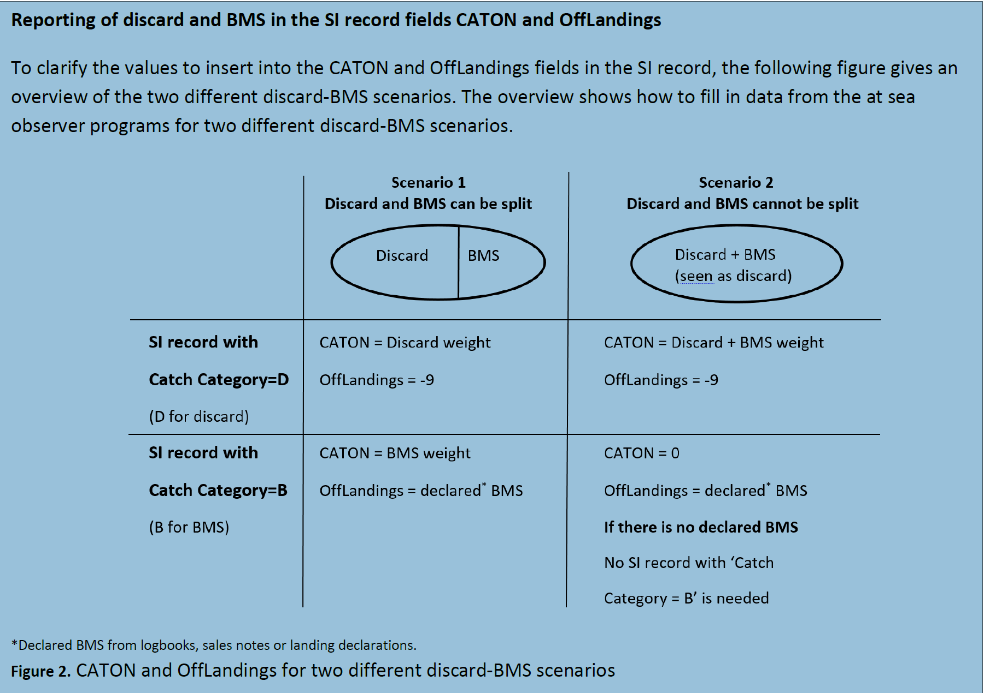
Reporting of Estimated BMS
Issue:
It should be clear when BMS and Dis is estimated together
Suggested solution:
Add a “DisBMS” code to catchCategory
Link to RCEF_tv14.8_example

Slide 12
FisheriesManagementUnit?
Issue:
We included FisheriesManagementUnit in Catch, since it is a stock unit, but do we need it as a separate field?
Suggested solution:
Keep FisheriesManagementUnit as an optional field or introduce within areaType
Link to RCEF_tv14.9_example
Concerns & Considerations:
Remember the link to effort to get zero landings
It can be tricky to have FisheriesManagementUnit in effort

Slide 13
Statistical rectangle in Catch?
Issue:
Some users request catch data at the rectangle level
Solution:
Introduce rectangle as an optional field or within areaType
Concerns & Considerations:
Is rectangle-level estimation actually needed?
While we have landings per rectangle, it’s uncertain whether discards or biological data can reliably be estimated at this resolution
Adding rectangle support is technically feasible and can be done if the need arises in the future

Slide 14
Other issues
Units
Stock relation

