Slide 1



Matlab tools for conversion to ICES hdf5 format and client for up-and downloading 4 October 2023 ICES Secretariat, at H. C. Andersens Boulevard 44-46, 1553, Copenhagen
Fritjof Basan– Federal Maritime and Hydrographic Agency of Germany

Slide 2
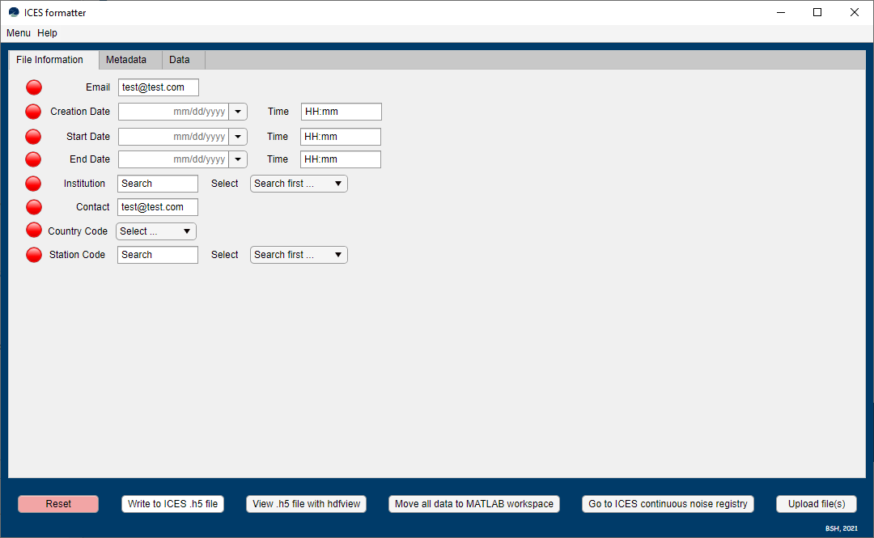
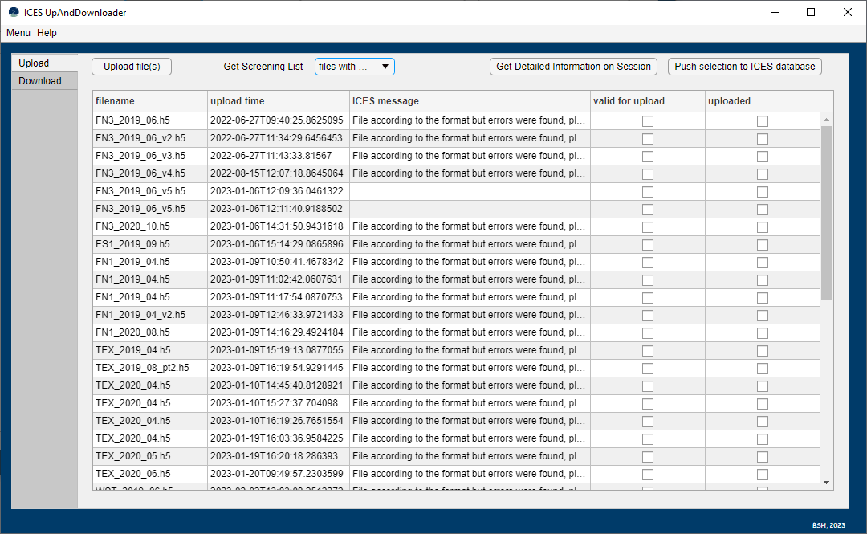
2 Matlab Tools
One tool for data conversion and one for up/download
GUI from app designer as method to organize and store scripts and make h5 files/ICES database more accessible
Long-lasting and comprehensible solution for agency such as BSH – enable easy access to workflow and data to more colleagues (also in the futzre)

Slide 3
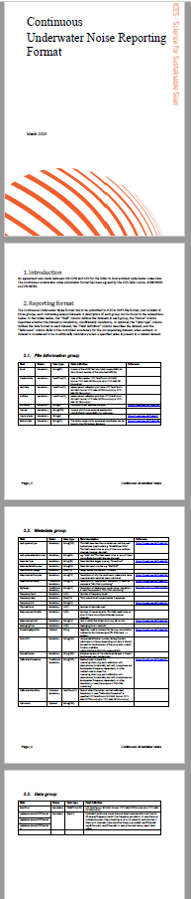
Conversion tool - structure
Whole tool is available at github: https://github.com/bshsound/format3000 and will also be made available on the ICES github after the workshop.
Tab – structure similar to ICES hdf5 format
Offers to:
Enter datasets manually
Load ICES format (e.g. as template)
Load Pamguide .csv output
Export to ICES format
Move to Matlab Workspace
(Batch-) upload data

Slide 4
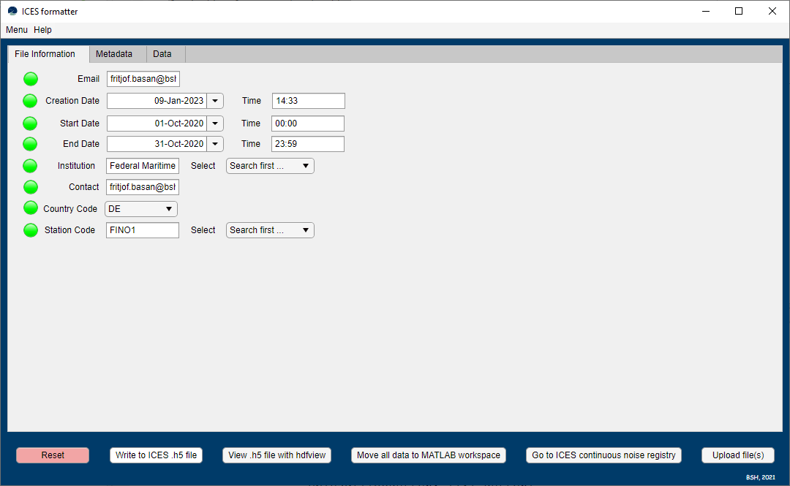
Conversion tool – structure – File Information
Added datasets get green light – missing datasets red
Search fields for Institution and Station Code
Accesses ICES library and automatically converts to ICES codes
Dropdown Menus for Country Codes (and stations and institutions)

Slide 5
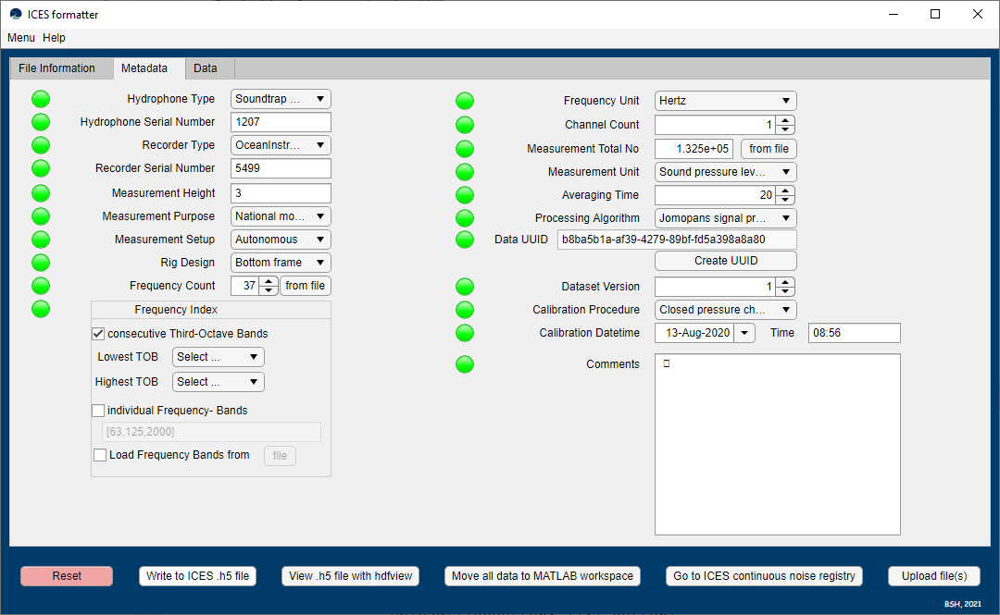
Conversion tool – structure – Metadata
Dropdown Menus to acces ICES vocabulary (not yet implemented to update vocabulary via API)
Possible to enter more than one channels
(Measurement Total No not yet automated …)

Slide 6
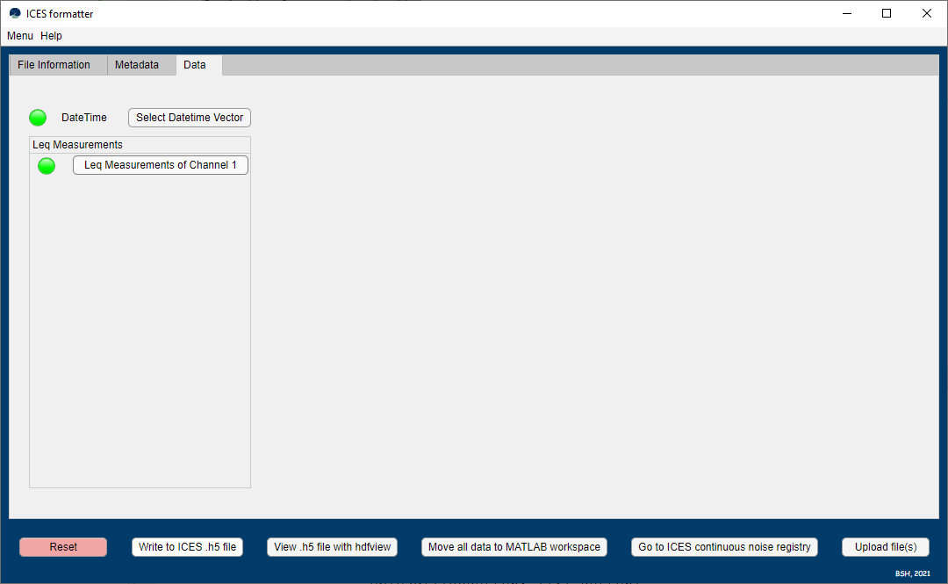
Conversion tool – structure – Data
Add datetime vector from .csv file, hdf5 file or from .mat file
Add Leq (TOLs) from .csv file, hdf5 file or from .mat file
Now data can be moved to Matlab workspace
Or written to ICES .h5 file
Link to ICES cont. Database is provided to upload file(s) manually)
Upload several files at once (batch upload possible)

Slide 7
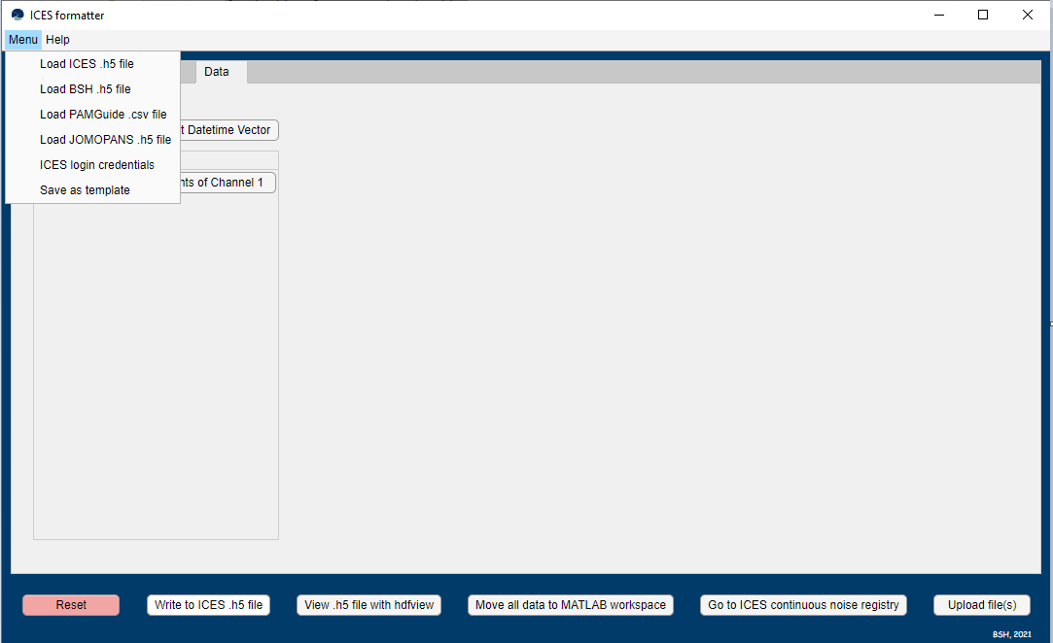
Conversion Tool – Import/Export
Templates can be helpful when several files with many identical datasets need to be uploaded (e.g. monthly h5 files for one deployment)
ICES login credentials necessary in order to upload files
Help until now only links to ICES format - no documentation of tool yet
Load ICES file can be helpful to read ICES h5 files
Load Pamguide .csv files imports datetime and TOLs from tabular Pamguide output (convenient to be combined with h5 template)

Slide 8
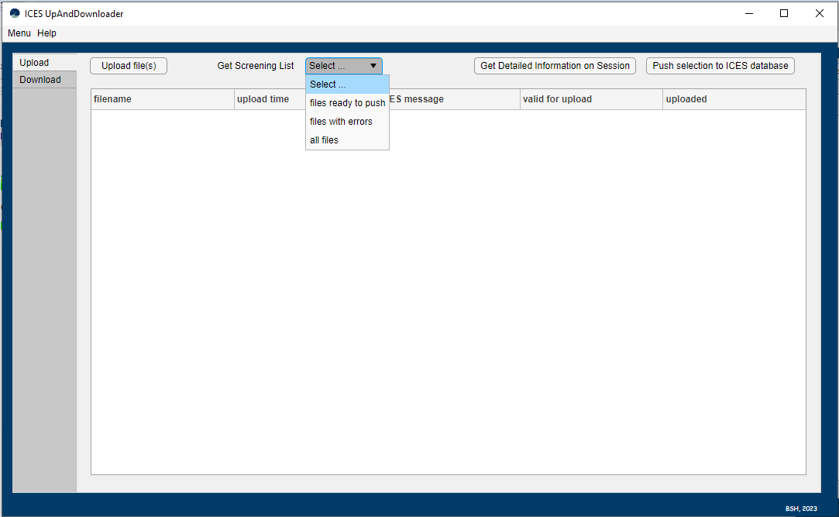
Upload/Download API client
Another tool to upload h5 files to ICES database and to download file from it
Pushing of files is not yet operational! (hopefully after the workshop)
Upload file(s) button works just like button in formatting tool
Get Screening List dropdown menu defines how personal list of submissions (ICES login required) is filtered and displayed

Slide 9
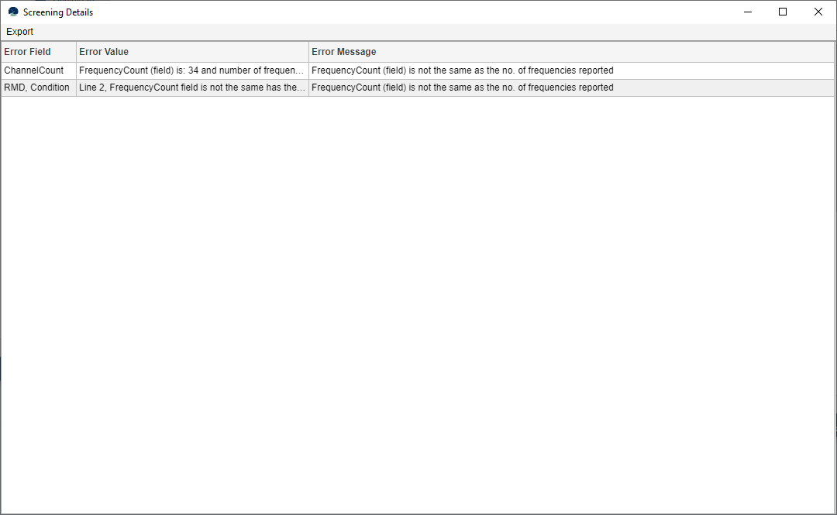
Upload/Download API client
List of submissions with errors is displayed (not valid for upload and also not uploaded)
In order to find out the problem, because of which the file cannot be uploaded – individual detailed session messages can be displayed when clicking on „Get Detailed Information on Session“

Slide 10
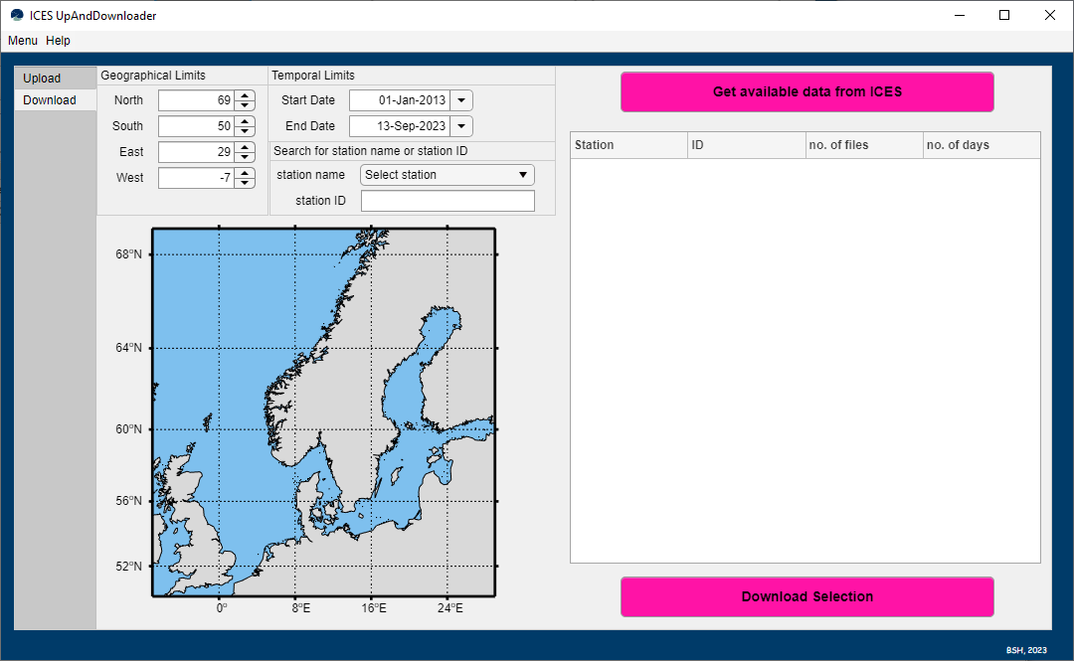
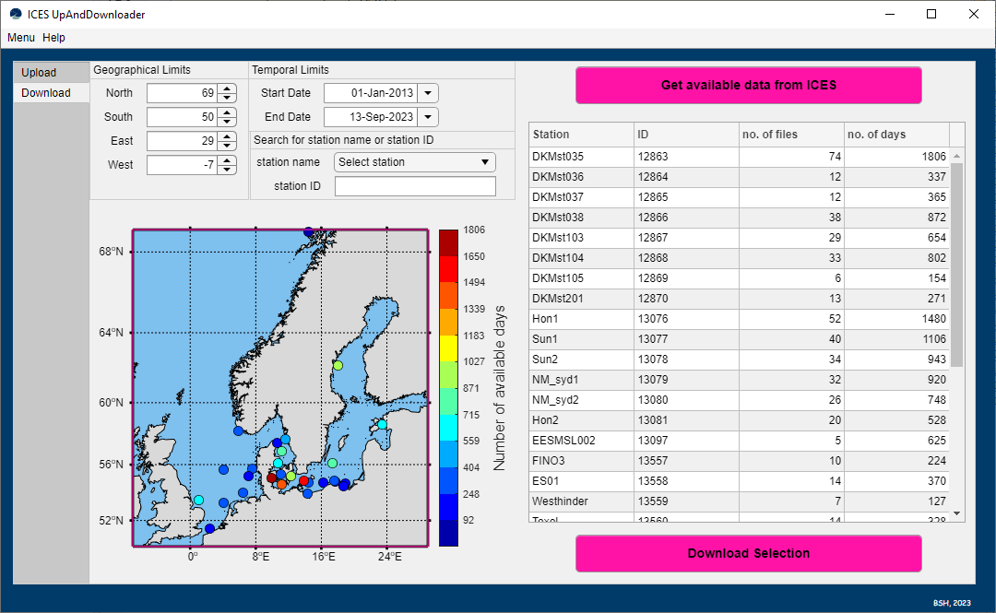
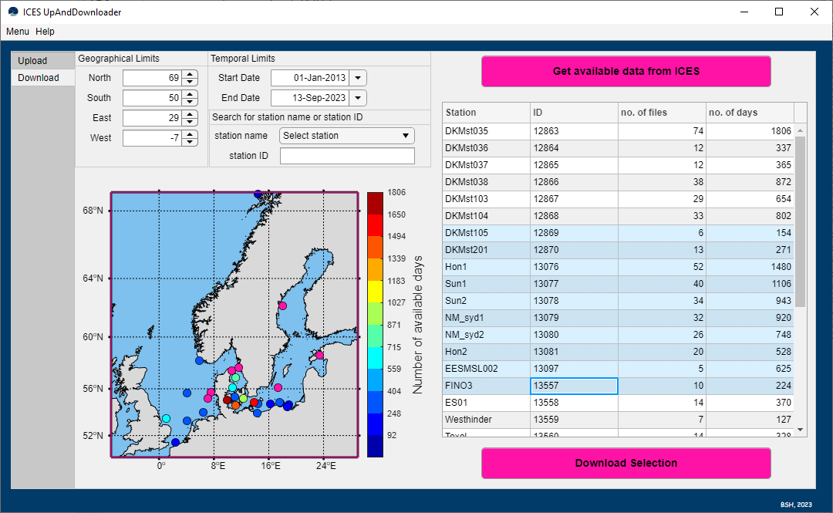
Upload/Download API client
User can enter either geographical and temporal limits or choose a station name from the drop down list (enter ist station ID)
If nothing is selected the default extent is used
„Get available data from ICES“ generates a table of available stations and how much files are available for the chosen period
Download will download the files to a directory that the user specifies

Slide 11
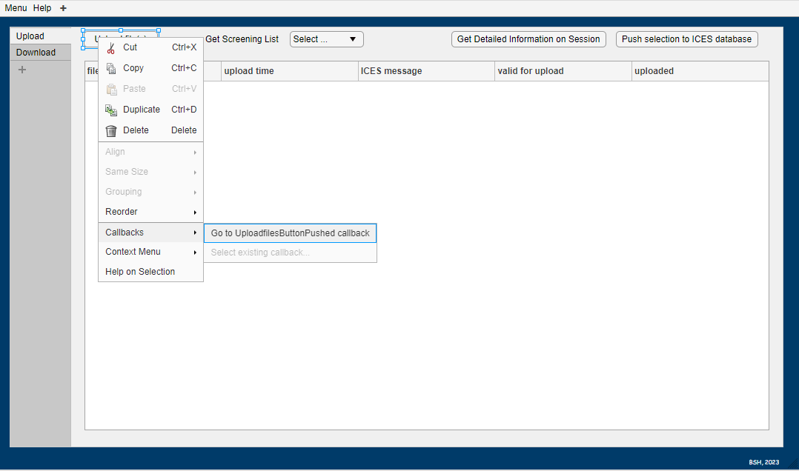
Conversion and Up/Download tool
Both tools are created in Matlab‘s app designer (.mlapp files)
To find specific scripts the tools can be opened in App Designer and by Right-Clicking one can navigate to corresponding callback functions

Slide 12
Future Plans
Integrate Push – in order to finalize option of batch uploading files
Update vocabularies via api
Fix bugs and errors
Integrate both tools into one
Open for collaboration in github environment

