Slide 1
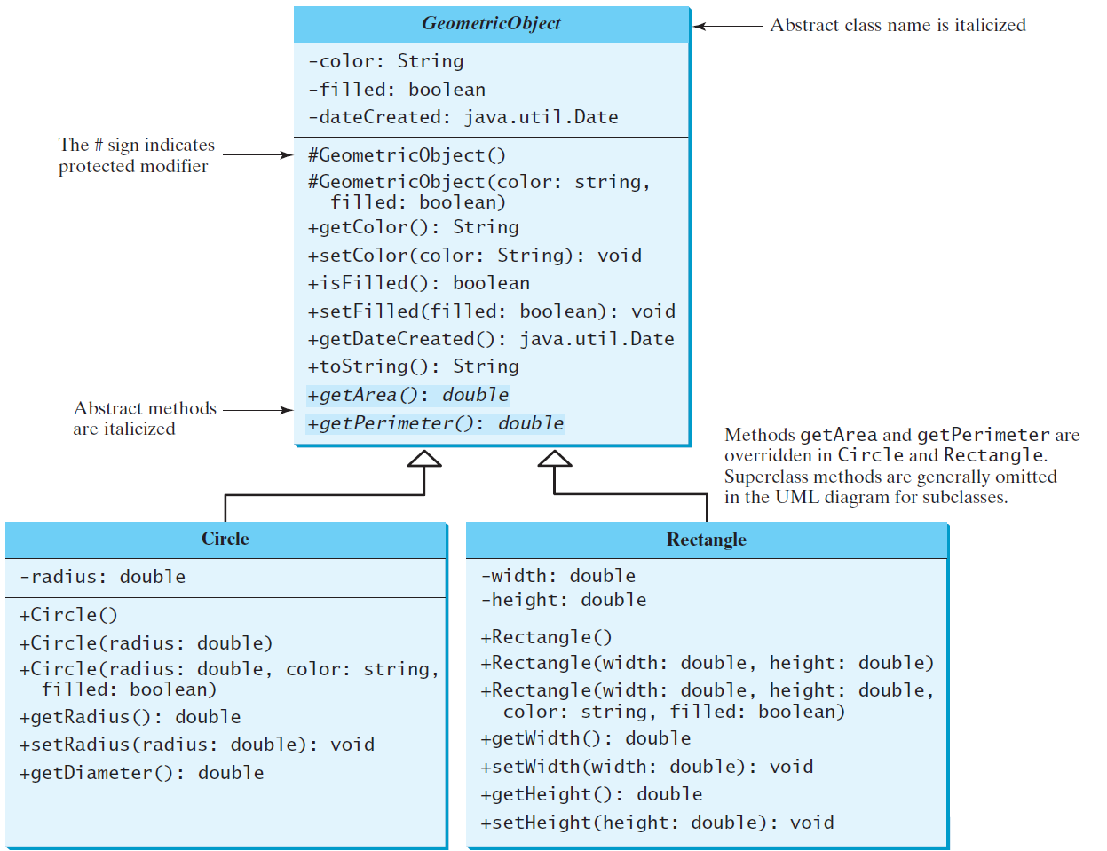
Abstract Classes and Abstract Methods

Slide 2
abstract method in abstract class
An abstract method cannot be contained in a nonabstract class. If a subclass of an abstract superclass does not implement all the abstract methods, the subclass must be defined abstract. In other words, in a nonabstract subclass extended from an abstract class, all the abstract methods must be implemented, even if they are not used in the subclass.

Slide 3
object cannot be created from abstract class
An abstract class cannot be instantiated using the new operator, but you can still define its constructors, which are invoked in the constructors of its subclasses. For instance, the constructors of GeometricObject are invoked in the Circle class and the Rectangle class.

Slide 4
superclass of abstract class may be concrete
A subclass can be abstract even if its superclass is concrete. For example, the Object class is concrete, but its subclasses, such as GeometricObject, may be abstract.

Slide 5
abstract class as type
You cannot create an instance from an abstract class using the new operator, but an abstract class can be used as a data type. Therefore, the following statement, which creates an array whose elements are of GeometricObject type, is correct.
GeometricObject[] geo = new GeometricObject[10];

Slide 6
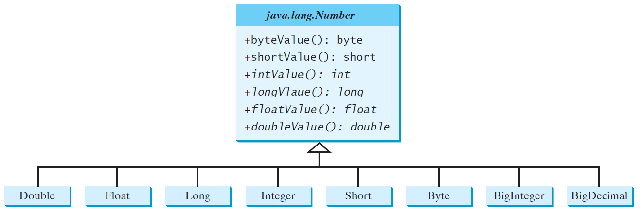
Case Study: the Abstract Number Class

Slide 7
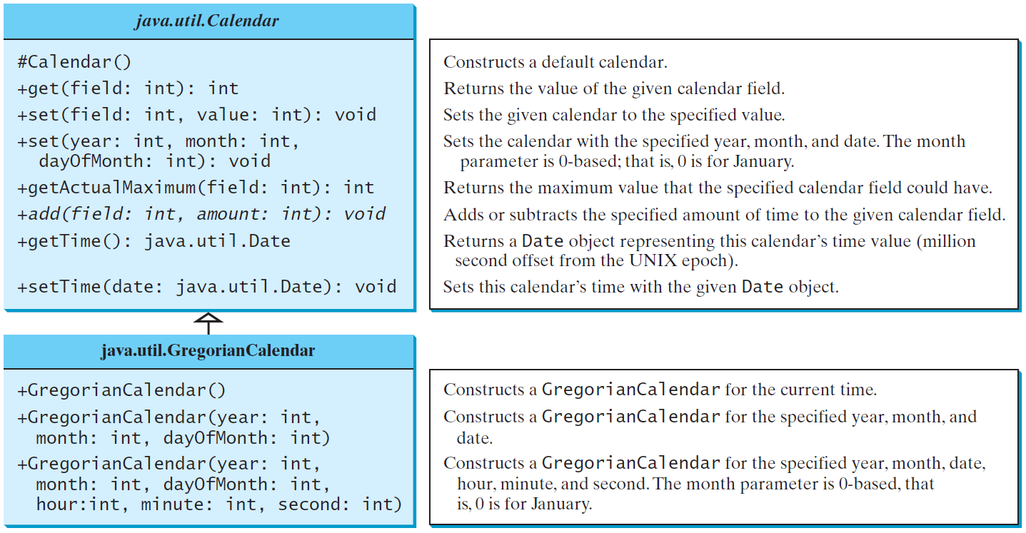
The Abstract Calendar Class and Its GregorianCalendar subclass

Slide 8
The GregorianCalendar Class
You can use new GregorianCalendar() to construct a default GregorianCalendar with the current time and use new GregorianCalendar(year, month, date) to construct a GregorianCalendar with the specified year, month, and date. The month parameter is 0-based, i.e., 0 is for January.

Slide 9
What is an interface?
Why is an interface useful?
An interface is a classlike construct that contains only constants and abstract methods. In many ways, an interface is similar to an abstract class, but the intent of an interface is to specify common behavior for objects. For example, you can specify that the objects are comparable, edible, cloneable using appropriate interfaces.

Slide 10
Define an Interface
To distinguish an interface from a class, Java uses the following syntax to define an interface:
public interface InterfaceName {
constant declarations;
abstract method signatures;
}
Example:
public interface Edible {
/** Describe how to eat */
public abstract String howToEat();
}

Slide 11
Interface is a Special Class
An interface is treated like a special class in Java. Each interface is compiled into a separate bytecode file, just like a regular class. Like an abstract class, you cannot create an instance from an interface using the new operator, but in most cases you can use an interface more or less the same way you use an abstract class. For example, you can use an interface as a data type for a variable, as the result of casting, and so on.

Slide 12
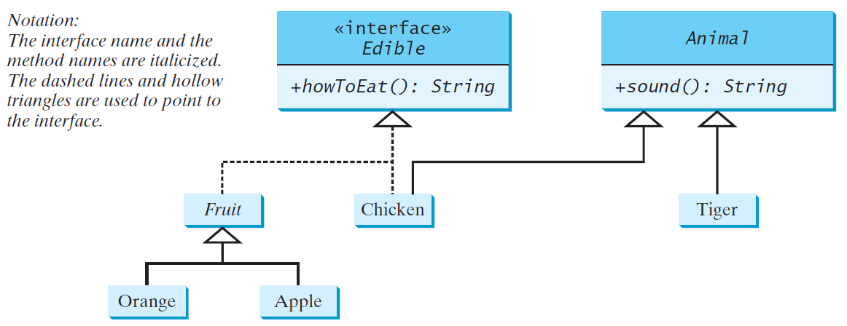
Example
You can now use the Edible interface to specify whether an object is edible. This is accomplished by letting the class for the object implement this interface using the implements keyword. For example, the classes Chicken and Fruit implement the Edible interface (See TestEdible).

Slide 13
Example: The Comparable Interface
// This interface is defined in
// java.lang package
package java.lang;
public interface Comparable<E> {
public int compareTo(E o);
}

Slide 14
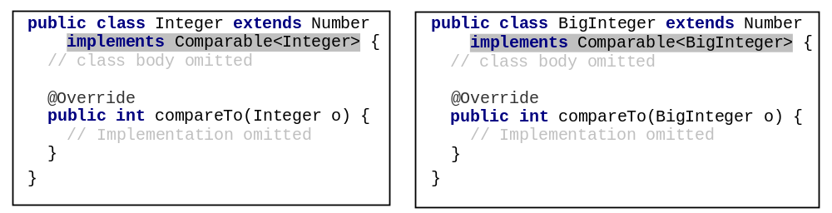
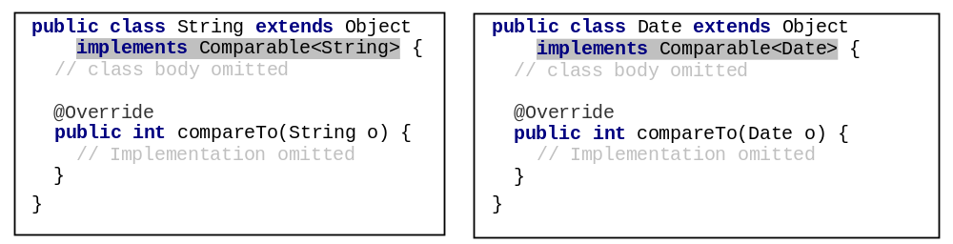
Integer and BigInteger Classes
String and Date Classes

Slide 15
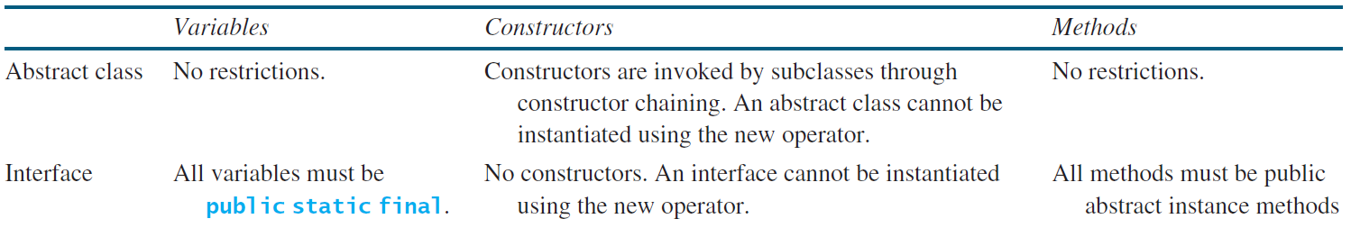
Interfaces vs. Abstract Classes
  In an interface, the data must be constants; an abstract class can have all types of data.
  Each method in an interface has only a signature without implementation; an abstract class can have concrete methods.

Slide 16
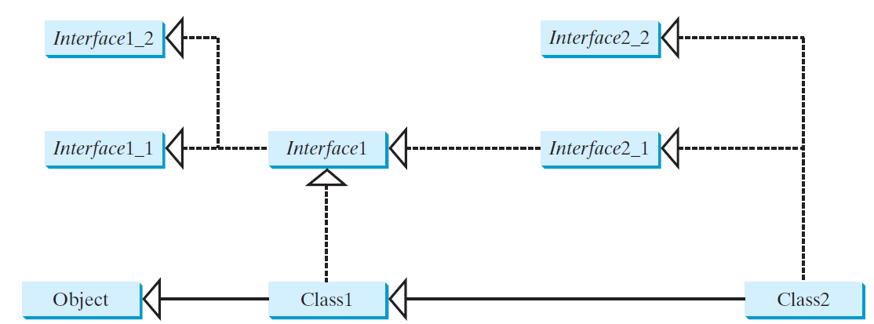
Interfaces vs. Abstract Classes, cont.
  All classes share a single root, the Object class, but there is no single root for interfaces. Like a class, an interface also defines a type. A variable of an interface type can reference any instance of the class that implements the interface. If a class extends an interface, this interface plays the same role as a superclass. You can use an interface as a data type and cast a variable of an interface type to its subclass, and vice versa.
  Suppose that c is an instance of Class2. c is also an instance of Object, Class1, Interface1, Interface1_1, Interface1_2, Interface2_1, and Interface2_2.

Slide 17
Whether to use an interface or a class?
  Abstract classes and interfaces can both be used to model common features. How do you decide whether to use an interface or a class? In general, a strong is-a relationship that clearly describes a parent-child relationship should be modeled using classes. For example, a staff member is a person. A weak is-a relationship, also known as an is-kind-of relationship, indicates that an object possesses a certain property. A weak is-a relationship can be modeled using interfaces. For example, all strings are comparable, so the String class implements the Comparable interface. You can also use interfaces to circumvent single inheritance restriction if multiple inheritance is desired. In the case of multiple inheritance, you have to design one as a superclass, and others as interface.

