Slide 1
DevOps Experts
Class 2
Yariv Freifeld

Slide 2
Docker

Slide 3
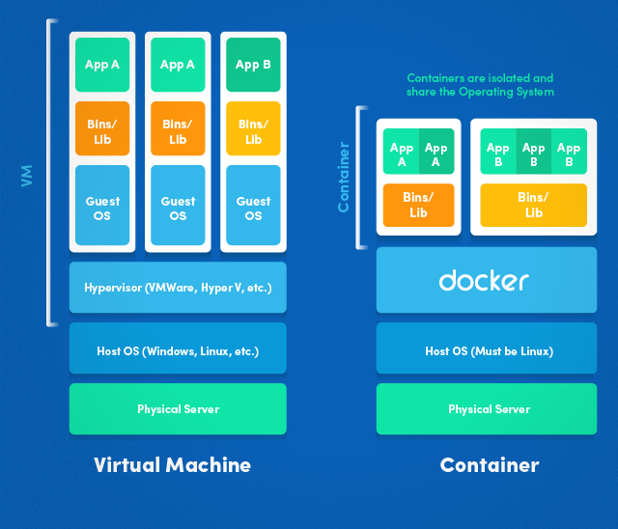
History

Slide 4
Docker
Docker is a computer program that performs operating-system-level virtualization also known as containerization.
It was first released in 2013 and is developed by Docker, Inc.
Docker is used to run software packages called "containers".
In a typical example use case, one container runs a web server and web application, while a second container runs a database server that is used by the web application.

Slide 5
Docker
Containers are isolated from each other and bundle their own tools, libraries and configuration files; they can communicate with each other through defined channels.
All containers are run by a single operating system kernel and are thus more lightweight than virtual machines.
Containers are created from "images" that specify their precise contents.
Images are often created by combining and modifying standard images downloaded from repositories.

Slide 6
Hypervisor
Hypervisor is a piece of software, firmware, or hardware that VMs run on top of (like our Ubuntu).
The hypervisors themselves run on physical computers, referred to as the “host machine”.
The host machine provides the VMs with resources, including RAM and CPU.
These resources are divided between VMs and can be distributed as you see fit.
So if one VM is running a more resource heavy application, you might allocate more resources to that one than the other VMs running on the same host machine.

Slide 7
Dockerfile
A Dockerfile is where you write the instructions to build a Docker image.
Once you’ve got your Dockerfile set up, you can use the docker build command to build an image from it.
It supports a simple set of commands that you need to use in your Dockerfile.
There are several commands supported like FROM, CMD, VOLUME, ENV and more
A Dockerfile is a text file that Docker reads in from top to bottom.
You can relate it to cooking. In cooking you have recipes. A recipe lets you know all of the steps you must take in order to produce whatever you’re trying to cook.

Slide 8
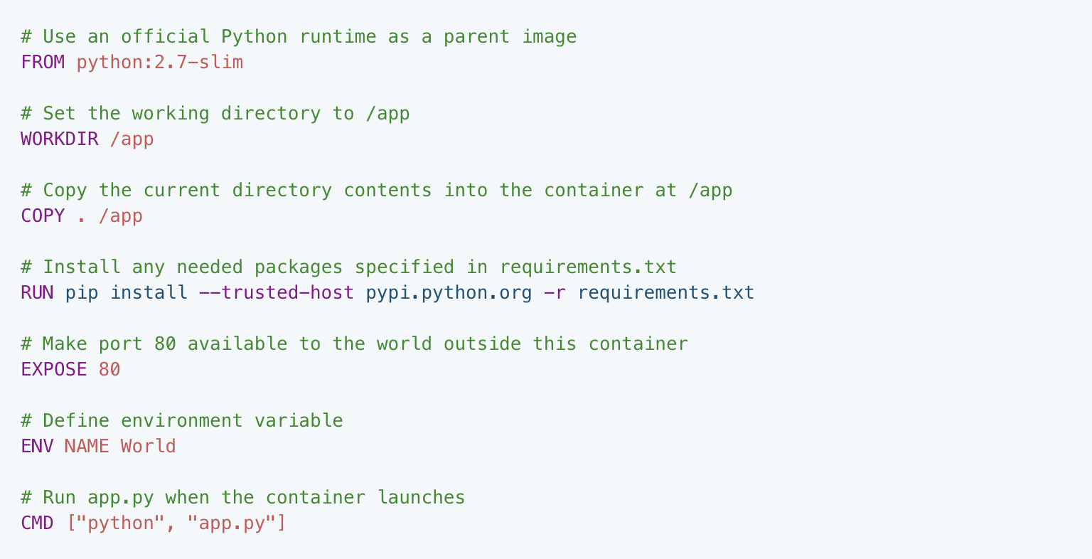

Slide 9
Image
Images are read-only templates that you build from a set of instructions written in your Dockerfile.
Images define both what you want your packaged application and its dependencies to look like and what processes to run when it’s launched.
The Docker image is built using a Dockerfile.
Each instruction in the Dockerfile adds a new “layer” to the image, with layers representing a portion of the images file system that either adds to or replaces the layer below it.
Layers are key to Docker’s lightweight yet powerful structure.

Slide 10
Containers
Unlike a VM which provides hardware virtualization, a container provides operating-system-level virtualization.
For all intent and purposes, containers look like a VM.
For example, they have private space for processing, can execute commands as root, have a private network interface and IP address, allow custom routes and iptable rules, can mount file systems, etc.

Slide 11
Containers
A Docker container, wraps an application’s software into an invisible box with everything the application needs to run.
That includes the operating system, application code, runtime, system tools, system libraries, etc.
Docker containers are built off Docker images.
Since images are read-only, Docker adds a read-write file system over the read-only file system of the image to create a container.

Slide 12
Setup
Download Docker toolbox from:
https://docs.docker.com/toolbox/overview
Follow the defaults and make sure Docker compose & Kitematic
are marked and Virtualbox and Git are not (we already have them
installed):

Slide 13
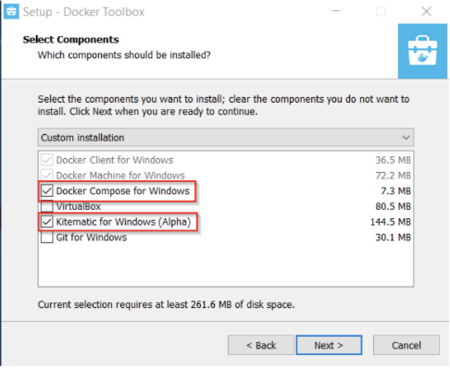
Setup

Slide 14

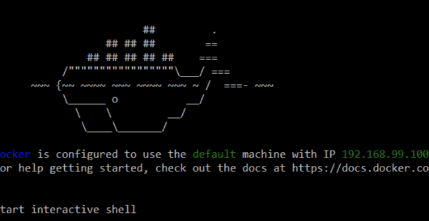
Setup
Once installation is done open the Docker toolbox app:
Wait until you see the following:

Slide 15
Commands
docker version
docker pull <image_name>
docker run -itd --name <container_name> <image_name>
docker push <username/image_name>
docker images (or ‘image ls’)
docker rm <container name or Id>
docker ps
docker exec -it <container name or id>
docker stop <container name or id>

Slide 16
Nginx
Nginx (Engine X) is an open source reverse proxy server for HTTP, HTTPS, SMTP, POP3, and IMAP protocols, as well as a load balancer, HTTP cache, and a web server (origin server).
According to Netcraft, nginx served or proxied 24.86% busiest sites in July 2018.
Some of the success stories are: Dropbox, Netflix, Wordpress.com, FastMail.FM.
We are going to use Nginx as a running Docker container:

Slide 17
Nginx
Pull Nginx image from hub: docker pull nginx
Run Nginx image: docker run --name docker-nginx -p 80:80 -d nginx
Checking all running containers: docker ps
Go to your host, open any browser and type your VM ip address :
ip a

Slide 18
Nginx
Stopping Nginx container:
docker stop docker-nginx
Removing Nginx container at the end: docker rm docker-nginx
https://www.nginx.com/products/
docker image rm nginx

Slide 19
Building a Dockerfile
touch 1.py
vim 1.py
import datetime
print(datetime.datetime.now())
python3 1.py

Slide 20
Building a Dockerfile
vim Dockerfile
FROM python:3
WORKDIR /usr/src
COPY first.py /usr/src
CMD ["python3","/usr/src/first.py"]

Slide 21
Building a Dockerfile
Let’s create an image from our Dockerfile
docker build -t timestamp:1.0 .
Don’t forget the dot in the end
This will download and extract everything your image needs to be able to run.
Finally, you will see your steps executing one after the other with the result:

Slide 22
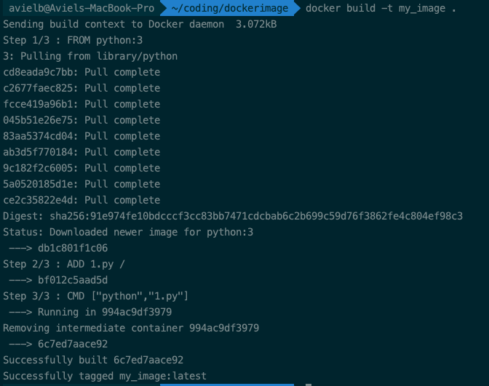

Slide 23
Building a Dockerfile
Once all steps are done, you can run your
image using the run command followed by your image name:
The result should be the current time.

Slide 24
Docker Network
With docker we can create a user-defined bridge network.
It is a self-contained IP subnet and gateway.
But unlike the default bridge, all containers within the user-defined bridge can communicate directly to one another without the need for port forwarding.
Additionally, automatic discovery using DNS is fully supported on this network.
If you want other devices in other networks to communicate with resources in your user-defined bridge network, you simply publish the TCP/UDP ports you need and Docker will expose the network addresses and ports to outside networks

Slide 25
Example
Create a network: docker network create <network_name>
List all networks: docker network ls
Remove a network: docker network rm <network_name>
Specifying a network to a specific network: Docker run --name <container_name> --network <network_name> <image_name>

Slide 26
Hands on
docker network create nginx-network
docker run --name nginx1 --rm --network nginx-network -d nginx:alpine
docker run --name nginx2 --rm --network nginx-network -d nginx:alpine
docker exec -it nginx1 sh
ping nginx2
Notes:
docker network create wordpress
docker container run --name mysql-container --rm --network wordpress -e MYSQL_ROOT_PASSWORD=wordpress -d mysql:5.7 docker container run --name wordpress-container --rm --network wordpress -e WORDPRESS_DB_HOST=mysql-container -e WORDPRESS_DB_PASSWORD=wordpress -p 8090:80 -d wordpress

Slide 27
Challenges
Create a small python script and execute it using the python:3 docker image.
Create a python file app.py with this content:
from flask import Flask
app = Flask(__name__)
@app.route('/')
def hello_world():
return 'Hello! I am a Flask application'
if __name__ == '__main__':
app.run(host='0.0.0.0')
Notes:
https://github.com/praqma-training/docker-katas/blob/master/labs/7-building-an-image.md

Slide 28
Docker registry and DockerHub
A registry is a storage and content delivery system, holding named Docker images, available in different tagged versions.
Users interact with a registry by using docker push and pull commands.
Docker repositories allow you share container images with your team, customers, or the Docker community at large.
Docker images are pushed to Docker Hub through the docker push command. A single Docker Hub repository can hold many Docker images (stored as tags).
Notes:
https://github.com/praqma-training/docker-katas/blob/master/labs/7-building-an-image.md

Slide 29
What is Docker Multi-Stage Build?
Docker multi-stage build is a feature that allows defining multiple stages in a single Dockerfile by using multiple FROM instructions. Each FROM starts a new stage, enabling you to build intermediate images and copy only the necessary artifacts into the final image.
The key idea is to break down the build process into several steps (stages), where only the last stage contains the minimal runtime environment required to run the application. Intermediate stages may include tools and dependencies used for compiling or processing, but these are not present in the final image.
Notes:
https://github.com/praqma-training/docker-katas/blob/master/labs/7-building-an-image.md

Slide 30
Why Use Docker Multi-Stage Build?
Multi-stage builds help produce much smaller images by only including the essential artifacts in the final image. The intermediate stages (which might contain compilers, build tools, and dependencies) are discarded, keeping the final image lightweight.
Example: Instead of shipping an image with both the build tools and the compiled binary, you can copy just the compiled binary into a minimal base image like alpine.
Notes:
https://github.com/praqma-training/docker-katas/blob/master/labs/7-building-an-image.md

Slide 31
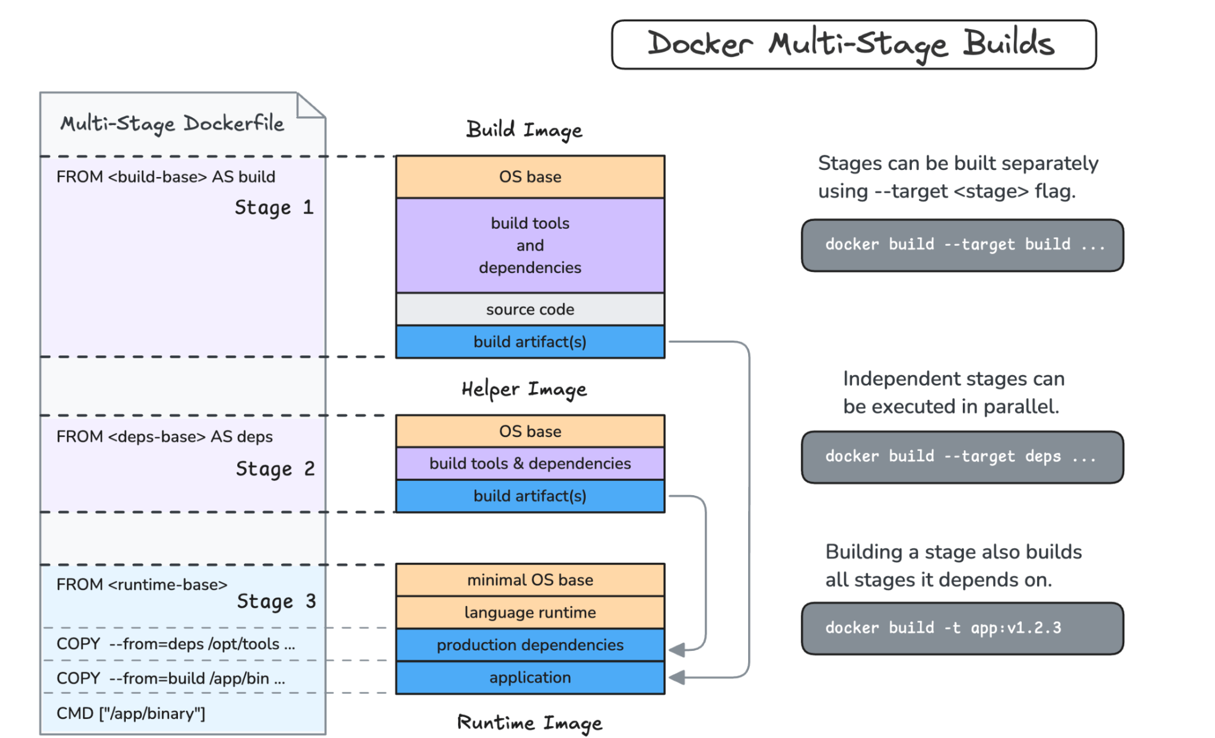

Slide 32
Reduce Image Size
Multi-stage builds help produce much smaller images by only including the essential artifacts in the final image. The intermediate stages (which might contain compilers, build tools, and dependencies) are discarded, keeping the final image lightweight.
Example: Instead of shipping an image with both the build tools and the compiled binary, you can copy just the compiled binary into a minimal base image like alpine.

Slide 33
Improve Security
By excluding unnecessary tools, libraries, and build-time dependencies, multi-stage builds minimize the attack surface of the image. The smaller the final image, the fewer potential vulnerabilities it has.

Slide 34
Docker image convention
docker.io/eduardusatchev/my-first-image:v0.1
{Registry URL} {Repository Owner} {Image Name} {Image Tag}
Notes:
https://github.com/praqma-training/docker-katas/blob/master/labs/7-building-an-image.md

Slide 35
YAML
YAML is a human-readable data serialization language.
It is commonly used for configuration files, but could be used in many applications where data is being stored (e.g. debugging output) or transmitted (e.g. document headers).
YAML targets many of the same communications applications as XML but has a minimal syntax which intentionally breaks compatibility.
It uses both Python-style indentation to indicate nesting, and a more compact format that uses [] for lists and {} for maps.

Slide 36
YAML
This files can have either the .yml or .yaml extensions.
yml files can sometimes be annoying to write because:
YAML is case sensitive.
YAML does not allow the use of tabs.
Spaces are used instead as tabs are not universally supported.
If you feel stuck use a YAML validator which can be found freely online, e.g: http://www.yamllint.com/

Slide 37
Docker Compose (dev)
Compose is a tool for defining and running multi-container Docker applications.
With Compose, you use a Compose file to configure your application's services.
Then, using a single command, you create and start all the services from your configuration.
Compose is great for development, testing, and staging environments, as well as CI workflows.

Slide 38
Docker Compose
Development purposes only.
Using Compose is basically a three-step process.
Define your app's environment with a Dockerfile so it can be reproduced anywhere.
Define the services that make up your app in docker-compose.yml so they can be run together in an isolated environment.
Lastly, run docker-compose up and Compose will start and run your entire app.
Volumes key can be added to the compose file (yml) to mount the project directory (current directory) on the host to /code inside the container, allowing us to modify the code on the fly, without having to rebuild the image.

Slide 39
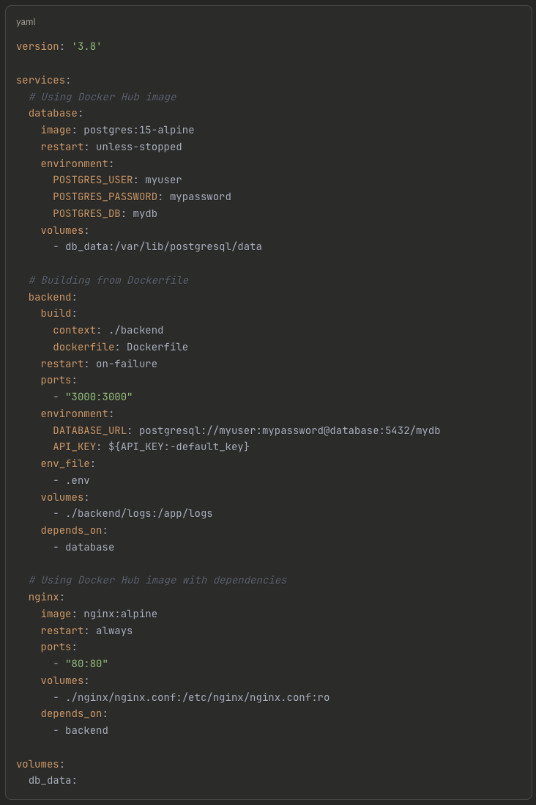
Docker Compose
Example

Slide 40
Docker Compose Exercise
Create a folder called composetest
Clone this repository: https://github.com/eduardusatchev/docker-flask-redis
Run docker-compose up

Slide 41
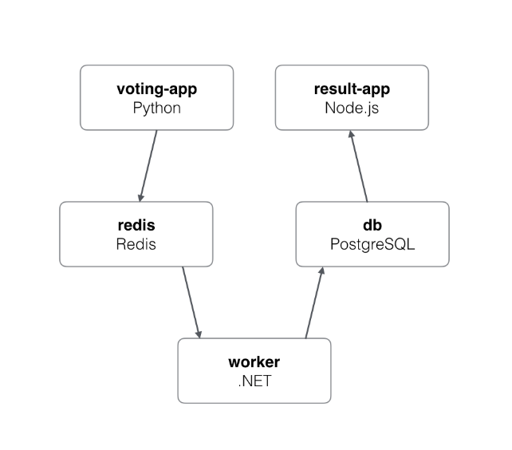
More exercise
Checkout the following repository:
https://github.com/dockersamples/example-voting-app

Slide 42
Hands on
Register to docker hub
Create a new public repository
Create an image
Tag it / build it with the proper convention and push to docker hub.

