Slide 1
DevOps Experts
Class 3
Eduard Usatchev

Slide 2
Container Orchestration

Slide 3
What is Container Orchestration
Container orchestration is all about managing the life cycles of containers, especially in large, dynamic environments. Software teams use container orchestration to control and automate many tasks:
Provisioning and deployment of containers
Redundancy and availability of containers
Scaling up or removing containers to spread application load evenly across host infrastructure

Slide 4
What is Container Orchestration
Movement of containers from one host to another if there is a shortage of resources in a host, or if a host dies
Allocation of resources between containers
External exposure of services running in a container with the outside world
Load balancing of service discovery between containers
Health monitoring of containers and hosts
Configuration of an application in relation to the containers running it

Slide 5
Container Orchestration Tools
Docker Swarm - Docker Swarm provides native clustering functionality for Docker containers, which lets you turn a group of Docker engines into a single, virtual Docker engine.
Mesosphere Marathon - Marathon is a container orchestration framework for Apache Mesos that is designed to launch long-running applications. It offers key features for running applications in a clustered environment.
Kubernetes - Kubernetes is an orchestration system for Docker containers. It handles scheduling and manages workloads based on user-defined parameters.

Slide 6
Container Orchestration
Container orchestration is all about managing the lifecycles of containers, especially in large, dynamic environments. Software teams use container orchestration to control and automate many tasks:
Provisioning and deployment of containers
Redundancy and availability of containers
Scaling up or removing containers to spread application load evenly across host infrastructure
Movement of containers from one host to another if there is a shortage of resources in a host, or if a host dies

Slide 7
Container Orchestration
Allocation of resources between containers
External exposure of services running in a container with the outside world
Load balancing of service discovery between containers
Health monitoring of containers and hosts
Configuration of an application in relation to the containers running it

Slide 8
Why Kubernetes?
Agile application creation and deployment: Increased ease and efficiency of container image creation compared to VM image use.
Continuous development, integration, and deployment: Provides for reliable and frequent container image build and deployment with quick and easy rollbacks (due to image immutability).
Dev and Ops separation of concerns: Create application container images at build/release time rather than deployment time, thereby decoupling applications from infrastructure.
Observability Not only surfaces OS-level information and metrics, but also application health and other signals.

Slide 9
Why Kubernetes?
Environmental consistency across development, testing, and production: Runs the same on a laptop as it does in the cloud.
Cloud and OS distribution portability: Runs on Ubuntu, RHEL, CoreOS, on-prem, Google Kubernetes Engine, and anywhere else.
Application-centric management: Raises the level of abstraction from running an OS on virtual hardware to running an application on an OS using logical resources.
Loosely coupled, distributed, elastic, liberated micro-services: Applications are broken into smaller, independent pieces and can be deployed and managed dynamically – not a monolithic stack running on one big single-purpose machine.

Slide 10
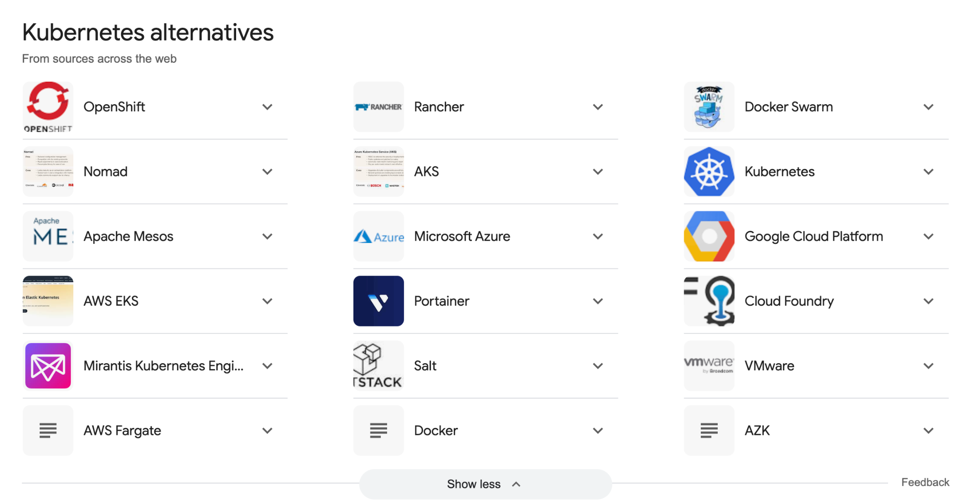

Slide 11
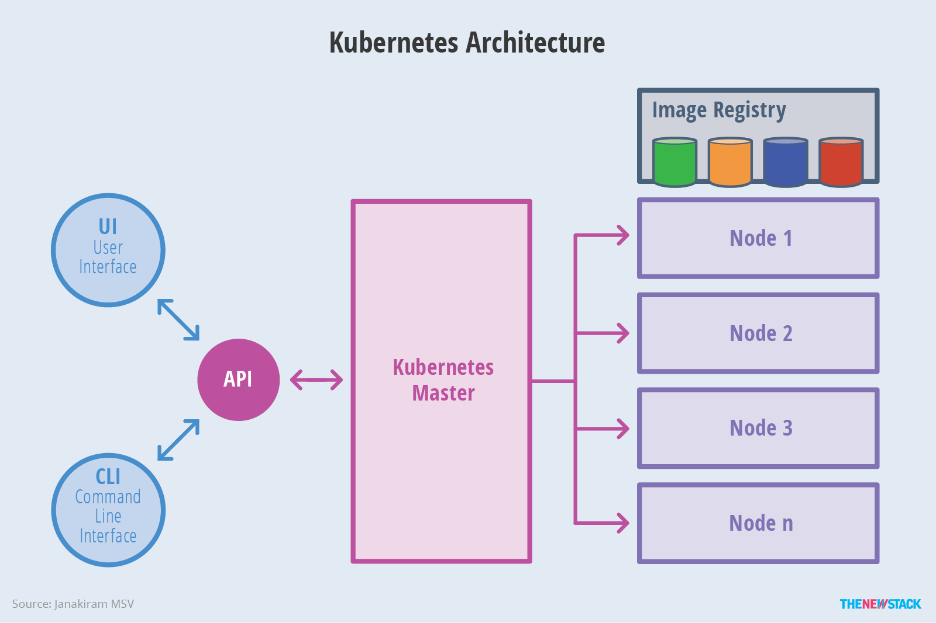
Kubernetes Architecture

Slide 12
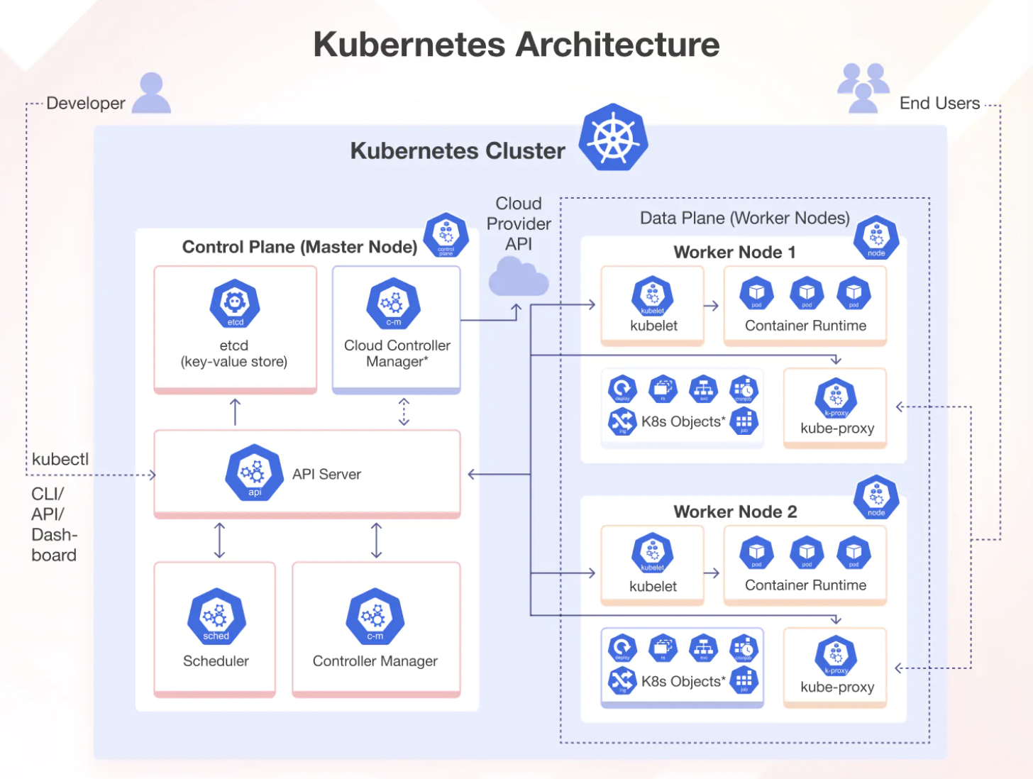

Slide 13
API Server: Central management point for Kubernetes, handling REST operations and cluster communication.
etcd: Key-value store that maintains cluster state and configuration data.
Controller Manager: Controls and maintains the cluster's desired state by managing controllers.
Scheduler: Assigns Pods to nodes based on resource availability and scheduling policies.
Kubelet: Agent running on each node, ensuring containers are running in Pods as expected.
Kube-proxy: Manages network routing for service discovery and load balancing across Pods.
Container Runtime: Software (e.g., Docker, containerd) responsible for running containers on each node.
kubectl: Command-line tool to interact with the Kubernetes cluster and manage its resources.

Slide 14
Kubernetes components communicate with each other primarily through the API Server, using RESTful HTTP/HTTPS protocols. Here’s how this communication happens:
API Server:
Acts as the central hub, exposing the Kubernetes API.
All other components (Scheduler, Controller Manager, Kubelet, etc.) communicate with the API Server to get the current state of the cluster and to make changes.
For instance, when a new Pod needs to be scheduled, the Scheduler fetches information from the API Server.
etcd:
The API Server interacts with etcd to store and retrieve cluster state and configuration.
etcd serves as the backend database for the API Server, storing all cluster data in a consistent and reliable manner.
Controller Manager:
Periodically fetches the desired state from the API Server.
Updates the API Server with changes to bring the cluster to the desired state (e.g., creating or terminating Pods).
Scheduler:
Watches for unassigned Pods by querying the API Server.
Selects an appropriate node for the Pod and informs the API Server, which updates the Pod's status.

Slide 15
Kubelet:
Continuously communicates with the API Server to receive Pod specifications.
Reports back to the API Server with the status of Pods running on the node.
Interacts with the container runtime to start, stop, and manage containers based on the Pod specifications.
Kube-proxy:
Listens to the API Server for updates on services and endpoints.
Configures the node's network to ensure that traffic is correctly routed to Pods.
Container Runtime:
The Kubelet interacts with the container runtime (e.g., Docker, containerd) on the node to manage container lifecycle operations (start, stop, etc.).
The container runtime does not directly communicate with the API Server but relies on instructions from the Kubelet.

Slide 16
Kubernetes Architecture
Master Components
Master components provide the cluster’s control plane.
Master components make global decisions about the cluster (for example, scheduling), and detecting and responding to cluster events (starting up a new pod when a replication controller’s ‘replicas’ field is unsatisfied).
Master components can be run on any machine in the cluster.
Master components can be api server, etcd, scheduler.

Slide 17
Kubernetes Architecture
Node components
Node components run on every node, maintaining running pods and providing the Kubernetes runtime environment.
Node components can be kubelet, proxy and container runtime

Slide 18
Working With Kubernetes
To work with Kubernetes, you use Kubernetes API objects to describe your cluster’s desired state
You describe what applications or other workloads you want to run, what container images they use, the number of replicas, what network and disk resources you want to make available, and more.
You set your desired state by creating objects using the Kubernetes API, typically via the command-line interface, kubectl.
You can also use the Kubernetes API directly to interact with the cluster and set or modify your desired state.

Slide 19
Environment Setup

Slide 20
Kubectl CLI
Use the Kubernetes command-line tool, kubectl, to deploy and manage applications on Kubernetes.
Using kubectl, you can inspect cluster resources;
With Kubectl you can also create, delete, and update components within your kubernetes cluster

Slide 21
Kubectl CLI
Kubectl command allows us to work in two methods:
Declarative.
Ad Hoc commands.
When working in declarative way we will create a YAML file that will describe our kubernetes components and kubectl will be used to deploy, update or remove them from our cluster.
When working in Ad Hoc commands we will run specific commands against our kubernetes cluster.

Slide 22
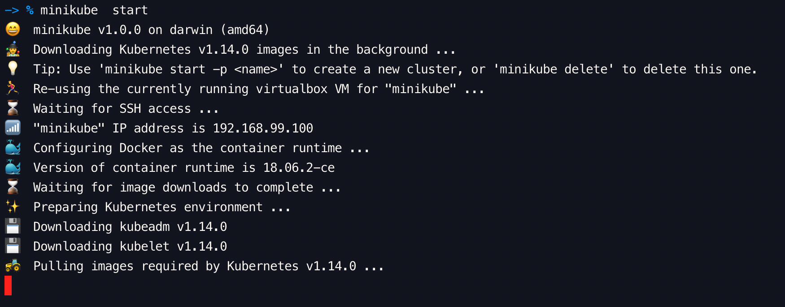
Kubectl CLI
Open CMD / Terminal:
Run minikube start

Slide 23
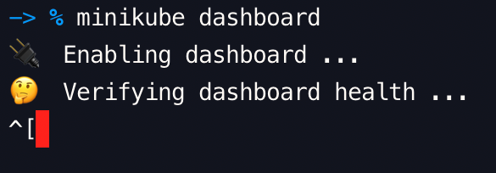
Kubectl CLI
Open CMD / Terminal:
Run minikube dashboard

Slide 24
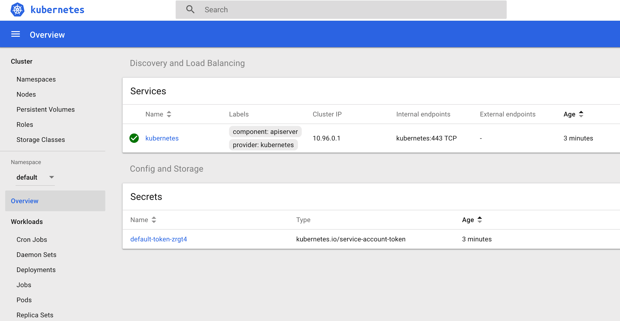

Slide 25
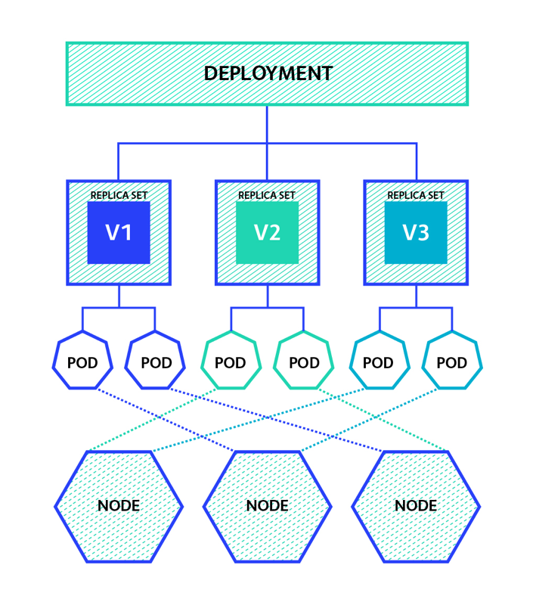
Kubernetes Components Hierarchy

Slide 26
Kubernetes Pods
A pod (as in a pod of whales or pea pod) is a group of one or more containers (such as Docker containers), with shared storage/network, and a specification for how to run the containers.
A pod’s contents are always co-located and co-scheduled, and run in a shared context.
A pod models an application-specific “logical host” - it contains one or more application containers which are relatively tightly coupled — in a pre-container world, being executed on the same physical or virtual machine would mean being executed on the same logical host.

Slide 27
Understanding Pod Networking
Pods in Kubernetes are assigned unique IP addresses within a cluster, enabling direct communication between them. By default, each pod is isolated and has its own IP address, which allows for secure communication and avoids port conflicts. These IP addresses are reachable only within the Kubernetes cluster network unless specific configurations are made for external access.

Slide 28
Kubernetes Networking Model
Pod-to-Pod Communication within the Same Node:
When multiple pods are scheduled on the same node, they can communicate with each other directly using localhost or the loopback interface. This communication happens through the pod’s assigned IP address within the cluster, typically in the form of a Virtual Ethernet (veth) pair. The communication occurs at the network layer, enabling high-performance and low-latency interactions between pods on the same node.

Slide 29
Pod-to-Pod Communication across Nodes:
When pods need to communicate across different nodes in the cluster, Kubernetes employs various networking solutions, such as Container Network Interfaces (CNIs) and software-defined networking (SDN) technologies. These solutions create a virtual network overlay that spans the entire cluster, enabling pod-to-pod communication across nodes. These networking solutions ensure that the pod’s IP address remains reachable and provides transparent network connectivity regardless of the pod’s location within the cluster.

Slide 30
Cluster-Internal Communication:
By default, pods within a Kubernetes cluster can communicate with each other using their internal IP addresses. This communication happens over a virtual network overlay provided by the underlying container runtime or network plugin. The internal IP addresses are assigned by the Kubernetes cluster networking solution and are routable only within the cluster.

Slide 31
DNS-Based Service Discovery:
Kubernetes provides a built-in DNS service for service discovery within the cluster. Services act as stable endpoints that abstract the underlying pods. Each service is assigned a DNS name, which resolves to the IP addresses of the pods backing that service. This DNS-based approach allows pods to communicate with each other using the service names rather than directly referencing the individual pod IP addresses.

Slide 32
Service Load Balancing:
When multiple pods are serving the same application, Kubernetes provides built-in load balancing capabilities for distributing traffic across those pods. By creating a service object and associating it with a set of pods, Kubernetes automatically load balances the incoming requests among the available pods. This load balancing mechanism ensures high availability and scalability of the application.

Slide 33
Network Policies:
Kubernetes offers network policies as a means to control traffic flow between pods. Network policies define rules that specify which pods can communicate with each other based on various parameters such as IP addresses, ports, and protocols. By enforcing network policies, you can segment your application’s network traffic and add an additional layer of security.

Slide 34
External Communication:
Pods often need to communicate with resources outside the Kubernetes cluster, such as external services or databases. Kubernetes provides several mechanisms to facilitate this external communication. One approach is to expose a pod or a set of pods using a service of type “LoadBalancer” or “NodePort,” allowing external clients to access the pods. Another option is to use an Ingress controller, which provides a way to route incoming traffic from outside the cluster to the appropriate pods based on defined rules.

Slide 35
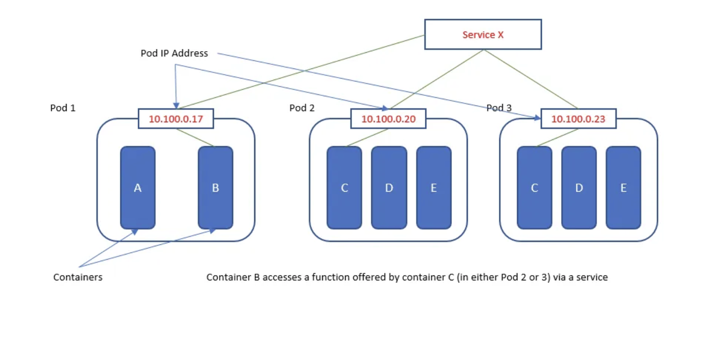

Slide 36
Kubernetes Pods Example
kubectl run nginx --image=nginx:1.15.12-alpine --generator=run-pod/v1
kubectl run redis --image=redis:5.0.4-alpine --generator=run-pod/v1
kubectl logs redis
kubectl describe pod redis

Slide 37
Kubernetes Deployments
A Deployment controller provides declarative updates for Pods and ReplicaSets.
You describe a desired state in a Deployment object, and the Deployment controller changes the actual state to the desired state at a controlled rate.
You can define Deployments to create new ReplicaSets, or to remove existing Deployments and adopt all their resources with new Deployments.

Slide 38
Kubernetes Deployments
The following are typical use cases for Deployments:
Create a Deployment to rollout a ReplicaSet.
Change the state of pods group
Rollback to an earlier Deployment revision if the current state of the Deployment is not stable.
Scale up the Deployment to facilitate more load.
Use the status of the Deployment as an indicator that a rollout has stuck.
Clean up older ReplicaSets that you don’t need anymore.

Slide 39
Deployment is a higher-level resource that helps manage the lifecycle of your pods. While you could directly create and manage pods on their own, using Deployments provides several advantages:
Replica Management: Deployments allow you to specify the desired number of replicas for your pods. Kubernetes ensures that the specified number of pod replicas are always running, automatically creating or deleting pods as needed to maintain the desired state. This helps with scalability and high availability of your applications.
Rolling Updates and Rollbacks: Deployments support rolling updates, allowing you to change the pod template (e.g., update container image versions) without causing downtime. Kubernetes gradually replaces old pods with new ones, ensuring that your application remains available during the update process. If something goes wrong during an update, Deployments also support automatic or manual rollbacks to a previous stable version.
Declarative Configuration: With Deployments, you define the desired state of your application (e.g., number of replicas, container images, resource limits) in a declarative YAML file. Kubernetes then continuously reconciles the actual state with the desired state, making necessary adjustments to achieve the desired state.

Slide 40
Health Checks and Self-Healing: Deployments support configurable health checks (readiness and liveness probes) for your pods. Kubernetes regularly checks the health of pods based on these probes and automatically restarts or replaces unhealthy pods to maintain the desired state of your application.
Scaling: Deployments allow you to easily scale your application up or down by adjusting the number of replicas. You can manually scale your application based on demand, or use tools like Horizontal Pod Autoscaler (HPA) to automatically scale your application based on CPU or custom metrics.

Slide 41
While you can use pods without Deployments in Kubernetes, it's generally not recommended for several reasons:
Limited Lifecycle Management: Pods created directly without a Deployment lack the lifecycle management features provided by Deployments. Deployments ensure that a specified number of pod replicas are running, manage rolling updates, and support automatic rollbacks in case of failures.
Scalability Challenges: Managing individual pods manually can be cumbersome, especially when it comes to scaling your application. With Deployments, you can easily scale your application up or down by adjusting the replica count, and Kubernetes takes care of creating or deleting pods accordingly. Without Deployments, you'd need to handle scaling manually.

Slide 42
Resilience and High Availability: Deployments provide built-in resilience and high availability features. They automatically replace failed pods, distribute pod replicas across different nodes for fault tolerance, and support rolling updates without causing downtime. Managing these aspects manually for individual pods is error-prone and less efficient.
Declarative Configuration: Deployments allow you to define the desired state of your application in a declarative YAML file. Kubernetes continuously reconciles the actual state with the desired state defined in the Deployment, ensuring that your application remains in the desired state. This declarative approach simplifies management and reduces the risk of misconfiguration.
Ease of Management: Deployments provide a higher level of abstraction for managing applications in Kubernetes. They encapsulate the deployment strategy, desired state, and lifecycle management logic, making it easier to manage and operate containerized applications.

Slide 43
Using pods without Deployments in Kubernetes means sacrificing essential features like lifecycle management, scalability, resilience, and ease of management. Deployments provide automation, scalability, and resilience, making them the preferred choice for managing containerized applications in Kubernetes production environments.

Slide 44
DaemonSet
A DaemonSet ensures that all (or some) Nodes run a copy of a Pod. As nodes are added to the cluster, Pods are added to them. As nodes are removed from the cluster, those Pods are garbage collected. Deleting a DaemonSet will clean up the Pods it created.
Some typical uses of a DaemonSet are:
running a cluster storage daemon on every node
running a logs collection daemon on every node
running a node monitoring daemon on every node
In a simple case, one DaemonSet, covering all nodes, would be used for each type of daemon. A more complex setup might use multiple DaemonSets for a single type of daemon, but with different flags and/or different memory and cpu requests for different hardware types. DaemonSet Demo

Slide 45
Kubernetes Services
A Kubernetes Service is an abstraction which defines a logical set of Pods and a policy by which to access them - sometimes called a micro-service.
The set of Pods targeted by a Service is (usually) determined by a Label Selector (see below for why you might want a Service without a selector).

Slide 46
Workloads examples
kubectl create deployment hello-node --image=gcr.io/hello-minikube-zero-install/hello-node
kubectl get deployments
kubectl describe deployment hello-node
kubectl get pods
kubectl scale deployment/hello-node --replicas=3
kubectl get all
kubectl expose deployment hello-node --type=ClusterIP --port=8080
kubectl get services

Slide 47
Declarative Workloads Examples
Clone https://github.com/avielb/k8s-demo.git
cd guestbook/
kubectl apply -f redis-master-deployment.yaml
kubectl apply -f redis-master-service.yaml
kubectl apply -f redis-slave-deployment.yaml
kubectl apply -f redis-slave-service.yaml
kubectl apply -f frontend-deployment.yaml
kubectl apply -f frontend-service.yaml
Or just do kubectl apply -f ./

Slide 48
Exercise
Deploy a MySQL pod container using the kubectl run command.
Write a YAML file that deploys MySQL pod container.
Write a YAML file to setup a service that expose the MySQL pod port (3306) on port 33006 on your machine host.
Edit the guestbook to deploy 3 redis slave replicas
Add the following label: appname: guestbook
Edit frontend-service.yaml to select the frontend deployment by that previous label.

Slide 49
Hands-On with Minikube
1. Set up a Minikube cluster: minikube start 2. Deploy and scale a basic Nginx deployment: kubectl create deployment nginx --image=nginx kubectl scale deployment nginx --replicas=3 3. Enable Minikube dashboard: minikube dashboard 4. Access Minikube services: minikube service <service-name>

Slide 50
Advanced Deployment Scenarios
1. Rolling updates and rollbacks: kubectl set image deployment/nginx nginx=nginx:1.16 --record kubectl rollout undo deployment/nginx 2. Autoscaling deployments using HPA: kubectl autoscale deployment nginx --cpu-percent=50 --min=1 --max=5

Slide 51
Debugging in Minikube
1. Debugging pods using kubectl exec and kubectl logs: kubectl exec -it <pod-name> -- /bin/bash kubectl logs <pod-name> 2. Use port-forwarding for external access: kubectl port-forward <pod-name> 8080:80

