Slide 1
Marcin ‘Icewall’ Noga http://www.icewall.pl @_Icewall PWNing Warszawa 2017

Slide 2
When Third-party components become a source of all evil

Slide 3
Intro
Yves Younan
Research Manager
Cisco Talos
Team
Aleksandar Nikolich
Ali Rizvi-Santiago
Marcin Noga
Piotr Bania
Tyler Bohan
Cory Duplantis
Lilith Wyatt
Claudio Bozzato
Talos Vulndev
- Third party vulnerability research
~ 200 bugów znalezionych w ostatnie
12 miesięcy
Microsoft
Apple
Oracle
Adobe
Google
IBM, HP, Intel, Lexmark
7zip, libarchive, NTP
- Security tools development
Fuzzers, Crash triage
- Mitigation development

Slide 4
Agenda
How components „provided/shared” by other providers can affect
your product.
Examples of bugs, misuses, other problems with use of libraries
in Enterprise solutions and their consequences.
Bugs analysis
Exploitation
Summary

Slide 5
Libarchive vs Splunk

Slide 6
Libarchive
Description
Open source library supports read and write operation in
a variety of archive formats.
Motivation
Huge number of supported formats ( more than 20 )
zip, rar, 7zip, mtree, cpio, xar, (…)
Popularity
Package Managers
Cmake
pkgutils
Archiving tools and File Browsers
Nautilus
Enterprise solutions
Splunk

Slide 7
Libarchive – plan of attack
Used methods to find vulnerabilities
A lot of supported formats, opensource, lets do this in a comprehensive way!
Fuzzing – using many machines
Automatic static code analysis
Code review

Slide 8
Libarchive - results
4 bugs
Which method turned out to be the most efficient one ?
Fuzzing
LIBARCHIVE RAR RESTARTMODEL CODE EXECUTION VULNERABILITY
CVE-2016-4302
Automatic Static Code Analysis
LIBARCHIVE MTREE PARSE_DEVICE CODE EXECUTION VULNERABILITY
CVE-2016-4301
Code review
LIBARCHIVE ZIP ZIP_READ_MAC_METADATA CODE EXECUTION VULNERABILITY
CVE-2016-1541
LIBARCHIVE 7ZIP READ_SUBSTREAMSINFO CODE EXECUTION VULNERABILITY
CVE-2016-4300

Slide 9
Libarchive – bug analysis
LIBARCHIVE 7ZIP READ_SUBSTREAMSINFO CODE EXECUTION VULNERABILITY
Why fuzzer did not find it ?
(...)
#define UMAX_ENTRY ARCHIVE_LITERAL_ULL(100000000)
(...)
Line 2129 static int
Line 2130 read_SubStreamsInfo(struct archive_read *a, struct _7z_substream_info *ss,
Line 2131 struct _7z_folder *f, size_t numFolders)
Line 2132 {
Line 2135 size_t unpack_streams;
(...)
Line 2149 if (type == kNumUnPackStream) {
Line 2150 unpack_streams = 0;
Line 2151 for (i = 0; i < numFolders; i++) {
Line 2152 if (parse_7zip_uint64(a, &(f[i].numUnpackStreams)) < 0)
Line 2153 return (-1);
Line 2154 if (UMAX_ENTRY < f[i].numUnpackStreams)
Line 2155 return (-1);
Line 2156 unpack_streams += (size_t)f[i].numUnpackStreams; // <---- INTEGER OVERFLOW
Line 2157 }
Line 2164 ss->unpack_streams = unpack_streams;
Line 2165 if (unpack_streams) {
Line 2166 ss->unpackSizes = calloc(unpack_streams,// <----- ALLOCATION BASED ON OVERFLOWED INT
Line 2167 sizeof(*ss->unpackSizes));
Line 2168 ss->digestsDefined = calloc(unpack_streams,
Line 2169 sizeof(*ss->digestsDefined));
Line 2170 ss->digests = calloc(unpack_streams,
Line 2171 sizeof(*ss->digests));
Line 2172 if (ss->unpackSizes == NULL || ss->digestsDefined == NULL ||
Line 2173 ss->digests == NULL)
Line 2174 return (-1);
Line 2175 }
Line 2134 uint64_t *usizes;
Line 2177 usizes = ss->unpackSizes;
Line 2178 for (i = 0; i < numFolders; i++) {
Line 2179 unsigned pack;
Line 2180 uint64_t sum;
Line 2181
Line 2182 if (f[i].numUnpackStreams == 0)
Line 2183 continue;
Line 2184
Line 2185 sum = 0;
Line 2186 if (type == kSize) {
Line 2187 for (pack = 1; pack < f[i].numUnpackStreams; pack++) {
Line 2188 if (parse_7zip_uint64(a, usizes) < 0) // <--- BUFFER OVERFLOW
Line 2189 return (-1);
Line 2190 sum += *usizes++;
Line 2191 }
Line 2192 }
0xffffffff / 100000000 = 42
hex(0xffffffff % 100000000) = 0x5a915ff
hex((100000000 * 42) + 0x5a915ffL) = 0xffffffff
(100000000 * 42) + 0x5a915ffL + 2
(100000000 * 42) + 0x5a91601L

Slide 10
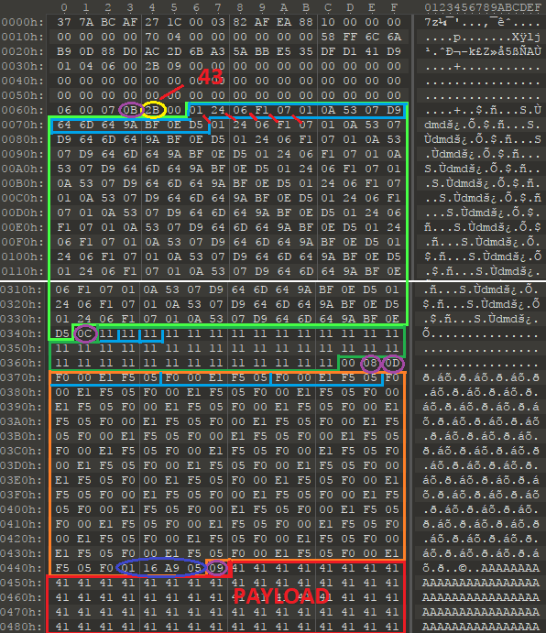
LIBARCHIVE 7ZIP READ_SUBSTREAMSINFO
43 at least one structure need to be repeated
Does file with such construction will be easy to find for further modifications ?
Unfortunatelly NO .
So ?
Debugger + hexeditor = manual file creation

Slide 11
Libarchive vs Splunk
Splunk?
„Allows logs aggregations from many sources, formats and their analysis”
How I discovered that Splunk uses libarchive ?
General HINT’s
Google for one of specific strings from COPYING, COPYRIGTHS, LICENSE files
e.g. : „Copyright by Tim Kientzle”
or general „Third-party software ComponentName”

Slide 12
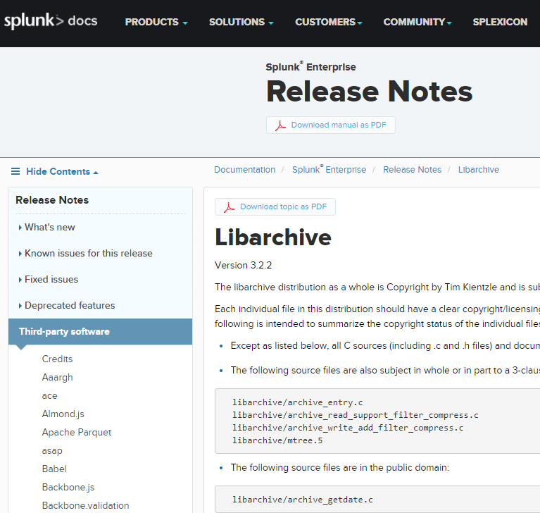
Libarchive vs Splunk

Slide 13
Libarchive vs Splunk
How to trigger the vulnerability ?
Two potential vectors
archive in directory with logs
by default only zip
upload kmz file ( zip ) in Splunk’s web panel.
Where exactly libarchive is used ?
hackers-grep
hackers-grep.py -n c:\splunk .*.exe "archive_read_open”
splunkd.exe

Slide 14
Splunk suicide
Libarchive allows to active support for particular formats or for all available.
Splunk’s authors have choosen the second options == bypass of file extensin limitation defined in confiugration file.
struct archive *a;
a = archive_read_new();
if( strcmp("7zip",formatName) == 0 ) { archive_read_support_format_7zip(a); }
if( strcmp("cab",formatName) == 0 ) { archive_read_support_format_cab(a); }
if( strcmp("rar",formatName) == 0 ) { archive_read_support_format_rar(a); }
if( strcmp("iso9660",formatName) == 0 ) { archive_read_support_format_iso9660(a); }
if( strcmp("zip",formatName) == 0 ) { archive_read_support_format_zip(a); }
(...)
vs
archive_read_support_format_all(a);

Slide 15
Splunk video
Autorzy splunk’a zdecydowali się aktywować wszystkie dostępne formaty
Zwiększenie ilości wektorów ataku
PLAY

Slide 16
MarkLogic vs „Converters”

Slide 17
Looking for a target ...
Google „metadata extraction”
I found MarkLogic documentation page
MarkLogic Server server offers the XQuery built-in, xdmp:document-filter, to extract and associate metadata from binary documents: These functions extract metadata and text from binary documents as XHTML.
Supported file formats:
Presentation
Raster Image
Spreadsheet
Archives
Word Processing and General Office
(...)

Slide 18

MarkLogic
Description
NoSQL database – non-relational database,
focused on aggregation large amount of different type data (BigData)
What BigData is ?
„massive” amount of different kind of data, which processing (PARSING)
can provide valuable informations.
Customers list
http://www.marklogic.com/customers/
gov
finanse
tv

Slide 19
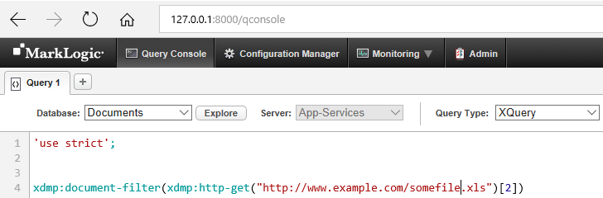
Where exactly metadata are extracted ?
Example of xdmp:document-filter call
Process Monitor

Slide 20
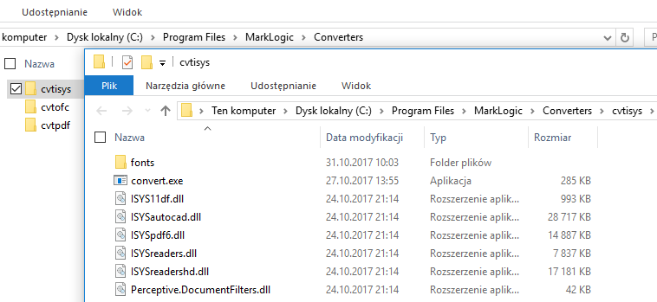
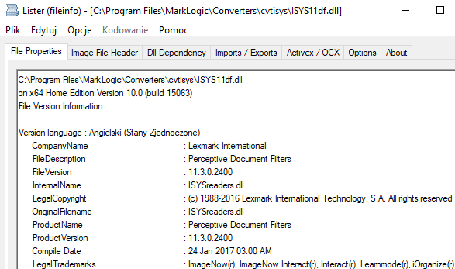
So converters ...
3 converters
To get more info about files we can :
Google for file names
Check info in resource directories

Slide 21
Perceptive Document Filters
Description
Owner
Lexmark
Set of libraries providing abilities for :
File type identification
Metadata extraction
Archive decompression
(...)
~ 100 supported formats
Commercial
Close source

Slide 22



BigData
Three major players providing SDK (libraries,...) for BigData solutions.
gov
finanse
tv
BigData solutions
Perceptive Document Filters
Outside In
Autonomy’s Keyview

Slide 23
Discovered bugs
Lexmark – Perceptive Document Filters
6 CVE
Oracle – Outside In (OIT)
17 CVE
HP – Autonomy’s KeyView
4 CVE

Slide 24
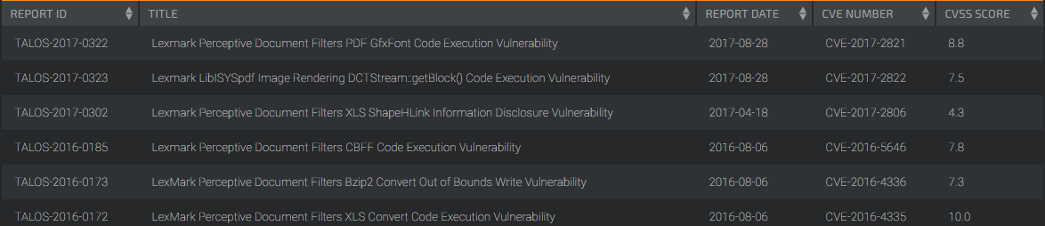
Perceptive Document Filters - results
6 bugs
Used methods to find vulnerabilities
Fuzzing / cross fuzzing
Mainly used files : doc, xls, ppt
initialy also archive files ( using corpus from libarchive), but ...

Slide 25
Components inception
First crash in Perceptive Doc. Filters revealed that it uses libarchie for
archive decompression.
gov
finanse
tv
BigData solutions
Perceptive Document Filters
Outside In
Autonomy’s Keyview
Libarchive

Slide 26
Perceptive Document Filters – bug analysis
LexMark Perceptive Document Filters XLS Convert Code Execution Vulnerability
CVE-2016-4335
Vulnerable function
reader::escher::MsofbtDggContainer::Handle
Library
libISYSreadershd.so
Type of vulnerability
Stack Based Buffer Overflow

Slide 27
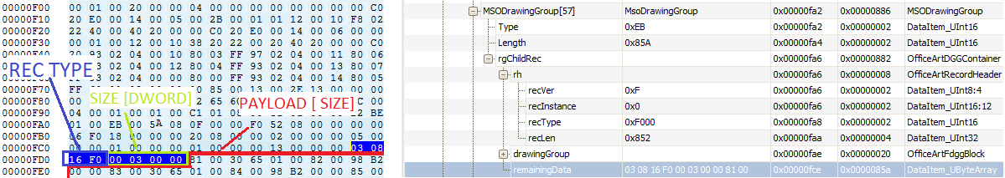
Perceptive Document Filters – bug analysis
Line 1 MSOFBH *__fastcall common read_MSOFBH(common StreamReader *this, MSOFBH *header)
Line 2 {
Line 3 version = readInt16(this, header);
Line 4 LOBYTE(header->version) = version & 0xF | header->version & 0xF0;
Line 5 header->version = version & 0xFFF0 | header->version & 0xF;
Line 6 header->instance = readInt16(this, header);
Line 7 header->size = readInt32(this, header);
Line 8 return header;
Line 9 }
Line 1 struct_a1 * reader::escher::MsofbtDggContainer::Handle(struct_a1 *a1, __int64 *a2, struct_v5 *MSOFBH_header, unsigned int a4)
Line 2 {
Line 3 char localBuffer [ 112 ];
Line 4 (...)
Line 5 if ( recType > 0xF11Au )
Line 6 {
Line 7 if (recType == 0xF11Eu || recType == 0xF122u )
Line 8 goto LABEL_7;
Line 9 goto LABEL_11;
Line 10 }
Line 11 if ( recType == 0xF016u )
Line 12 {
Line 13 CPageMemoryStream::Read(&localBuffer, MSOFBH_header->size)
Line 14

Slide 28
Exploitation CVE-2016-4335

Slide 29
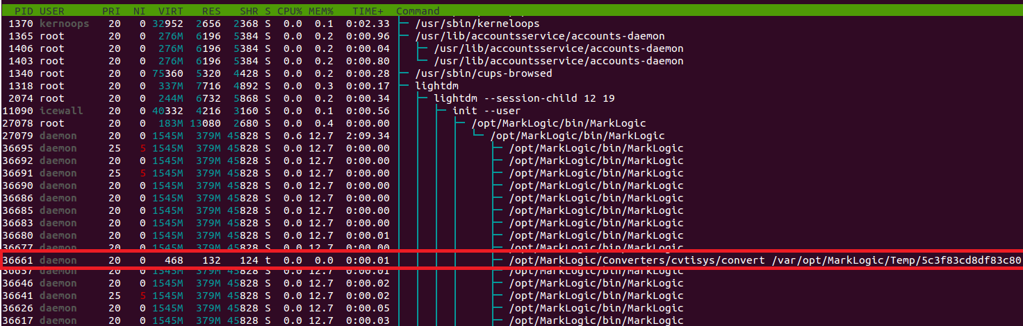
Just after xdmp:document-filter API call
Process convert executed with daemon privilages.

Slide 30
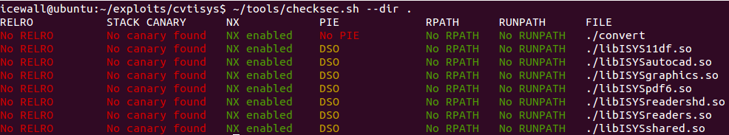
Perceptive Doc. Filters – mitigations check

Slide 31
Exploitation strategy
Trigger the vulnerability via xdmp:document-filter API.
Convert binary does not drop privilages == auto priv escal
Convert
created by MarkLogic
lack of ASLR
ROP ( DEP bypass )
Remote Shell!
Full exploitation write-up:
http://blog.talosintelligence.com/2017/06/lexmark-perceptive-vuln-deep-dive.html
„ Deep dive in Lexmark Perceptive Document Filters Exploitation”

Slide 32
MarkLogic 0wn3d via Perceptive Doc. Filters
VIDEO

Slide 33
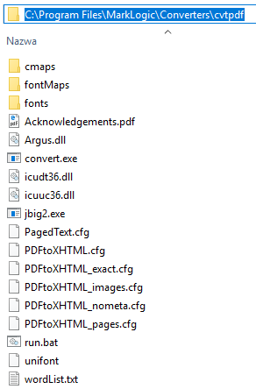
Iceni Argus PDF
Description
Owner
Iceni
Commercial
Close source
Its purpose as MarkLogic component:
Extraction of PDF content
Conversion PDF to XHTML
Related API:
xdmp:pdf-convert

Slide 34
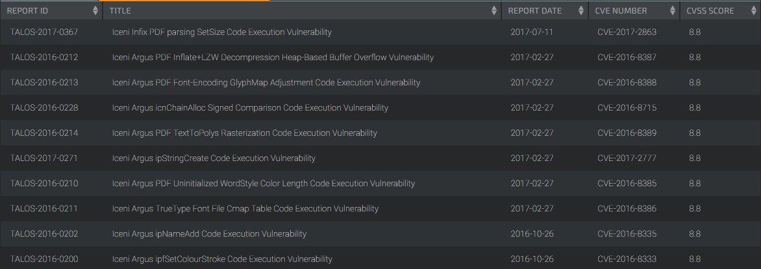
Iceni Argus PDF – fuzzing results
10 bugs

Slide 35
Iceni Argus PDF – bug analysis
Iceni Argus ipNameAdd Code Execution Vulnerability
CVE-2016-8335
Vulnerable function
ipNameAdd
Type of vulnerability
Stack Based Buffer Overflow
Library
Argus.dll/so

Slide 36
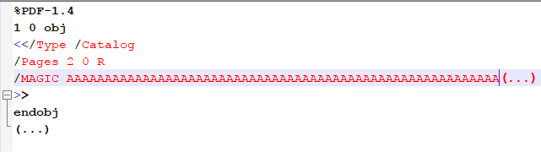
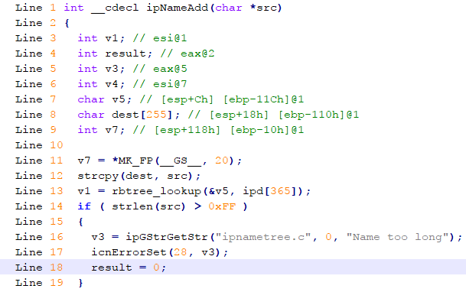
Iceni Argus PDF – bug analysis
Line 1 if ( *token == '/' )
Line 2 {
Line 3 if ( strlen(token) - 1 > 0xFF )
Line 4 {
Line 6 v64 = ipGStrGetStr("ipscan.c", 1, "Name too long '%s'");
Line 8 return v13;
Line 9 }
Line 10 ipNameAdd(token + 1);
Line 15 goto LABEL_20;
Line 16 }
Line 27 if ( isReal(token) )
Line 28 {
Line 29 v11 = strtod(token, 0);
Line 30 LOBYTE(v12) = 6;
Line 31 LOBYTE(objNumber) = 6;
Line 32 *&v76 = v11;
Line 33 goto LABEL_20;
Line 34 }
Line 35 if ( !isInteger(token) )
Line 36 {
Line 44 v55 = ipNameAdd(token);

Slide 37
Exploitation CVE-2016-8335

Slide 38
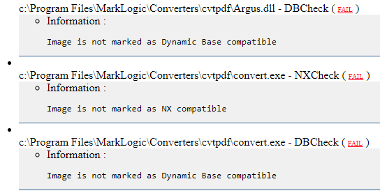
Maybe this time Windows ?
Check of implemented Mitigations
Results from BinScope’a

Slide 39
Remote SYSTEM ?
W00t ?
BinScope showed lack of DEP ?!?
Bug in ProcessExplorer
DEP is indeed forced on x64 arch. , but only for 64bit processes.

Slide 40
Exploitation strategy
Trigger the vulnerability via xdmp:pdf-convert API.
Convert binary does not drop privilages == auto priv escal
convert
created by MarkLogic
lack of ASLR
Lack of DEP !!!
Exploitation like in 90’ – JMP ESP
Remote Shell!
Full exploitation write-up:
http://blog.talosintelligence.com/2017/09/deep-dive-marklogic-exploitation.html
„Deep Dive in MarkLogic Exploitation Process via Argus PDF Converter”

Slide 41
MarkLogic 0wn3d via Iceni Argus PDF
VIDEO

Slide 42
Conclusions

Slide 43
Conclusions
What kind of problems we could observe related with components :
misuse can increase vectors of attack
lack of support for basic mitigations in 2016!!!
even in big commercial solutions
Components inception
One component to rule them all!

Slide 44
Thank You! Q&A

