Slide 1
Does mobility impact the spread of COVID?
Brittany Dougall, Jeffrey Adams, Li Jin, Jerico Johns

Slide 2
Research Problem
How much does a percentage change in mobility impact the percentage change in new COVID-19 cases within a given state, given a 2 week lag period?
Does having a mask mandate implemented in a state impact the change in COVID cases?
Do demographics impact the change in COVID cases?

Slide 3
Features
Dependent Variable:
%_Change_COVID = %_change_in_week_over_week_covid_cases(July 18th - 24th)
Independent Variables:
Mobility = %_change_in_week_over_week_mobility_retail_and_recreation(Sat,Sun,M...F)
Mask_Flag = Public_mask_mandate_flag(In place as of June 28th)
%_female(2019)
%_white(2019)
%65_and_older(2019)
%24_and_younger(2019)

Slide 4
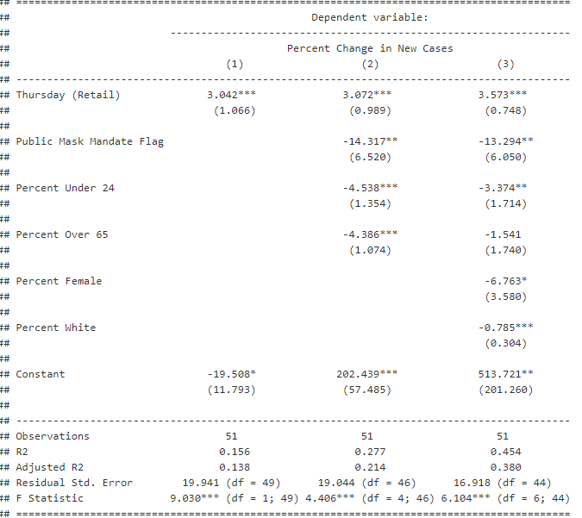
Results

Slide 5
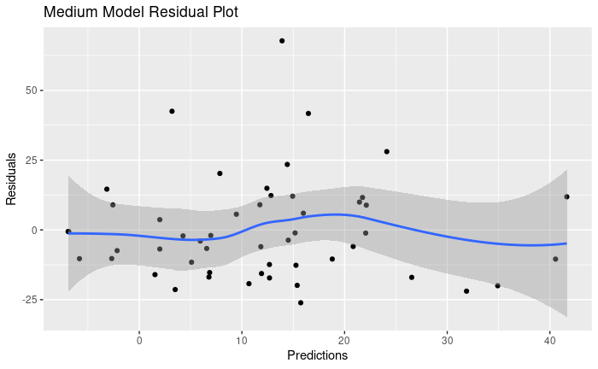
Model 2Residual Plot
Don’t know if we want to show this

Slide 6
VIF Test
MODEL FIT:
F(8,42) = 1.94, p = 0.08
R² = 0.27
Adj. R² = 0.13
Standard errors: Robust, type = HC3
----------------------------------------------------------------------
Est. S.E. t val. p VIF
------------------------------ -------- ------- -------- ------ ------
(Intercept) 2.47 24.16 0.10 0.92
Sunday_retail -0.44 1.78 -0.25 0.80 2.18
Monday_retail 1.68 1.77 0.95 0.35 2.15
Tuesday_retail -0.51 1.72 -0.30 0.77 2.29
Wednesday_retail 1.29 1.91 0.68 0.50 2.64
Thursday_retail 2.80 2.19 1.28 0.21 2.65
Friday_retail -0.27 1.45 -0.18 0.85 1.63
Saturday_retail 1.39 0.86 1.62 0.11 1.65
public_mask_mandate_flag -11.81 8.28 -1.43 0.16 1.51
----------------------------------------------------------------------
Don’t know if we want to show this

Slide 7
Conclusions
Retail mobility
Demographics
Mask mandate

