Slide 1
Computer Project
Submitted by: S.M. Abdul Wassae
NCC ID: 00151170
Submitted to: Mohammad Azizur Rahman

Slide 2
Product Transportation Cost Management System
(Web Application)

Slide 3
Introduction:
PTCMS=Product Transport Cost Management System a small part of a large project named product transportation management system which is developed with limited features and scope.
Background study:
In Bangladesh mainly courier servicing companies are transporting products from one center to another center. Some production companies are transporting their own product for distribution purposes too. But according to survey on different companies we have found that they are handling the processes manually using pen and papers. So a IT solution is in need for them to handle huge number of data in short time and calculating their expenses over transportation and maintenance but no local IT farm are giving their attention in this sector. So I have tried to make a common solution.

Slide 4
Aims and Objectives
Get vehicle info which are used on transport
Identify different route for two centers
Provide level of access on adding and editing center, route, vehicle, employee, staff, transport.
Get individual total cost for each transportation.
Identify free staffs to go on transportation.
Ordering a large transportation using multiple vehicles.

Slide 5
Functional Requirement:
Add and edit center
Add multiple route for two centers
Add employee and staff with separate facilities
Add and edit various type of vehicles
Send multiple staffs in a single transport
Manage level of access for every employee
Cost calculation per transportation
Non-Functional Requirement:
Accessing pages should be secured via authentication
Solution have to be well enough to calculate large number of costs over transportation.

Slide 6
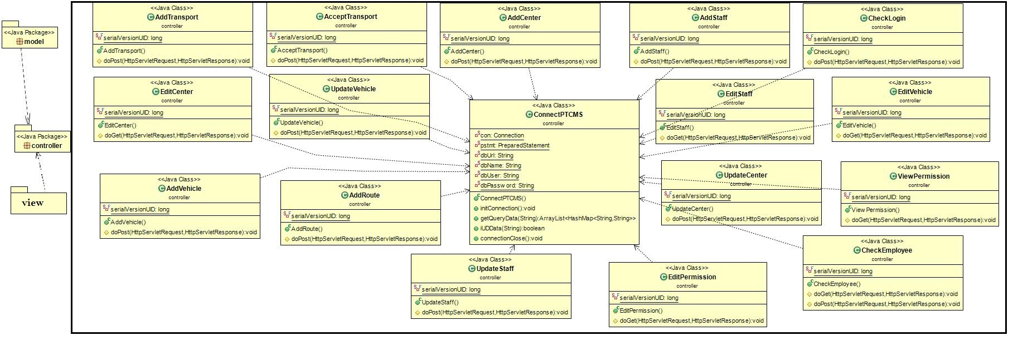
Detailed Class Diagram: It is following MVC pattern

Slide 7
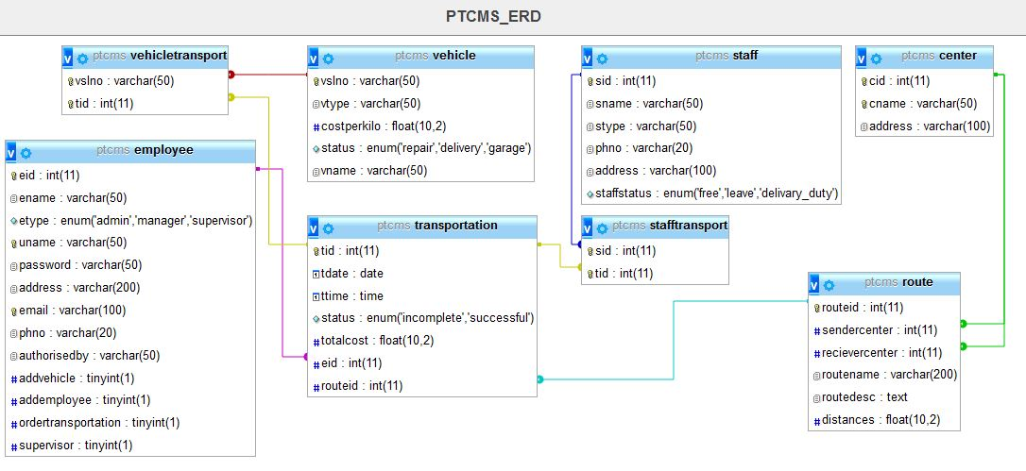
ERD

Slide 8
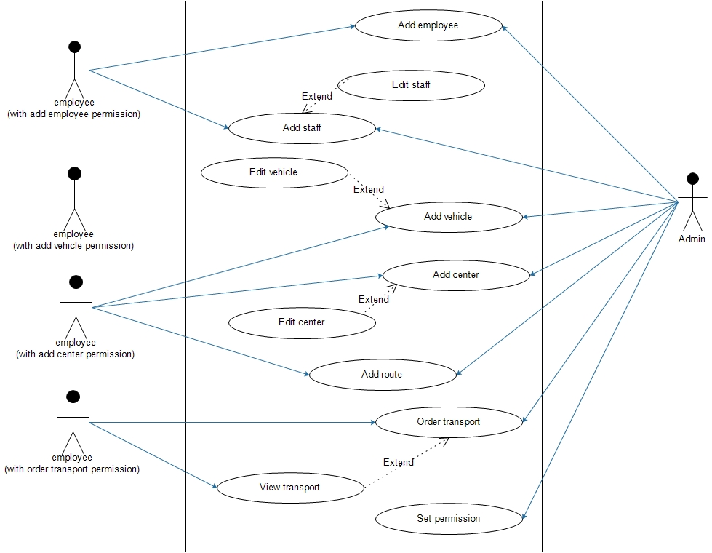
Use-case Diagram:

Slide 9
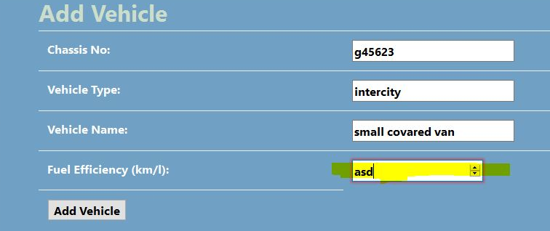
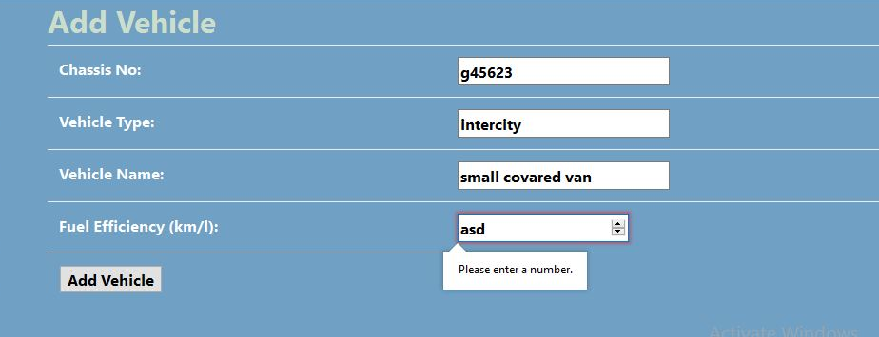
Testing-1: Black-box Testing
Fig:1.1
Fig:1.2

Slide 10
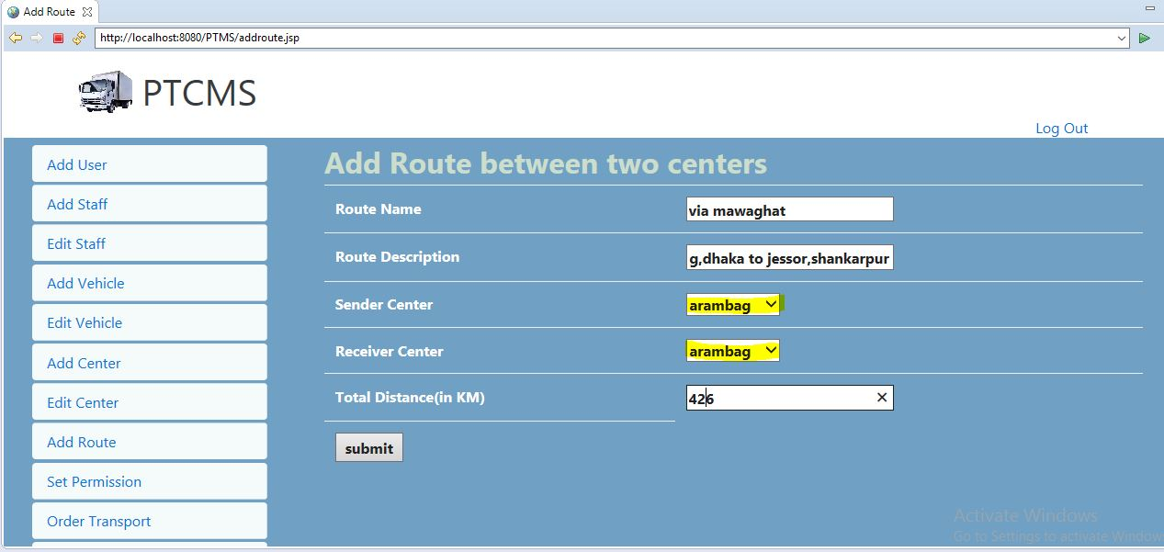
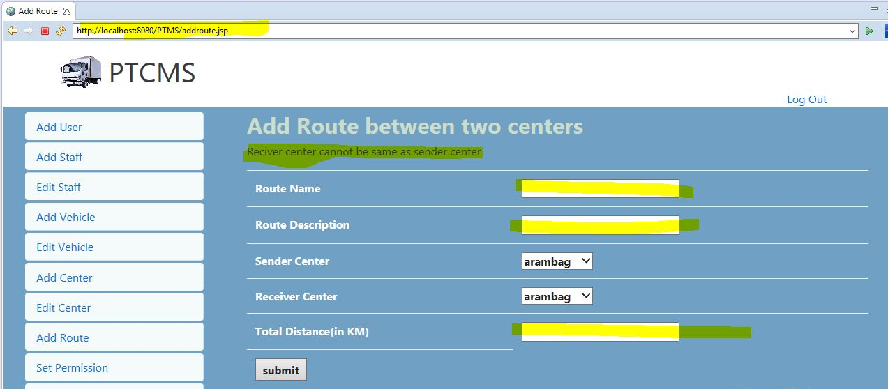
Testing-2: Unit Testing
Fig:2.1
Fig:2.2

Slide 11
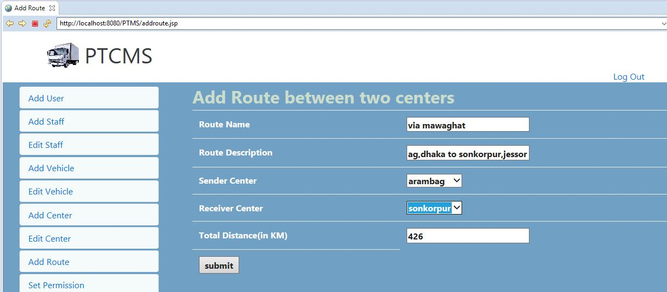
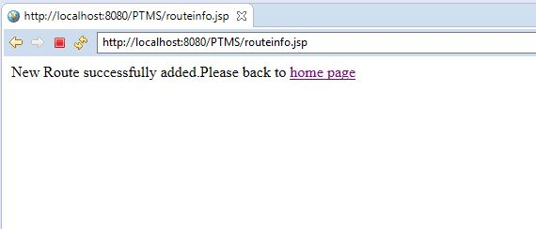
Fig:2.3
Fig:2.4

Slide 12
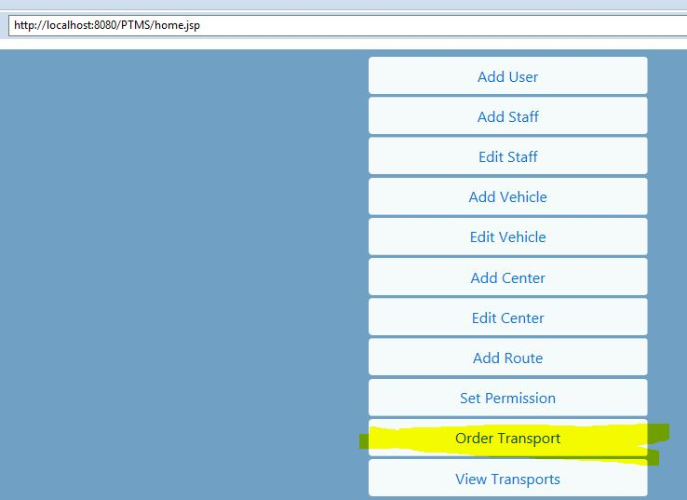
Testing-3: Integration Testing
Fig:3.1

Slide 13
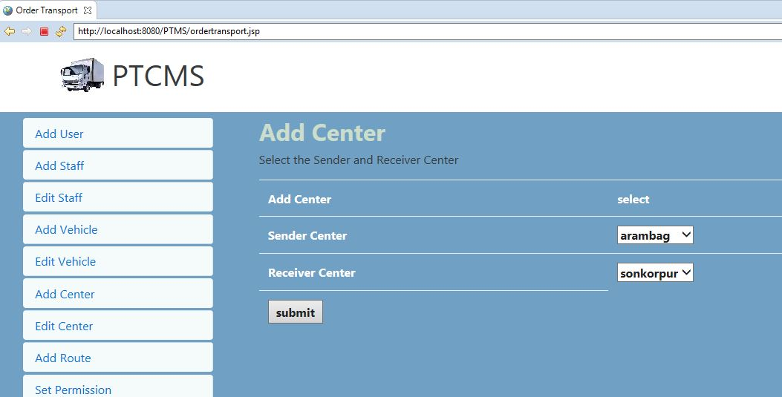
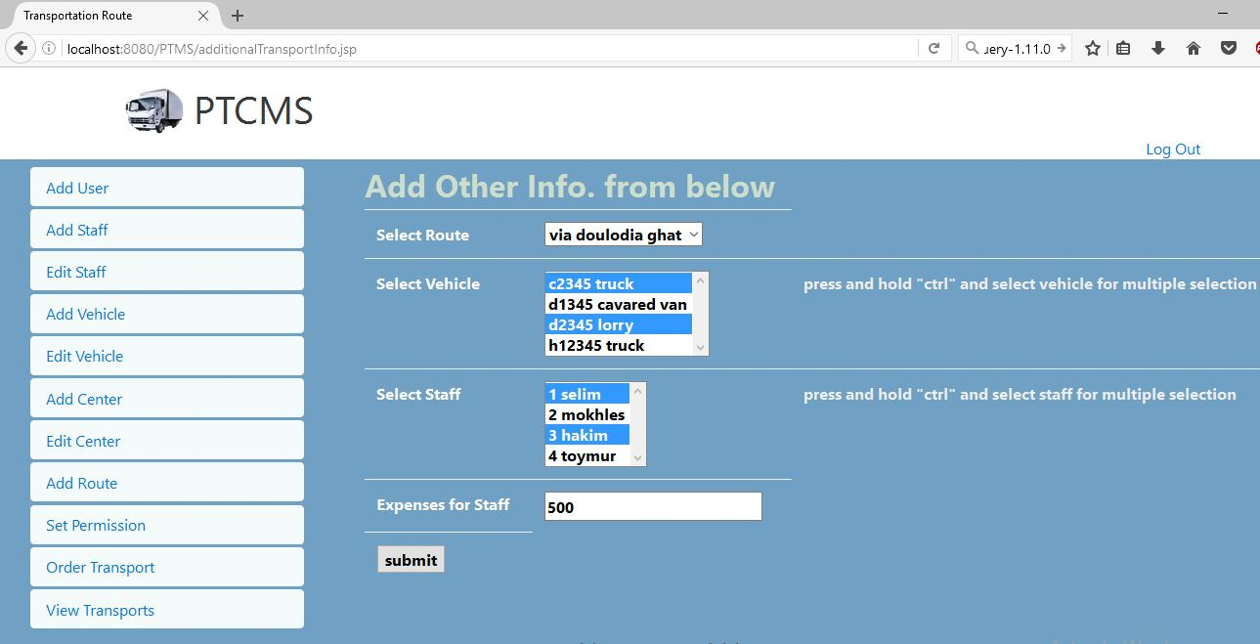
Fig:3.2
Fig:3.3

Slide 14
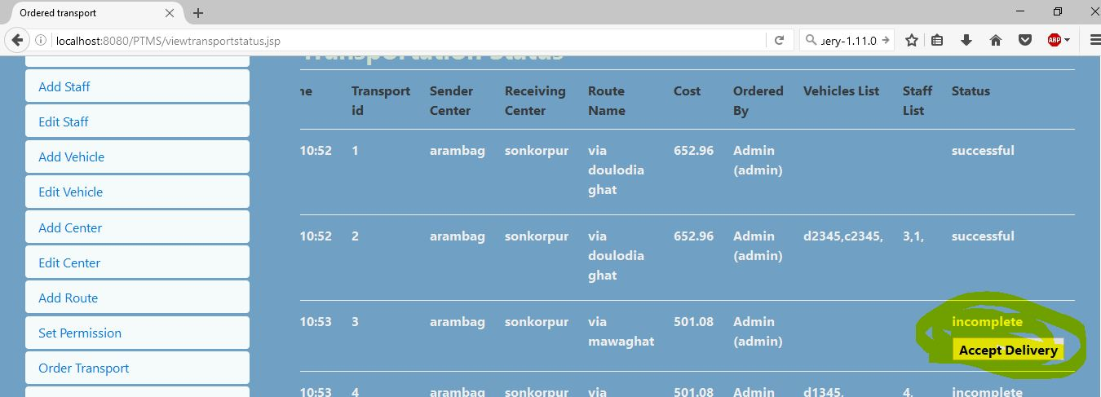
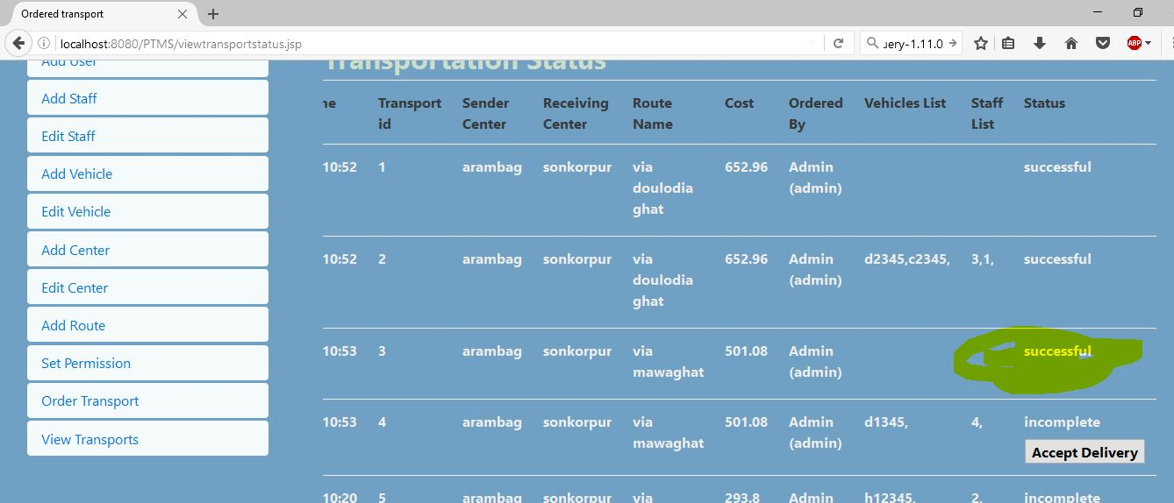
Fig:3.4
Fig:5.5

Slide 15
Strength:
Mobility of access as a web solution
Fit for any kind of transportation
No need to involve with production
Well secured by maintaining level of access
JSP is used as secured technology
Extendable as Object-Oriented solution used
Can be used for small or large organization
Weakness:
Not suitable for global market
Need more features for large organization
Any employee from same permission of different center can access features.
Should not edit vehicle status if on delivery

Slide 16
Further development:
Separated individual costs
Actual cost, differences with estimated cost and its reason
Repair and car maintenance cost should be added
Transport time estimation as average speed of vehicle on specific route
Cost for hired vehicle
Display weekly, monthly, yearly cost report
Identifying vehicle is in trouble on the way of transport

Slide 17
What have been learned
JSP
Implementation of mysql with jsp
Collecting real world data using servey
Use of SWOT and MoSCoW analysis
Bootstrap 4 css framework

Slide 18
Any Question?

Slide 19
Thank You

