Slide 1
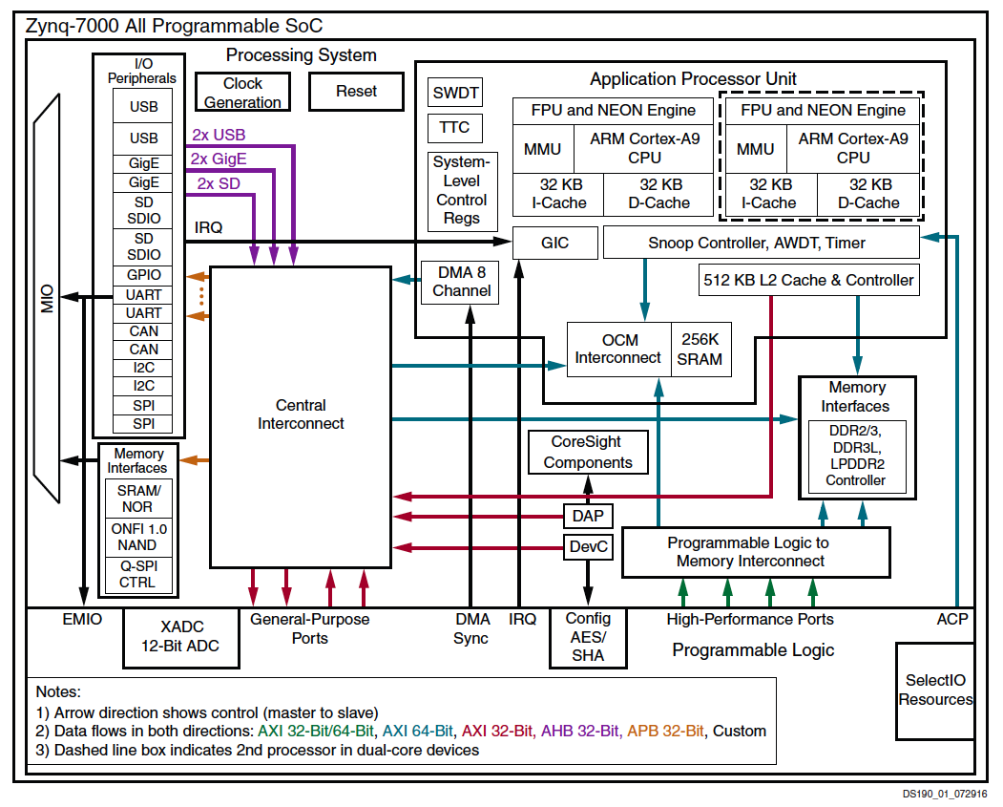
Programmable SoC

Slide 2
Divide-and-Conquer Overlay

Slide 3
Leaf Interface
HS
S

