Slide 1
Apache Spark
Advanced in-memory BigData Analytics
Vitalii Bondarenko
Data Platform Competency Manager at Eleks
Vitaliy.bondarenko@eleks.com

Slide 2

Agenda
Spark Platform
Spark Core
Spark Extensions
Using Apache Spark

Slide 3


About me
Vitalii Bondarenko
Data Platform Competency Manager
Eleks
www.eleks.com
20 years in software development
9+ years of developing for MS SQL Server
3+ years of architecting Big Data Solutions
DW/BI Architect and Technical Lead
OLTP DB Performance Tuning
Big Data Data Platform Architect

Slide 4

Spark Stack
Clustered computing platform
Designed to be fast and general purpose
Integrated with distributed systems
API for Python, Scala, Java, clear and understandable code
Integrated with Big Data and BI Tools
Integrated with different Data Bases, systems and libraries like Cassanda, Kafka, H2O
First Apache release 2013, Aug 2016 v.2.0 has been released

Slide 5

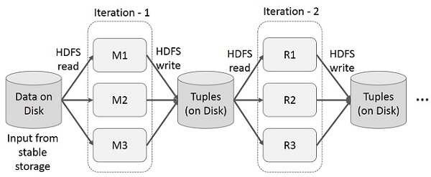
Map-reduce computations

Slide 6
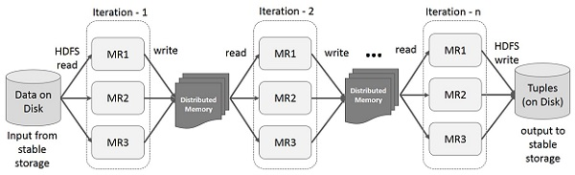
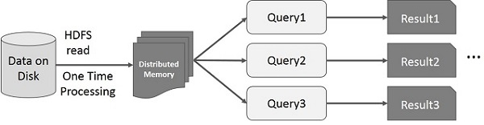
In-memory map-reduce

Slide 7

Execution Model
Spark Execution
Shells and Standalone application
Local and Cluster (Standalone, Yarn, Mesos, Cloud)
Spark Cluster Architecture
Master / Cluster manager
Cluster allocates resources on nodes
Master sends app code and tasks tor nodes
Executers run tasks and cache data
Connect to Cluster
Local
SparkContext and Master field
spark://host:7077
Spark-submit

Slide 8

RDD: resilient distributed dataset
Parallelized collections with fault-tolerant (Hadoop datasets)
Transformations set new RDDs (filter, map, distinct, union, subtract, etc)
Actions call to calculations (count, collect, first)
Transformations are lazy
Actions trigger transformations computation
Broadcast Variables send data to executors
Accumulators collect data on driver
from pyspart import SparkContext as sc
inputRDD = sc.textFile("log.txt")
errorsRDD = inputRDD.filter(lambda x: "error" in x)
warningsRDD = inputRDD.filter(lambda x: "warning" in x)
badLinesRDD = errorsRDD.union(warningsRDD)
print "Input had " + badLinesRDD.count() + " concerning lines"

Slide 9
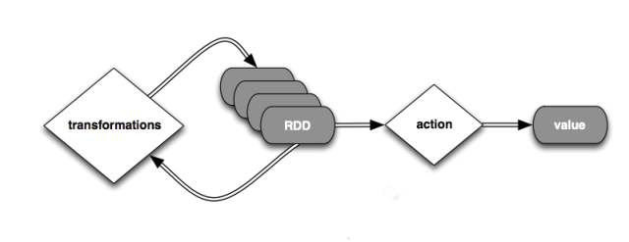
Spark program scenario
Create RDD (loading external datasets, parallelizing a collection on driver)
Transform
Persist intermediate RDDs as results
Launch actions

Slide 10

Transformations (1)

Slide 11

Transformations (2)

Slide 12

Actions (1)

Slide 13

Actions (2)

Slide 14


Spark Streaming Architecture
Micro-batch architecture
SparkStreaming Concext
Batch interval from 500ms
Transformation on Spark Engine
Outup operations instead of Actions
Different sources and outputs

Slide 15
Spark Streaming Example
from pyspark.streaming import StreamingContext
ssc = StreamingContext(sc, 1)
input_stream = ssc.textFileStream("sampleTextDir")
word_pairs = input_stream.flatMap(
lambda l:l.split(" ")).map(lambda w: (w,1))
counts = word_pairs.reduceByKey(lambda x,y: x + y)
counts.print()
ssc.start()
ssc.awaitTermination()
Process RDDs in batches
Start after ssc.start()
Output to console on Driver
Awaiting termination

Slide 16

Spark SQL
SparkSQL interface for working with structured data by SQL
Works with Hive tables and HiveQL
Works with files (Json, Parquet etc) with defined schema
JDBC/ODBC connectors for BI tools
Integrated with Hive and Hive types, uses HiveUDF
DataFrame abstraction

Slide 17
Spark DataFrames
# Import Spark SQLfrom pyspark.sql
import HiveContext, Row
# Or if you can't include the hive requirementsfrom pyspark.sql
import SQLContext, Row
sc = new SparkContext(...)
hiveCtx = HiveContext(sc)
sqlContext = SQLContext(sc)
input = hiveCtx.jsonFile(inputFile)
# Register the input schema RDD
input.registerTempTable("tweets")
# Select tweets based on the retweet
CounttopTweets = hiveCtx.sql("""SELECT text, retweetCount FROM tweets ORDER BY retweetCount LIMIT 10""")
hiveCtx.cacheTable("tableName"), in-memory, column-store, while driver is alive
df.show()
df.select(“name”, df(“age”)+1)
df.filtr(df(“age”) > 19)
df.groupBy(df(“name”)).min()

Slide 18
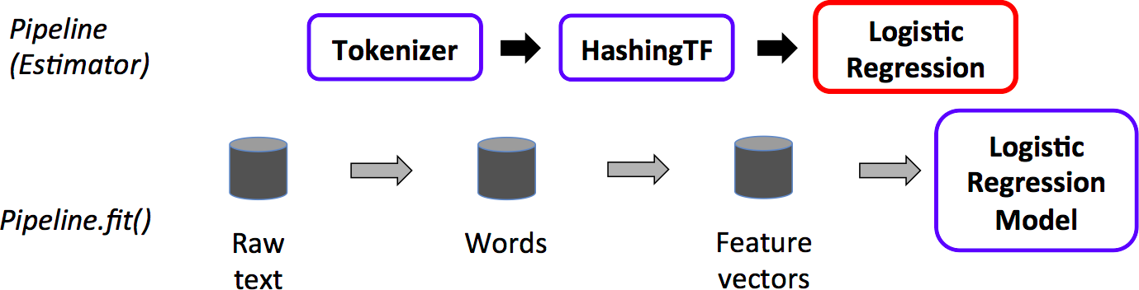
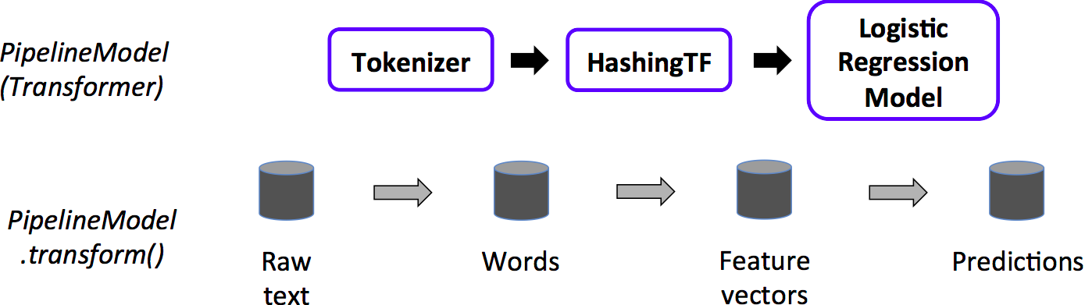
Spark ML
Spark ML
Classification
Regression
Clustering
Recommendation
Feature transformation, selection
Statistics
Linear algebra
Data mining tools
Pipeline Cmponents
DataFrame
Transformer
Estimator
Pipeline
Parameter

Slide 19
DEMO: Spark
Local Spark installation
Shells and Notebook
Spark Examples
HDInsight Spark Cluster
SSH connection to Spark in Azure
Jupyter Notebook connected to HDInsight Spark
Transformations
ActionsSimple SparkSQL querying
Data Frames
Data exploration with SparkSQL
Connect from BI
Training a model
Data visualization

Slide 20
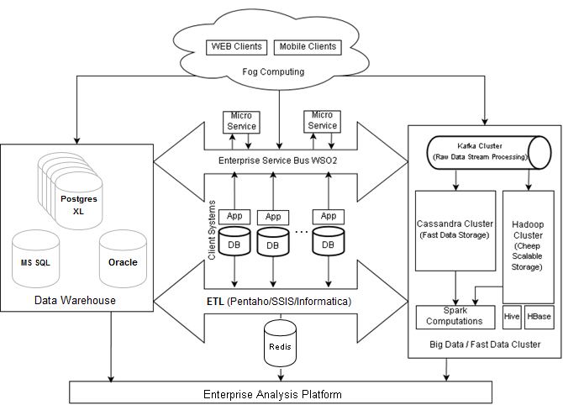
Eleks Enterprice Platform

Slide 21
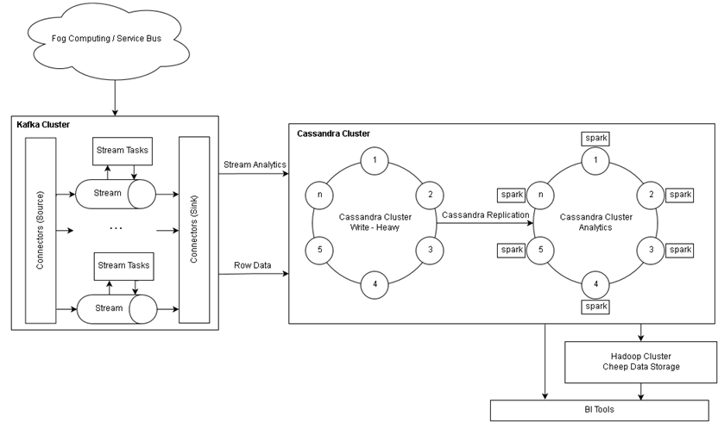
Fast Data Processing

Slide 22
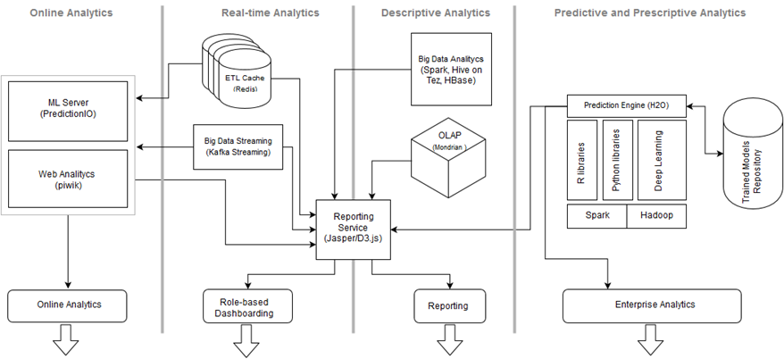
BI / DS Platform

Slide 23
Using Spark
Visual data exploration and interactive analysis (HDFS)
Spark with NoSQL (HBase and Cassandra)
Spark with Data Lake
Spark with Data Warehouse
Machine Learning using R Server, Mllib
Putting it all together in a notebook experience
Using BI with Spark
Spark Environmens
On-Premis, Cloudera, Hortonworks, DataBricks
HDInsight, AWS, DataBriks Cloud
Sparkling Water (H2O), prediction.io

Slide 24
Q&A

