Slide 1
HDInsight: Spark Advanced in-memory BigData Analytics with Microsoft Azure
Vitalii Bondarenko
Data Platform Competency Manager at Eleks
Vitaliy.bondarenko@eleks.com

Slide 2

Agenda
Spark Platform
Spark Core
Spark Extensions
Using HDInsight Spark

Slide 3


About me
Vitalii Bondarenko
Data Platform Competency Manager
Eleks
www.eleks.com
20 years in software development
9+ years of developing for MS SQL Server
3+ years of architecting Big Data Solutions
DW/BI Architect and Technical Lead
OLTP DB Performance Tuning
Big Data Data Platform Architect

Slide 4
Spark Platform

Slide 5
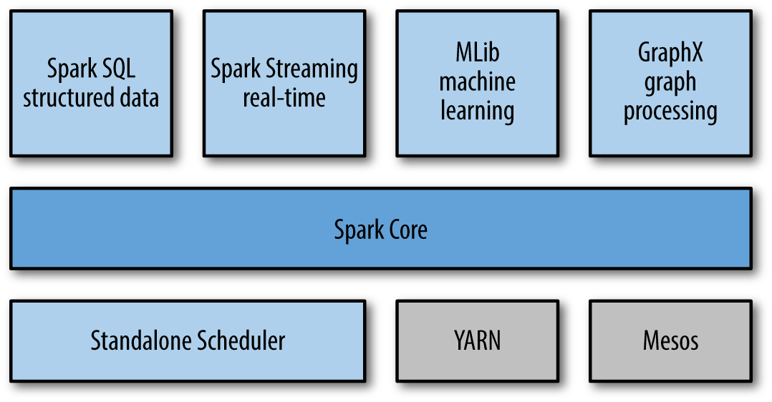
Spark Stack
Clustered computing platform
Designed to be fast and general purpose
Integrated with distributed systems
API for Python, Scala, Java, clear and understandable code
Integrated with Big Data and BI Tools
Integrated with different Data Bases, systems and libraries like Cassanda, Kafka, H2O
First Apache release 2013, this moth v.2.0 has been released

Slide 6
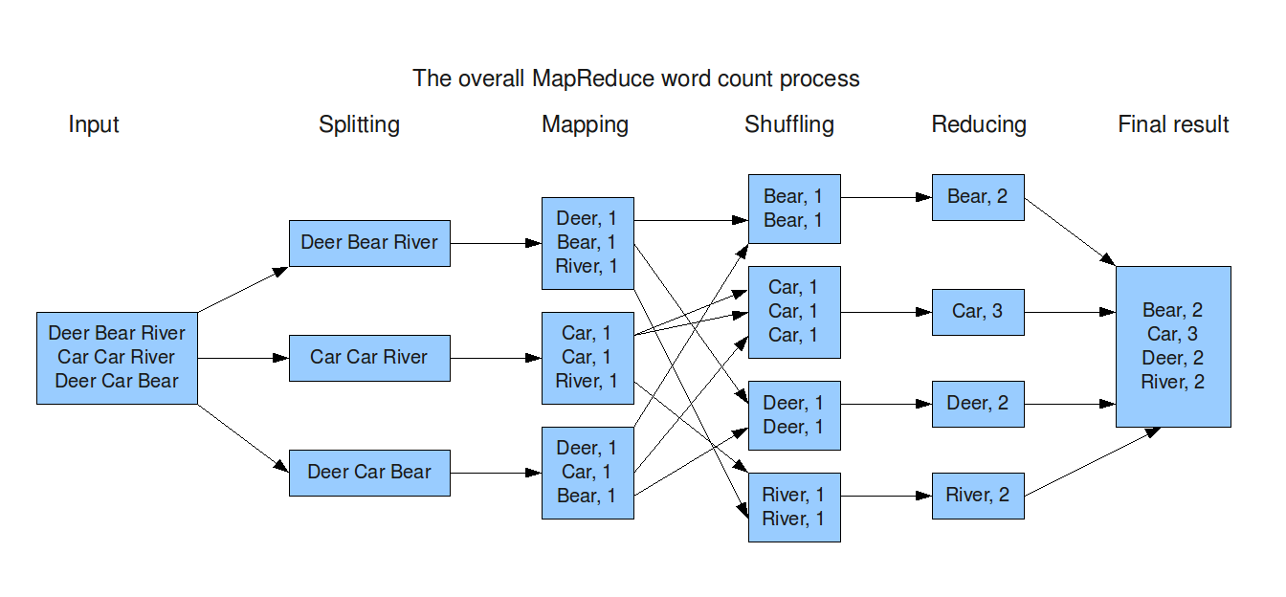
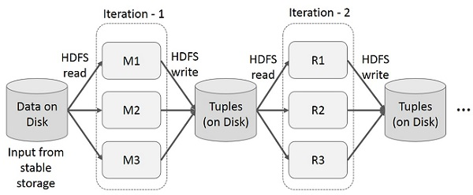
Map-reduce computations

Slide 7
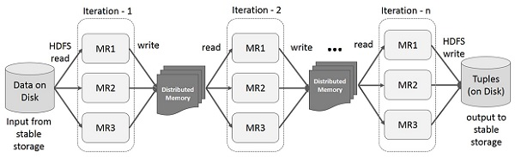
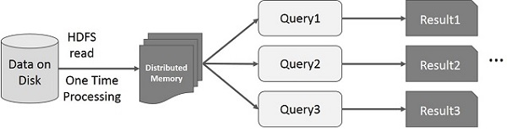
In-memory map-reduce

Slide 8
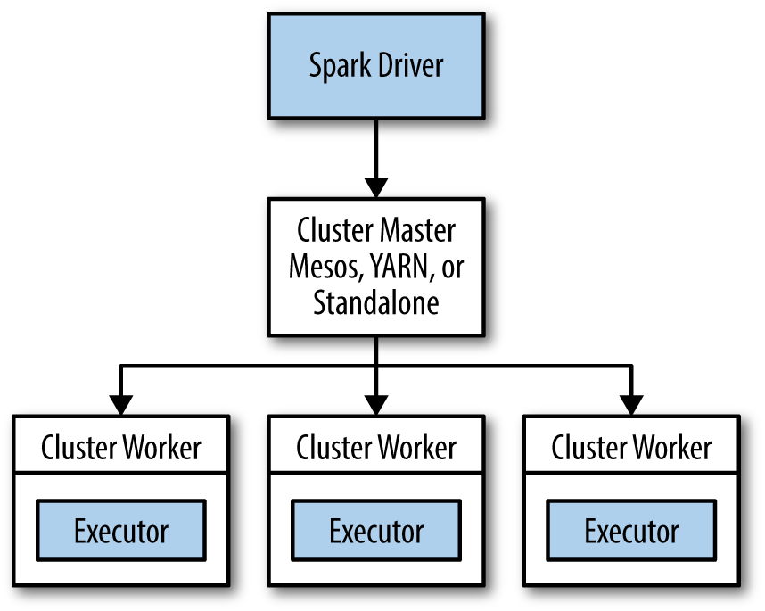
Execution Model
Spark Execution
Shells and Standalone application
Local and Cluster (Standalone, Yarn, Mesos, Cloud)
Spark Cluster Arhitecture
Master / Cluster manager
Cluster allocates resources on nodes
Master sends app code and tasks tor nodes
Executers run tasks and cache data
Connect to Cluster
Local
SparkContext and Master field
spark://host:7077
Spark-submit

Slide 9
DEMO: Execution Environments
Local Spark installation
Shells and Notebook
Spark Examples
HDInsight Spark Cluster
SSH connection to Spark in Azure
Jupyter Notebook connected to HDInsight Spark

Slide 10
Spark Core

Slide 11
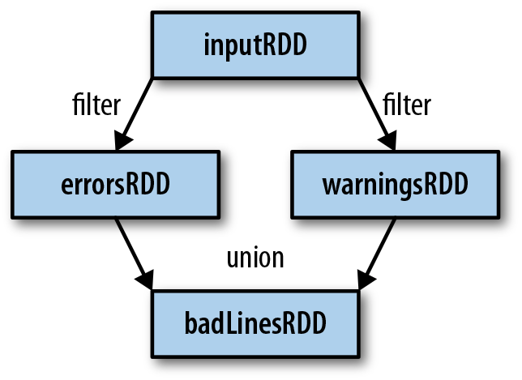
RDD: resilient distributed dataset
Parallelized collections with fault-tolerant (Hadoop datasets)
Transformations set new RDDs (filter, map, distinct, union, subtract, etc)
Actions call to calculations (count, collect, first)
Transformations are lazy
Actions trigger transformations computation
Broadcast Variables send data to executors
Accumulators collect data on driver
inputRDD = sc.textFile("log.txt")
errorsRDD = inputRDD.filter(lambda x: "error" in x)
warningsRDD = inputRDD.filter(lambda x: "warning" in x)
badLinesRDD = errorsRDD.union(warningsRDD)
print "Input had " + badLinesRDD.count() + " concerning lines"

Slide 12
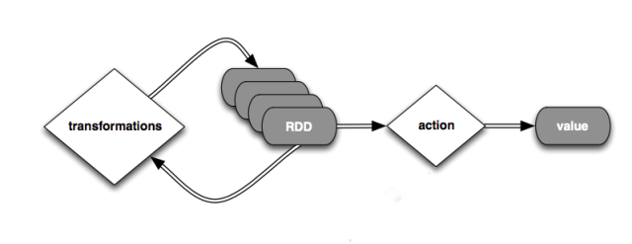
Spark program scenario
Create RDD (loading external datasets, parallelizing a collection on driver)
Transform
Persist intermediate RDDs as results
Launch actions

Slide 13
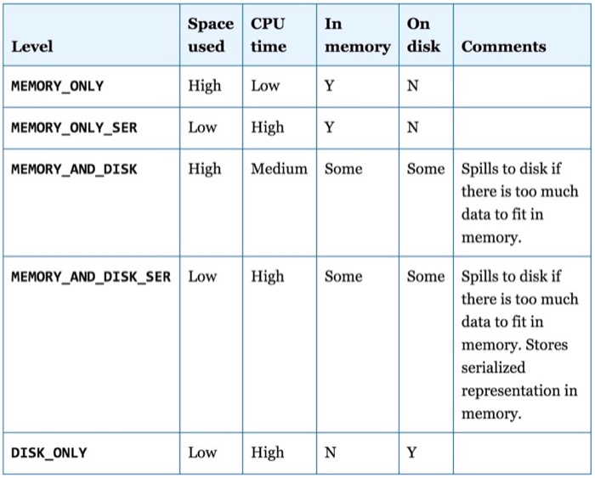
Persistence (Caching)
Avoid recalculations
10x faster in-memory
Fault-tolerant
Persistence levels
Persist before first action
input = sc.parallelize(xrange(1000))
result = input.map(lambda x: x ** x)
result.persist(StorageLevel.MEMORY_ONLY)
result.count()
result.collect()

Slide 14
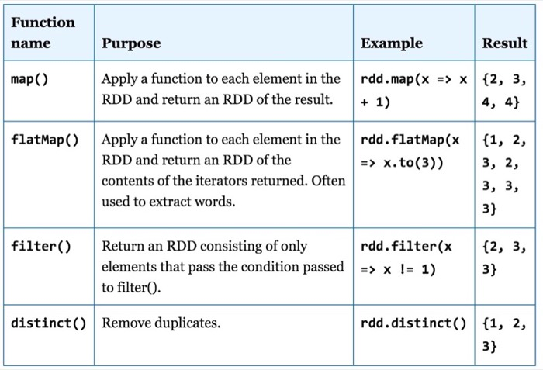
Transformations (1)

Slide 15
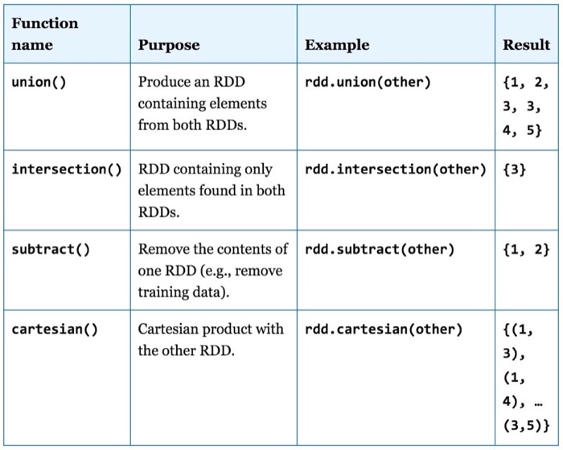
Transformations (2)

Slide 16
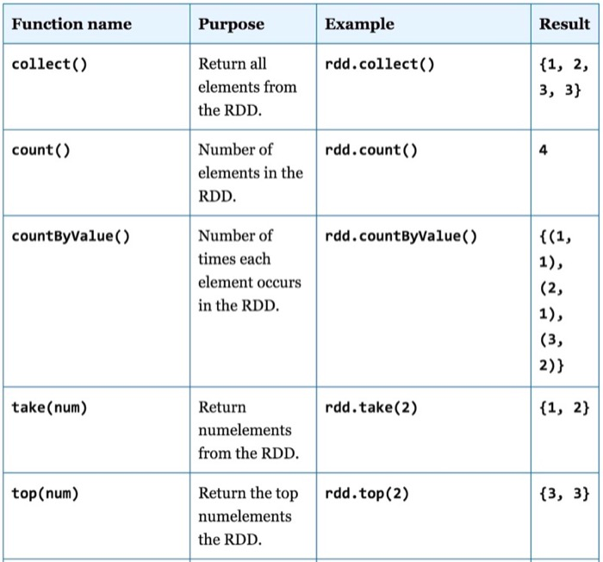
Actions (1)

Slide 17
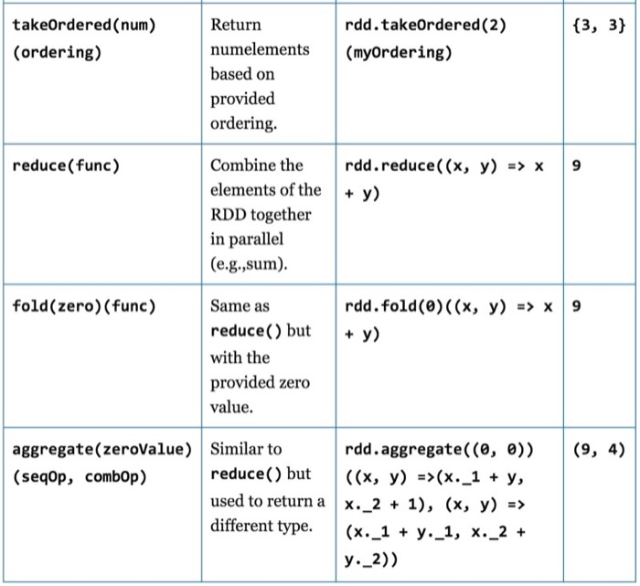
Actions (2)

Slide 18
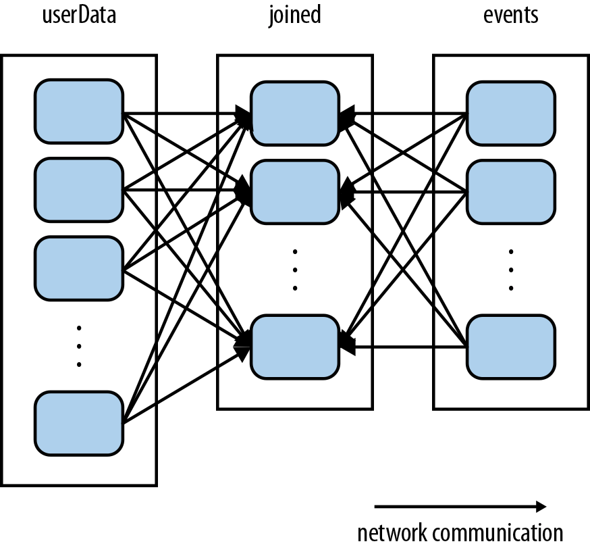
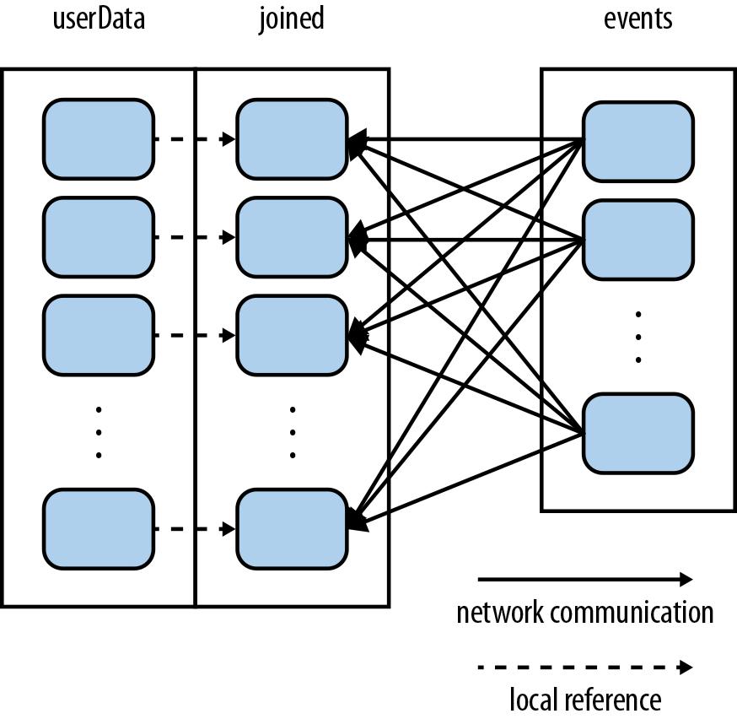
Data Partitioning
userData.join(events)
userData.partitionBy(100).persist()
3-4 partitions on CPU Core
userData.join(events).mapValues(...).reduceByKey(...)

Slide 19
DEMO: Spark Core Operations
Transformations
Actions

Slide 20
Spark Extensions

Slide 21
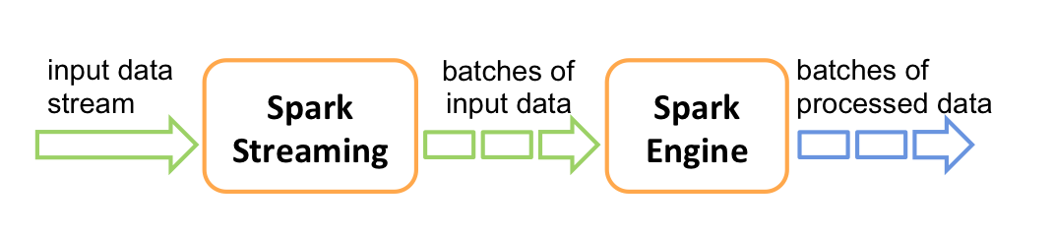
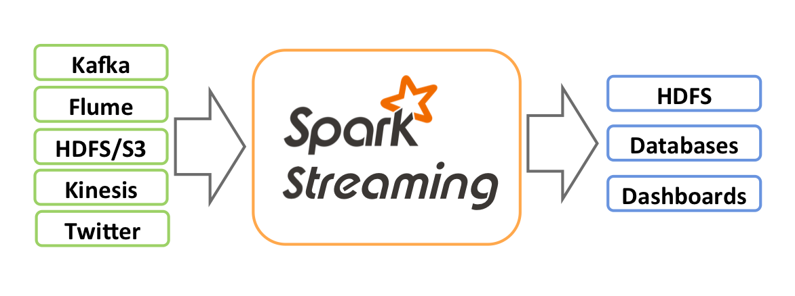
Spark Streaming Architecture
Micro-batch architecture
SparkStreaming Concext
Batch interval from 500ms
Transformation on Spark Engine
Outup operations instead of Actions
Different sources and outputs

Slide 22
Spark Streaming Example
from pyspark.streaming import StreamingContext
ssc = StreamingContext(sc, 1)
input_stream = ssc.textFileStream("sampleTextDir")
word_pairs = input_stream.flatMap(
lambda l:l.split(" ")).map(lambda w: (w,1))
counts = word_pairs.reduceByKey(lambda x,y: x + y)
counts.print()
ssc.start()
ssc.awaitTermination()
Process RDDs in batches
Start after ssc.start()
Output to console on Driver
Awaiting termination

Slide 23
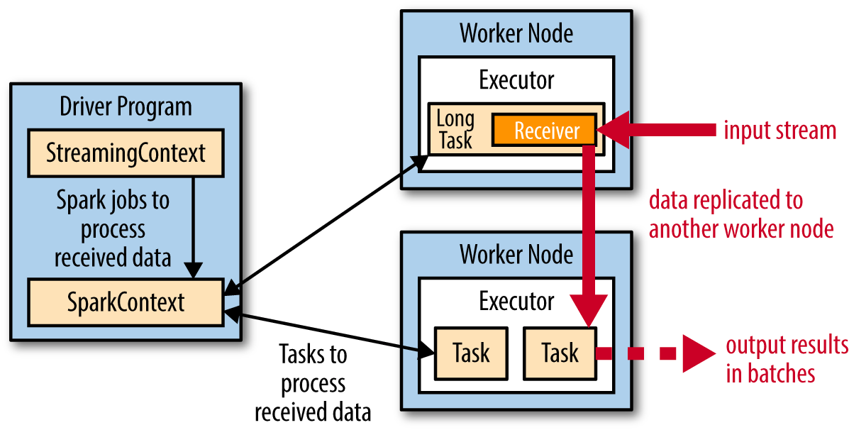
Streaming on a Cluster
Receivers with replication
SparkContext on Driver
Output from Exectors in batches saveAsHadoopFiles()
spark-submit for creating and scheduling periodical streaming jobs
Chekpointing for saving results and restore from the point ssc.checkpoint(“hdfs://...”)

Slide 24
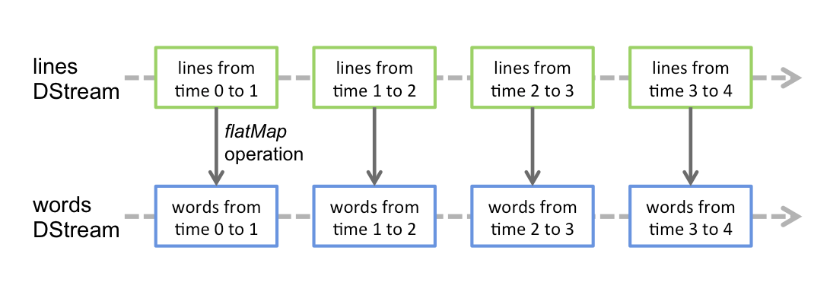
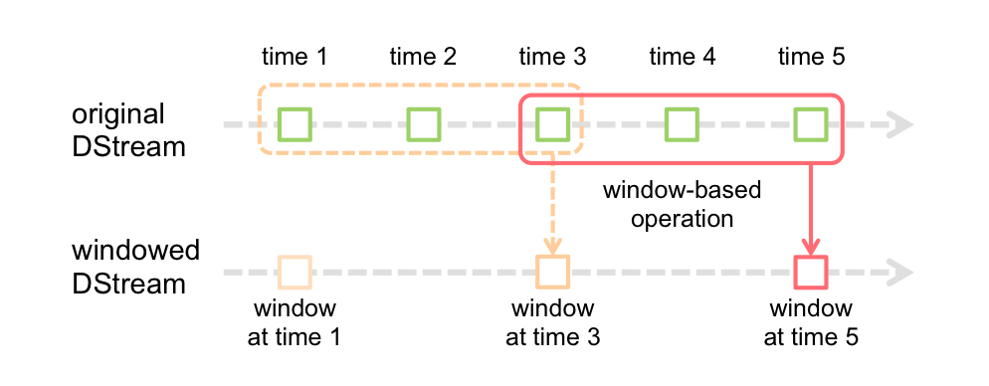
Streaming Transformations
DStreams
Stateless transformantions
Stagefull transformantions
Windowed transformantions
UpdateStateByKey
ReduceByWindow, reduceByKeyAndWindow
Recomended batch size from 10 sec
val ipDStream = accessLogsDStream.map(logEntry => (logEntry.getIpAddress(), 1))
val ipCountDStream = ipDStream.reduceByKeyAndWindow(
{(x, y) => x + y}, // Adding elements in the new batches entering the window
{(x, y) => x - y}, // Removing elements from the oldest batches exiting the window
Seconds(30), // Window duration
Seconds(10)) // Slide duration

Slide 25
DEMO: Spark Streaming
Simple streaming with PySpark

Slide 26
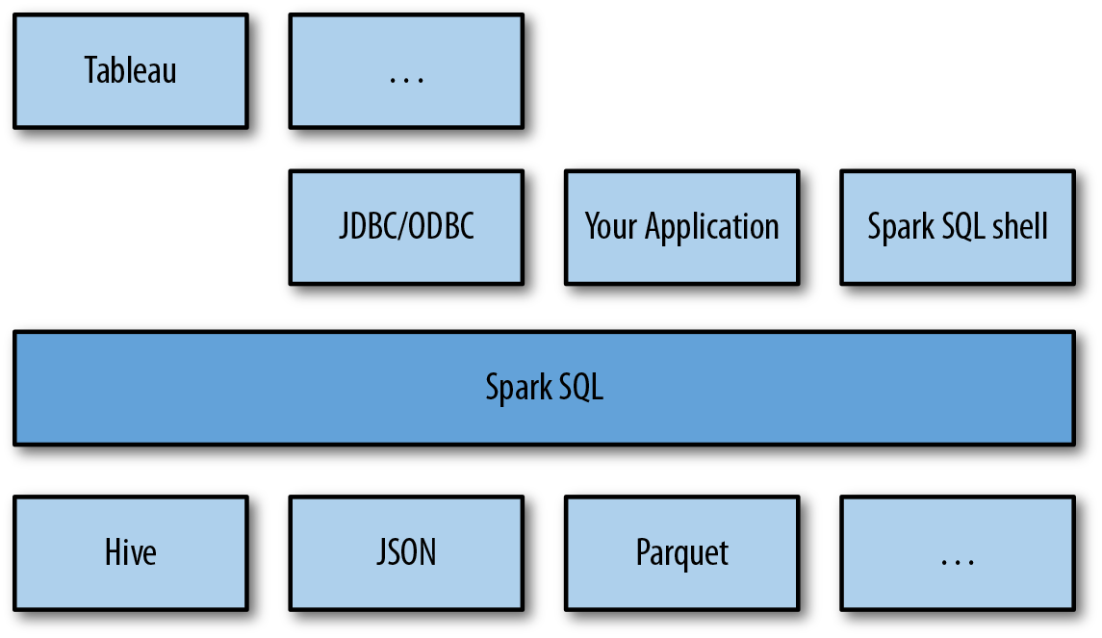
Spark SQL
SparkSQL interface for working with structured data by SQL
Works with Hive tables and HiveQL
Works with files (Json, Parquet etc) with defined schema
JDBC/ODBC connectors for BI tools
Integrated with Hive and Hive types, uses HiveUDF
DataFrame abstraction

Slide 27
Spark DataFrames
# Import Spark SQLfrom pyspark.sql
import HiveContext, Row
# Or if you can't include the hive requirementsfrom pyspark.sql
import SQLContext, Row
sc = new SparkContext(...)
hiveCtx = HiveContext(sc)
sqlContext = SQLContext(sc)
input = hiveCtx.jsonFile(inputFile)
# Register the input schema RDD
input.registerTempTable("tweets")
# Select tweets based on the retweet
CounttopTweets = hiveCtx.sql("""SELECT text, retweetCount FROM tweets ORDER BY retweetCount LIMIT 10""")
hiveCtx.cacheTable("tableName"), in-memory, column-store, while driver is alive
df.show()
df.select(“name”, df(“age”)+1)
df.filtr(df(“age”) > 19)
df.groupBy(df(“name”)).min()

Slide 28
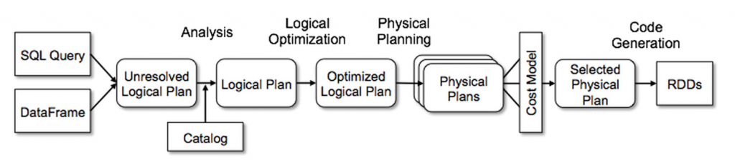
Catalyst: Query Optimizer
SELECT name
FROM (
SELECT id, name
FROM People) p
WHERE p.id = 1
Analysis: map tables, columns, function, create a logical plan
Logical Optimization: applies rules and optimize the plan
Physical Planing: physical operator for the logical plan execution
Cost estimation

Slide 29
DEMO: Using SparkSQL
Simple SparkSQL querying
Data Frames
Data exploration with SparkSQL
Connect from BI

Slide 30
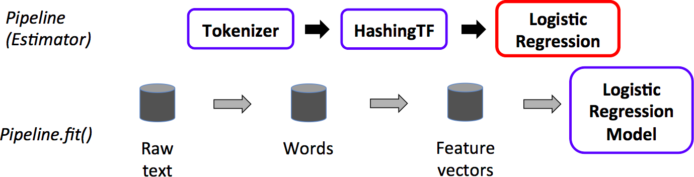
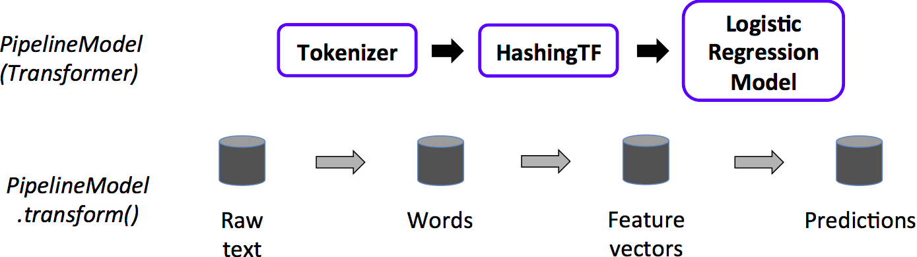
Spark ML
Spark ML
Classification
Regression
Clustering
Recommendation
Feature transformation, selection
Statistics
Linear algebra
Data mining tools
Pipeline Cmponents
DataFrame
Transformer
Estimator
Pipeline
Parameter

Slide 31
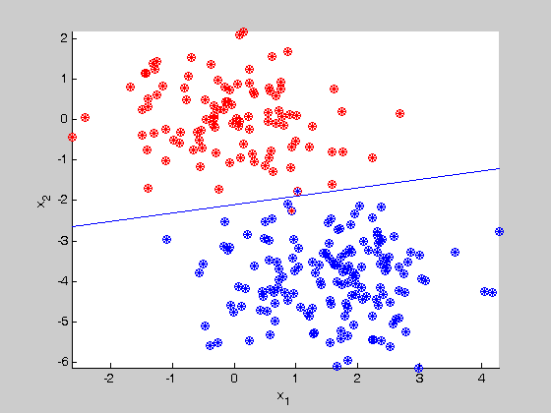
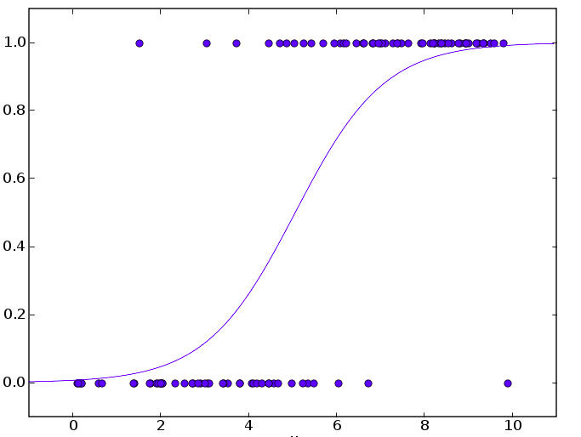

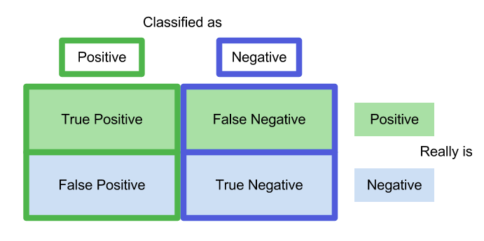
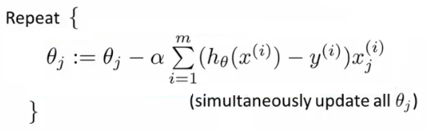
Logistic Regression

Slide 32
DEMO: Spark ML
Training a model
Data visualization

Slide 33
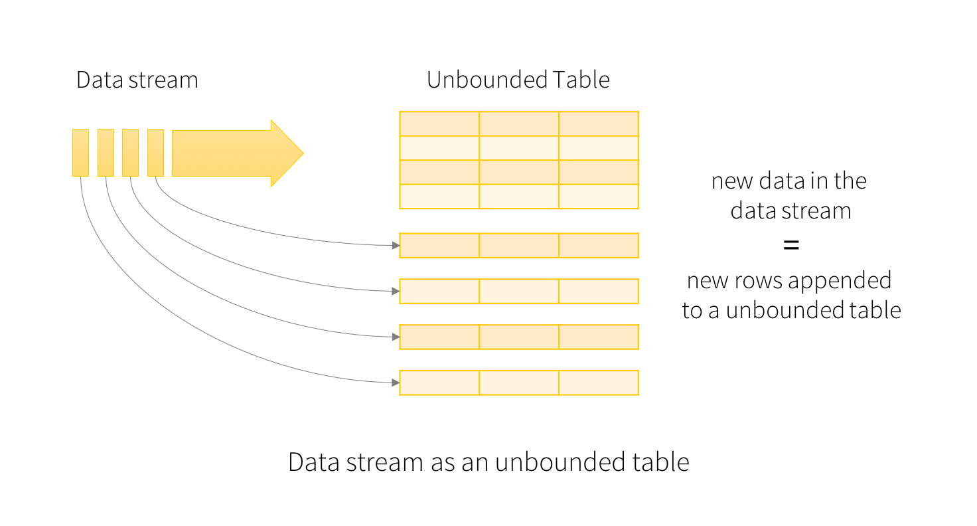
New in Spark 2.0
Unifying DataFrames and Datasets in Scala/Java (compile time syntax and analysis errors). Same performance and convertible.
SparkSession: a new entry point that supersedes SQLContext and HiveContext.
Machine learning pipeline persistence
Distributed algorithms in R
Faster Optimizer
Structured Streaming

Slide 34
New in Spark 2.0
spark = SparkSession\
.builder()\
.appName("StructuredNetworkWordCount")\
.getOrCreate()
# Create DataFrame representing the stream of input lines from connection to localhost:9999
lines = spark\
.readStream\
.format('socket')\
.option('host', 'localhost')\
.option('port', 9999)\
.load()
# Split the lines into words
words = lines.select(
explode(
split(lines.value, ' ')
).alias('word')
)
# Generate running word count
wordCounts = words.groupBy('word').count()
# Start running the query that prints the running counts to the console
query = wordCounts\
.writeStream\
.outputMode('complete')\
.format('console')\
.start()
query.awaitTermination()
windowedCounts = words.groupBy(
window(words.timestamp, '10 minutes', '5 minutes'),
words.word
).count()

Slide 35
HDInsight: Spark

Slide 36
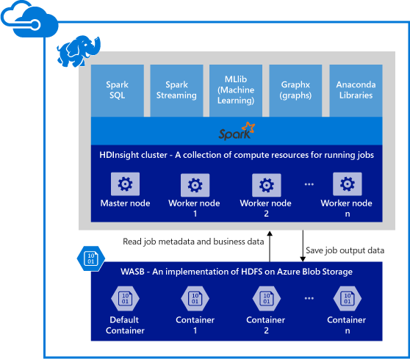
Spark in Azure

Slide 37
HDInsight benefits
Ease of creating clusters (Azure portal, PowerShell, .Net SDK)
Ease of use (noteboks, azure control panels)
REST APIs (Livy: job server)
Support for Azure Data Lake Store (adl://)
Integration with Azure services (EventHub, Kafka)
Support for R Server (HDInsight R over Spark)
Integration with IntelliJ IDEA (Plugin, create and submit apps)
Concurrent Queries (many users and connections)
Caching on SSDs (SSD as persist method)
Integration with BI Tools (connectors for PowerBI and Tableau)
Pre-loaded Anaconda libraries (200 libraries for ML)
Scalability (change number of nodes and start/stop cluster)
24/7 Support (99% up-time)

Slide 38
HDInsight Spark Scenarious
Streaming data, IoT and real-time analytics
Visual data exploration and interactive analysis (HDFS)
Spark with NoSQL (HBase and Azure DocumentDB)
Spark with Data Lake
Spark with SQL Data Warehouse
Machine Learning using R Server, Mllib
Putting it all together in a notebook experience
Using Excel with Spark

Slide 39
Q&A

