Slide 1
Spark Platform

Slide 2

Spark Stack
Pyspark shell
Scala shell
IPython Jupyter Notebook
StandUsing Excel with Sparkallong application (python, scala, java)
Databricks Spark Cloud Cluster
Azure HDInsight: Spark Cluster

Slide 3
DEMO: Execution Environments
Pyspark shell
Scala shell
IPython Jupyter Notebook
StandUsing Excel with Sparkallong application (python, scala, java)
Databricks Spark Cloud Cluster
Azure HDInsight: Spark Cluster

Slide 4
Spark Core

Slide 5

Execution Model
Standalone application
Cluster
SparkContext and Master field
local
spark://host:7077
Master / Cluster manager
Cluster allocates resources on nodes
Master sends app code and tasks to nodes
Executers run tasks and cache data
Spark-submit
Standalone cluster
Mesos
Yarn
Cloud

Slide 6

RDD: resilient distributed dataset
Parallelized collections
Hadoop datasets (fault-tolerant)
Transformations set new RDDs (filter, map, distinct, union, subtract, etc)
Actions call to calculations (count, collect, first)
Transformations are lazy
Actions trigger transformations computation
Optimization opportunity
Recovery from lost partitions
Accumulators collect data on driver
Broadcast Variables send data to executors
inputRDD = sc.textFile("log.txt")
errorsRDD = inputRDD.filter(lambda x: "error" in x)
warningsRDD = inputRDD.filter(lambda x: "warning" in x)
badLinesRDD = errorsRDD.union(warningsRDD)
print "Input had " + badLinesRDD.count() + " concerning lines"

Slide 7
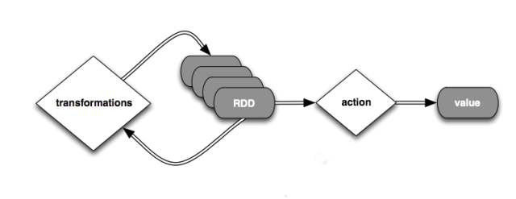
Spark program session
Create RDD (loading external datasets, parallelizing a collection on driver)
Transform
Persist intermediate RDDs as results
Launch actions
Transformations are lazy
Actions trigger transformations computation

Slide 8
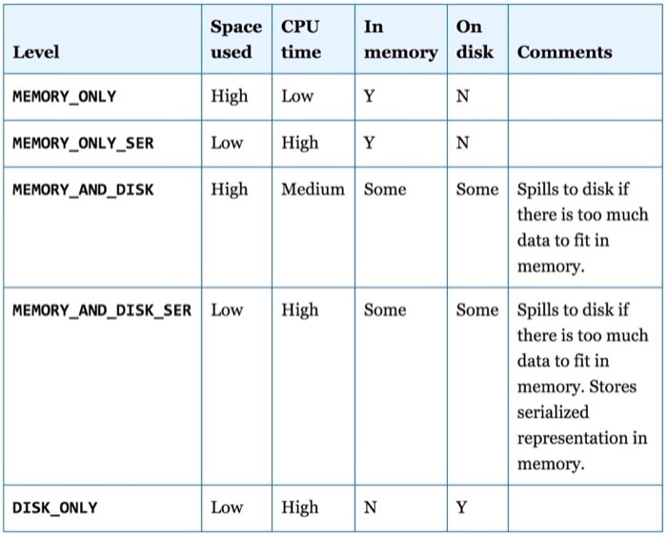
Persistence (Caching)
Avoid recalculations
10x faster in-memory
Fault-tolerant
Persistence levels
Persist before first action
input = sc.parallelize(xrange(1000))
result = input.map(lambda x: x ** x)
result.persist(StorageLevel.MEMORY_ONLY)
result.count()
result.collect()

Slide 9

Transformations (1)

Slide 10

Transformations (2)

Slide 11

Actions (1)

Slide 12

Actions (2)

Slide 13
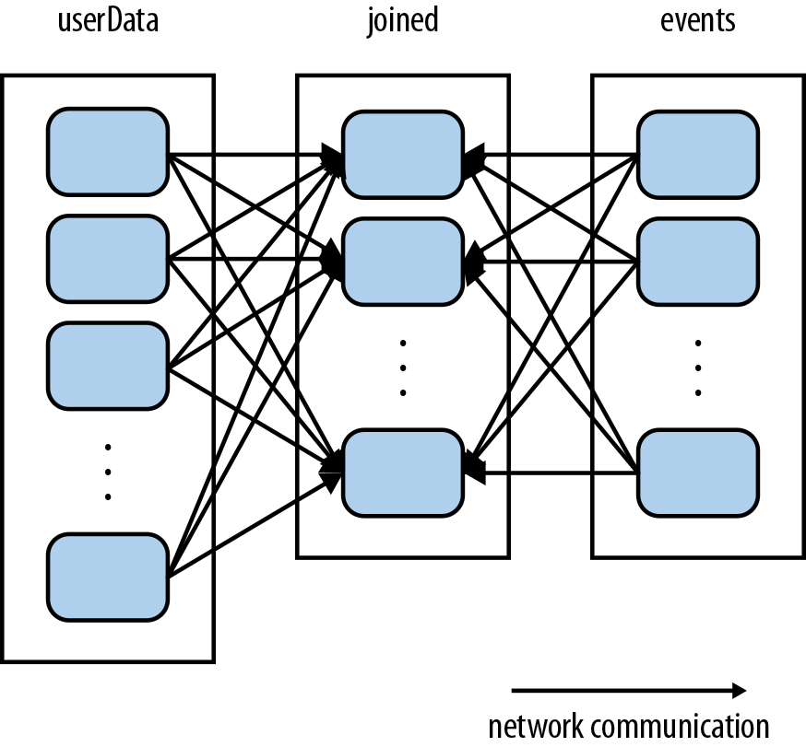
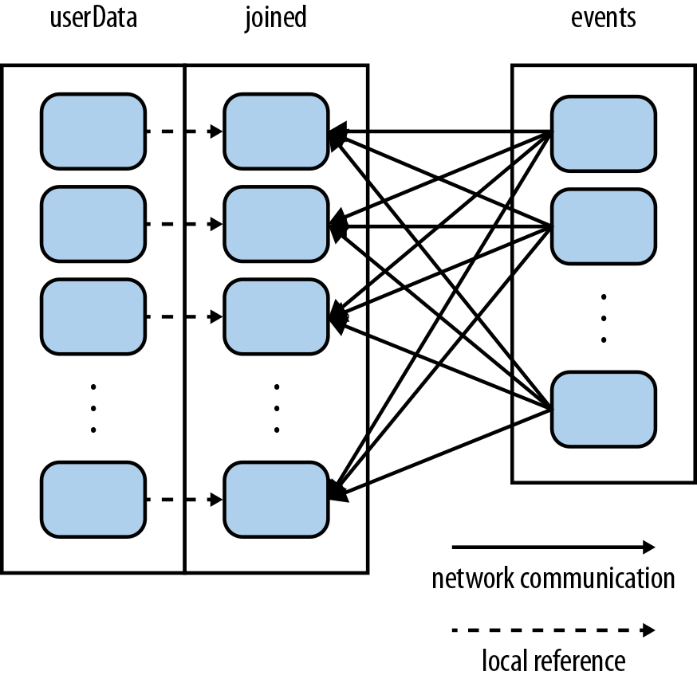
Data Partitioning
userData.join(events)
userData.partitionBy(100).persist()
3-4 partitions on CPU Core
userData.join(events).mapValues(...).reduceByKey(...)

Slide 14
DEMO: Spark Core Operations
Transformations
Actions
Aggregations

Slide 15
Spark Extensions

Slide 16


Spark Streaming Architecture
Micro-batch architecture
SparkStreaming Concext
Batch interval from 500ms
Transformation on Spark Engine
Outup operations instead of Actions
Different sources and outputs

Slide 17
Spark Streaming Example
from pyspark.streaming import StreamingContext
ssc = StreamingContext(sc, 1)
input_stream = ssc.textFileStream("sampleTextDir")
word_pairs = input_stream.flatMap(
lambda l:l.split(" ")).map(lambda w: (w,1))
counts = word_pairs.reduceByKey(lambda x,y: x + y)
counts.print()
ssc.start()
ssc.awaitTermination()
Precess RDDs in batches
Start after ssc.start()
Output to console on Driver
Awaiting termination

Slide 18
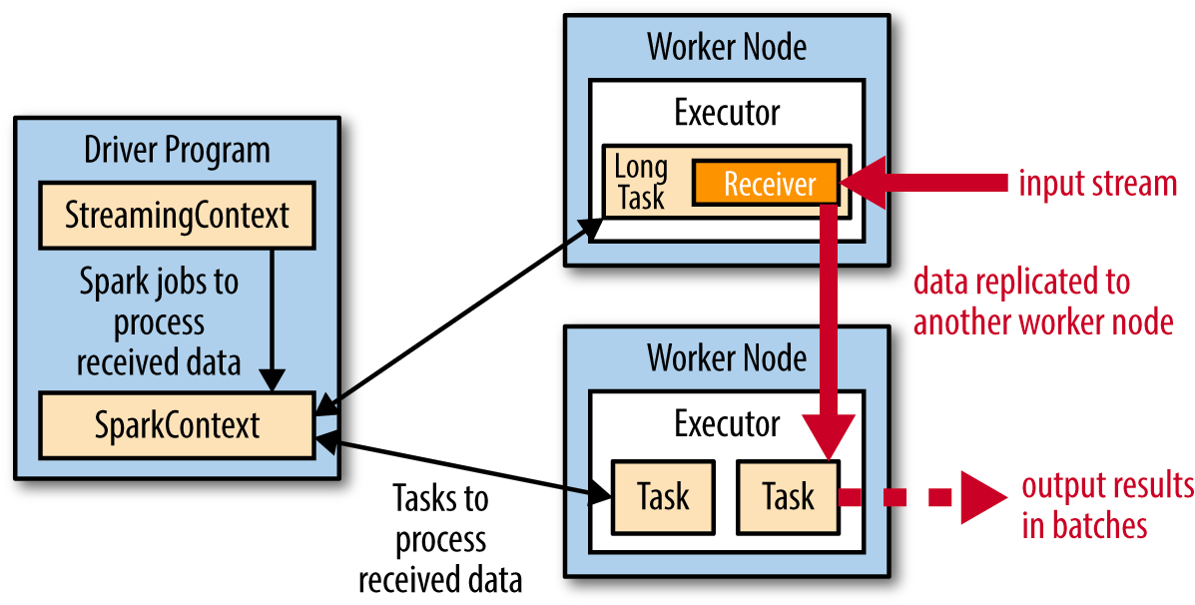
Streaming on a Cluster
Receivers with replication
SparkContext on Driver
Output from Exectors in batches saveAsHadoopFiles()
spark-submit for creating and scheduling periodical streaming jobs
Chekpointing for saving results and restore from the point ssc.checkpoint(“hdfs://...”)

Slide 19
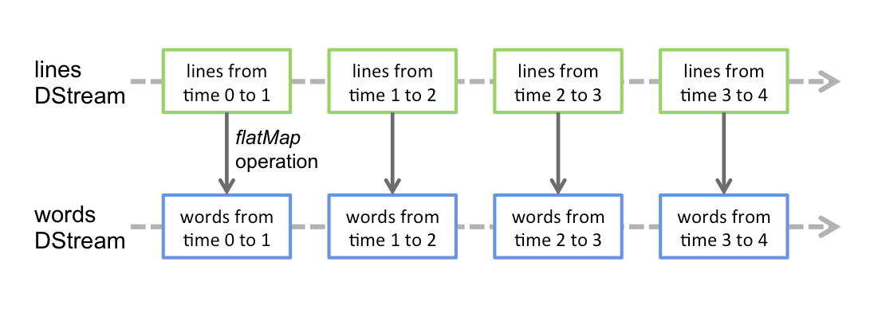
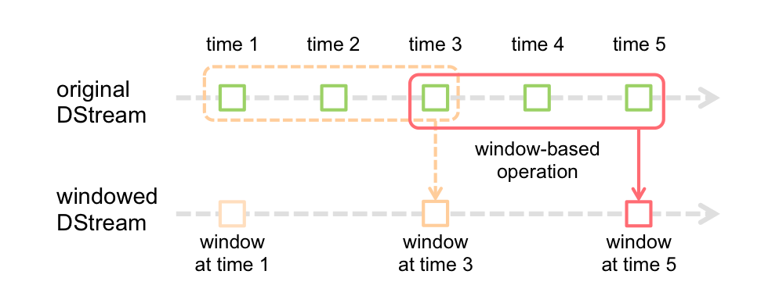
Transformations
DStreams
Stateless transformantions
Stagefull transformantions
Windowed transformantions
UpdateStateByKey
ReduceByWindow, reduceByKeyAndWindow
Recomended batch size from 10 sec
val ipDStream = accessLogsDStream.map(logEntry => (logEntry.getIpAddress(), 1))
val ipCountDStream = ipDStream.reduceByKeyAndWindow(
{(x, y) => x + y}, // Adding elements in the new batches entering the window
{(x, y) => x - y}, // Removing elements from the oldest batches exiting the window
Seconds(30), // Window duration
Seconds(10)) // Slide duration

Slide 20
DEMO: Spark Streaming
Simple streaming with PySpark

Slide 21

Spark SQL
SparkSQL interface for working with structured data by SQL
Works with Hive tables and HiveQL
Works with files (Json, Parquet etc) with defined schema
JDBC/ODBC connectors for BI tools
Integrated with Hive and Hive types, uses HiveUDF
DataFrame abstraction

Slide 22
Spark DataFrames
# Import Spark SQLfrom pyspark.sql
import HiveContext, Row
# Or if you can't include the hive requirementsfrom pyspark.sql
import SQLContext, Row
sc = new SparkContext(...)
hiveCtx = HiveContext(sc)
sqlContext = SQLContext(sc)
input = hiveCtx.jsonFile(inputFile)
# Register the input schema RDD
input.registerTempTable("tweets")
# Select tweets based on the retweet
CounttopTweets = hiveCtx.sql("""SELECT text, retweetCount FROM tweets ORDER BY retweetCount LIMIT 10""")
hiveCtx.cacheTable("tableName"), in-memory, column-store, while driver is alive
df.show()
df.select(“name”, df(“age”)+1)
df.filtr(df(“age”) > 19)
df.groupBy(df(“name”)).min()

Slide 23
Using HiveContext
from pyspark.sql import HiveContext
hiveCtx = HiveContext(sc)
rows = hiveCtx.sql("SELECT key, value FROM mytable")
keys = rows.map(lambda row: row[0])
saveAsTable(“TableName”)
Hive format, text files, RCFiles, ORC, Parquet, Avro, protocol Buffers
JDBC/ODBC with Trhift Server on Driver Node for BI Tools
Beeline and spark-sql shells
EXPLAIN SELECT … for execution plan

Slide 24
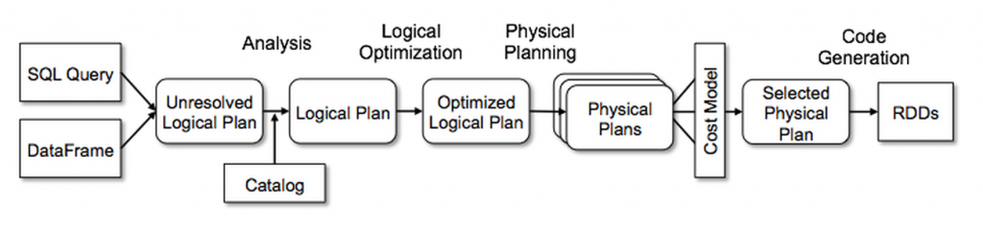
Catalyst: Query Optimizer
SELECT name
FROM (
SELECT id, name
FROM People) p
WHERE p.id = 1
Analysis: map tables, columns, function, create a logical plan
Logical Optimization: applies rules and optimize the plan
Physical Planing: physical operator for the logical plan execution
Cost estimation

Slide 25
DEMO: Using SparkSQL
Simple SparkSQL querying
Using Hive connector
Using beeline utility
Connect from BI

Slide 26
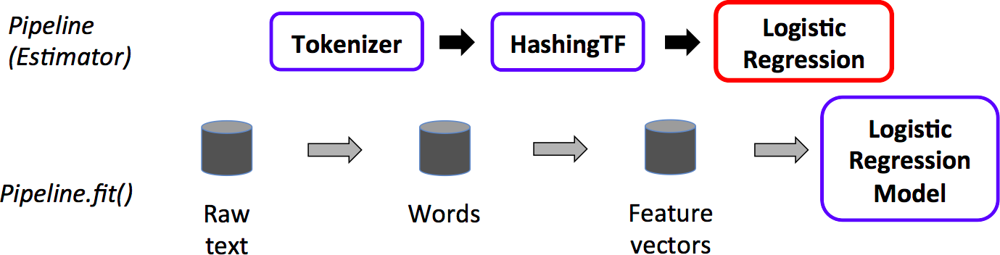
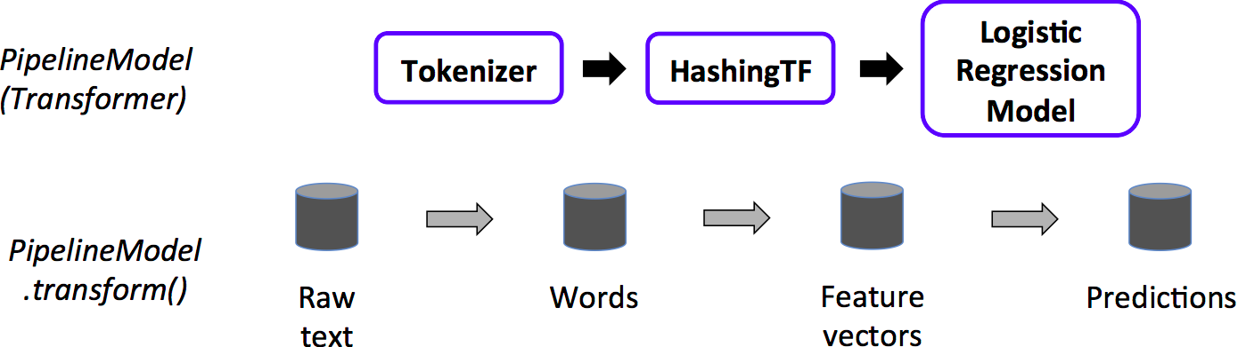
Spark ML
Spark ML
Classification
Regression
Clustering
Recommendation
Feature transformation, selection
Statistics
Linear algebra
Data mining tools
Pipeline Cmponents
DataFrame
Transformer
Estimator
Pipeline
Parameter

Slide 27
DEMO: Spark ML
Training a model
Data visualization

Slide 28
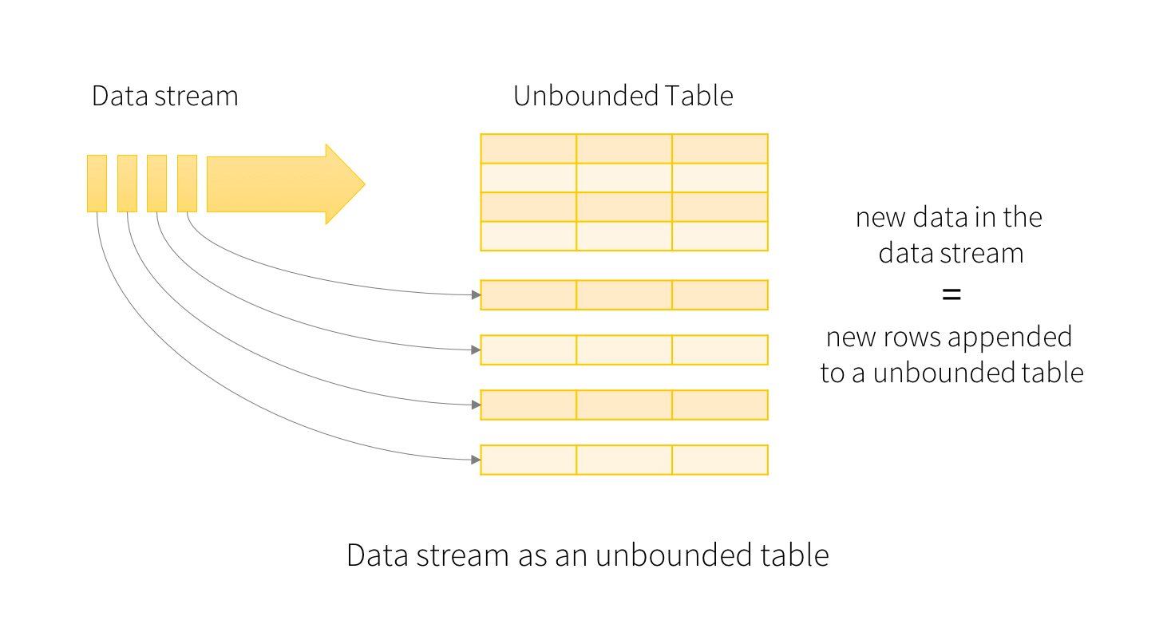
New in Spark 2.0
Unifying DataFrames and Datasets in Scala/Java (compile time syntax and analysis errors). Same performance and convertible.
SparkSession: a new entry point that supersedes SQLContext and HiveContext.
Machine learning pipeline persistence
Distributed algorithms in R
Faster Optimizer
Structured Streaming

Slide 29
New in Spark 2.0
spark = SparkSession\
.builder()\
.appName("StructuredNetworkWordCount")\
.getOrCreate()
# Create DataFrame representing the stream of input lines from connection to localhost:9999
lines = spark\
.readStream\
.format('socket')\
.option('host', 'localhost')\
.option('port', 9999)\
.load()
# Split the lines into words
words = lines.select(
explode(
split(lines.value, ' ')
).alias('word')
)
# Generate running word count
wordCounts = words.groupBy('word').count()
# Start running the query that prints the running counts to the console
query = wordCounts\
.writeStream\
.outputMode('complete')\
.format('console')\
.start()
query.awaitTermination()
windowedCounts = words.groupBy(
window(words.timestamp, '10 minutes', '5 minutes'),
words.word
).count()

Slide 30
HDInsight: Spark

Slide 31
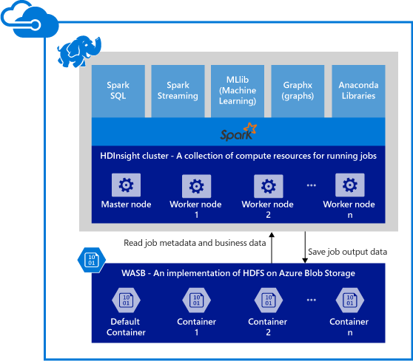
Spark in Azure

Slide 32
HDInsight benefits
Ease of creating clusters (Azure portal, PowerShell, .Net SDK)
Ease of use (noteboks, azure control panels)
REST APIs (Livy: job server)
Support for Azure Data Lake Store (adl://)
Integration with Azure services (EventHub, Kafka)
Support for R Server (HDInsight R over Spark)
Integration with IntelliJ IDEA (Plugin, create and submit apps)
Concurrent Queries (many users and connections)
Caching on SSDs (SSD as persist method)
Integration with BI Tools (connectors for PowerBI and Tableau)
Pre-loaded Anaconda libraries (200 libraries for ML)
Scalability (change number of nodes and start/stop cluster)
24/7 Support (99% up-time)

Slide 33
HDInsight Spark Scenarious
Streaming data, IoT and real-time analytics
Visual data exploration and interactive analysis (HDFS)
Spark with NoSQL (HBase and Azure DocumentDB)
Spark with Data Lake
Spark with SQL Data Warehouse
Machine Learning using R Server, Mllib
Putting it all together in a notebook experience
Using Excel with Spark

Slide 34
Q&A

