Slide 1


Slide 2
A Regional Director asked me to analyze the data from the Northeast Region for EmporiUm
These regions include
Maryland, Maine, Massachusetts,
and New Jersey

Slide 3
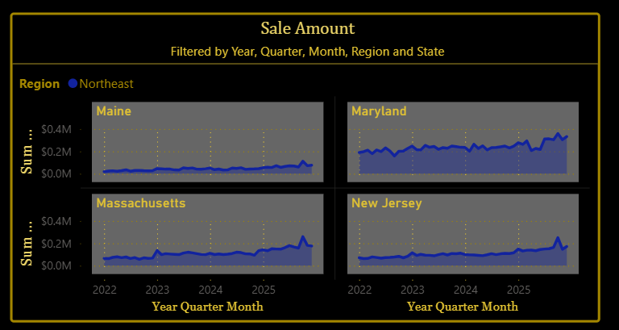
Sales have risen since our start in 2022 to 2025 in all Northeast Region states
The first thing I noticed when analyzing the data is that Maryland makes up almost half of the regions sales
Why is that?
University sizes?
Number of Stores?
Better Marketing?
Wouldn't hurt to look further into this

Slide 4
What We're Really Here For

Slide 5
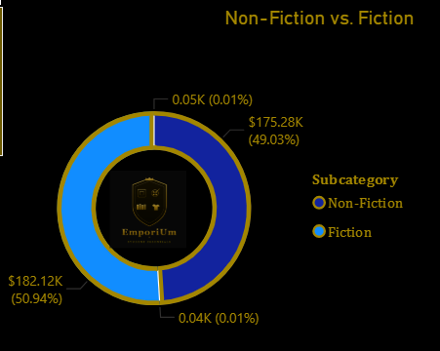
Book Sales
Looking at our customers purchases
Fiction and non-fiction are almost evenly split
This suggests that our readers are a diverse bunch and that our company has a balanced customer base.

Slide 6
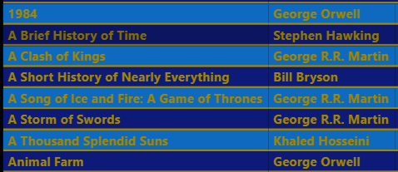
There seems to be recurring names of:
George R. R. Martin
George Orwell
Suggesting these authors perform consistently well.
It wouldn’t hurt to look further into this and see if we could include them I future promotions or featured displays

Slide 7
Why does Book Sales Matter?
This data gives us a good insight into what customers interests are. By understanding what the highest selling titles and authors are we can promote books and/or authors with intent, make more informed inventory decisions, and reveal local reading preferences to compare to different regions and states.

Slide 8
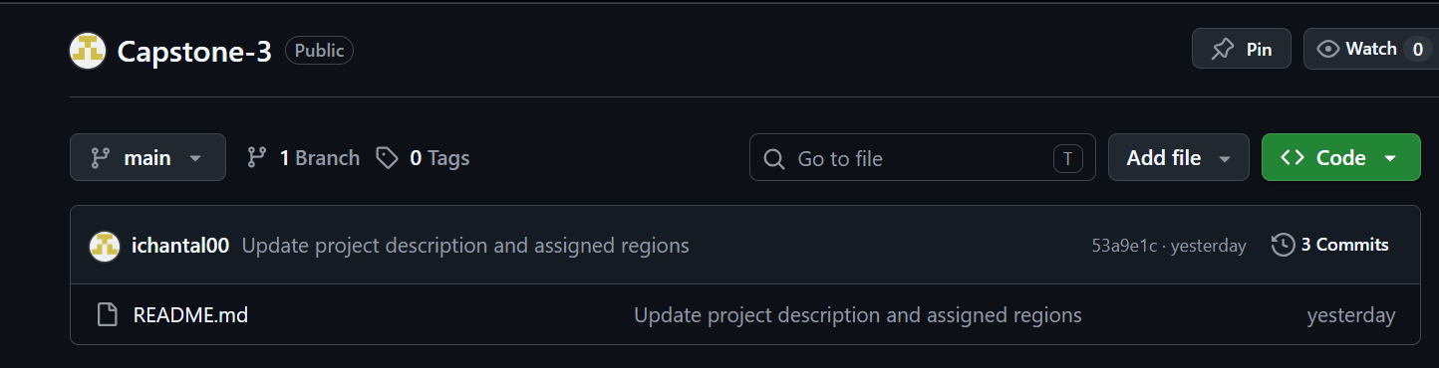

Thank You for Watching
If you want to hear more of my insane ramblings or at look further into my work yourself, you can find out more on my Github.
https://github.com/ichantal00/Capstone-3.git

