Slide 1
Sales projections: East Region
2x +2 = 4
X+58(3+65%) = 7
By Chantal Lee
3x +643 =3454
X+5u(t-5%) = 7​
SELECT * FROM East

Slide 2
My Thoughts
We should provide more visibility and promotions to Books (General)
Stationery Supplies by cross-selling during the Fall.

Slide 3
We'll be looking at the data from 1/1/2022 - 12-31-2025

Slide 4
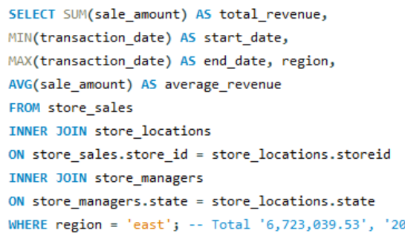
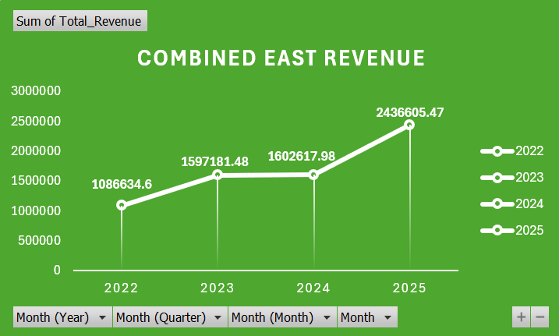
Total Revenue For East Region
2022: Mostly ~$85K–$100K/month
2023: Jumps to ~$120K–$140K/month
2024: Stabilizes ~$120K–$150K/month
2025: Huge jump to ~$175K–$300K/month
Over 600k increase from 2024 to 2025

Slide 5
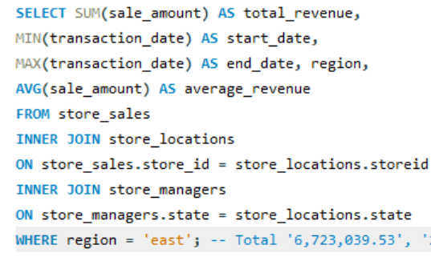
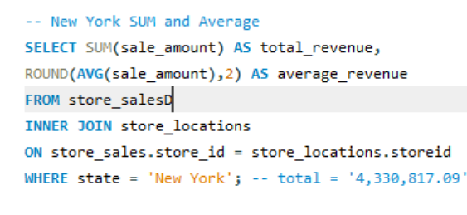
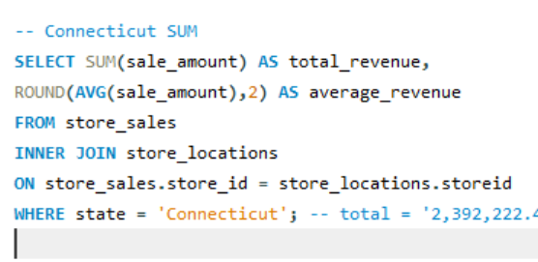
Total Revenue Comparison by State vs. Region
New York
Connecticut
East
Total = 4,330,817.09
Average = 139.53
Total = 2,392,222.44
Average = 137.66
Total = 6,723,039.53
Average = 138.85

Slide 6

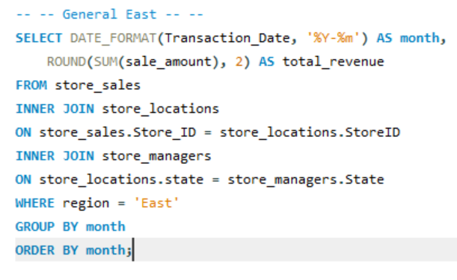
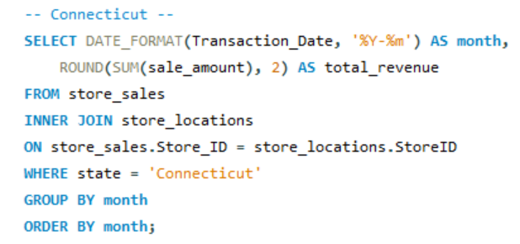
Month by Month
Early year dip between January and February
Mid-year stability between March and August
And fall spikes between September and October
Patterns Start to Emerge

Slide 7
Performance Sales Rank by Store
New York
Top Performing Store:
Store 850
Location: New York, New York
Region: East
Price: $621,565.02
Connecticut
Top Performing Store:
Store 870
Location: New London, Connecticut
Region: East
Price: $331,116.76
Lowest Performing Store:
Store 851
Location: Queens, New York
Region: East
$288,553.14
Lowest Performing Store:
Store 871
Location: Old Saybrook, Connecticut
Region: East
Price: $277,310.18

Slide 8
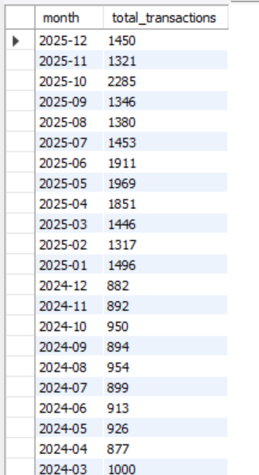
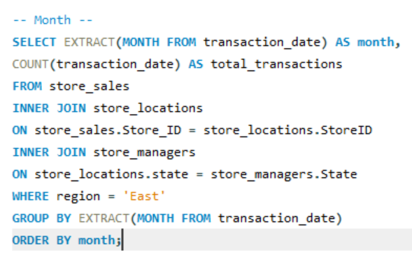
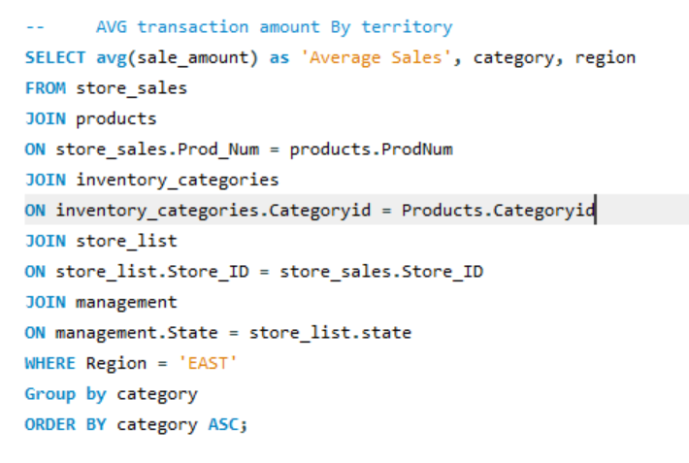
Number of transactions per month
Average by category
"Average Sales", category, region
32.05,"Apparel and Merchandise", East
31.66,"Art Supplies", East
28.85,"Books (General)",East
10.01,"Stationery and Supplies", East
472.37,"Technology & Accessories", East
173.22,"Textbooks",East
Has reached and steadied in the thousands in 2025
With an uptick to 2,00o in October...

Slide 9
Overview of categories that we sell:
Most Popular
Technology & Accessories
Textbooks
Technology & Accessories
Textbooks
Apparel and Merchandise
Art Supplies
Books (General)
Stationery and Supplies
Least Popular
Books (General)
Stationery Supplies

Slide 10
Which is interesting....

Slide 11
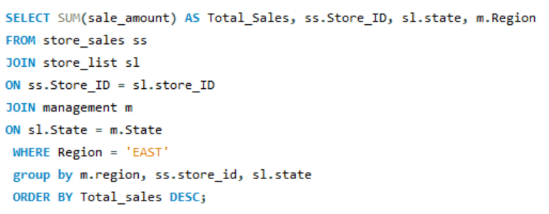
Performance Sales Rank by Store cont.

Slide 12
Recommendations
While Technology & Accessories and Textbooks are the primary revenue drivers and should remain a focus for growth, the remaining categories contribute a small percentage of total sales. This suggests an opportunity to improve performance through better product placement, targeted promotions, or inventory adjustments.
We should test strategies to increase profitability by providing more visibility and promotions to Books (General)​ and Stationery Supplies by cross-selling during the Fall.
Example:
Focusing on timing promotions (back-to-school, semester starts)
Offer bundles or discounts during peak periods
Selling notebooks with textbooks
Selling art supplies with tablets

