Slide 1
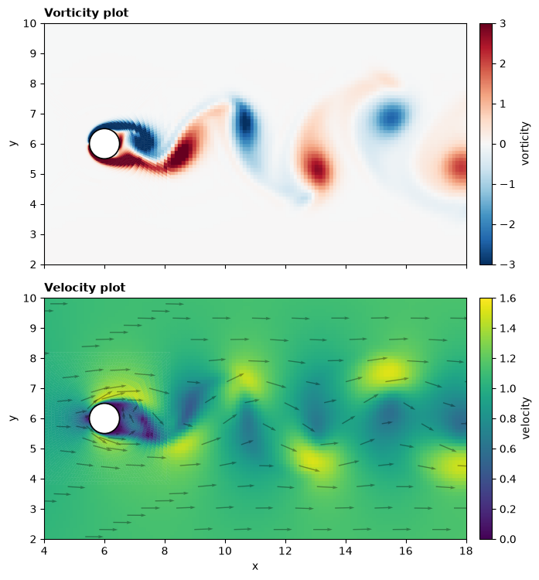
12 steps to the cylinder wake
How ns_staggered_euler.py solves flow past a cylinder at Re = 150 on the known-sizes O–H staggered mesh
equation → discretise on our mesh → rearrange for the unknown → code → what we see
Time stepping / projection after Griebel, Dornseifer & Neunhoeffer (1998)
as in github.com/CaptainProton42/NavierStokes; finite-volume operators on the multiblock mesh

Slide 2
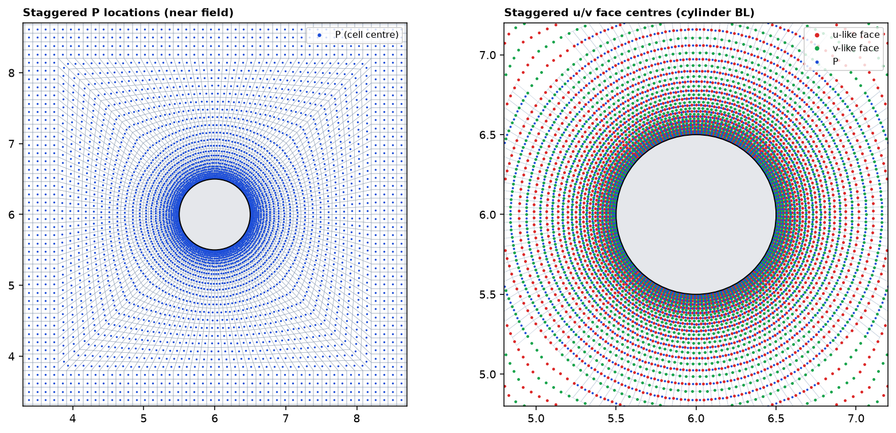
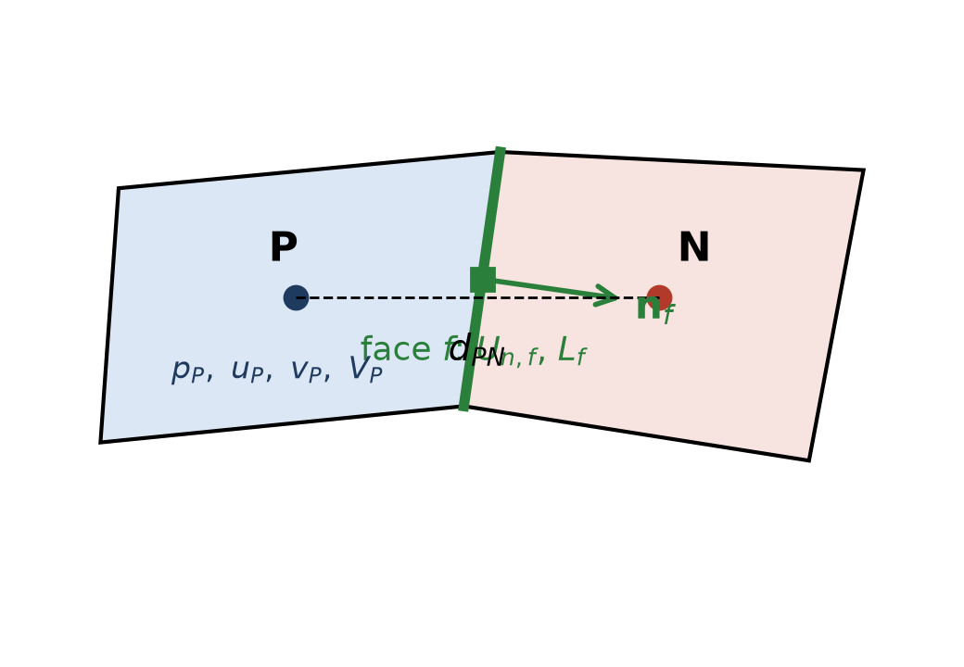
STEP 1 What we solve, and where the unknowns sit
• Mesh from mesh_from_known_sizes.py: O-ring + transition + Cartesian blocks, 26,444 cells (d_min = 0.015)
• No i, j — a cell knows its neighbours only through its faces (owner / neighbour arrays)
• Staggered (MAC): p, u, v at cell centres P; U_n = u·n on face centres f
• The pressure difference across a face and the velocity through it sit in the same place → no checkerboard
left: cell centres P (pressure) right: face centres (velocity U_n) in the cylinder boundary layer
P = S["cell_centers"] # p, u, v live here
Fc = S["face_centers"] # Un lives here
n = S["face_normals"] # owner -> neighbour
L = S["face_lengths"]
own = S["face_owner"]
nei = S["face_neigh"] # -1 on a boundary
ns_staggered_euler.py on the known-sizes O–H staggered mesh · 2

Slide 3
STEP 1b One tool for every term: cell integral → face sum
def accumulate(flux, own, nei, Nc): # sum_f s_{P,f} * flux_f, for every cell at once
out = np.zeros(Nc)
np.add.at(out, own, flux) # + for the owner cell
m = nei >= 0
np.add.at(out, nei[m], -flux[m]) # - for the neighbour cell
return out
• Convection, diffusion, divergence and pressure gradient are all this function with a different flux
• On a Cartesian cell the face sum collapses to the usual (i+1) − 2(i) + (i−1) stencils; here the faces may point anywhere
• Cell area V_P is itself a face sum: V_P = ½ Σ (x_f · n_f) L_f
• d_PN = |x_N − x_P| plays the role of Δx between the two cells; L_f plays the role of Δy of the face
ns_staggered_euler.py on the known-sizes O–H staggered mesh · 3

Slide 4
STEP 2 The time derivative: forward (explicit) Euler
• Everything on the right-hand side is a known number → the new field is a one-line numpy expression, no equation to solve for the velocity
• Same update for every cell, for u and for v
• The price: Δt is limited by the smallest cell (Step 9) — the whole domain marches at the step dictated by the cylinder boundary layer
• First order in time; this is one reason Cd and St come out a few % above reference values
ns_staggered_euler.py on the known-sizes O–H staggered mesh · 4

Slide 5
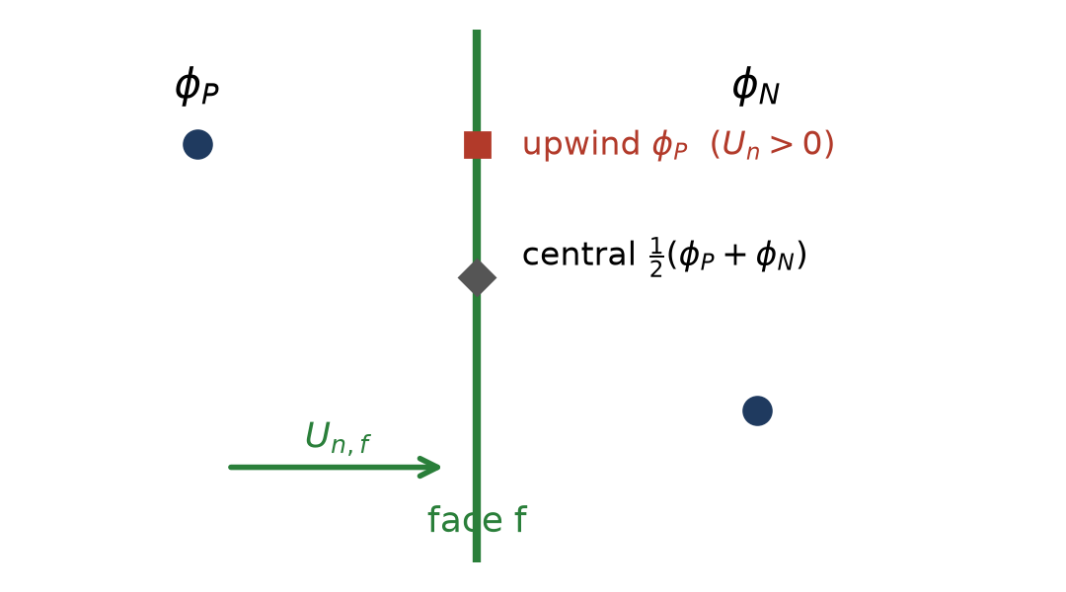
STEP 3 The convective term — three ways to pick φ at the face
• γ = 0 central: the average, 2nd order, no built-in damping (--scheme central)
• γ = 1 upwind / donor cell: the upstream cell, 1st order, numerical viscosity ≈ ½|U_n| d_PN (--scheme upwind)
• γ = CFL = max |U_n| Δt / h_min: Griebel's adaptive blend (--scheme donor, ≈ 0.36 here)
What we see: same 37k-cell mesh to tU/D = 150 — donor keeps Cl ≡ 0 (its numerical viscosity holds the symmetric wake), central sheds vortices. The scheme is not cosmetic.
phi_f[interior] = (1-gamma)*0.5*(phi[o]+phi[nn]) \
+ gamma*np.where(Un[interior] >= 0, phi[o], phi[nn])
ru = accumulate(Un * uf * L, own, nei, Nc) # for u
rv = accumulate(Un * vf * L, own, nei, Nc) # for v
conv_u, conv_v = -ru / vol, -rv / vol
Boundary faces: φ_f = (U∞, 0) at the inlet, 0 on walls and cylinder, owner value at the outlet
ns_staggered_euler.py on the known-sizes O–H staggered mesh · 5

Slide 6
STEP 4 The viscous term — central gradient across each face
g = np.empty(Nf)
g[interior] = (phi[nei[interior]] - phi[own[interior]]) / d_pn[interior]
g[bnd] = (phi_bc[bnd] - phi[own[bnd]]) / (0.5 * d_pn[bnd])
lap = accumulate(nu * g * L, own, nei, Nc) / vol
• On a Cartesian cell this is exactly ν(φ_{i+1} − 2φ_i + φ_{i−1})/Δx² — written as a flux balance so skewed ring cells work too
• No non-orthogonal correction: first-order on strongly skewed cells, one reason the Δt safety factor τ is 0.4 rather than 0.5
• u_bc = U∞ at the inlet, 0 on walls / cylinder; v_bc = 0 on all of them; outlet: zero gradient
ns_staggered_euler.py on the known-sizes O–H staggered mesh · 6

Slide 7
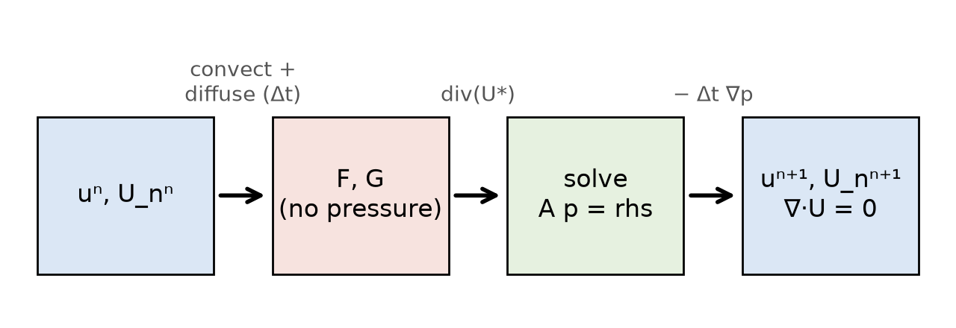
STEP 5 The predictor F, G — momentum without pressure
cu, cv = _convective(u, v, Un, gamma) # Step 3
F = u + dt * (_laplacian(u, u_bc) + cu) # Step 2 + 4
G = v + dt * (_laplacian(v, v_bc) + cv)
uf, vf = face_values(F, G, gamma=0.0) # average to faces
Un_star = uf * n[:, 0] + vf * n[:, 1] # provisional flux
• F, G carry the right momentum but nobody has enforced continuity: ∇·(F,G) ≠ 0
• The pressure is left out on purpose — its only job (Steps 6–8) is to remove that divergence
• Because F, G contain no old pressure, the p we solve for next is the pressure itself, not an increment
ns_staggered_euler.py on the known-sizes O–H staggered mesh · 7

Slide 8
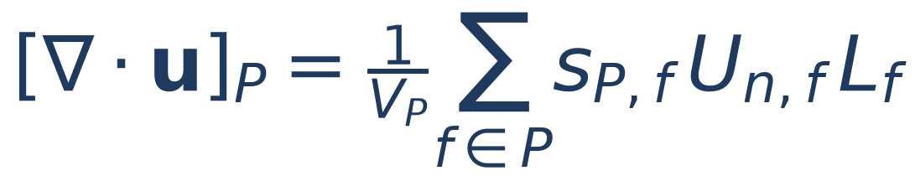
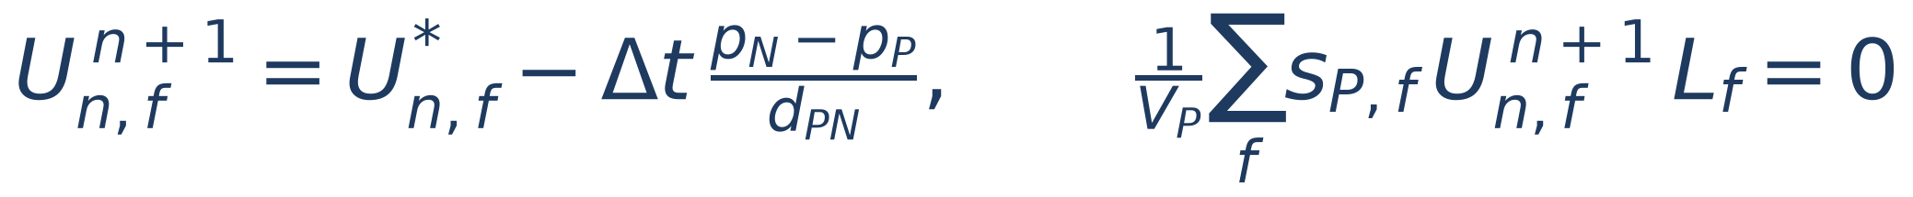

STEP 6 Divergence of a cell ⇒ the equation for the pressure
We want the end-of-step flux to be corrected by the pressure difference across the face AND zero divergence:
Put the first into the second — one linear equation per cell, unknowns p in the cell and its neighbours:
o, c = own[interior], nei[interior]; g = L[interior] / d_pn[interior]
rows = r_[o, o, c, c]; cols = r_[c, o, o, c]; data = r_[g, -g, g, -g]
A = sparse.coo_matrix((data, (rows, cols)), shape=(Nc, Nc)).tocsr() # built once
• A is symmetric and never changes (the mesh does not move)
• All boundaries ∂p/∂n = 0 → rows sum to zero: p defined up to a constant, and solvable only if rhs.sum() == 0 (inflow = outflow)
ns_staggered_euler.py on the known-sizes O–H staggered mesh · 8

Slide 9
STEP 7 Boundary conditions on the flux, and the mass balance
def _enforce_Un_bc(Un):
Un[inlet] = U_inf * n[inlet, 0] + v_in(t) * n[inlet, 1] # prescribed
Un[wall_top] = Un[wall_bottom] = Un[cylinder] = 0.0 # no-slip
return Un # outlet: left as is (zero gradient)
def _balance_outlet(Un): # make rhs.sum() == 0
Q_other = np.sum(Un[~outlet & bnd] * L[~outlet & bnd])
Q_out = np.sum(Un[outlet] * L[outlet])
Un[outlet] += -(Q_other + Q_out) / np.sum(L[outlet])
return Un
What we saw without _balance_outlet: the solver ran, but max|div| sat at 1e-2, largest in the tiny cells on the cylinder — the unbalanced mass was spread over the domain as a constant divergence.
With it: max|div| = 1e-12.
step 10220 t=48.09 max|div|=1.571e-02 # before
step 31819 t=150.0 max|div|=7.857e-13 # after
• inlet x = 0: u = U∞ (+ a short transverse pulse, Step 10); outlet x = 24 D: ∂u/∂n = 0; walls y = 0, 12 D and cylinder (centre 6 D, 6 D): u = 0
• A zero-gradient outlet does not automatically let out what came in
ns_staggered_euler.py on the known-sizes O–H staggered mesh · 9

Slide 10
STEP 8 Solve for p, then correct — faces first, cells second
rhs = vol / dt * _div(Un_star); rhs -= rhs.mean() # compatibility
p = solve(A, rhs); p -= p.mean() # free constant
Un = Un_star.copy() # faces first
Un[interior] -= dt * (p[nei[interior]] - p[own[interior]]) / d_pn[interior]
Un = _enforce_Un_bc(Un) # _div(Un) ~ 1e-12
pf = 0.5 * (p[own] + p[nei]); pf[bnd] = p[own[bnd]] # Green-Gauss
gx = accumulate(pf * n[:, 0] * L, own, nei, Nc) / vol
gy = accumulate(pf * n[:, 1] * L, own, nei, Nc) / vol
u = F - dt * gx; v = G - dt * gy # cells second
• --poisson sor: Gauss–Seidel sweeps, ω = 1.7 (Griebel's original) — thousands of sweeps
• --poisson cg: Jacobi-PCG on the mean-free operator — ≈1000 iterations, 390 ms/step
• --poisson lu (default): pin one cell, splu(A) once, two triangular solves per step — 2 ms
• Same (p_N − p_P)/d_PN that built A is used to correct the faces → divergence is zero to solver precision
max|div| = 7.9e-13 in the log, every 20 steps
ns_staggered_euler.py on the known-sizes O–H staggered mesh · 10

Slide 11
STEP 9 Choosing Δt — the smallest cell decides
def stable_dt():
umax = max(np.abs(Un).max(), U_inf)
return tau * min(hmin / umax, Re * hmin**2 / 4)
• h_min / |u|_max — CFL: fluid may not cross more than one cell per step
• Re h_min² / 4 — diffusive limit of explicit Euler: halving d_min quarters Δt
• τ is the safety factor (Griebel use 0.5; 0.4 here for the skewed ring cells)
• Fine mesh: h_min = 0.0177 (first ring on the cylinder), |u|_max ≈ 1.58 while shedding → Δt ≈ 0.0045
• ≈ 1,100 steps per shedding period, 26,600 steps to tU/D = 120 — about 12 ms each with the LU solver
• Adaptive in name only once the start-up transient is over: h_min is fixed and |u|_max barely moves
• Far-field cells are 0.12 wide and could take a 7× larger step; one global explicit Δt does not allow it
ns_staggered_euler.py on the known-sizes O–H staggered mesh · 11

Slide 12
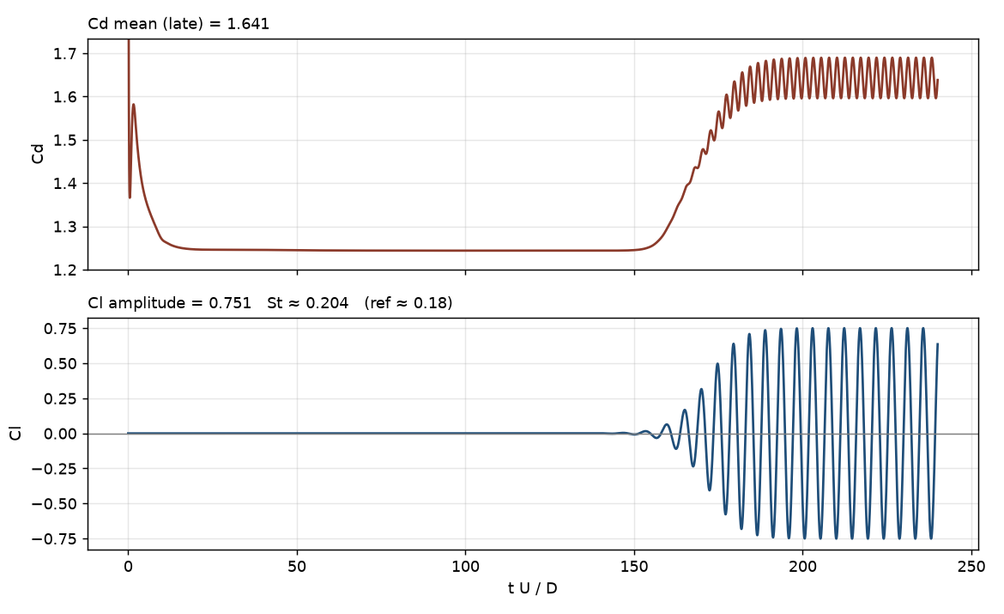
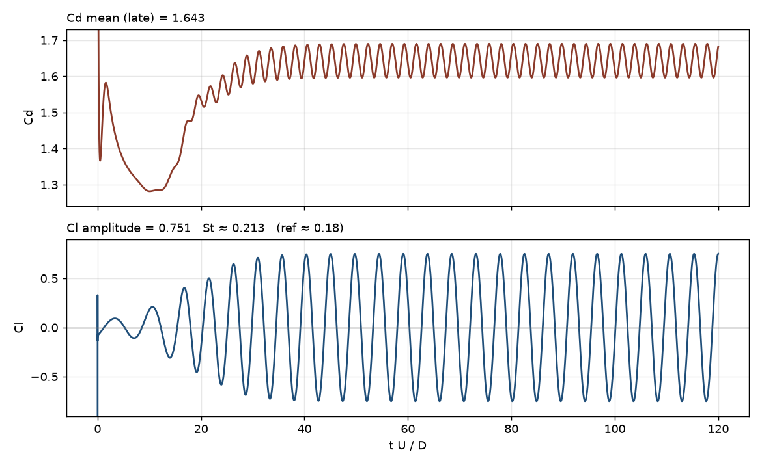
STEP 10 Initial condition — why a symmetric start never sheds
• u = U∞, v = 0 everywhere (impulsive start), projected once with Steps 6–8 so step 1 begins divergence-free
• The O–H mesh is exactly mirror-symmetric about y = 0, and so is every operator above → a symmetric start stays symmetric
• Cl printed as −0.000 for 120 time units while the wake grew into the long, steady, unstable symmetric bubble
• Only at tU/D ≈ 120 had round-off grown enough (×10¹³) to start the oscillation — the left plot
• A small seed one diameter behind the cylinder brings the onset to tU/D ≈ 20 — the right plot; both end on the same limit cycle (earlier 40 D × 10 D domain; Cl ± 0.75)
r2 = (P[:, 0] - 1.0)**2 + P[:, 1]**2
v += perturb * U_inf * np.exp(-r2 / 0.5**2) # perturb = 0.1 (--perturb)
ns_staggered_euler.py on the known-sizes O–H staggered mesh · 12

Slide 13
STEP 11 The time loop — and what comes out
while t < t_end:
dt = stable_dt() # Step 9
gamma = scheme_gamma(dt) # Step 3
Un = _enforce_Un_bc(Un) # Step 7
cu, cv = _convective(u, v, Un, gamma) # Step 3
F = u + dt * (_laplacian(u, u_bc) + cu) # Steps 4-5
G = v + dt * (_laplacian(v, v_bc) + cv)
Un_star = face_normal(F, G) # Step 5
Un_star = _balance_outlet(_enforce_Un_bc(Un_star)) # Step 7
rhs = vol / dt * _div(Un_star); rhs -= rhs.mean() # Step 6
p = solve(A, rhs); p -= p.mean() # Step 8
Un = Un_star - dt * grad_face(p); Un = _enforce_Un_bc(Un)
u, v = F - dt * gx(p), G - dt * gy(p)
t += dt
Cd, Cl = forces_on_cylinder(p, u, v) # diagnostics
if step % 100 == 0: save_frame(u, v, t) # Step 12
• Forces: Σ_cyl p n L (pressure) + ν u_t/(d/2) (wall shear), over ½ρU∞²D
• Fine mesh, central: after the impulsive transient Cl grows exponentially and saturates at ± 0.71 by tU/D ≈ 30
• Period 1/St ≈ 4.8 → St ≈ 0.21; Cd ≈ 1.56 oscillating at twice the lift frequency
• Unbounded-cylinder references: St ≈ 0.18, Cd ≈ 1.33 — the 8.3 % blockage of the 12 D-high channel and first-order Euler push both up
• Cost: 12 ms/step, 37k cells, 26,600 steps → ≈ 6 min to tU/D = 120
forces : Cd_mean=1.564 Cl_amp=0.712 St=0.207
ns_staggered_euler.py on the known-sizes O–H staggered mesh · 13

Slide 14
STEP 12 The pictures — snapshots, one instant per frame
coll = PolyCollection(S["quads"], array=field, cmap="RdBu_r") # one colour per cell
ax.add_collection(coll)
idx = np.arange(0, Nc, Nc // 400) # ~400 sampled cells
ax.quiver(P[idx, 0], P[idx, 1], u[idx], v[idx]) # velocity vector there
• Top: vorticity ω_z = ∂v/∂x − ∂u/∂y from the Green–Gauss gradient of Step 8 — red / blue = the two senses of rotation
• Bottom, 'Velocity plot': the speed |u| — free stream ≈ 1, wake (slow) dark, shoulders (fast) bright; arrows = (u_P, v_P) in the sampled cells
• One frame every 100 steps (≈ 0.45 time units, ~11 per shedding period); GIF loops the last ~4 periods, MP4 is the whole history
• Nothing is traced between frames: the next frame is simply the next saved state, coloured and arrowed again
• No streamlines. An arrow is the local velocity vector at that instant, not a path
ns_staggered_euler.py on the known-sizes O–H staggered mesh · 14

Slide 15
SUMMARY The twelve steps on one slide
step | what | in our solver
1 | Mesh arrays, staggered unknowns, accumulate() | p, u, v at P; U_n on faces
2 | Explicit Euler | φⁿ⁺¹ = φⁿ + Δt·RHS(n)
3 | Convective flux, γ-blend | central / upwind / donor
4 | Viscous flux | ν (φ_N − φ_P)/d_PN · L_f
5 | Predictor F, G | momentum without pressure
6 | Divergence ⇒ Poisson | Σ L/d (p_N − p_P) = V/Δt ∇·u*
7 | BCs + outlet mass balance | rhs.sum() == 0 → div 1e-12
8 | Solve (LU) and correct | faces first, then cells
9 | Δt = τ·min(h/u, Re h²/4) | 0.0045 on the fine mesh
10 | Symmetric start + seed | shedding by tU/D ≈ 20–30
11 | Loop, Cd / Cl | Cl ±0.71, St 0.21, Cd 1.56
12 | Snapshots | cell colour + arrows, no streamlines
ns_staggered_euler.py on the known-sizes O–H staggered mesh · 15

