Slide 1

Personal Assistant Voice-Controlled with text to speech and Image recognition
Using Python for Speech Recognition and Automation

Slide 2
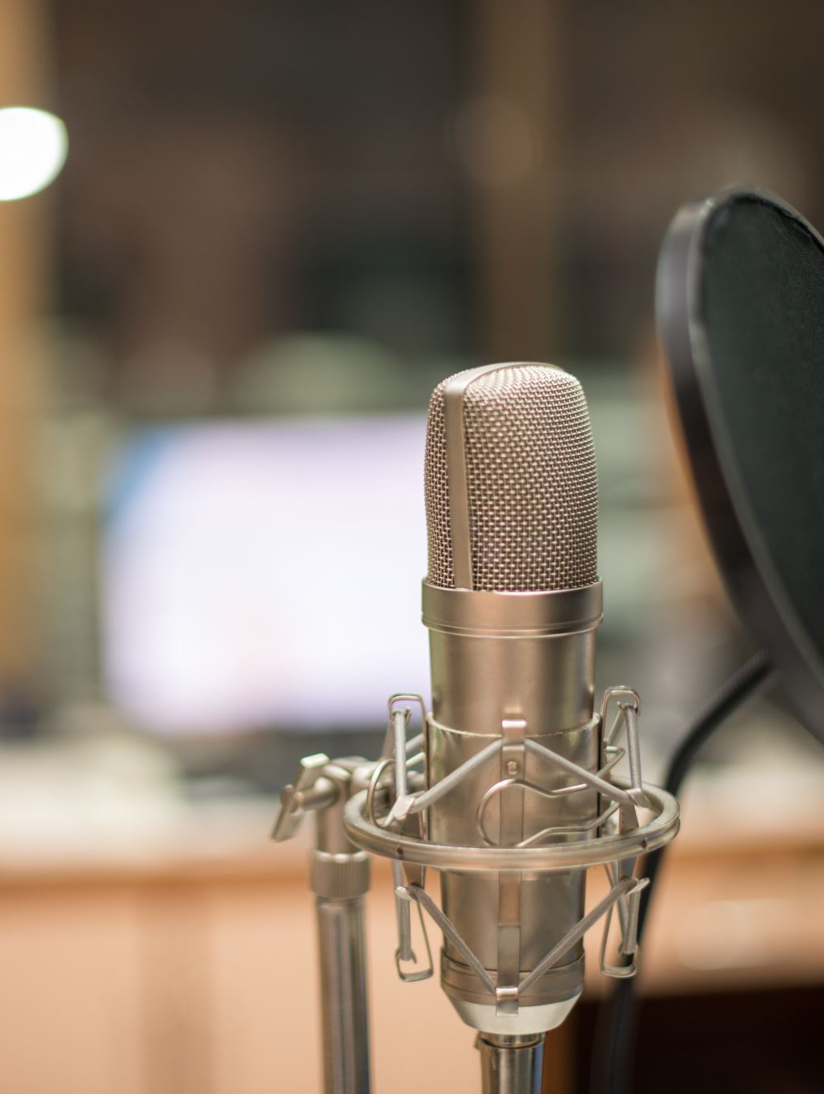
Introduction
This is a Python-based voice-controlled assistant that can respond to commands, perform tasks like playing music, fetching information, and even interacting with websites and apps.

Slide 3
Required Libraries
• speech_recognition
• pyttsx3
• pywhatkit
• wikipedia
• pyjokes
• webbrowser
• pyautogui
• pytesseract
• cv2

Slide 4
Initial Setup
import speech_recognition as sr
import pyttsx3
import pywhatkit
import datetime
import wikipedia
import pyjokes
import time
import webbrowser
import pyautogui
import pytesseract
import cv2

Slide 5
Speech Recognition Setup
listener = sr.Recognizer()
engine = pyttsx3.init()

Slide 6
Text-to-Speech Setup
voices = engine.getProperty('voices')
engine.setProperty('voice', voices[1].id) # Female voice
engine.setProperty('rate', 180) # Speed of speech
engine.setProperty('volume', 1) # Volume

Slide 7
Command Recognition
def take_command():
command = ""
with sr.Microphone() as source:
voice = listener.listen(source)
command = listener.recognize_google(voice)

Slide 8

Performing Actions (Sample)
def open_website(command: str):
if 'open' in command:
website = command.replace('open', '').strip()
webbrowser.open(website)
# youtube.com

Slide 9
Main Logic (Trigger Word)
def run_alexa():
command = take_command()
if 'orange' in command:
talk("I am now listening for commands.")

Slide 10
Handling Multiple Commands
if 'play' in command:
song = command.replace('play', '').strip()
pywhatkit.playonyt(song)

Slide 11
Error Handling
except sr.UnknownValueError:
1
print("Sorry, I couldn't understand that.")
2
except sr.RequestError:
3
print("Sorry, I couldn't connect to the speech recognition service.")
4

Slide 12
Sample Outputs
• open website youtube.com
• Telling the time
• Telling a joke

Slide 13
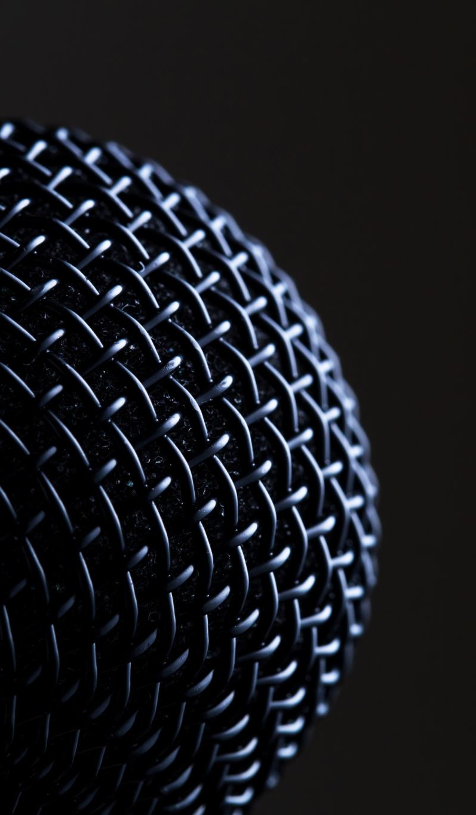
Conclusion
This is a Python-based voice-controlled assistant that integrates speech recognition, web browsing, app launching, and more.

Slide 14

Thank You!
Thank you for viewing the presentation.

