Slide 1
Antonym Pairs Generation

Slide 2
Generate Antonyms (Three different approaches)
First Approach:
1. Create root antonyms for selected category (e.g. Countries)
a. create 50 different antonym pairs by hand
b. select 50 antonym pairs from original antonyms which are most similar topic (country)
2. Generate new antonym pairs from root antonym
a. for every word in root antonyms find its synonym, hyponym set , then find antonyms for all these words using wordnet. (observation: wordnet can only produce few antonym pairs)
b. for every word in root antonyms find its synonym and antonym from API: http://www.thesaurus.com using Web Crawler. (observation: this method produce plenty of antonym pairs)
3. Combine all generated antonym pairs
a. do some processing to root antonym pairs, antonym pairs from wordnet, antonym pairs from API
b. collect all three antonym pairs set to generate final antonym pairs

Slide 3
Apply Polar Framework
Select Top n subset of Antonym pairs (e.g. 300 dimension)
a. select first antonym vector with maximal variance
b. select other antonym vector with “Orthogonality maximization” (from POLAR)
Transfer word vector into Polar space (from POLAR)
Word vector std normalization

Slide 4
Results Visualization and Evaluation

Slide 5
Root antonyms(e.g. country)
[('country', 'metropolitan'), ('continent', 'sea'), ('export', 'import'), ('cooperation', 'rivalry'), ('industry', 'nature'), ('party', 'work'), ('defund', 'promotional'), ('business', 'recreation'), ('citizen', 'emperor'), ('decentralize', 'streamline'), ('hot', 'cold'), ('city', 'nature'), ('mountainous', 'oceanic'), ('disadvantageous', 'good'), ('peaceful', 'sandstorm'), ('north', 'west'), ('kind', 'nasty'), ('even', 'uneven'), ('rock', 'wood'), ('east', 'west'), ('aridity', 'saturation'), ('customer', 'worker'), ('conflict', 'peace'), ('nationality', 'solitude'), ('funded', 'impoverished'), ('committee', 'individual'), ('openness', 'stockade'), ('history', 'news'), ('expand', 'reduce'), ('common', 'royal'), ('modern', 'past'), ('communism', 'freedom'), ('deconstruct', 'structure'), ('freedom', 'stockade'), ('power', 'weak'), ('endemic', 'foreign'), ('downfall', 'prime'), ('accountable', 'despotic'), ('fortune', 'trouble'), ('love', 'war'), ('friendly', 'mean'), ('expensive', 'thrifty'), ('growth', 'reduce'), ('fear', 'safe'), ('river', 'sea'), ('friendship', 'rivalry'), ('peace', 'violent'), ('structured', 'unstructured'), ('cheap', 'value'), ('invade', 'placate'), ('provident', 'wasteful'), ('lavish', 'thrifty'), ('benefit', 'injure'), ('army', 'marine'), ('democratic', 'despotic'), ('unemployment', 'workforce'), ('religion', 'science'), ('cleanse', 'corrupt'), ('low', 'top'), ('home', 'work')]

Slide 6
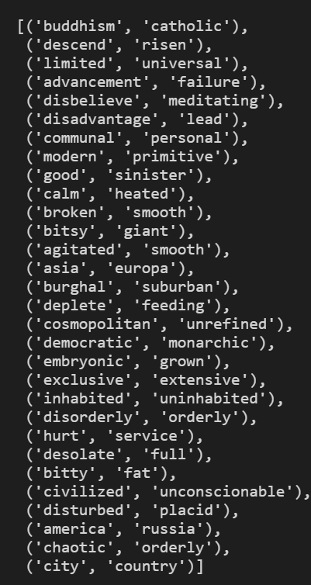
Overview of generated antonym pairs
Randomly select 30 antonym pairs from final antonym pairs

Slide 7
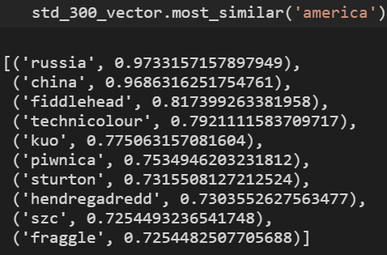
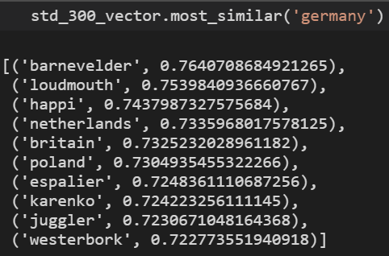
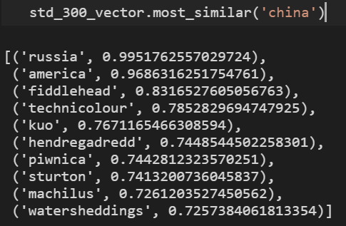
Result of most similar words

Slide 8
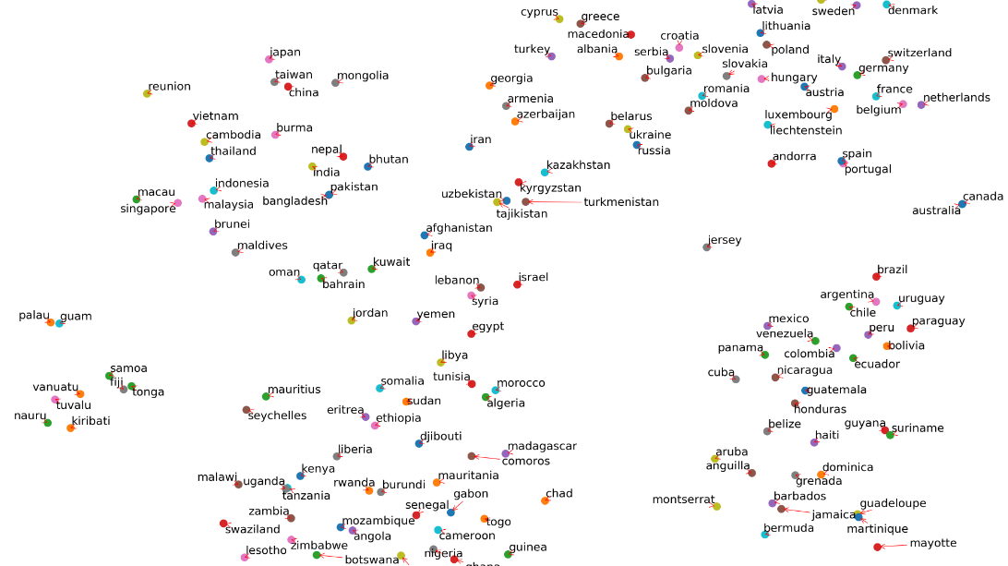
All country visualization
Before polar transformation

Slide 9
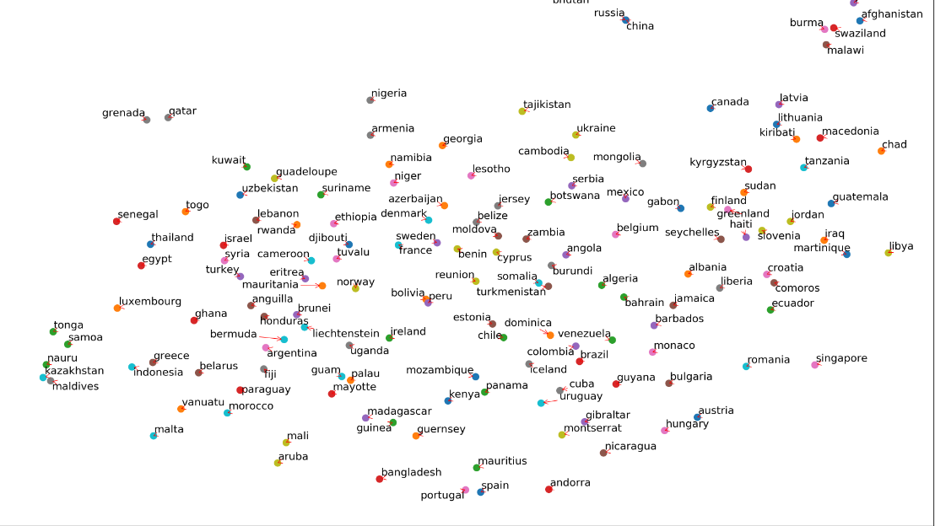
All country visualization
After polar transformation

Slide 10
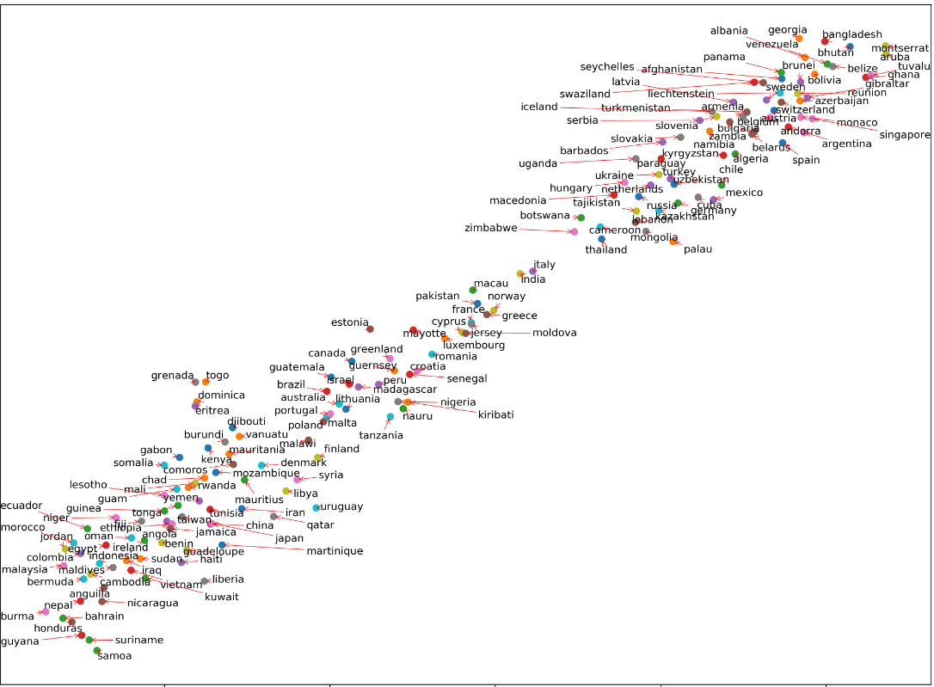
Country visualization after polar (using original antonyms)

Slide 11
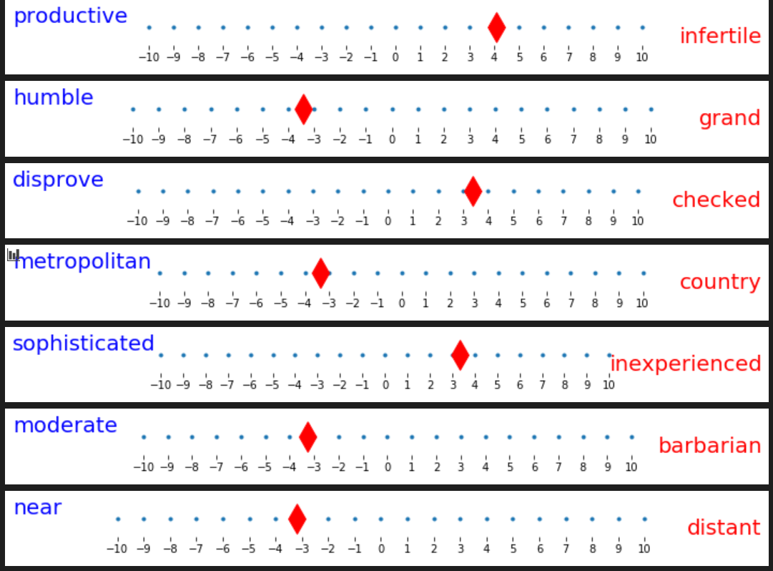
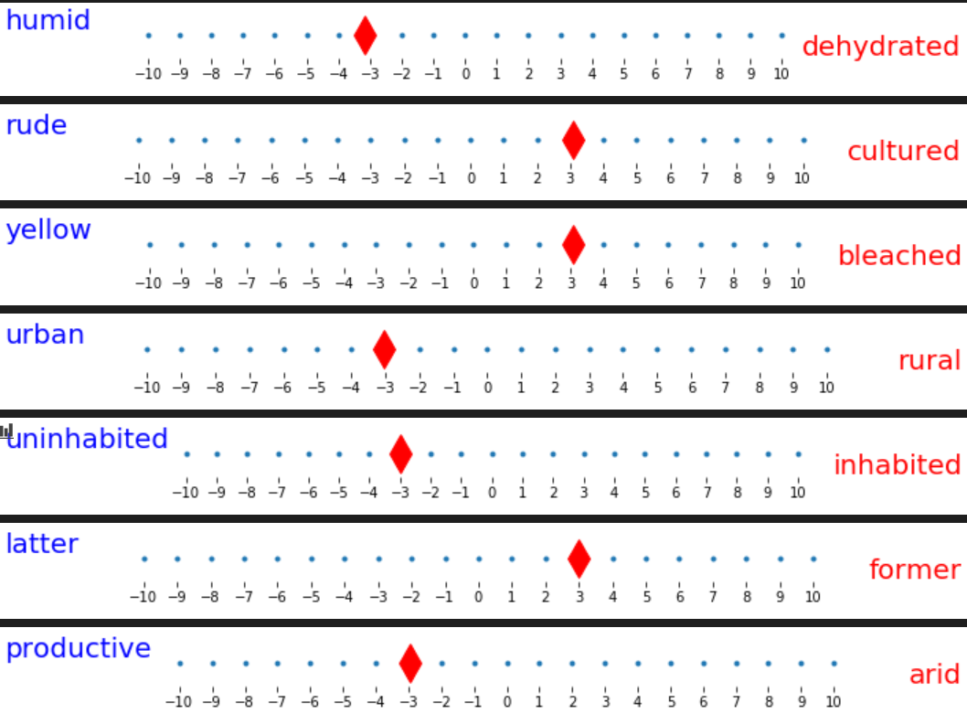
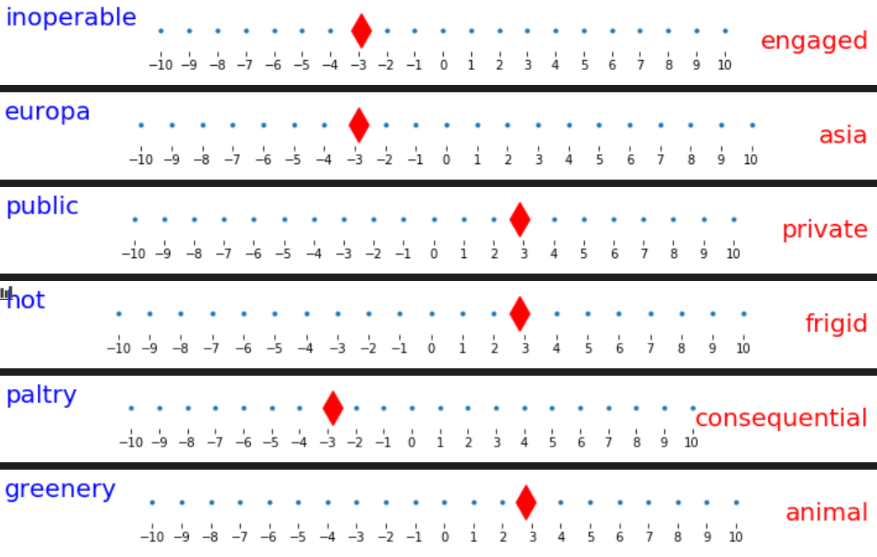
England

Slide 12
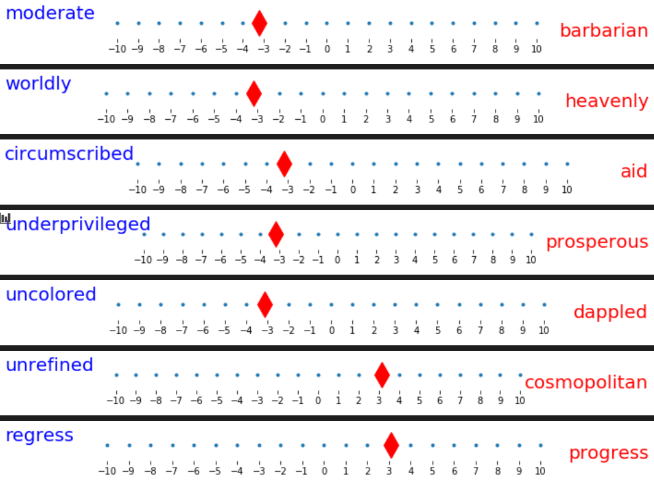
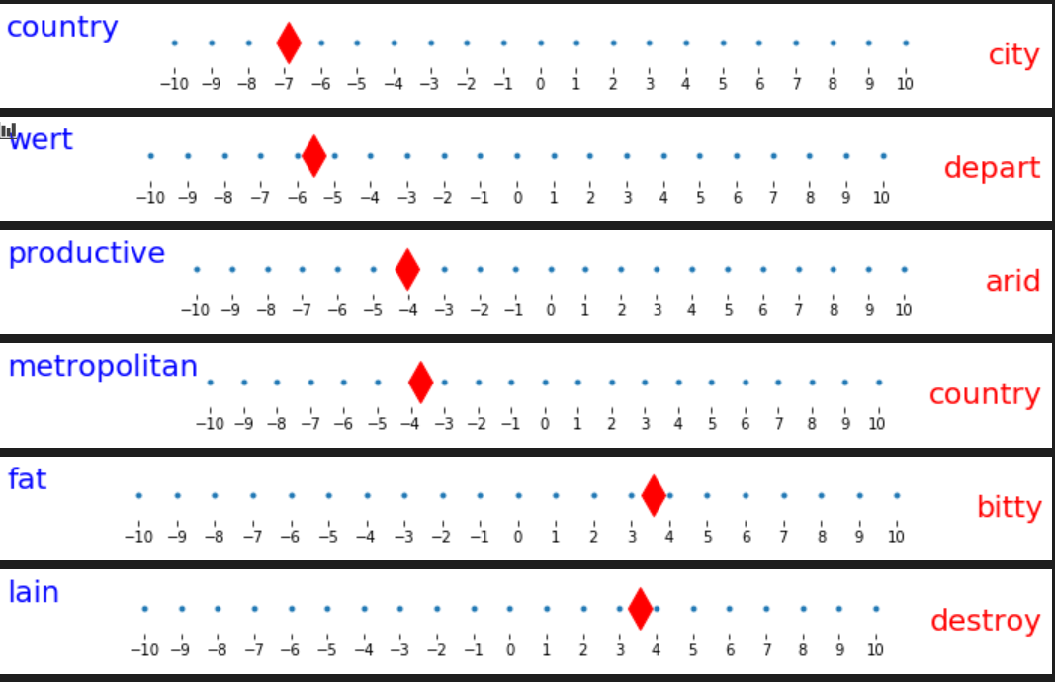
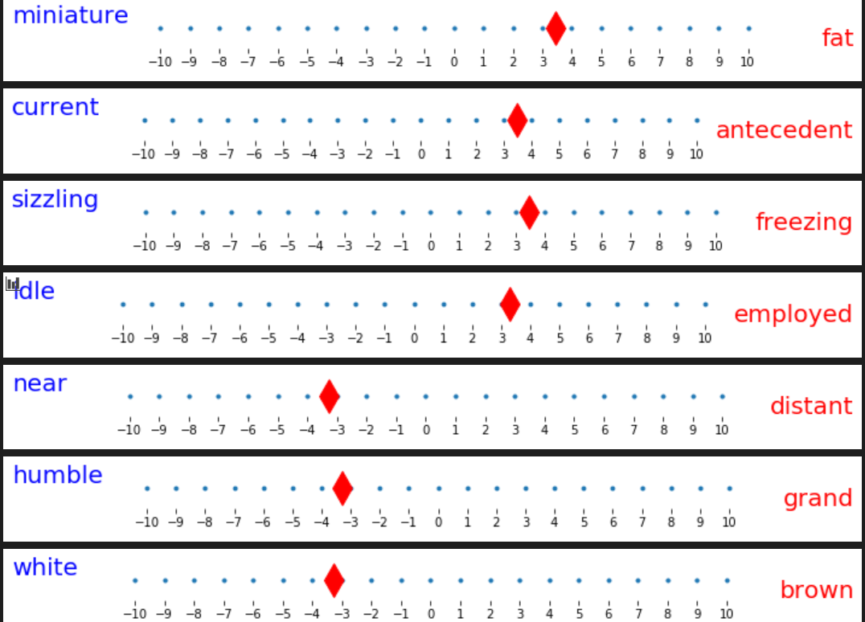
Germany

Slide 13
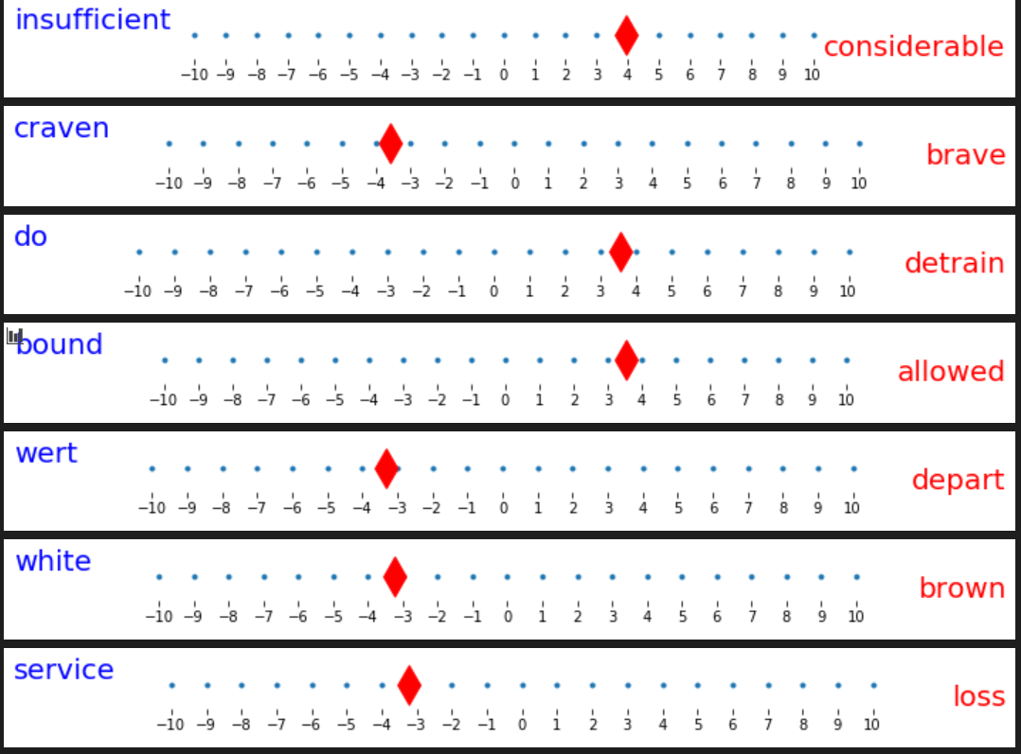
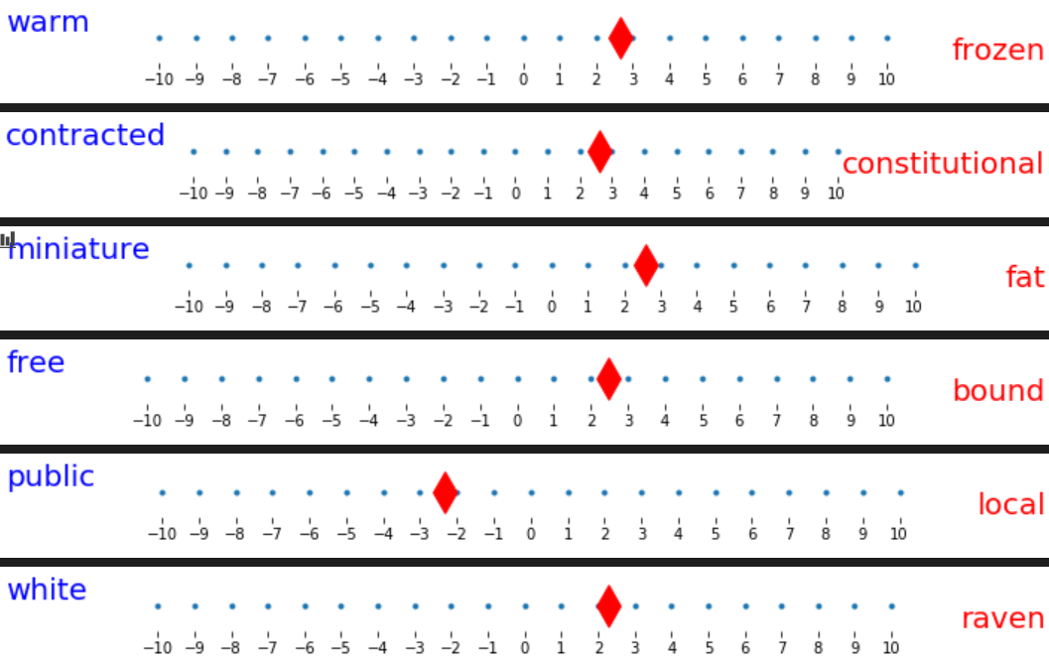
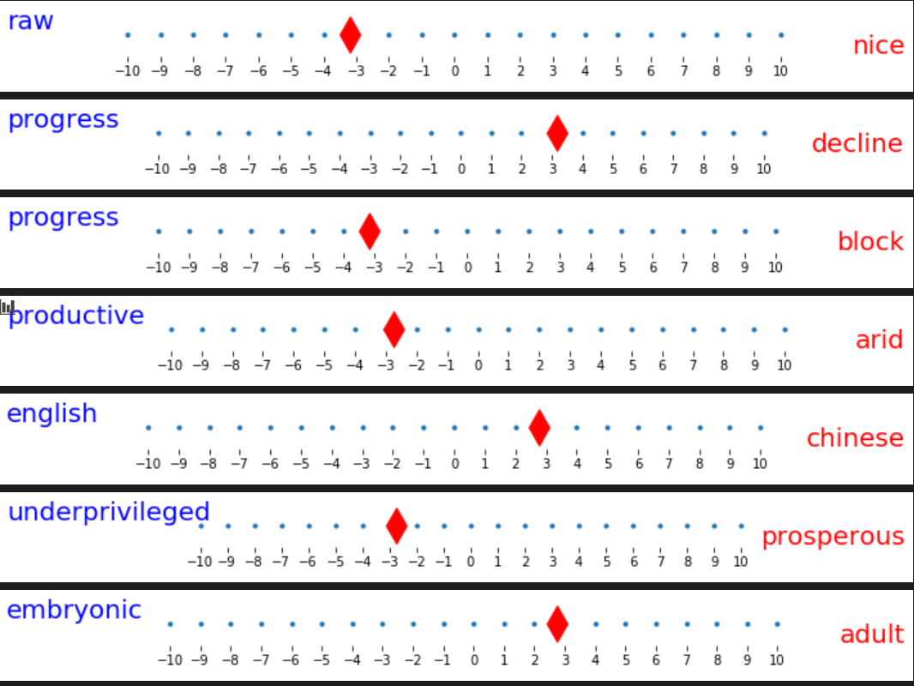
China

Slide 14
I have also done some experiment for topic “food” and “music”.
And I compared the results between using generated antonyms and using original antonyms.
I also compared the result before polar transformation and after polar transformation.

Slide 15
Some conclusions
1. The quality of results is depend on the quality of antonym pairs
2. The more different aspects antonym pairs contain, the better result it has (e.g. original antonyms works better than generated antonyms)
3. The root antonym is very important, it limited the final generated antonyms and influenced the final results
4. Sometimes the generated antonyms is “bad”, it contains some general antonym pairs like (big, small) (bad, good)…
5. Sometimes the polar transformation works bad. (e.g. when search most similar words in trained model)

