Slide 1

Crossing Gap Using VQE
A Comparative Study
I-C. Chen, N. Innan, S.K. Roy, and J. Saroni

Slide 2
Outline
Variational Quantum Eigensolver
Subspace Search VQE (SS-VQE)
Variational Quantum Deflation (VQD)
Bring spectral gap problem to highly excited state
VQE with Quantum Natural Gradient

Slide 3


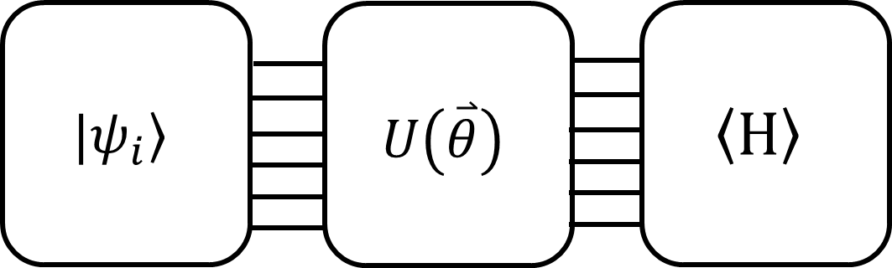
Variational Quantum Eigensolver
The ground state energy
Where
Peruzzo et al. Nature Comm.5, 4213 (2014)

Slide 4

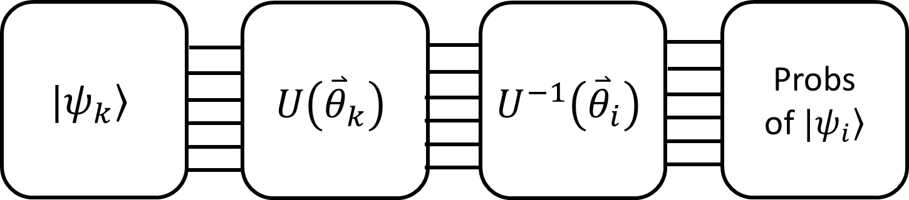
Variational Quantum Deflation (VQD)
The cost function:
Oscar Higgott et al. Quantum 3, 156 (2019).

Slide 5


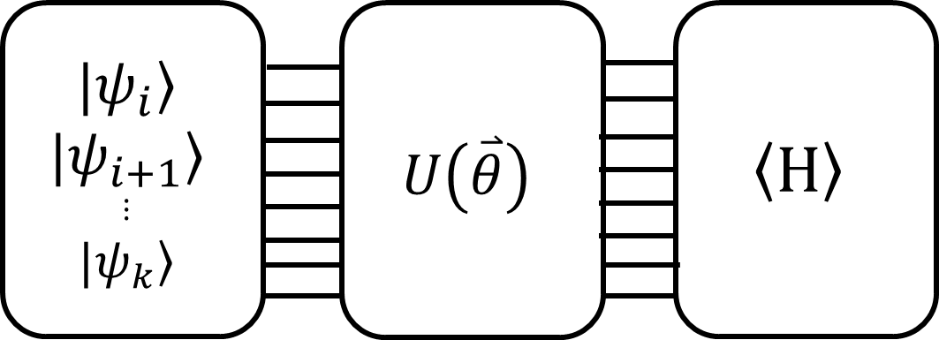
Subspace Search VQE (SS-VQE)
The prepared initial states needs to be orthogonal with each other
Ken M. Nakanishi et al. Phys. Rev. Research 1, 033062

Slide 6
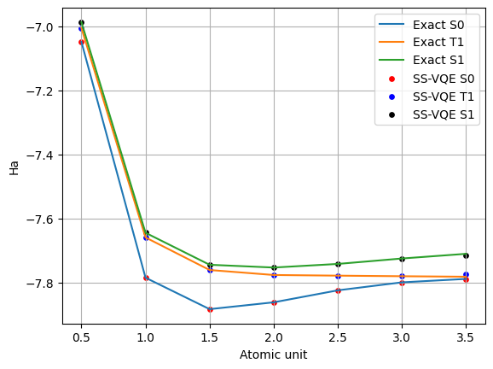
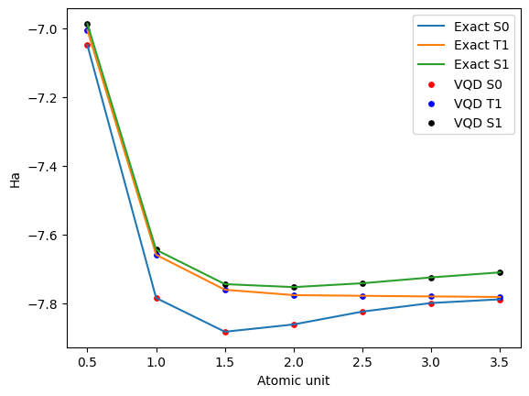
Result for LiH with Sz=0
We use spin restrict UCCSD

Slide 7
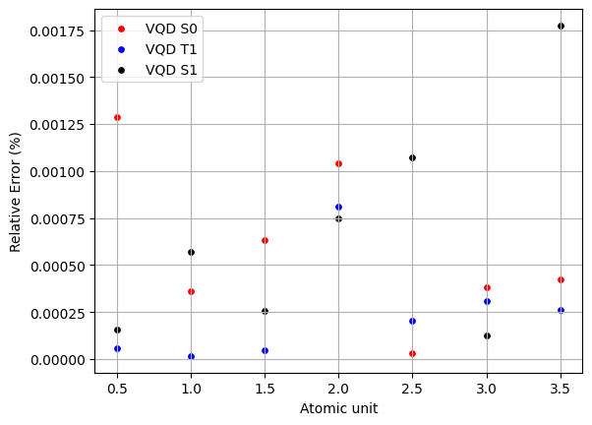
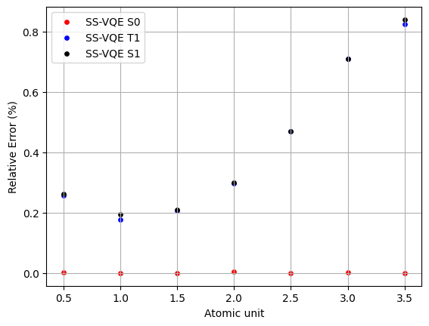
Their Accuracy

Slide 8
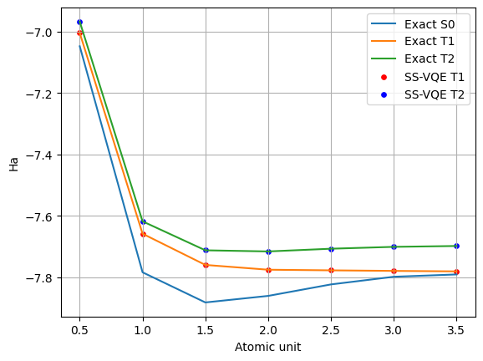
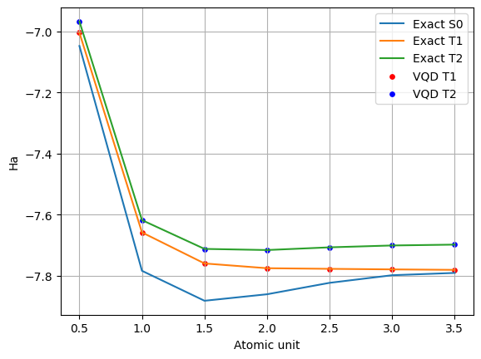
Result for LiH with Sz=1
We use spin restrict UCCSD

Slide 9
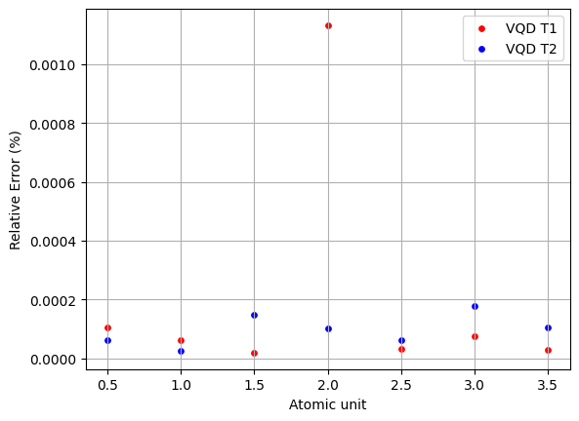
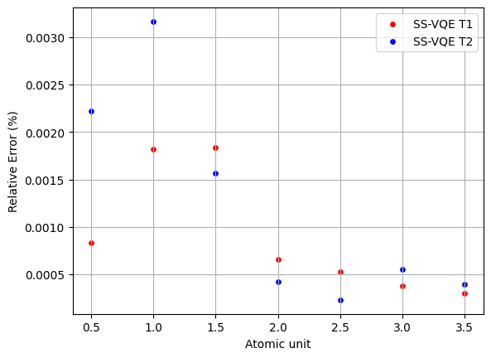
Their Accuracy

Slide 10


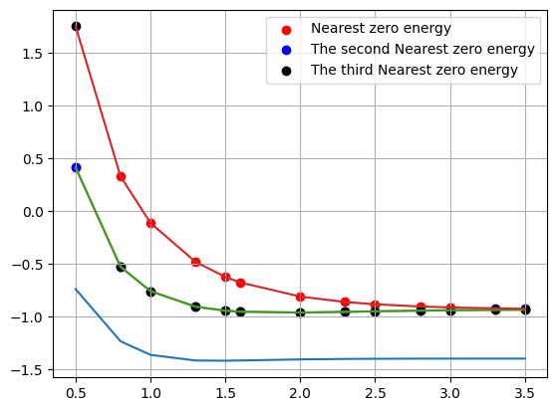
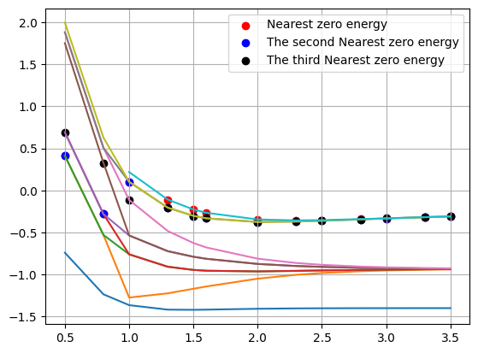
Map Highly Excited State to Ground State
Fold the Hamiltonian:
Sz=1
FS-VQD
Sz=0
FS-VQD
Ha
Ha
Atomic unit
Atomic unit
Lila Cadi Tazi et al. arXiv:2305.04783

Slide 11
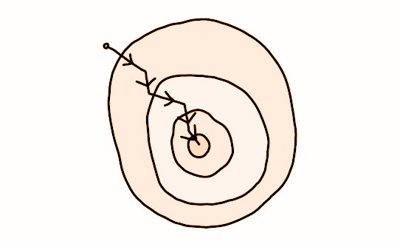

VQE with Quantum Natural Gradient Optimizer
QNG is an optimizer designed to improve efficiency by utilizing the geometry of the quantum parameter space.
It moves beyond "flat" optimization landscapes by utilizing the Fubini-Study metric tensor, g, for curvature-aware steps.
James Stokes et al, Quantum 4, 269 (2020).

Slide 12
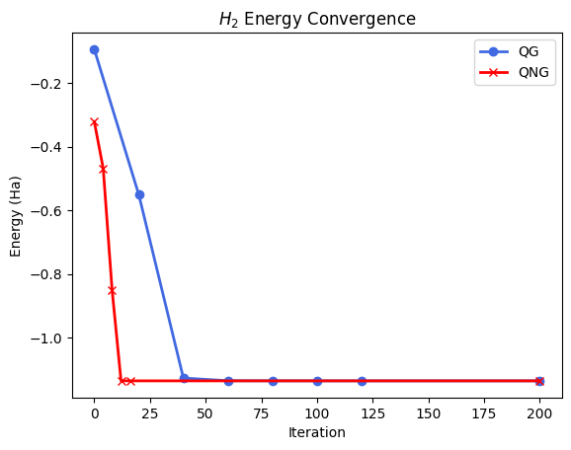
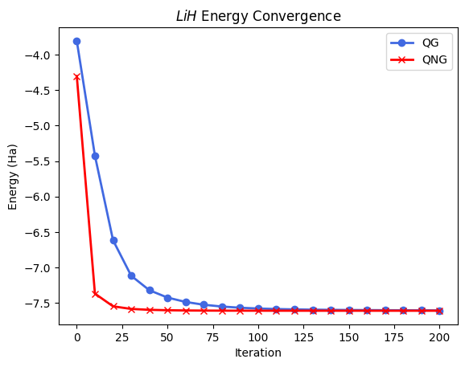
Results for H₂ and LiH

Slide 13
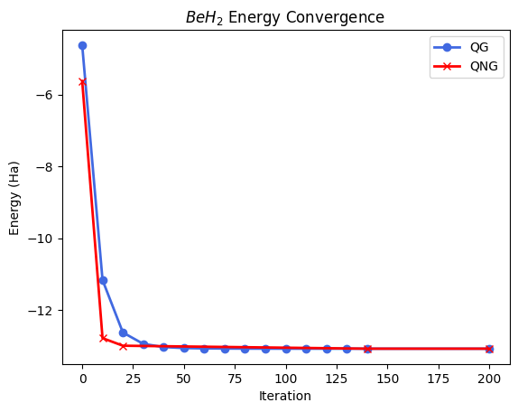
Results for BeH₂

Slide 14
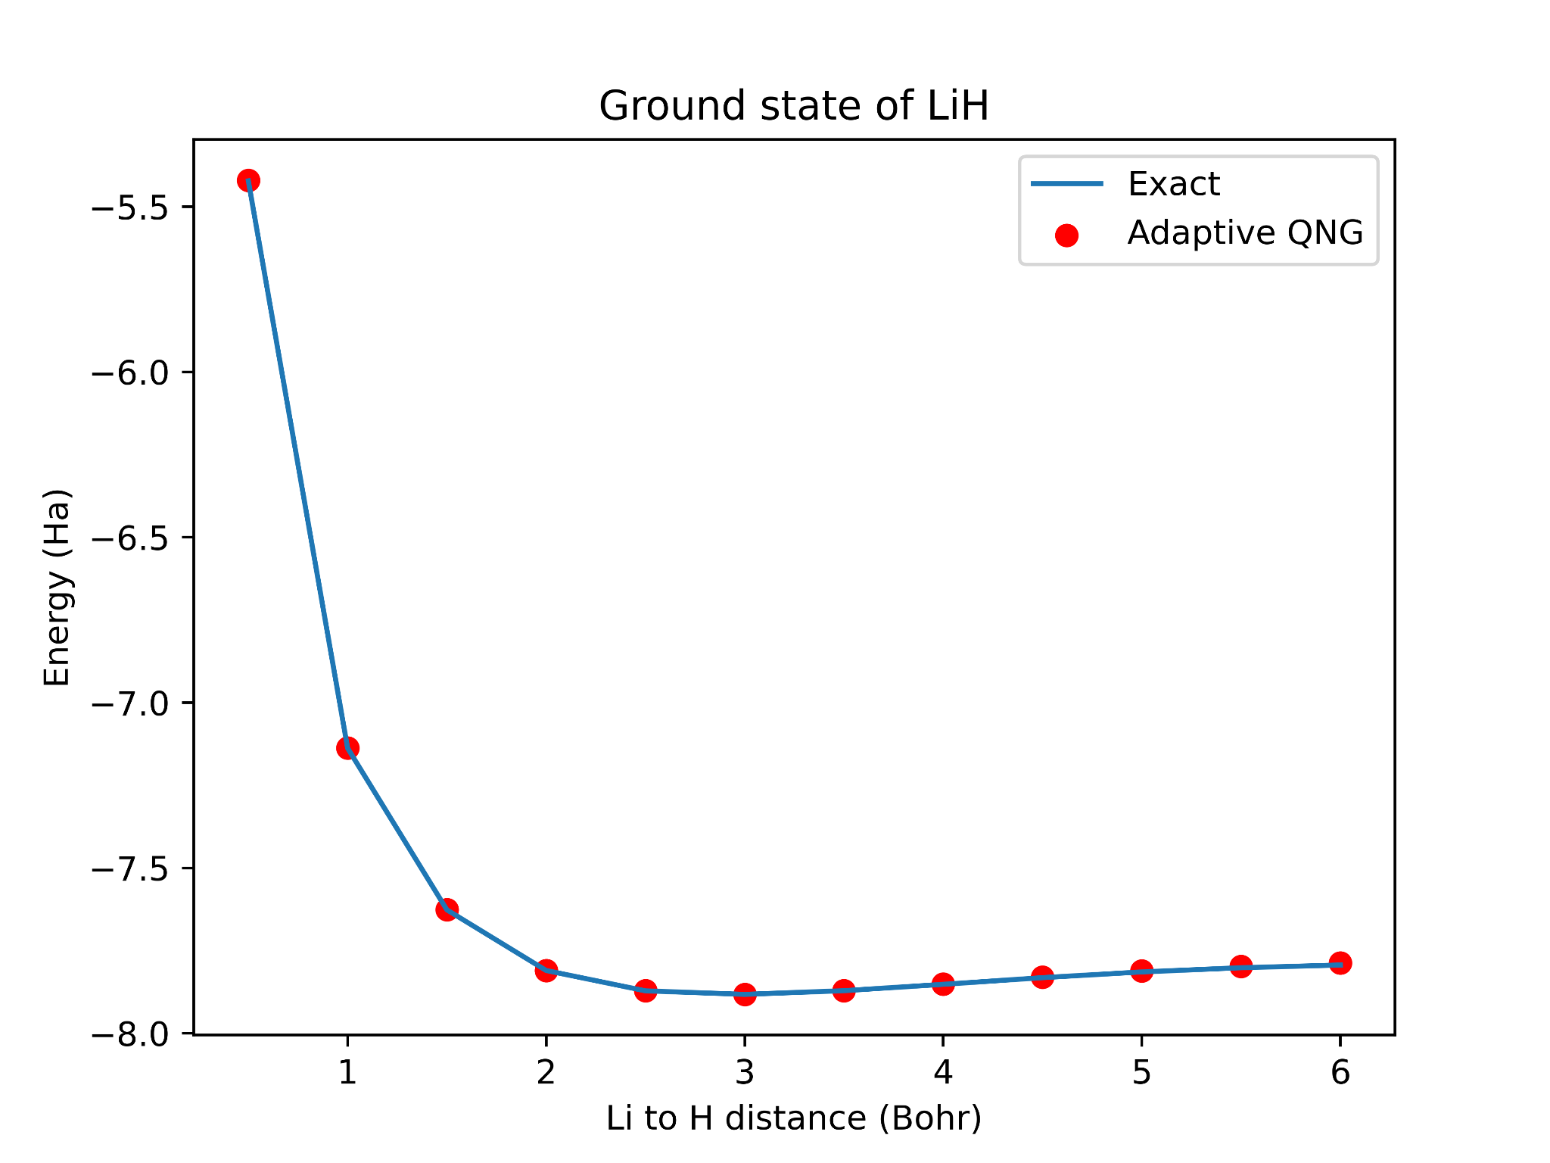
Adaptive Quantum Natural Gradient VQE for LiH
We adaptively select only gates that have a gradient threshold above 10⁻⁵
This reduces redundant gates and keeps accuracy.
Harper R. Grimsley et al, Nature Communications volume 10,3007 (2019)
https://pennylane.ai/qml/demos/tutorial_adaptive_circuits/

Slide 15
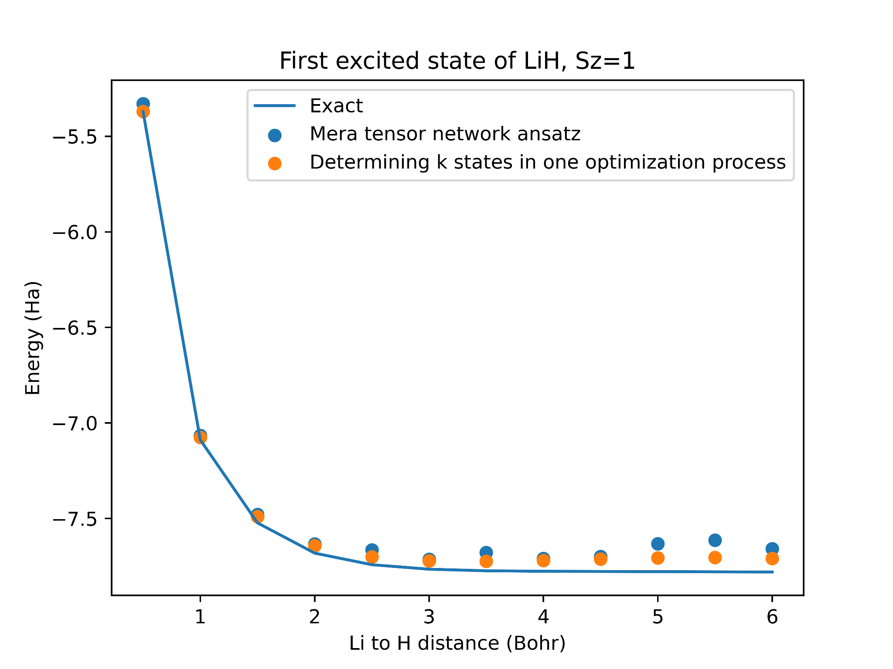
Improving speed: Tapered SSVQE with Mera and strongly entangling layers ansatz
Pauli tapering reduces the number of qubit for VQE.
Mera tensor network method speed up a lot but trade off with the accuracy
SSVQE algorithm in one optimization process
https://pennylane.ai/qml/demos/tutorial_qubit_tapering/
https://docs.pennylane.ai/en/stable/code/api/pennylane.MERA.html

Slide 16
Conclusion
The VQD works best for finding the first excited state.
The FS-VQD allow us explore highly excited state without starting training from the lowest energy state.
QNG significantly enhances the efficiency of VQE by considering the geometry of the parameter space.
QNG demonstrates faster convergence to ground state energy, reducing computational resources and time.
The effectiveness of QNG across various molecular systems showcases its broad applicability in quantum computational chemistry.

Slide 17
Outlook
Explore larger system (i.e. H₂O)
Make adaptive version more stable
Merge QNG with VQE approaches

Slide 18
Thank You
for you attention!

