Slide 1
Regression
May, 08, 2020

Slide 2
Table of Contents
Linear Regression
Polynomial Regression
Regularization

Slide 3
1. Linear Regression

Slide 4
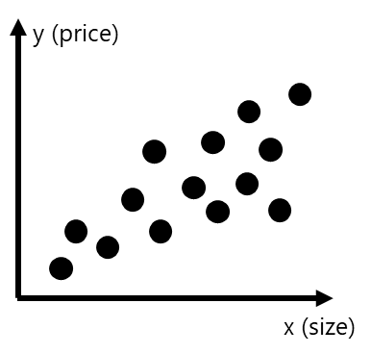






Motivating Example: Predicting House Price
n: #features
Problem formulation:
Given the age and the size of a house, predict its price.
training set
( x^{(i)}, y^{(i)} )
Age | Size | Price
10 | 98 | 1200w
8 | 92 | 900w
5 | 100 | 1000w
12 | 160 | 800w
2 | 180 | 1000w
i^{th} training example
Solution: Linear regression: the target value (price) is expected to be a linear combination of the features (age and size).
m: #training examples
$$\hat{y}=h_{θ}\left(x\right)=θ_{0}+θ_{1}x_{1}+…+θ_{n}x_{n}$$
 | Features (predictor) of the i^{th} training example
 | ground truth value (target) of the i^{th} training example
 | predicted value of the i^{th} training example
m | # training examples
n_{x} | # features
 | the j^{th} feature of the i^{th} training example
$$x^{(i)}$$
features
X
y
target
$$y^{(i)}$$
$${\hat{y}}^{(i)}$$
Linear Regression
$$x_{j}^{(i)}$$
Univariate Linear Regression: n=1 Multivariate Linear Regression: n>1 (as the example shown to the right)
age, size x^{(i)}
Price ${\hat{y}}^{(i)}$
Linear Model

Slide 5


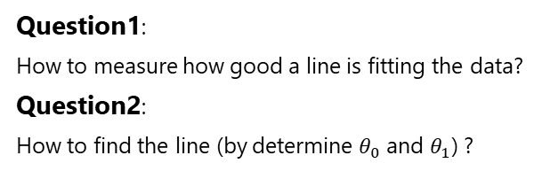
Univariate Linear Regression
n: #features
Given a training data set:
training set
Objective:
Find a line that best fits the training data:
( x^{(i)}, y^{(i)} )
Size | Price
98 | 1200w
92 | 900w
100 | 1000w
160 | 800w
180 | 1000w
i^{th} training example
m: #training examples
Linear Regression
feature
X
y
target
Good
Bad
So Bad
Linear Regression
Question1:
How to measure how good a line is fitting the data?
Question2:
How to find the line (by determine $θ_{0}$ and $θ_{1}$) ?
District, size x^{(i)}
Price ${\hat{y}}^{(i)}$
Hypothesis function:
$$y=hθ\left(x\right)= θ_{0}+θ_{1}x$$
Linear Model

Slide 6

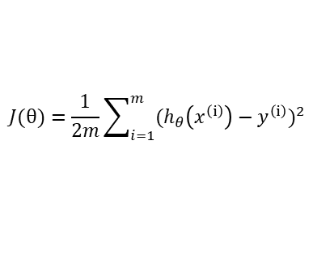

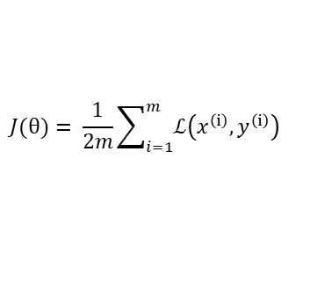
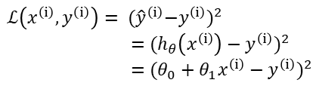

Loss Function and Cost Function
Loss Function
Cost Function
Loss = error of a single training example
Cost = total loss of all training examples
y (price)
y (price)
$y^{\left(ⅈ\right)}$
loss
$${\hat{y}}^{\left(ⅈ\right)}$$
$x^{\left(ⅈ\right)}$
x (size)
x (size)
$$ℒ\left(x^{\left(ⅈ\right)},y^{\left(ⅈ\right)}\right)= {{(\hat{y}}^{\left(ⅈ\right)}−y^{\left(ⅈ\right)})}^{2}$$
$=$ ${(h_{θ}\left(x^{\left(ⅈ\right)}\right)−y^{\left(ⅈ\right)})}^{2}$
$=$ ${(θ_{0}+θ_{1}x^{\left(ⅈ\right)}−y^{\left(ⅈ\right)})}^{2}$
$$J(θ)= \frac{1}{2m}\sum_{i=1}^{m}{ℒ\left(x^{\left(ⅈ\right)},y^{\left(ⅈ\right)}\right)}$$
$$J(θ)=\frac{1}{2m}\sum_{i=1}^{m}{{(h_{θ}\left(x^{\left(ⅈ\right)}\right)−y^{\left(ⅈ\right)})}^{2}}$$
Squared Error Function
Loss Function: Measure How Good a Model is

Slide 7












Loss Function vs. Hypothesis Function
For simplicity, we fix $θ_{0}=0.$
So the loss function is a function of only one parameter: $θ_{1}$
y (price)
y (price)
y (price)
$$J(θ)$$
3
3
3
3
2
2
2
2
1
1
1
1
$$θ_{1}$$
1
2
3
x (size)
1
2
3
x (size)
1
2
3
x (size)
0
0.5
1
1.5
2
$$θ_{0}=0, { θ}_{1}=1$$
$$θ_{0}=0, { θ}_{1}=0.5$$
$$θ_{0}=0, { θ}_{1}=1.5$$
$J(θ)=$ 0
$J(θ)=$ $\frac{1}{2∗3}$ (${0.5}^{2}+1^{2}+{1.5}^{2}$) = 0.583
$J(θ)=$ $\frac{1}{2∗3}$ (${0.5}^{2}+1^{2}+{1.5}^{2}$) = 0.583
$${ θ}_{1}=1, J(θ)=\text{ 0}$$
$${ θ}_{1}=0.5,J(θ)= \text{0.583}$$
$${ θ}_{1}=1.5,J(θ)= \text{0.583}$$

Slide 8
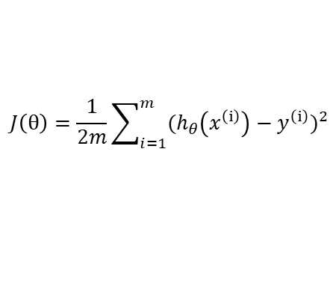




Fit Model: Minimize the Loss Function
Ordinary Least Square
Training = find the right value for $θ_{0},{ θ}_{1}$ to minimize the cost function $J(θ)$
$$\underset{θ}{minimize}{J(θ)}$$
$$J\left(θ\right)=\frac{1}{2m}\sum_{i=1}^{m}{{(h_{θ}\left(x^{\left(ⅈ\right)}\right)−y^{\left(ⅈ\right)})}^{2}}$$
Normal Equation
Gradient Descent
y (price)
y (price)
y (price)
$$J(θ)$$
3
2
1
$$θ_{1}$$
x (size)
x (size)
x (size)
0
0.5
1
1.5
2

Slide 9

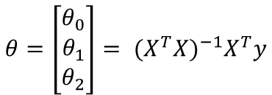



Normal Equation
$$θ_{0}$$
$$θ_{1}$$
$$θ_{2}$$
Age (x₁) | Size (x₂) | Price (y)
10 | 98 | 1200w
8 | 92 | 900w
5 | 100 | 1000w
12 | 160 | 800w
2 | 180 | 1000w
 | Age (x₁) | Size (x₂) | Price (y)
1 | 10 | 98 | 1200w
1 | 8 | 92 | 900w
1 | 5 | 100 | 1000w
1 | 12 | 160 | 800w
1 | 2 | 180 | 1000w
X
y
X
y
Normal Equation
Refer to appendix for the formulas
$$θ={\left[\begin{matrix}θ_{0} \\ θ_{1} \\ θ_{2}\end{matrix}\right]= {(X^{T}X)}^{−1}X}^{T}y$$
Prediction
$$\hat{y}=h_{θ}\left(x\right)=θ_{0}+θ_{1}x_{1}+ θ_{2}x_{2}$$

Slide 10
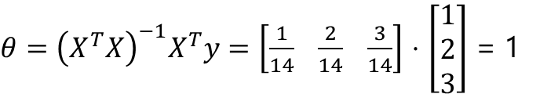

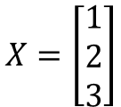
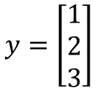






Normal Equation: Example
y (price)
$$J(θ)$$
x | y
1 | 1
2 | 2
3 | 3
3
3
2
2
1
1
$$θ_{1}$$
$$X=\left[\begin{matrix}1 \\ 2 \\ 3\end{matrix}\right]$$
$$y=\left[\begin{matrix}1 \\ 2 \\ 3\end{matrix}\right]$$
1
2
3
x (size)
0
0.5
1
1.5
2
We fix $θ_{0}$ to 0.
${\left(X^{T}X\right)}^{−1}$ = $\frac{1}{14}$
$$X^{T}=\left[1 2 3\right]$$
$θ={\left(X^{T}X\right)}^{−1}X^{T}y=\left[\frac{1}{14} \frac{2}{14} \frac{3}{14}\right]$ $⋅$ $\left[\begin{matrix}1 \\ 2 \\ 3\end{matrix}\right]$ = 1
$\left(X^{T}X\right)$ =14
${\left(X^{T}X\right)}^{−1}X^{T}$=$\left[\frac{1}{14} \frac{2}{14} \frac{3}{14}\right]$

Slide 11
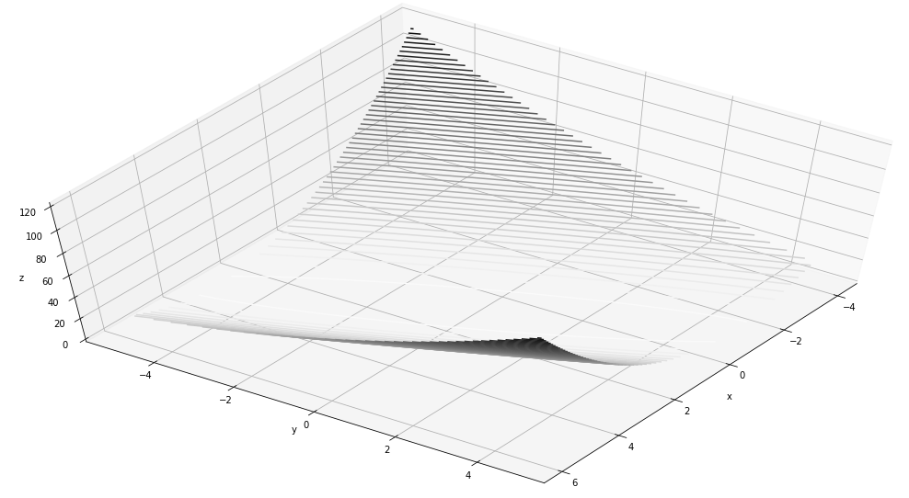
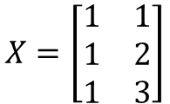

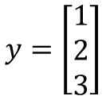
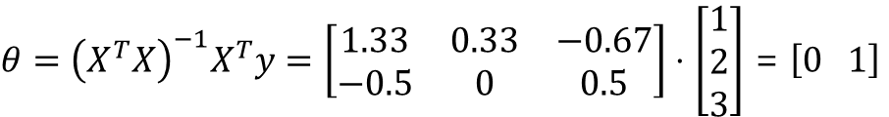


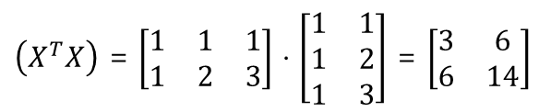
Normal Equation: Example
y (price)
x₀
1
1
1
x₁ | y
1 | 1
2 | 2
3 | 3
3
2
1
$$X=\left[\begin{matrix}1 & 1 \\ 1 & 2 \\ 1 & 3\end{matrix}\right]$$
$$y=\left[\begin{matrix}1 \\ 2 \\ 3\end{matrix}\right]$$
1
2
3
x (size)
$$X^{T}=\left[\begin{matrix}1 & 1 & 1 \\ 1 & 2 & 3\end{matrix}\right]$$
${\left(X^{T}X\right)}^{−1}$ = $\left[\begin{matrix}2.33 & −1 \\ −1 & 0.5\end{matrix}\right]$
$θ={\left(X^{T}X\right)}^{−1}X^{T}y=\left[\begin{matrix}1.33 & 0.33 & −0.67 \\ −0.5 & 0 & 0.5\end{matrix}\right]⋅$ $\left[\begin{matrix}1 \\ 2 \\ 3\end{matrix}\right]$ = $\left[0 1\right]$
$\left(X^{T}X\right)$ = $\left[\begin{matrix}1 & 1 & 1 \\ 1 & 2 & 3\end{matrix}\right]$ $⋅$ $\left[\begin{matrix}1 & 1 \\ 1 & 2 \\ 1 & 3\end{matrix}\right]$ = $\left[\begin{matrix}3 & 6 \\ 6 & 14\end{matrix}\right]$
${\left(X^{T}X\right)}^{−1}X^{T}$=$\left[\begin{matrix}1.33 & 0.33 & −0.67 \\ −0.5 & 0 & 0.5\end{matrix}\right]$

Slide 12
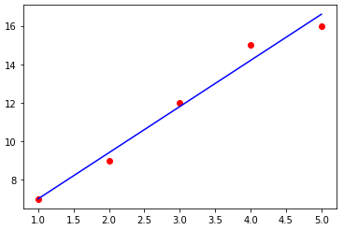

Normal Equation: Implementation
$$θ={\left(X^{T}X\right)}^{−1}X^{T}y$$
def normal_equation(X):
# compute X transpose
X_transpose = np.transpose(X)
# compute dot product of X transpose and X
X_trans_dot_X = X_transpose.dot(X)
# compute the inverse of the dot production
inv_matrix = np.linalg.inv(X_trans_dot_X)
# compute the dot product of X transpose and y
X_trans_dot_y =x_transpose.dot(y)
# compute the final dot product
return inv_matrix.dot(X_trans_dot_y)
return np.linalg.inv(X_b.T.dot(X_b)).dot(X_b.T).dot(y)
x = np.array([1,2,3,4,5]) # univariate, 1 feature, 5 training examples
y = np.array([7,9,12,15,16])
x_bias = np.ones((5,1)) # used for multiplying with theta_0, bias term
x = np.reshape(x,(5,1)) # column vector
x = np.append(x_bias,x,axis=1) # combine x with x_b
theta = normal_equation(x, y) # you will have [4.6, 2.4]

Slide 13
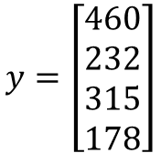
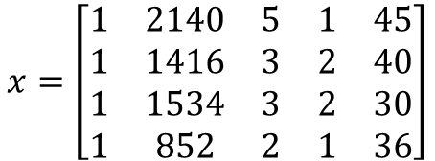
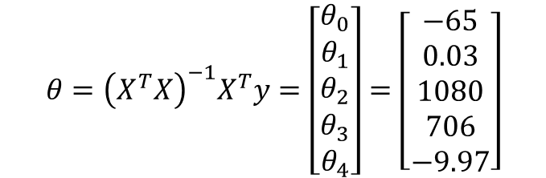
Normal Equation: Example
x₀
1
1
1
1
Size (x₁) | #rooms (x₂) | #floors (x₃) | Age (x₄) | Price (y)
2140 | 5 | 1 | 45 | 460
1416 | 3 | 2 | 40 | 232
1534 | 3 | 2 | 30 | 315
852 | 2 | 1 | 36 | 178
$$x=\left[\begin{matrix}1 & 2140 & 5 & 1 & 45 \\ 1 & 1416 & 3 & 2 & 40 \\ 1 & 1534 & 3 & 2 & 30 \\ 1 & 852 & 2 & 1 & 36\end{matrix}\right]$$
$$y=\left[\begin{matrix}460 \\ 232 \\ 315 \\ 178\end{matrix}\right]$$
m*(n+1) matrix
N+1 dimensional vector
$$θ={\left(X^{T}X\right)}^{−1}X^{T}y=\left[\begin{matrix}θ_{0} \\ θ_{1} \\ θ_{2} \\ θ_{3} \\ θ_{4}\end{matrix}\right]=\left[\begin{matrix}−65 \\ 0.03 \\ 1080 \\ 706 \\ −9.97\end{matrix}\right]$$

Slide 14
Normal Equation: Scikit-Learn’s Implementation
from sklearn.linear_model import LinearRegression
# generate data
X = 2 * np.random.rand(100, 1)
y = 4 + 3 * X + np.random.randn(100, 1)
# train linear model
lin_reg = LinearRegression()
lin_reg.fit(X, y)
print('intercept', lin_reg.intercept_)
print('coef', lin_reg.coef_)
>> intercept [4.21509616]
>> coef [[2.77011339]]
# Use linear model to predict new instance
X_new = np.array([[0], [2]])
lin_reg.predict(X_new)
>> array([[4.21509616], [9.75532293]])

Slide 15
Normal Equation: Scikit-Learn’s Implementation (Under the Hood)
theta_100_svd, residuals, rank, s = np.linalg.lstsq(X_100_b, y_100, rcond=1e-6)
print(theta_100_svd)
>> array([[4.21509616], [2.77011339]]
theta_100 = np.linalg.pinv(X_100_b).dot(y_100)
print(theta_100)
>> array([[4.21509616], [2.77011339]]
Normal Equation may not work if the matrix $X^{T}X$ is not invertible (i.e., singular), such as if m < n or if some features are redundant, but the pseudo-inverse is always defined.

Slide 16
Normal Equation: Computational Complexity
The computational complexity of inverting such a matrix is typically about O(n^{2.4}) to O(n³),
The SVD approach used by Scikit-Learn’s LinearRegression class is about O(n²).
Predictions are fast

Slide 17
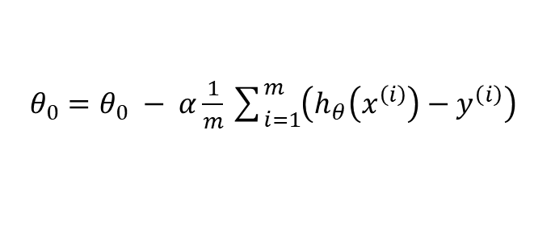

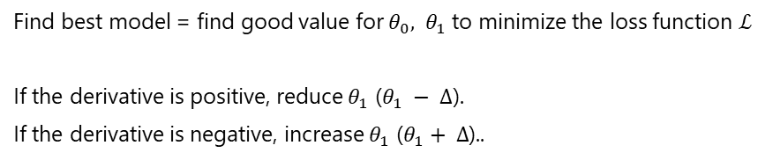
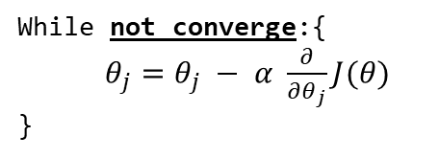

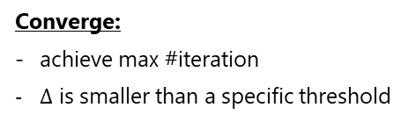

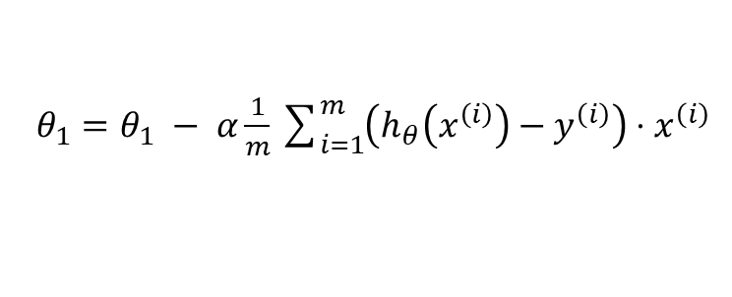
Gradient Descent
Find best model = find good value for $θ_{0},{ θ}_{1}$ to minimize the loss function $ℒ$
If the derivative is positive, reduce $θ_{1}$ ($θ_{1} − ∆$).
If the derivative is negative, increase $θ_{1}$ ($θ_{1}+ ∆$)..
$$ℒ$$
3
positive derivative
2
1
$θ_{0}=θ_{0} − α\frac{1}{m}\sum_{i=1}^{m}{\left(h_{θ}\left(x^{\left(i\right)}\right)−y^{\left(i\right)}\right)}$
…
$$∆$$
$$θ_{1}$$
0
0.5
1
1.5
2
$θ_{1}=θ_{1} − α\frac{1}{m}\sum_{i=1}^{m}{\left(h_{θ}\left(x^{\left(i\right)}\right)−y^{\left(i\right)}\right)⋅x^{\left(ⅈ\right)}}$
reduce $θ_{1}$
While not converge:{
$θ_{j}=θ_{j} − α \frac{∂}{∂θ_{j}}J(θ)$
}
Converge:
achieve max #iteration
$∆$ is smaller than a specific threshold

Slide 18
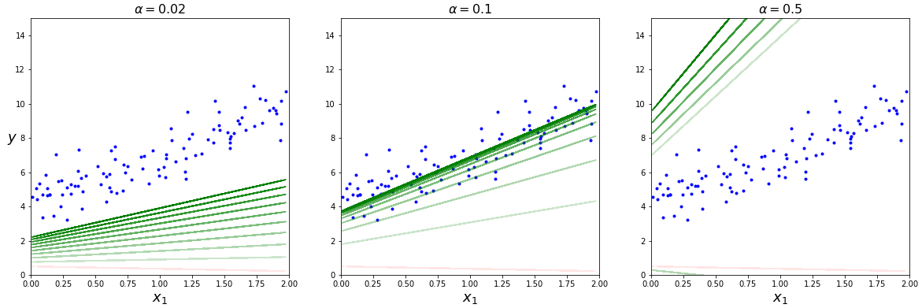





Learning Rate
$$α too small$$
$$α just all right$$
$$α too big$$
$$θ_{j}=θ_{j} − α \frac{∂}{∂θ_{j}}J(θ)$$
$$ℒ$$
$$ℒ$$
$$ℒ$$
3
3
3
2
2
2
…
1
…
1
…
1
$$θ_{1}$$
$$θ_{1}$$
$$θ_{1}$$
0
0.5
1
1.5
2
0
0.5
1
1.5
2
0
0.5
1
1.5
2
Find out the best learning rate:
hyperparameter tuning

Slide 19
Gradient Descent – Implementation
lr = 0.1 # learning rate
n_iterations = 1000 # 1000 iterations
m = 100 # 100 training example
theta_bgd = np.random.randn(2,1) # random initialization
for iteration in range(n_iterations):
gradients = 2/m * X_100_b.T.dot(X_100_b.dot(theta_bgd) - y_100)
theta_bgd = theta_bgd - lr * gradients
print(theta_bgd)
>> array([[4.21509616], [2.77011339]])

Slide 20
Gradient Descent – Scikit-Learn

Slide 21
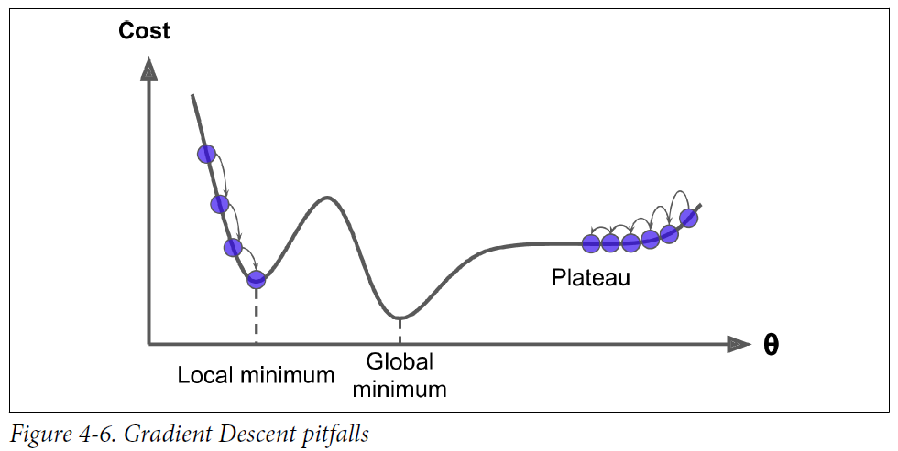
Problems with Gradient Descent
Local Minima
Learning Plateau
Picture from “hands-on machine learning with scikit-learn (2nd edition)”

Slide 22
Comparison of Linear Regression Algorithms
Algorithm | Large m | Out-of-core support | Large n | Hyperparams | Scaling required | Scikit-Learn
Normal Equation | Fast | No | Slow | 0 | No | N/A
SVD | Fast | No | Slow | 0 | No | LinearRegression
Batch GD | Slow | No | Fast | 2 | Yes | SGDRegressor
Stochastic GD | Fast | Yes | Fast | >=2 | Yes | SGDRegressor
Mini-batch GD | Fast | Yes | Fast | >=2 | Yes | SGDRegressor

Slide 23
2. Polynomial Regression

Slide 24
Problems with Gradient Descent
Local Minima
Learning Plateau
Picture from “hands-on machine learning with scikit-learn (2nd edition)”

Slide 25
3. Regularization

Slide 26



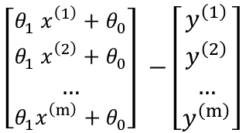


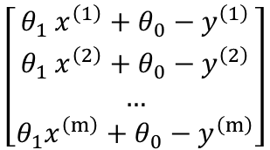

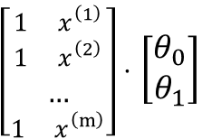


Normal Equation
1. Vectorization of cost function
${{(θ}_{1} x^{\left(1\right)}+θ_{0}−y^{\left(1\right)})}^{2}$ + ${{(θ}_{1} x^{\left(2\right)}+θ_{0}−y^{\left(2\right)})}^{2}$ + … + ${{(θ}_{1} x^{\left(1\right)}+θ_{0}−y^{\left(1\right)})}^{2}$
$$J\left(θ\right)=\frac{1}{2m}\sum_{i=1}^{m}{{(h_{θ}\left(x^{\left(ⅈ\right)}\right)−y^{\left(ⅈ\right)})}^{2}}$$
$$\left[\begin{matrix}θ_{1} x^{\left(1\right)}+θ_{0}−y^{\left(1\right)} \\ θ_{1} x^{\left(2\right)}+θ_{0}−y^{\left(2\right)} \\ … \\ {θ_{1}x}^{\left(m\right)}+θ_{0}−y^{\left(m\right)}\end{matrix}\right]$$
$$=\frac{1}{2m}\sum_{i=1}^{m}{{({θ_{1}x}^{\left(ⅈ\right)}+θ_{0}−y^{\left(ⅈ\right)})}^{2}}$$
[$θ_{1} x^{\left(1\right)}+θ_{0}−y^{\left(1\right)}$, $θ_{1} x^{\left(2\right)}+θ_{0}−y^{\left(2\right)}$, … , $θ_{1} x^{\left(m\right)}+θ_{0}−y^{\left(m\right)}$]
$$=\frac{1}{2m}{\text{(}Xθ\text{ – }y\text{)}}^{T}\text{(}Xθ\text{ – }y\text{)}$$
$${\text{(}Xθ\text{ – }y\text{)}}^{T}$$
$$\left[\begin{matrix}θ_{1} x^{\left(1\right)}+θ_{0} \\ θ_{1} x^{\left(2\right)}+θ_{0} \\ … \\ {θ_{1}x}^{\left(m\right)}+θ_{0}\end{matrix}\right] −\left[\begin{matrix}y^{\left(1\right)} \\ y^{\left(2\right)} \\ … \\ y^{\left(m\right)}\end{matrix}\right]$$
$\left[\begin{matrix}1 x^{\left(1\right)} \\ 1 x^{\left(2\right)} \\ … \\ 1 x^{\left(m\right)}\end{matrix}\right]⋅$ $\left[\begin{matrix}θ_{0} \\ θ_{1}\end{matrix}\right]$
$$y$$
$$X$$
$$θ$$
($Xθ$ – $y$)

Slide 27
















Normal Equation
2. Compute $θ$
$$\underset{θ}{minimize}{J\left(θ\right) }$$
$$\frac{∂AB}{∂x}=\frac{∂A}{∂x}B+A\frac{∂B}{∂x}$$
$$\frac{∂}{∂θ}[{\text{(}Xθ\text{ – }y\text{)}}^{T}\text{(}Xθ\text{ – }y\text{)}]$$
$$\frac{∂}{∂θ}J\left(θ\right)=0$$
$$\frac{∂z^{T}z}{∂z}\frac{∂z}{∂θ}$$
$$\frac{∂}{∂θ}[{\text{(}Xθ\text{ – }y\text{)}}^{T}\text{(}Xθ\text{ – }y\text{)}]=0$$
$$\frac{∂{\text{(}Xθ\text{ – }y\text{)}}^{T}}{∂θ}\text{(}Xθ\text{ – }y\text{)}+{\text{(}Xθ\text{ – }y\text{)}}^{T}\frac{∂\text{(}Xθ\text{ – }y\text{)}}{∂θ}$$
$$2X^{T}Xθ−2X^{T}y=0$$
$$\text{(}Xθ\text{ – }y\text{)}$$
$$X^{T}$$
$$2X^{T}Xθ=2X^{T}y$$
$$J(θ)$$
$$X^{T}Xθ=X^{T}y$$
3
$${{\left(X^{T}X\right)}^{−1}X}^{T}Xθ={{\left(X^{T}X\right)}^{−1}X}^{T}y$$
2
1
$$θ={{\left(X^{T}X\right)}^{−1}X}^{T}y$$
$$θ_{1}$$
0
0.5
1
1.5
2

Slide 28
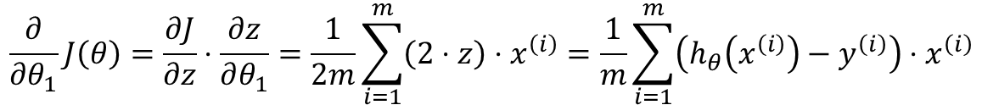


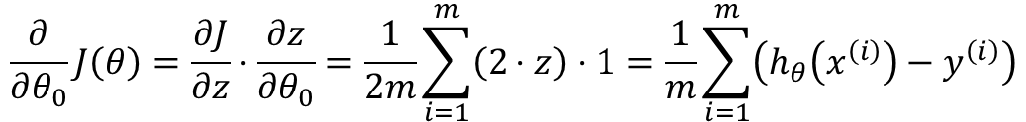



Gradient Descent
$$θ_{j}=θ_{j} − α \frac{∂}{∂θ_{j}}J(θ)$$
$$J(θ)$$
3
$$\frac{∂}{∂θ_{j}}J\left(θ\right)=\frac{∂}{∂θ_{j}}\frac{1}{2m}\sum_{i=1}^{m}{{(h_{θ}\left(x^{\left(ⅈ\right)}\right)−y^{\left(ⅈ\right)})}^{2}}$$
2
1
$$=\frac{1}{2m}\frac{∂}{∂θ_{j}}\sum_{i=1}^{m}{{({θ_{1}x}^{\left(ⅈ\right)}+θ_{0}−y^{\left(ⅈ\right)})}^{2}}$$
$$θ_{1}$$
$$Batch Gradients$$
0
0.5
1
1.5
2
z
$$Chain Rule$$
$$\frac{∂}{∂θ_{0}}J\left(θ\right)=\frac{∂J}{∂z}⋅\frac{∂z}{∂θ_{0}}=\frac{1}{2m}\sum_{i=1}^{m}{\left(2⋅z\right)⋅1}=\frac{1}{m}\sum_{i=1}^{m}{\left(h_{θ}\left(x^{\left(i\right)}\right)−y^{\left(i\right)}\right)}$$
$$\frac{∂}{∂θ_{1}}J\left(θ\right)=\frac{∂J}{∂z}⋅\frac{∂z}{∂θ_{1}}=\frac{1}{2m}\sum_{i=1}^{m}{\left(2⋅z\right)⋅x^{\left(ⅈ\right)}}=\frac{1}{m}\sum_{i=1}^{m}{\left(h_{θ}\left(x^{\left(i\right)}\right)−y^{\left(i\right)}\right)⋅x^{\left(ⅈ\right)}}$$

Slide 29
Explore without leaving your slides
y (price)
x (size)

Slide 30





Learning Rate
$$θ_{j}=θ_{j} − α \frac{∂}{∂θ_{j}}J(θ)$$
$$ℒ$$
$$ℒ$$
$$ℒ$$
3
3
3
2
2
2
…
1
…
1
…
1
$$θ_{1}$$
$$θ_{1}$$
$$θ_{1}$$
0
0.5
1
1.5
2
0
0.5
1
1.5
2
0
0.5
1
1.5
2
$$α just all right$$
$$α too small$$
$$α too big$$
Slow: take too many steps to converge
Risk of divergence
Find out the best learning rate: hyperparameter tuning

Slide 31















Normal Equation
$$θ={\left(X^{T}X\right)}^{−1}X^{T}y$$
$$J\left(θ\right)=\frac{1}{2m}\sum_{i=1}^{m}{{(h_{θ}\left(x^{\left(ⅈ\right)}\right)−y^{\left(ⅈ\right)})}^{2}}$$
$$θ_{1} x^{\left(1\right)}+θ_{0}−y^{\left(1\right)}$$
$$\underset{θ}{minimize}{J\left(θ\right) }$$
$$\frac{1}{2m}$$
$$θ_{1} x^{\left(2\right)}+θ_{0}−y^{\left(2\right)}$$
$$J(θ)$$
$$=\frac{1}{2m}\sum_{i=1}^{m}{{({θ_{1}x}^{\left(ⅈ\right)}+θ_{0}−y^{\left(ⅈ\right)})}^{2}}$$
…
3
$$θ_{1} x^{\left(m\right)}+θ_{0}−y^{\left(m\right)}$$
2
$${{(θ}_{1} x^{\left(1\right)}+θ_{0}−y^{\left(1\right)})}^{2}$$
$$θ_{1} x^{\left(1\right)}+θ_{0}−y^{\left(1\right)}$$
1
$$\frac{1}{2m}$$
$$θ_{1} x^{\left(2\right)}+θ_{0}−y^{\left(2\right)}$$
$$θ_{1}$$
…
0
0.5
1
1.5
2
$$θ_{1} x^{\left(m\right)}+θ_{0}−y^{\left(m\right)}$$
$$J\left(θ\right)= \frac{1}{6}\left({14θ}_{1}^{2}−2{8θ}_{1}+14\right)$$
$${\left(Xθ−y\right)}^{T}\left(Xθ−y\right)$$

Slide 32




Fit Model: Minimize the Loss Function
Find the best model = find good value for $θ_{0},{ θ}_{1}$ to minimize the loss function $ℒ$
y (price)
$$\underset{θ_{1}}{minimize}{J(θ)}$$
y⁽³⁾
y⁽²⁾
$$J\left(θ\right)=\frac{1}{2m}\sum_{i=1}^{m}{{(h_{θ}\left(x^{\left(ⅈ\right)}\right)−y^{\left(ⅈ\right)})}^{2}}$$
y⁽¹⁾
$$= \frac{1}{6}\left[{\left(θ_{1}x^{\left(1\right)}−y^{\left(1\right)}\right)}^{2}+{\left(θ_{1}x^{\left(1\right)}−y^{\left(1\right)}\right)}^{2}+{\left(θ_{1}x^{\left(1\right)}−y^{\left(1\right)}\right)}^{2}\right]$$
x⁽¹⁾
x⁽²⁾
x⁽³⁾
x (size)
$$= \frac{1}{6}\left[{\left(θ_{1}⋅1−1\right)}^{2}+{\left(θ_{1}⋅2−2\right)}^{2}+{\left(θ_{1}⋅3−3\right)}^{2}\right]$$
$$J(θ)$$
3
$$= \frac{1}{6}\left[\left(θ_{1}^{2}−2θ_{1}+1\right)+\left({4θ}_{1}^{2}−8θ_{1}+4\right)+\left({9θ}_{1}^{2}−18θ_{1}+9\right)\right]$$
2
$$= \frac{1}{6}\left({14θ}_{1}^{2}−2{8θ}_{1}+14\right)$$
1
$$θ_{1}$$
Normal Equation
Gradient Descent
0
0.5
1
1.5
2

