Slide 1
Linear Models
May, 08, 2020

Slide 2
Table of Contents
Linear Regression
Polynomial Regression
Regularization
Logistic Regression

Slide 3
1. Linear Regression

Slide 4
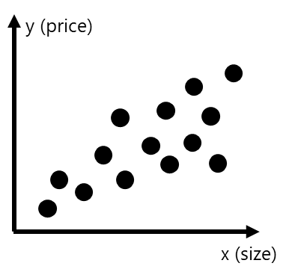






Motivating Example: Predicting House Price
n: #features
Problem formulation:
Given the age and the size of a house, predict its price.
training set
( x^{(i)}, y^{(i)} )
Age | Size | Price
10 | 98 | 1200w
8 | 92 | 900w
5 | 100 | 1000w
12 | 160 | 800w
2 | 180 | 1000w
i^{th} training example
Solution: Linear regression: the target value (price) is expected to be a linear combination of the features (age and size).
m: #training examples
$$\hat{y}=h_{θ}\left(x\right)=θ_{0}+θ_{1}x_{1}+…+θ_{n}x_{n}$$
 | Features (predictor) of the i^{th} training example
 | ground truth value (target) of the i^{th} training example
 | predicted value of the i^{th} training example
m | # training examples
n_{x} | # features
 | the j^{th} feature of the i^{th} training example
$$x^{(i)}$$
features
X
y
target
$$y^{(i)}$$
$${\hat{y}}^{(i)}$$
Linear Regression
$$x_{j}^{(i)}$$
Univariate Linear Regression: n=1 Multivariate Linear Regression: n>1 (as the example shown to the right)
age, size x^{(i)}
Price ${\hat{y}}^{(i)}$
Linear Model

Slide 5


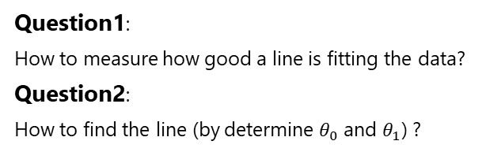
Univariate Linear Regression
n: #features
Given a training data set:
training set
Objective:
Find a line that best fits the training data:
( x^{(i)}, y^{(i)} )
Size | Price
98 | 1200w
92 | 900w
100 | 1000w
160 | 800w
180 | 1000w
i^{th} training example
m: #training examples
Linear Regression
feature
X
y
target
Good
Bad
So Bad
Linear Regression
Question1:
How to measure how good a line is fitting the data?
Question2:
How to find the line (by determine $θ_{0}$ and $θ_{1}$) ?
District, size x^{(i)}
Price ${\hat{y}}^{(i)}$
Hypothesis function:
$$y=hθ\left(x\right)= θ_{0}+θ_{1}x$$
Linear Model

Slide 6

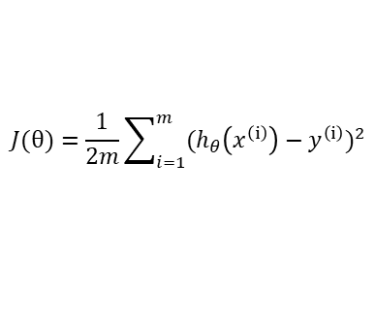

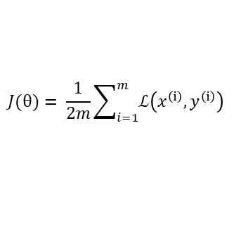
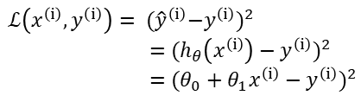

Loss Function and Cost Function
Loss Function
Cost Function
Loss = error of a single training example
Cost = total loss of all training examples
y (price)
y (price)
$y^{\left(ⅈ\right)}$
loss
$${\hat{y}}^{\left(ⅈ\right)}$$
$x^{\left(ⅈ\right)}$
x (size)
x (size)
$$ℒ\left(x^{\left(ⅈ\right)},y^{\left(ⅈ\right)}\right)= {{(\hat{y}}^{\left(ⅈ\right)}−y^{\left(ⅈ\right)})}^{2}$$
$=$ ${(h_{θ}\left(x^{\left(ⅈ\right)}\right)−y^{\left(ⅈ\right)})}^{2}$
$=$ ${(θ_{0}+θ_{1}x^{\left(ⅈ\right)}−y^{\left(ⅈ\right)})}^{2}$
$$J(θ)= \frac{1}{2m}\sum_{i=1}^{m}{ℒ\left(x^{\left(ⅈ\right)},y^{\left(ⅈ\right)}\right)}$$
$$J(θ)=\frac{1}{2m}\sum_{i=1}^{m}{{(h_{θ}\left(x^{\left(ⅈ\right)}\right)−y^{\left(ⅈ\right)})}^{2}}$$
Squared Error Function
Loss Function: Measure How Good a Model is

Slide 7












Loss Function vs. Hypothesis Function
For simplicity, we fix $θ_{0}=0.$
So the loss function is a function of only one parameter: $θ_{1}$
y (price)
y (price)
y (price)
$$J(θ)$$
3
3
3
3
2
2
2
2
1
1
1
1
$$θ_{1}$$
1
2
3
x (size)
1
2
3
x (size)
1
2
3
x (size)
0
0.5
1
1.5
2
$$θ_{0}=0, { θ}_{1}=1$$
$$θ_{0}=0, { θ}_{1}=0.5$$
$$θ_{0}=0, { θ}_{1}=1.5$$
$J(θ)=$ 0
$J(θ)=$ $\frac{1}{2∗3}$ (${0.5}^{2}+1^{2}+{1.5}^{2}$) = 0.583
$J(θ)=$ $\frac{1}{2∗3}$ (${0.5}^{2}+1^{2}+{1.5}^{2}$) = 0.583
$${ θ}_{1}=1, J(θ)=\text{ 0}$$
$${ θ}_{1}=0.5,J(θ)= \text{0.583}$$
$${ θ}_{1}=1.5,J(θ)= \text{0.583}$$

Slide 8
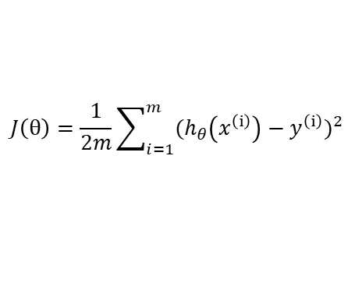




Fit Model: Minimize the Loss Function
Ordinary Least Square
Training = find the right value for $θ_{0},{ θ}_{1}$ to minimize the cost function $J(θ)$
$$\underset{θ}{minimize}{J(θ)}$$
$$J\left(θ\right)=\frac{1}{2m}\sum_{i=1}^{m}{{(h_{θ}\left(x^{\left(ⅈ\right)}\right)−y^{\left(ⅈ\right)})}^{2}}$$
Normal Equation
Gradient Descent
y (price)
y (price)
y (price)
$$J(θ)$$
3
2
1
$$θ_{1}$$
x (size)
x (size)
x (size)
0
0.5
1
1.5
2

Slide 9

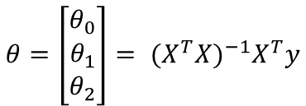



Normal Equation
$$θ_{0}$$
$$θ_{1}$$
$$θ_{2}$$
Age (x₁) | Size (x₂) | Price (y)
10 | 98 | 1200w
8 | 92 | 900w
5 | 100 | 1000w
12 | 160 | 800w
2 | 180 | 1000w
 | Age (x₁) | Size (x₂) | Price (y)
1 | 10 | 98 | 1200w
1 | 8 | 92 | 900w
1 | 5 | 100 | 1000w
1 | 12 | 160 | 800w
1 | 2 | 180 | 1000w
X
y
X
y
Normal Equation
Refer to appendix for the formulas
$$θ={\left[\begin{matrix}θ_{0} \\ θ_{1} \\ θ_{2}\end{matrix}\right]= {(X^{T}X)}^{−1}X}^{T}y$$
Prediction
$$\hat{y}=h_{θ}\left(x\right)=θ_{0}+θ_{1}x_{1}+ θ_{2}x_{2}$$

Slide 10
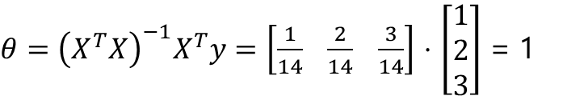

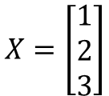
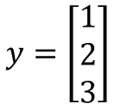






Normal Equation: Example
y (price)
$$J(θ)$$
x | y
1 | 1
2 | 2
3 | 3
3
3
2
2
1
1
$$θ_{1}$$
$$X=\left[\begin{matrix}1 \\ 2 \\ 3\end{matrix}\right]$$
$$y=\left[\begin{matrix}1 \\ 2 \\ 3\end{matrix}\right]$$
1
2
3
x (size)
0
0.5
1
1.5
2
We fix $θ_{0}$ to 0.
${\left(X^{T}X\right)}^{−1}$ = $\frac{1}{14}$
$$X^{T}=\left[1 2 3\right]$$
$θ={\left(X^{T}X\right)}^{−1}X^{T}y=\left[\frac{1}{14} \frac{2}{14} \frac{3}{14}\right]$ $⋅$ $\left[\begin{matrix}1 \\ 2 \\ 3\end{matrix}\right]$ = 1
$\left(X^{T}X\right)$ =14
${\left(X^{T}X\right)}^{−1}X^{T}$=$\left[\frac{1}{14} \frac{2}{14} \frac{3}{14}\right]$

Slide 11
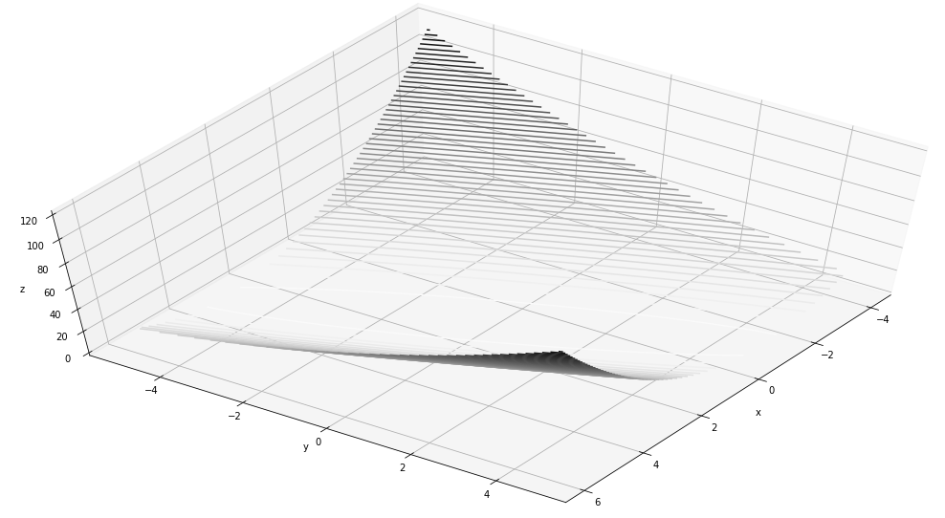
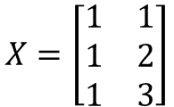

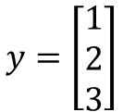
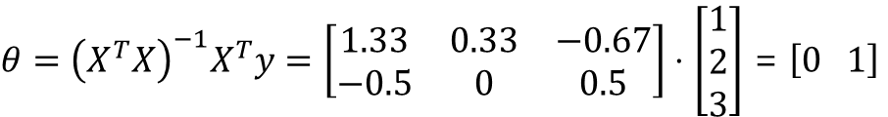


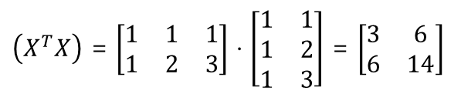
Normal Equation: Example
y (price)
x₀
1
1
1
x₁ | y
1 | 1
2 | 2
3 | 3
3
2
1
$$X=\left[\begin{matrix}1 & 1 \\ 1 & 2 \\ 1 & 3\end{matrix}\right]$$
$$y=\left[\begin{matrix}1 \\ 2 \\ 3\end{matrix}\right]$$
1
2
3
x (size)
$$X^{T}=\left[\begin{matrix}1 & 1 & 1 \\ 1 & 2 & 3\end{matrix}\right]$$
${\left(X^{T}X\right)}^{−1}$ = $\left[\begin{matrix}2.33 & −1 \\ −1 & 0.5\end{matrix}\right]$
$θ={\left(X^{T}X\right)}^{−1}X^{T}y=\left[\begin{matrix}1.33 & 0.33 & −0.67 \\ −0.5 & 0 & 0.5\end{matrix}\right]⋅$ $\left[\begin{matrix}1 \\ 2 \\ 3\end{matrix}\right]$ = $\left[0 1\right]$
$\left(X^{T}X\right)$ = $\left[\begin{matrix}1 & 1 & 1 \\ 1 & 2 & 3\end{matrix}\right]$ $⋅$ $\left[\begin{matrix}1 & 1 \\ 1 & 2 \\ 1 & 3\end{matrix}\right]$ = $\left[\begin{matrix}3 & 6 \\ 6 & 14\end{matrix}\right]$
${\left(X^{T}X\right)}^{−1}X^{T}$=$\left[\begin{matrix}1.33 & 0.33 & −0.67 \\ −0.5 & 0 & 0.5\end{matrix}\right]$

Slide 12
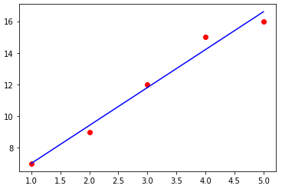

Normal Equation: Implementation
$$θ={\left(X^{T}X\right)}^{−1}X^{T}y$$
def normal_equation(X):
# compute X transpose
X_transpose = np.transpose(X)
# compute dot product of X transpose and X
X_trans_dot_X = X_transpose.dot(X)
# compute the inverse of the dot production
inv_matrix = np.linalg.inv(X_trans_dot_X)
# compute the dot product of X transpose and y
X_trans_dot_y =x_transpose.dot(y)
# compute the final dot product
return inv_matrix.dot(X_trans_dot_y)
return np.linalg.inv(X_b.T.dot(X_b)).dot(X_b.T).dot(y)
x = np.array([1,2,3,4,5]) # univariate, 1 feature, 5 training examples
y = np.array([7,9,12,15,16])
x_bias = np.ones((5,1)) # used for multiplying with theta_0, bias term
x = np.reshape(x,(5,1)) # column vector
x = np.append(x_bias,x,axis=1) # combine x with x_b
theta = normal_equation(x, y) # you will have [4.6, 2.4]

Slide 13
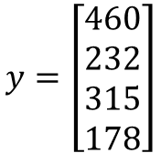
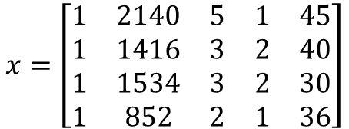
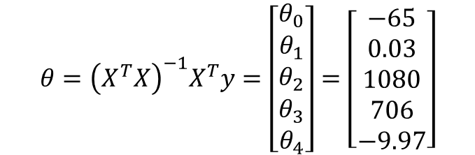
Normal Equation: Example
x₀
1
1
1
1
Size (x₁) | #rooms (x₂) | #floors (x₃) | Age (x₄) | Price (y)
2140 | 5 | 1 | 45 | 460
1416 | 3 | 2 | 40 | 232
1534 | 3 | 2 | 30 | 315
852 | 2 | 1 | 36 | 178
$$x=\left[\begin{matrix}1 & 2140 & 5 & 1 & 45 \\ 1 & 1416 & 3 & 2 & 40 \\ 1 & 1534 & 3 & 2 & 30 \\ 1 & 852 & 2 & 1 & 36\end{matrix}\right]$$
$$y=\left[\begin{matrix}460 \\ 232 \\ 315 \\ 178\end{matrix}\right]$$
m*(n+1) matrix
N+1 dimensional vector
$$θ={\left(X^{T}X\right)}^{−1}X^{T}y=\left[\begin{matrix}θ_{0} \\ θ_{1} \\ θ_{2} \\ θ_{3} \\ θ_{4}\end{matrix}\right]=\left[\begin{matrix}−65 \\ 0.03 \\ 1080 \\ 706 \\ −9.97\end{matrix}\right]$$

Slide 14
Normal Equation: Scikit-Learn’s Implementation
from sklearn.linear_model import LinearRegression
# generate data
X = 2 * np.random.rand(100, 1)
y = 4 + 3 * X + np.random.randn(100, 1)
# train linear model
lin_reg = LinearRegression()
lin_reg.fit(X, y)
print('intercept', lin_reg.intercept_)
print('coef', lin_reg.coef_)
>> intercept [4.21509616]
>> coef [[2.77011339]]
# Use linear model to predict new instance
X_new = np.array([[0], [2]])
lin_reg.predict(X_new)
>> array([[4.21509616], [9.75532293]])

Slide 15
Normal Equation: Scikit-Learn’s Implementation (Under the Hood)
theta_100_svd, residuals, rank, s = np.linalg.lstsq(X_100_b, y_100, rcond=1e-6)
print(theta_100_svd)
>> array([[4.21509616], [2.77011339]]
theta_100 = np.linalg.pinv(X_100_b).dot(y_100)
print(theta_100)
>> array([[4.21509616], [2.77011339]]
Normal Equation may not work if the matrix $X^{T}X$ is not invertible (i.e., singular), such as if m < n or if some features are redundant, but the pseudo-inverse is always defined.

Slide 16
Normal Equation: Computational Complexity
The computational complexity of inverting such a matrix is typically about O(n^{2.4}) to O(n³),
The SVD approach used by Scikit-Learn’s LinearRegression class is about O(n²).
Predictions are fast

Slide 17
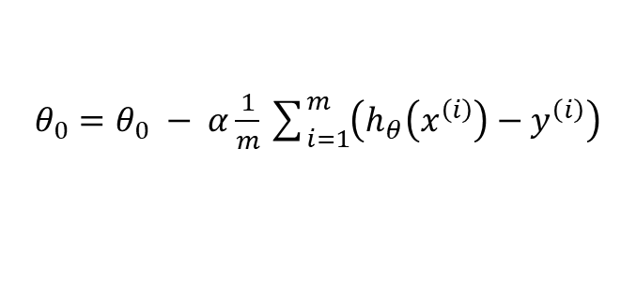

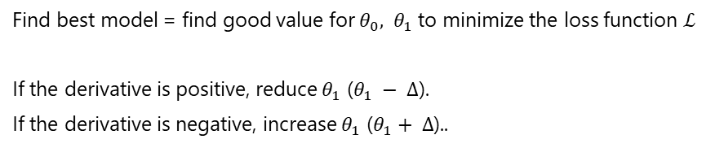
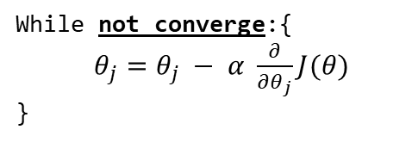

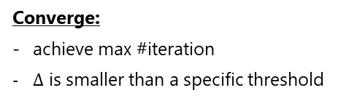

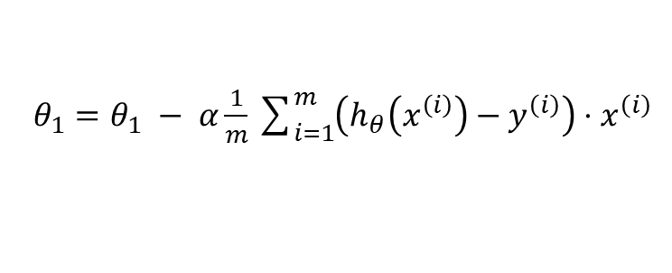
Gradient Descent
Find best model = find good value for $θ_{0},{ θ}_{1}$ to minimize the loss function $ℒ$
If the derivative is positive, reduce $θ_{1}$ ($θ_{1} − ∆$).
If the derivative is negative, increase $θ_{1}$ ($θ_{1}+ ∆$)..
$$ℒ$$
3
positive derivative
2
1
$θ_{0}=θ_{0} − α\frac{1}{m}\sum_{i=1}^{m}{\left(h_{θ}\left(x^{\left(i\right)}\right)−y^{\left(i\right)}\right)}$
…
$$∆$$
$$θ_{1}$$
0
0.5
1
1.5
2
$θ_{1}=θ_{1} − α\frac{1}{m}\sum_{i=1}^{m}{\left(h_{θ}\left(x^{\left(i\right)}\right)−y^{\left(i\right)}\right)⋅x^{\left(ⅈ\right)}}$
reduce $θ_{1}$
While not converge:{
$θ_{j}=θ_{j} − α \frac{∂}{∂θ_{j}}J(θ)$
}
Converge:
achieve max #iteration
$∆$ is smaller than a specific threshold

Slide 18
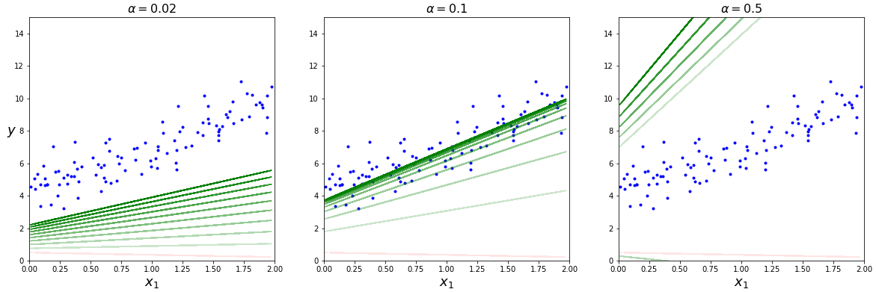





Learning Rate
$$α too small$$
$$α just all right$$
$$α too big$$
$$θ_{j}=θ_{j} − α \frac{∂}{∂θ_{j}}J(θ)$$
$$ℒ$$
$$ℒ$$
$$ℒ$$
3
3
3
2
2
2
…
1
…
1
…
1
$$θ_{1}$$
$$θ_{1}$$
$$θ_{1}$$
0
0.5
1
1.5
2
0
0.5
1
1.5
2
0
0.5
1
1.5
2
Find out the best learning rate:
hyperparameter tuning

Slide 19
Gradient Descent – Implementation
lr = 0.1 # learning rate
n_iterations = 1000 # 1000 iterations
m = 100 # 100 training example
theta_bgd = np.random.randn(2,1) # random initialization
for iteration in range(n_iterations):
gradients = 2/m * X_100_b.T.dot(X_100_b.dot(theta_bgd) - y_100)
theta_bgd = theta_bgd - lr * gradients
print(theta_bgd)
>> array([[4.21509616], [2.77011339]])

Slide 20
Gradient Descent – Scikit-Learn

Slide 21
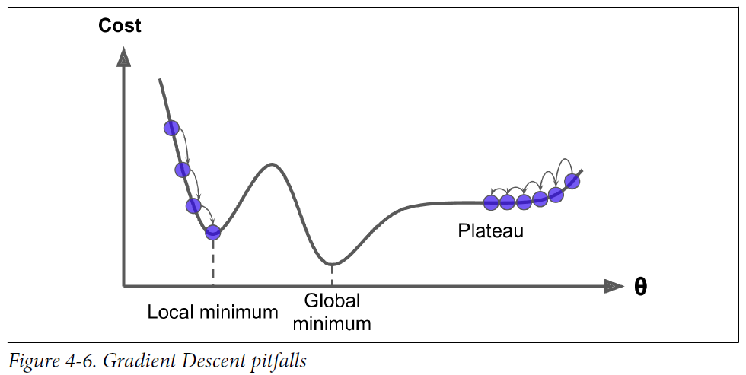
Problems with Gradient Descent
Local Minima
Learning Plateau
Picture from “hands-on machine learning with scikit-learn (2nd edition)”

Slide 22
Comparison of Linear Regression Algorithms
Algorithm | Large m | Out-of-core support | Large n | Hyperparams | Scaling required | Scikit-Learn
Normal Equation | Fast | No | Slow | 0 | No | N/A
SVD | Fast | No | Slow | 0 | No | LinearRegression
Batch GD | Slow | No | Fast | 2 | Yes | SGDRegressor
Stochastic GD | Fast | Yes | Fast | >=2 | Yes | SGDRegressor
Mini-batch GD | Fast | Yes | Fast | >=2 | Yes | SGDRegressor

Slide 23
2. Polynomial Regression

Slide 24
Problems with Gradient Descent
Local Minima
Learning Plateau
Picture from “hands-on machine learning with scikit-learn (2nd edition)”

Slide 25
3. Regularization

Slide 26
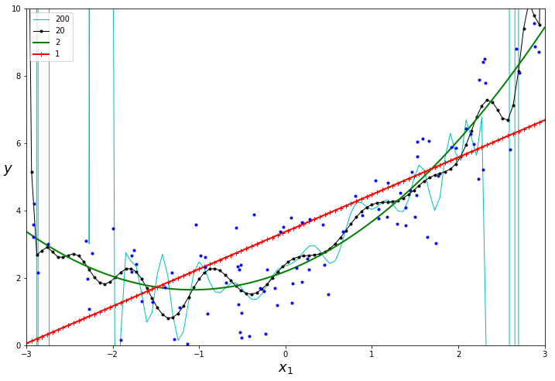
Why Regularization
Degree of freedom
Objective:
reduce overfitting
Solution :
reduce the degree of freedom of a model
Add regularization term to the cost function
Ridge
Lasso
Elastic Net

Slide 27
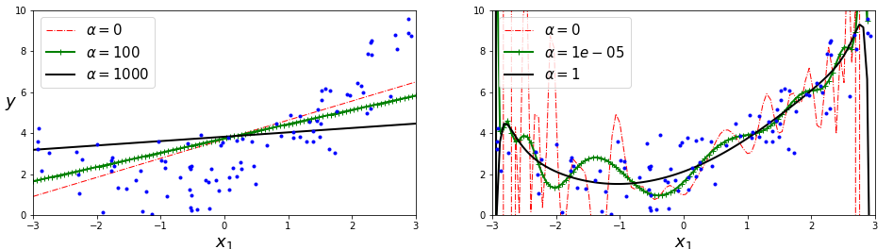
Ridge Regularization

Slide 28
Ridge Regularization

Slide 29
Ridge Regularization

Slide 30
Ridge Regularization

Slide 31
Ridge Regularization

Slide 32
Ridge Regularization

Slide 33
Ridge Regularization

Slide 34
Lasso Regularization

Slide 35
Elastic Net Regularization

Slide 36
Early Stopping

Slide 37



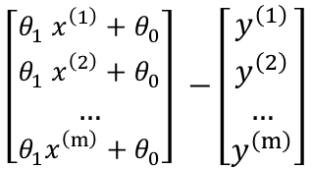


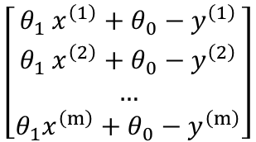

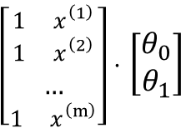


Normal Equation
1. Vectorization of cost function
${{(θ}_{1} x^{\left(1\right)}+θ_{0}−y^{\left(1\right)})}^{2}$ + ${{(θ}_{1} x^{\left(2\right)}+θ_{0}−y^{\left(2\right)})}^{2}$ + … + ${{(θ}_{1} x^{\left(1\right)}+θ_{0}−y^{\left(1\right)})}^{2}$
$$J\left(θ\right)=\frac{1}{2m}\sum_{i=1}^{m}{{(h_{θ}\left(x^{\left(ⅈ\right)}\right)−y^{\left(ⅈ\right)})}^{2}}$$
$$\left[\begin{matrix}θ_{1} x^{\left(1\right)}+θ_{0}−y^{\left(1\right)} \\ θ_{1} x^{\left(2\right)}+θ_{0}−y^{\left(2\right)} \\ … \\ {θ_{1}x}^{\left(m\right)}+θ_{0}−y^{\left(m\right)}\end{matrix}\right]$$
$$=\frac{1}{2m}\sum_{i=1}^{m}{{({θ_{1}x}^{\left(ⅈ\right)}+θ_{0}−y^{\left(ⅈ\right)})}^{2}}$$
[$θ_{1} x^{\left(1\right)}+θ_{0}−y^{\left(1\right)}$, $θ_{1} x^{\left(2\right)}+θ_{0}−y^{\left(2\right)}$, … , $θ_{1} x^{\left(m\right)}+θ_{0}−y^{\left(m\right)}$]
$$=\frac{1}{2m}{\text{(}Xθ\text{ – }y\text{)}}^{T}\text{(}Xθ\text{ – }y\text{)}$$
$${\text{(}Xθ\text{ – }y\text{)}}^{T}$$
$$\left[\begin{matrix}θ_{1} x^{\left(1\right)}+θ_{0} \\ θ_{1} x^{\left(2\right)}+θ_{0} \\ … \\ {θ_{1}x}^{\left(m\right)}+θ_{0}\end{matrix}\right] −\left[\begin{matrix}y^{\left(1\right)} \\ y^{\left(2\right)} \\ … \\ y^{\left(m\right)}\end{matrix}\right]$$
$\left[\begin{matrix}1 x^{\left(1\right)} \\ 1 x^{\left(2\right)} \\ … \\ 1 x^{\left(m\right)}\end{matrix}\right]⋅$ $\left[\begin{matrix}θ_{0} \\ θ_{1}\end{matrix}\right]$
$$y$$
$$X$$
$$θ$$
($Xθ$ – $y$)

Slide 38
















Normal Equation
2. Compute $θ$
$$\underset{θ}{minimize}{J\left(θ\right) }$$
$$\frac{∂AB}{∂x}=\frac{∂A}{∂x}B+A\frac{∂B}{∂x}$$
$$\frac{∂}{∂θ}[{\text{(}Xθ\text{ – }y\text{)}}^{T}\text{(}Xθ\text{ – }y\text{)}]$$
$$\frac{∂}{∂θ}J\left(θ\right)=0$$
$$\frac{∂z^{T}z}{∂z}\frac{∂z}{∂θ}$$
$$\frac{∂}{∂θ}[{\text{(}Xθ\text{ – }y\text{)}}^{T}\text{(}Xθ\text{ – }y\text{)}]=0$$
$$\frac{∂{\text{(}Xθ\text{ – }y\text{)}}^{T}}{∂θ}\text{(}Xθ\text{ – }y\text{)}+{\text{(}Xθ\text{ – }y\text{)}}^{T}\frac{∂\text{(}Xθ\text{ – }y\text{)}}{∂θ}$$
$$2X^{T}Xθ−2X^{T}y=0$$
$$\text{(}Xθ\text{ – }y\text{)}$$
$$X^{T}$$
$$2X^{T}Xθ=2X^{T}y$$
$$J(θ)$$
$$X^{T}Xθ=X^{T}y$$
3
$${{\left(X^{T}X\right)}^{−1}X}^{T}Xθ={{\left(X^{T}X\right)}^{−1}X}^{T}y$$
2
1
$$θ={{\left(X^{T}X\right)}^{−1}X}^{T}y$$
$$θ_{1}$$
0
0.5
1
1.5
2

Slide 39
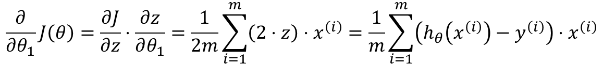


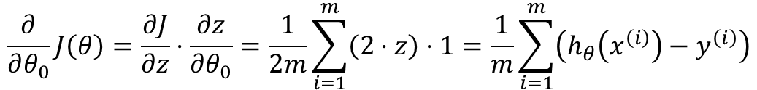



Gradient Descent
$$θ_{j}=θ_{j} − α \frac{∂}{∂θ_{j}}J(θ)$$
$$J(θ)$$
3
$$\frac{∂}{∂θ_{j}}J\left(θ\right)=\frac{∂}{∂θ_{j}}\frac{1}{2m}\sum_{i=1}^{m}{{(h_{θ}\left(x^{\left(ⅈ\right)}\right)−y^{\left(ⅈ\right)})}^{2}}$$
2
1
$$=\frac{1}{2m}\frac{∂}{∂θ_{j}}\sum_{i=1}^{m}{{({θ_{1}x}^{\left(ⅈ\right)}+θ_{0}−y^{\left(ⅈ\right)})}^{2}}$$
$$θ_{1}$$
$$Batch Gradients$$
0
0.5
1
1.5
2
z
$$Chain Rule$$
$$\frac{∂}{∂θ_{0}}J\left(θ\right)=\frac{∂J}{∂z}⋅\frac{∂z}{∂θ_{0}}=\frac{1}{2m}\sum_{i=1}^{m}{\left(2⋅z\right)⋅1}=\frac{1}{m}\sum_{i=1}^{m}{\left(h_{θ}\left(x^{\left(i\right)}\right)−y^{\left(i\right)}\right)}$$
$$\frac{∂}{∂θ_{1}}J\left(θ\right)=\frac{∂J}{∂z}⋅\frac{∂z}{∂θ_{1}}=\frac{1}{2m}\sum_{i=1}^{m}{\left(2⋅z\right)⋅x^{\left(ⅈ\right)}}=\frac{1}{m}\sum_{i=1}^{m}{\left(h_{θ}\left(x^{\left(i\right)}\right)−y^{\left(i\right)}\right)⋅x^{\left(ⅈ\right)}}$$

Slide 40
Explore without leaving your slides
y (price)
x (size)

Slide 41





Learning Rate
$$θ_{j}=θ_{j} − α \frac{∂}{∂θ_{j}}J(θ)$$
$$ℒ$$
$$ℒ$$
$$ℒ$$
3
3
3
2
2
2
…
1
…
1
…
1
$$θ_{1}$$
$$θ_{1}$$
$$θ_{1}$$
0
0.5
1
1.5
2
0
0.5
1
1.5
2
0
0.5
1
1.5
2
$$α just all right$$
$$α too small$$
$$α too big$$
Slow: take too many steps to converge
Risk of divergence
Find out the best learning rate: hyperparameter tuning

Slide 42















Normal Equation
$$θ={\left(X^{T}X\right)}^{−1}X^{T}y$$
$$J\left(θ\right)=\frac{1}{2m}\sum_{i=1}^{m}{{(h_{θ}\left(x^{\left(ⅈ\right)}\right)−y^{\left(ⅈ\right)})}^{2}}$$
$$θ_{1} x^{\left(1\right)}+θ_{0}−y^{\left(1\right)}$$
$$\underset{θ}{minimize}{J\left(θ\right) }$$
$$\frac{1}{2m}$$
$$θ_{1} x^{\left(2\right)}+θ_{0}−y^{\left(2\right)}$$
$$J(θ)$$
$$=\frac{1}{2m}\sum_{i=1}^{m}{{({θ_{1}x}^{\left(ⅈ\right)}+θ_{0}−y^{\left(ⅈ\right)})}^{2}}$$
…
3
$$θ_{1} x^{\left(m\right)}+θ_{0}−y^{\left(m\right)}$$
2
$${{(θ}_{1} x^{\left(1\right)}+θ_{0}−y^{\left(1\right)})}^{2}$$
$$θ_{1} x^{\left(1\right)}+θ_{0}−y^{\left(1\right)}$$
1
$$\frac{1}{2m}$$
$$θ_{1} x^{\left(2\right)}+θ_{0}−y^{\left(2\right)}$$
$$θ_{1}$$
…
0
0.5
1
1.5
2
$$θ_{1} x^{\left(m\right)}+θ_{0}−y^{\left(m\right)}$$
$$J\left(θ\right)= \frac{1}{6}\left({14θ}_{1}^{2}−2{8θ}_{1}+14\right)$$
$${\left(Xθ−y\right)}^{T}\left(Xθ−y\right)$$

Slide 43




Fit Model: Minimize the Loss Function
Find the best model = find good value for $θ_{0},{ θ}_{1}$ to minimize the loss function $ℒ$
y (price)
$$\underset{θ_{1}}{minimize}{J(θ)}$$
y⁽³⁾
y⁽²⁾
$$J\left(θ\right)=\frac{1}{2m}\sum_{i=1}^{m}{{(h_{θ}\left(x^{\left(ⅈ\right)}\right)−y^{\left(ⅈ\right)})}^{2}}$$
y⁽¹⁾
$$= \frac{1}{6}\left[{\left(θ_{1}x^{\left(1\right)}−y^{\left(1\right)}\right)}^{2}+{\left(θ_{1}x^{\left(1\right)}−y^{\left(1\right)}\right)}^{2}+{\left(θ_{1}x^{\left(1\right)}−y^{\left(1\right)}\right)}^{2}\right]$$
x⁽¹⁾
x⁽²⁾
x⁽³⁾
x (size)
$$= \frac{1}{6}\left[{\left(θ_{1}⋅1−1\right)}^{2}+{\left(θ_{1}⋅2−2\right)}^{2}+{\left(θ_{1}⋅3−3\right)}^{2}\right]$$
$$J(θ)$$
3
$$= \frac{1}{6}\left[\left(θ_{1}^{2}−2θ_{1}+1\right)+\left({4θ}_{1}^{2}−8θ_{1}+4\right)+\left({9θ}_{1}^{2}−18θ_{1}+9\right)\right]$$
2
$$= \frac{1}{6}\left({14θ}_{1}^{2}−2{8θ}_{1}+14\right)$$
1
$$θ_{1}$$
Normal Equation
Gradient Descent
0
0.5
1
1.5
2

