Slide 1







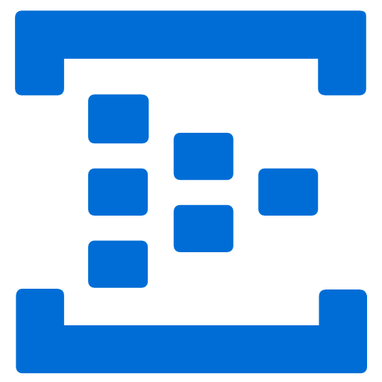

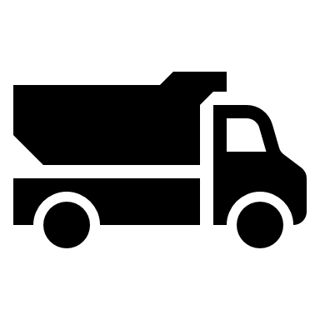
Remote Dashboard and Control System
<<Factory>>
<<Azure>>
H/W
PC
Command
<<ASP.NET Web API>>
RS232C
C++ App
IoT Device SDK
Status
<<ASP.NET MVC>>
Dashboard/
Control
Printer
(dot printer)
Referral data Processs
<<Status>>
Store/Notification to share status
Volume->Mix->Shipment->Print
Raw Cement
Purchas Order

