Slide 1







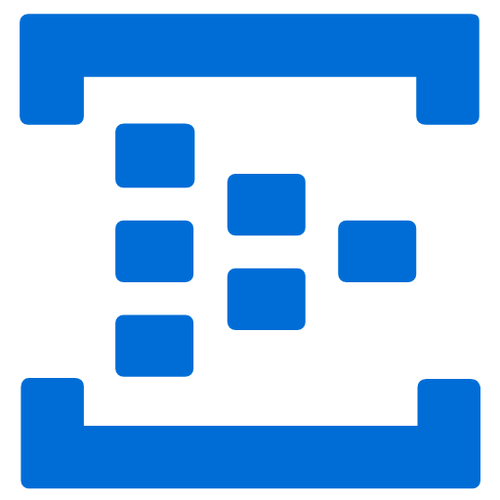

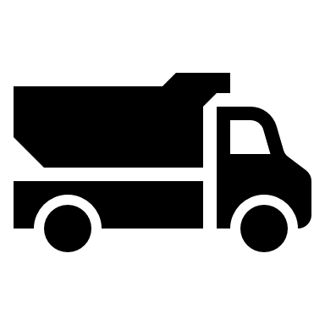
Remote Dashboard and Control System
<<Factory>>
<<Azure>>
H/W
PC
<<ASP.NET Web API>>
RS232C
C++ App
IoT Device SDK
<<ASP.NET MVC>>
Dashboard/
Control
Printer
(dot printer)
Store/Notification to share status
Status (Start-end)
数量->Mix->出庫->Print
Raw Cement
Purchas Order

