Slide 1

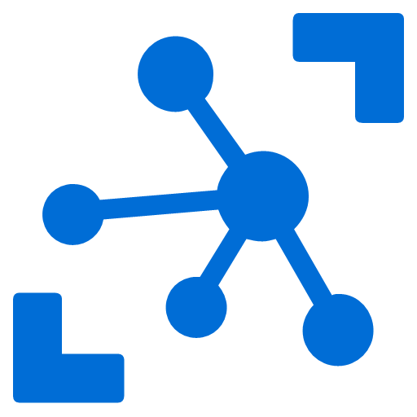



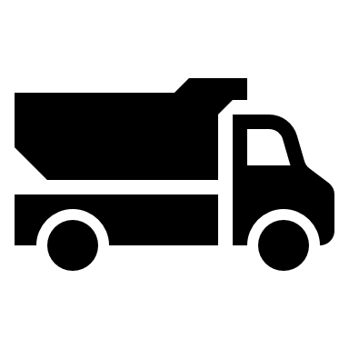
Remote Dashboard and Control System
Option
<<Factory>>
<<Azure>>
<<ASP.NET SignalR>>
H/W
PC
RS232C
C++ App
IoT Device SDK
<<ASP.NET MVC>>
Dashboard/
Control
Status (Start-end)
数量->Mix->出庫->Print
Printer
(dot printer)
生コン
伝票

