Slide 1
Fröbel am freitag
Raspberry pico’s as a musical instrument

Slide 2
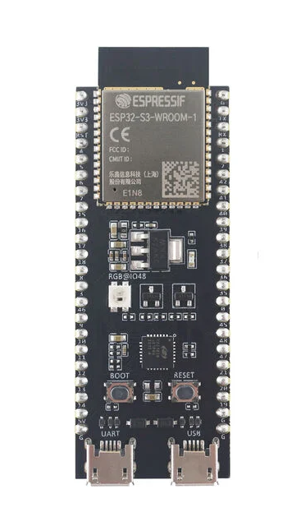
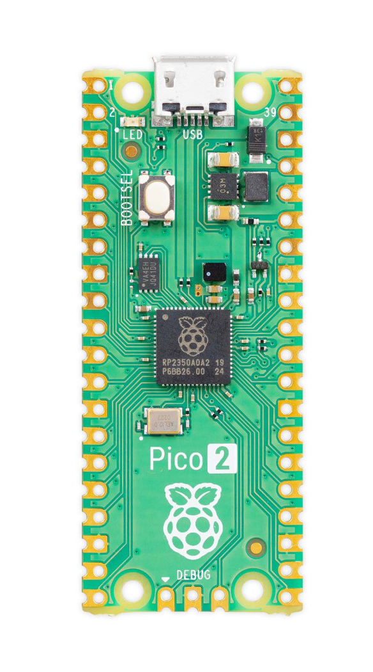
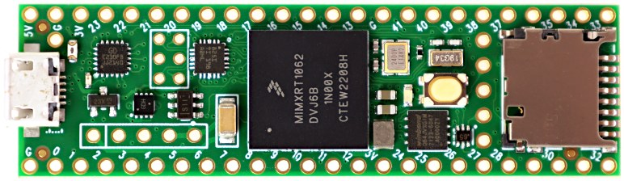
ESP32S3
RP2350
ARM Cortex-M7
Touchytouch
AMY
Mozzi

Slide 3
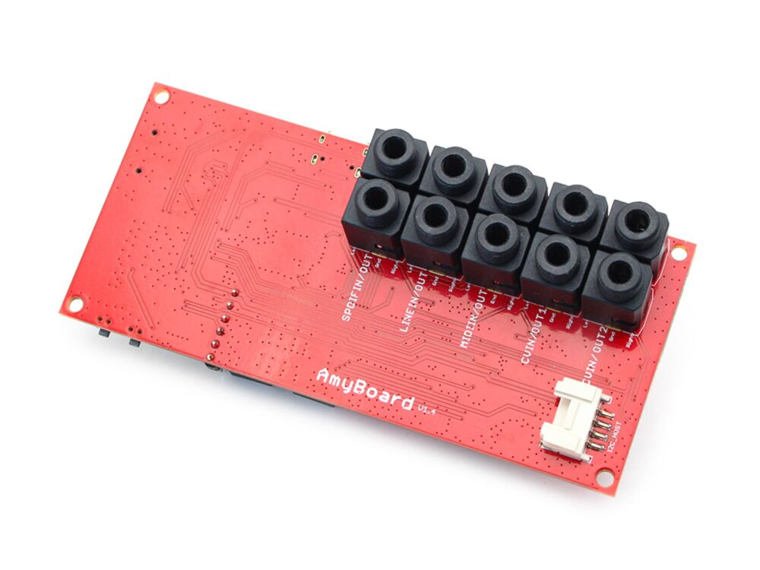
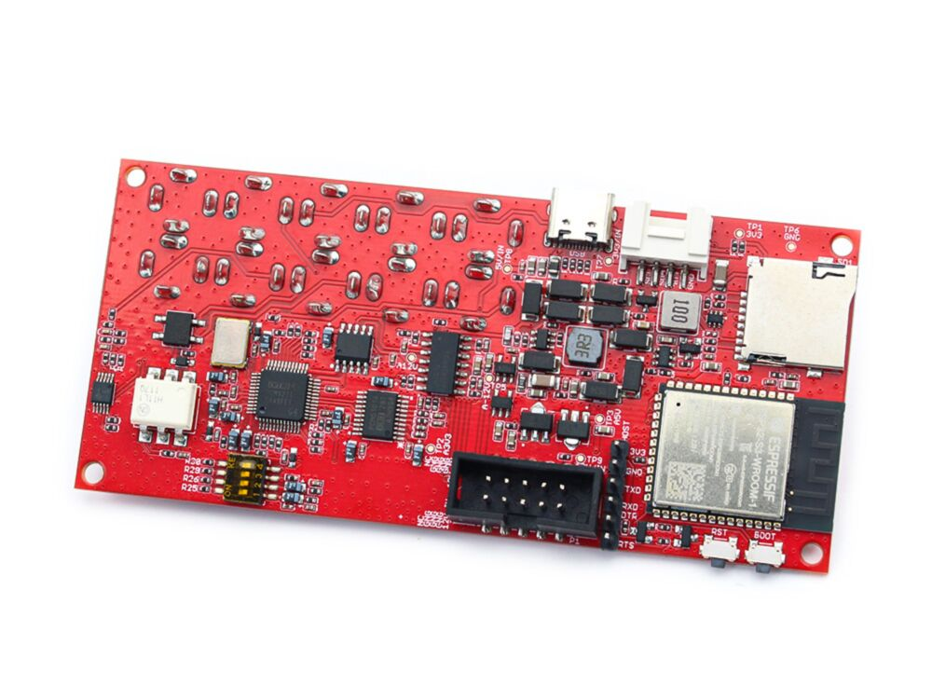
AMY SYNTH Library
https://github.com/shorepine/amy
https://www.amyboard.com/editor

Slide 4
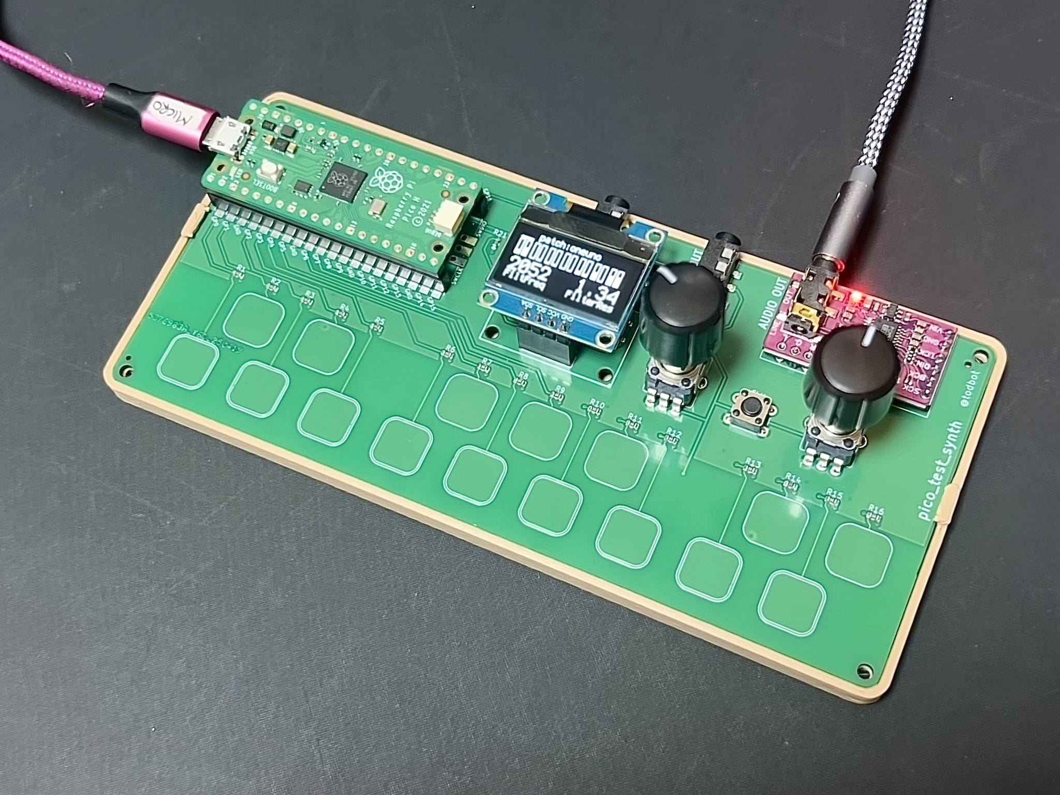
AMY SYNTH Library
https://github.com/todbot/pico_test_synth

Slide 5
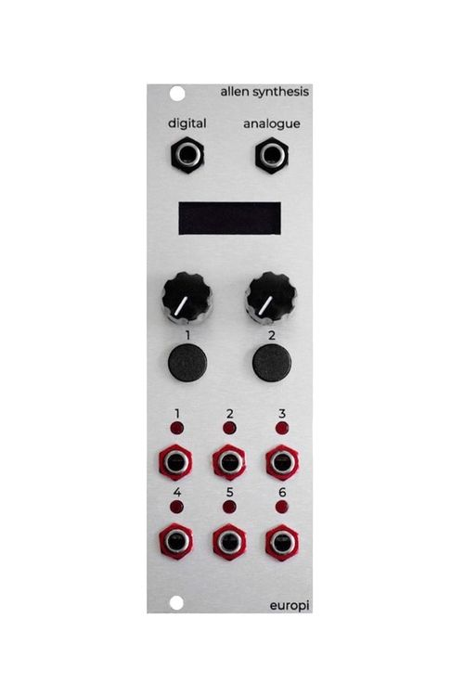
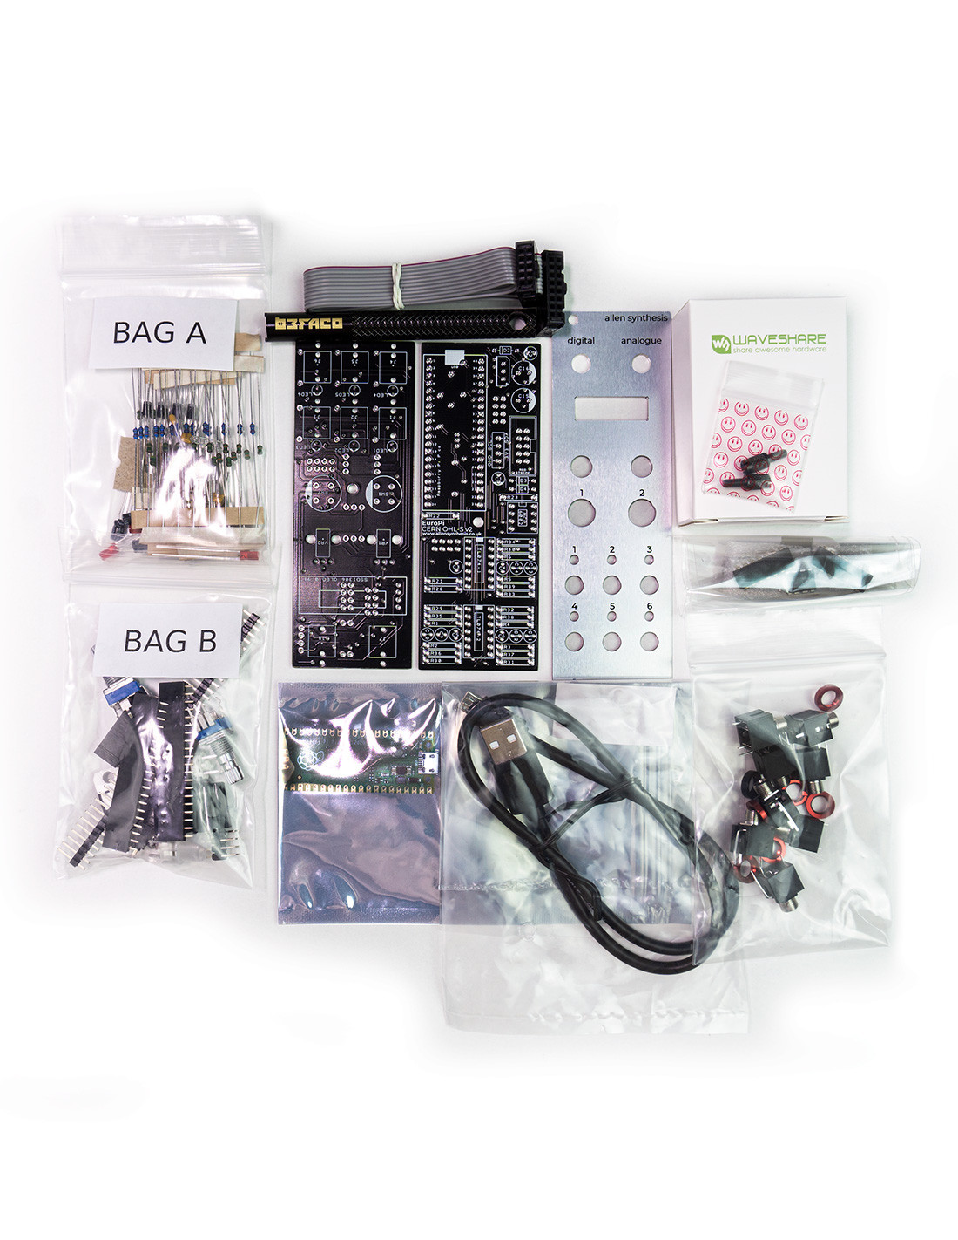
EuroPI
https://github.com/Allen-Synthesis/EuroPi

Slide 6
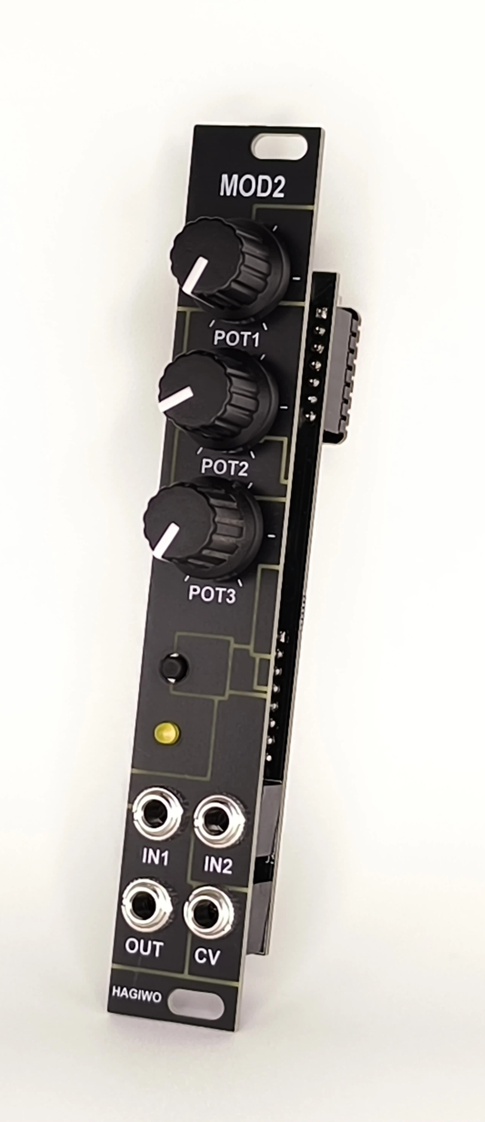
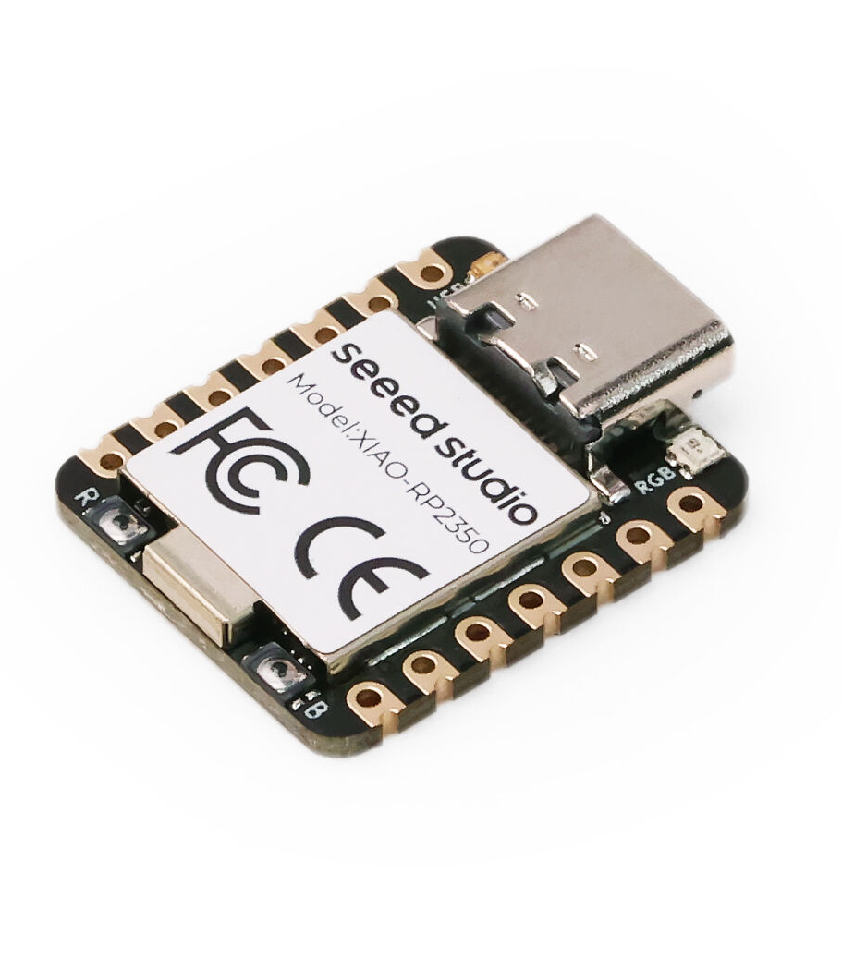
Hagiwo MOD2
https://note.com/solder_state/n/nce8f7defcf98

Slide 7
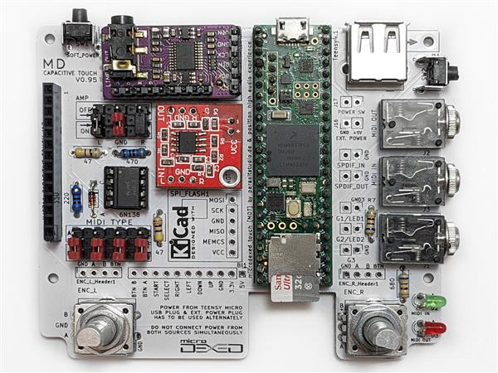
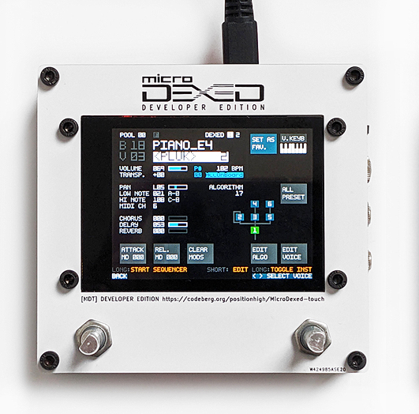
MicroDexed Touch
https://codeberg.org/positionhigh/MicroDexed-touch

Slide 8
Arduino & Rp2040/Rp2350
https://github.com/earlephilhower/arduino-pico

Slide 9
Circuitpython & Rp2040 / Rp2350
Circuitpython
https://circuitpython.org
Mu editor
https://codewith.mu
VSCode
https://code.visualstudio.com
+
CircuitPython extension

