Slide 1
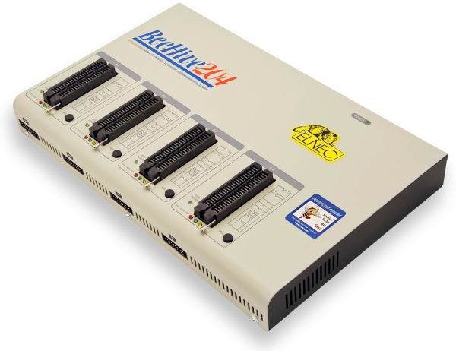

ELNEC:
Universal Programmer

Slide 2
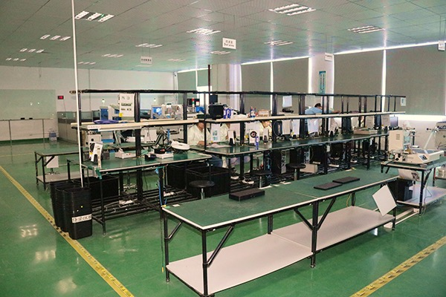
IC Programming Service
Professional and Reliable
Support numerous kinds of IC
Provide Tapping Service of every kind of package

