Slide 1
Risk Analysis of Flowlines
Isabella Chittumuri
February 12, 2024

Slide 2
Agenda
Background
Partner
Research Goals
Progress Made
Future Work

Slide 3
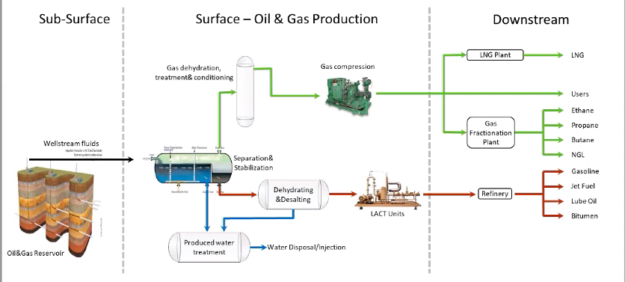
Background
Notes:
Oil and gas wells produce oil, natural gas, and water
Flowlines transport the mixture from wellheads to surface facilities
Pipelines carry separated products (oil, gas) to destinations like refineries.
Flowlines are buried to prevent freezing and maintain integrity.
The transition from flowline to pipeline at the Lease Automatic Custody Transfer (LACT) unit where products are handed over to companies like Chevron for further processing.
American Petroleum Institute (API) sets standards for flowline materials and construction.

Slide 4
Partner
Colorado Energy and Carbon Management Commission (ECMC)
Regulate Colorado's oil and gas resources
Ensure protection of public health, safety, and environment.
Implement regulations to minimize environmental and public impacts
Notes:
Formally known as Colorado Oil and Gas Conservation Commission (COGCC)

Slide 5
Research Goals
Innovative use of GIS and machine learning for risk analysis
Aim to mitigate environmental impacts and prevent casualties
Critical need for more detailed flowline failure data
Notes:
Flowline failures pose environmental and safety risks

Slide 6
Progress Made
Literature Review
Short internal report on data needed
Data cleaning and exploratory data analysis
Notes:
Understand what kind of parameters we need such as reason for spill, we only have descriptive stats
Report for ECMC about what kinds of data we need such as reason for spill
Data cleaning: no unique identifier, connect through longitude and latitude, one-to-many relationships as in their can be many failures within one flowline segment

Slide 7
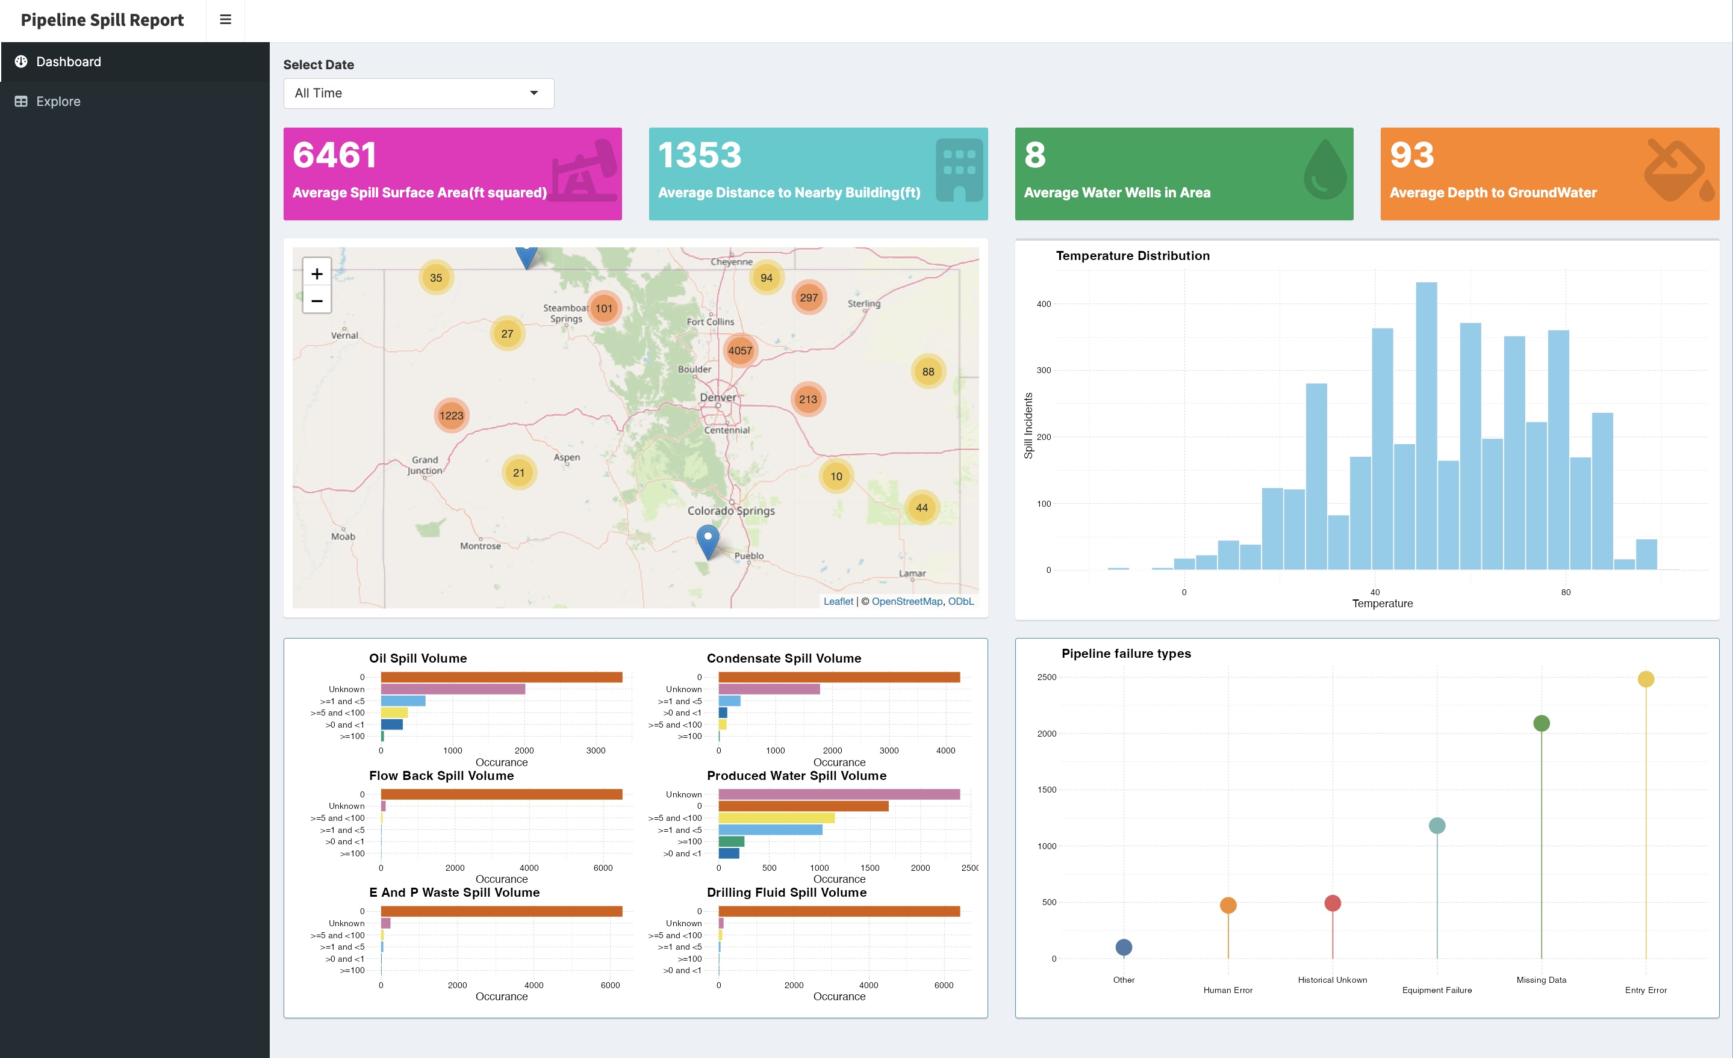
Progress Made
Notes:
From the last 5 years

Slide 8
Future Work
START MODELING (finally)
Methodology: Logistic Regression, Support Vector Machine (SVM), K Nearest Neighbors (K-NN), Gradient Boosting Decision Trees, AdaBoost, Random Forests

