Slide 1
GIS and Machine Learning for Predicting Pipeline Spills
Isabella Chittumuri
Department of Applied Mathematics and Statistics, CSM
Qualifying Exam
October 11, 2024

Slide 2
Agenda
Overview
The Problem
Industry
Conclusion
Notes:
- Intro to GIS data and ML models
- A brief introduction to GIS data structures, focusing on raster data, and explaining how machine learning models integrate with these data types to perform spatial analysis
ML models w/ vector data
An explanation of why machine learning models struggle to work with vector data, highlighting the limitations and challenges of applying ML algorithms to vector-based spatial datasets.
Petroleum example using GIS/ML
A summary of a paper from the petrochemical industry, showcasing how vector data has been used in conjunction with ML models to address a specific problem in resource management or exploration.
Summary of the problem and research plan
A recap of the challenges in applying ML to vector data, what has been done so far, and an outline of your proposed research direction to overcome these limitations in your own work.

Slide 3
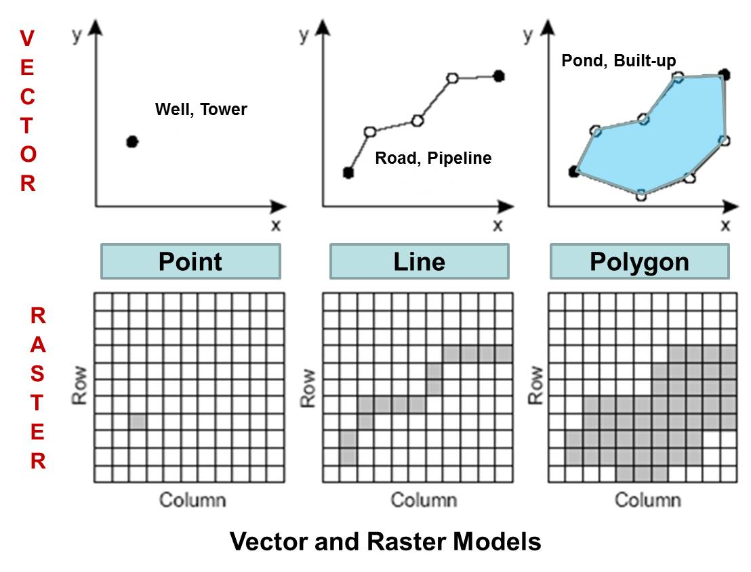
Overview: Definitions
Geographic Information System (GIS)
GeoDataFrame
Notes:
- Geographic Information System (GIS) is a computer system that analyzes and visualizes geographically referenced information
- GIS helps in integrating various forms of spatial data and analyzing geographic patterns and trends.
- GeoDataFrame is a data structure that extends a typical DataFrame by allowing for the storage and manipulation of geometric data (points, lines, polygons) along with features
- Vector Data:
Represents geographic features as points (e.g., cities), lines (e.g., roads), and polygons (e.g., boundaries).
Collection: Often derived from ground truthing, field surveys, GPS tracking, or manually digitized data from maps.
- Raster Data:
Represents the world as a grid of pixels.
Each pixel contains a value representing an attribute, like elevation, temperature, or land cover.
Commonly used in remote sensing and satellite imagery.
Comparison
Raster: Good for continuous data (e.g., elevation, temperature).
Vector: Best for discrete, precise features (e.g., infrastructure, boundaries, survey data).
Difference in Usage: Vector data is often more accurate (ground-truth data), while raster data provides broader and often automated coverage.

Slide 4
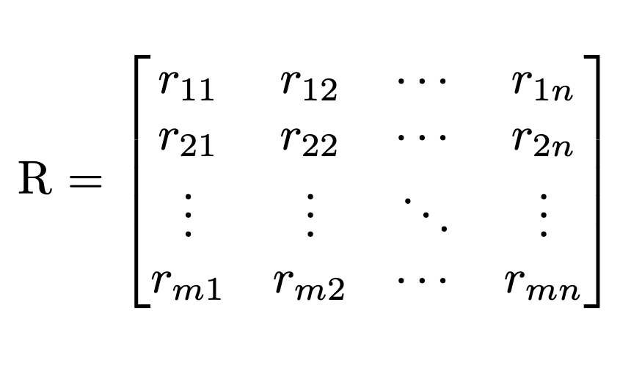
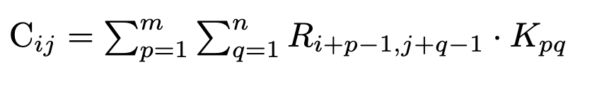
Overview: GIS/ML Compatibility
Raster Data Grid Structure
Convolutional Operation
Notes:
- Raster data can be thought of as a matrix or a grid, where each cell (pixel) has a value. Let’s assume a raster image with dimensions M×NM \times NM×N. This can be represented mathematically as the image
- Here, r_ij​ is the value at pixel (i, j). Each pixel can represent a piece of information such as land cover, temperature, or elevation.
For machine learning models, particularly in image recognition tasks, this grid format works well because:
Each pixel r_ij can be treated as an independent feature or input into the ML algorithm.
Convolutional neural networks (CNNs) can apply filters across this matrix, allowing for the automatic detection of patterns like edges, corners, or textures.
2. A typical convolution operation used in CNNs slides a kernel (filter) over the raster image. If we represent the kernel as K, with dimensions m×nm \times nm×n, the convolution operation for pixel (i, j) looks the the equation on the right
- This equation sums up the weighted pixel values in the neighborhood defined by the kernel, which is directly feasible for raster data since it’s structured as a matrix.

Slide 5
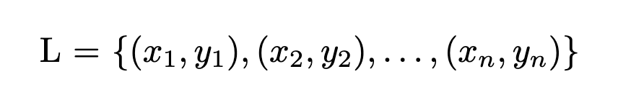
The Problem
Vector Data: Irregular Geometries
e.g. Line data as a series of points
Notes:
Vector data, on the other hand, consists of points, lines, and polygons that are stored as coordinates. This makes it much more difficult to fit into standard ML models designed for regular, grid-like input.
A line in vector data is represented as a series of connected points with coordinates (x1,y1)(x2,y2)

Slide 6
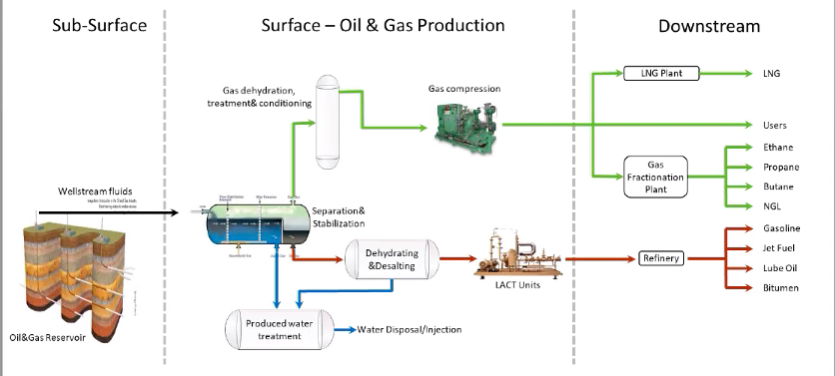
Background
Notes:
Oil and gas wells produce oil, natural gas, and water
Flowlines transport the mixture from wellheads to surface facilities
Pipelines carry separated products (oil, gas) to destinations like refineries.
Flowlines are buried to prevent freezing and maintain integrity.
The transition from flowline to pipeline at the Lease Automatic Custody Transfer (LACT) unit where products are handed over to companies like Chevron for further processing.
American Petroleum Institute (API) sets standards for flowline materials and construction.

Slide 7
Partner
Colorado Energy and Carbon Management Commission (ECMC)
Regulate Colorado's oil and gas resources
Ensure protection of public health, safety, and environment.
Implement regulations to minimize environmental and public impacts
Notes:
Formally known as Colorado Oil and Gas Conservation Commission (COGCC)

Slide 8
Research Goals
Innovative use of GIS and machine learning for risk analysis
Aim to mitigate environmental impacts and prevent casualties
Critical need for more detailed flowline failure data
Notes:
Flowline failures pose environmental and safety risks

Slide 9
Progress Made
Literature Review
Short internal report on data needed
Data cleaning and exploratory data analysis
Notes:
Understand what kind of parameters we need such as reason for spill, we only have descriptive stats
Report for ECMC about what kinds of data we need such as reason for spill
Data cleaning: no unique identifier, connect through longitude and latitude, one-to-many relationships as in their can be many failures within one flowline segment

Slide 10
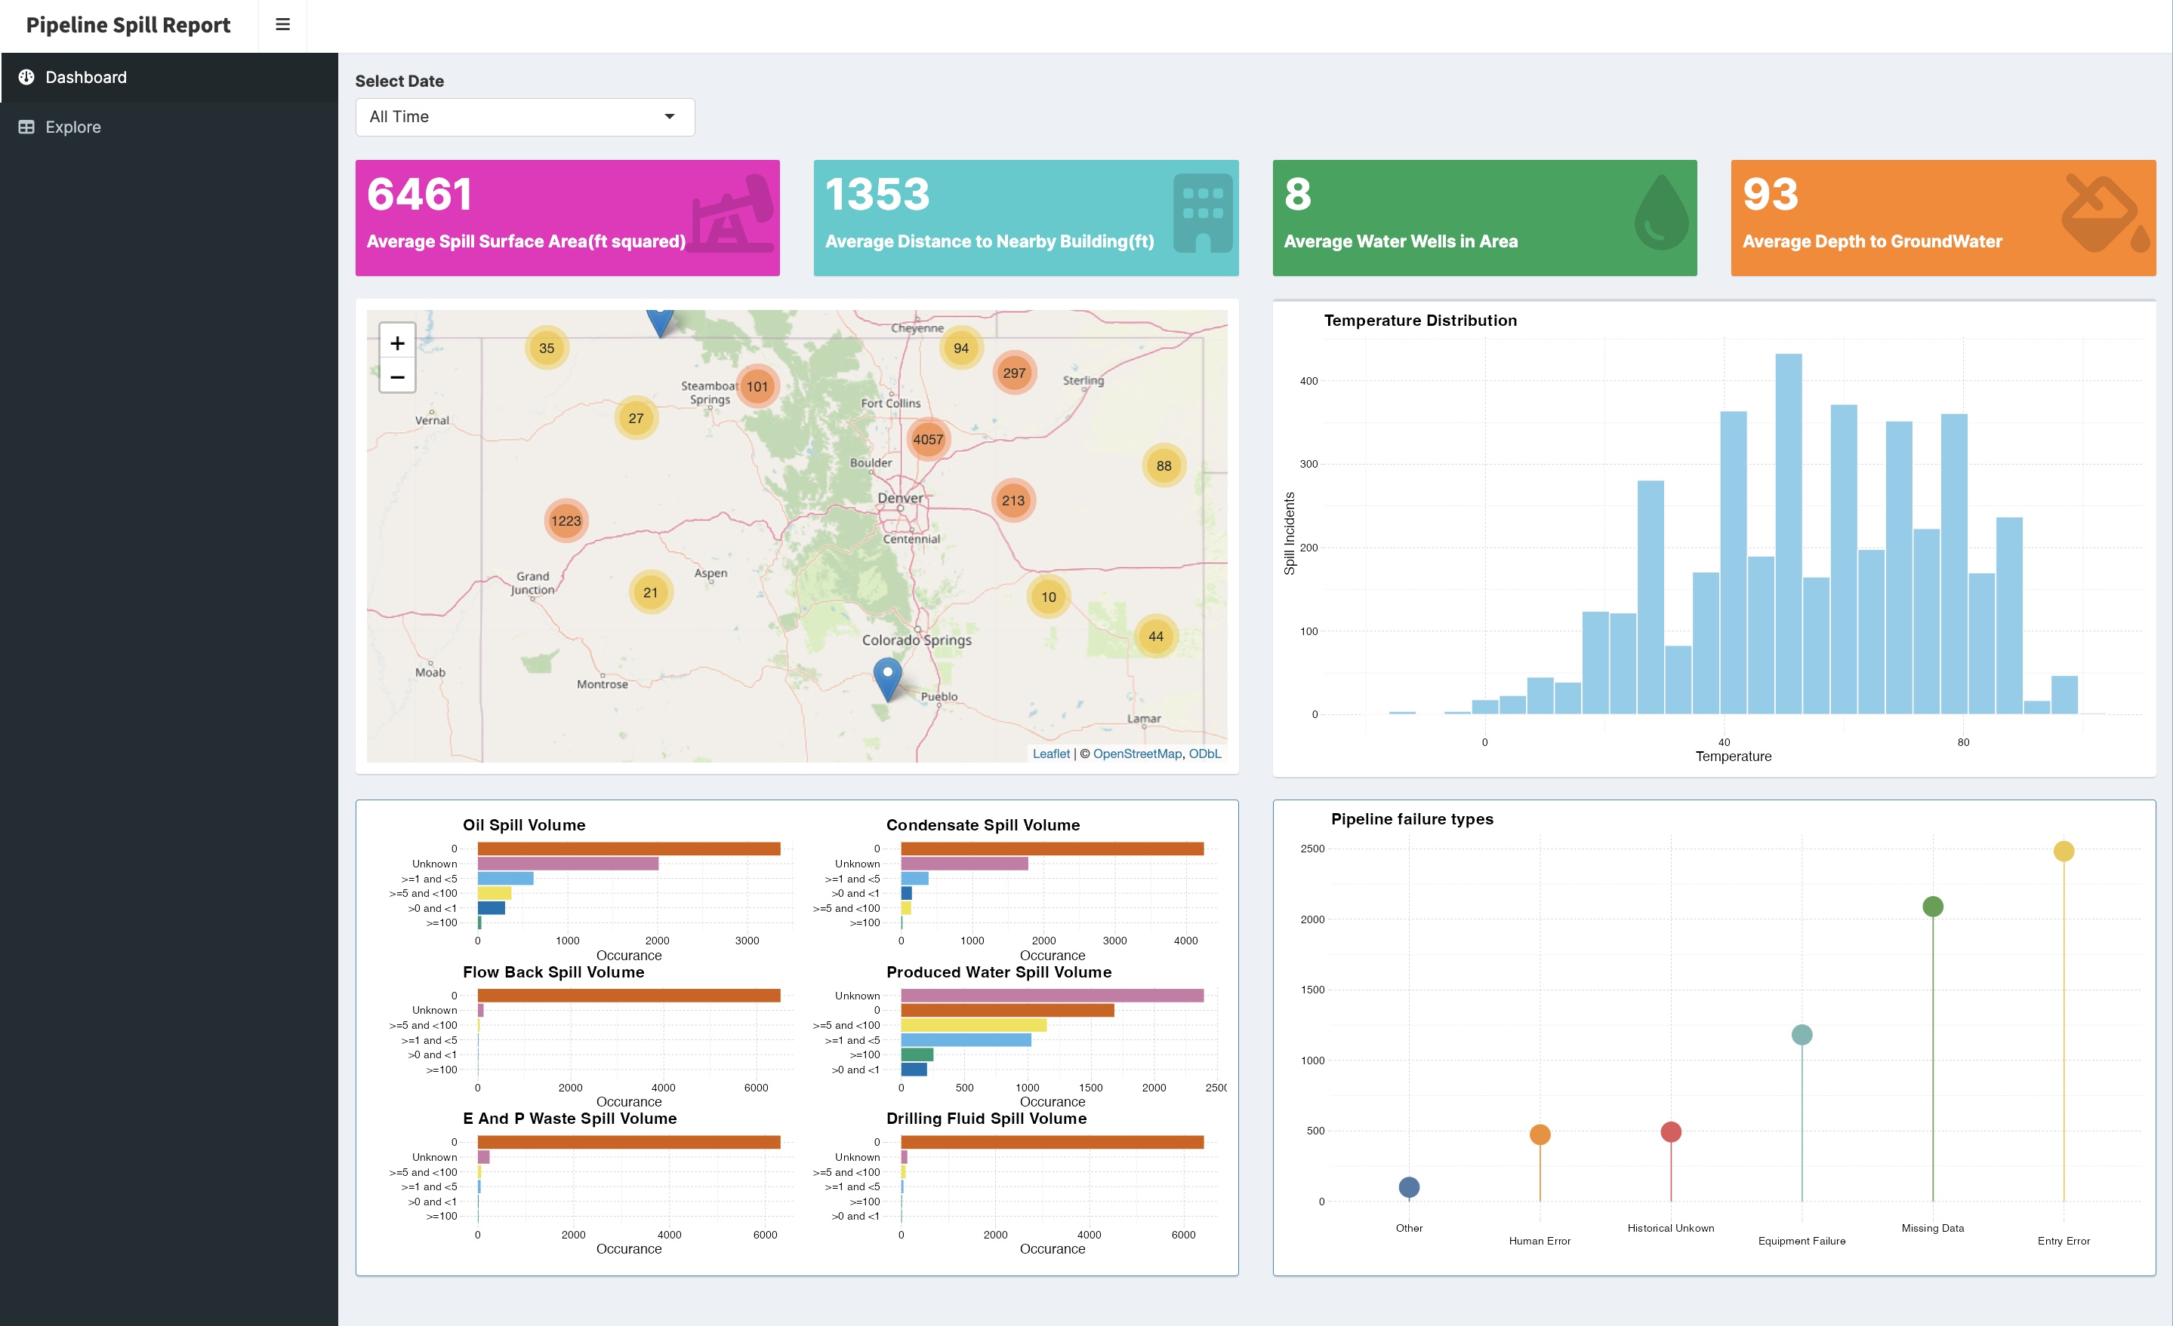
Progress Made
Notes:
From the last 5 years

Slide 11
Future Work
START MODELING (finally)
Methodology: Logistic Regression, Support Vector Machine (SVM), K Nearest Neighbors (K-NN), Gradient Boosting Decision Trees, AdaBoost, Random Forests

