Slide 3
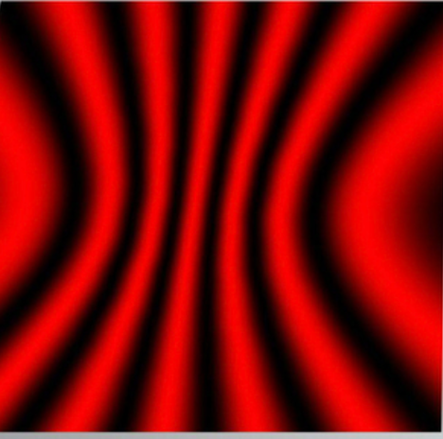


C
D
$$λ_{0}$$
$$λ_{0}$$
Interference fringes
Photoresist
Substrate

