Slide 1
Production planning by MRP at finite capacity

Slide 2
INTRODUCTION
Manufacturers always need to innovate and pay attention to optimizing their business organization and take urgent decisions to keep the cost down, thus increasing the profit margin. Researchers also play their part in keeping their solutions efficient and up-to-date.
In this context the most common production planning method in the industry is materials requirements planning (MRP) , but it is not flawless. We noticed that the MRP algorithm does have a major flaw that it does not take into account the production capacity. We will suggest other methods that could be used alongside MRP to fill in its gaps and establish the best production plan.

Slide 3
Material Requirements Planning
Material requirements planning (MRP) is a system for calculating the materials and components needed to manufacture a product.

Slide 4
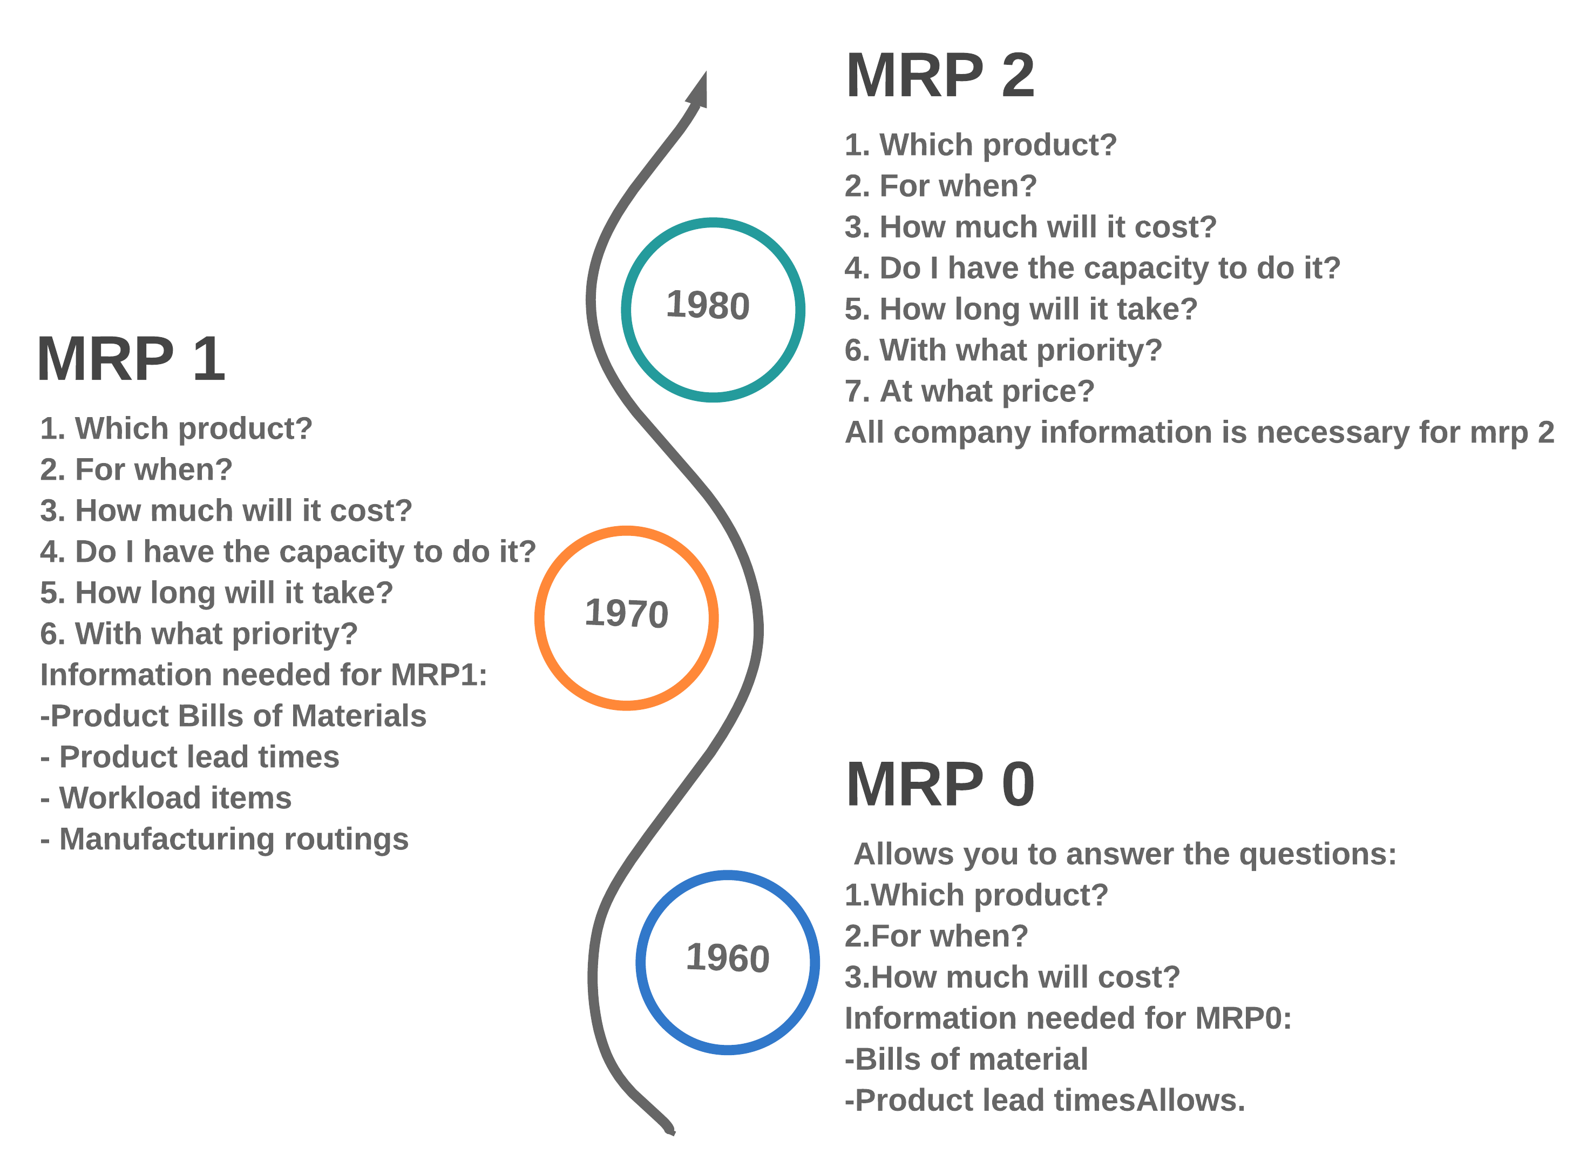
Material Requirements Planning History

Slide 5

Material Requirements Planning History
MRP-0
Allows you to answer the questions:
Which product?
For when?
How much will it cost?
Information needed for MRP0:
Bills of material
Product lead time allowed.

Slide 6

Material Requirements Planning History
MRP-1
Allows you to answer the questions:
Which product?
For when?
How much will it cost?
do I have the capacity to do it?
How long will it take?
Information needed for MRP1:
Product Bills of Materials
Product lead times
Workload items
Manufacturing routings

Slide 7

Material Requirements Planning History
MRP-2
Allows you to answer the questions:
Which product?
For when?
How much will it cost?
do I have the capacity to do it?
How long will it take?
With what priority
At what price?
All company information is necessary for MRP 2

Slide 8
The Logic Of MRP
The planning goal is described a production plan for a time scale defined by a planning horizon and a refresh period. A production plan answers the following questions .

Slide 9
The Logic Of MRP
What to produce?
01
When to produce?
02
How much to produce ?
03

Slide 10
MRP Steps
There are different levels of industrial planning which can be broken down into successive stages over time .

Slide 11
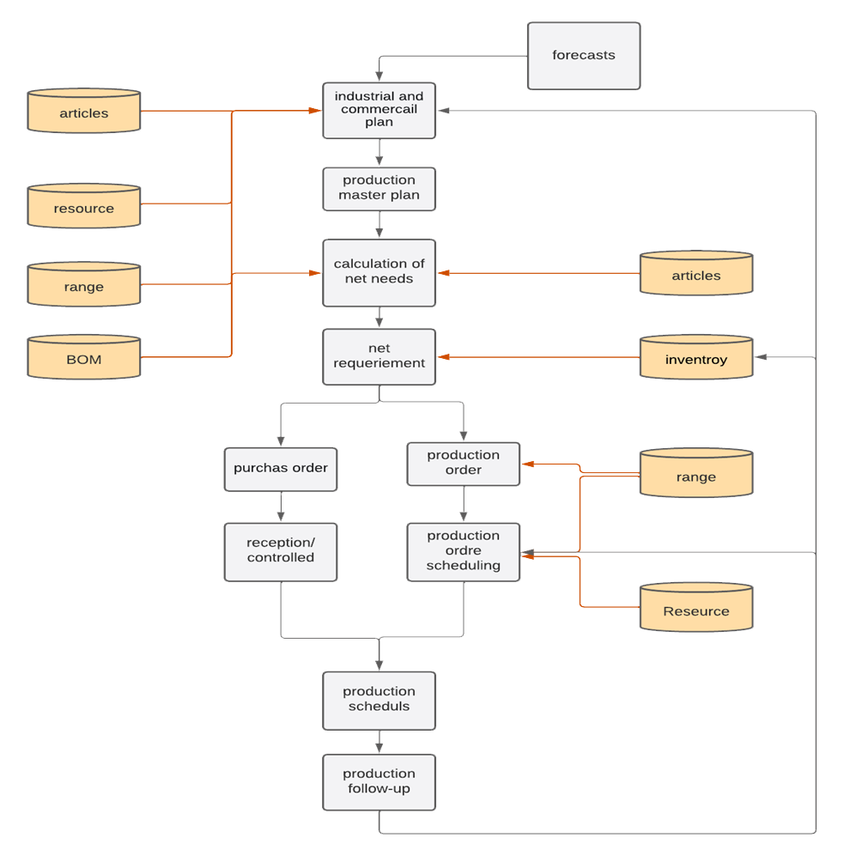

Slide 12
Production Capacity Planning
CRP role is determining the capacities necessary to carry out a production operation. Indeed, from firm and planned manufacturing orders.
The CRP can calculate the load caused by these orders on the resources of a workshop by simulating their execution.

Slide 13
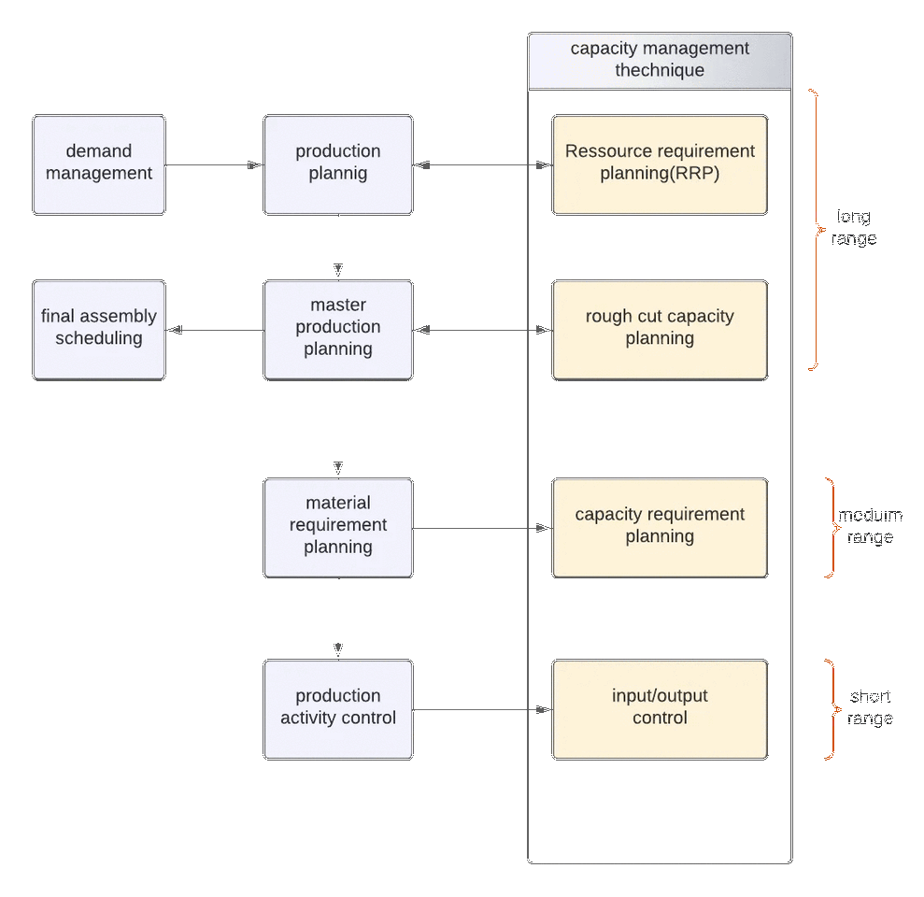

Slide 14
Resource Requirements Plans
The first phase of capacity management involve looking forward in the long term to predict the requirements for large structural parts of the operation, such as the numbers, locations and sizes of new plants.
This process is similar to MRP Except, that instead of planning the needs in components, we planned the needs in human resources, materials, and financial resources necessary to the realization of the production plan (PMP).

Slide 15
Validating The Production Plan
Rough-cut capacity plans (RCCPs) – are used in the medium term, to check the master production schedules against known capacity bottlenecks, in case capacity constraints are breached.
The feedback loop at this level only checks the MPS and key resources there are three MPS validation techniques which are grouped under the term Rough Cut Capacity Planning.

Slide 16
Validating The Production Plan
Capabiliy sheet approach
This approach corresponds to the resource profile approach but at this level, products are treated by reference.
Approach by resource profile
This method is based on a production plan and resource profiles established for each product
This method is particularly well adapted to workshops manufacturing products of the same family
Capacity Planning Using Overall Factors

Slide 17
Capacity Requirements Plans
CRP role is determining the capacities necessary to carry out a production operation. Indeed, from firm and planned manufacturing orders. The CRP is able to calculate the load caused by these orders on the resources of a workshop by simulating their execution.

Slide 18
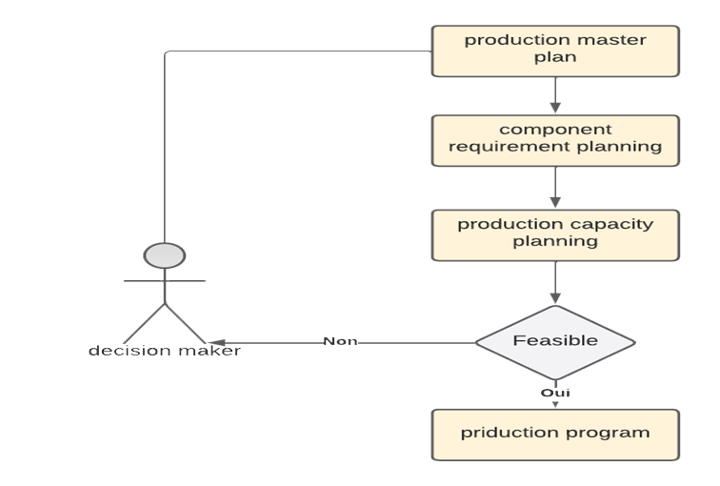
Capacity Requirements Plans

Slide 19
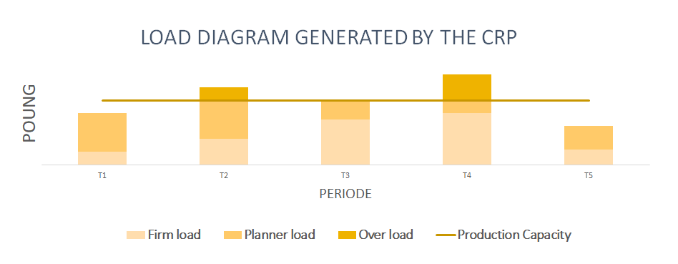
Capacity Requirements Plans

Slide 20
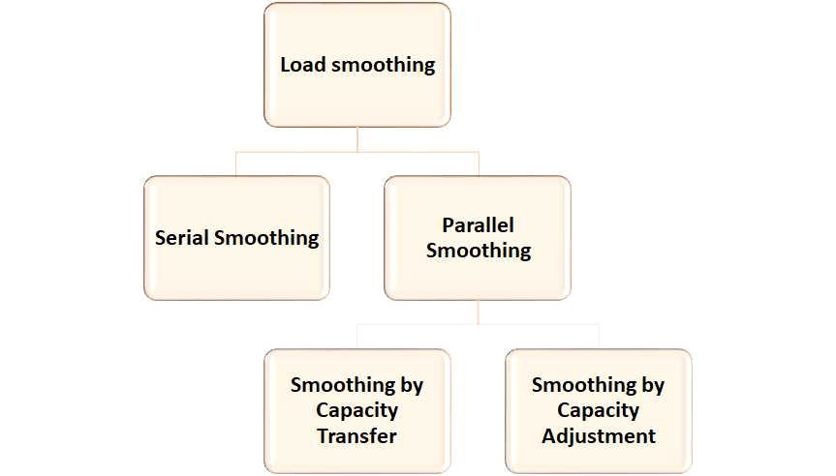
Load Smoothing Techniques

Slide 21
Conclusion
We conclude that the MRP method works and raises its main flaw, namely the failure to take production capacity into account when developing the schedule. However, there is a number of methods that can be used to plan production capacity requirements at different times during the production of the MRP system. These methods cannot guarantee that there will be no overflow. Therefore, there are load smoothing techniques that can be applied to the MRP results in an attempt to eliminate temporary overflow issues. This type of process only appeared with MRP-2.

Slide 22

References
Scan This code for more informations

Slide 23
THANK YOU FOR ATTENTION

