Slide 1
NURTURING ELEMENTARY TEACHERS’ WORK (NETWORK) THROUGH AN ONLINE LEARNING COMMUNITY
Debi Hanuscin, Physics Education
I-Chun Tsai, SISLT

Slide 2
A Professional Continuum
Reforms describe a continuous, career-long process of learning in which teachers have regular, sustained opportunities to engage in inquiry, knowledge acquisition and integration, reflection, and collaboration (NRC, 1996; NCTM, 2003).
Researchers recognize a professional continuum of learning that spans preservice teacher education, induction of beginning teachers, and continued professional development (e.g., Feiman-Nemser, 2001).

Slide 3
A Professional Continuum
Preservice Education | Induction Years | Continuing Professional Development
Examine beliefs critically in relation to vision of good teaching | Learn the context- students, curriculum, and school community | Extend and deepen subject matter knowledge for teaching
Develop subject matter knowledge for teaching | Design a responsive instructional program | Extend and refine repertoire in curriculum, instruction, and assessment
Develop an understanding of learners, learning, and issues of diversity | Create a classroom learning community | Strengthen skills and dispositions to study and improve teaching
Develop a beginning repertoire | Enact a beginning repertoire | Expand responsibilities and develop leadership skills
Develop the tools and dispositions to study teaching | Develop a professional identity

Slide 4
The Problem
As Goodlad (1990) describes, there is a general lack of collaboration and connectedness between schools of education and K-12 education.
Universities typically regard preservice preparation as their task, with responsibility of new teacher induction resting with schools (Feinman-Nemser, 2001).
In particular, the science teacher education continuum has been criticized as “a fractured system, lacking both continuity and accountability” (Kahle & Kronebusch, 2003 p.585).

Slide 5
The Induction Years
During induction, for example, novice teachers are often overwhelmed with the number of duties and responsibilities that are part of the teaching job (Kagan, 1992; Fessler & Christensen, 1992; Huberman, 1993) and the feelings of isolation that characterize teaching alone for the first time (Holt-Reynolds, 1995).
Not only must they focus on translating subject matter into pedagogical content knowledge, they must also adjust to a new culture (Kahle & Kronebusch, 2003). This can discourage new teachers from attempting ambitious pedagogies (Feinman-Nemser, 2001).

Slide 6
CHALLENGES FOR TEACHER EDUCATION
Teacher education programs “prepare students for the best of all non-existent worlds and then toss them into public schools where, quite frequently, the antithesis of everything the university program is trying to teach is an accepted, operating norm” (Haberman, 1988, p.1).
Rather than implementing reform-based practices, novice teachers “adopt ways of thinking and acting that [place] them in harmony with the existing occupational culture” (Schempp, Sparkes, & Templin, 1993, p.448).
Fieman-Nemser argues teacher ed programs are a “weak intervention compared to the influence of teachers’ own schooling and their on-the-job experience” (2001, p. 1014).

Slide 7
The Role of Teacher Educators
What do you currently do to support your former students as they enter the induction years of their teaching career?
  On your own?
  As part of the Teacher Development Program?

Slide 8
How would you respond?
What should a teacher do when a parent criticizes everything sent home? What do you do when the parent does the homework for the student and when a student misses an answer the parent says the teacher is wrong? This causes the student to not listen to the teacher and the student might start misbehaving. I am concerned on what to do when a parent emails or calls criticizing everything the teacher does?
Generate a response on your own.
Share and discuss your responses at your table.

Slide 9
Genesis of the “NETwork”
Dr. Hanuscin has kept in touch via email with former students dating back to 1999.
These students email her with questions and concerns, as well as requests for specific resources.
Often, individuals have similar questions, concerns, and/or requests.
She had worked (as a graduate student) on the Inquiry Learning Forum (ILF), a virtual site to support math and science teachers in Indiana, and thought that might be a way to support communication among new teachers.
An email from Dr. Jim Laffey (SISLT) caught her eye…

Slide 10
Interface Design II
SISLT course
As a class project, students are required to develop/design an interactive web environment
Dr. Laffey solicits colleagues for potential projects
Dr. Hanuscin became a “client” who needed to build a virtual space to “Nurture Elementary Teachers’ Work” (NETwork)

Slide 11
Members of the NETwork (06-07)
Teacher Education Program | Preservice Teachers | Student Teachers | Beginning/ Early Career Teachers
Indiana University |  |  | 5
University of Missouri | 66 | 6 | 17
Total Members |  |  | 94

Slide 12
Findings of Pilot Study (WebCT)
  While members were highly motivated to participate in the community, they did not experience a high degree of learning satisfaction while using the WebCT tools
  While prospective teachers did not experience a high level of satisfaction with the site, they did perceive usefulness for the site in their future student teaching and classroom teaching experiences

Slide 13
Findings of Pilot Study (WebCT)
Social interaction within the site was limited to some degree by the functionality of available tools within WebCT; members expressed frustration and provided suggestions for improving the functionality of the space
  Members wanted to know who else was logged in when they visited the site
  Members wanted to be able to identify who was posting (quick link to profile info)
  Members had no clear idea of activities that occurred in the site while they were logged off
  (Tsai & Hanuscin, 2007)

Slide 14
SAKAI
A free and open source product that is built and maintained by the Sakai community. Sakai’s development model is called “community source” because many of the developers creating Sakai are drawn from the “community” of organizations that have adopted and are using this online collaboration and learning environment.

Slide 15
Fostering Community through Sakai
CANS (context-aware activity notification system) was developed for Sakai by researchers in the School of Information Science and Learning Technologies
  Emails a digest of recent activity (posts, new resources, chat discussions, etc.)
SOCIAL PRESENCE is enhanced by a window showing who is currently logged in, with special icons next to those who are currently in the chat room
SOCIAL IDENTITY is supported by the use of avatars/photos that appear along with member names, signature options on posts/emails, and direct links to member profiles and private messaging in discussions

Slide 16
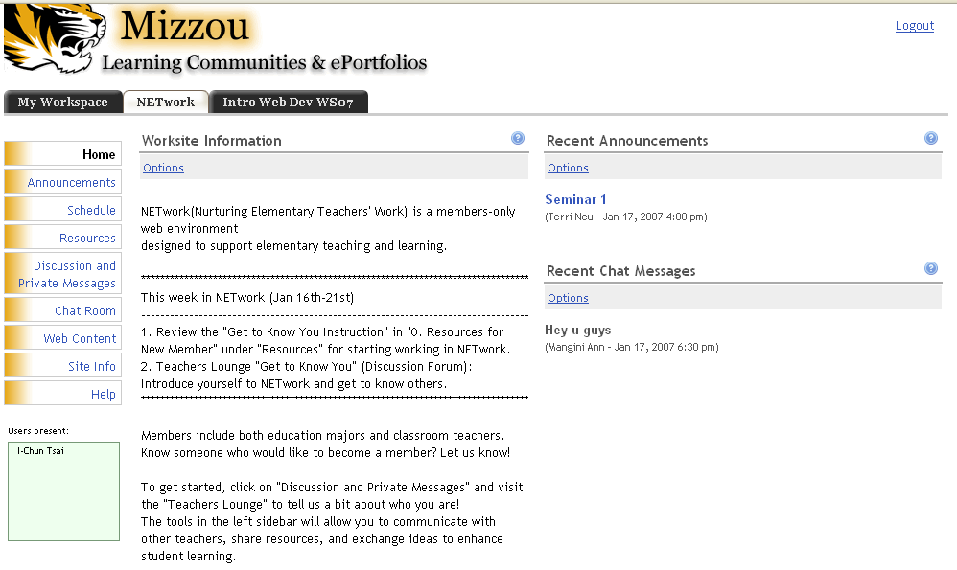
The NETwork in SAKAI

Slide 17
Social Learning Perspectives
Members’ participation and social interaction are primary determinants of a successful community of practice (Lave & Wenger, 1991).
Previous studies found it is challenging and difficult to sustain members’ interaction and participation in online communities of practice (Rovai, 2002).
  Insufficient physical awareness information
  Technology usage

Slide 18
Social Constructs
Sense of Community:
McMillan and Chavis (1986) define sense of community as “a feeling that members have of belonging, a feeling that members matter to one another and to the group, and shared faith that members’ needs will be met through their commitment to be together”
Social Ability:
Social ability represents the ability of members to use resources/tools of the social context to achieve important goals (Laffey, Lin, & Lin, 2006).
Technology acceptance is considered as a primary factor influencing members’ social interaction in online learning environment.
  Students’ intention of applying technologies impacted their appropriation behavior in online learning environment. (Lin, 2005)
  Students’ perceived ease of use of online tools has direct impact of their social ability and perceived usefulness is found to have influence on sense of community. (Tsai, et. al., 2007)

Slide 19
Research Questions
What are the characterizations of member activity that represent different patterns/levels of participating in the community? Are there differences in the patterns/levels of participation for experienced members and new members and for pre-service and in-service teachers?
How do members’ perceptions of sense of community, social ability, perceived ease of use, perceived usefulness, satisfaction with their NETwork experience, and perceptions of the effectiveness of NETwork for supporting teaching change through participating in the community?

Slide 20
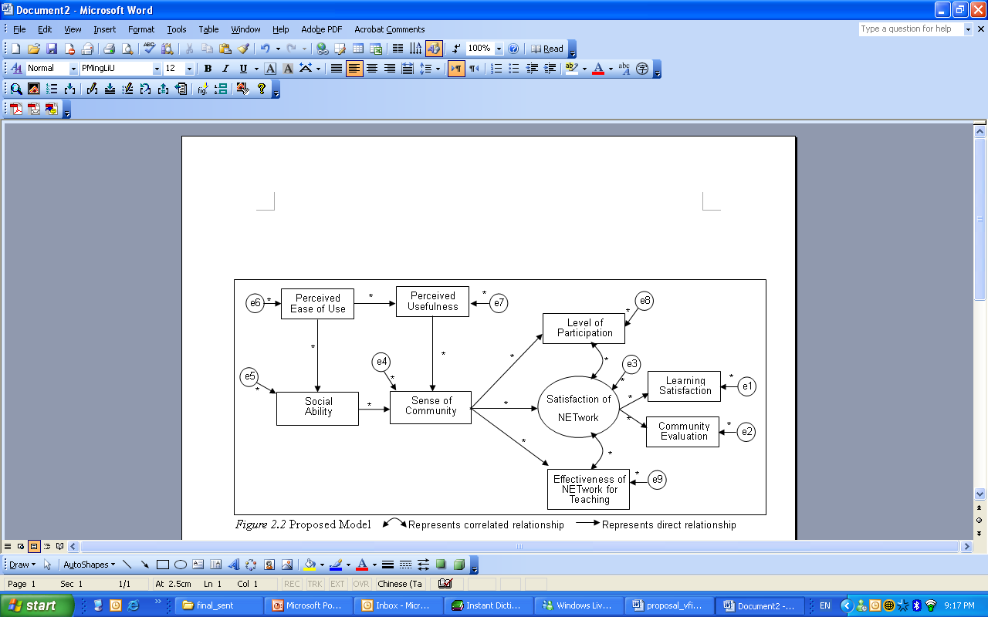
Testing a Model

Slide 21
Participants & Methods
Types of NETwork Members |  |  | Methods
Experienced Members (Since Aug. 2006) | Pre-service Teachers (EPST) |  | Serial Interviews (3 times) : 2 EPST & 2 EIST First Survey: all members Final Survey: all members Semester-end interviews : 2 EPST & 2 EIST CANS data: all members
 | In-service Teachers (EIST)
New Members (Since Jan. 2007) | Pre-service Teachers (NPST) |  | Serial Interviews (3 times) : 2 NPST & 2 NIST First Survey: all members Final Survey: all members Semester-end interviews : 2 NPST & 2 NIST CANS data: all members
 | In-service Teachers (NIST)

Slide 22
Data Analysis
  Analysis of CANS Data:
  Social Network Analysis
  Trajectory [activity log] [trajectory]
  Content Analysis:
  Coding scheme of serial interviews
  Coding scheme of semester-end interview
  Statistic Analysis:
  Descriptive data
  Path Analysis

Slide 23
Level of Participation
Participants | Discussion Board |  | Resources |  | Chat Room
 | posting.new | posting.read | resource.new | resource.read | chat.new
In-service Teachers | 3.67 (11/3) | 13 (39/3) | 0 | 0.67 (2/3) | 94 (282/3) from 2
Pre-service Teachers | 14.54 (480/33) | 83.52 (2756/33) | 1.18 (39/33) | 6.06 (200/33) | 9.97 (329/33) from 10
Total Average | 13.64 (491/36) | 77.64 (2795/36) | 1.08 (39/36) | 5.61 (202/36) | 16.97 (611/36)
Note. 3 in-service teachers and 33 pre-service teachers participated actively.

Slide 24
Preliminary Findings
Pre- and In-service teachers do experience an increase in their teaching confidence when discussing with others who have similar learning and teaching experience.
In-service teachers’ participation influence how the pre-service teachers’ perceptions of the value of the community.
Voluntary & required participation make the value different.
Members’ perceptions of effectiveness of teaching, sense of community, social presence with other members, and social presence with professors can be best understood over the long term.

Slide 25
Questions for Discussion
In what ways does an online collaborative like NETwork bridge the gap between teacher education and induction?
How feasible is an undertaking like the NETwork for an individual faculty member? For a teacher education program? For a content area? For a center?
Is an online collaborative like the NETwork best introduced in the context of a course, or on its own? (voluntary vs. required)

