Slide 1
The Social Nature of an Online Community of Practice for Learning to Teach Elementary Science
I-Chun Tsai
May 1, 2008
Chair: | Jim Laffey
Committee: | Gail Fitzgerald Julie Caplow Deborah Hanuscin Jessica Summers

Slide 2
Rationale of Study I
Previous studies have explored online learning experience not only in courses but also in communities of practice.
The development of internet technology and concept of community of practice offer potential for diminishing the gaps and disconnect among stages of teachers’ professional development. (Feiman-Nemser, 2001)
Although members’ Participation and Social Interaction are primary determinants of a successful CoP. (Wenger, 1998), previous studies found online systems to be effective in supporting the continuum of teachers’ professional development but does difficult to sustain members’ participation and social interaction (Job-Sluder & Barab, 2004; Graay & Tatar, 2004; Roup, et al., 1993).

Slide 3
Rationale of Study II
challenging and difficult to sustain:
  Insufficient physical awareness information
  Technology usage limitations
Researchers have studied the relationships between social constructs and learning in CoP rarely examined all potential social constructs simultaneously although these factors are intertwined and interdependent. (Rovai, 2001, 2002, 2003; Lin, 2005; Picciano,2002)
The previous study examining relationships between social factors and students’ participation have mostly studied online courses. Research is needed for teacher online CoPs. (Tsai, et al., 2008)

Slide 4
Purpose of the Study
to understand the nature of participation, social constructs, and learning in a Community of Practice
to test a model of how well the social constructs of the online community explain the effectiveness of professional development in a community.

Slide 5
Research Context
An online teacher community, NETwork (Nurturing Elementary Teachers’ work), has been in place using the Sakai course management system to support K-8 science teaching since August 2006.
The purpose of NETwork at the University of Missouri is to overcome the current disconnection between pre-service teacher education and in-service teaching practice and to provide pre-service and in-service teachers a collaborative learning environment.

Slide 6
Research Context- NETwork Members
NETwork Members |  | N | Membership | Status
Pre-service Teachers | TDP | 33 | Since Aug. 06 | Finished first-semester field experience courses and taking second-semester field experience courses [PO]
 |  | 5 | Since Aug. 06 | Student Teaching in Schools [PO]
 |  | 30 | Since Jan. 07 | Taking first-semester field experience courses [PN]
In-service Teachers |  | 17 | Since Aug. 06 | Teaching in schools [IO]
 |  | 7 | Since Jan. 07 | Teaching in schools [IN]
Total |  | 92

Slide 7
Research Context- NETwork Activity
Learning Activities |  | Primary Participants
DB Discussion (p.87) | Field Experience Weekly Discussion (Required) | Pre-service teachers who were taking field experience courses
 | Extended Class Discussion (Required/ Not Required) | Pre-service teachers who were taking field experience courses
 | NETwork Discussion Topic (Not Required) | All NETwork members
 | General Discussion (Not Required)
CR Discussion | Chat Room Discussion- hosted by Professors (Not Required)
Resources Sharing | General Resources sharing (Not Required)
 | Course work sharing by pre-service teachers (Not Required) | Pre-service teachers who were taking field experience courses

Slide 8
Research Questions 1
How do members participate in the primary learning activities through Chat Room discussion, Discussion Board discussion, and information sharing in Resources?
  1a. What are the characterizations of member activity that represent different levels of participating in the community, and to what extent did members participate?
  1b. What are the characterizations of member activity that represent different patterns of participating in the community? Are there differences in the patterns of participation for experienced members and new members and for pre-service and in-service teachers?
Data Analysis for RQ1

Slide 9
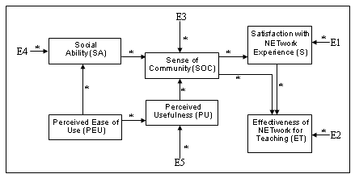
Research Questions 2
How well does the proposed model explain the relationships among the social constructs of online learning (i.e. sense of community, social ability, perceived ease of use, perceived usefulness) and explain community outcomes/effects (satisfaction with NETwork experience and effectiveness of NETwork for Teaching)?
Data Analysis for RQ2

Slide 10
Research Questions 3
How do members’ perceptions (sense of community, social ability, ease of use, usefulness, satisfaction with their NETwork experience, and of the effectiveness of NETwork for supporting teaching) change through participating in the community?
Data Analysis for RQ3

Slide 11
Research Methods & Participants
NETwork Members |  | N | CANS; DB&CR Content | Serial Interviews | Semester-end Interviews | First Survey | Final Survey
Experienced Members (Since Aug. 2006) | Pre-service Teachers (PO) | 38 | All | 2 | 2 | 25 | 32
 | In-service Teachers (IO) | 17 | All | 1 | 2 | 2 | 4
New Members (Since Jan. 2007) | Pre-service Teachers (PN) | 30 | All | 2 | 4 | 23 | 30
 | In-service Teachers (IN) | 7 | All | 0 | 0 | 0 | 0
Total |  | 92 | All | 5 | 8 | 50 | 66
Time for Participation |  |  | During Spring 2007 |  | End of the Spring 2007 | 5th week of the Spring 2007 | End of the Spring 2007

Slide 12
Data Collection & Data Analysis
Data Collection |  |  | Analysis Strategies | Answered RQ
Serial Interviews |  | Content Analysis: coding schemes based on CoP framework & concepts |  | RQ1b, RQ3
Semester-end interviews |  |  |  | RQ1b, RQ3
First Survey Data |  | Correlation Analysis & Path Analysis; Dependent-sample t tests |  | RQ2*, RQ3*
Final Survey Data
CANS Data |  | Descriptive Statistics, SNA, & Visualization techniques |  | RQ1a*, RQ1b*
Discussion Content | DB | Content Analysis: Coding Schemes based on CoP framework & IAM |  | RQ1b,
 | CR
RQ1

Slide 13
Data Analysis for RQ1
Analysis Techniques |  | Login | DB 3 Conditions |  |  | RS | CR
 |  |  | Entire DB | FE & NETwork only | NETwork only
RQ1a: Levels of participation | CANS Data: a set of Trajectories and descriptive statistic results of members’ participation levels across time | X | X | X | X | X | X
RQ1b: Patterns of participation | CANS Data: SNA Diagrams; a set of Statistic Parameters; a set of Trajectories and descriptive statistic results of members’ participation patterns across time | X | X | X | X | X | X
 | Content Analysis for DB & CR discussion content |  | X | X | X |  | X
 | Content Analysis for serial interviews & semester-end interviews |  | X | X | X | X | X

Slide 14
Results & Discussion for RQ1
Members’ levels and patterns of participation were different across time, tools, and member types, which were influenced by the norms, policies, and practices of the community.
Members’ identity and levels of participation are reciprocally associated, illustrating how members’ identities are formed via participation and non-participation in a community of practice (Wenger, 1998).
There were similarities and differences in members’ usage of CMC tools, including discussion board, chat room, resources, social presence box, and daily email digest. Members showed growth of their knowledge and skills for teaching via mutual engagement, creating joint enterprise, and establishing shared repertoire supported by CMC tools.
Lack of time influences members’ levels of participation.
RQ1
RQ2
Table 4.1.28
Table 4.1.29

Slide 15
Data Analysis for RQ2
Data Analysis |  | Variables
Path Analysis | A. Develop initial path model based on the proposal model B. Construct and examine the final path model | Proposed Model: PEU, PU, SA, SOC, S, and ET
 | A. Explore further relationships among social ability’s sub-constructs and other social constructs | Set1: PEU, PU, SN, SPi, SPp Set2: SN, SPi, SPp, SOC, S

Slide 16
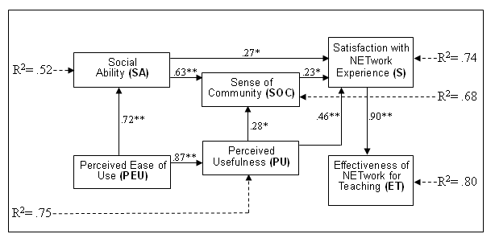
Results & Discussion for RQ2
The final model uses SOC, SA, PEU, and PU to explain 74% and 80% respectively of variance in members’ satisfaction with NETwork experience and effectiveness of NETwork for Teaching.

Slide 17
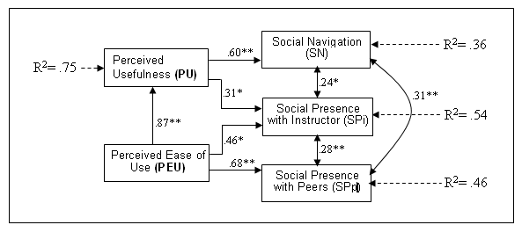
Results & Discussion for RQ2
Members’ PU was found to significantly explain the variance of SN and SPi.
Members’ PEU directly impact their SPi and SPp.
Members’ PEU did not directly impact SN but mediated by PU.

Slide 18
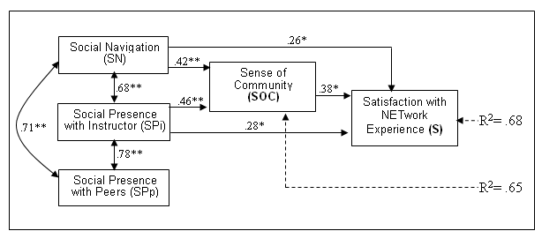
Results & Discussion for RQ2
Members’ perceptions of SN and SPi directly explain SOC and S, but members’ perceptions of SPp didn’t.
SOC was not a mediator for the relationships between any sub-constructs of social ability to S.
RQ2
RQ3

Slide 19
Data Analysis for RQ3
Analysis Stages | Explanations | Variables
Content Analysis | Content Analysis for serial and semester-end interviews | n/a
Dependent- samples T Tests | The relationships among social constructs were identified by examining if the correlation coefficients show the significant correlations between each two factors. | IV: Time- week 5 v.s. week 15 (data from first survey and final survey) DV: PEU, PU, SA, SOC, S, & ET

Slide 20
Results & Discussion for RQ3
Members’ perceptions of social constructs of online learning significantly changed after participating in NETwork activities. However, members’ perceptions of some social constructs might need longer time to measure the differences.
  When examining changes in all pre-service teachers’ perceptions of social constructs, significant changes were found in perceptions of SN, PEU, PU, & S after participating in NETwork (refer to Table 4.3.8, p.252).
  In comparing new members with old members, pre-service teachers/new members showed significant changes in their perceptions of PEU & PU (refer to Table 4.3.4, p.246), while pre-service teachers/old members showed significant changes in their perception of SN, PU, S, & ET (refer to Table 4.3.6, p.249).
  Evidence of changes in perceptions of pre-service teachers/old members’ when examining changes from first and post surveys implemented in Fall2006 to the final survey conducted in Spring 2007 suggests that change in some social constructs (i.e. SOC, ET, SA) may should be looked at over longer time periods than just one semester (refer to Table 4.3.16, p.263).

Slide 21
Results & Discussion for RQ3
After participating in NETwork activities, members expressed the effectiveness of participating in NETwork for their current or future in-school teaching.
  Although members’ perception of effectiveness of NETwork for teaching and sense of community did not show significant changes in the quantitative data, members who participated in serial and final interviews expressed the effectiveness of NETwork for their current and future teaching and reported about changes in their sense of community which came from interacting with others in DB or CR.

Slide 22

Thank You….
Suggestions & Questions

Slide 23
Results & Discussion for RQ1 (Table 4.1.28)
Included Discussion Activities |  | Nov 06 | Dec 06 | Jan 07 | Feb 07 | March 07 | April 07 | May 07
Login Frequency |  | n/a | n/a | 102 |  85 |  69 |  78 |  43
DB: Posting Activity | Entire DB discussion | n/a | n/a | 11.3 |  21.4 |  17.3 |  12.5 |  1.6
 | FE & NETwork Only | n/a | n/a | 4.2 |  13.0 |  10.0 |  4.7 |  1.4
 | NETwork Only | n/a | n/a | 2.8 |  9.3 |  7.3 |  3.6 |  0.9
DB: Reading Activity | Entire DB discussion | n/a | n/a | 54.1 |  396.4 |  312.4 |  214.9 |  47.9
 | FE & NETwork Only | n/a | n/a | 6 |  152.9 |  179.8 |  94.8 |  41
 | NETwork Only | n/a | n/a | 3.4 |  101.2 |  120.3 |  64.3 |  25.9
RS: Reviewing Activity |  | n/a | n/a | 13.1 |  14.6 |  8.0 |  22.1 |  4.7
RS: Uploading Activity |  | 1.06 |  .13 |  0 |  0 |  0 |  .16 |  .14
CR Chatting Frequency |  | n/a | n/a | 3.8 |  4.0 |  1.5 |  0.2 |  0
Results & Discussion for RQ1

Slide 24
Results & Discussion for RQ1 (Table 4.1.29)
Included Discussion Activities |  | PN | PO | IN | IO
Login Frequency |  | 292.4 (1) | 14.1 (3) | 9 (4) | 35.3 (2)
Posting Activity | Entire DB discussion | 54.4 (1) | 2.8 (3) | 0 (4) | 10 (2)
 | FE & NETwork Only | 27.7 (1) | 2.2 (3) | 0 (4) | 10 (2)
 | NETwork only | 19.6 (1) | 2.0 (3) | 0 (4) | 9.0 (2)
Reading Activity | Entire DB discussion | 909.5 (1) | 40.3 (3) | 13.5 (4) | 176.0 (2)
 | FE & NETwork Only | 401.3 (1) | 42.8 (3) | 13.5 (4) | 171.7 (2)
 | NETwork only | 260.1 (1) | 40.6 (3) | 13.5 (4) | 141.7 (2)
RS: Reviewing Activity |  | 49.9 (1) | 15.3 (2) | 5 (3) | 4 (4)
RS: Uploading Activity |  | 0.2 (2) | .97 (1) | 0 (3) | 0 (3)
CR Chatting Frequency |  | 7.2 (2) | 26 (1) | 0 (4) | 1 (3)
Results & Discussion for RQ1

Slide 25
Literature Review I
Sense of Community (SoC) & Social Ability (SA) are two critical factors influencing members’ levels of participation and social interaction (Rovai, 2003; Laffey et. al., 2006).
  Students with higher SoC tend to have more information exchange, satisfaction, and collaboration. (Wellman, 1999; Tinto, 1993; Scott, 2004)
  Students perceived higher social presence tend to have higher assignment scores. (Picciano, 2002)
  SA was a significant predictor for students’ online learning satisfaction. (Lin et. al., 2006)
  When SoC is a mediator for the relationship between SA and students’ online learning satisfaction. (Tsai, et. al., 2007)

Slide 26
Literature Review II
Technology acceptance is considered as a primary factor influencing members’ social interaction in online learning environment.
  Students’ intention of applying technologies impacted their appropriation behavior in online learning environment. (Lin, 2005)
  Students’ perceived ease of use of online tools has direct impact of their SA and perceived usefulness is found to have influence on SoC. (Tsai, et. al., 2007)

Slide 27
Literature Review III- Studies in Teachers’ CoPs
Tapped In (Gray & Tatar, 2004)
  Members seek for ideas and colleague outside of their local practice.
  Level of participation: login times
  Changes of participation pattern is shown by comparing login times across years, case study of a particular member, & content analysis.
ILF (Job-Sluder & Barab, 2004)
  Video-based lessons provide members with opportunities for observing and discussing how to teach with inquiry-based strategies.
  Level of participation: login times & number of postings
  Teachers’ reflection: analyze content of postings
  Changes of participation pattern is shown by comparing login times & numbers of postings across years.

