Slide 1
Netconf AND Ansible
Here is where your presentation begins

Slide 2
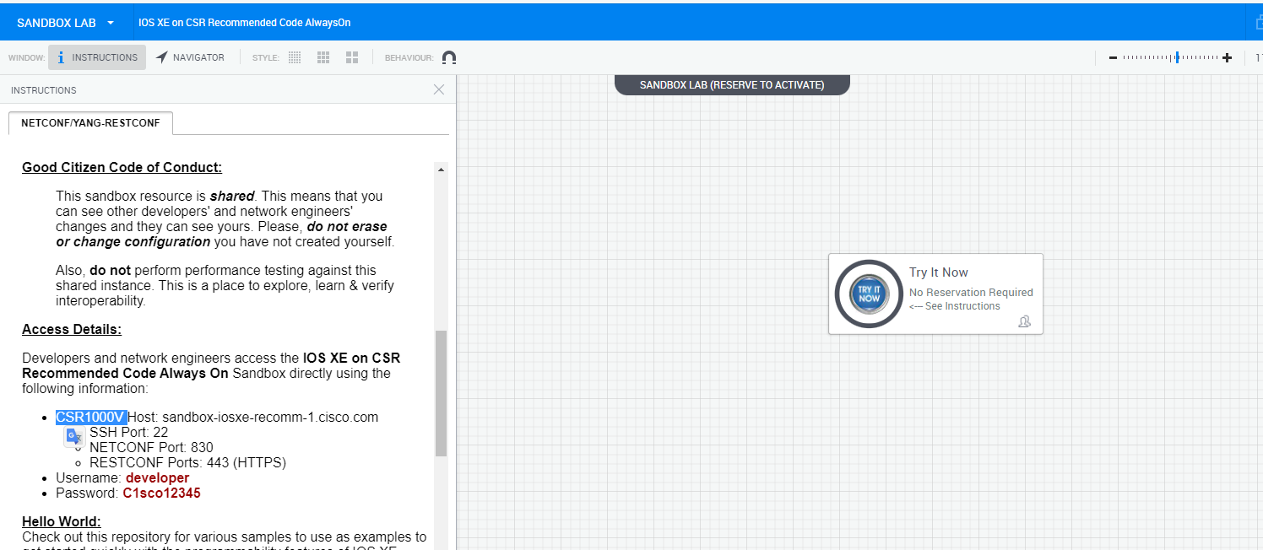
Sandbox

Slide 3
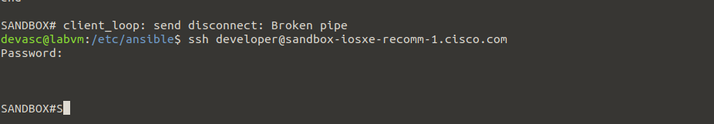

Slide 4
Search Filter netconf

Slide 5
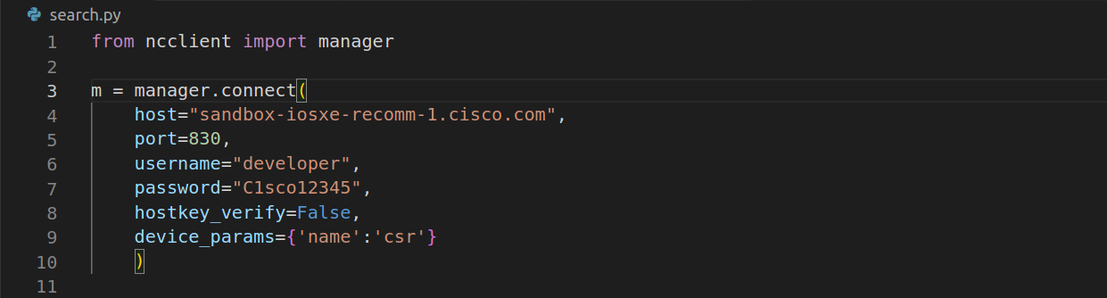
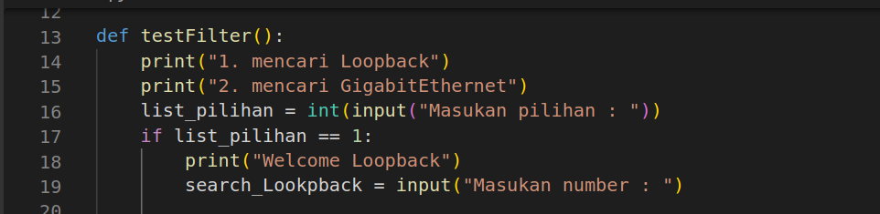

Slide 6
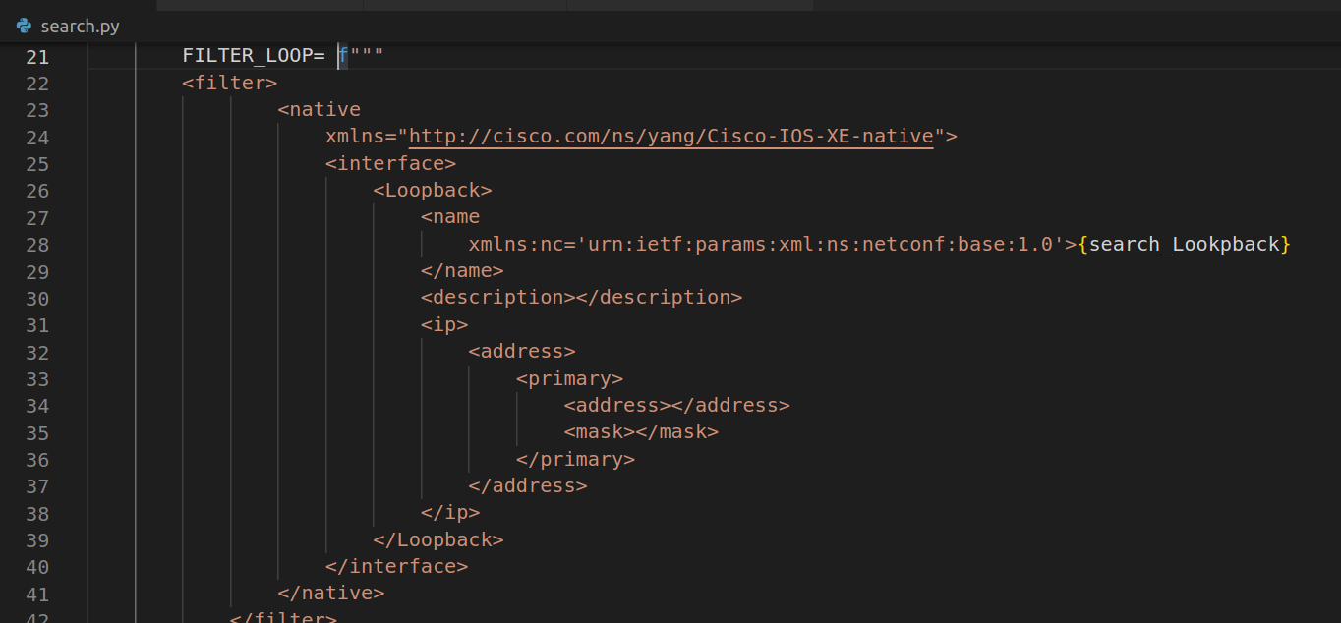
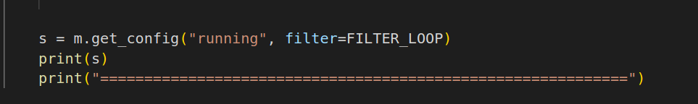

Slide 7
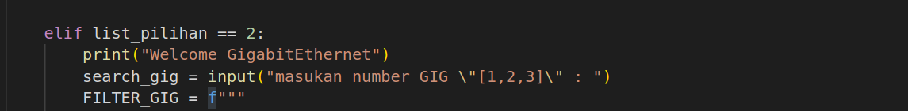
Gigabit Ethernet

Slide 8
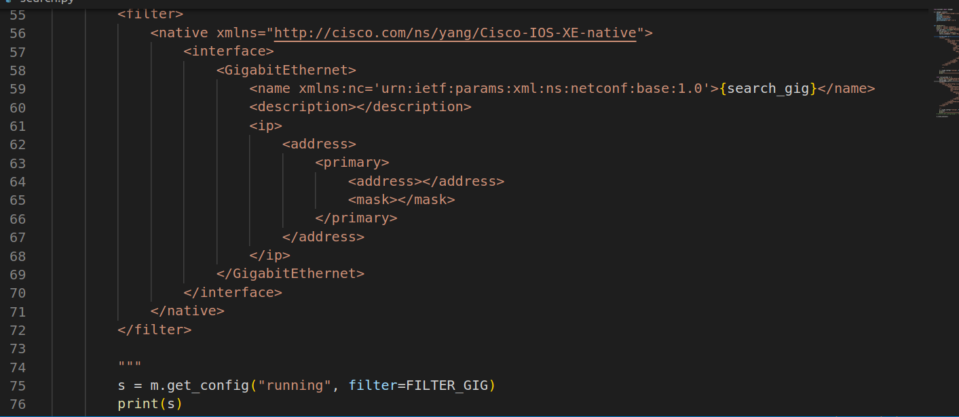

Slide 9
Create Input netconf

Slide 10
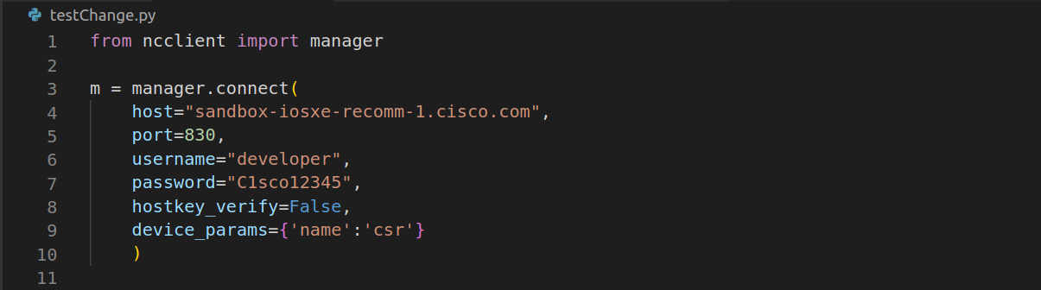
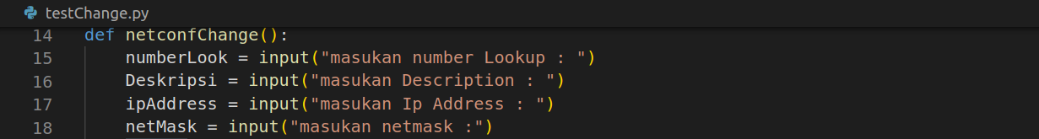

Slide 11
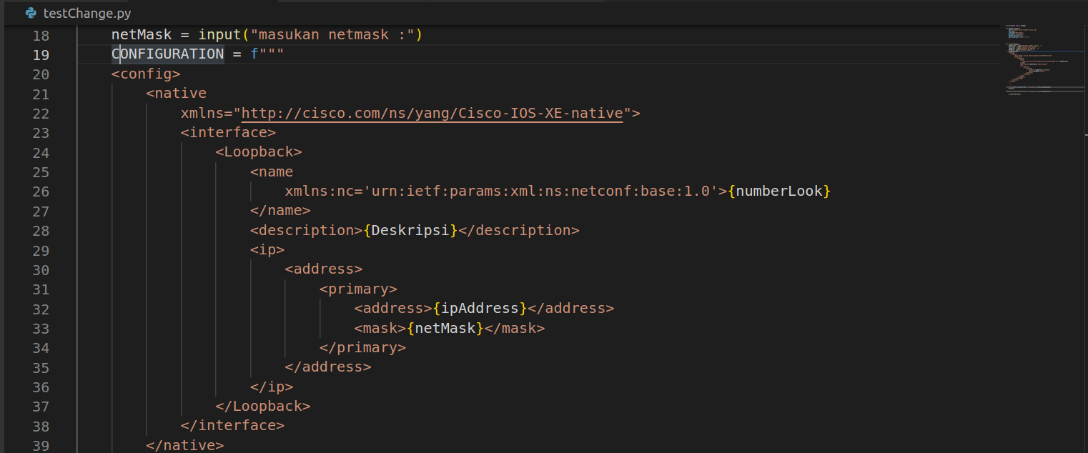
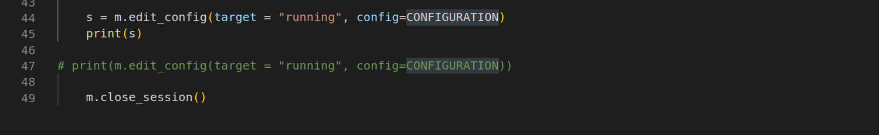

Slide 12
Main

Slide 13
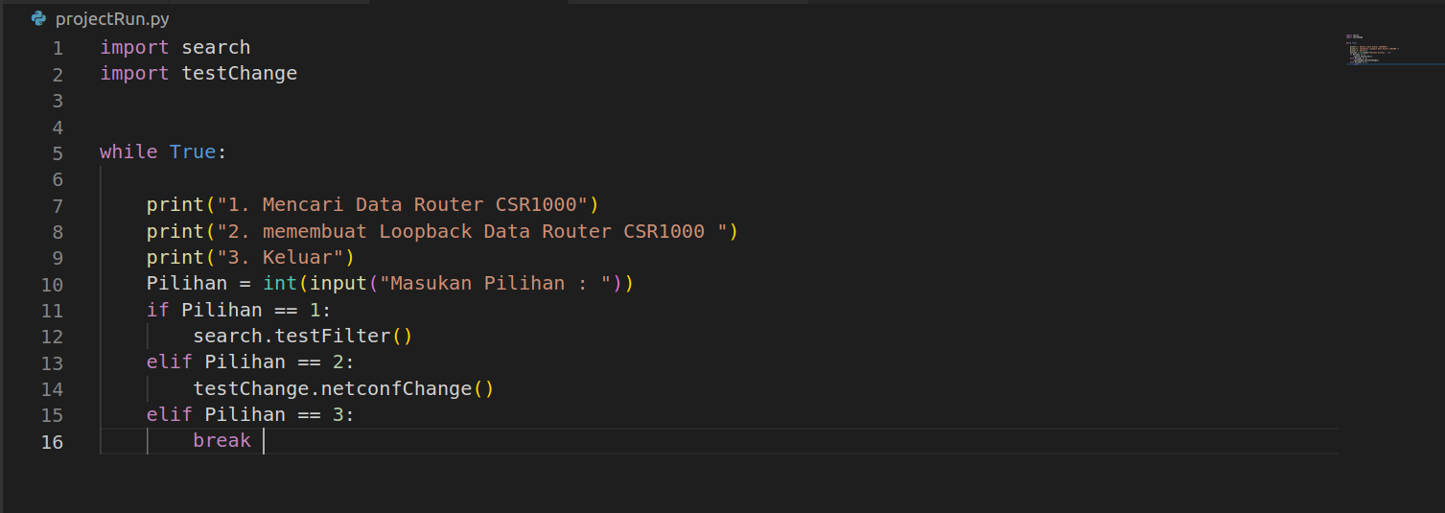

Slide 14
output

Slide 15
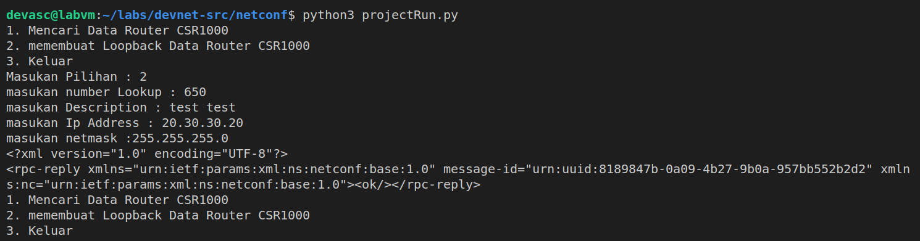
Create Input netconf

Slide 16
Find Input

Slide 17
Ansible

Slide 18
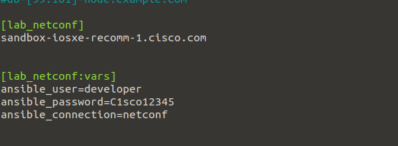

Frist Ansible

Slide 19
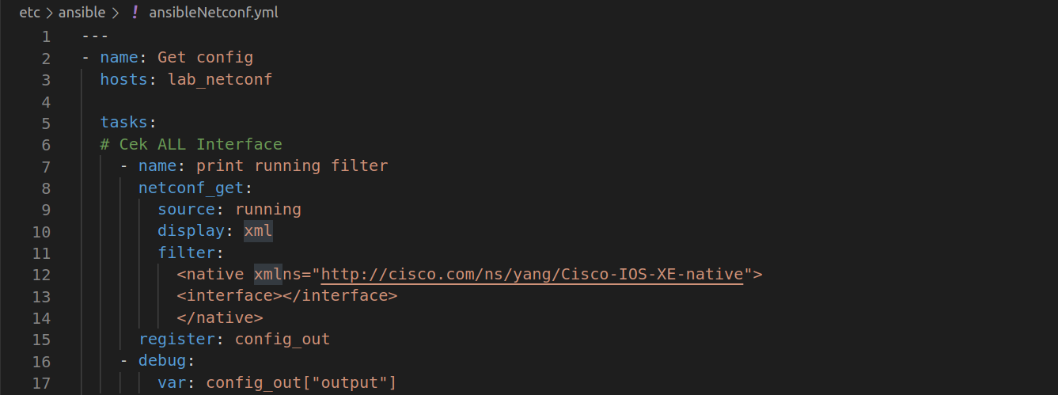

Slide 20
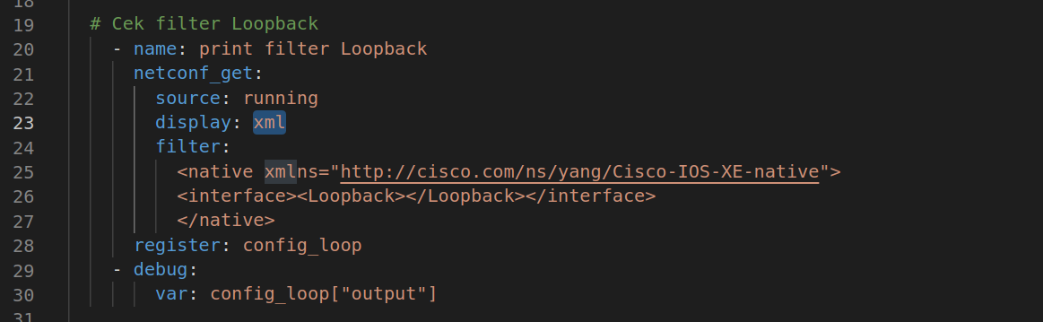
Filter Loopback

Slide 21
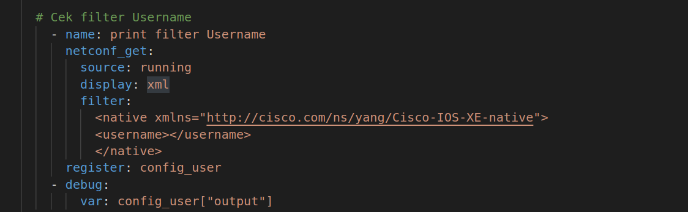
Filter username

Slide 22
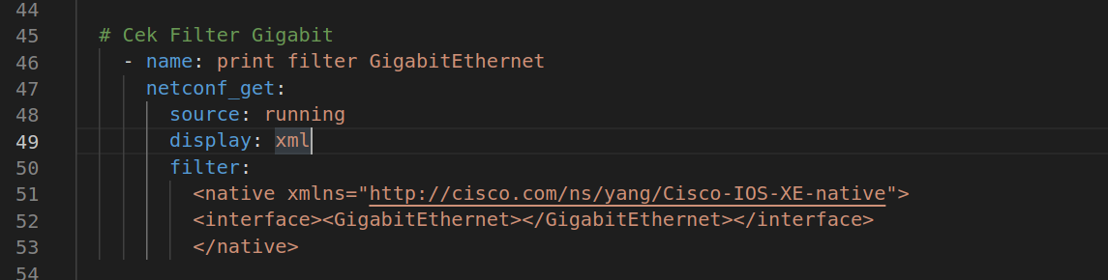
Filter Gig

Slide 23
Output

Slide 24
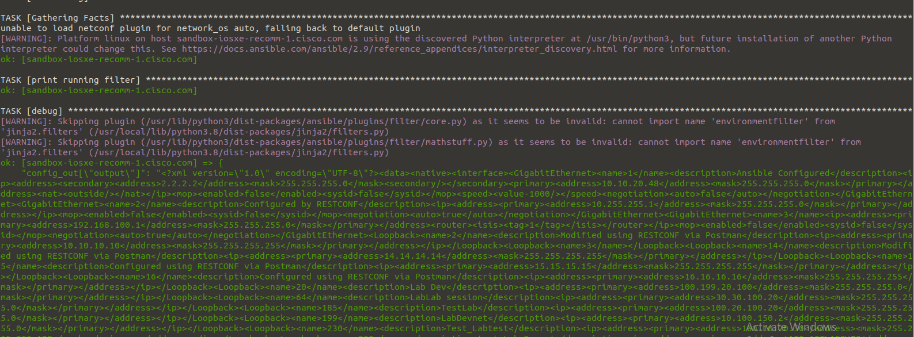

Slide 25
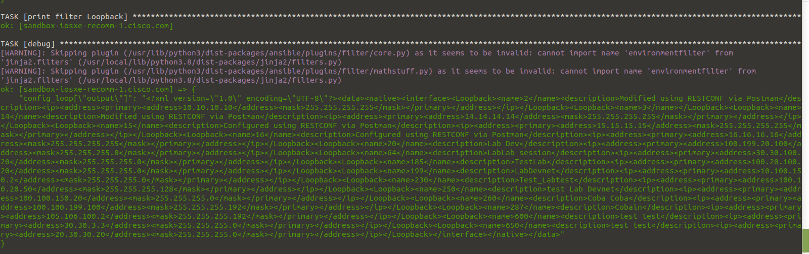

Slide 26
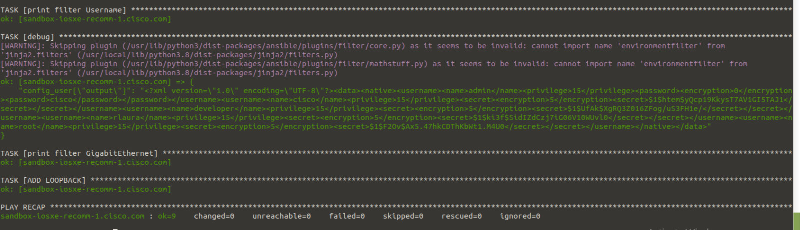

Slide 27
Video Demo
https://drive.google.com/file/d/1vrmAlzv2_lwDWQN3-iBiYEz2fiecf9g1/view?usp=sharing

