Slide 1
Outils d’Analyse de la Société Numérique Sept. 2021
- Cours sur projet -
Fabrice Le Guel
(fabrice.le-guel@universite-paris-saclay.fr)
Univ. Paris Saclay - RITM
Master IREN

Slide 2


Slide 3
0. Goals
Understand and discuss ‘Dataopolies’
Assessing the market power of digital platforms
Does large amounts of data confer a competitive advantage ?
An important debate, e.g. :
-Tucker, C., (2018)., ACCC Digital Platforms Inquiry Submission; Anja Lambrecht and Catherine E. Tucker, “Can big data protect a firm from competition?”, Competition Policy International, (2017)
versus
-Cremer, YA de Montjoye and H Schweitzer, Competition policy for the digital era, 4 April (2019)

Slide 4
Facebook’s and Google’s collection of data
Note :
Personal data (see GDPR) are extremely heterogenous (individual-level data, bundled individual-level data, aggregated-level data, high frequencies data…)
Personal data can be categorized as volunteered, observed, or inferred.

Slide 5
Facebook’s collection of data (see ACCC report)
Registered user sign up data on platform:
name, surname, gender, date of birth, phone number
On Facebook platform:
pages liked/followed, friend network, content or ads liked/commented/clicked on, time spend looking at ads, phone contact details
Idem (same personal details) on:
Instagram, WhatsApp, Messenger (+ people messaged)

Slide 6
Facebook’s collection of data (see ACCC report)
Facebook’s off platform:
Personal data collection on users visiting websites or using apps (through Apple’s App Store or Google Play), including:
Device data (OS, battery level, browser type, device id, IP address, location, cookies, etc
Payment data on Facebook platform (such as game purchases or donations), billing address, credit card details
Facebook like/share buttons
Facebook login (sign-up to services or websites)

Slide 7
Facebook’s collection of data (see ACCC report)
Facebook’s off platform:
Facebook pixel (piece of code on app or website in order to monitor usage and track performance of ad campaigns)
Nb: “Facebook Business Tools”= Facebook like button, Facebook login, Facebook analytics: data are transmitted to Facebook (via APIs) the moment the user calls up one of this third party
CONCLUSION:
Facebook can collect large amount of personal information on its own platforms but also on many third parties without paid for it (data brokers).

Slide 8
Google’s collection of data (see ACCC report)
Registered user sign up data:
name, surname, gender, date of birth, phone number
On Google platform:
search, content or ads liked/commented/clicked on, time spend looking at ads, maps, YouTube, Gmail, Blogger
Device data:
from Android phones, Google Pixel, Google Home
Data collection via mobile apps (YouTube, Gmail, Chrome)
IP address, location, device attributes,etc.

Slide 9
Google’s collection of data (see ACCC report)
Off platform data:
Data collected via websites using Google APIs such as Google Analytics, Google Ad Manager, Google Ads/AdSense, log-ins to sign-up for services/websites using Google account credentials
Internet of Things data:
Google Home, Nest, smoke alarms, indoor and outdoor cameras, thermostats, etc
Payment data:
‘Google Pay’ can collect data such as purchase history, credit cards details, billing address
Google Software Development Kits (SDKs):
Installed on websites/apps allows Google to collect data
CONCLUSION: Google does not pay a monetary fee to access high quality data.

Slide 10
Introduction

Slide 11

I. Context
UK (March 2019)
‘Unlocking digital competition, Report of the Digital Competition Expert Panel’
“An independent report on the state of competition in digital markets, with proposals to boost competition and innovation for the benefit of consumers and businesses.”
Detail :
This is the final report of the Digital Competition Expert Panel. Appointed by the Chancellor in 2018, and chaired by former Chief Economist to President Obama, Professor Jason Furman, the Panel makes recommendations for changes to the UK’s competition framework that are needed to face the economic challenges posed by digital markets, in the UK and internationally. Their report recommends updating the rules governing merger and antitrust enforcement, as well as proposing a bold set of pro-competition measures to open up digital markets.

Slide 12

I. Context
Australia (June 2019)
‘Digital Platforms Inquiry’
“On 4 December 2017, the then Treasurer, the Hon Scott Morrison MP, directed the ACCC to conduct an inquiry into digital platforms. The inquiry looked at the effect that digital search engines, social media platforms and other digital content aggregation platforms have on competition in media and advertising services markets. In particular, the inquiry looked at the impact of digital platforms on the supply of news and journalistic content and the implications of this for media content creators, advertisers and consumers”

Slide 13

I. Context
EU (April 2019)
‘Competition Policy for the Digital Era’ (Crémer, De Montjoye, Schweitzer)
“Commissioner Vestager has asked us to explore how competition policy should evolve to continue to promote pro-consumer innovation in the digital age.
We structured our report as follows. First, we describe the digital world and what we see as the main ways in which markets function in the digital era (Chapter 2). We then outline our views of the goals of EU competition law in the digital era and the methodologies it should use (Chapter 3). Second, with this framework as background, we discuss the application of competition rules to platforms (Chapter 4) and data (Chapter 5), and we inquire whether European merger control needs an update (Chapter 6). We finally provide our conclusions. ”

Slide 14
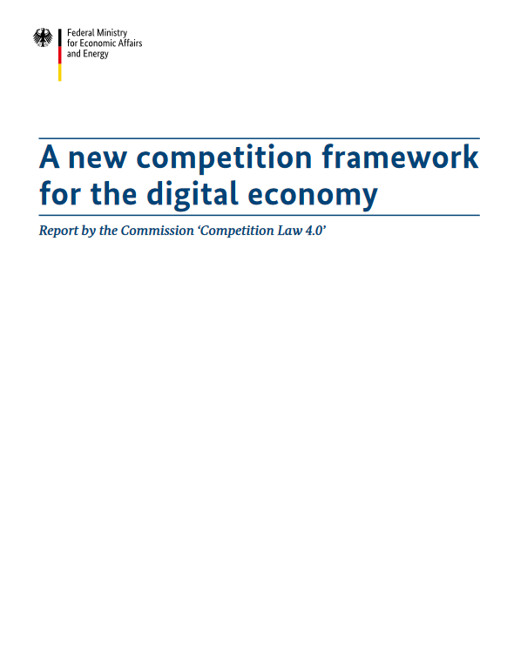
I. Context
Germany (September 2019)
‘A new competition framework for the digital economy Report by the Commission ‘Competition Law 4.0’’
“The Commission ‘Competition Law 4.0’ is convinced of the necessity to ensure that positions of power in the digital economy remain contestable, to prevent their being used to impede innovation and competition or their being lever-aged to other markets.”

Slide 15
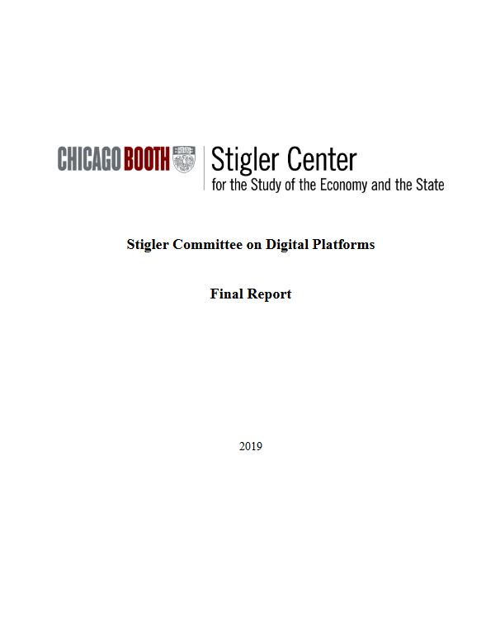
I. Context
USA (September 2019)
‘Stigler Committee on Digital Platform Final Report’
“The term “Digital Platform” lacks a consistent definition—different companies may be characterized as a platform in different environments. For example, Google, Facebook, Amazon, Apple, and Microsoft raise different concerns regarding how their “bottleneck power” impacts the markets in which they operate. 6 Considerations on market power involve all five companies mentioned above. By contrast, considerations about the news media or democracy are more specific to companies such as Google and Facebook and—to a lesser extent—Twitter. For this reason, the focus of our analysis in this Brief will be primarily Google and Facebook.”

Slide 16
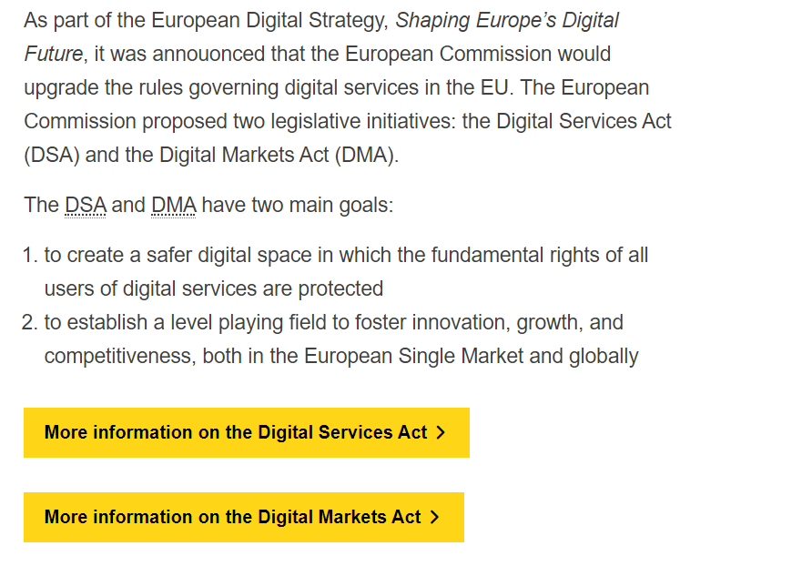
I. Context December 2020: EU ‘Digital Services Act’ and ‘Digital Markets Act’
https://ec.europa.eu/digital-single-market/en/digital-services-act-package

Slide 17
I. Context
Competition in digital markets and market power :
US House Judiciary Committee.,(2020)., ‘Investigation of Competition in Digital Markets Majority Staff Report and Recommendations’ https://judiciary.house.gov/uploadedfiles/competition_in_digital_markets.pdf?utm_campaign=4493-519 ; (from : https://judiciary.house.gov/issues/issue/?IssueID=14921)
‘Data-opolies’ :
Maurice E. Stucke, ‘Should We Be Concerned About Data-opolies?’, (2018) 2 GEO. L. TECH. REV. 275, 309, https://georgetownlawtechreview.org/wp-content/uploads/2018/07/2.2-Stucke-pp-275-324.pdf

Slide 18
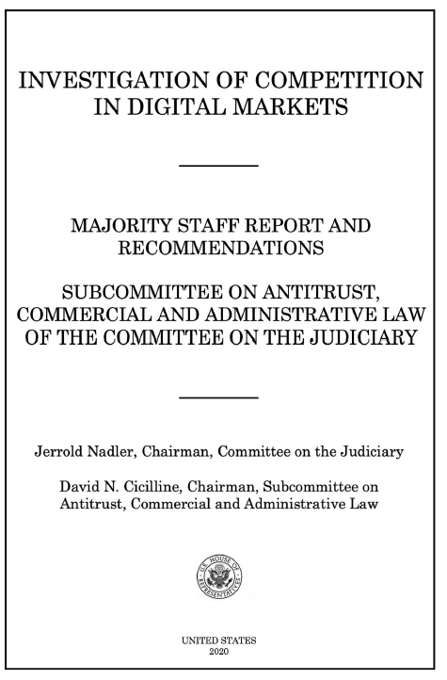
I. Context Competition in digital markets and market power
(1) document competition problems in digital markets (specifically with Amazon, Apple, Facebook, Google)
(2) examine whether dominant firms are engaging in anticompetitive conduct
(3) assess whether existing antitrust laws, competition policies, and current enforcement levels are adequate to address these issues.

Slide 19
I. Context Competition in digital markets and market power
“During the investigation, Subcommittee staff found evidence of monopolization and monopoly power.”
“In interviews with Subcommittee staff, numerous businesses described how dominant platforms exploit their gatekeeper power to dictate terms and extract concessions that no one would reasonably consent to in a competitive market.
Market participants that spoke with Subcommittee staff indicated that their dependence on these gatekeepers to access users and markets requires concessions and demands that carry significant economic harm, but that are “the cost of doing business” given the lack of options.”

Slide 20
I. Context Competition in digital markets and market power
“This significant and durable market power is due to several factors, including a high volume of acquisitions by the dominant platforms”…
…plus “strong network effects”…
… leading to data-opolies

Slide 21
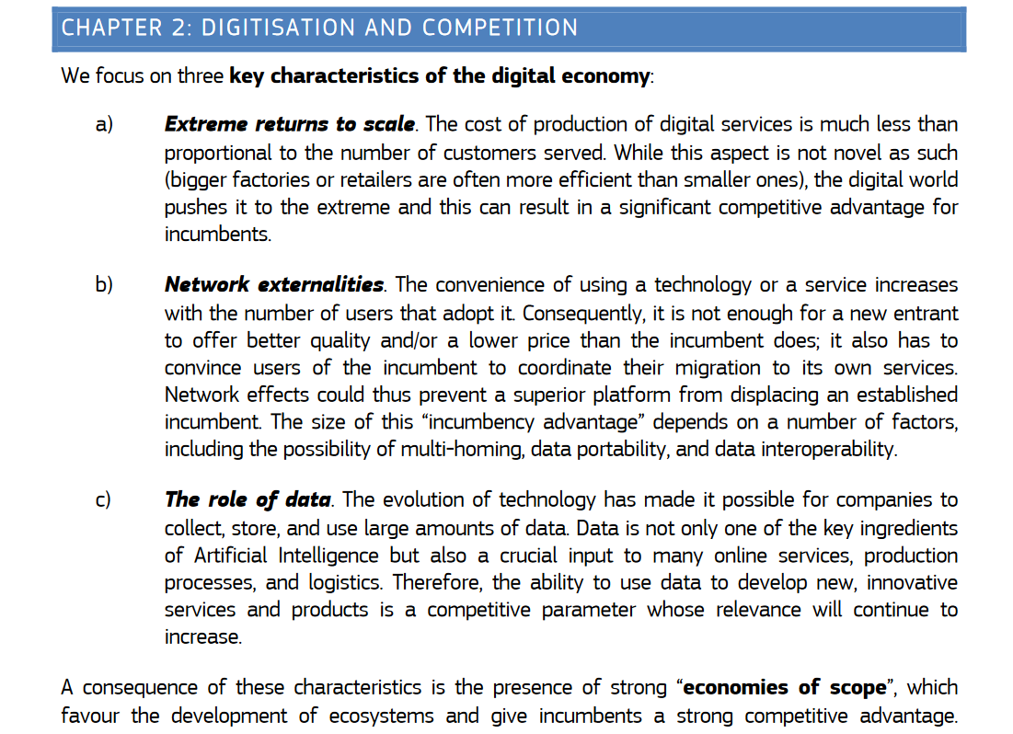
I. Context Competition policy for the Digital Era (Crémer et al. 2019)

Slide 22
I. Context Data-opolies
“As we transition to a data-driven economy, we are witnessing the emergence of data-opolies—companies that control a key platform, which, like a coral reef, attracts users, sellers, advertisers, software developers, apps, and accessory makers to its ecosystem.
Apple and Google, for example, each control a popular mobile phone operating system (and key apps on that platform); Amazon controls the largest online merchant platform; and Facebook controls the largest social network platform.
Through their leading platforms, a significant volume and variety of personal data flows. The velocity in acquiring and exploiting this personal data helps these companies obtain significant market power.”

Slide 23

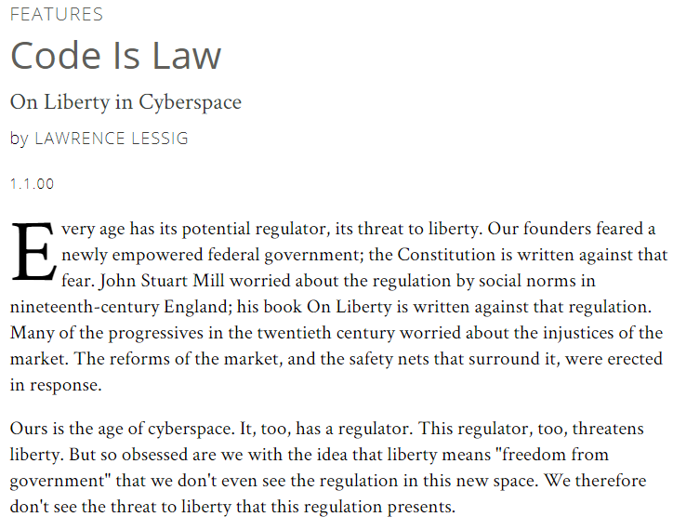
I. Context Data-opolies
Lessig (2000), ‘Code is Law’
“Ours is the age of cyberspace. It, too, has a regulator.”
“This regulator is code--the software and hardware that make cyberspace as it is.”
“This regulator, too, threatens liberty.”
“Self-government is all about tracking and modifying influences that affect fundamental values”

Slide 24

I. Context Data-driven regulation
« La régulation par la donnée vient compléter les outils traditionnels du régulateur. Au lieu de prescrire aux acteurs économiques un certain comportement, il s’agit de créer un réseau d’informations et d’incitations pour réduire les asymétries d’information et démultiplier l’impact de l’action du régulateur en mobilisant les utilisateurs et leurs relais. Cette approche appelle une nouvelle culture et de nouvelles compétences au sein de l’Etat. »
[…]
En pratique, cela (la régulation par la donnée) passe non seulement par la collecte d’informations auprès des acteurs régulés mais aussi par un élargissement des données, par des outils de crowdsourcing, par des démarches de simulation, par l’animation d’un écosystème d’acteurs de la mesure, de comparateurs...
Le développement de la régulation par la donnée engendre, pour les régulateurs, de nouveaux besoins en termes de compétence, d’outils ou encore d’appropriation des nouvelles technologies. »

Slide 25
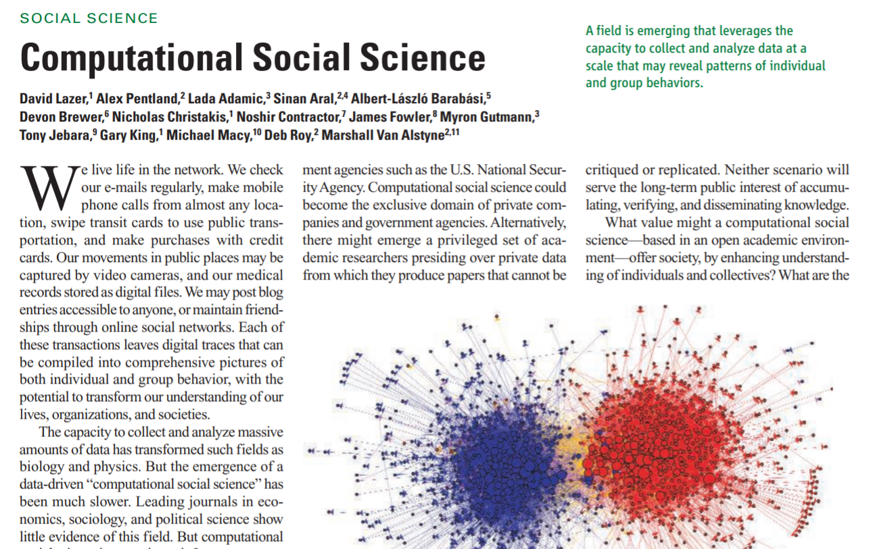
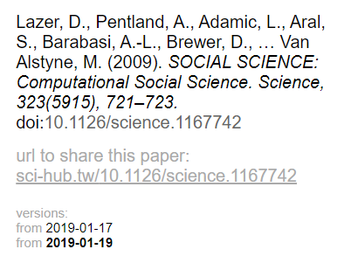
I. Context Computational Social Science

Slide 26
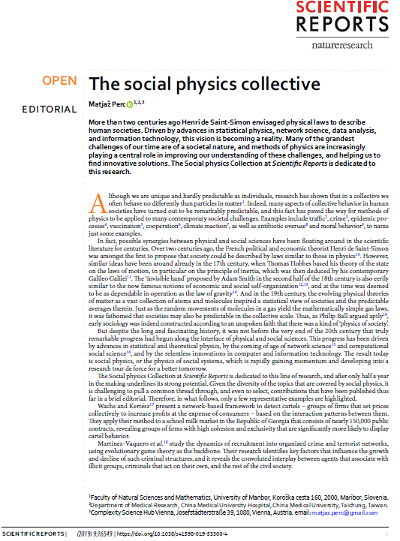
I. Context Social Physics
“More than two centuries ago Henri de Saint-Simon envisaged physical laws to describe human societies. Driven by advances in statistical physics, network science, data analysis, and information technology, this vision is becoming a reality”
“many aspects of collective behavior in human societies have turned out to be remarkably predictable, and this fact has paved the way for methods of physics to be applied to many contemporary societal challenges.”

Slide 27
I. Context Economics and Data Sciences
Lazer et al., (2009)., ‘Computational Social Sciences’, Science.
Edelman., (2012)., ‘Using Internet data for Economic research’, JEP.
Einav et Levin., (2014)., ‘Economics in the Age of Big Data’, Science.
Varian., (2014)., ‘Big Data: new tricks for econometrics’, JEP.
Mullainathan et Spiess., (2017)., ‘Machine learning: an applied econometric approach’, JEP.
Athey et Imbens., (2019)., ‘Machine Learning Methods That Economists Should Know About’, Annual Review of Economics.
Gentzkkow et al. (2019)., ‘Text as Data’, JEL.
Currie et al., (2020)., 'Technology and Big Data Are Changing Economics: Mining Text to Track Methods' AEA Papers and Proceedings.

Slide 28
II. Topic
Sujet 1 : Doit-on être concerné par la concentration des données personnelles ?
- Should we be concerned about data-opolies ? -
Contexte : Actuellement, un vif débat à lieu à propos du pouvoir de marché des plateformes du numérique comme Google ou Facebook. Récemment, l’US House Judiciary Committee a publié un rapport de 450 pages à ce propos (US House Judiciary Committee, 2020), proposant pour la première fois de réguler les grandes plateformes. Un point particulier dans ce rapport concerne la concentration des données personnelles (page 42): « Much like a network effect, data-rich accumulation is self-reinforcing. Companies with superior access to data can use that data to better target users or improve product quality, drawing more users and, in turn, generating more data—an advantageous feedback loop. In short, new users and greater engagement bring in more data, which enables firms to improve user experiences and develop new products—in turn capturing more data. »
Le ‘data challenge’ : étudiez cette question de concentration des données personnelles à partir d’un échantillon de données (data-driven regulation) et en utilisant, en fonction de ce que vous maitrisez ; le web-scraping, l’économétrie ou de la data science (un travail en équipe avec des compétences complémentaires peut dans ce sens être intéressant). Dans un document (20 pages max), vous devez répondre à ces questions, selon ce plan :
Partie 1: Revue de littérature
Quel est le débat en Economie sur le statut des données personnelles ?
Définir le concept de ‘data-ololies’ ?
Quels problèmes économiques posent la concentration des données personnelles ?
Partie 2 : Stratégie empirique
Comment empiriquement mesurer la concentration des données ? A l’aide des données du projet Exodus Privacy et de votre savoir-faire, étudiez cette concentration, discutez vos résultats. Cette concentration est-elle effective ?
Partie 3 : Recommandations
Face à vos résultats, quelles régulations proposez-vous ?

Slide 29
III. Organisation
1. SET GROUPS
Group 1
Group 2
Group 3
Group 4
Group 5

Slide 30
Organisation
2. ORGANIE GROUPS MEETINGS
‘Office’ hours (on Fridays , between 12h45-14h off-line (office hours) or 12h-14h online). Meeting by group with appointment (please, send me a mail before)
‘Oral presentation’ in November (by group) + first draft (first version)
End of December or first week of january: due date (final draft)

