Slide 1

Presented by
Charishma

Slide 2
Agenda:
What is Maven
How to use Maven
Maven Architecture
Features of Maven
How to Install Maven on Windows
How can Maven benefit development process?
Steps/process involved in building the project
Maven Repository
Maven Plugins
Maven Lifecycle

Slide 3
Maven:
Maven is an automation and management tool developed by Apache Software Foundation.
It is written in Java Language to build projects written in C#, Ruby, Scala, and other languages.
It is based on Project Object Model(POM) .
It allows developers to create projects, dependency, and documentation using POM and plugins.
It has a similar development process as ANT, but it is more advanced than ANT.
Maven can also build any number of projects into desired output such as jar, war, metadata.

Slide 4
How to use Maven
To configure the Maven in Java, you need to use Project Object Model, which is stored in a pom.xml.file .
POM includes all the configuration setting related to Maven.
Plugins can be configured and edit in the <plugins>tag of a pom.xml file.
When user start working on Maven Project , it provides default setting of configuration, so the user does not need to add every configuration in pom.xml.

Slide 5
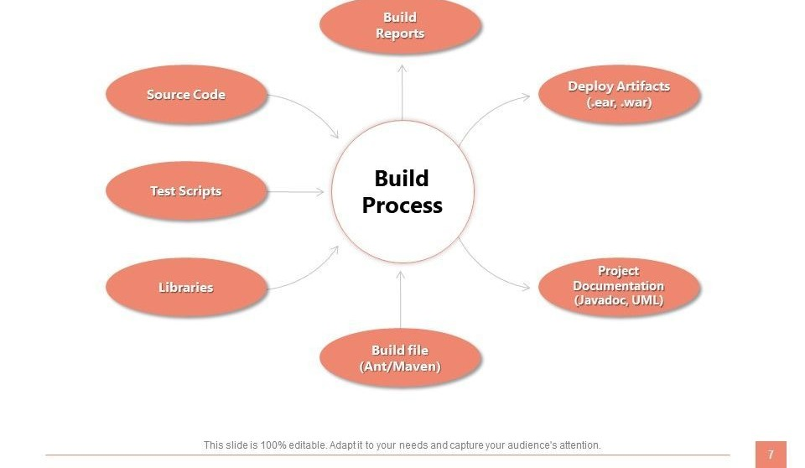
Maven Architecture

Slide 6
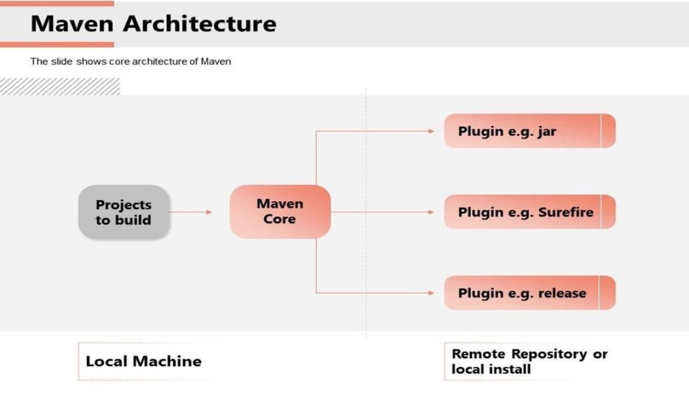

Slide 7
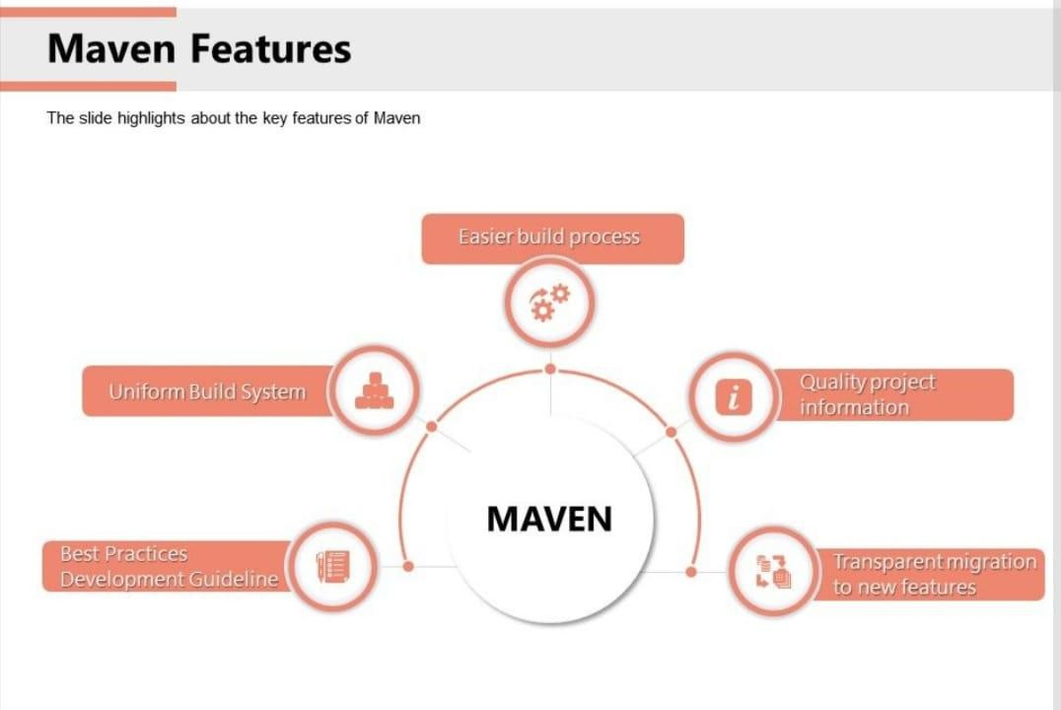
Features of Maven

Slide 8
How to Install Maven on Windows
To Install Maven on Windows , you need to perform following Steps :
Download Maven & Extract it.
Add JAVA_HOME and MAVEN_HOME in Environment Variable.
Add Maven path in Environment Variable.
Right click on My Computer ->properties->Advanced System Settings ->Environment Variables -> Click New Button.
Verify Maven

Slide 9
How can Maven benefit development process
Maven helps the developer to create a java-based project more easily.
Maven can be easily added to a project in Maven configuration.
It increases the performance of project and building process.
It can download the project dependency libraries automatically.

Slide 10
Steps/process involved in building the project
✔ Add / Write the code for application creation and process that into source code repository.
✔ Edit configuration / pom.XML / plugin details.
✔ Build the application.
✔ Save the build process output as WAR or EAR file to a local location or server.
✔ Get the file from local location or server and deploy the file to the production site.
✔ client site Updated the application document with date and updated version number of the application .
✔ create and generate a report as per the application or requirement.

Slide 11
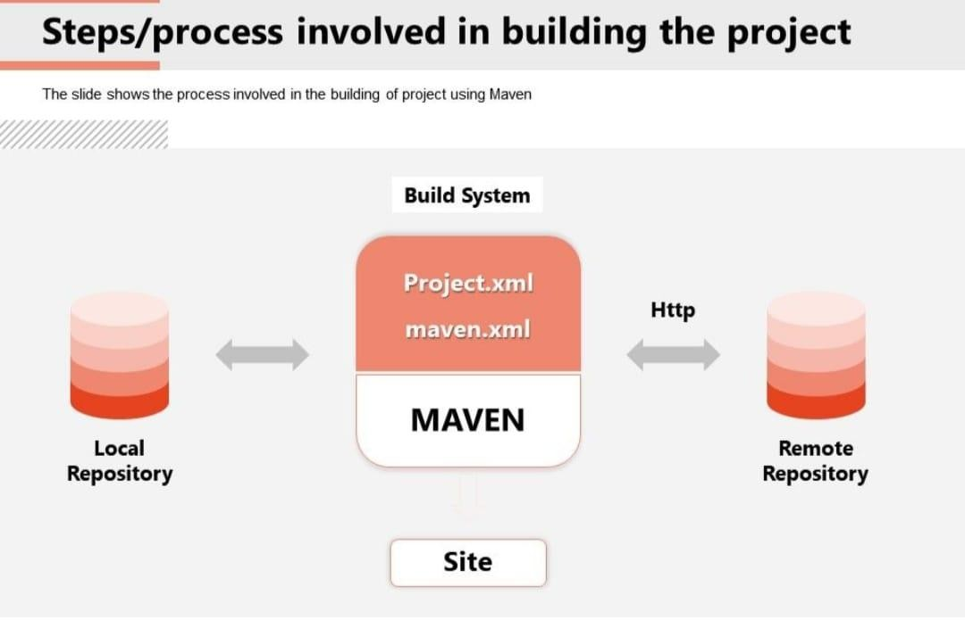

Slide 12
Maven Repository
Maven Repository is a directory of Packaged JAR file with pom.xml file .
There are 3 types of Maven Repository.
1. Local Repository : It is Located in your local system.it is created by Maven When you run any maven command.
2. Central Repository : It is Located on the web. It has been created by the apache Maven Community itself.
3.Remote Repository : It is Located in Web. Most of Libraries can be missing from the central repository.

Slide 13
Maven Plugins
The maven Plugins are central part of maven framework, it is used to perform specific goal.
According to Apache Maven, there are 2 types of Maven Plugins.
Build Plugins : These plugins are executed at the time of build. These plugins should be declared inside the <build> element.
Reporting Plugins : These plugins are executed at the time of site generation. These plugins should be declared inside the <reporting> element.

Slide 14
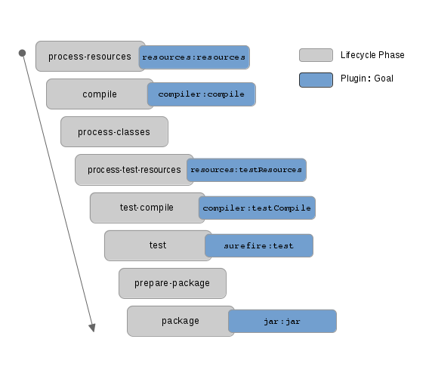
Maven Lifecycle

Slide 15
Thank You…

