Slide 1
Universal Skin Detection Without Color Information
Jia Khot Lalit Maurya Rachit Kumar
Paper: Universal Skin Detection Without Color Information (IEEE WACV 2017)

Slide 2
Project Abstract
This project reimplements the 2017 "Universal Skin Detection Without Color" method to detect skin in grayscale images. It uses face detection, local texture features (LBP, lacunarity), and grayscale statistics to adaptively segment skin. Hyperparameters were tuned for better segmentation performance.

Slide 3
Member-Wise Contributions
Jia:
Facial Recognition Handling
Geometric Mask Creation
Superpixel Feature Extraction (Basic + LBP)
Learned Probability Handling
Project Report + Presentation
Lalit:
Prior Probability Mask Creation
Distance Based Probability Mask Creation
Divergence Handling
Region Growing Algorithm
Project Report
Rachit:
Dataset Acquisition, Cleaning and Preprocessing
Region Growing Algorithm
Hyperparameter Tuning
PowerPoint Presentation + Streamlit App
Detailed contributions can be found in the commit history of this repo: https://github.com/icingtea/skin_detection | (Warning: >70 messy commits and about 5 branches.)

Slide 4
Dataset Acquirement and Cleanup
Face Annotation Parsing
Solo Subjects
Facial Masking
Face + Landmark Detection
Crop Masking
Hyperparameter Tuning
Optuna Loops
Facial Masking Validation with Dataset
Binary Masking
Intensity Histogram
Distance Mapping
Hit-and-Trial
Feature Extraction
Superpixel Mapping
Basic Statistical Features
LBP evaluation + Rotational Invariance
Lacunarity Calculation
Feature-Based Probabilities
Divergence (Distance) Calculation
Learned Probabilities
Region Growing
Threshold Parameter Calculation
Neighbor Selection
Class Probabilities
Seed Selection
Final Facial Pixel Map
Human Validation
Feature Consolidation

Slide 5
Dataset Acquirement and Cleanup
Dataset: Relabelled HELEN Dataset 2,330 high-res facial images with detailed segmentation masks (facial skin, eyes, lips, etc.)
Goal: Prepare binary facial-skin-only masks ONLY for validation of our facial mask extraction, to tune hyperparameters further on.
Preprocessing: - Extracted skin-only regions
- Ensured solo subjects for simplicity in validation
- Created 1/0 binary masks (skin, not skin)
- Manually reviewed any abnormalities
Paper Limitations: The dataset in the reference paper (as well as most skin segmentation datasets) is not publicly available, so masking validation could only be performed on facial masks, not entire skin masks.

Slide 6
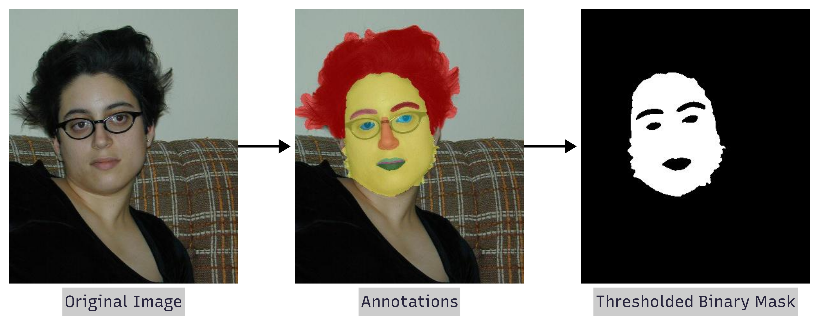

Slide 7
Facial Masking
Goal: Predict skin pixels within the face region only using grayscale-based intensity and location priors.
Preprocessing: - Used OpenCV’s Haar Cascades for facial landmarks
- Constructed a face mask avoiding non-skin areas
- Generated intensity histograms over masked skin
- Created a distance-based prior
P(s | I) ∝ P(I | s) × [P₍face₎(s)]^α > λ
where: P(I | s) = p of intensity I given it’s skin, P₍face₎(s) = spatial prior, α = weight for prior, λ = threshold.
Paper Limitations: The original method in the paper did not detail how their spatial prior was derived. We are using stacked Gaussians over selected landmarks.

Slide 8
Hyperparameter Tuning
Goal: Tuning α (weight for spatial prior) and λ (probability threshold) for accurate facial masking in the prior step.
Automated phase: We used Optuna to minimize MSE (and XOR, depending on results) between predicted and GT masks • α ∈ [0.1, 0.9] • λ ∈ [1e-6, 10] (log-scale)
Manual phase: Eyeballing predicted masks on samples; balanced coverage vs. leakage, and tuned the automated parameters as needed intuitively.
α (alpha) controls how tightly the skin mask hugs the face’s spatial center.
High α → masks concentrate near the facial center
Low α → intensity values dominate
λ (lambda) determines how aggressively we threshold combined probabilities.
low λ risks letting in noise (false positives)
high λ risks cutting out true skin pixels (false negatives)

Slide 9
Basic Feature Extraction
Goal: Extract grayscale-based features from local regions for skin detection, since color information is unavailable in this task .
Superpixels: Clusters with uniform local properties; We used SLIC (Simple Linear Iterative Clustering) to extract these. • Assumption: Skin superpixels have similar grayscale properties.
Extracted Features (Basic): - Mean pixel intensity
- Mean local neighborhood SD
- Mean Local entropy
Computation: Sliding general kernels for local/neighborhood features, later aggregated
STD(NNᵢ) = √[ (1 / r²) × Σⱼ∈NN (xⱼ − x̄ᵢ)² ]
ENT(NNᵢ) = − Σⱼ P(xⱼ) × log(P(xⱼ))

Slide 10
LBP Feature Extraction
Goal: Capture local texture descriptors and structural irregularity from grayscale superpixels to enhance skin pixel classification accuracy.
Paper Limitations: There was no implementation suggested for lbp_riu2, so we implemented our own based off of our own understanding, after doing some research into rotation invariant LBP maps.
Local Binary Patterns: Captures local texture by thresholding pixel neighborhoods.
We used 12 pairs of (P, R) for 12 LBP maps: [4,1] [4,2] [4,3] [4,4] [8,1] [8,2] [8,3] [8,4] [16,2] [16,3] [16,5] [16,7]
LBP₍P,R₎ = Σₚ s(I(p) − I(c)) × 2^p
s(x) = { 1 if x > 0, 0 otherwise }
Where P = num_pixels
R = neighborhood_radius

Slide 11
Rotation-Invariant Encoding:
- Created lookup table of size 2ᴾ, for each possible pattern.
- For each binary pattern, counted bit transitions.
- Patterns with <2 transitions are retained (uniformity), and other patterns are set to P+1 to reduce unique outliers
- Computed standard lacunarity, and did an element-wise lookup
Lacunarity (LBP-based, non traditional): Measures gappiness/irregularity in LBP-based Binary maps by counting the density of 0s. The binary maps are computed with empirically found values suggested in the paper.
For each LBP₍P,R₎, generated binary masks based on selected values of k per P:
P=4 → k ∈ {1, 2, 4}
P=8 → k ∈ {1, 4, 7, 8}
P=16 → k ∈ {1, 8, 15, 16}
Total: 44 binary maps, and 44 lacunarities, creating a 44 dimensional feature vector.

Slide 12
Feature-Based Probabilities
Goal: Leverage previously learned texture-based features from known skin regions (face mask) to estimate the likelihood that other superpixels represent skin.
Paper Limitations: The paper does not specify which features it consider, or how many very clearly. We have considered all the features we implemented the extraction for.
We define each superpixel’s feature set as:
class Feature:
label: int
mean_intensity: float
std_intensity: float
entropy: float
lacunarity_vector: np.ndarray # shape: (44,)
The facial mask (computed in earlier steps) is used to select seed superpixels presumed to be skin. These seed superpixels form a representative region denoted as Ωs​, with certain features corresponding to the set format.

Slide 13
Learned probability by feature: Probability of a superpixel being skin given a feature type = Φk​(feature divergence between superpixel feature and reference feature), where the divergence is the Euclidean distance for a scalar quantity, and:
Φk(x) = 1 / (1 + e^(-1/x))
For probability space features, the paper uses KL divergence, which does not apply since we have no such features in our (or the paper’s) feature set.
Paper Limitations: The choice of the Φk​() function has not been explained in the reference paper, and seems practically arrived at. We feel it may be to sharply penalize large distances.
Approach Change: The reference features in question in the paper are those of the established skin patch Ωs​. The reference features we have picked for accuracy are those of the established skin SUPERPIXEL that, when computed with superpixel I for divergences, provides the highest conditional skin probability P for I with feature set F(I).
P_I(s | F(I)) = product of feature-wise learned probabilities.
This probability is used to subsequently pick seed superpixels for the region-growing algorithm.

Slide 14
Region Growing Algorithm
Goal: Use estimates gathered so far to detect skin pixels outside of the face.
Algorithm:
The region growing algorithm is the culmination of this paper. It leverages all the information extracted from all superpixels and known skin superpixels to classify skin pixels beyond just the face.
1. The first step is to select seed superpixels: After calculating P_I(s | F(I)) for every superpixel, we create a seed superpixel set with a percentile threshold. These superpixels will be the starting point of the algorithm.
2. After selecting seed superpixels: Create two sets, skin superpixels sp_s and non-skin superpixels sp_ns. Initialize sp_s with seed superpixels and known skin superpixels (these are extracted from the skin mask).
3. For each superpixel in sp_s we calculate all valid neighbors N_sp. A superpixel is a valid neighbor if it is in neither sp_s or sp_ns.

Slide 15
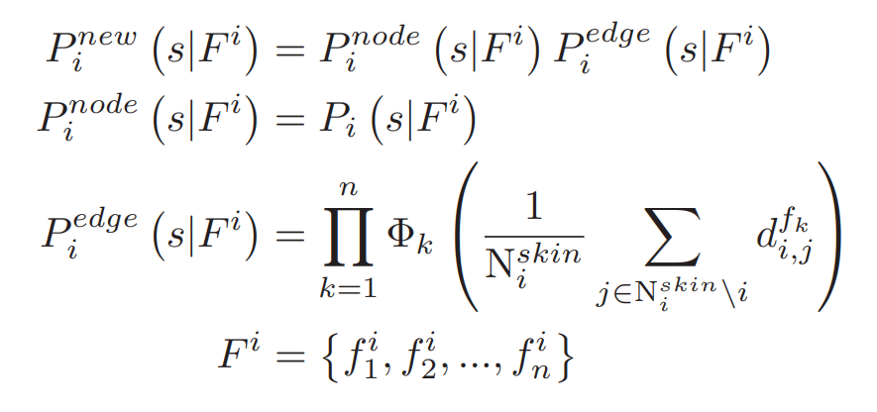
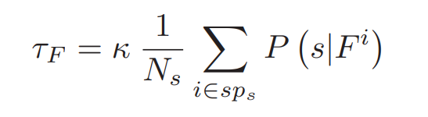
4. For each neighboring superpixel sp_i, we calculate P_i_new defined as below:
5. If P_i_new > T_F:
sp_s.add(sp_i)
Else:
sp_ns.add(sp.i)
6. Repeat steps 3-5 for n iterations as desired.

Slide 16
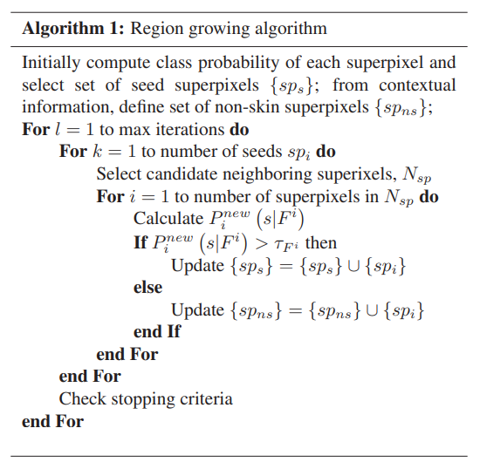

Slide 17
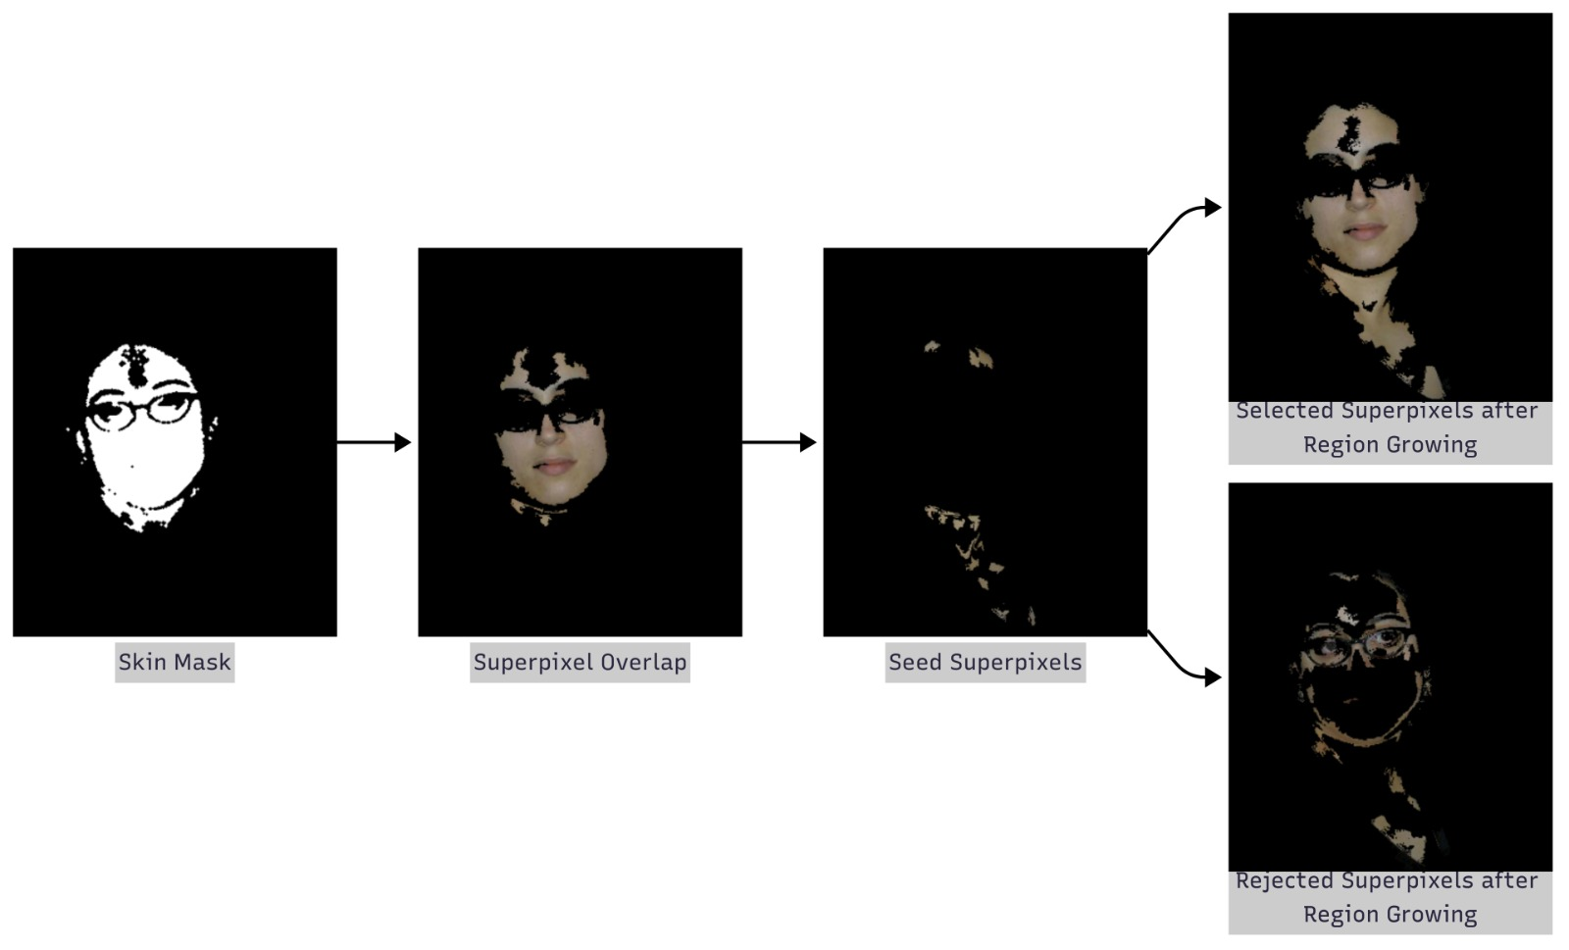

Slide 18
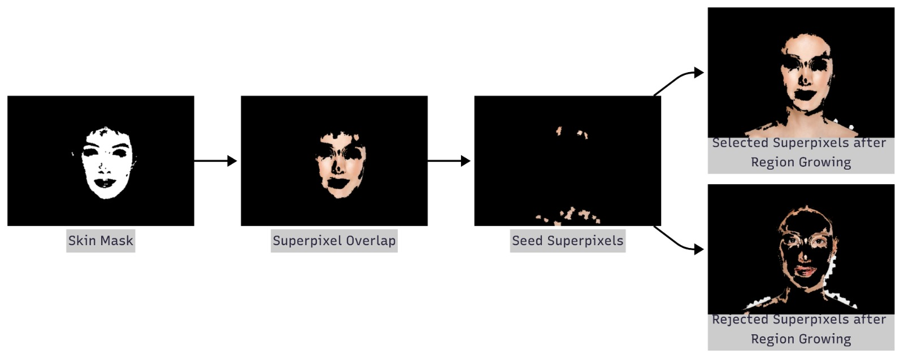

Slide 19
Limitations
General Observations Regarding Results
The algorithm demonstrates satisfactory performance in images where skin regions exhibit consistent pixel characteristics.
Favorable results are observed in images with minimal variation in lighting, contrast, and perspective. It seems to do well with people of different races and genders, and seems to capture seeds and significant sections of non-facial skin as well.
Scope for Improvement:
We could not compare results with ground truth because the dataset used in the original paper is not public, and similar datasets are hard to find.
The algorithm needs manual tuning for different skin tones and lighting. A better method could be to adjust parameters automatically based on the brightness and noise in the whole image.

Slide 20
Using all features together does not always give the best results. Sometimes, a smaller set of features works better. We plan to use image characteristics to choose the best feature set for each case.
In noisy or detailed images, fewer algorithm steps (iterations) give better results. This shows that our current features may not fully separate skin and non-skin areas. Adding more image features could help.
Sometimes the algorithm grows regions too far. We need better rules to stop this from happening.
Having labeled skin segmentation datasets would help us test the algorithm more accurately. We are planning to contact data owners to ask for permission to use their datasets.
Examples of some final outputs are illustrated as follows:

Slide 21
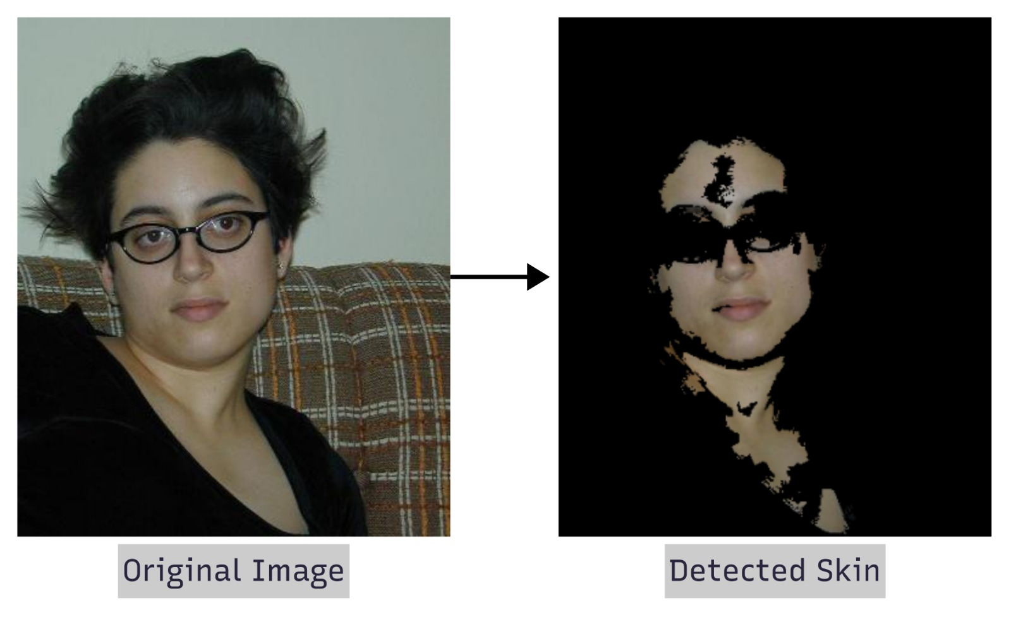

Slide 22
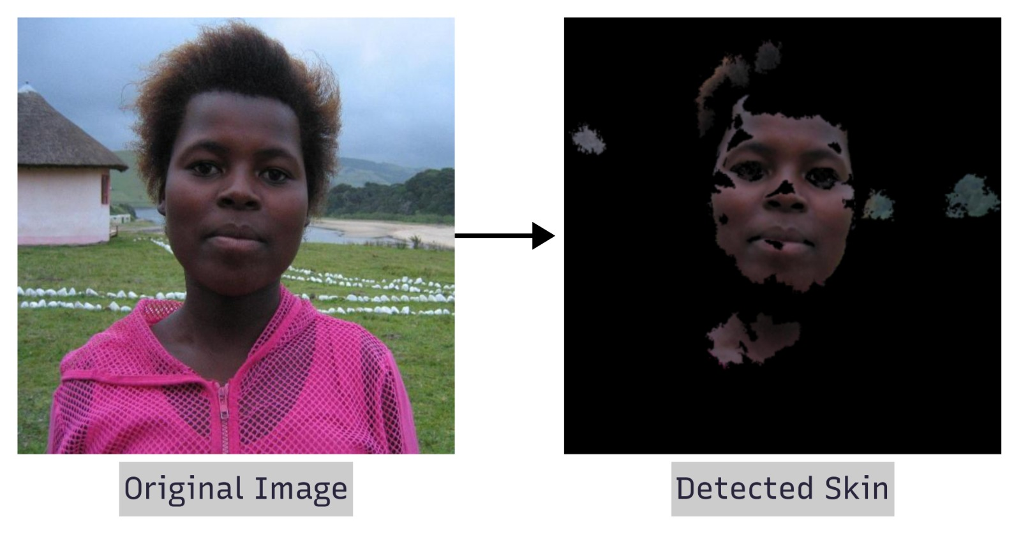

Slide 23
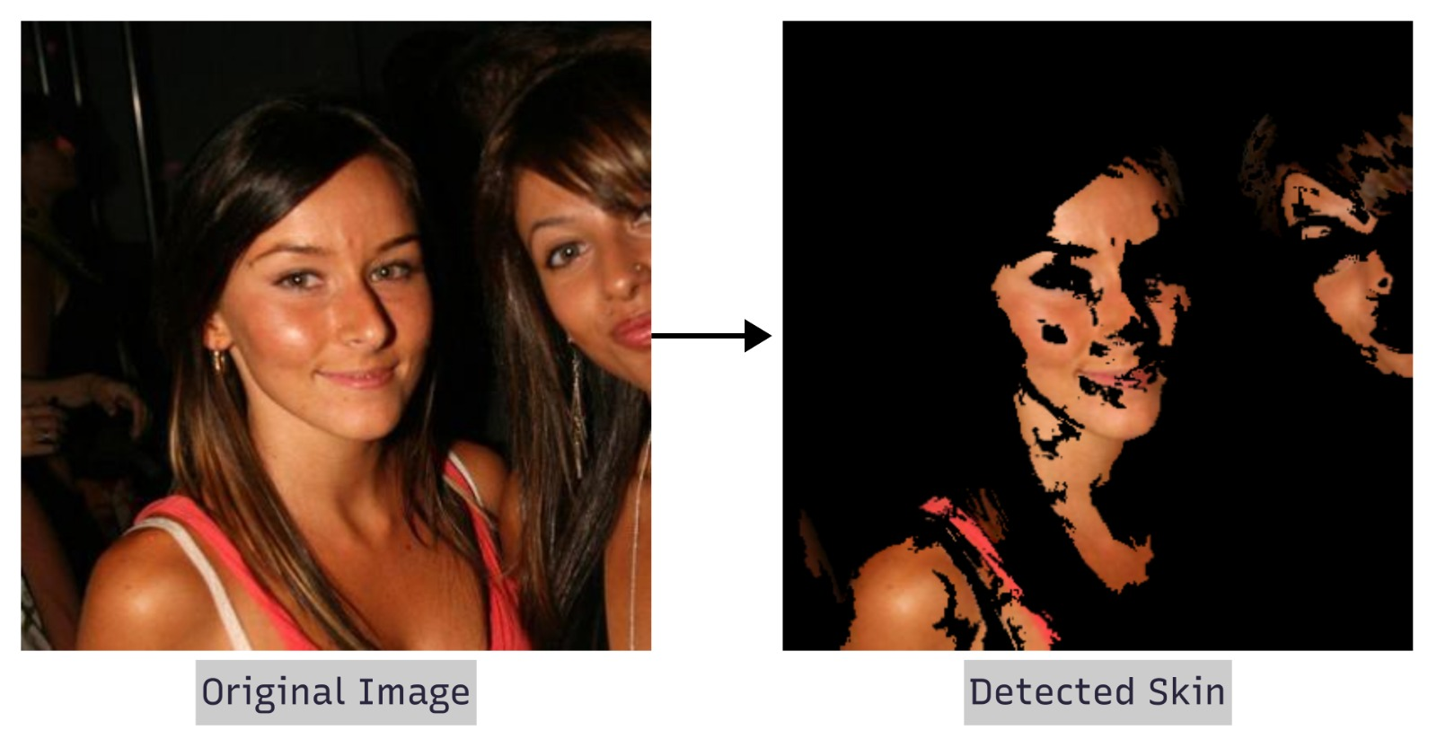

Slide 24
Following are some outputs of images that display varying performance for different subsets of the feature set:

