Slide 1

YAT
Yet Another Terminal
An open source software project by Matthias Kläy
2015-06-01
Based on YAT 2.0 Gamma 1 Version 1.99.32

Slide 2
Agenda
Existing Terminals
YAT
YAT History
YAT Development
YAT Demo
YAT Home

Slide 3
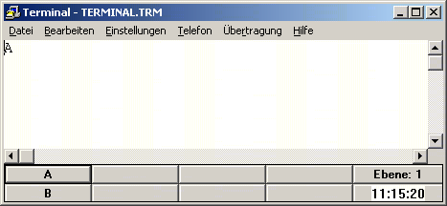
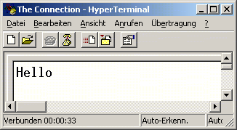
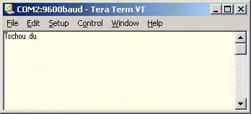
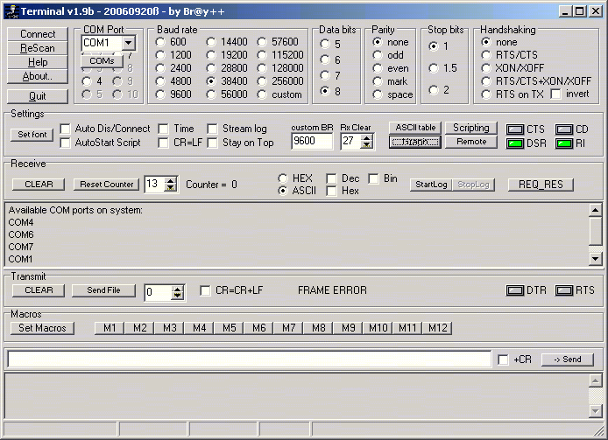

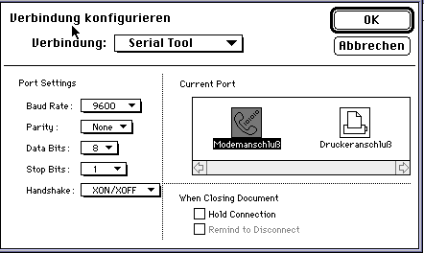
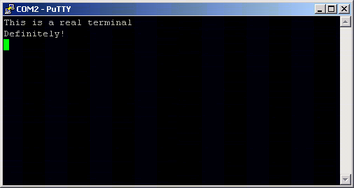
Existing Terminals
Original Win 3.11 terminal  Predefined keys  Limited to COM1..4  Limited to 19200 baud  Complex settings dialogs
Win 95 HyperTerminal  COM1..256 / TCP  No predefined keys  Limited features
Tera Term  Continued development  SSH/UTF-8/… support  Win16 subsystem
Br@y++ Terminal  Scripting (experimental)  No TCP support  Cramped user interface
Good ol’ VersaTerm  Very comprehensive  Available for Mac only
PuTTY & Co.  Highly optimized for Telnet/SSH/…  Not really useful for straight forward serial device communication

Slide 4
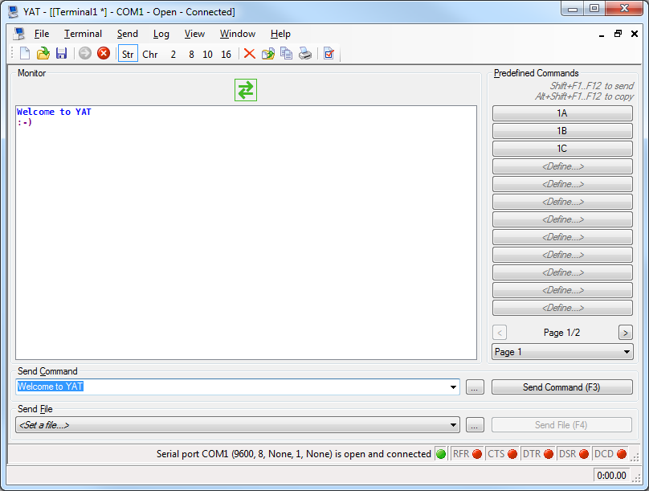
YAT
 File and terminal status
 Unlimited number of predefined commands
 Bidirectional monitor  Rx only monitor  Tx only monitor
 String/Char  Hex/Dec/Oct/Bin  Timestamp  Length
 Send command
 Multi-line command
 Contol line status
 Send file
 Terminal status
 Stopwatch

Slide 5
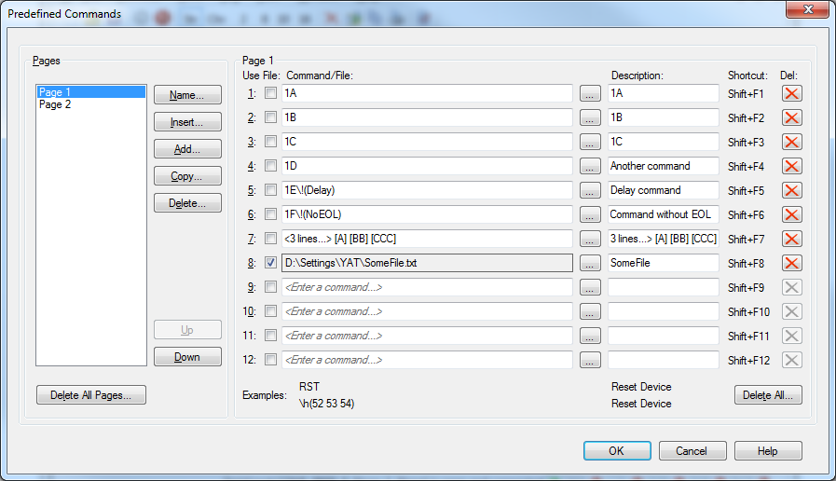
Predefined Commands
 Description
 Shortcut
 Any number of pages
 Keywords
 Multi-line
 File

Slide 6
Parser Format
Default "OK"
Binary
Octal
Decimal
Hexadecimal
Character
String "\s(OK)"
ASCII controls "<CR><LF>“
C-style controls "\n\r"
"\b(01001111)\b(01001011)"
"\o(117)\o(113)"
"\d(79)\d(75)"
"\h(4F)\h(4B)"
"\c(O)\c(K)"
"\b(01001111 01001011)"
"\o(117 113)"
"\d(79 75)"
"\h(4F 4B)"
"\c(O K)"

Slide 7
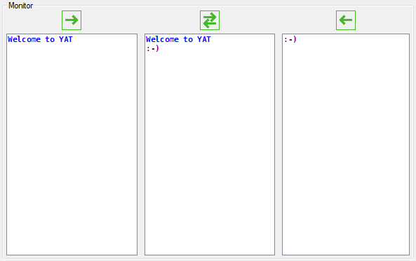
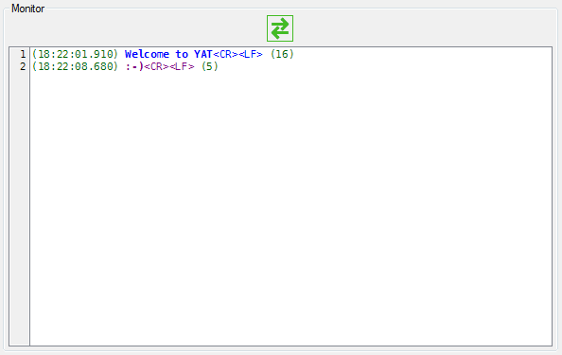
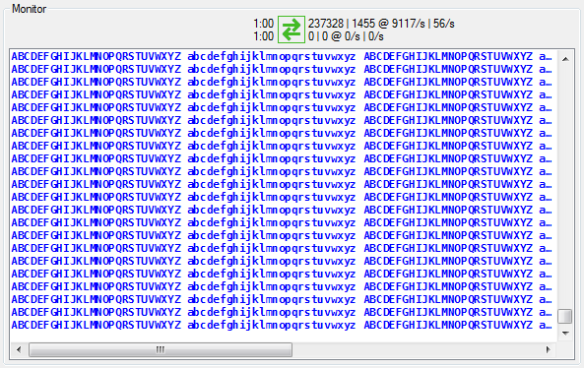
Terminal Monitor
 Bidirectional monitor  Rx only monitor  Tx only monitor
 String/Char  Hex/Dec/Oct/Bin  Timestamp  Length
 Up time  Byte and line counts  Byte and line rates

Slide 8

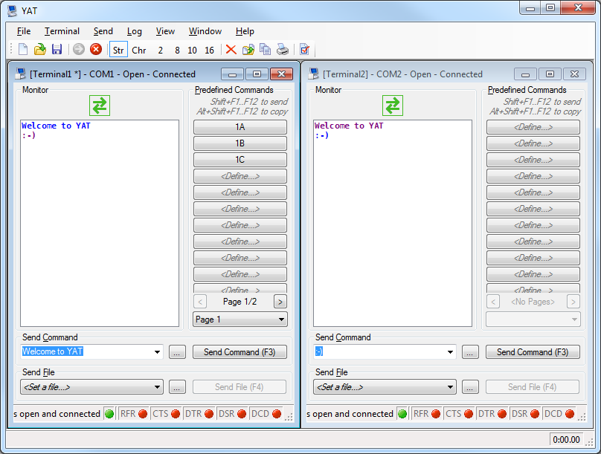
Workspace
 Manual Layout  Cascade  Tile Horizontal  Tile Vertical
.yaw
 Multiple Terminals

Slide 9

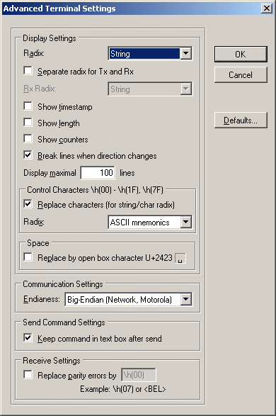
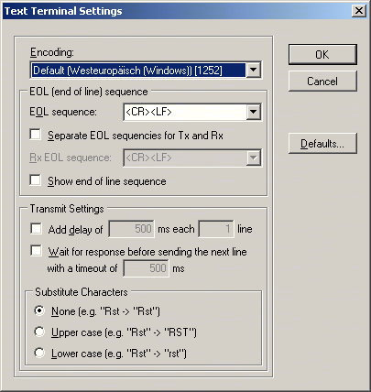
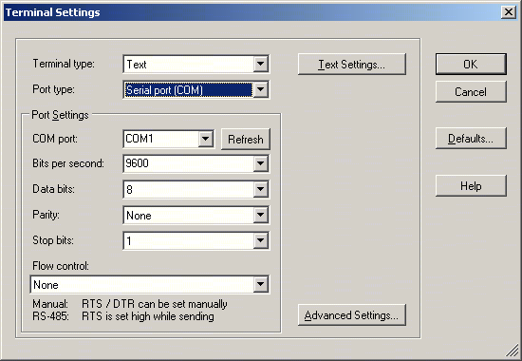
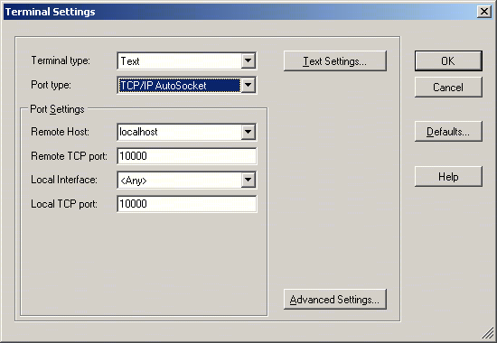
Terminal Settings
.yat
 Text or Binary Settings
 Text or Binary
 Serial Port (COM)  Virtual Ports (USB/Bluetooth/…)  COM1…COM256…COMnnnnn  Any baud rate
 TCP/IP Client  TCP/IP Server  TCP/IP AutoSocket  UDP/IP Socket
 Advanced Settings

Slide 10
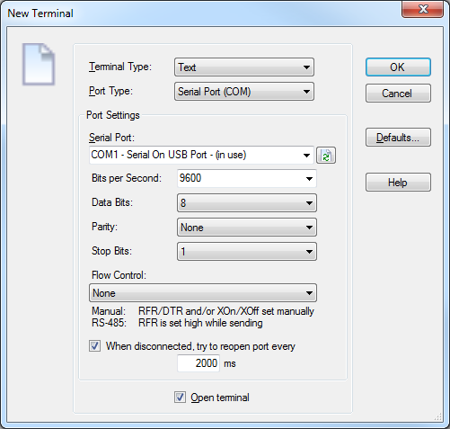
Terminal Settings
.yat
 Text or Binary
 Serial Port (COM)  TCP/IP Client  TCP/IP Server  TCP/IP AutoSocket  UDP/IP Socket  USB Ser/HID
 Virtual Ports (USB/Bluetooth/…)  COM1…COM256…COMnnnnn  Any baud rate
 Standard flow control modes  Manual flow control modes  Additional port settings

Slide 11
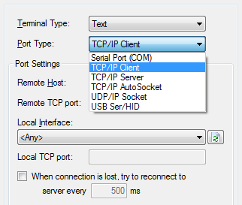
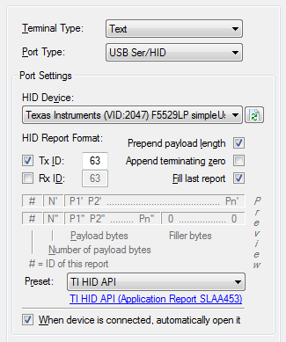
TCP, UDP and USB
.yat
 Socket selection
 Device selection
 Format definition
 Format preview
 Format presets

Slide 12
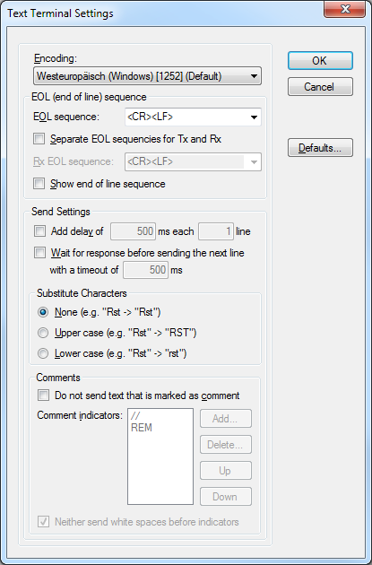
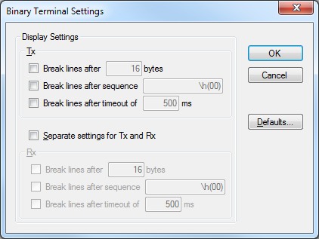
Text or Binary
.yat
 Encoding
 EOL definition
 Display line break
 Send settings
 Comments exclusion

Slide 13
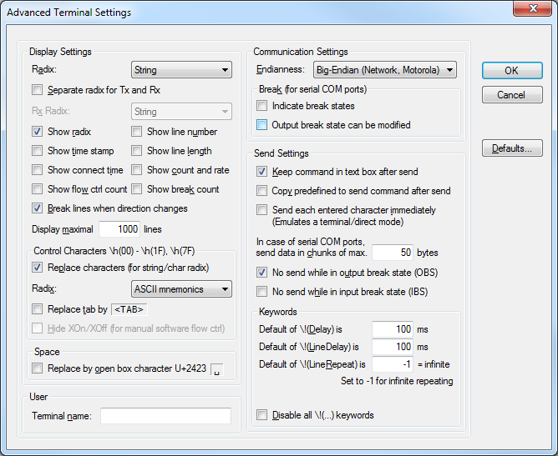
Advanced Terminals
.yat
 Advanced communication settings
 Display
 Send settings
 Keywords

Slide 14
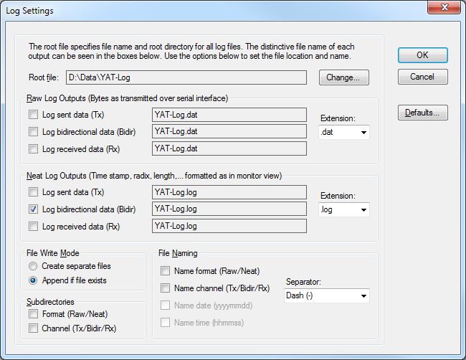
Log Settings
.yat
 Location
 Output format
 File naming

Slide 15
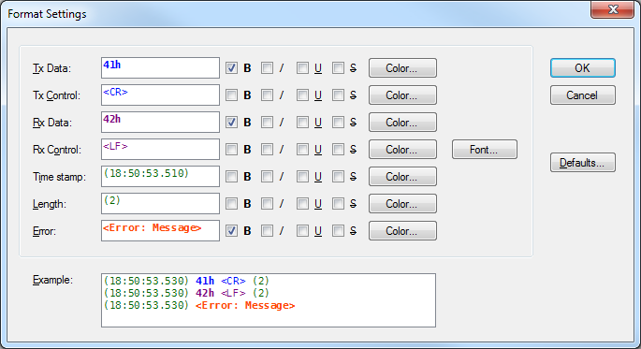
Monitor Format
.yat
 Elements
 Font and color
 Preview

Slide 16
YAT History
HSR Hochschule für Technik Rapperswil
KTI/CTI project “BBP - Balance Based Pipetting” between HSR and Mettler-Toledo
XTerm232 1.0
2003-08..10
WK
WK
SourceForge
WK
YAT 2.0
2006 2007 2008
Alpha 1..3
Beta 1
Beta 2
Beta 3

Slide 17
YAT Development
Framework
.NET 3.5 SP1
Programming
C#
Visual Studio 2013
Libraries
ALAZ socket extension
USB Ser/HID
Testing
NUnit
Manual
Build
Visual Studio 2013
Installer
VS 2013 Installer
Documentation
OpenOffice

Slide 18
YAT Architecture
Persistance / Settings
View / GUI
Model
Testing
Serial Port / Sockets

Slide 19
YAT Source Code
C# source code files: 280
Size of files: 2MB
Lines of code: > 50’000
Notes:
Manual
MKY.Types.EnumEx: 604 LoC @ 21'315 B = 35.3 CpL
YAT.Domain.Terminal: 1'979 LoC @ 65'238 B = 33.0 CpL
YAT.Model.Terminal: 3'381 LoC @ 101'197 B = 29.9 CpL
32 CpL
Designer
YAT.Gui.Controls.Monitor: 177 LoC @ 8'845 B = 49.9 CpL
YAT.Gui.Forms.Terminal: 2'771 LoC @ 209'536 B = 75.6 CpL
64 CpL
Total
Manual: 420 Files à 4'585 KB = 143'281 LoC
Designer: 44 Files à 785 KB = 12'265 LoC
Total: 464 Files à 5370 KB = 155'546 LoC
Davon
ALAZ: 28 Files à 256 KB = 8'200 LoC

Slide 20
YAT Demo
Notes:
Show first start
Define some keys
Send something
Close YAT
Start again → everything restored
Show timestamp/length
Show connect time
Show counters
Show stopwatch
Show format
Show space replacement

Slide 21
YAT Home
SourceForge
http://sourceforge.net/projects/y-a-terminal/
Source code repository (Subversion)
Mailing list
Releases
Feature request tracker
Bug tracker

Slide 22
Sign up for YAT
max.muster@mymail.com

Slide 23
Q&A

Slide 24
Thanks

