Slide 1
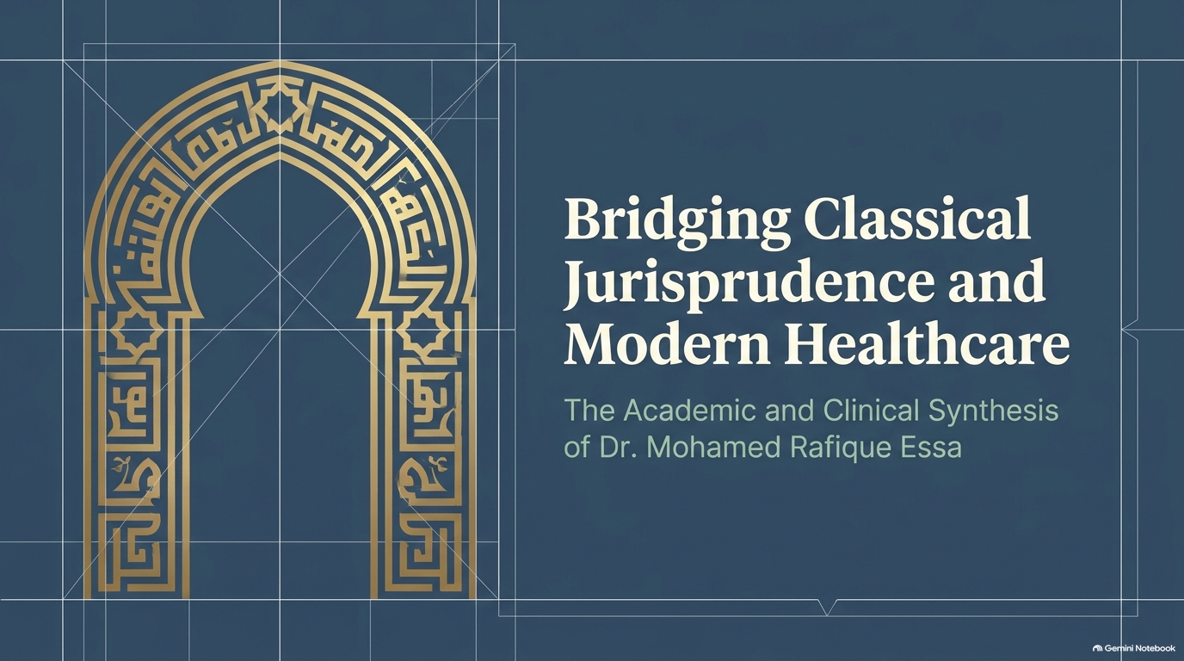

Slide 2
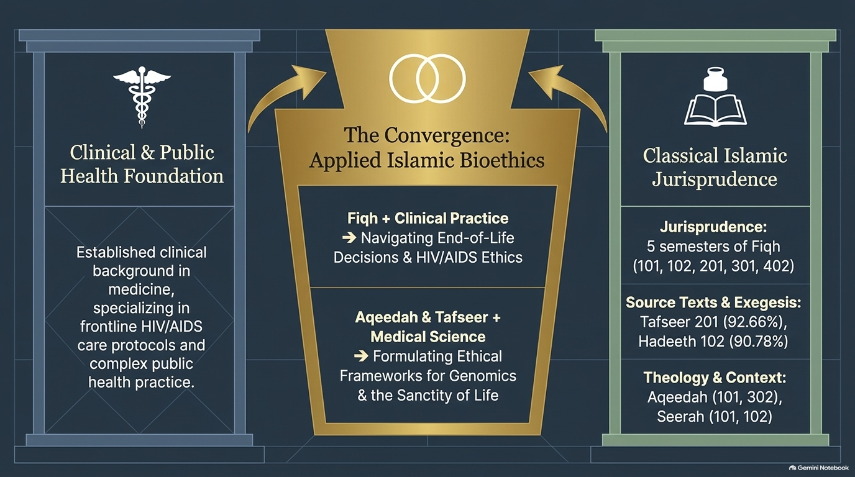

Slide 3
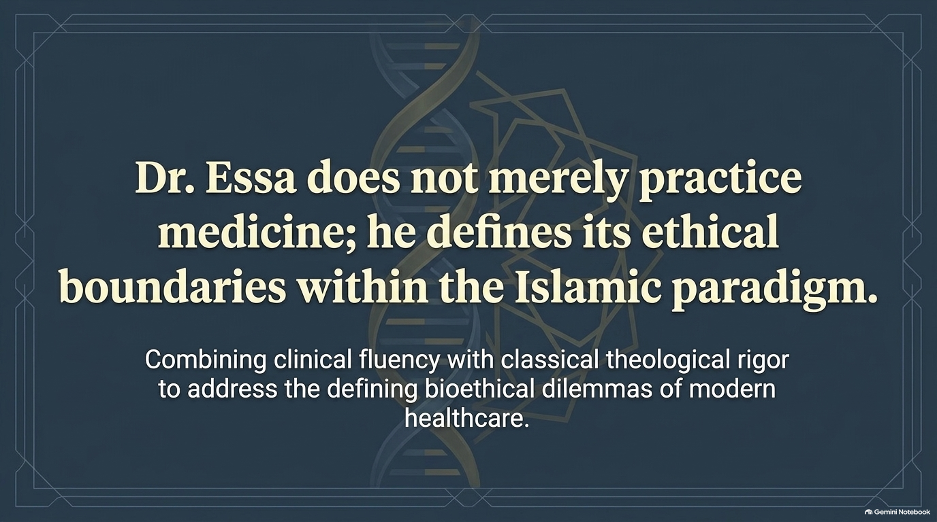
Notes:
Combining clinical fluency with classical theological rigor to address the bioethical dilemmas of modern healthcare.

