Slide 1
Google Data Analytics Capstone: Fitbit Case Study
Presented by: Wai Nam Hill Lam
Last Updated: September 2nd, 2025

Slide 2
Problem:
How can we leverage user activity data to increase long-term app engagement and prevent user churn?
Purpose:
To analyse user activity patterns to identify key trends and relationships.

Slide 3
Analytical Goals
Discover:
How does walking help or improve users’ health?
What are the key daily activity patterns that can inform engagement strategies?

Slide 4
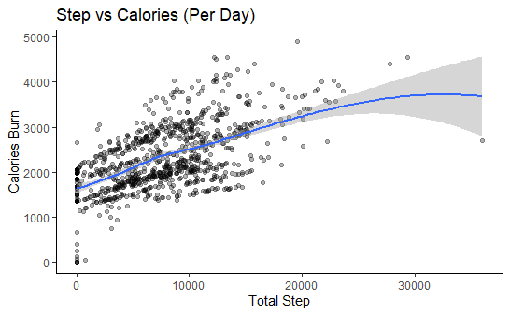
Findings
Users who walk more have a higher calorie burn
Once past 20k steps per day, the growth slows down
correlation (r ≈ 0.59)

Slide 5
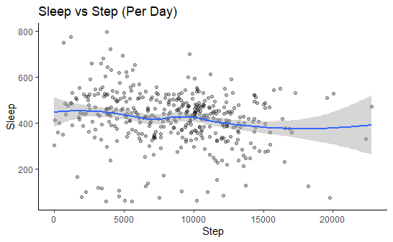
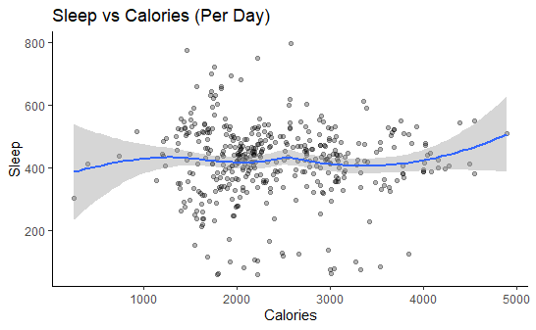
Findings
Users who walk and burn more do not necessarily sleep better
correlation (r ≈ -0.1 ~ -0.2)
correlation (r ≈ -0.1 ~ -0.2)

Slide 6
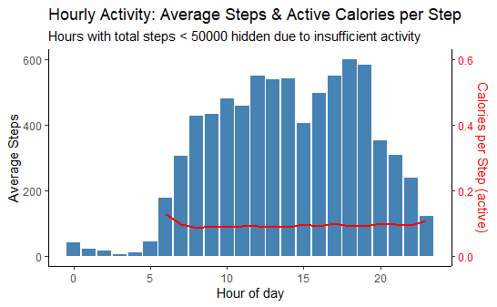
Findings
Peak at 12 pm and 7 pm
Steps and walk efficiency are overall stable during the day

Slide 7
Suggestion
Target users with motivational notifications shortly before peak activity times (e.g., 11:30 AM and 6:30 PM) to encourage movement.
Design a gamification challenge, for example, achieve 15k steps on 10 different days this month.
Promote walking no matter when; walking is always healthy.

Slide 8
Future improvement
larger simple size:
increase the simple size with more users’ data
include more user information
include a longer timeline

Slide 9
Thank You

