Slide 1
International Finance, Econ 434
Barry W. Ickes

Slide 2
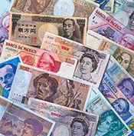

Slide 3
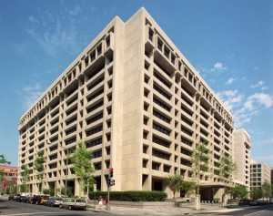
World Headquarters

Slide 4
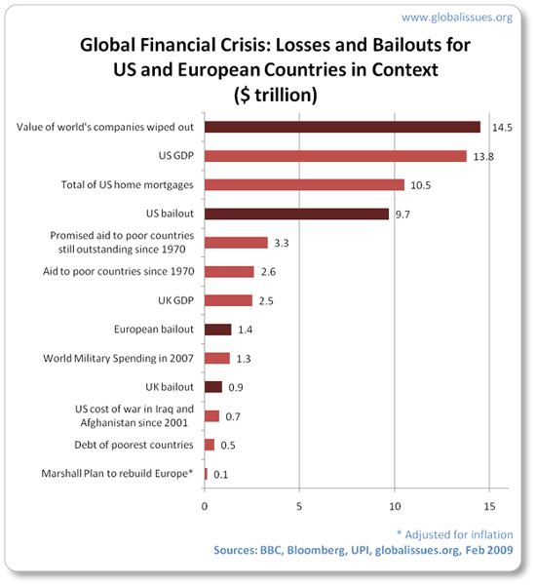
Global Losses in Context

Slide 5
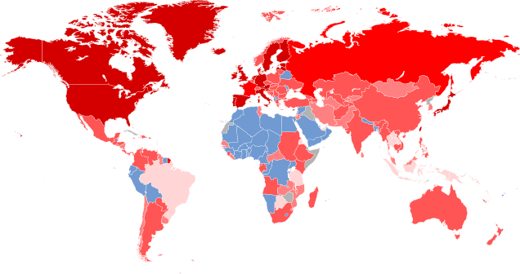
World Financial Crisis

Slide 6
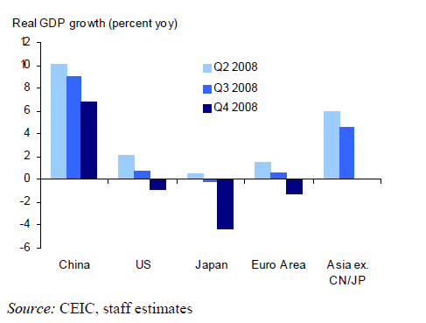
Worldwide Shock
Barry W. Ickes

Slide 7
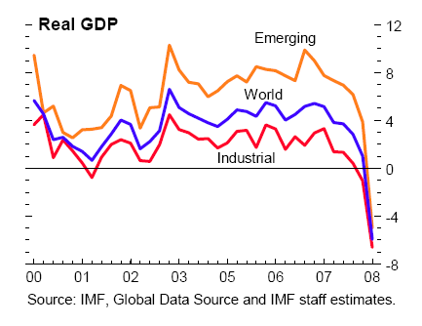
Global Growth
(in percent, quarter over quarter annualized)

Slide 8
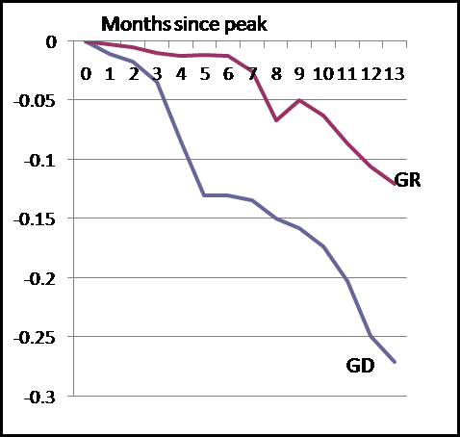
Industrial Production

Slide 9
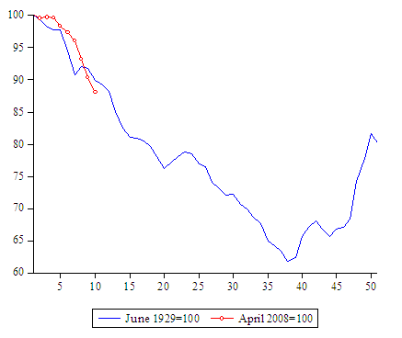
World Industrial Output, Then and Now
Barry W. Ickes

Slide 10
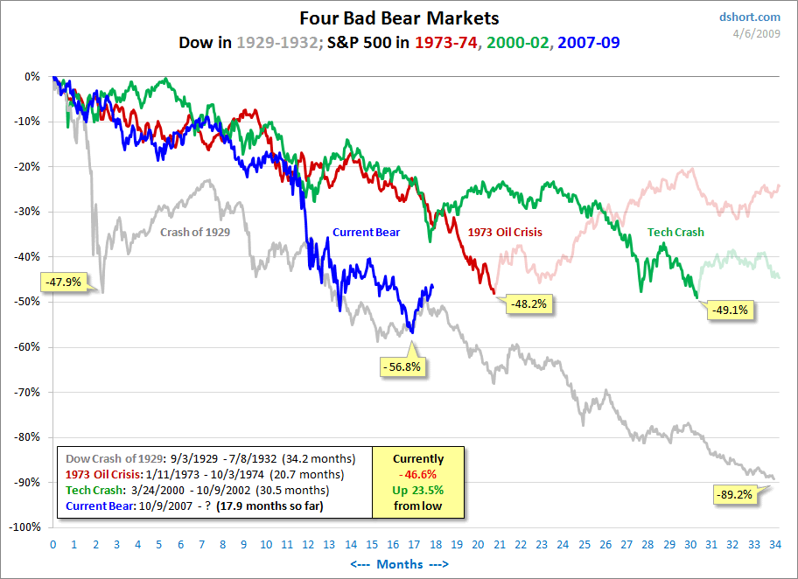
Our Stock Market, Then and Now
Barry W. Ickes

Slide 11
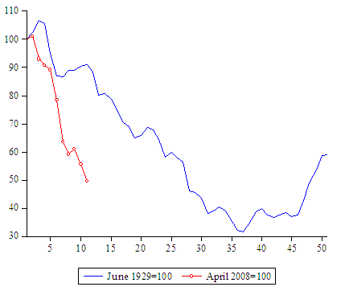
World Stock Markets, Then and Now

Slide 12
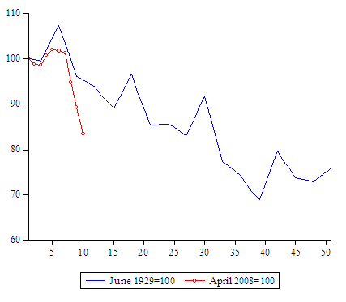
Volume of World Trade, Then and Now
Barry W. Ickes

Slide 13
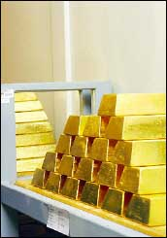
A Barbarous Relic?

Slide 14
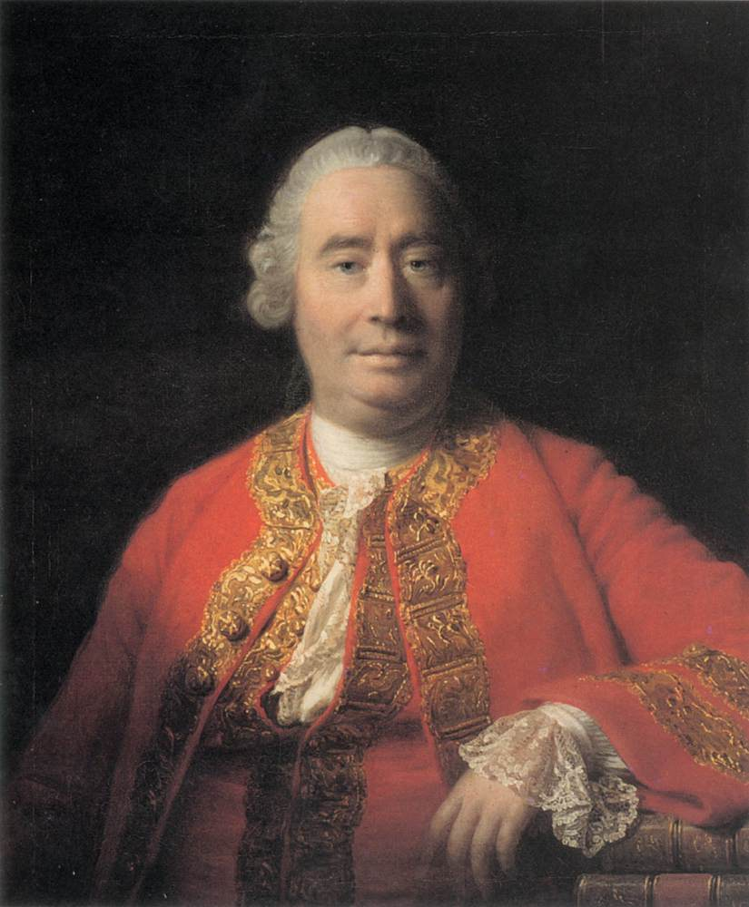

Slide 15
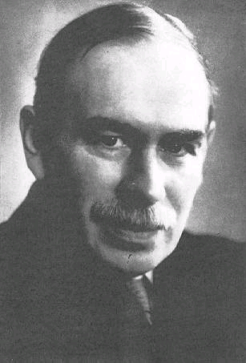
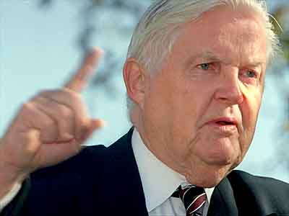
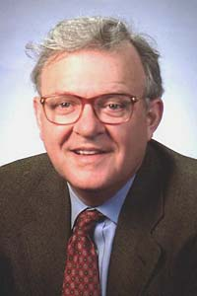
Pioneers of International Finance

Slide 16
Core of our subject
Multiple fiat currencies
  Gives rise to exchange rates
Facilitate international trade
Facilitate international risk sharing
  Intertemporal trade
  Gross flows are huge
Financial Crises are costly
  And obviously they spillover across countries

Slide 17
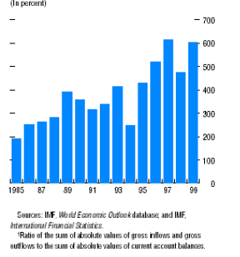
Gross Global capital flows relative to net flows

Slide 18
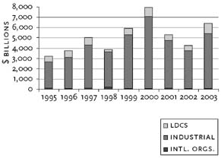
World Financial Flows

Slide 19
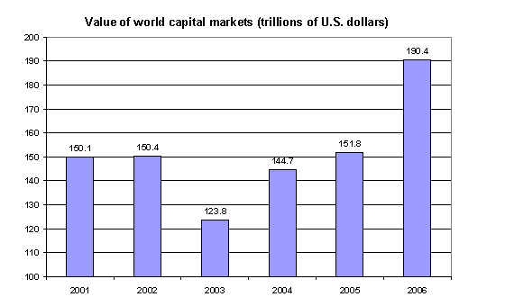
Value of World Capital Markets
= 4 (World GDP)

Slide 20
How Large is this?
Daily Forex turnover is $3.2 trillion
  World GDP is about $54 trillion dollars per year
US GDP is $14.4 trillion per year
  US exports = $1.97 trillion, imports = $2.67 trillion
    Net exports = -$706 billion
      By comparison total US investment in residential construction = $704 billion in 2006 before the housing bust
  Federal government expenditure = $2.9 trillion
    $566 billion is national defense
Why are foreign exchange flows so large, and what is their impact?

Slide 21
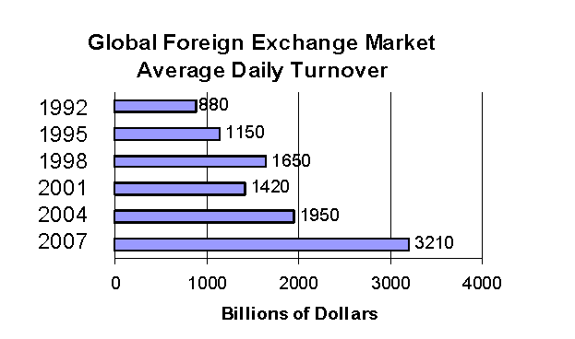
Daily Forex Turnover

Slide 22
Globalization
Globalization is not new
But massive 2-way diversification differentiates the current from the earlier period of globalized capital markets.
  Capital flows now from poor to rich countries
    Why?

Slide 23
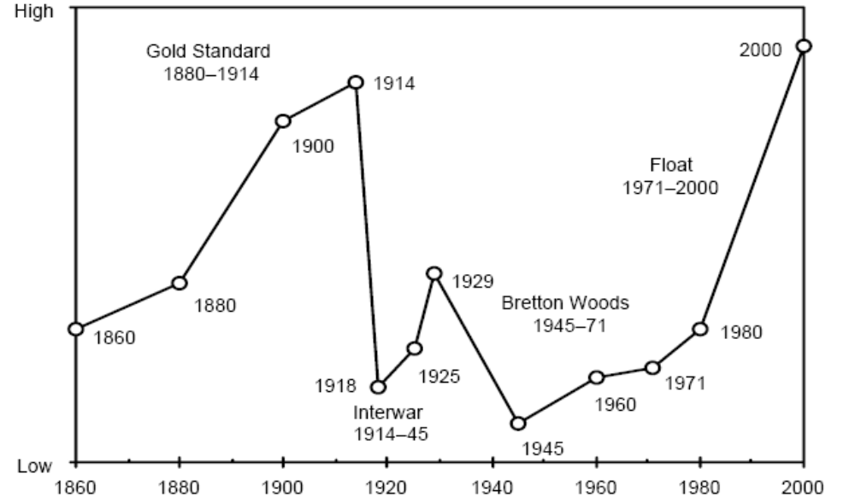
Stylized view of financial integration

Slide 24
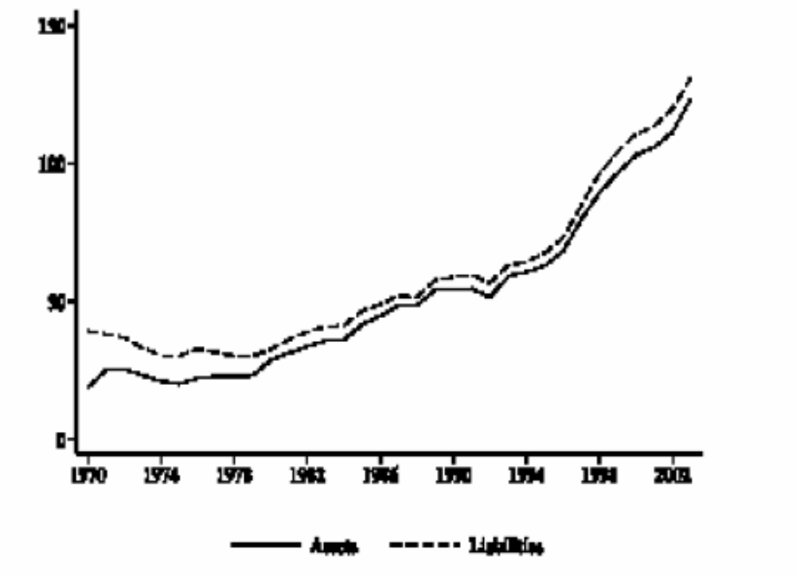
World Assets and Liabilities, 1970-2003 pct of world GNP

Slide 25
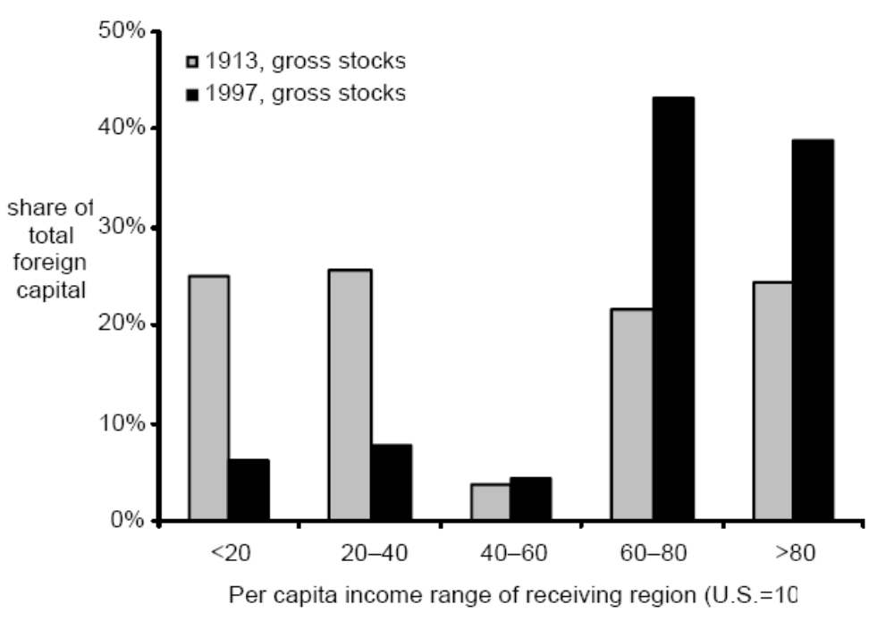
Foreign Assets, then and now

Slide 26
Systems of International Finance
Bimetallism
Gold Standard
Gold Exchange Standard
Bretton Woods
Non-system
New Bretton Woods?

Slide 27
Models
Why do we use models?
  Instructor is an _______
  To simplify
  To understand logically what we are talking about
  To make testing possible

Slide 28
Topics
Huge US Current Account Deficit
  US uses most of world savings
What explains the value of the dollar?
Financial Crises
  Large welfare losses
Optimal Currency Arrangements
  Common currency areas, the euro
International Financial Architecture

Slide 29
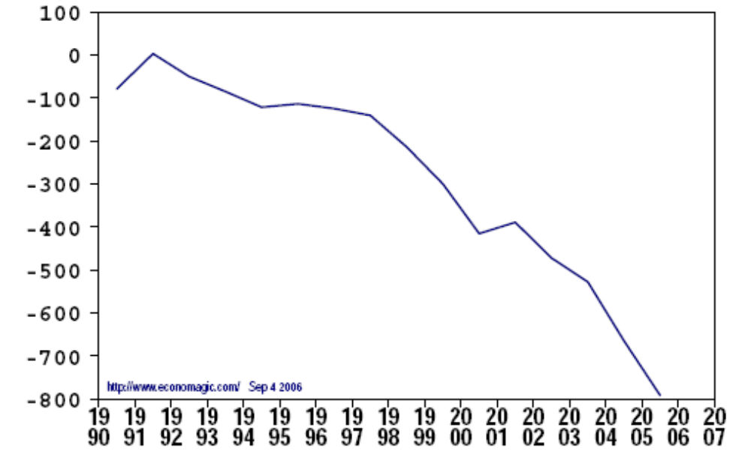
US Current Account Balance, billions of dollars

Slide 30
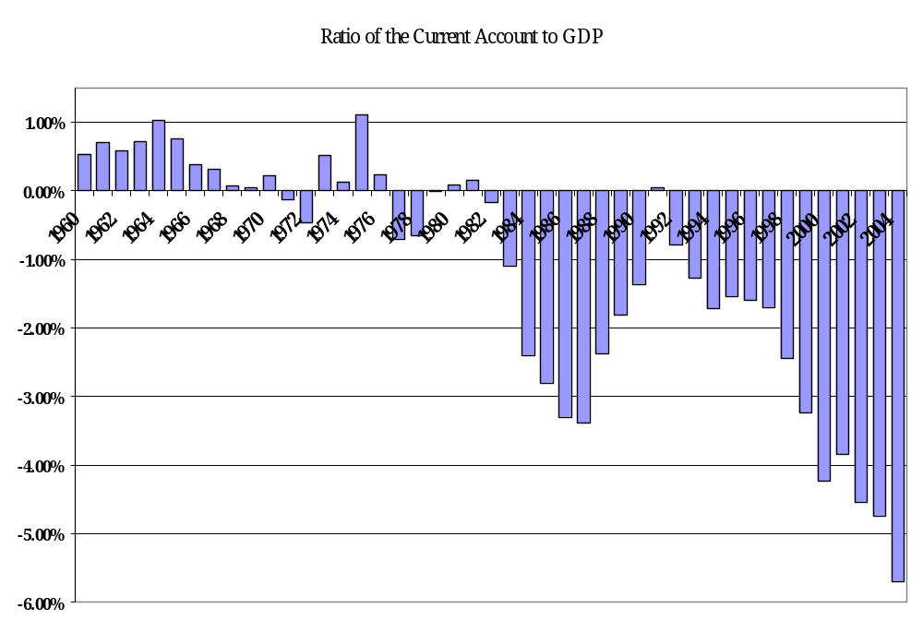
Current Account Balance as share of GDP

Slide 31
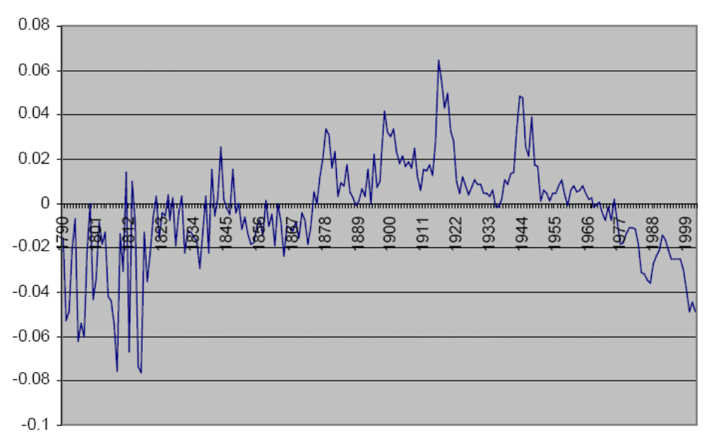
US Balance of Trade Since 1970

Slide 32
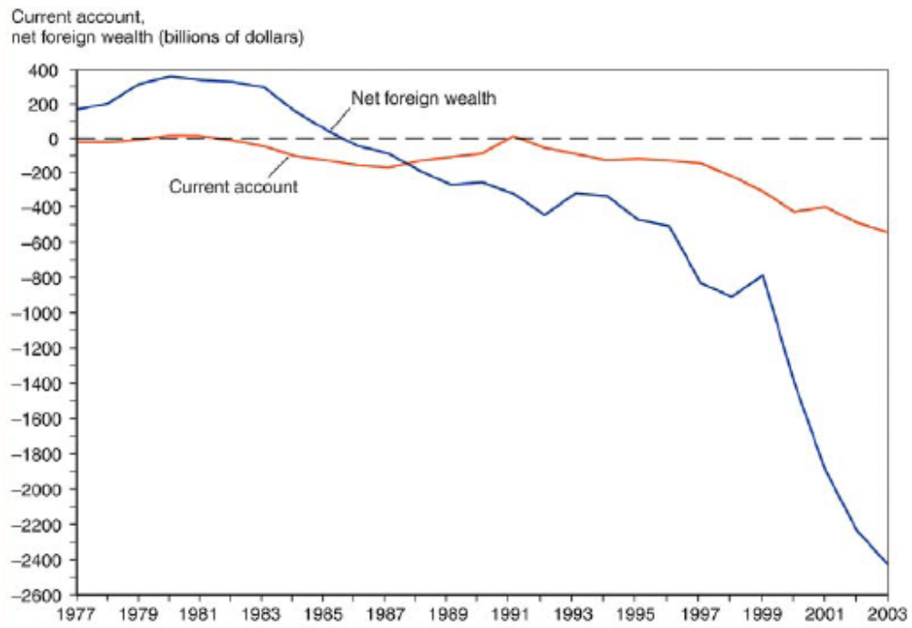
Current Account and Net Foreign Wealth

Slide 33
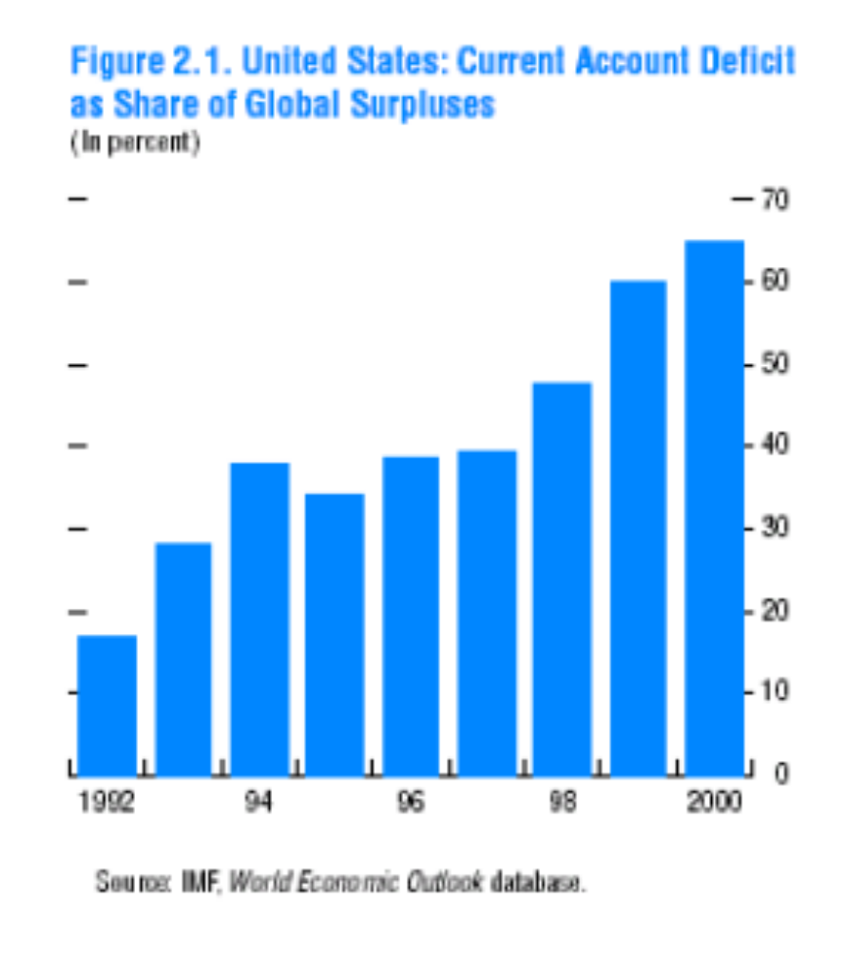
US Share of Global Savings

Slide 34
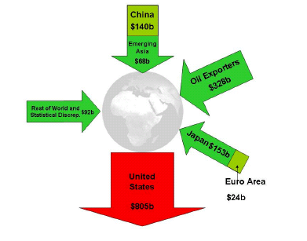
Global Current Account Flows, 2005

Slide 35
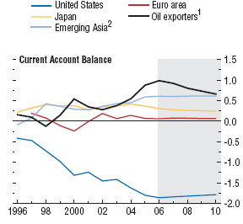
Current Account Balances by Region pct of world GDP

Slide 36
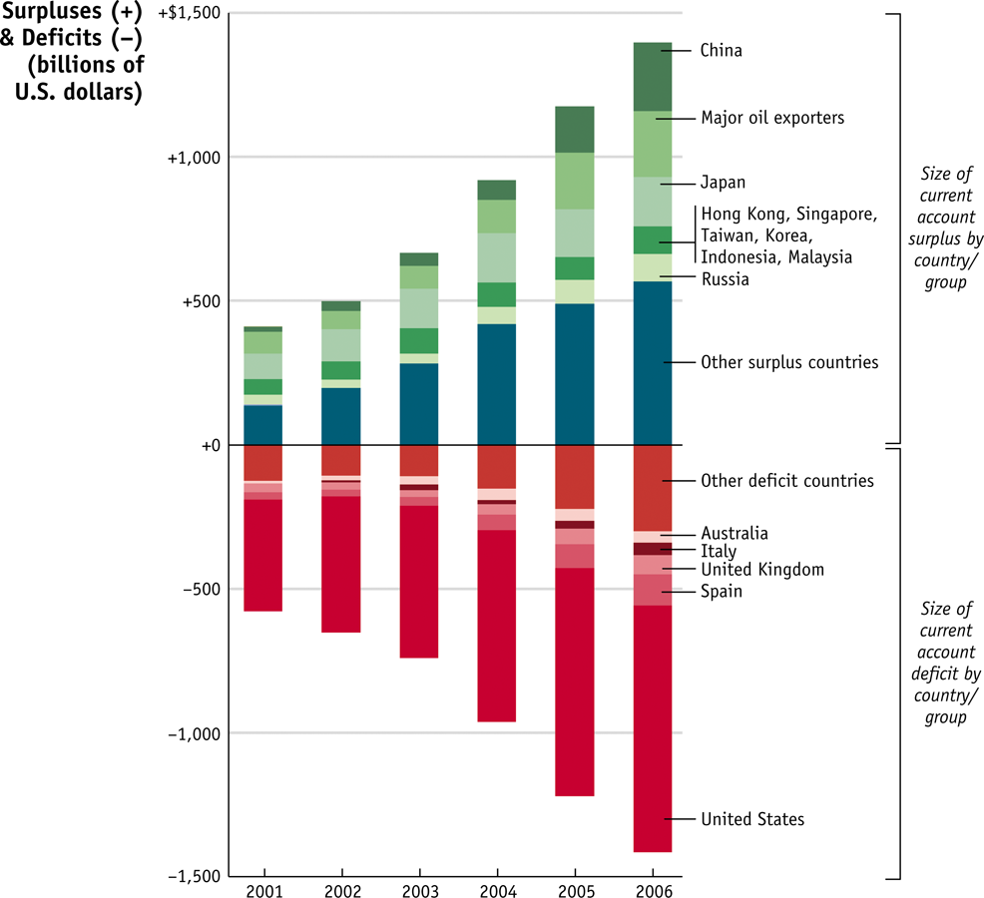
Current Account Balances by Region

Slide 37
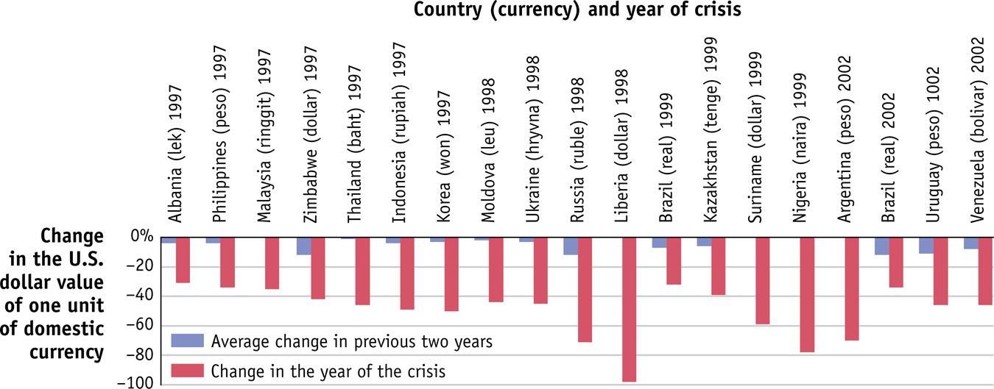
Currency Crises

Slide 38
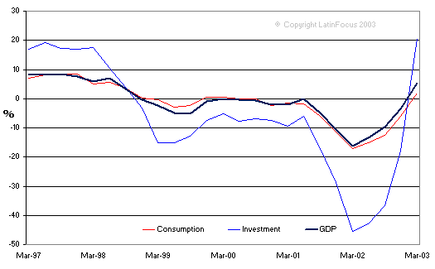
Argentine Crisis

Slide 39
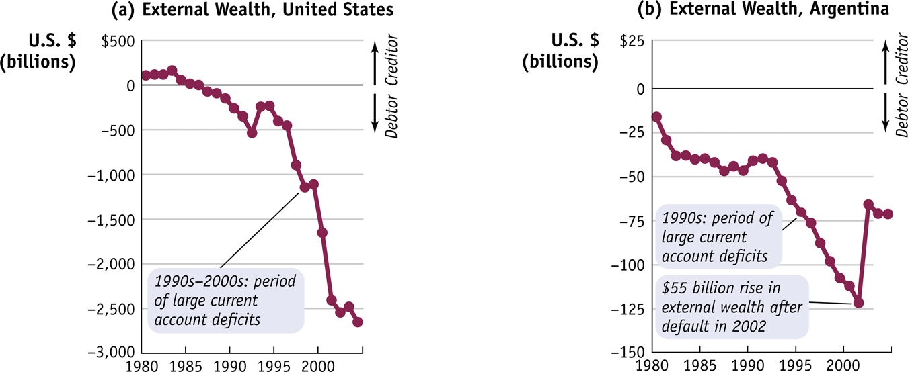
US and Argentine External Wealth
Why did the sharp decline in external wealth cause a currency crisis in Argentina but not (yet) in the US?

Slide 40
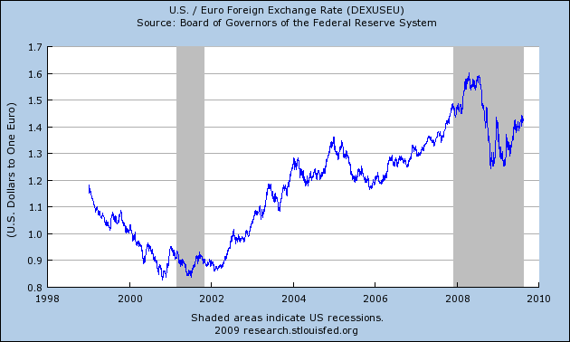
Dollars per Euro

Slide 41
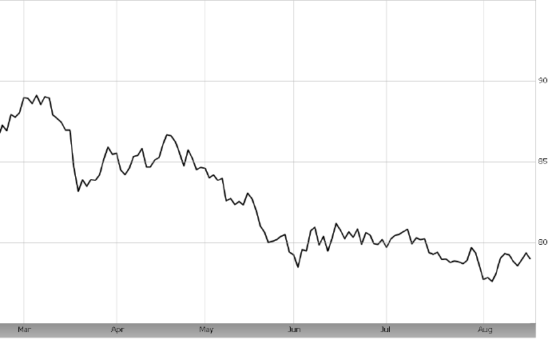
US Dollar Index Against Major Currencies

