Slide 1
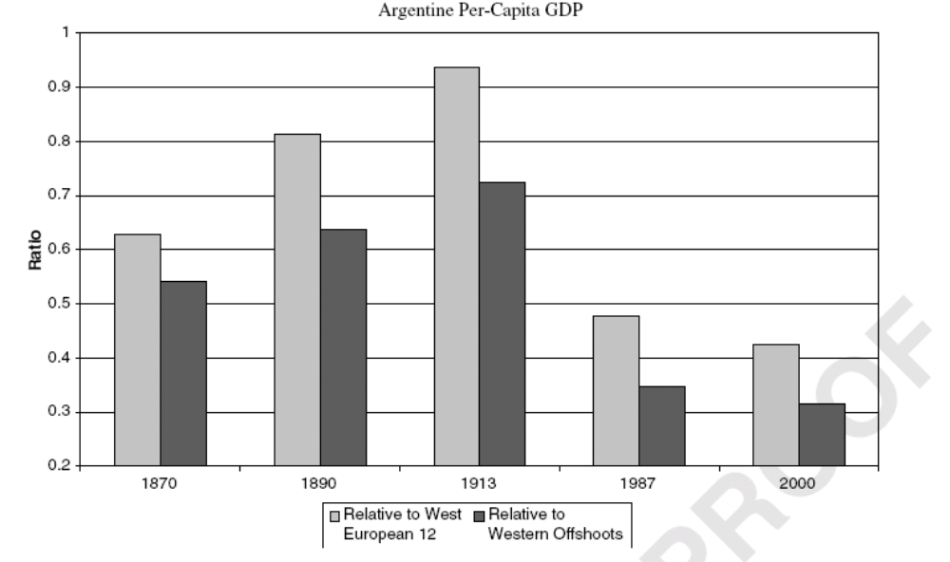
Argentine Regression

Slide 2
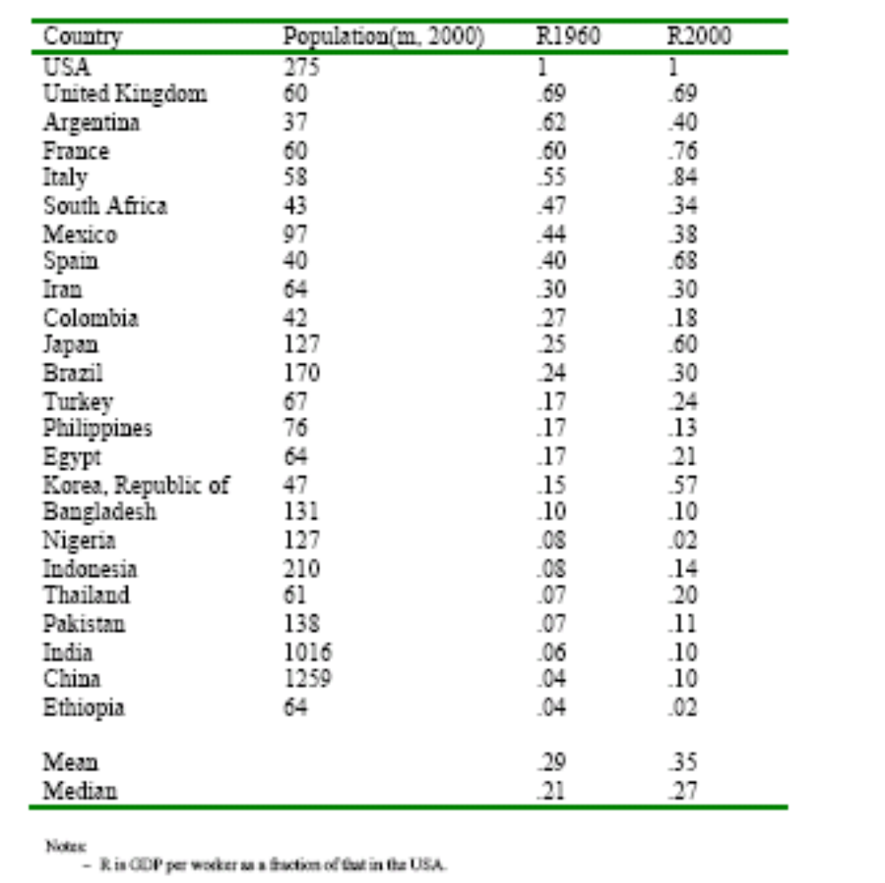
International Disparities

Slide 3
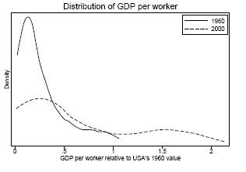
Cross-Country Density

Slide 4
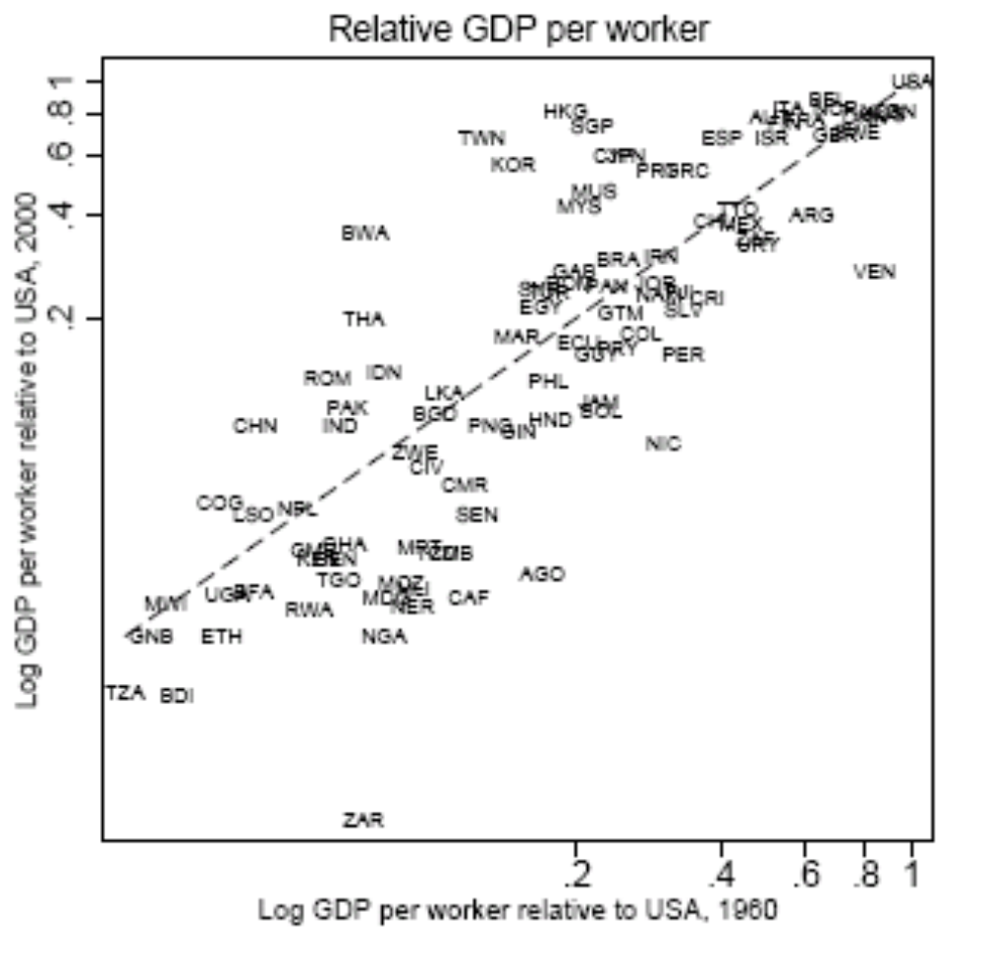
Persistence in Ranking

Slide 5
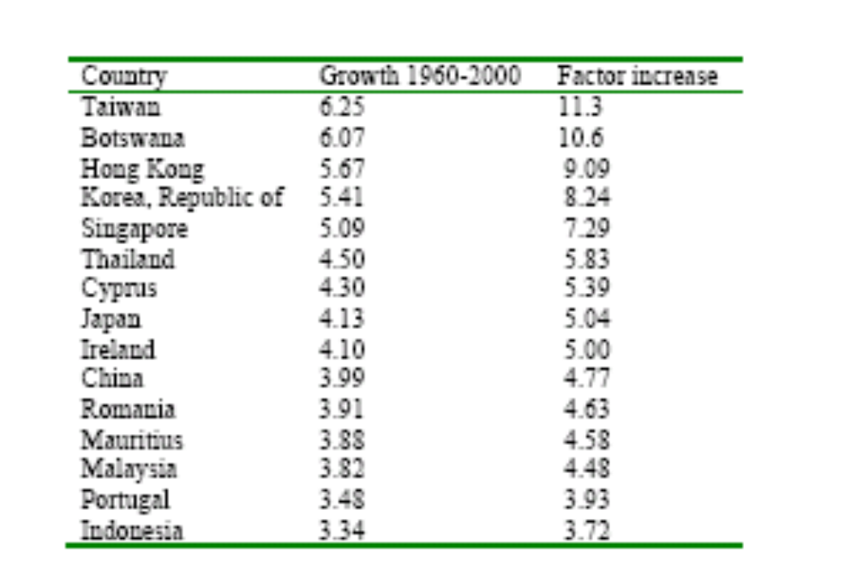
Fifteen Growth Miracles

Slide 6
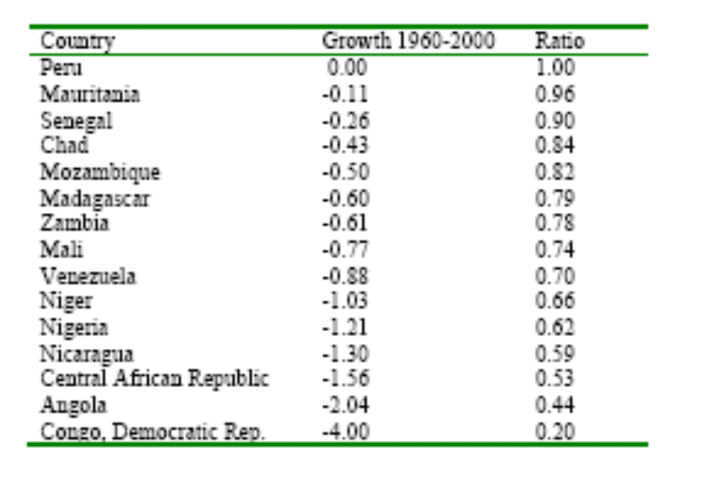
Fifteen Growth Disasters

Slide 7
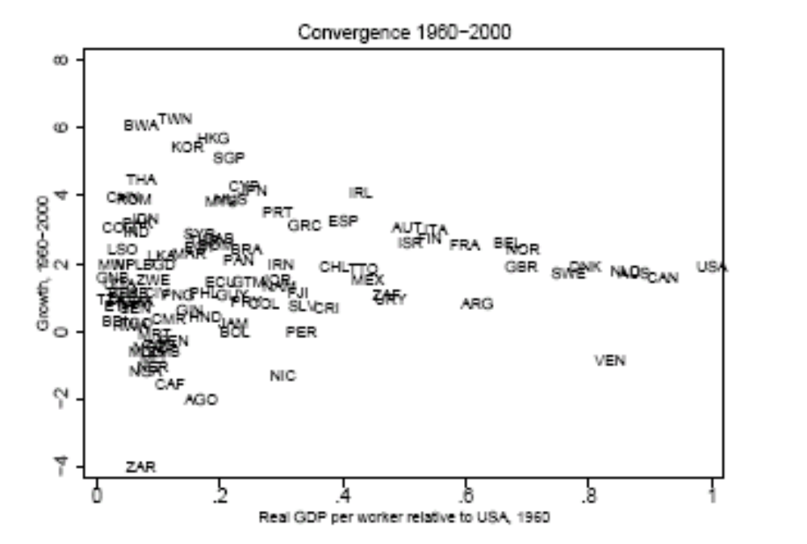
Convergence

Slide 8
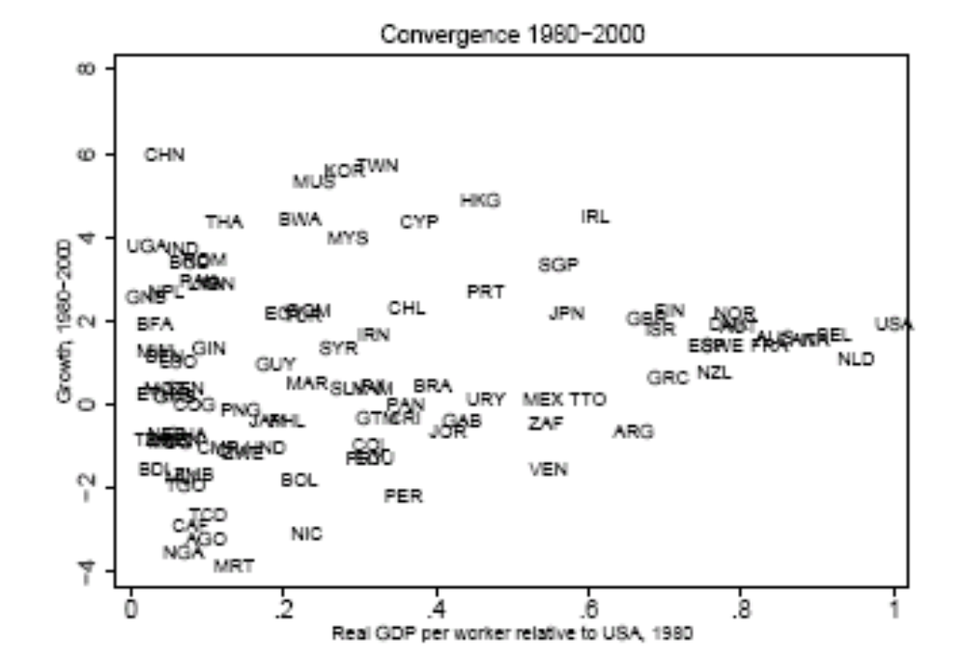
Tougher to Converge Recently

Slide 9
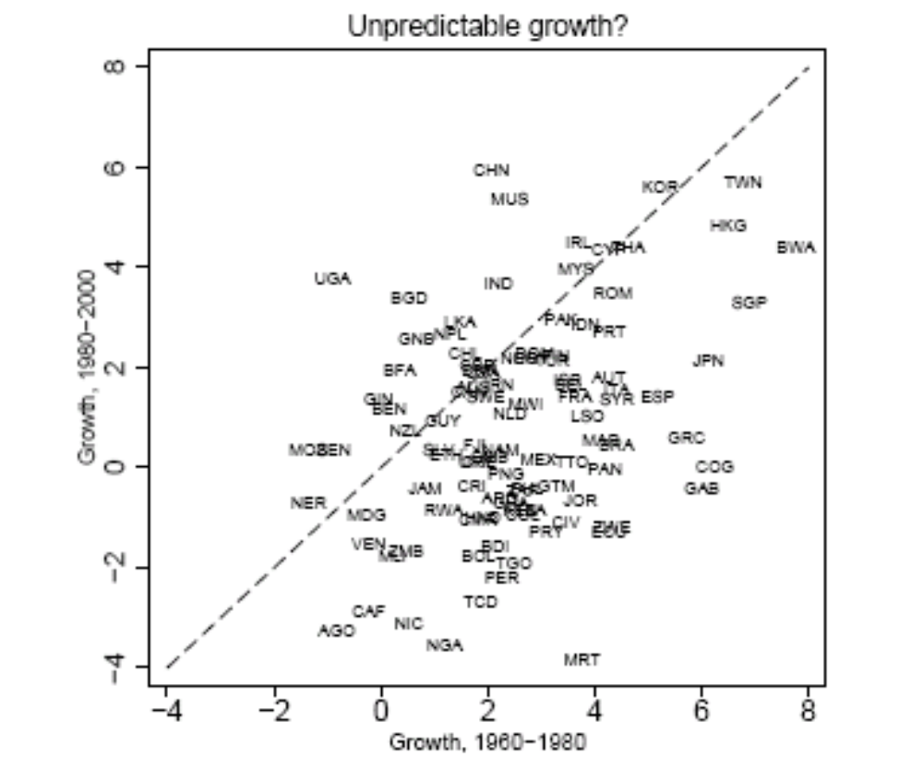
Unpredictable Growth

Slide 10
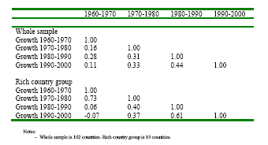
Growth Rate Correlations by Decade

Slide 11
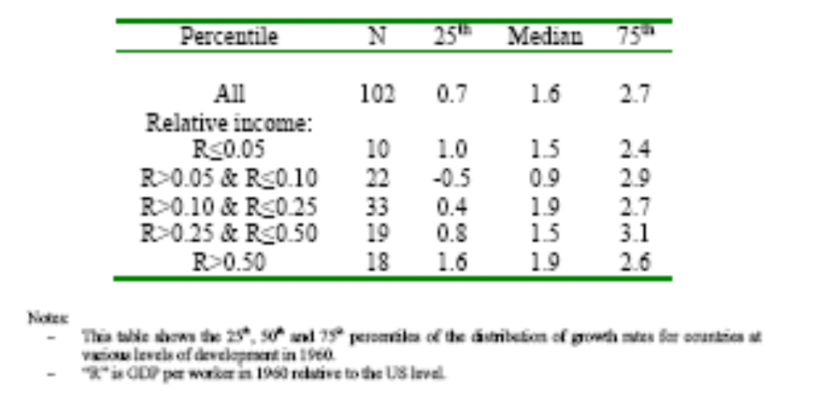
Growth Rate by Initial Level of Income

Slide 12
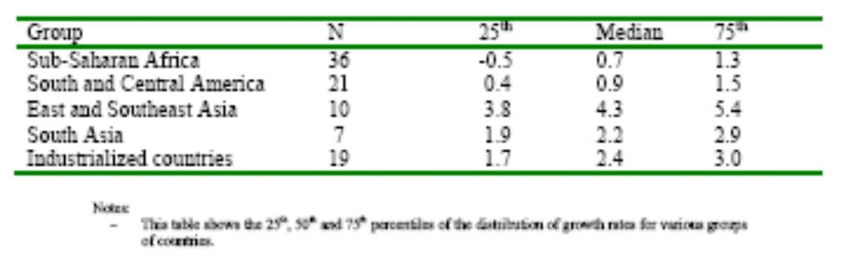
Growth by Country Group

Slide 13
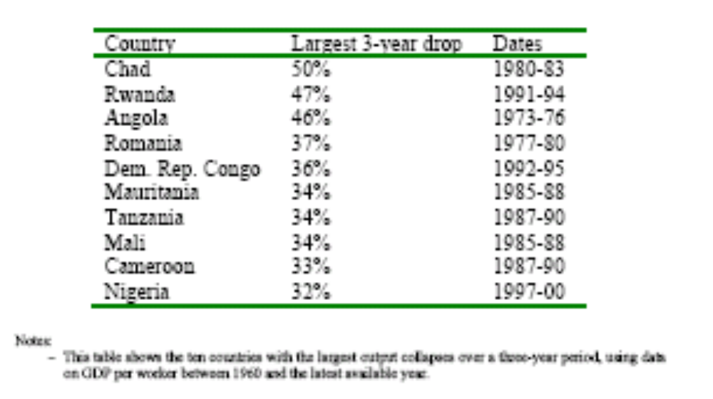
Output Collapses

Slide 14
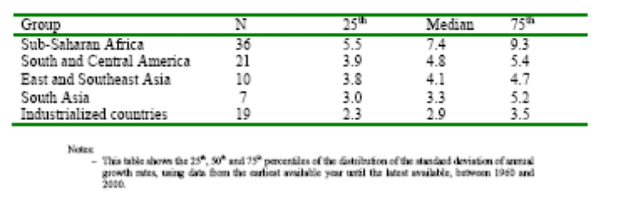
Volatility By Region

Slide 15
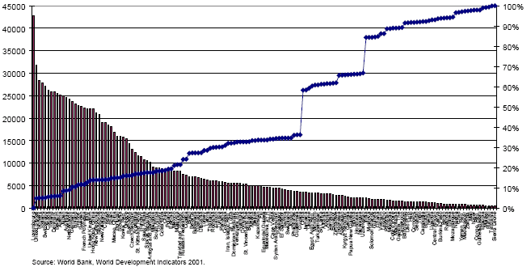
Global Income Distribution
GDP per-capita in 1999 PPP-adjusted, and cumulative population

Slide 16
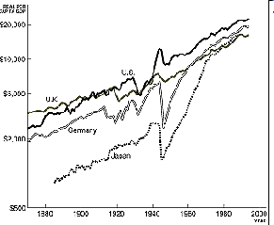
Per-Capita GDP 1870-1994

Slide 17
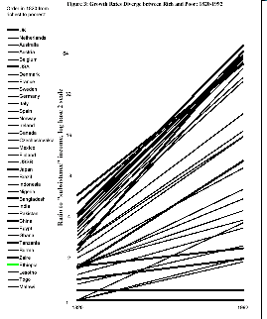
Divergence, Big Time

Slide 18
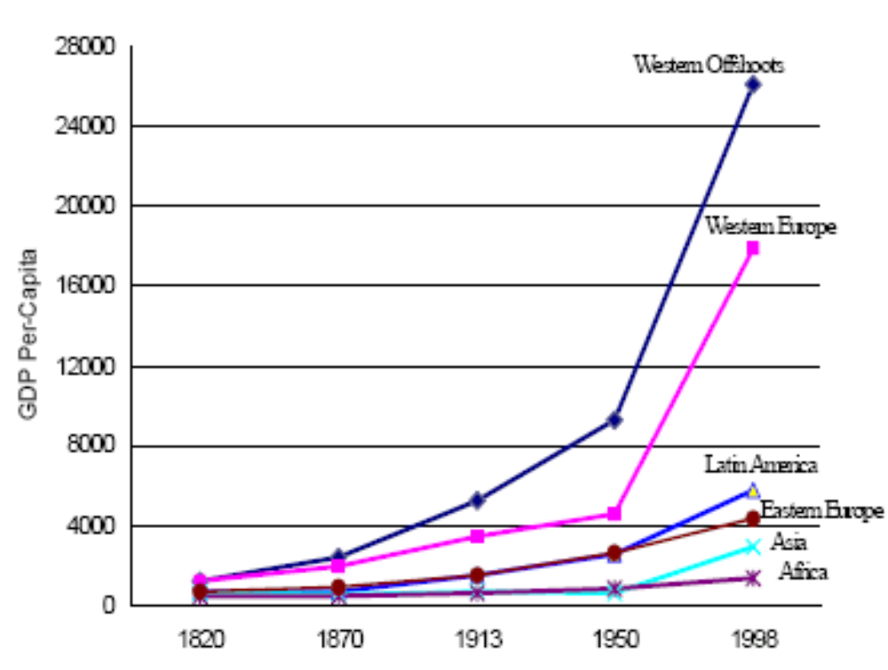
Great Divergence by Region

Slide 19
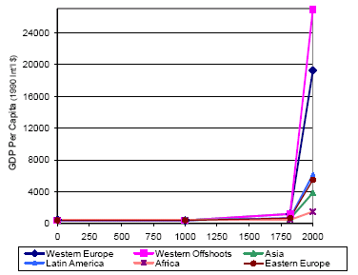
Regional Income per-capita, the long-view (Maddison, 2003)

Slide 20
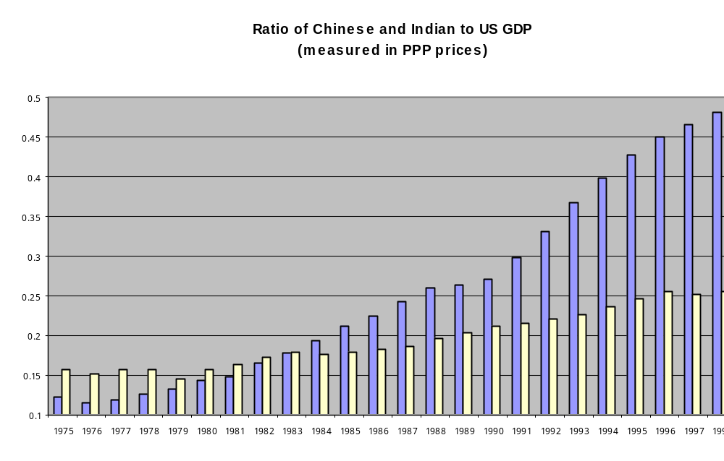
China, India relative to US

Slide 21
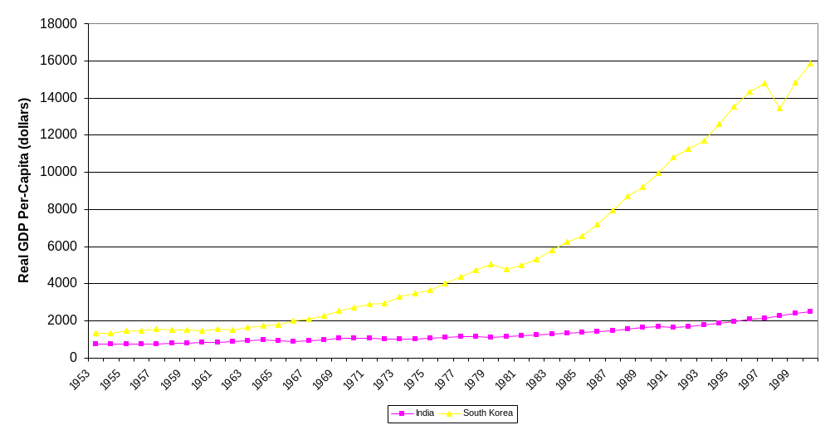
India vs South Korea

Slide 22
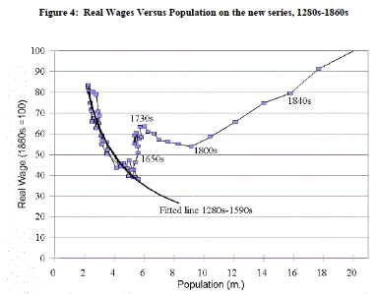
Clark’s New Data

