Slide 1
Russia in 2004 and Beyond
Barry W. Ickes
The Pennsylvania State University
October 2004

Slide 2
Main Theme
Future depends on energy and resources
  Strategy crucial
Political uncertainty is strong
  367 days since Khodorkovsky’s arrest
Solid growth performance on a fragile foundation
  Corruption
    Ranked 90th in 2004 TI index
  Regional disparities
  Illusion
  Relative price of investment
  Health Crisis

Slide 3
Extrapolation is Risky
Since 1998 growth and stability
Extrapolation from post-1998 period is risky
  Real appreciation has reduced competitiveness
  Growth is from low base
  Oil production has increased along with oil prices
Major plus
  Russia is well-placed to benefit from resource boom in China
But
  Recent growth is not due to fundamental reform
  Warning signs

Slide 4
Doubling GDP
Feasible, but
Not on the basis of manufacturing
  This is not where FDI goes
  Investment is insufficient
    Wagons for oil
  Look at MBMW
  Lossmakers survive
  Lack of competitiveness
Russia does not invest enough
  Recovery and oil boom create illusion

Slide 5
A Consumer Boom?
New Ikeas and Ritz Carlton to Moscow
  Retail trade turnover up 11% over last year
But
  Income is highly skewed in Russia
    Regionally and across population
  Demographics are bad
  Recovery growth versus sustained growth

Slide 6
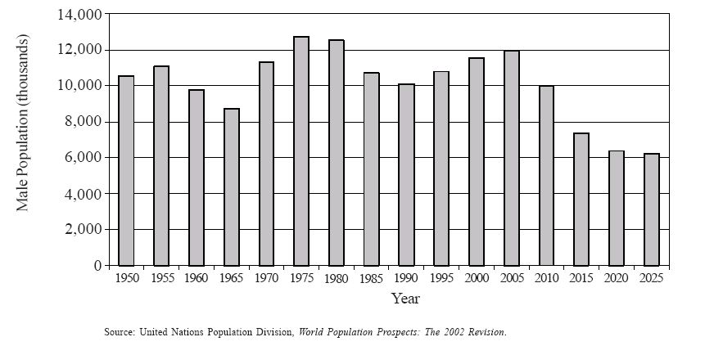
Male Population Aged 15-24, 1950-2025

Slide 7
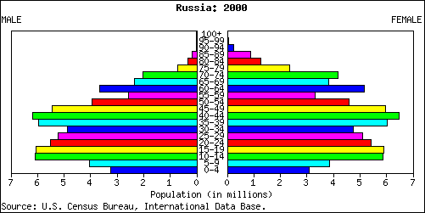
Population in 2000

Slide 8
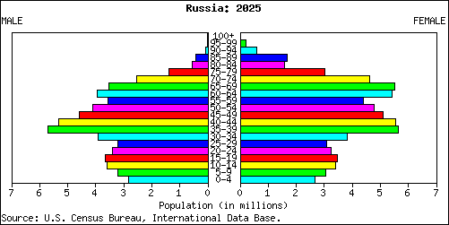
Population in 2025

Slide 9
Growth Competitiveness Index
Country 2004 Rank
Czech Republic 40
South Africa 41
Tunisia 42
Slovak Republic 43
Latvia 44
Botswana 45
China 46
Italy 47
Mexico 48
Country 2004 Rank
Jamaica 65
Turkey 66
Peru 67
Ghana 68
Indonesia 69
Russia 70
Algeria 71
Dominican Republic 72
Sri Lanka 73

Slide 10
Macro fundamentals are strong
GDP growth fueled by high oil prices
  High oil prices postpone restructuring
Reserves high, debt low, current account in surplus
Real appreciation could be a problem
  Sensitive to how measured
  More due to oil than productivity growth
Productivity is rising, but so are real wages
High oil prices is key

Slide 11
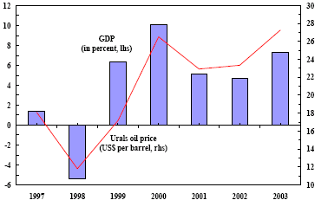
GDP Growth and Crude Oil Prices

Slide 12
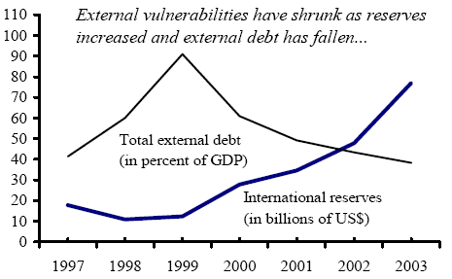
Debt and International Reserves

Slide 13
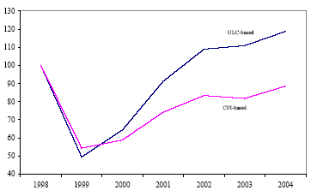
Real Effective Exchange Rate

Slide 14
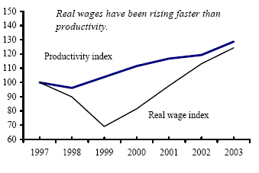
Real Wages and Productivity

Slide 15
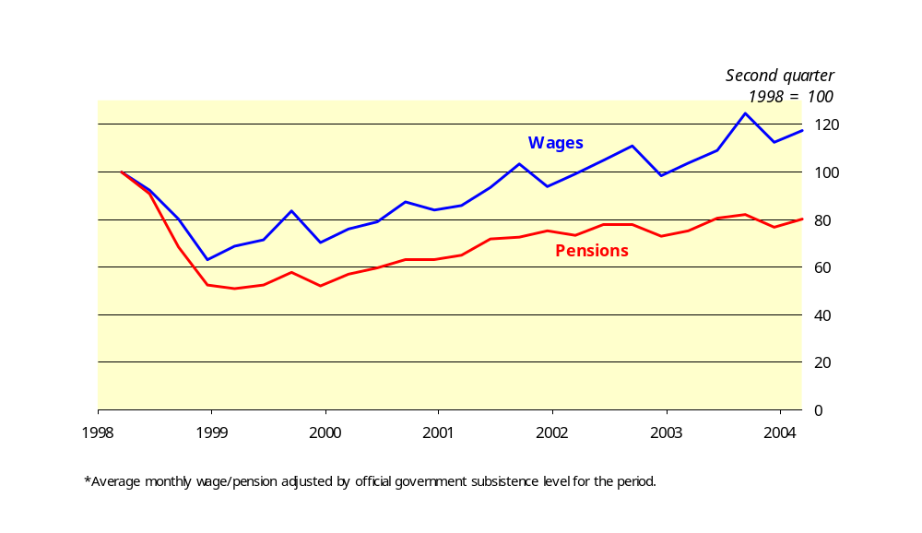
Real Wages and Pensions*, 1998-2004

Slide 16
Restructuring
Lossmaking Enterprises survive
Nonmonetary Payments survive
Investment is key to restructuring
  Cost of investment is too high
    Why?

Slide 17
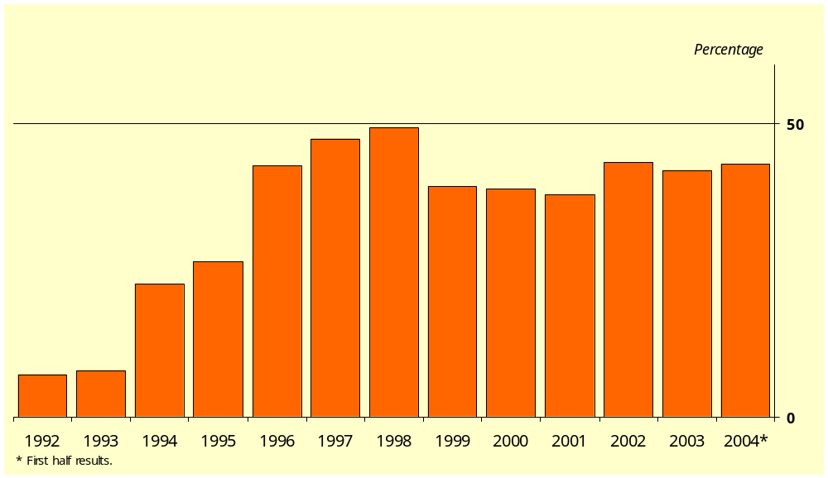
Share of Loss-Making Industrial Enterprises in Russia,
1992-2004

Slide 18
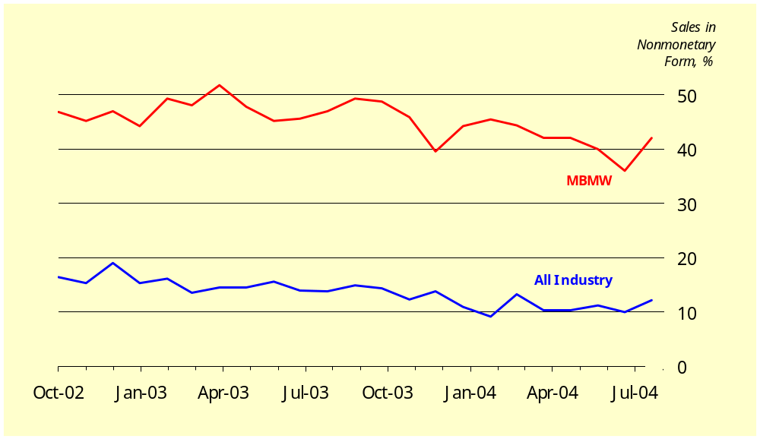
Nonmonetary Payments in Russian Industry,
Oct. 2002-August 2004

Slide 19
Capital Inflow and FDI
Capital Inflows increasing
  Yukos still unsettled, and unsettling
  Foreigners coming in, insiders fleeing
FDI highly concentrated
  Regionally
    Demonstrates role of Moscow
  By sector
Conoco-Phillips
  Demonstrates the role of relational capital
    Need for connections

Slide 20
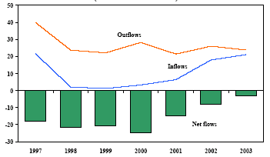
Private Capital Flows (billions of US$)

Slide 21
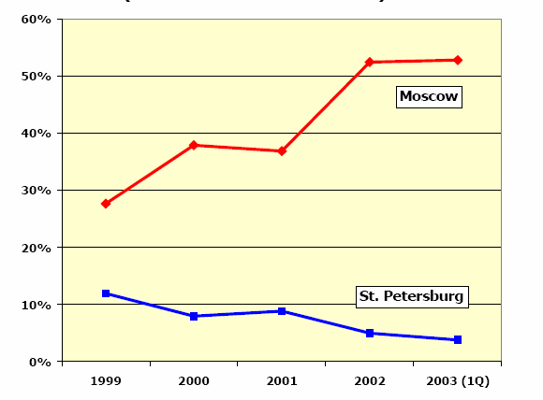
FDI in Moscow and St. Petersburg

Slide 22
Investment is Critical
Russia invests too little (domestic prices)
Russia has a high cost of investment
  At international prices the problem is greater
Cost of investment impacts growth
  Informal barriers
  Relational capital
  Cold

Slide 23
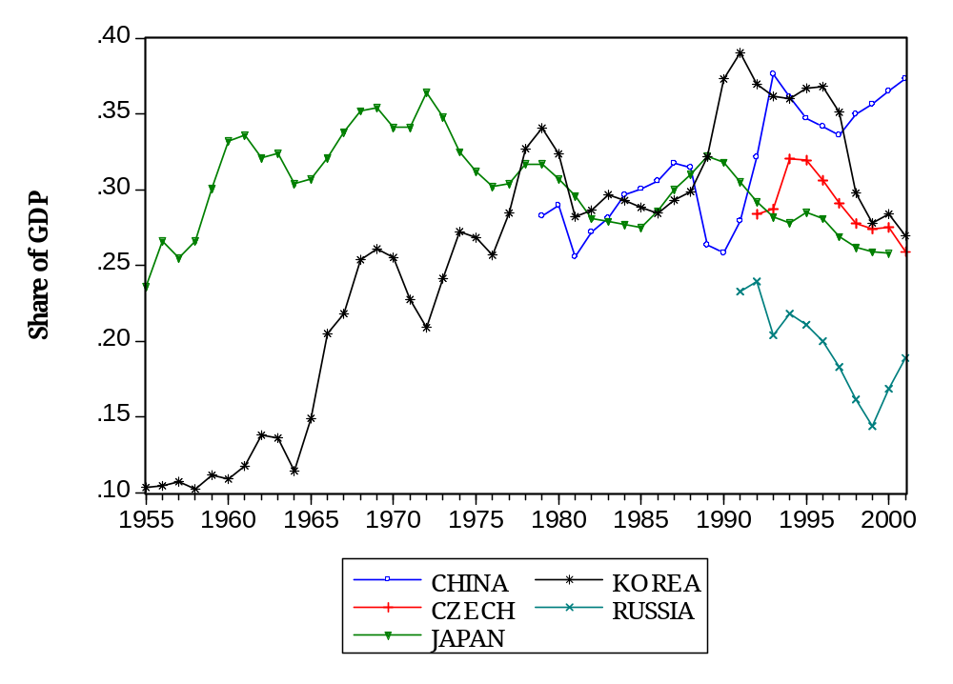
Investment Rates in Selected Economies, Domestic Prices

Slide 24
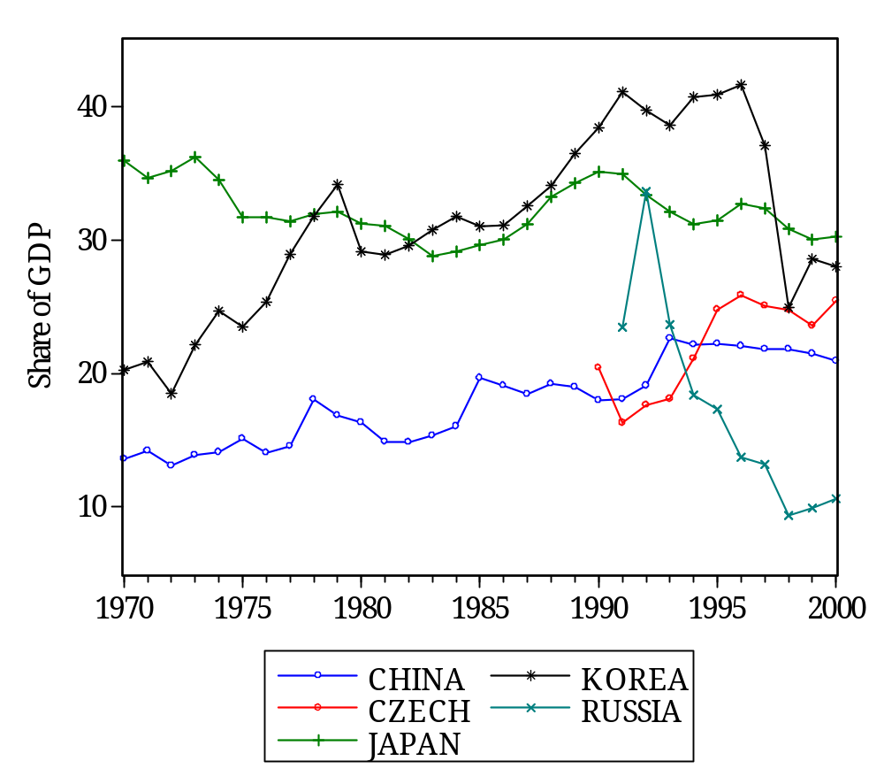
Investment Rates in Selected Economies, International Prices

Slide 25
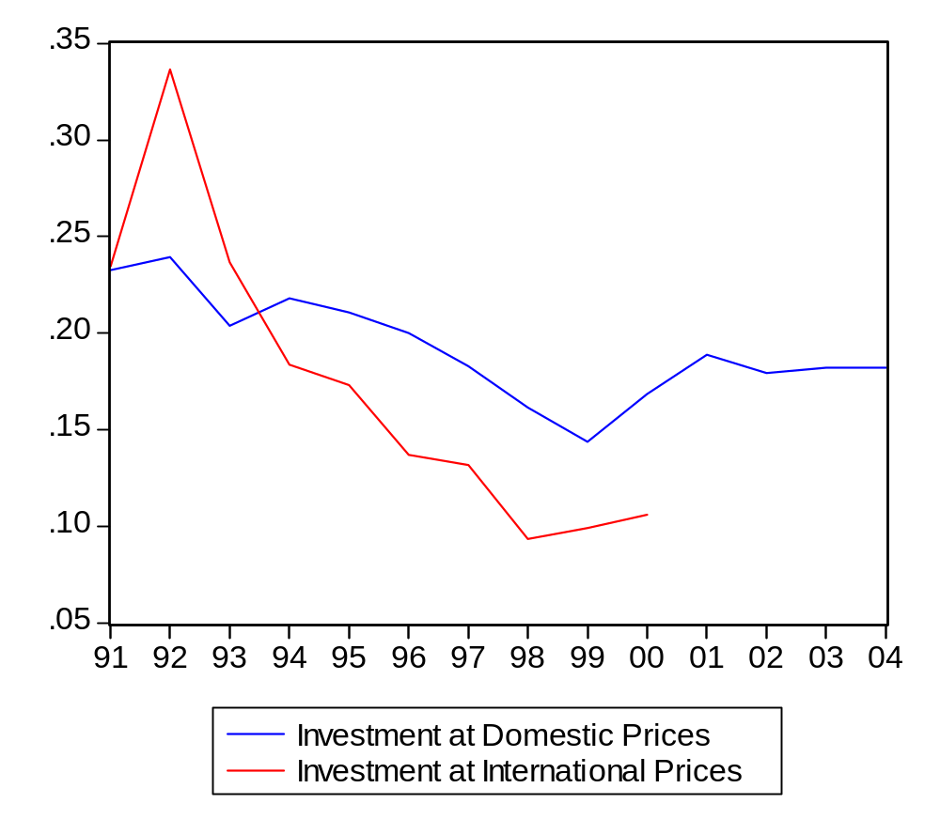
Russian Investment at Domestic and International Prices

Slide 26
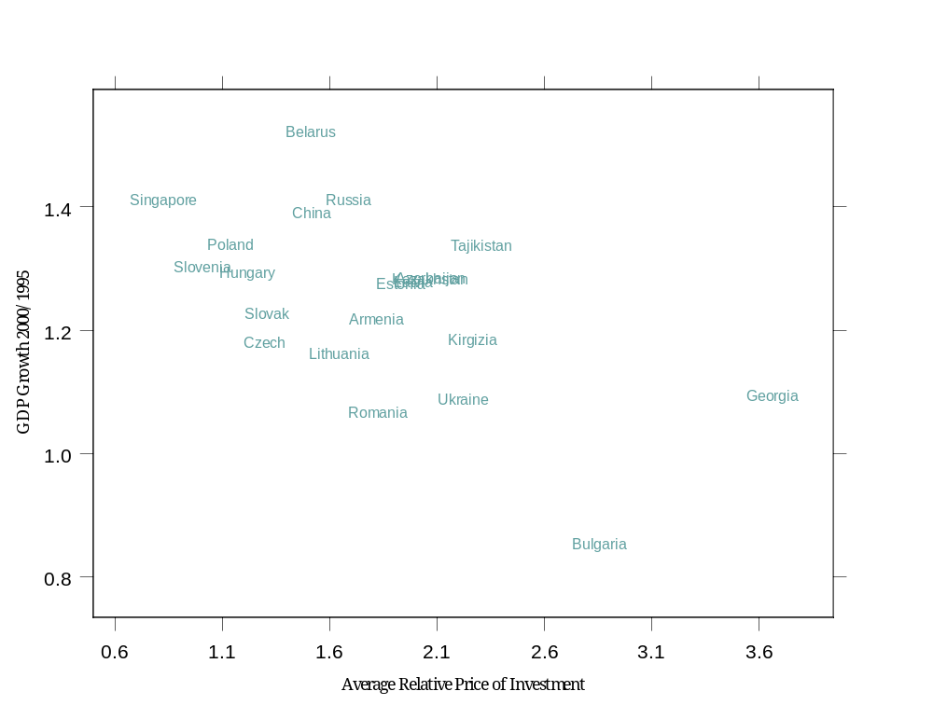
Relative Price of Investment and GDP Growth

Slide 27
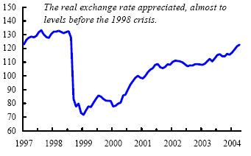
Real Exchange Rate Since 1997

Slide 28
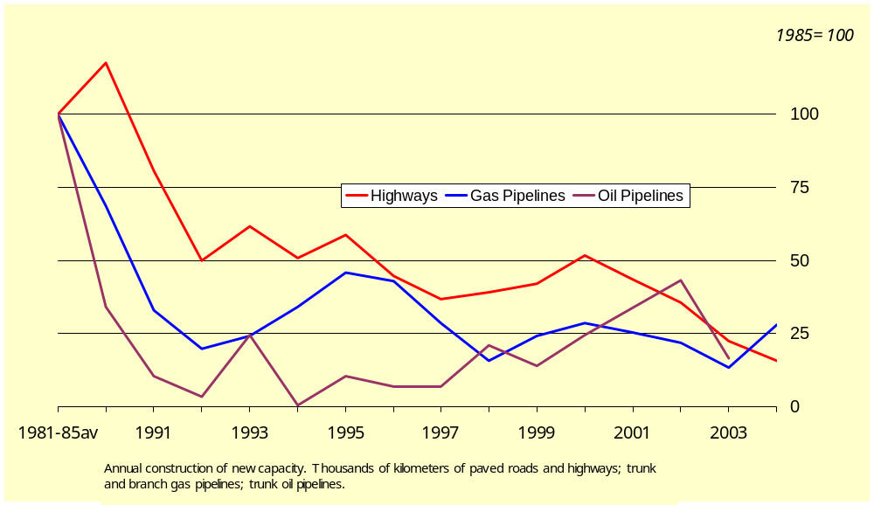
Transportation Infrastructure Investment, 1981-2004

Slide 29
How to Exploit Energy
Energy (and resources) key to Russia’s role
  Russia should focus on its abundance, but how?
Two approaches
  Top-down
    Oil is a strategic asset
    Secrecy, government direction, control of pipelines
    View of energy as rent to be exploited
    Energy as foreign policy resource
    Useful for propping up dinosaurs

Slide 30
Bottom Up
Market driven
Maximize number of actors involved
Competition as discovery process
  New deposits versus better extraction
Share in world technology
Develop complementary industries

Slide 31
Resource Abundance
Resource abundance is not just an endowment
  US example
    Relative mineral intensity of production increased sharply (1879-1914) just as US became a manufacturing power
    Not a windfall,
      but the return on investment in exploration and technological innovation in resource sectors
    How?
      an accommodating legal environment;
      investment in the infrastructure of public knowledge;
      education in mining, minerals, and metallurgy.
  Russia has always depended on resources
    But as windfall, not something to husband

Slide 32
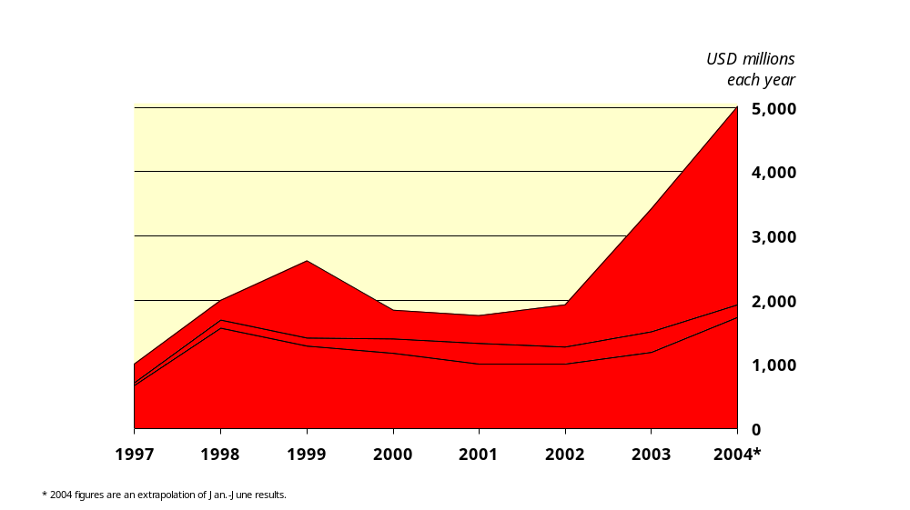
Foreign Direct Investment in Russian Industry 1997-2004

Slide 33
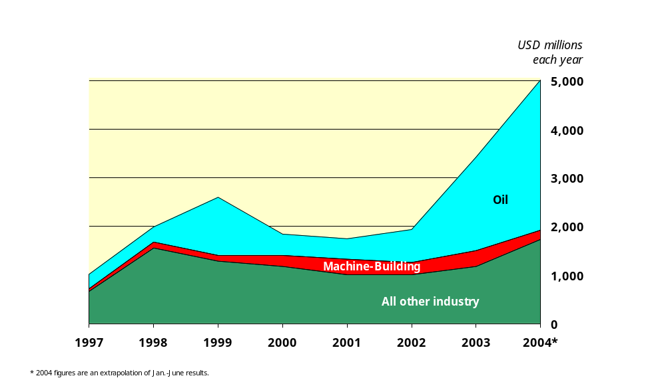
Foreign Direct Investment in Russian Industry 1997-2004

Slide 34
Regional Differentiation
Moscow versus Russia
  Incomes
  Health
    Problematic: no demographic boom for growth
Problem is lack of labor mobility
  Too much industry in the wrong places
  Very important due to lack of capital mobility

Slide 35
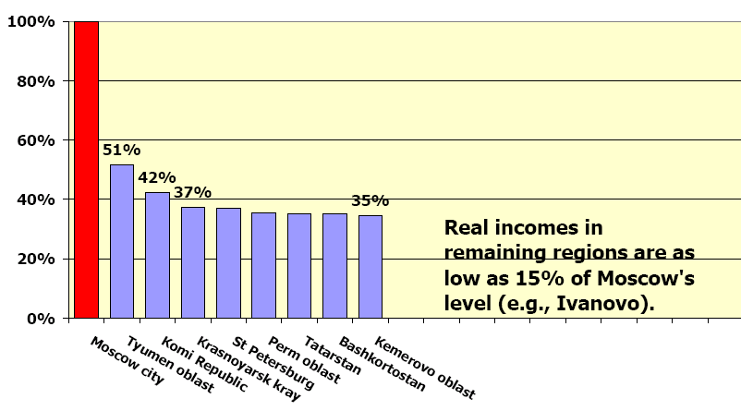
Real Incomes in Some Russian Regions

Slide 36
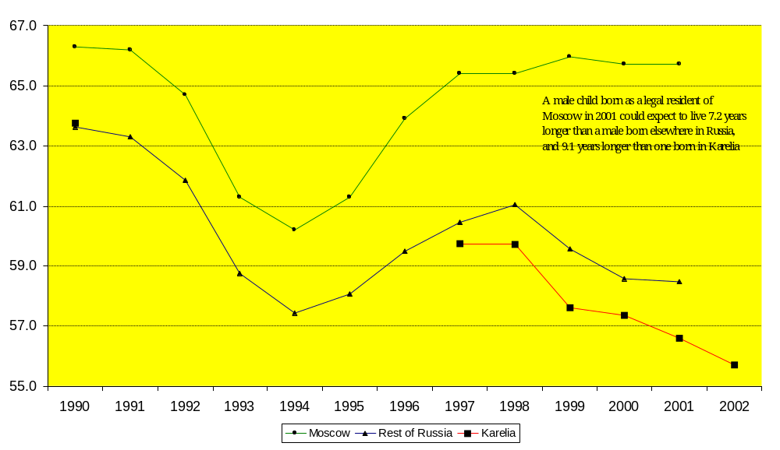
Moscow vs. Rest: Life Expectancy

Slide 37
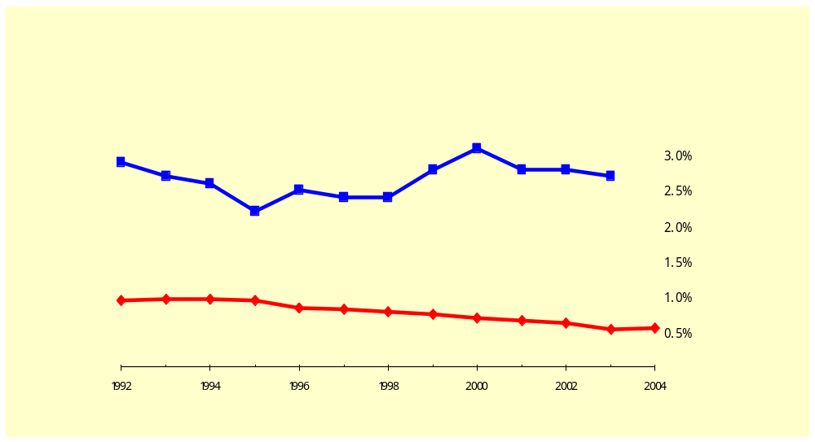
Internal Migration in Russia and the U.S.
Percentage of total population that moved from one oblast/state to another each year

Slide 38
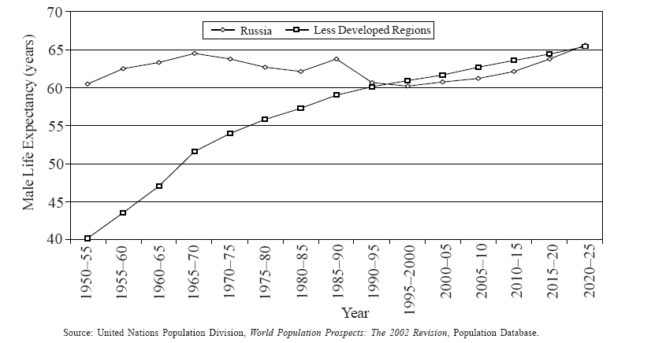
Male Life Expectancy: Russia vs LDC’s, 1950-2025

Slide 39
Russia’s Future Role in the World Economy
Strong commodity demand is good for Russia
Russia needs FDI to exploit its energy resources
  But political uncertainty needs to be reduced
Russia needs to choose the correct approach
Putin’s dilemma
  State control of energy provides state power
  Market control can double GDP

Slide 40
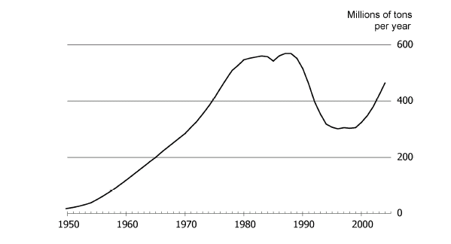
Russian Oil Production

