Slide 1
Output Fall
U-shape output fall is ubiquitous in transition
U-shaped output fall is a mystery
  Removing distortions should raise output
Transformational recession is critical to understand
  Shapes politics and economics of transition

Slide 2
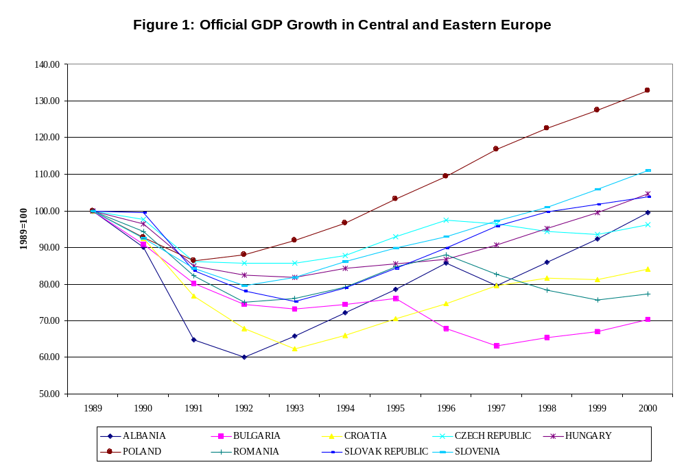
GDP in CEE’s

Slide 3
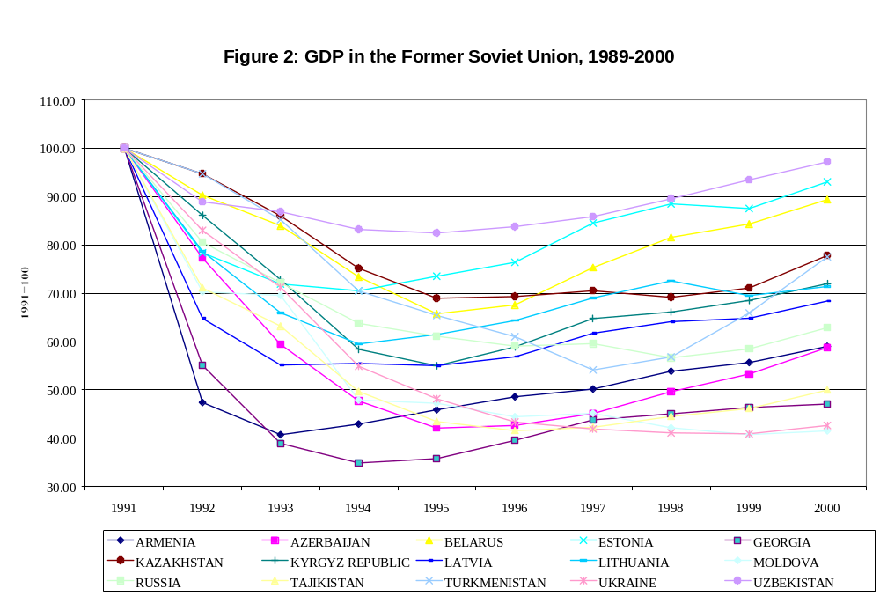
GDP in FSU

Slide 4



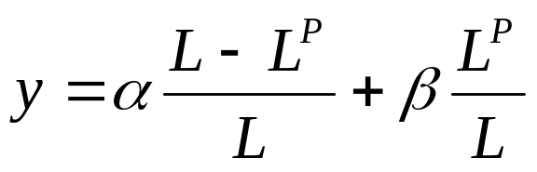
Output and Adjustment
Start with all labor in state sector
Productivity = in state sector
Productivity = in private sector
  Assume throughout transition
Labor moves to private sector
Output, y is a weighted average of productivity in each sector:

Slide 5
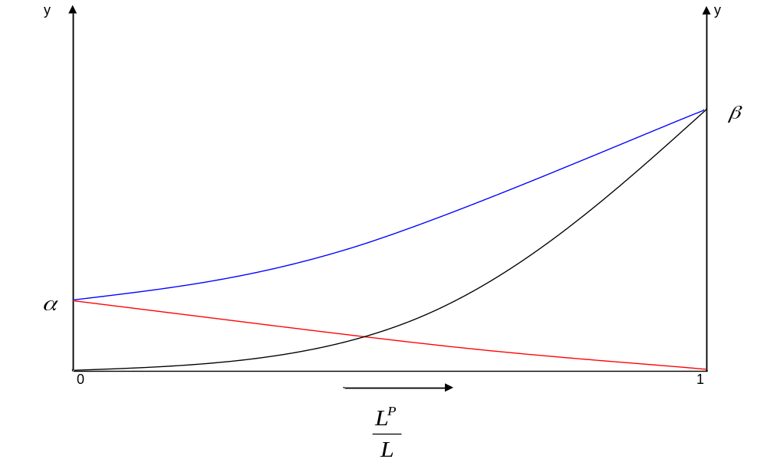
Per-capita output during transition

Slide 6
Problem
Output path should be “j-shaped”
  adjustment leads to monotonic increase
But output path is “u-shaped”
  Output fall is sustained, not immediate
How to explain output fall?
  State sector declines faster than private sector expands
  Rigidity and unemployment of capital and labor required to make u-shaped output fall
    Essential transition problem
  Measurement issues postponed

Slide 7
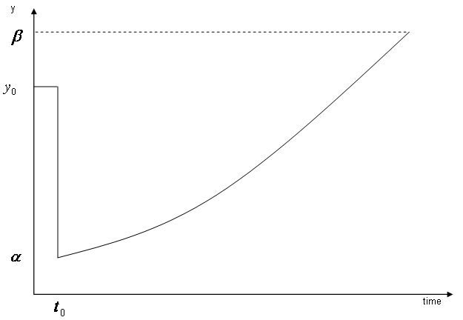
Hypothetical output path

Slide 8
Adjustment
Why does output fall during adjustment?
Slow adjustment of the capital stock
Wage rigidity
Specific Factors model
  Assume labor mobile, capital immobile
  Initially most employment in state sector, point A
  Productivity is higher in private sector
Suppose demand for state output falls
  capital immobile. We move to point C. (C’ in lower part)
With no unemployment output rises
  Employment has shifted to the sector with higher productivity

Slide 9
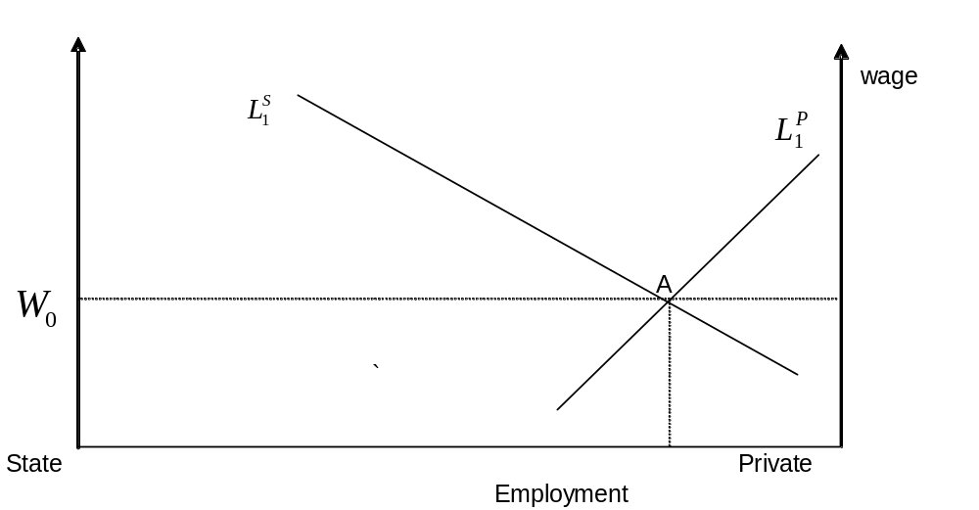
Initial situation

Slide 10
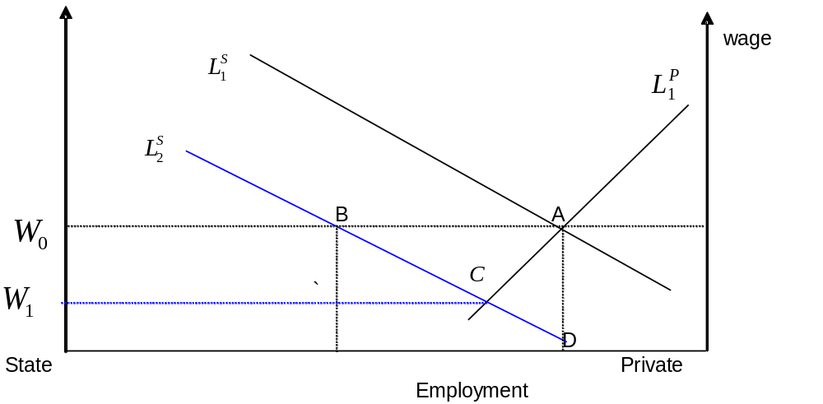
Decline in State Demand (1)

Slide 11
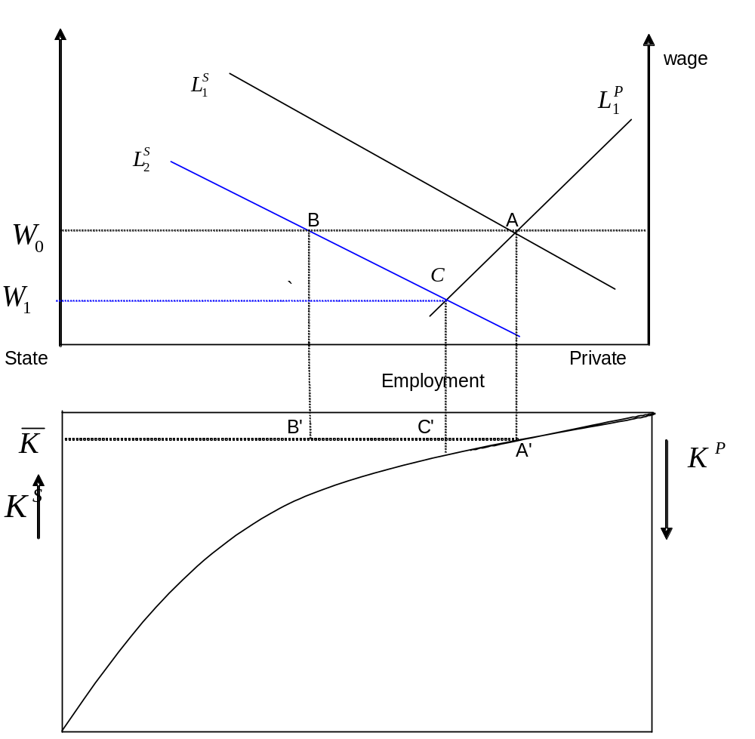
Decline in State Demand

Slide 12
Wage Rigidity
If wages are rigid we are at point B
  Unemployment, output is below point what it would be at point C, because the marginal product of unemployed labor is positive
  Transfer from unemployed to employed
  The expansion of the private sector lags the decline of the state sector
    This causes output to fall
If wages are rigid then job creation slows down
  Taxes to support unemployment

Slide 13
Full Adjustment
Eventually capital can adjust too
We move to D
Private sector demand rises
State sector demand falls further as capital leaves
If capital is more productive in P then wages rise

Slide 14
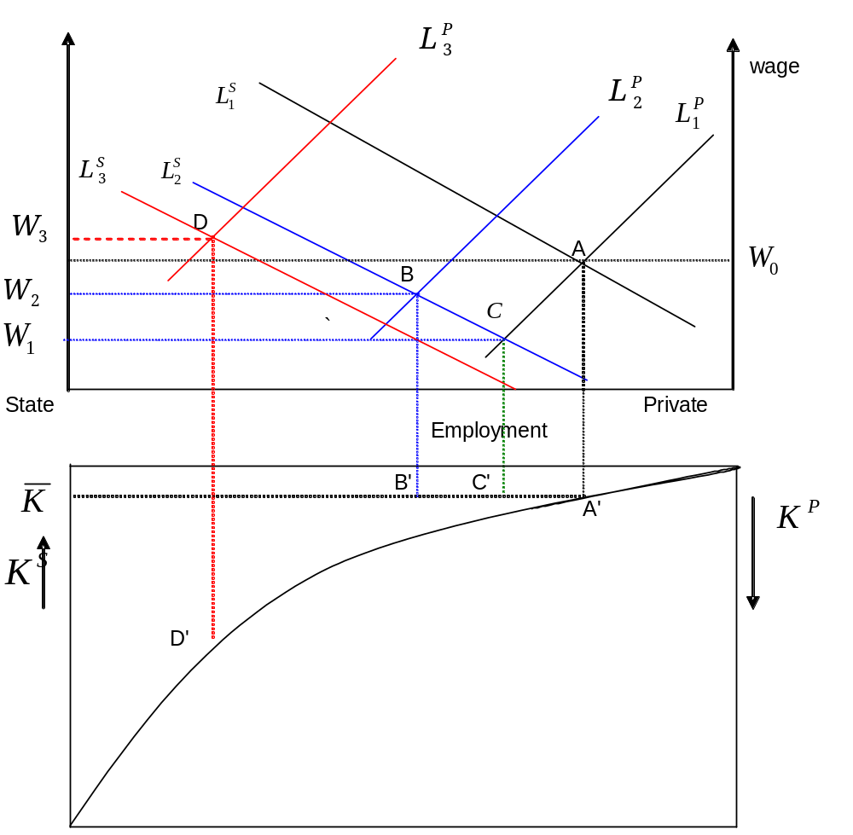
Full Adjustment

Slide 15
Adjustment Questions
Three factors are critical to adjustment
  the rate of contraction in the state sector
  the rate of private sector expansion
  the pace at which capital can flow from the state to the private sector
What might these depend on?
  (3) depends on financial system and ownership changes – institutional changes
  (1) and (2) depend on taxes and subsidies (i.e., elimination of SBCs
    (2) also depends on financial system and ownership changes

Slide 16


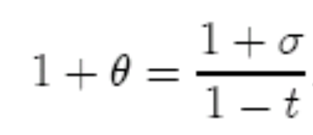
Taxes and Subsidies
Assume state sector is less productive
  Treat it as lower quality goods
  Taxes, t, and subsidies (soft budget constraints)
  So
  Thus we have

Slide 17


Adjustment
If then state sector has become efficient
Unlikely, indeed, could increase
  Good workers leave, asset stripping
Then reallocation is necessary
  Reduce subsidies and lower taxes
    Political economy questions
  Requires factors to respond to prices
    Labor may respond, but liquidity constraints
    Capital movement requires ownership changes

Slide 18
Economists Party Policy Platform Package
Federalism interferes
  Who gets hurt when people move out?
    Home politicians, home owners of fixed assets
    Destination workers (more competition drives down wages)
  Who benefits when people move out?
    Workers who move, if they can afford to
    Workers who stay, since they face less competition

Slide 19
Output Fall
Transition-related recession is common
Growth has resumed
  But only in CEE are initial output levels reached
Baltics perform best in FSU
Next best are Belarus and Uzbeksitan!
Sharper the fall, faster the recovery
Is the output fall real?
  Is this a welfare loss?

Slide 20
Measurement Issues
change in statistical systems
  output fulfillment versus tax evasion
    Ratchet effect
growth of hidden economy
population versus statistical sampling
new entry
good versus bad output

Slide 21
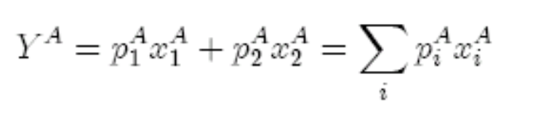
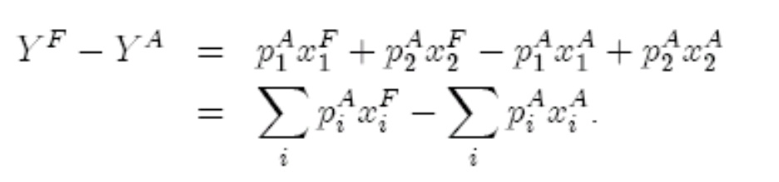
Camellia Effect
Highly specialized production, special preferences
Preferences change, measured output falls
Initial output bundle is point A
  Base-weighted output at point A is
Preferences change, new optimum is at B
But slow adjustment means move from A to F, inside frontier
  Measured output is lower at F, using base-weighted index

Slide 22
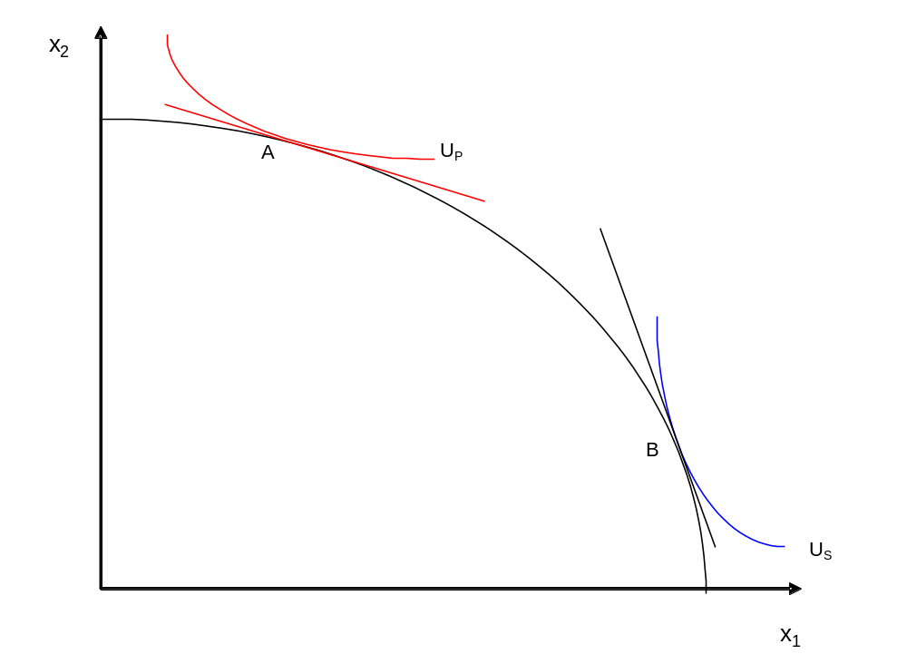
Initial Bundle and new Preferred Bundle

Slide 23


Camellia, continued
But at new prices, output has risen
And clearly welfare is higher at F
  Why?
  At new prices is valued much less
  Planners’ preferences valued defense more than society
Shift from industry to services
Measured output falls but welfare rises
  Pollution effect

Slide 24
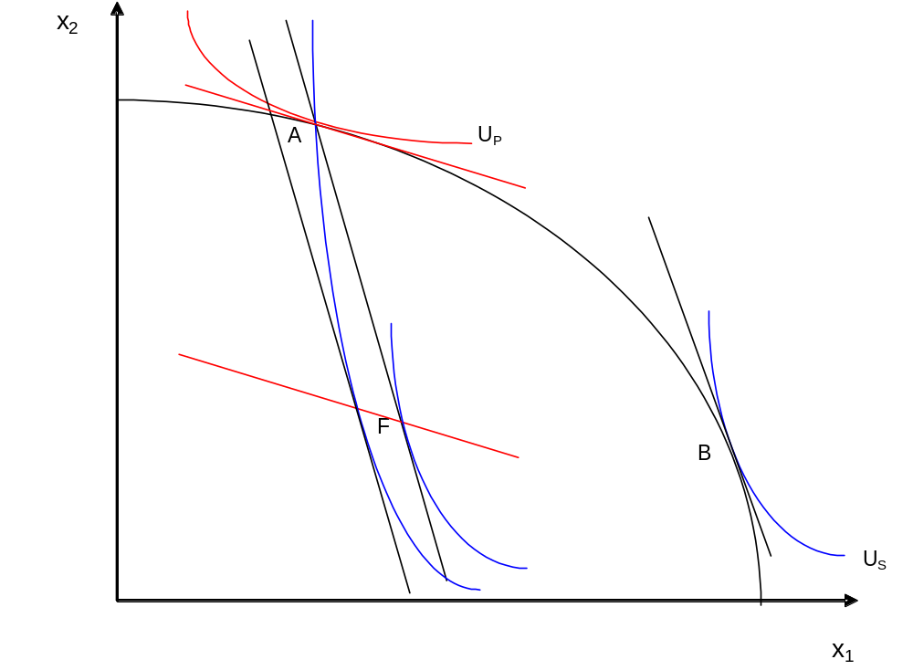
Camellia Effect

Slide 25
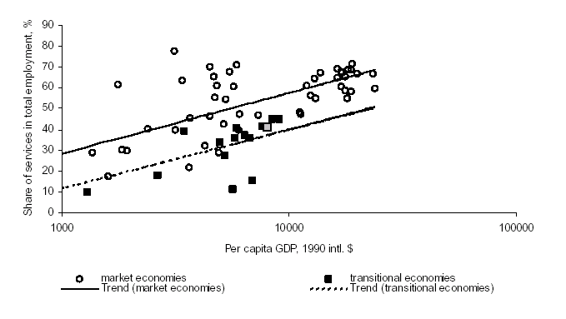
Level of Development and Services, 1990

Slide 26
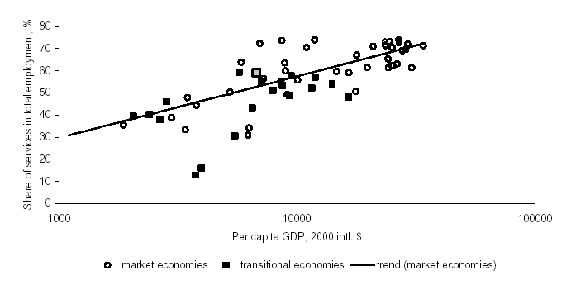
Level of Development and Services, 2000

Slide 27
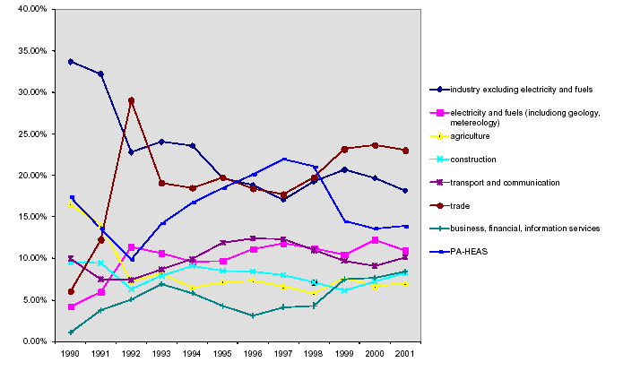
Value Added by Sector, Russia

Slide 28
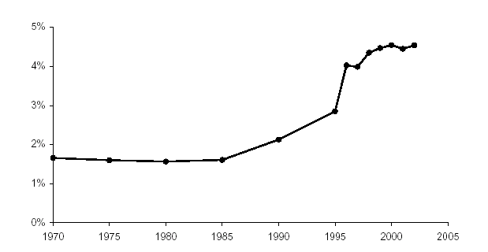
Government Employees, Russia

Slide 29
Hidden Economy
Perhaps output fall is overstated due to growth in hidden economy
  Increased tax evasion in transition
Look at power consumption
  Easy to measure, correlated with production
  Output has fallen more in CIS than in CEE’s
  Output has fallen more than power consumption in CIS
    Surprising if budget constraints are harder
    Effect is larger in CEE than in CIS
  Can we conclude that output fall in CIS is overstated due to bigger growth in hidden economy?

Slide 30
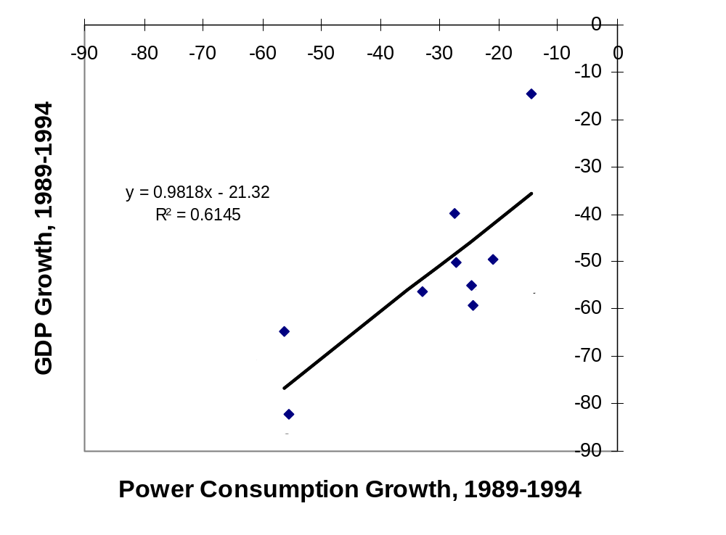
Power Consumption, CIS

Slide 31
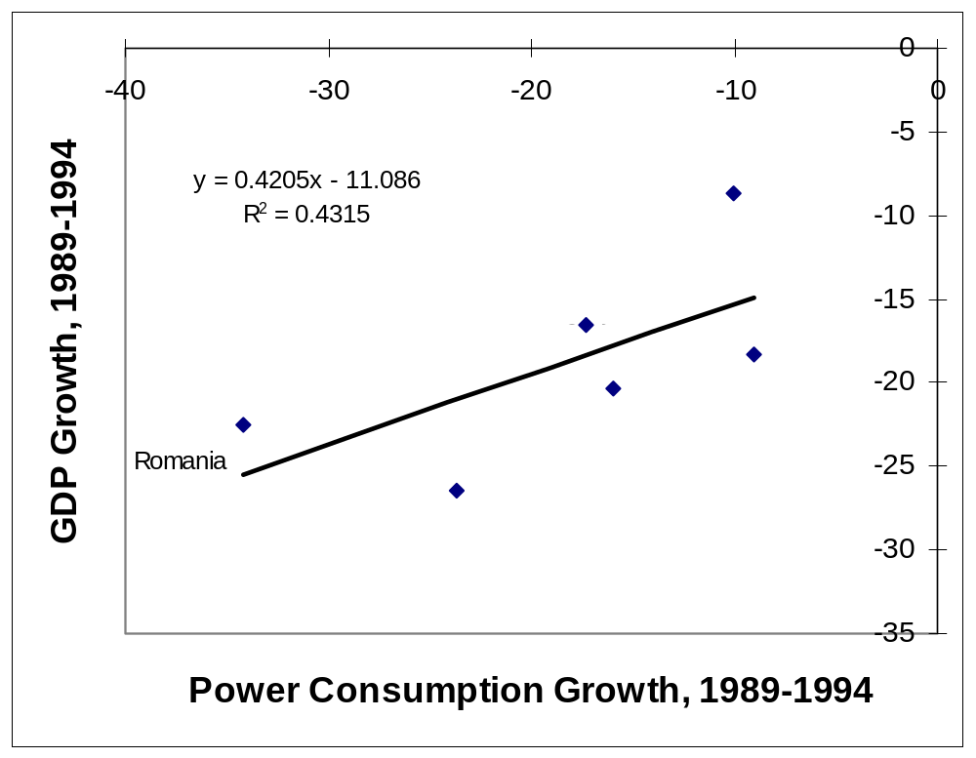
Power Consumption, Central Europe

Slide 32
Hidden Economy, cont.
Does this mean that hidden economy is bigger in CIS?
  Not necessarily
    Structural changes matter, services use less power
    Privatization matters
    Differences in energy prices increases in CIS and CEE’s
Cyclical effects
  Finland in 1990-1993.
    GDP decreased by 13.6%, electricity fell by only 5.5%. Energy intensity of production increased
      In the case of Finland by 22%, less than the FSU average of 32%, but far higher than that of CEE, 8.3%
    but no growth in hidden economy
  Energy is less elastic in short run than output
Ignore rapid growth in second economy in late 80’s

Slide 33
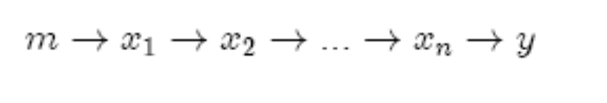
Theories of Output Fall
Monopoly power
Double Marginalization
  Chain of production broken up
  Under planning P = MC
  Under markets monopolists charge P > MC
    If intermediate producers exert monopoly power x_{i} falls at each stage, hence y falls
    Lower output means lower government revenue and demand
    Lower output, same labor input means lower real wages
  Double marginalization thus implies:
    Lower input demand, lower output, lower real wages, which we do observe

Slide 34

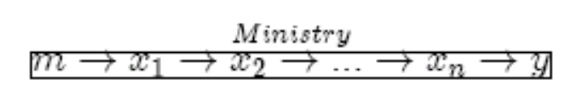
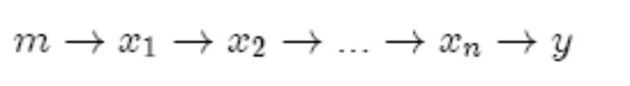
Disorganization
Again chain of production
Now focus on cutoff of links
Leontief Production functions
Ministries control production:
No planning no control:
Alternative use of resource, value = c

Slide 35


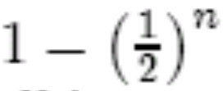
Bargaining Problems
Holdup due to lack of contracts
Suppose surplus split at each step
  Let final value = 1
  Then final producer gets ½, the rest split upstream
  Surplus at stage n – 1th stage is ½ which must be split
    So now there is ¼ to split, then 1/8, and so on, till first stage where the surplus is
  First intermediate producer has to split with raw materials supplier
  But he has to pay at least c to get raw material
  So necessary to keep production
  Else raw material diverted and output = 0
  Size of output fall could be as large as

Slide 36
Disorganization, cont.
The number of steps, n, is the complexity of production
The higher is n the more likely output will fall
Problem is hold-up
  Each firm must produce before bargaining
  Problem would go way with contracts!
    As long as c < 1, production could take place if the intermediate producers could sign a contract to split the 1 − c.
    So really this problem is one of asset specificity and incomplete contracts.
  But that is the early transition problem
  Or with vertical integration
    But that is what the breakup of ministries was about
    And future ownership considerations

Slide 37
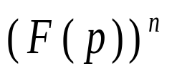
Uncertainty
Uncertainty is another mechanism for disorganization
Assume n suppliers, each necessary for state production
  Value = n
  If a supplier defects, output = 0
Suppliers have alternative use, value = c, which is distributed uniformly on
  Like a lottery drawing
State firm does not know which could be very low early in transition
State firm offers each supplier a price p
  If p > c, production takes place; probability that production takes place is the probability that each producer receives a sufficient price
    The probability that a given producer receives a sufficient price is F(p)
  Hence the probability that they all do is

Slide 38
State Enterprise
Supplier #1
Supplier #2
Supplier #3
Supplier #4
Supplier #5
Supplier #6
State Enterprise offers p, suppliers deliver inputs

Slide 39

More Uncertainty
Expected profits are thus
  Price minus costs, multiplied by probability that production takes place
Notice that as long as price is increasing in n
  state firm needs to insure deliveries
  But firm never pays p >
If full information, then production always takes place if
Transition means that increases
Output in state sector falls in transition but only if efficient
If incomplete information, then problem is more complex

Slide 40
Incomplete Information
When no alternatives, p can be low and production still takes place
As increases, some enterprise may draw c such that
In this case output starts to fall before reaches one,
  which is inefficient, because the outside opportunities are inferior to continued state production.
When suppliers defect private production increases and state output falls
  Probability of defection increases with n
We obtain a U-shaped output path

Slide 41
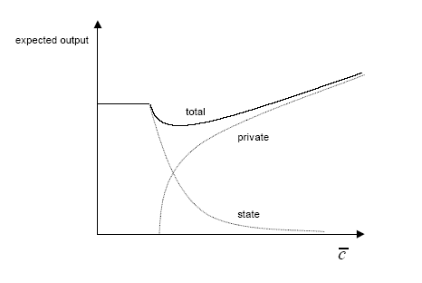
Expected State, Private and Total Output

Slide 42
Implication
Disorganization occurs because of inability to contract
  If the firm could write contracts with suppliers no problem
  Problematic early in transition
Vertical integration no solution
  Ownership rights not yet specified

Slide 43
Assessment
Problem with these models is they predict lower output, but not unsold production
But the output fall is associated with difficulty in selling, build-up of inventories
These models are supply-driven (also the credit crunch models) yet unwanted output is associated with the declines in measured output.
This is much more consistent with liberalization rendering unmarketable value destroying output.

Slide 44
Micro Distortions
Circus mirror effect, taken seriously
Prices in Soviet system did not reflect costs
  basic factors were seriously undervalued
  raw materials and natural resources were undervalued
  highly processed goods – in particular investment products and services – were seriously overvalued
  inputs and consumables received differentiated valuations, depending on ‘priority’
Implication
  Principles of economic valuation use in STE’s systematically hide tremendous waste, exaggerating both net outputs and net income (economic value) produced, while understating the productivity of most seriously mismeasured factor of production, capital
Lower prices for inputs than for final uses generates understatement of share of gross output used in production
True nature of the system cannot be revealed until price liberalization takes place.

Slide 45
Output shares at Soviet Pricing
Raw Materials
Primary Factors
Production Process
Inter-industry flows
Final Output

Slide 46
Output shares at Market Pricing
Raw Materials
Primary Factors
Production Process
Inter-industry flows
Final Output

Slide 47
Micro Distortions, cont.
Liberalization makes waste apparent
  Final output appears to shrink
Cost adjustment further disrupts system
  Price liberalization leads producers to raise prices to cover material costs
  Industrial prices rise faster than general inflation
  At higher prices, demand falls, but production continues
    Leads to unsold production and inter-enterprise arrears
      In Russia, from R37 billion to R3.2 Trillion in 6 months

Slide 48
Implications
Highlights the structural problem of cost recovery
  Waste in Soviet-type production revealed by liberalization
    Liberalization blamed for costs or previous system
  Huge investment required to adjust, but where will that come from?
  Creates strong incentives to “soften” the blow by subsidizing existing structures
    But that weakens incentives to adjust

Slide 49
Good and Bad Output
How to correctly value output in transition
Two key processes going on
  Adoption of market rule of valuation
    Tends to reduce value of previous activity (except in resource sector)
  Adaptation of behavior
    Tends to raise value as new entry and new economic activity arises
Problem is that these take place simultaneously

Slide 50
Adoption
In principle, this should take place as quickly as possible
  Eliminate negative value added
  But this GDP fall is good, not bad
  Faster GDP shrinks the better off the economy
Of course there may still be distributional consequences
  Compensation in principle, but in practice

Slide 51
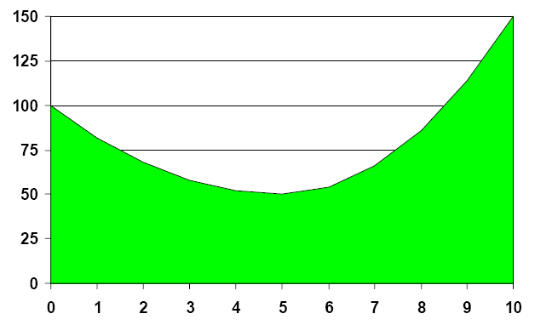
Stylized Aggregate GDP

Slide 52
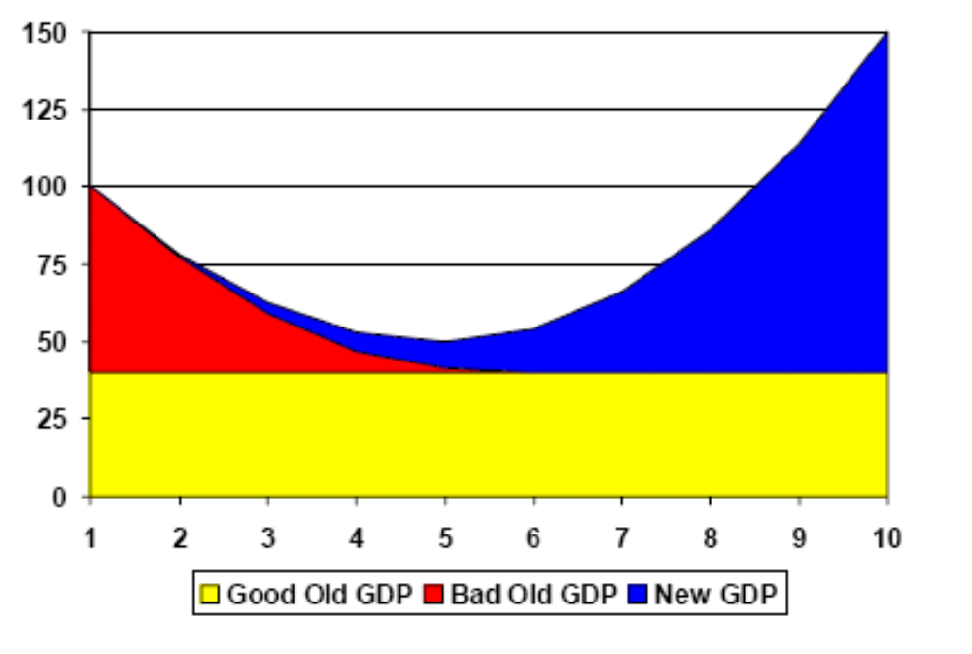
Clear Cut Transition

Slide 53
Clear Cut Transition
In this case it is clear that GDP rise is good, after period 6
But in this case transition was working well even when output was falling
  The gdp path is just not that informative because it adds good and bad output together

Slide 54
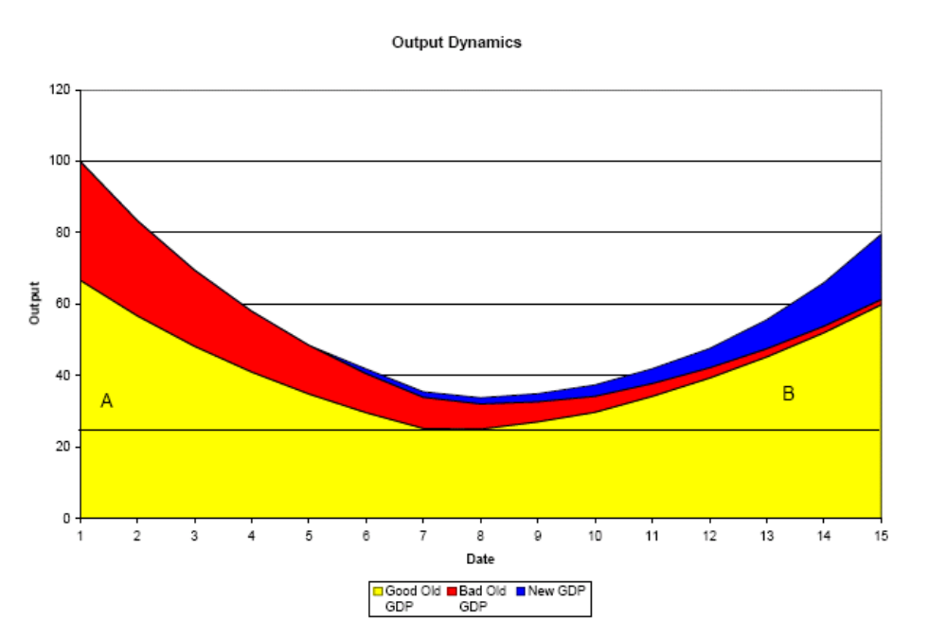
More General Case

Slide 55
More General Case
Now we have included disorganization effects
Problem is how to shrink bad output without making area A too large
Second problem is how to make area B large without causing bad output to recover
In the pessimistic case aggregate output is the same, but very different story
  Demonstrates problem with aggregate GDP

Slide 56
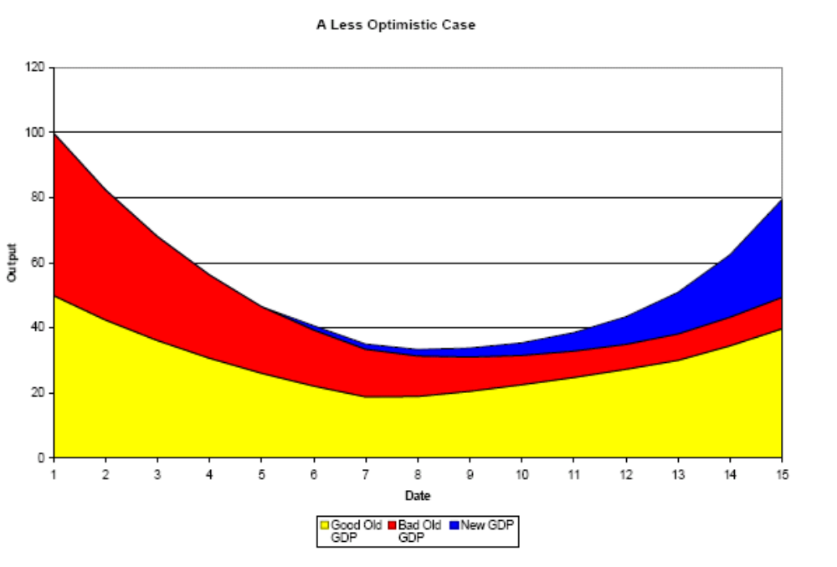
More Pessimistic Case

Slide 57
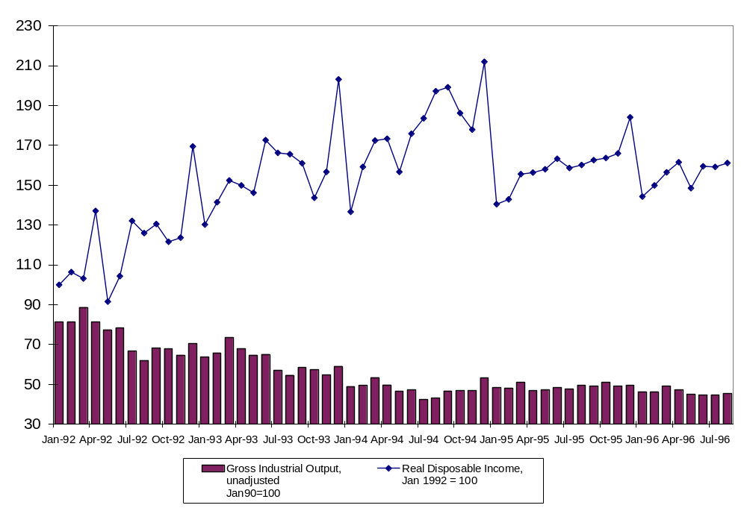
Industrial Output and Real Income

Slide 58
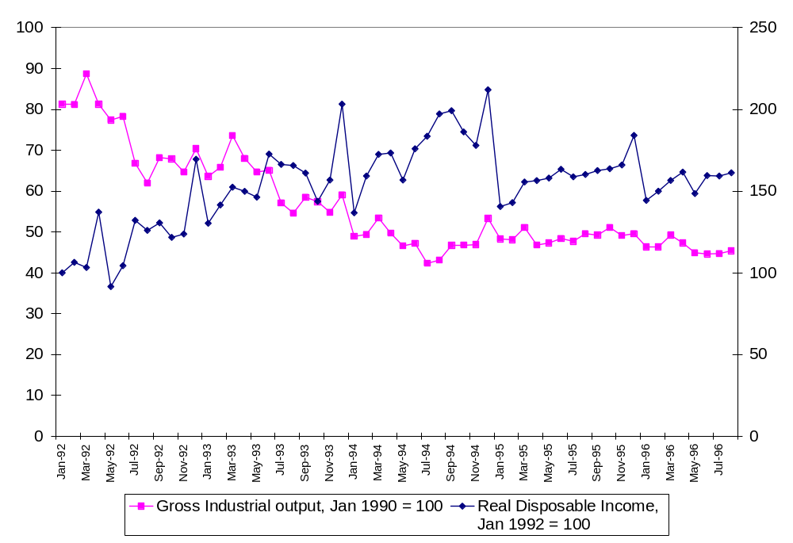
Industrial Output and Real Income

Slide 59
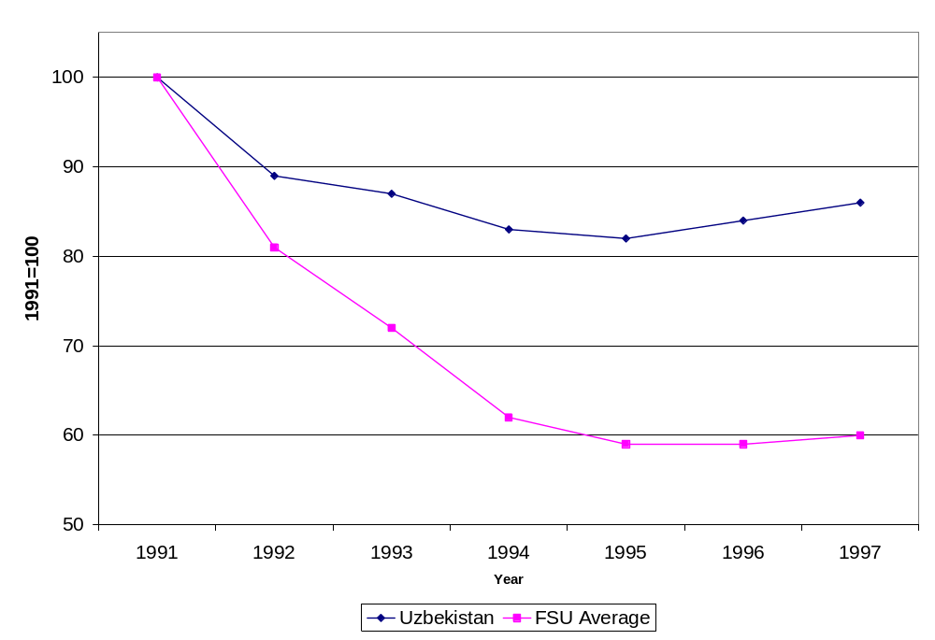
Uzbek Growth Puzzle

Slide 60
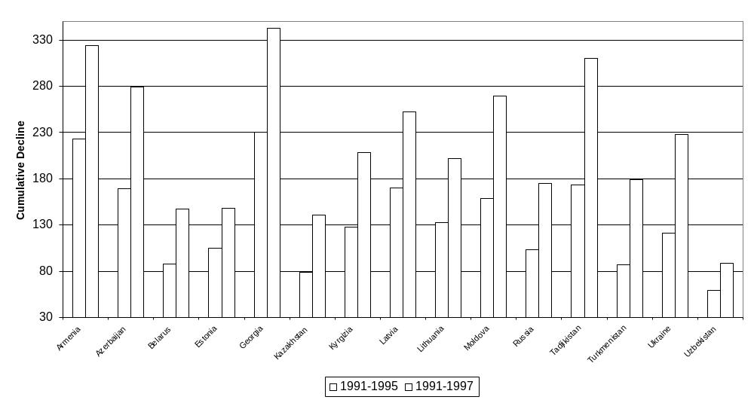
Cumulative Output Fall in FSU

Slide 61
Explaining the Puzzle
Is it due to superior wisdom of Islam Karimov?
Is it due to different initial conditions?
Is it due to lack of reforms
Need to perform a counterfactual exercise
Estimate a growth model for transition countries
How well does it explain Uzbekistan?
  Fits worse than for all other countries
  Does predict higher growth, however due to different IC’s

Slide 62
Uzbek puzzle
Uzbekistan was the least “over-industrialized” republic of FSU
  So initial shock was smaller
Model suggests it was not policy
  Contributions were worse than for other countries
Energy self-sufficiency and cotton important
But it could also be bad output due to lack of reform

Slide 63
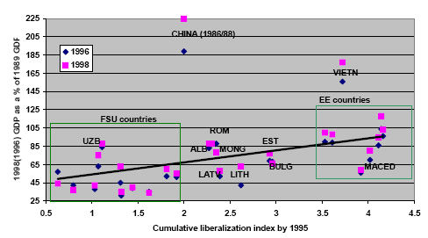
Liberalization and Output Change

Slide 64



Slide 65
