Slide 1
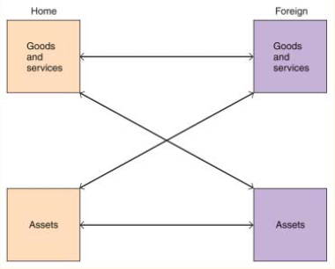
Three Types of International Transactions

Slide 2
Three Types of International Transactions
Goods for Goods is straight trade
Goods for assets is intertemporal trade
  The theory of intertemporal trade describes the gains from trade of goods and services for assets, of goods and services today for claims to goods and services in the future (today’s assets).
Assets for assets is portfolio diversification
  The theory of portfolio diversification describes the gains from trade of assets for assets, of assets with one type of risk with assets of another type of risk.

Slide 3
Portfolio Diversification
Gains from portfolio diversification are large
This explains why asset trade is so large
Gains from international sharing of risks
  This makes economies more interdependent than even trade relations
  Important mechanism for transmitting shocks cross countries
  Important in the current financial crisis
We consider a simple model with one good but two states
  This is characterization of uncertainty. For example, it could rain or be sunny. Agents have expectations about these states. By trading they can hedge some risks.

Slide 4


Portfolio Diversification
Consider a two-country, two-period endowment economy (one good, y_{i}) with two states of nature:
  Let
    For example, the probability that harvest is good
  So with only two states, we have
    Thus in each country the endowment is stochastic
    Assume risks are not perfectly correlated across countries
  Assume identical agents in each country are risk averse
  Then, if contracts can be enforced, there are gains from trade

Slide 5
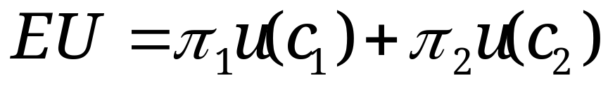
Expected Utility
Agents maximize expected utility
Preferences are state-dependent
What is the budget constraint?
  If no trade then there is no choice to make
    c_{i} = y_{i} for each state i
Suppose a country can buy (sell) an asset (b_{i}) that pays off in case state i occurs
  Let p_{i} be the price of this asset (where does this come from?)
  Expected consumption is now

Slide 6
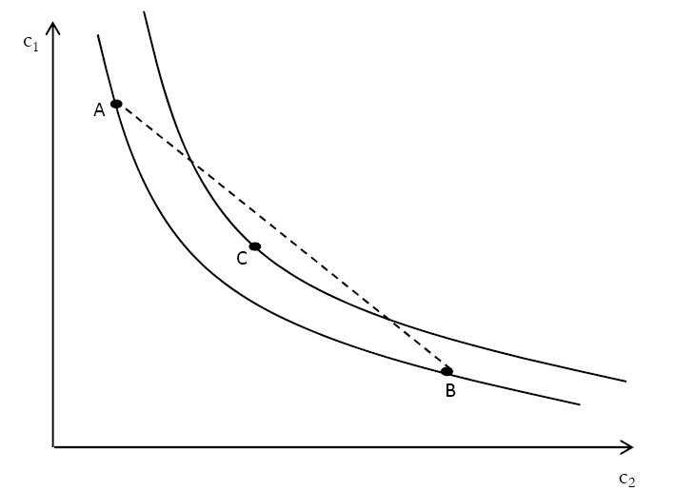
State Dependent Preferences
Agents prefer certain consumption, C, to a lottery of A and B

Slide 7
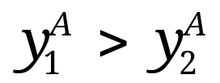


Gains from trade
Would agents be willing to pay for these claims?
  Yes, if they are risk averse
    Risk averse agents are willing to sacrifice some income for certain income
  Suppose that in country A,
  And in country B,
    And we suppose that people know the
    Then for some p there will be gains from trade
      Country A will deliver b₁ of the good if state 1 occurs
      Country B will deliver b₂ of the good if state 2 occurs

Slide 8
Implications
International risk sharing makes both countries better off
  This is just insurance
Result depends on risk aversion
Notice that we have derived a motive for capital flows, even though
  There is only one good
  There is only one time period
How is contract enforced?

Slide 9
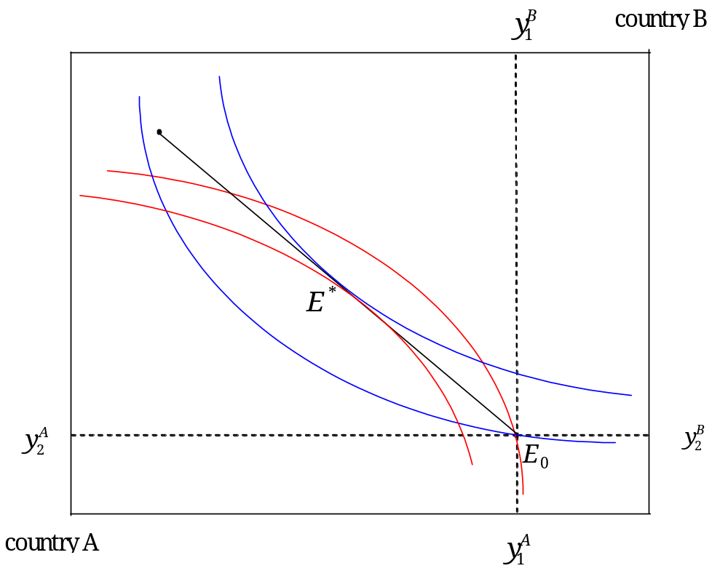
Gains from Trade

Slide 10
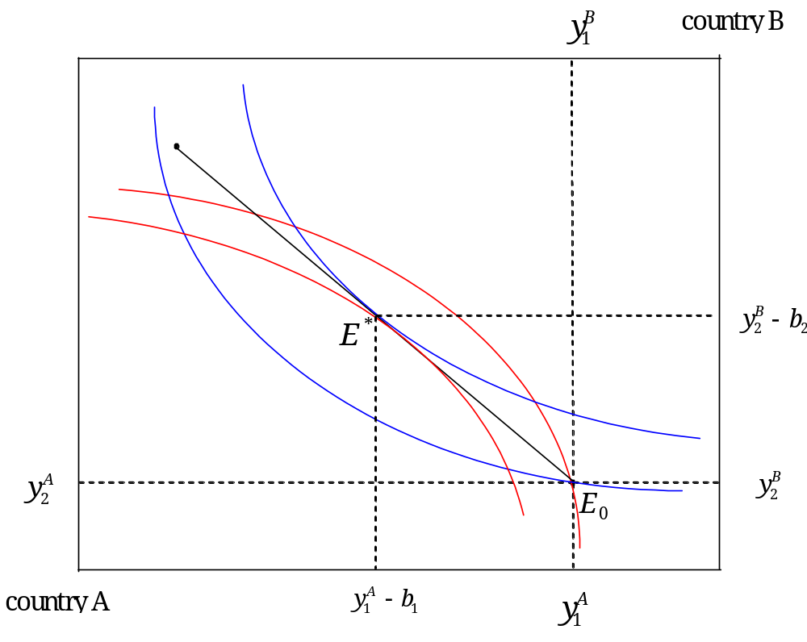


Gains with Trade

Slide 11
Extent of Portfolio Diversification
In 1999, US owned assets in foreign countries represented about 30% of US capital, while foreign assets in the US was about 36% of US capital.
  These percentages are about 5 times as large as percentages from 1970, indicating that international capital markets have allowed investors to increase diversification.
Likewise, foreign assets and liabilities as a percent of GDP has grown for the US and other countries.

Slide 12
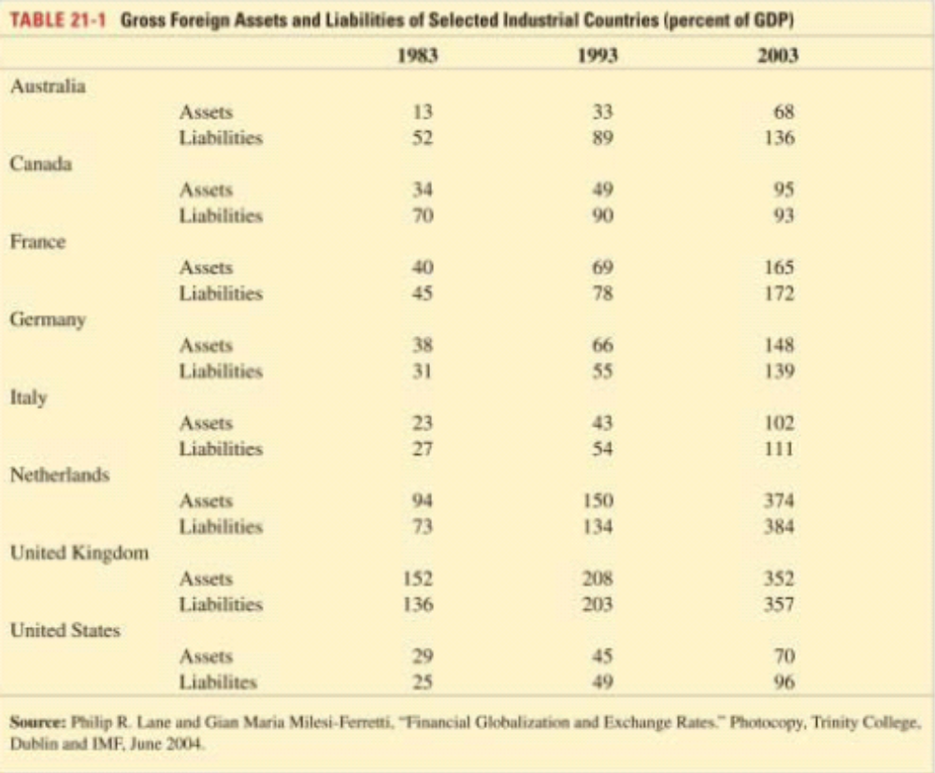
Extent of International Portfolio Diversification_x000b_

Slide 13
Home Bias
Investors hold too large a share of portfolio in domestic assets
  In principle investors should hold domestic assets in proportion to size of the economy
  In practice, much less international diversification
  Costly in terms of return and risk; analyze using efficiency frontier
Why is there home bias?
  Transaction costs seem too small
  Perhaps information asymmetries
  Imperfect capital market integration?
Home bias seems to be decreasing over time
  But it is has not gone away!

Slide 14
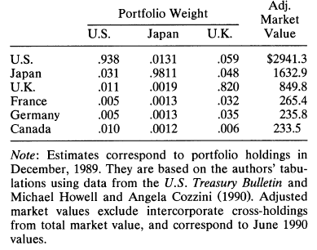
Equity Portfolio Weights

Slide 15
Efficiency Frontier
Suppose we have two assets, A and B
  Asset A has lower risk and lower expected return
  Asset B has higher risk and higher expected return
  Suppose that returns are not perfectly correlated
  => a diversified portfolio will generate higher expected return and lower risk
    As we add asset B to the portfolio, ER rises and risk falls
    Eventually diversification offset by higher risk (point C)
So we obtain the efficiency frontier

Slide 16
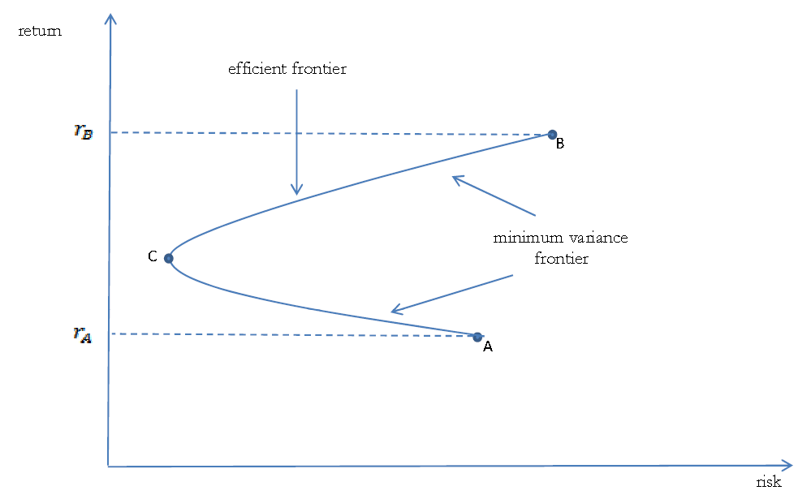
Efficiency Frontier
Efficient Portfolios lay along the segment CB
Minimum Variance Portfolio

Slide 17
Digression
Easy step from Efficiency frontier to the Capital Asset Pricing Model (CAPM)
  Workhorse idea of finance
  Use Tobin Separation Theorem
    Add risk-free asset (T-bills) to investor’s choices
    Investor divides wealth between T-bills and a portfolio of risk assets on the efficiency frontier
To learn about the CAPM click here.

Slide 18
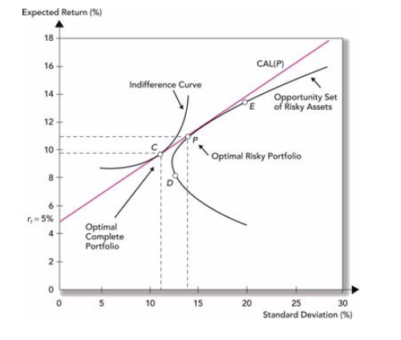
Tobin Separation Theorem

Slide 19
Tobin Separation Theorem
Consider an agent more risk averse than in previous slide
  Indifference curve will be tangent to the CAL to the southwest of point C. But it will still be on CAL
  So agent will hold more cash and less of P, but all risky assets will still be portfolio P
Indeed, all agents hold the same portfolio of risky assets. They hold different shares of risky and risk-free assets, but not different portfolios of risky assets!

Slide 20
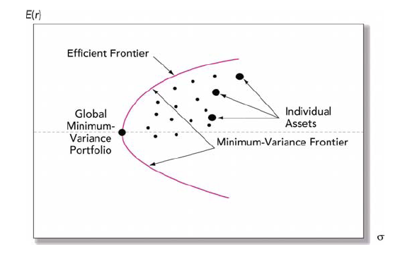
Efficiency Frontier with Many Assets

Slide 21
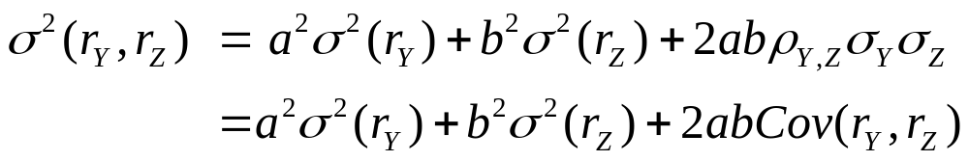

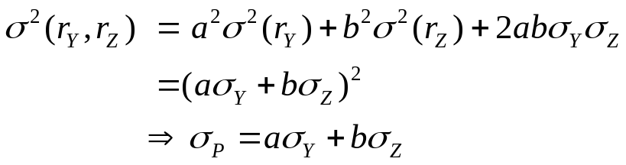


Risk and Return
How does diversification reduce risk? The key is covariance
  Suppose we have two assets, y and z, and suppose that their weights are a and b
  The variance of the returns are given by:
  Notice that if there is no benefit:
  So, if it follows that
    Thus, when assets are not perfectly correlated diversification reduces risk

Slide 22
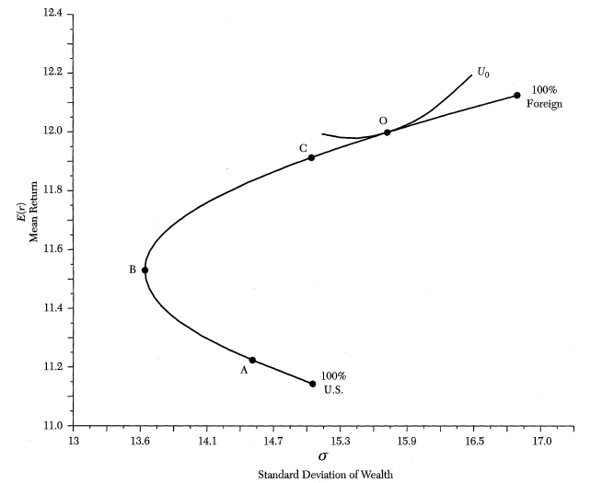
Home Bias mean return and std dev (1970-1996) for SP 500 and Morgan Stanley EAFE fund
39% foreign

Slide 23
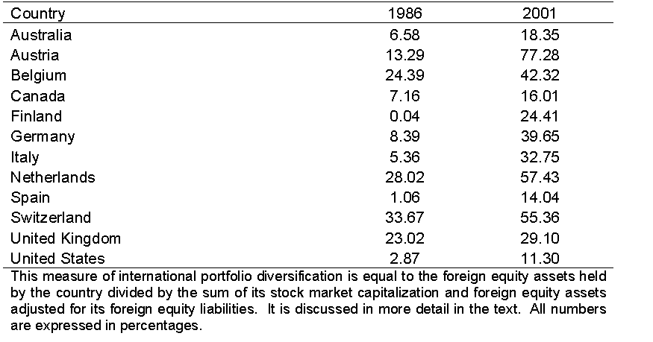
International Portfolio Diversification

Slide 24
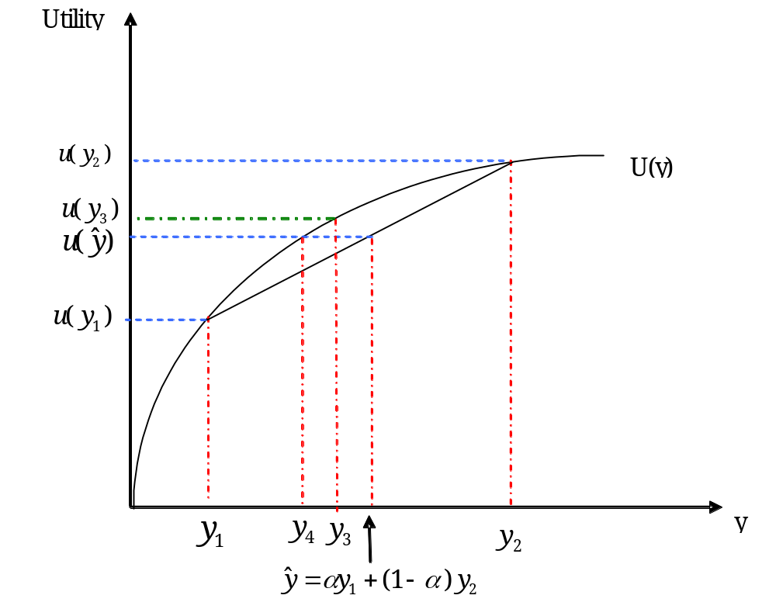
Certain and Uncertain Income

Slide 25
Can there be too much risk sharing?
Risk sharing enables consumption smoothing
  Marginal benefits are positive
  Possibilities are endless given derivatives
    Swaps, options and other ways to insure
  Many bets are made with leverage
    Banks and financial institutions are often too big to fail or federally insured
      Moral hazard
Implies social cost of insurance could be greater than private cost

Slide 26
Current Account: Intertemporal Framework
Huge US current account deficit
  Current account balance is the record of a country’s current transactions with the rest of the world
Why do we care?
  Because debts must be paid back => lower future consumption
    Perhaps via lower exchange value of the dollar
A current account deficit means a decline in net foreign assets
  That is why the US net international position has deteriorated

Slide 27
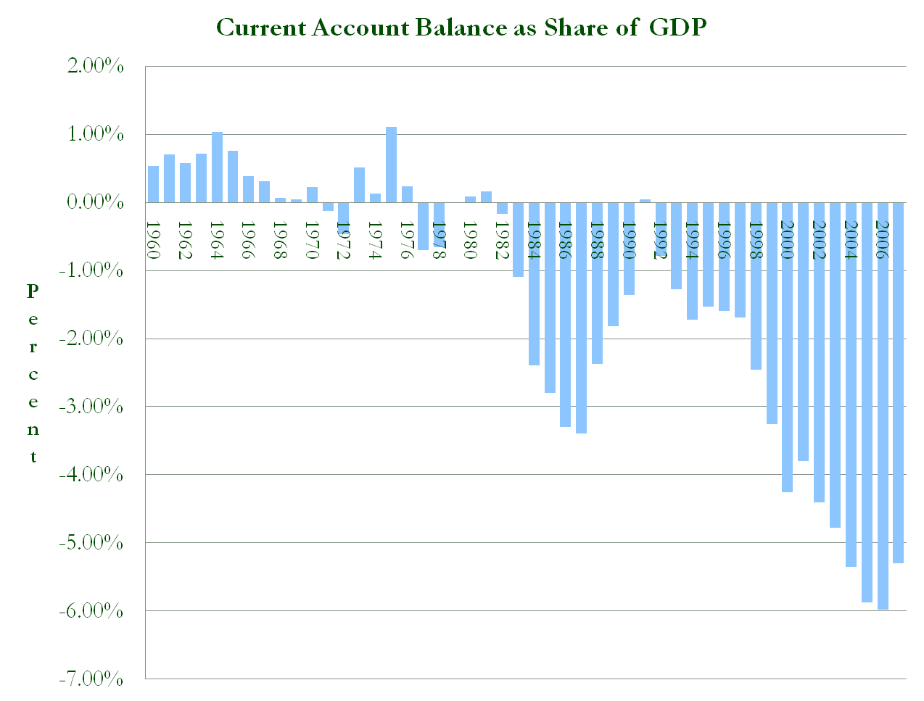
Current Account as Share of GDP

Slide 28
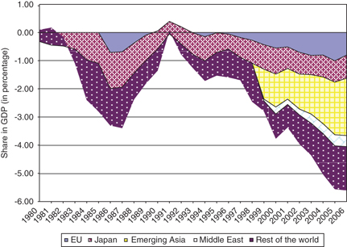
US Current Account Deficit by Region

Slide 29
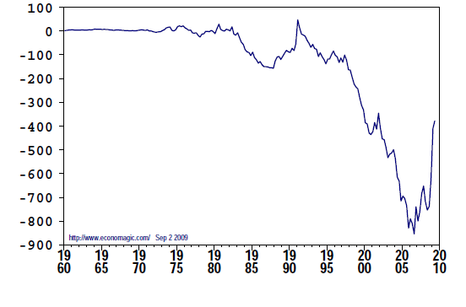
Current Account Balance billions of dollars, seasonally adjusted at annual rates

Slide 30
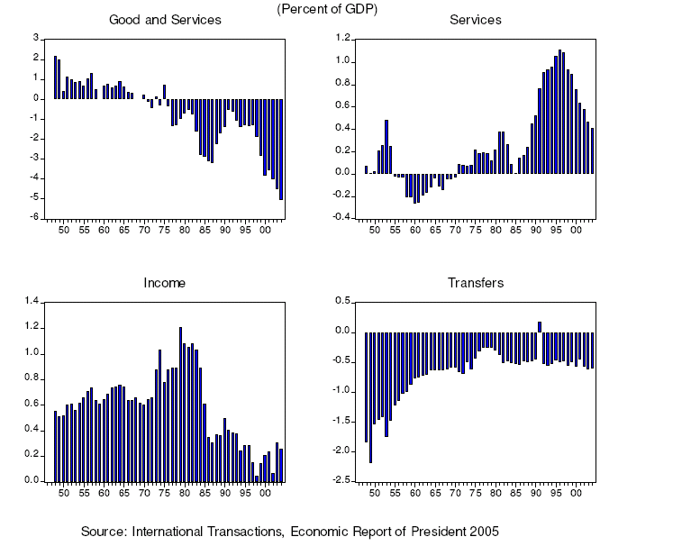
Components of Current Account Deficit, 1946-2004

Slide 31
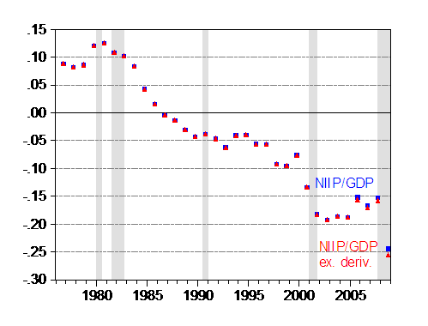
US Net International Investment Position
(share of GDP)

Slide 32
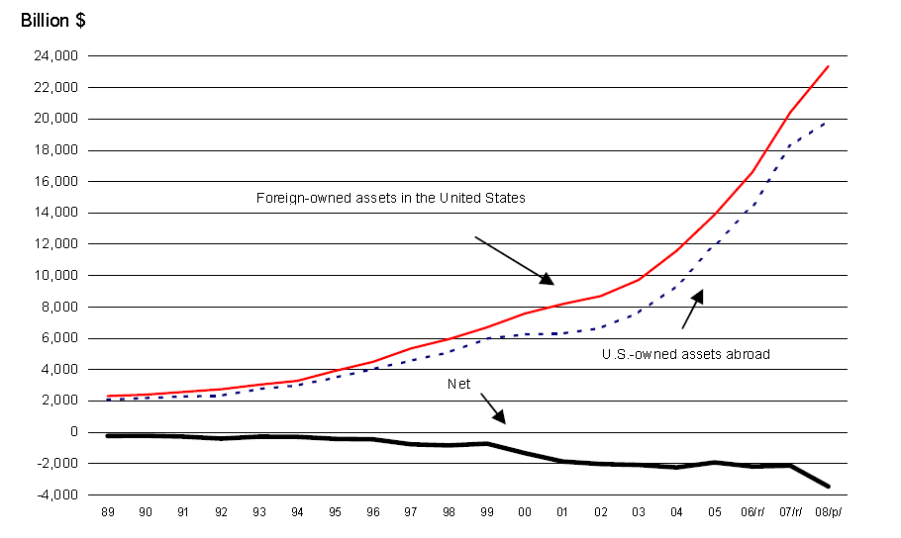
US Net International Investment Position

Slide 33
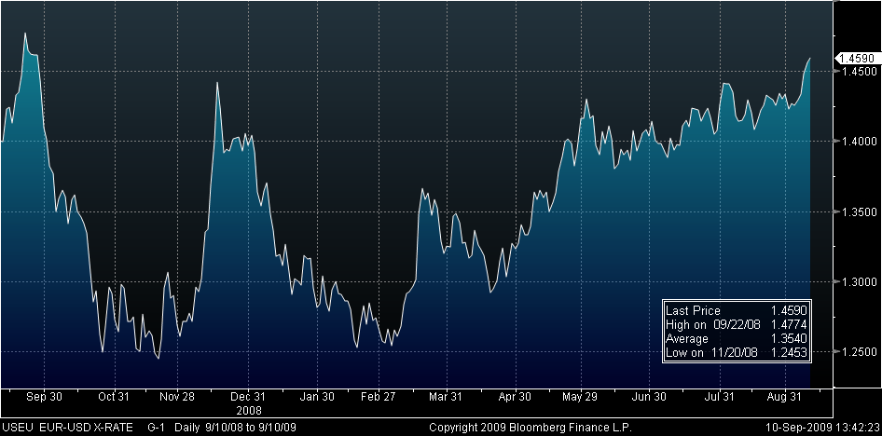
Dollar Price of one Euro

Slide 34
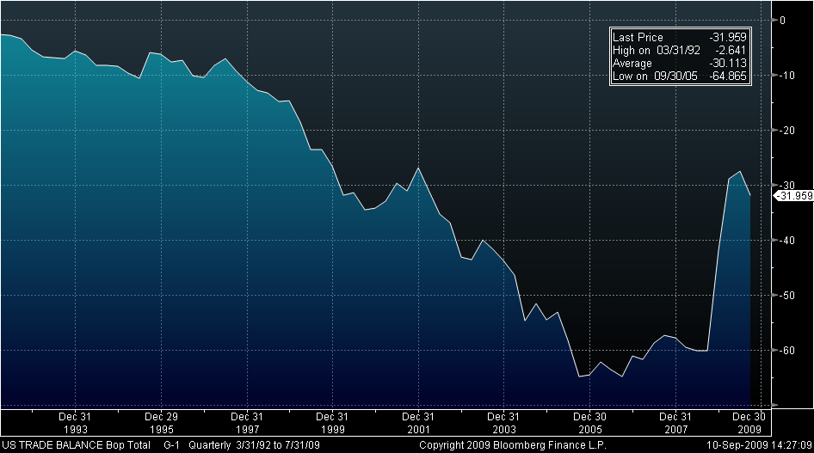
Trade Balance (net exports), since 3/31/92

Slide 35

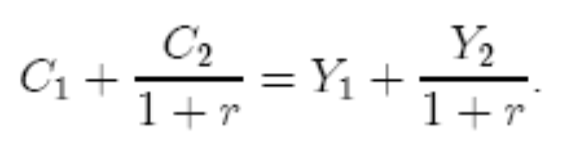
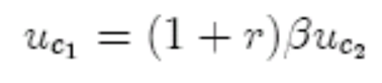
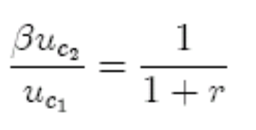
Current Account in an Intertemporal Framework
Consider a small economy with identical consumers.
  Consumption is chosen to maximize:
  Income in each of the two periods is given, so budget constraint is:
  Optimal consumption when:
  Or
  Marginal rate of substitution = relative price

Slide 36
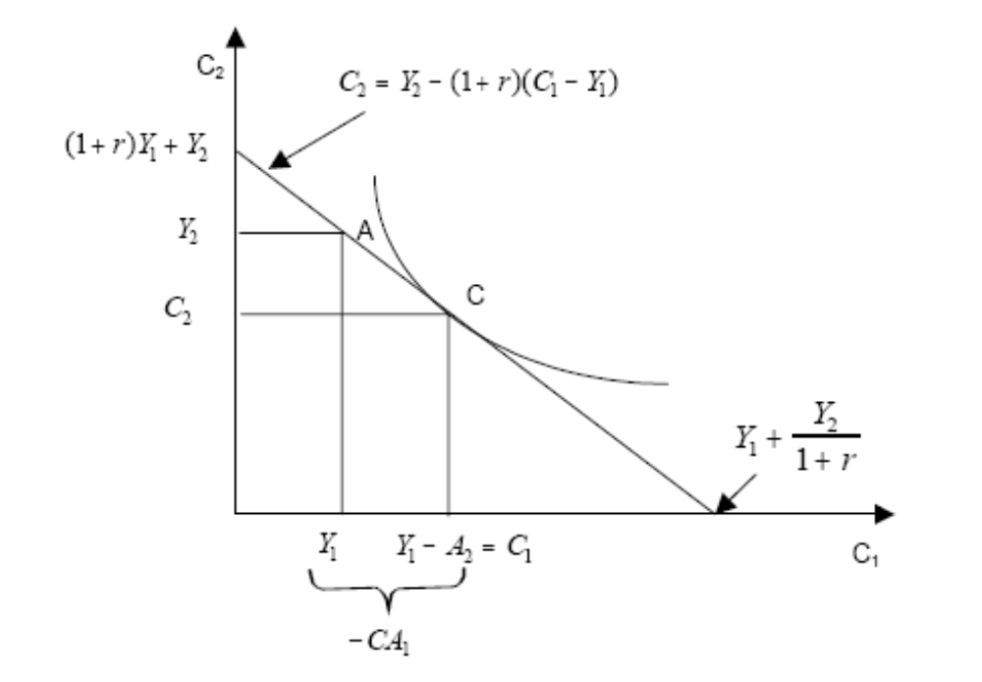
Optimum Consumption

Slide 37
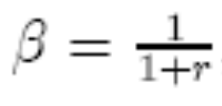
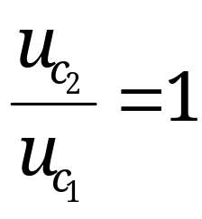
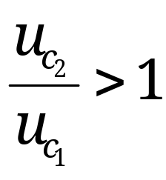
Autarky
Notice that if then consumption would be equal across periods.
Call this interest rate, rª, the autarky interest rate
  Notice that if r = rª then so c₁ = c₂
  if r < rª then so c₁ > c₂ (and vice versa)
    So if r < rª (interest rates very low) consumption is decreasing over time (and vice versa)
  The notion of an autarky rate will be useful later

Slide 38

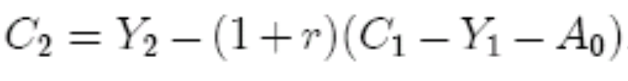
Current Account
From NIA we have Y = C +NX
If C_{i} ≠ Y_{i} we have borrowing and lending, NX≠ 0
  Let A_{t} be net foreign assets in time t, (A₀ = initial assets)
  The budget constraint is thus:
  Second period consumption is
  Second period CA surplus = First period CA deficit plus interest on the debt, plus initial assets
We can define the current account as net exports plus net interest payments: CA ≡ NX + rA

Slide 39



More current account
Since there are only two periods the CA in period two equals NX in period two, or:
So we can write
PV of future surpluses = the initial level of debt
  No free lunch

Slide 40

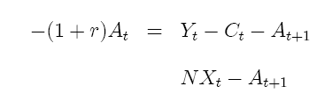

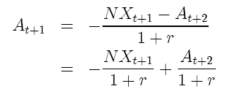
Longer Time Horizon
What if there are more than two periods?
  No problem. Start with definition of CA:
  So I can write
  which must be true for any period, so
  or

Slide 41
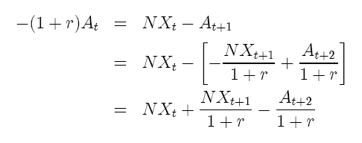


Longer time horizon (cont.)
Now just substitute for A_{t+1}
And if I repeat the process:
And again,
We just keep pushing the last term, terminal assets further and further into the future

Slide 42


Longer time horizon (cont.)
We can write it compactly as
As T gets very large the last term goes to zero
  Why? No Ponzi schemes, and no wasted wealth.
  So,
  PV of future NX equals (negative) initial level of assets

Slide 43
Implications
If we start life NA > 0, we can consume more than we earn over our lifetimes (in pv)
  i.e., PV of NX < 0
If we start with net debt, we are going to have to produce more than we earn over our lifetimes (in pv)
  i.e., PV of NX > 0
So negative US NFA today means that we will have to run future current account surpluses
This is a very weak constraint!

Slide 44


Adding Investment
Now suppose a country can invest
  Production function F(K), with return =
    But diminishing returns
  How to raise K? By investing today
  Suppose endowment is at A in figure
  Present value of production maximized at P*
    Marginal rate of technical substitution = 1+r
    First period investment =
  If economy closed then consumption choices must be along BA in figure
What if small open economy facing r*?
  Production and consumption decisions are separated

Slide 45
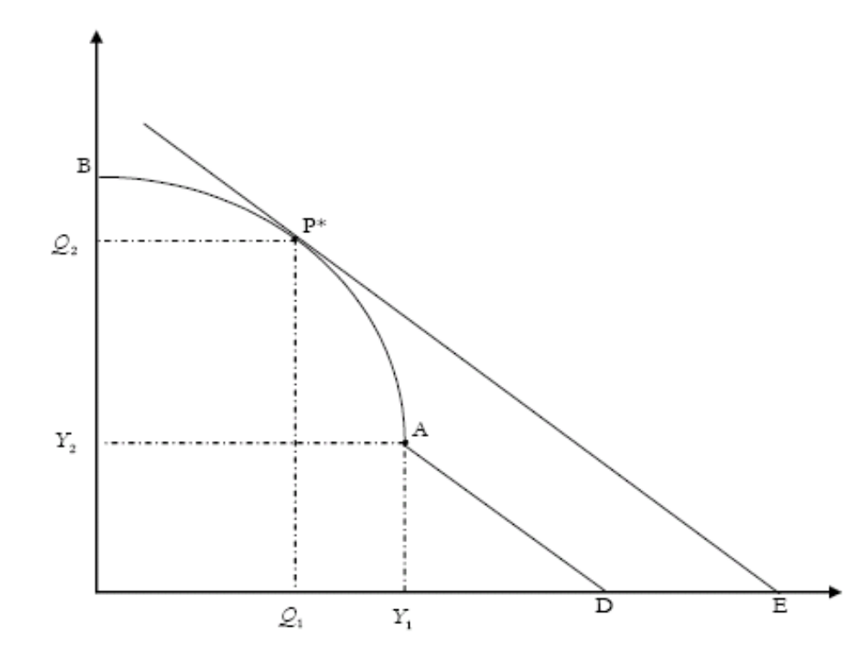
Production Possibilities

Slide 46
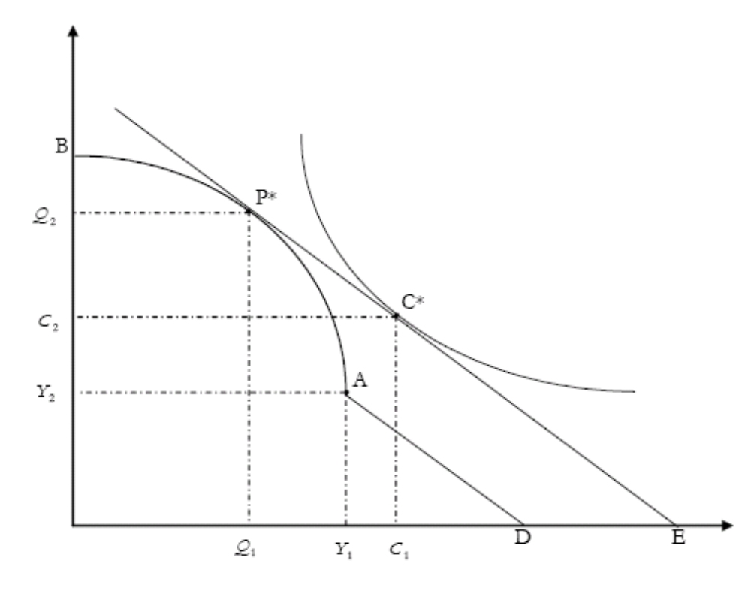
Separation

Slide 47

Implications
With open capital markets, production at P* and consumption at C*
  Notice that C* is outside the closed economy consumption possibilities set
  Consumption in period one is greater than production
    Current account deficit in period one =
    In period two we pay back, as
  What if there were initial debt?

Slide 48
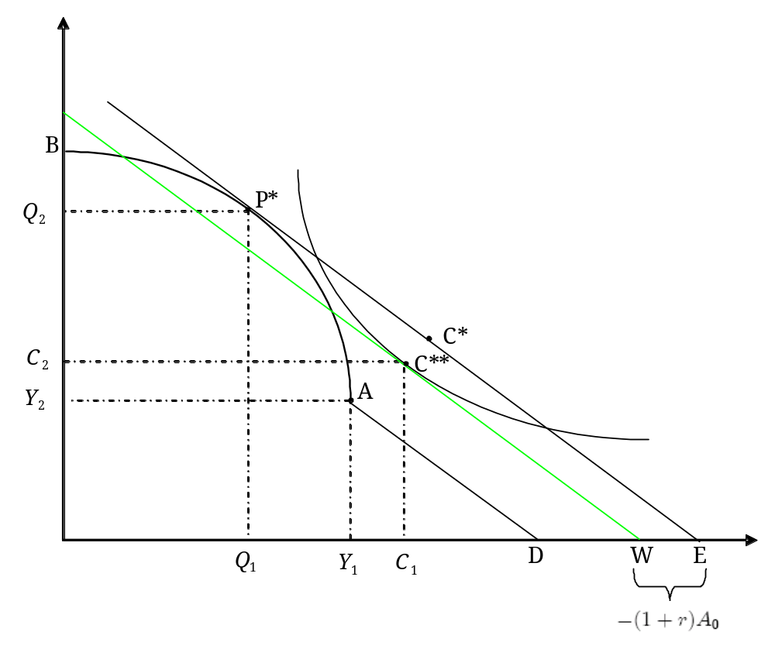
Optimum with initial debt

Slide 49


Investment and the Current Account Balance
Now two ways to hold wealth: I and K
Capital stock evolves according to
So the change in domestic wealth is
  Thus, domestic wealth increases (sometimes called accumulation) only if earnings exceed spending on consumption (government included).
  Using the capital stock equation and the definition of the current account we can rearrange to obtain:

Slide 50
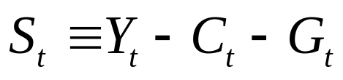
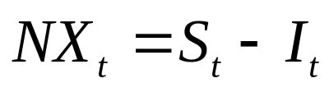
Current Account with Investment
Using the definition of savings
  (1)
Then Net Exports is given by
(2)
    notice this is NX not CA on the LHS of (1) because we do not have net interest income on the RHS of (1).
  Thus, national saving in excess of domestic capital formation flows into net foreign asset accumulation.
=> the current account is fundamentally an intertemporal phenomenon.
  Example: Norway discovers oil

Slide 51
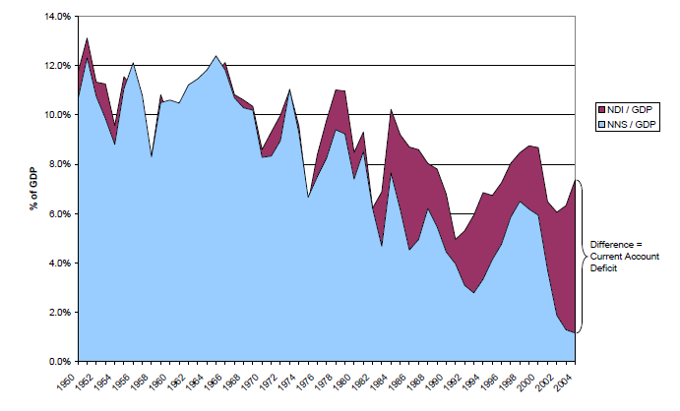
Current Account, NNI and NNS

Slide 52
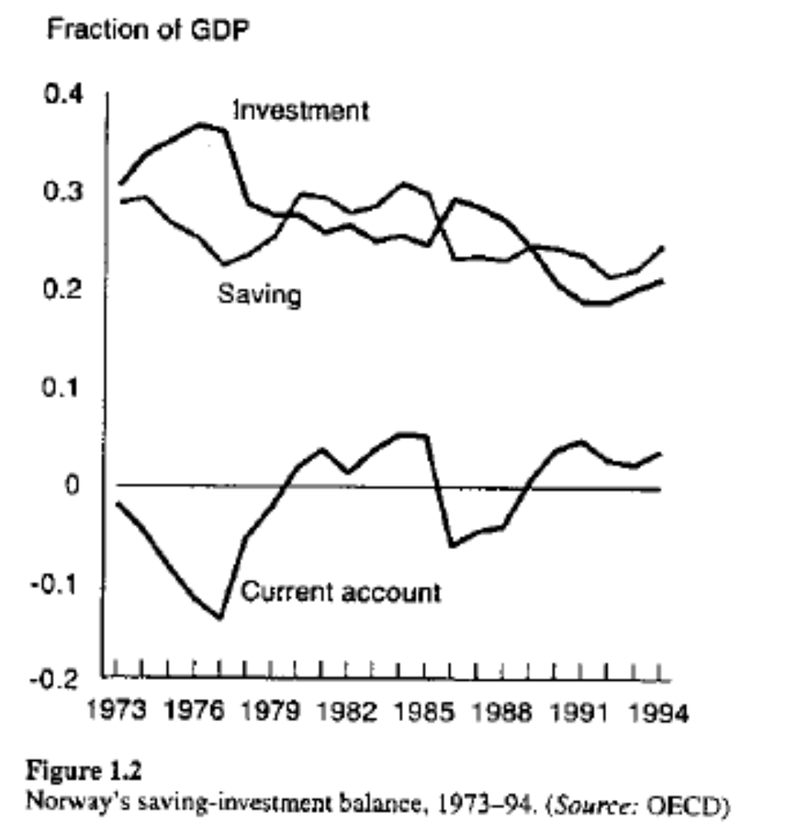
Norway and the Current Account

Slide 53

Two-Country Model
Small country model takes r as given
To determine r we use the two-country model
Key point is that world savings = 0, or
So
This implies that the equilibrium world interest rate must be fall between the autarky interest rates of the home and foreign country

Slide 54
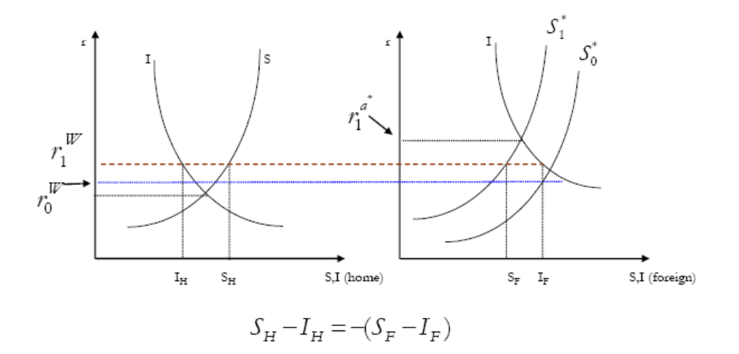
Equilibrium world interest rate: a decrease in foreign savings

Slide 55
Missing world savings
World current account balances must sum to 0
  But they don’t
Why?
  Proof of life elsewhere in the universe?
  Statistical discrepancies
    But why is it a missing surplus?
  Timing
    Does not explain missing surplus
  Misreporting of interest income
    Explains the relation to world interest rates
  Also non-reporting of maritime freight earnings

Slide 56
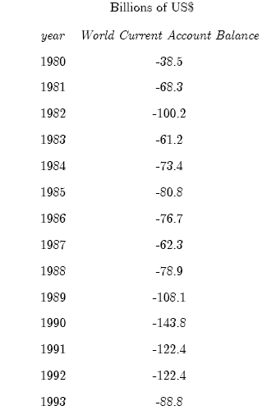
Measured World Current Account Balances

Slide 57
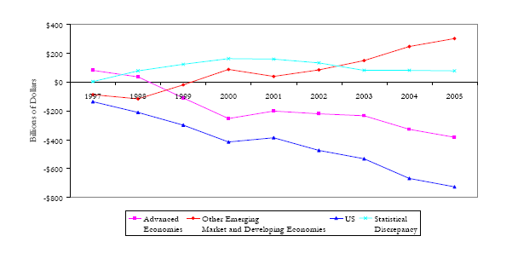
Current Accounts by region

Slide 58
Two-Country Model Utilized
Global Imbalances can be analyzed using this model
Global Current Account Balances
Two Hypotheses
  US Party
    Fiscal expansion or investment boom
  Global Glut
    ROW savings increases or I* decreases
      Many take this as primary cause of the asset bubble
How to distinguish?

Slide 59

CSI: State College
State College Economics

Slide 60

Hypothesis Testing

Slide 61
Hypotheses Compared
Key Difference: real interest rates
  In US party case, r* increases
  In global glut case, r* falls
Real interest rates are low
  But where is the rise in world savings?
Why a global glut?
  Excess reserves accumulation
  Insurance against crises
    Costly insurance
    Looked at today, maybe a good investment after all

Slide 62


Real Interest Rates
In the model this is just r*
In the data we only observe i
But Fisher equation gives
So we need to know expected inflation to measure the real interest rate
  We can use realized rates, but how often does ?
  Fortunately, we can use TIPS data

Slide 63
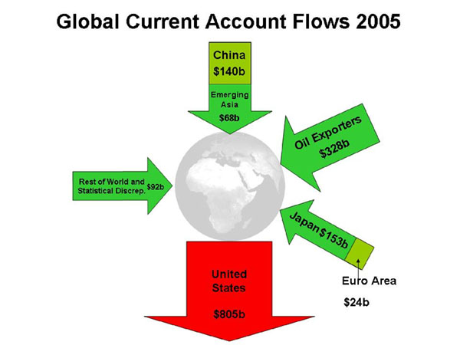
Global Imbalances

Slide 64
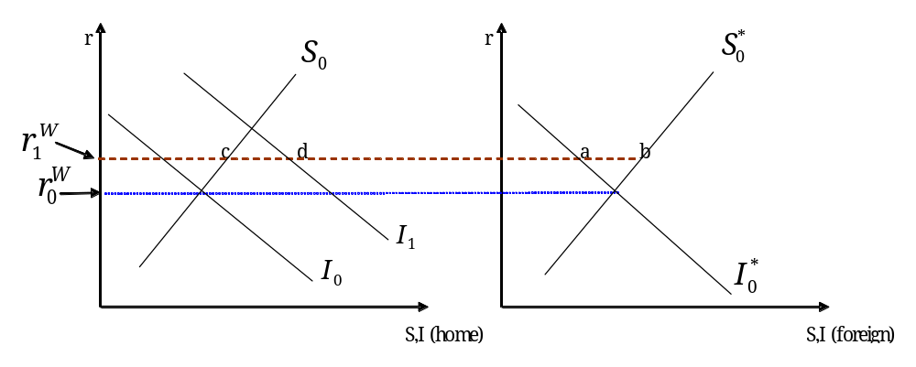
US Fiscal Expansion
Investment rises relative to Savings in the US. Alternatively, S could fall relative to I in US due to budget deficits

Slide 65
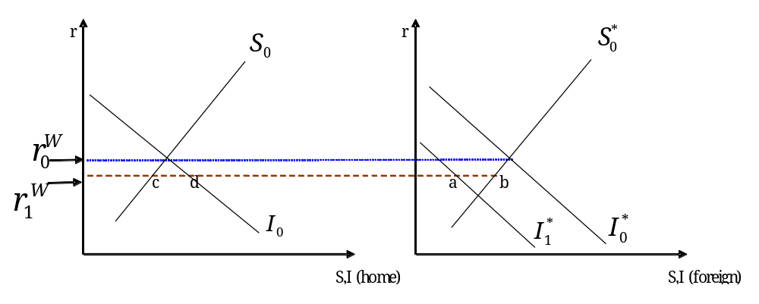
Global Savings Glut
Investment falls relative to savings in ROW. Alternatively, we could have a rise in S*

Slide 66
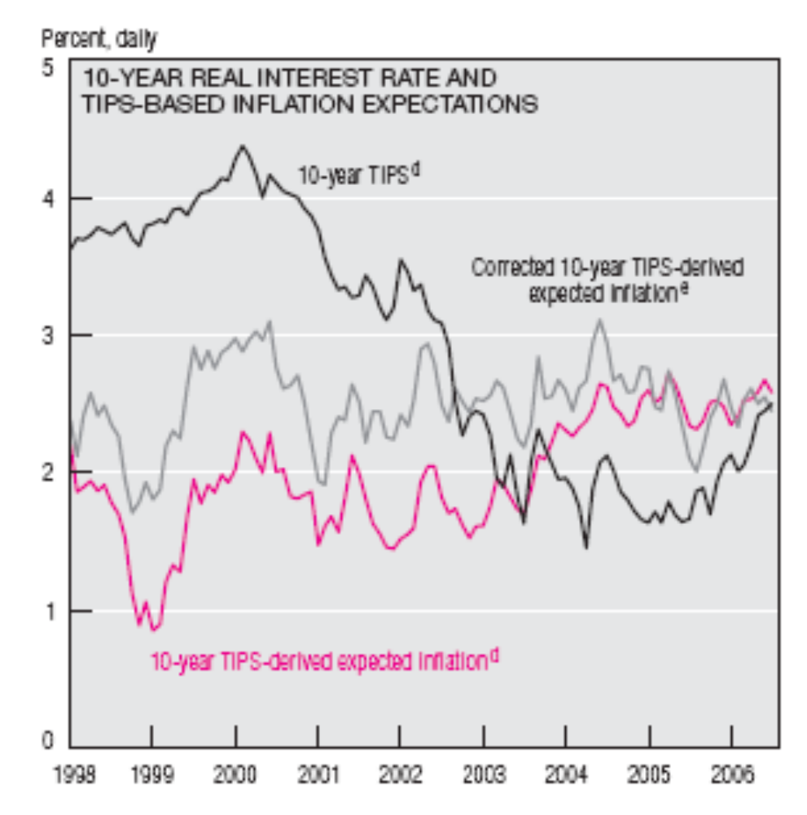
Realized Interest Rates

Slide 67
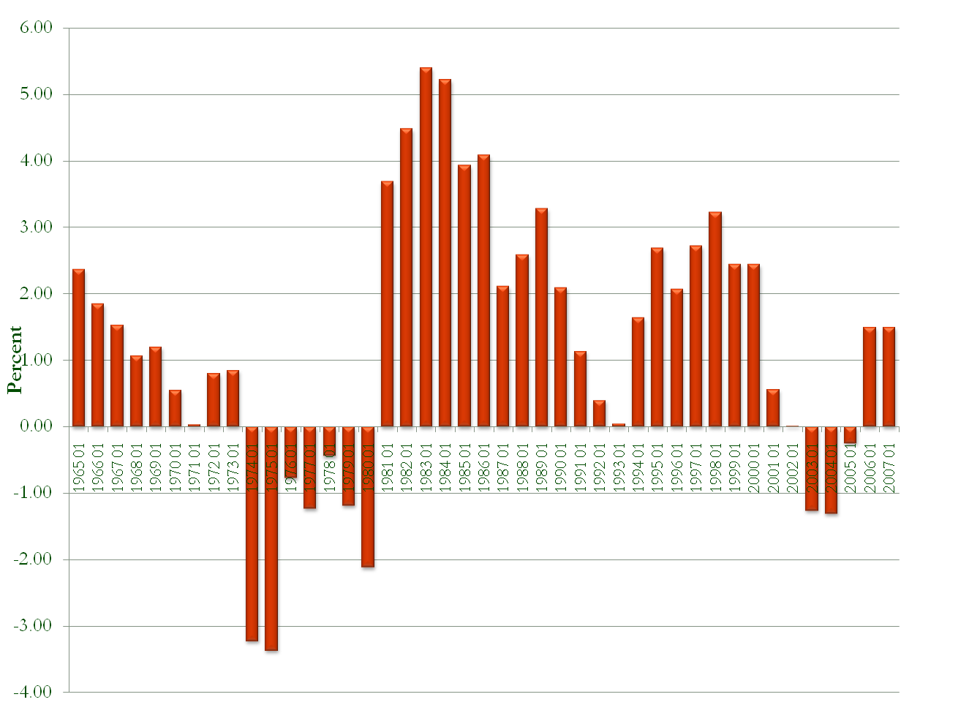
Realized US T-bill rates

Slide 68

30-Year Treasury Inflation-Indexed Bond,
Due 4/15/2028: Percent

Slide 69

Historical Real Interest Rates

Slide 70

World Real Interest Rates

Slide 71

World Real Interest Rates

Slide 72

Excess Reserves, Developing Countries
(level of reserves in excess of 1 year’s short-term debt)

Slide 73

Excess Reserves Beyond 2-years Debt

Slide 74
Opportunity Cost of Excess Reserves
Total roughly $1.5 Trillion
Suppose diversified yield = 6%
  => $90 billion, roughly 1.8% of combined GDP’s of the 10 leading holders of excess reserves
  Big number
  As large as gains from trade liberalization
  Developing countries presumably have better uses for their wealth than holding US Treasuries

Slide 75

Excess Reserves 10 leading Countries

Slide 76
War and the Current Account
Good test of theory
  Temporary increase in spending
  In non-belligerent countries, opportunity to earn higher returns
    So current accounts of belligerents and non-belligerents should move opposite
      E.g., Sweden and Japan
  But sovereign debt is complicated
    Fear of repudiation
    Why is there sovereign lending?

Slide 77
Adam Smith on Sovereign Debt
"When national debts have once been accumulated to a certain degree, there is scarce, I believe, a single instance of their having been fairly and completely paid. The liberation of public revenue, if it has ever been brought about at all, has always been brought about by a bankruptcy; sometimes by an avowed one, but always by a real one, though frequently by a pretended payment [in a depreciated currency]...When it becomes necessary for a state to declare itself bankrupt, in the same manner as when it becomes necessary for an individual to do so, a fair, open, and avowed bankruptcy is always the measure which is both least dishonourable to the debtor, and least fruitful to the creditor." Wealth of Nations, Book V, Chapter III, 882.

Slide 78

Current Accounts of Sweden and Japan

Slide 79

US Current Account Balance, Savings and Investment

Slide 80

Valuation
Intuitively, net wealth is sum of past CA:
But this ignores valuation
  Valuation effects can occur because the returns on assets we own abroad may differ from those foreigners own here, and also from capital gains and losses due to movements in the dollar.
  Normally one would think that these factors would balance out -- why should a country enjoy such an advantage?

Slide 81

Valuation
US is different
  The dollar is the world's reserve currency.
  The US borrows in its own currency, something other countries cannot do.
    Exorbitant privilege
  US is safe haven
Valuation effects are quite large

Slide 82

U.S. Net Foreign Assets, relative to GDP
1952:1 to 2004:1

Slide 83


Net Valuation Component (relative to GDP)

Slide 84

How Valuation Effects Impact US External Wealth

Slide 85
Valuation
Notice that when the CA > 0, the valuation effect was negative. Now it is positive
Where does it come from?
  US is safe haven
  World money center, US borrows short and lends long
    But where does the advantage come from?
  Dark matter
Will positive valuation effects survive?

