Slide 1
Family Death Rate and Exams
Analysis based on Mike Adams, “The Dead Grandmother/Exam Syndrome and the
Potential Downfall Of American Society,” The Connecticut Review, 1990

Slide 2
Warning
Taking this class can be dangerous
Tendency of family members to die before exams
  Basic data
FDR low when no exam is likely
FDR rises when exams are imminent
FDR is grade dependent

Slide 3
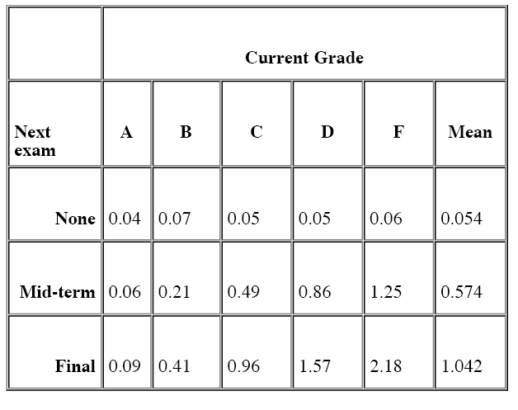
Family Death Rate (per 100 students), Basic Data

Slide 4
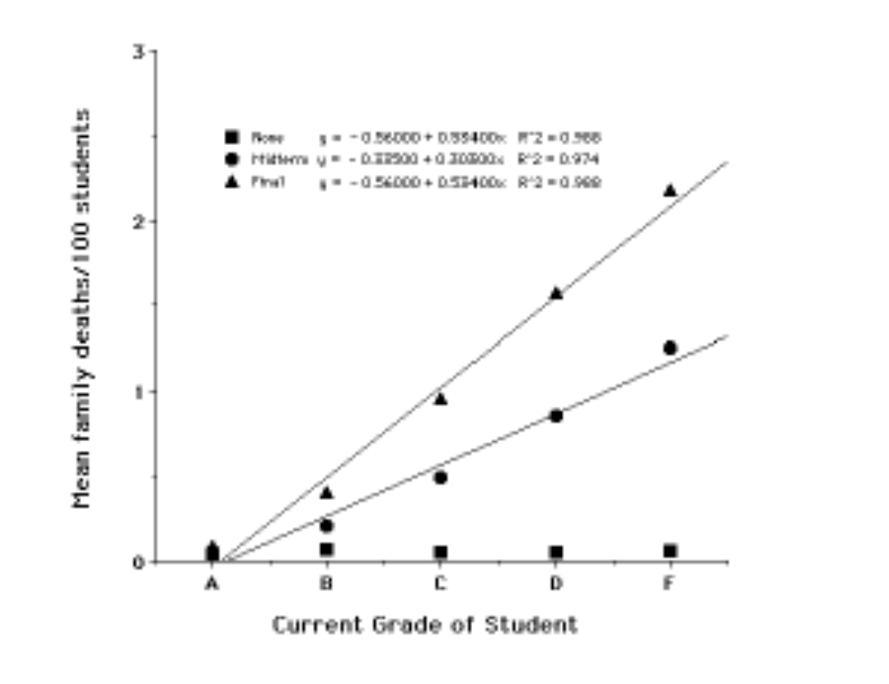
FDR and Current Grade

Slide 5
Implications
Family members worry themselves to death over students’ grades
  Could explain why so many grandmothers die
  But, why not grandfathers?
At least American families are close-knit
Interestingly, not related to family size
  Designated worrier hypothesis
    Could explain why grandmothers are 24 times more likely to die than grandfathers
    Issue for Womens’ Studies Department

Slide 6
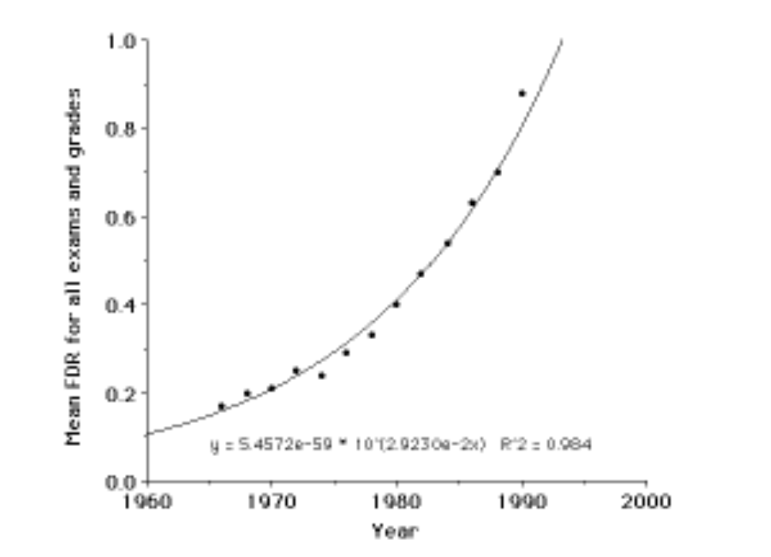
FDR over time

Slide 7
More Implications
Could explain the high divorce rate
  US has highest pct of population attending college and highest divorce rate
  Yemen has lowest in both
  Connection?
    Divorce is the only way (currently) known to increase number of grandmothers!
Problem growing worse over time
  Extrapolation suggests that 100 years from now the FDR will stand at 644/100 students/exam.
    At that rate only the largest families would survive even the first semester of a student's college career.

Slide 8
Three Suggested Solutions
Cancel Exams
  Medical schools would close, economy would die
Allow only orphans to attend college
  Shortage of orphans
    No ethical way to increase supply
Have students lie to their families
  Not enough to just lie to grandma
  Not just about exams, but about college altogether
    Students must pretend they are in the armed forces, have joined some religious cult, or have been kidnapped by aliens.
      Can’t appear at football games without shirt wearing PSU facepaint
Interim solution
  Study for exams, less risk for “A” students

Slide 9
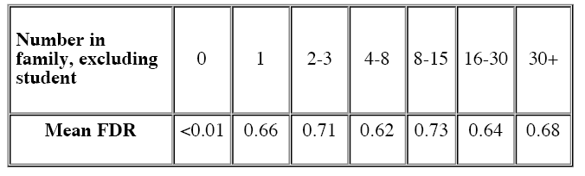
FDR and Family Size

