Slide 1
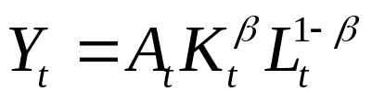

Dynamic Model
Neoclassical production function
  General Form,
    Output comes from capital, labor, and technology level
    Notice that A is only measured as residual
  Useful to have a specific production function,
  Here is capital’s share of national income
    Notice that all income goes to capital or labor

Slide 2
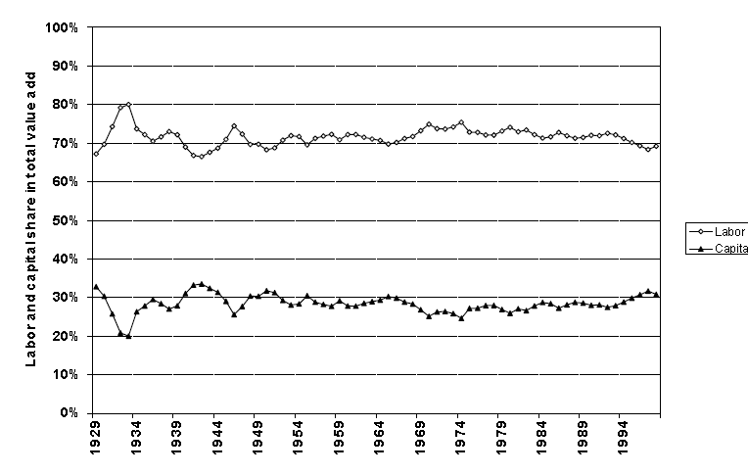
Labor and Capital Shares

Slide 3
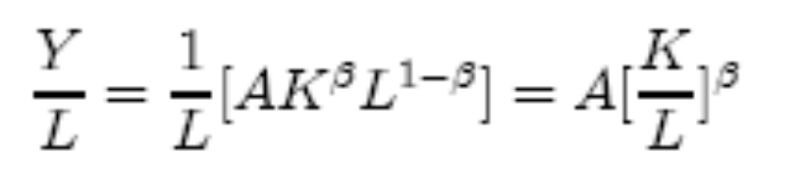
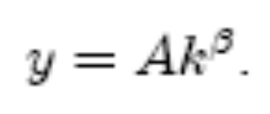
Dynamic Model (cont.)
It is useful to think about output per worker
In per-worker terms,
Or
Graphically, we have

Slide 4
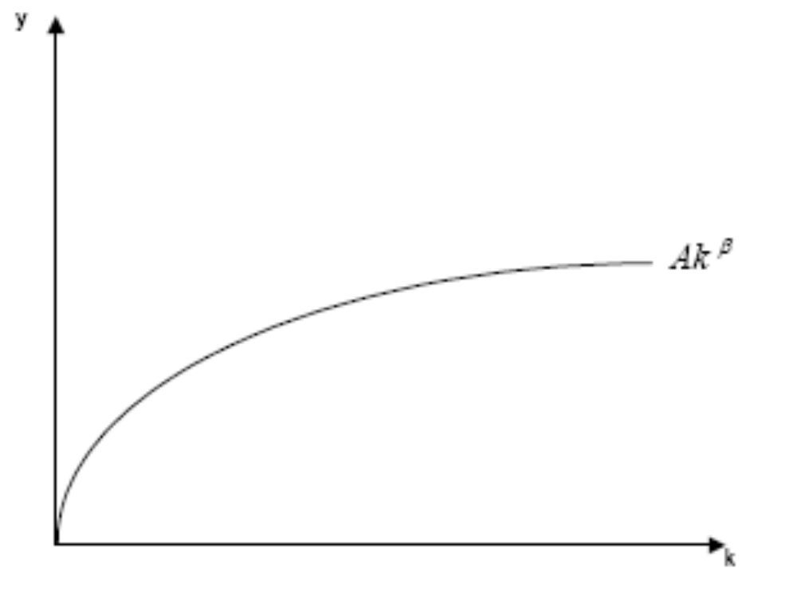
Neoclassical production function

Slide 5
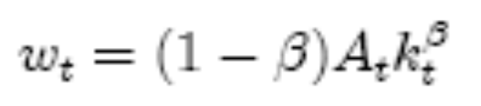
Dynamic Model (cont.)
Agents live two periods,
  Save and work when young, spend when old
What do agents earn?
  If markets are competitive w = marginal product of labor
  Given our production function, this is
Notice that wages rise when k increases but less than proportionally

Slide 6
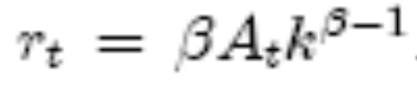
Capital
What about the return to capital?
If markets are competitive, then the r equals the marginal product of capital:
  Notice that as k rises r falls. This is just diminishing marginal productivity
Notice that a rise in A (whatever that is) raises both wages and the return to capital
  So it is good!

Slide 7

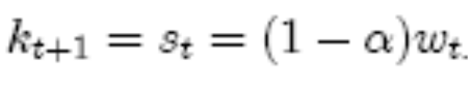
Accumulation
Assume that savings is proportional to wages
  Simplifying assumption – (shouldn’t it depend on r?). Let be the fraction of income that is consumed
  So savings is:
Assume 100% depreciation each period, so the capital stock in t+1 is equal to savings in t
But we know w just depends on k!!!!

Slide 8
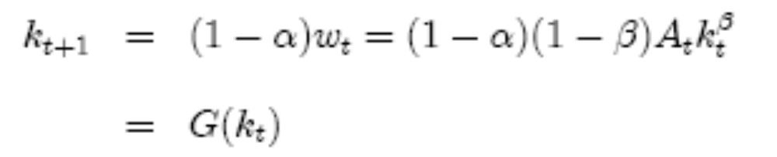
Transition Equation
Using the expression for wages,
This is the transition equation
  Capital stock in t+1 is a function of capital stock in t
  notice that a higher capital stock today means more next period, because it leads to more income and savings,
  Notice also, that there are diminishing returns (since β < 1)!!!!
=> we eventually reach steady state equilibrium

Slide 9
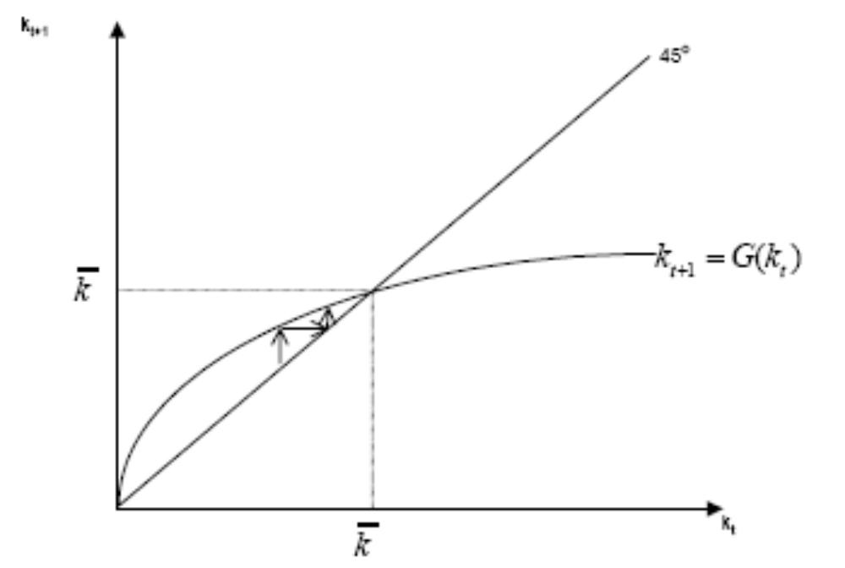
Transition Equation

Slide 10
Steady State Equilibrium
Steady state equilibrium k is constant
  Hence y must be constant
  Capital and labor grow at same rate
  If k is constant so is r and w
Unless A is growing over time, y constant in steady state
  Only growth is adjustment to steady state
    “Catch Up” growth

Slide 11

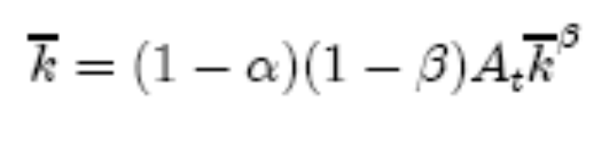
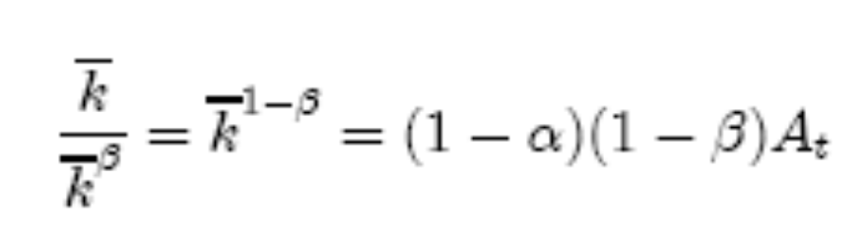
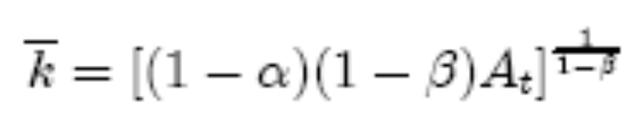
Steady State
We can determine the steady state level of k
Set in the transition equation
so,
or,

Slide 12
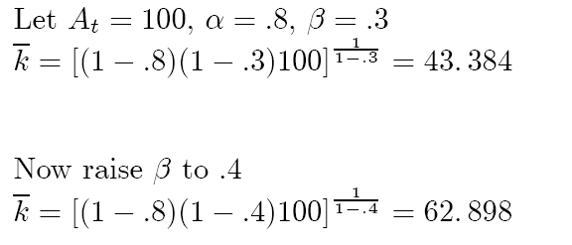
Steady State: Implications
From this expression it is clear that and hence
  Increase if the savings rate rises (obvious)
  Increases if A increases (obvious)
  Increases if capital’s share increases
  Example:

Slide 13

Steady State
Notice that if the capital-labor ratio is initially below its steady state value then savings leads to increases in the capital labor ratio.
Similarly, if we start off with too high a capital stock, we decumulate until we reach .
Notice that at , however, savings is just sufficient to keep the capital-labor ratio constant.
  There is no net savings or net investment at this value of the capital labor ratio.
  If A or the saving rate increases, so does

Slide 14
Two Countries
Consider two countries, US and Japan
Japan has higher savings rate
  Then Japan has higher steady state capital-labor ratio, and higher output, savings, and consumption
  In autarky this difference would be permanent

Slide 15
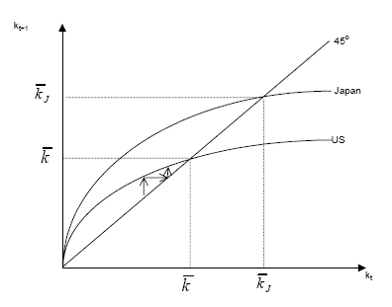
Autarkic Equilibrium

Slide 16
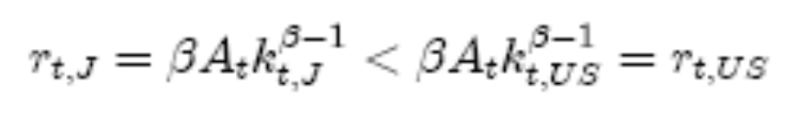
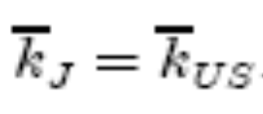
Open capital markets
With open capital markets, Japanese savers will want to invest in US. Why?
  Because initially Japan had higher k and we know that r is inversely related to k
As Japan invests in US, rises, and falls
  This continues until returns are equalized, but this requires
  Graphically,

Slide 17
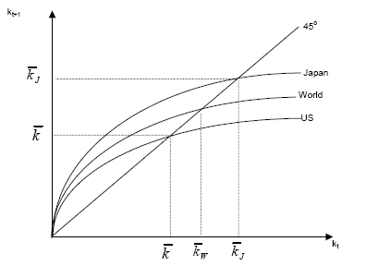
Equilibrium in two-country model

Slide 18
New Steady State
In new steady state wages will also be equalized
Capital-labor ratios in each country converge to world steady state capital-labor ratio
  In Japan from above, in US from below. Hence,
    Per-capita income rises in US in the transition
    Per-capita income falls in Japan in the transition
  But Japanese investors earn returns on their investment in the US
    And we know this has higher return

Slide 19

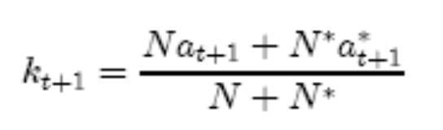
How is determined?
Factor-price equalization makes world like one country
Let N be the population, and a assets.
  So sum world savings and divide by population
  Then,
  World transition equation simplified by factor-price equalization
    Implies wages equalized

Slide 20
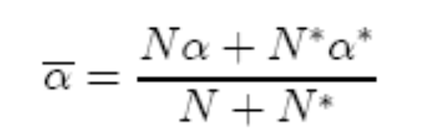
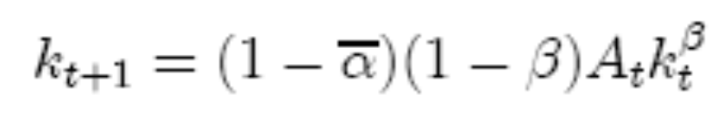

Determination of
World capital accumulation depends on the world savings rate, which is the weighted average of those in each country:
  So
  In the new steady state the capital-labor ratio for each country will be equal to

Slide 21
Steady State Equilibrium
If this were not the case then the return to capital would differ in the two countries.
  Since the US saves less than Japan this means that some of the savings required to have a capital-labor ratio equal to will have to come from Japan.
  Thus Japan will have positive net foreign assets, and the US will have negative net foreign assets.

Slide 22


Benefits of Capital Mobility
Assume Japan and US same size and same production function
  Under autarky, , due to different savings rates
Now open capital markets
  Capital flows to US due to higher rates of return
  New steady state where returns are equalized
    Clearly y_{US} rises, what about Japan?
    Capital is more productive in US, so Japan earns more too
      Return BC > BG (return on using the capital at home)
      US pays FD to Japan but earns DA on the net inflow

Slide 23
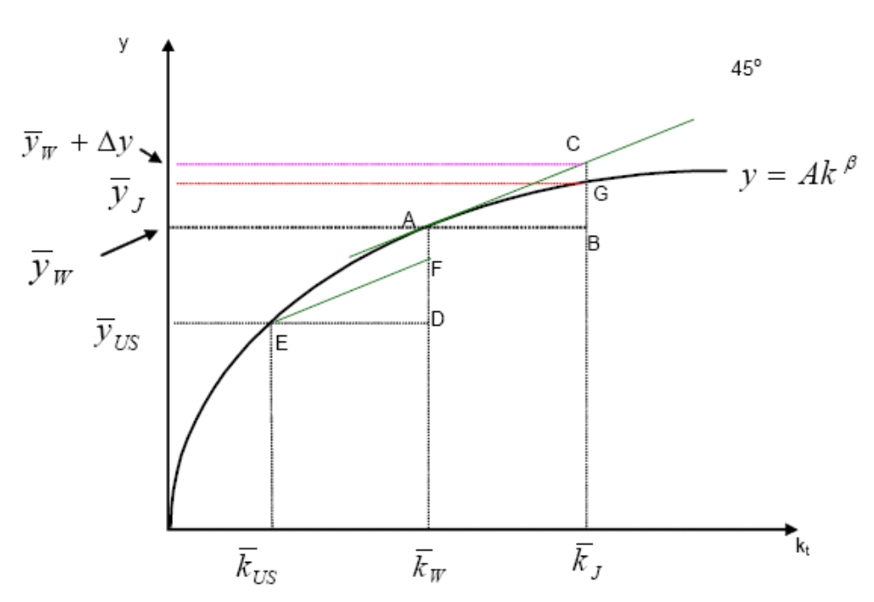
Autarky vs Liberalization

Slide 24

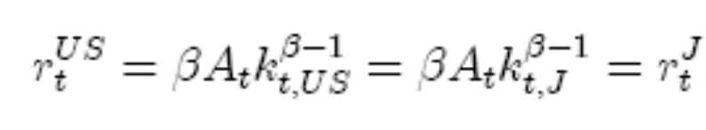
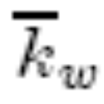
Problem: What if Congress forbids foreign ownership?
Suppose we start in equilibrium, then Congress forbids foreign ownership
  Initially, we are at so interest rates equal
  New law shifts US to its transition curve
    Off the world curve
  Asset accumulation now lower in US
  In new steady state we have
  <

Slide 25
Who gains, who loses?
Given lower k in US
  wages lower in US (higher in Japan)
    So young and future workers lose
  What about interest rates?
      r^{US} will be higher
      So first old generation wins
    Opposite is true in Japan
So winners and losers, but we know aggregate losses exceed gains

Slide 26
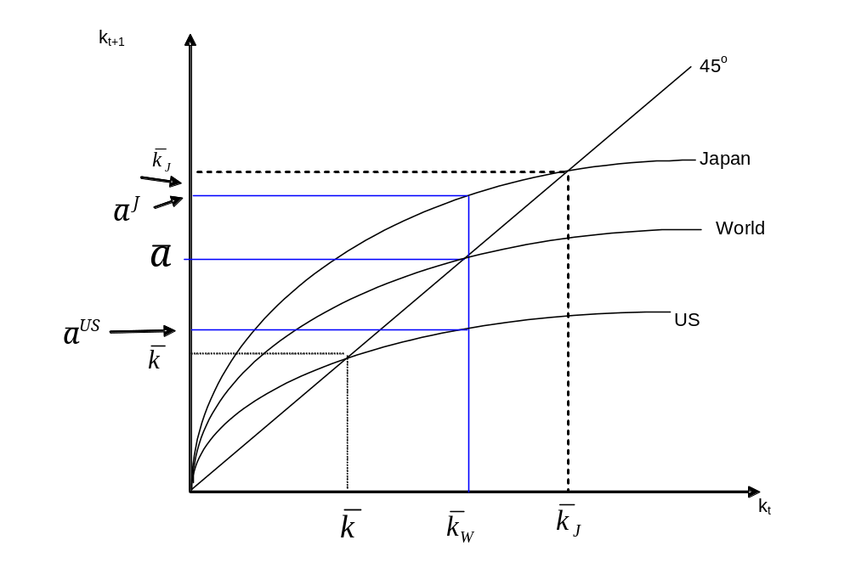
Closed Capital Markets

Slide 27
Adjustment to the new Steady State
Start from autarky, then open capital markets
Investment flows to US from Japan
So along the transition path US accumulates k
  Implies current account deficit
  In new steady state higher capital-labor ratio
  But how do we get there?

Slide 28

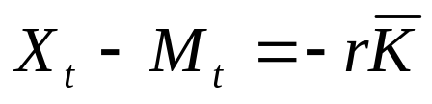
Adjustment
Transition involves an increase in US k
  Import of capital as returns are higher until new steady state is reached
  implies negative current account in transition
  Definition of current account
  In steady state, investment = 0
  In steady state, current account = 0
  Net Exports is positive in steady state:

Slide 29
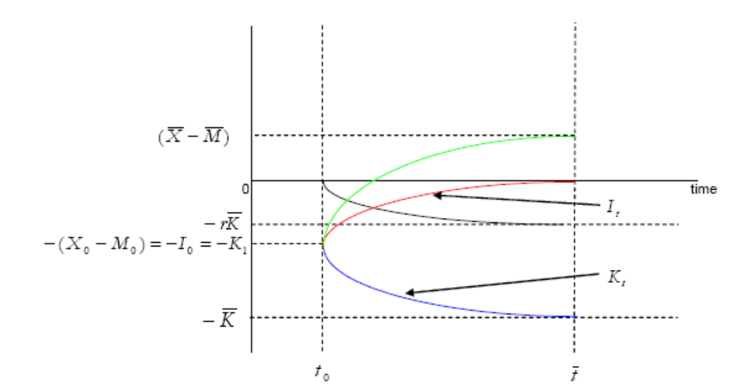
Adjustment to Steady State

Slide 30
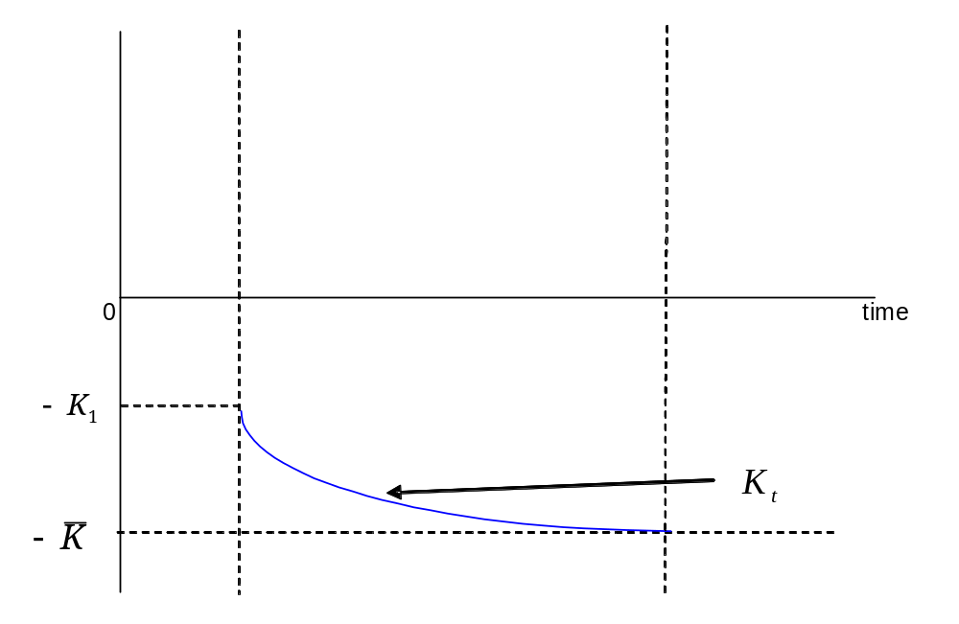
Adjustment to Steady State: Net Foreign Assets

Slide 31
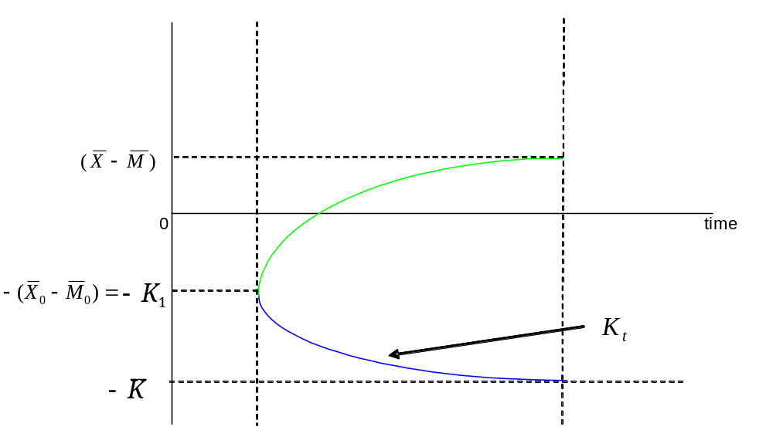
Adjustment to Steady State: Add Net Exports

Slide 32
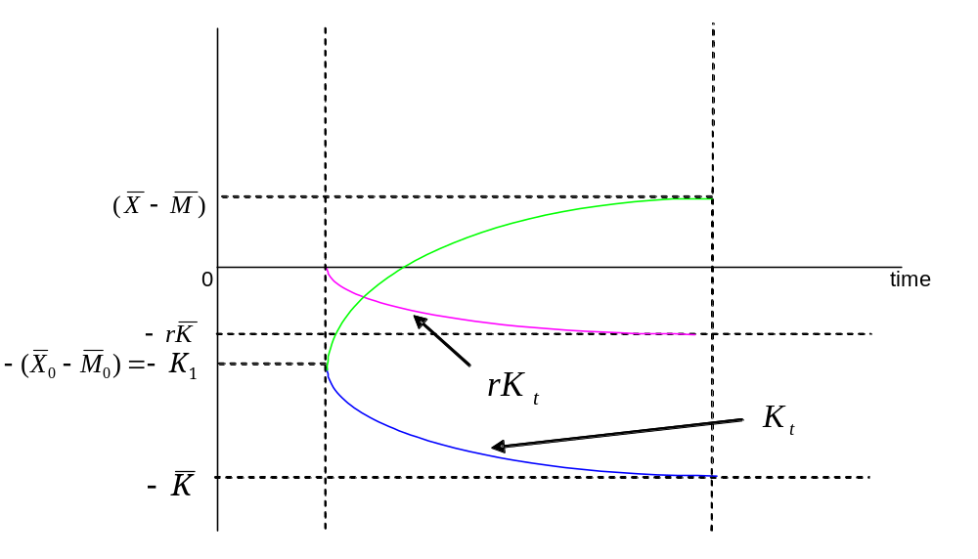
Adjustment to Steady State: Add interest payments

Slide 33
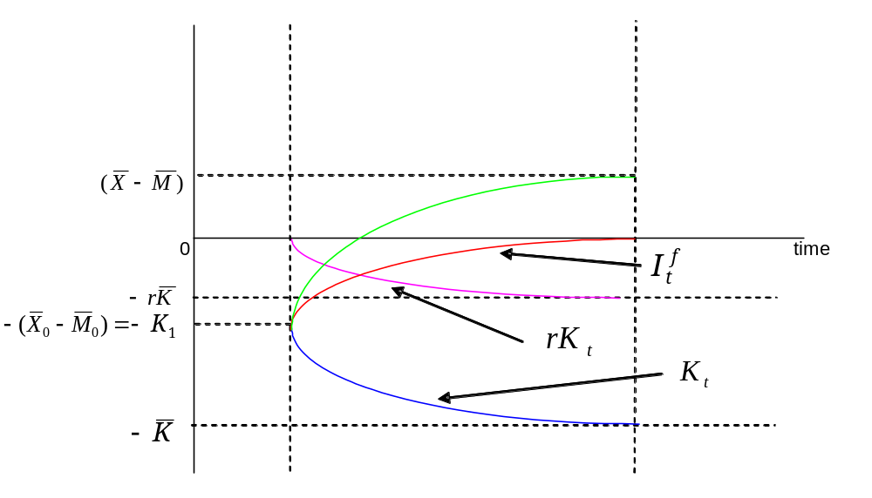
Adjustment to Steady State: Add Current Account

Slide 34
In New Steady State
Net foreign assets are lower (more negative)
  US borrowed to accumulate k
Net interest payments are negative
Current account balance = 0
Net exports are higher
Capital-labor and per-capita income are higher

Slide 35
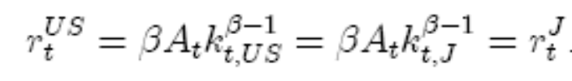




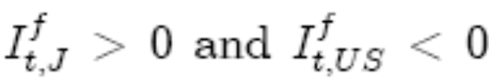
Rise in Productivity
Suppose initially that
Now let
  Transition curve for US shifts upwards
  So now must rise
  Japanese savers want to invest in US
  Interest rates can be equalized only if rises
  So in Japan and opposite in US
    Or,

Slide 36
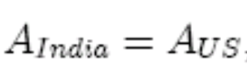


Digression (for now)
If interest rates are equalized why doesn’t k flow from rich to poor countries?
  India has 1/5th of US per-capita income
  Suppose that
    (textbook calls this the “naïve” model
  This implies
  This would seem to imply huge differences in r
  If capital’s share = 0.4 implies our k is larger than India’s

Slide 37


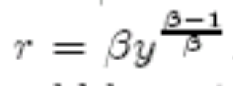

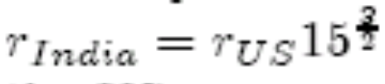
Return difference
Naïve model =>return to k_{US} is 58 times higher in India
  Where does the 58 come from?
  Ignoring A, and
  So
  We know that
  So
  And 15^{1.5} = 58

Slide 38
Lucas Paradox
Capital should flow from US to India
  But it flows the other way
Naïve model does not seem to work. Why?
  Ignoring differences in A!
  Ignoring risk premia
    Emerging markets must earn extra return to compensate for risk

Slide 39
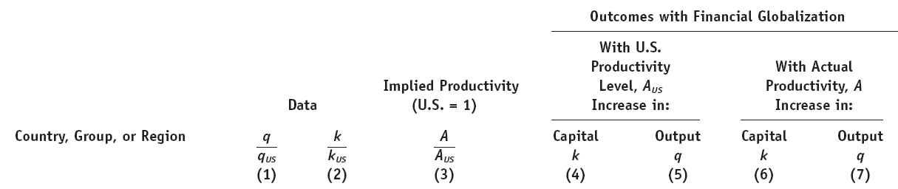
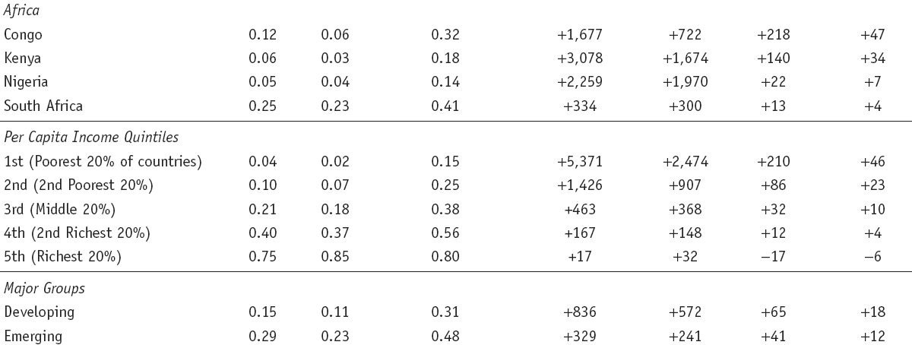
Gains from Financial Globalization

Slide 40
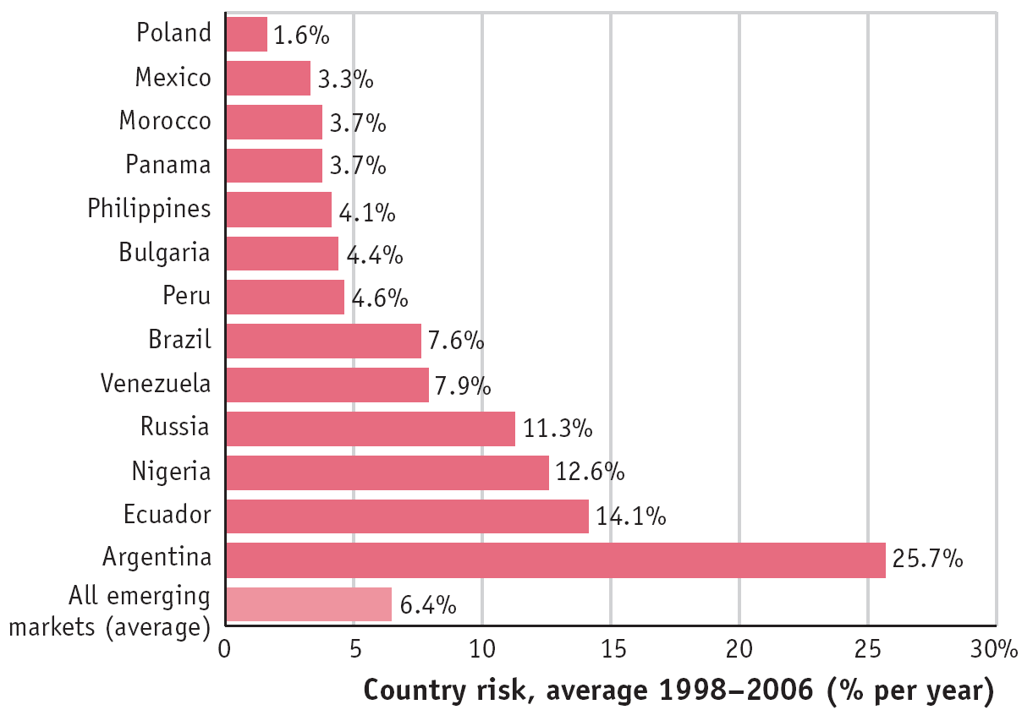
Risk Premia

Slide 41
Implications
Rise in productivity causes US CA deficit
  Japan has to accumulate foreign assets
  Both countries benefit from higher US productivity
  Rise in productivity is one explanation of US current account deficit, at least in 1990’s
  Less valid in this century

Slide 42
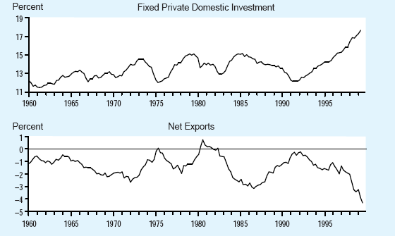
Fixed Investment and Net Exports percent of GDP

Slide 43
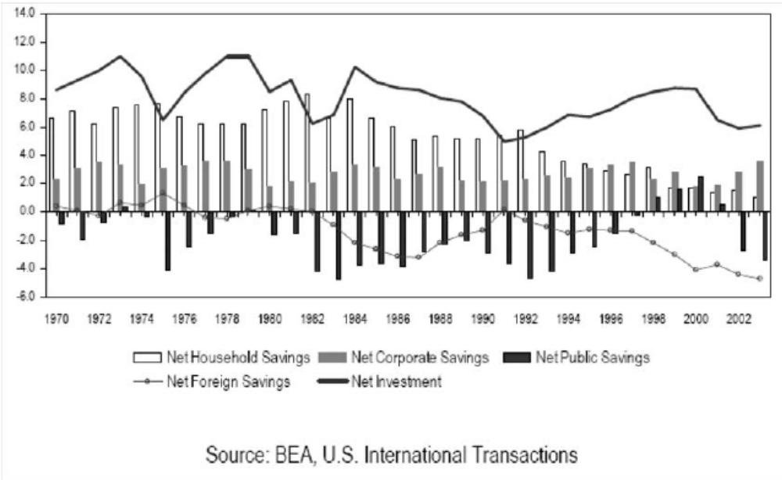
US Savings and Investment, 1970-2003
(percent of GDP)

