Slide 1
Thoughts on the Financial Crisis
Barry W. Ickes
Econ 434
http://ickmansblog.blogspot.com/

Slide 2
A Real Crisis
This is a huge crisis
Setting for a crisis
Key Factors
  Financial Innovation and deregulation
  World Savings Glut
  Agency
  Leverage
  Housing Bubble
  Subprime

Slide 3
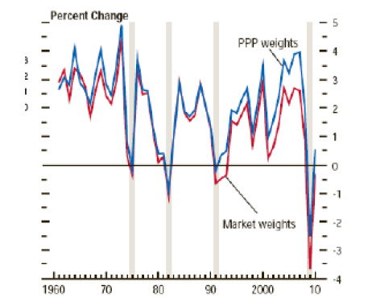
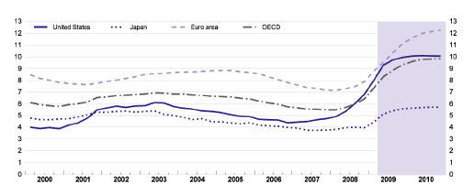
Output contracts and Unemployment Increases

Slide 4
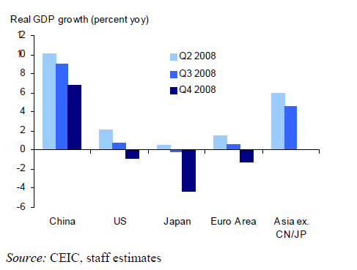
Worldwide Shock
Barry W. Ickes

Slide 5
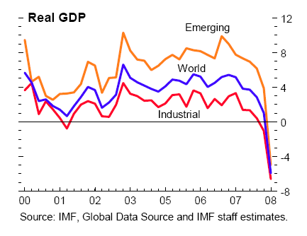
Global Growth
(in percent, quarter over quarter annualized)

Slide 6
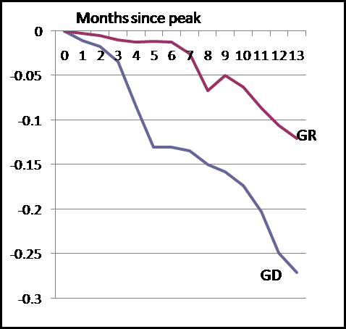
Industrial Production

Slide 7
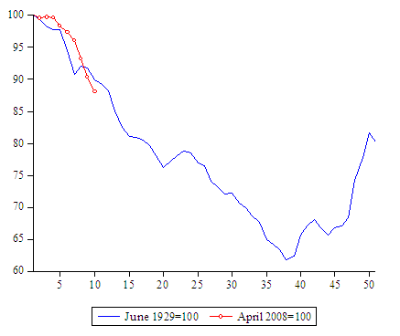
World Industrial Output, Then and Now
Barry W. Ickes

Slide 8
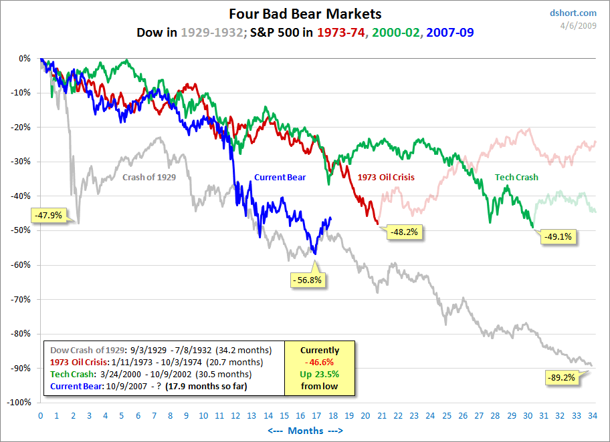
Our Stock Market, Then and Now
Barry W. Ickes

Slide 9
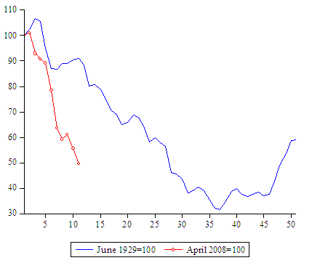
World Stock Markets, Then and Now

Slide 10
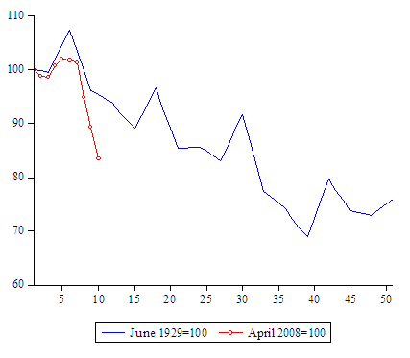
Volume of World Trade, Then and Now
Barry W. Ickes

Slide 11
Financial Innovation
Expansion in ability to share risks
Huge growth in the financial system
  Arrow notes:
    "the root is this conflict between the genuine social value of increased variety and spread of risk-bearing securities and the limits imposed by the growing difficulty of understanding the underlying risks imposed by growing complexity."
Increased complexity of assets
  Securitization
  Credit default swaps

Slide 12
Credit Default Swap
Derivative used to swap risk
Purchase of insurance against credit risks
  E.g., default
Advantage
  Exposure to risk that does not require cash outlay
  Works fine if defaults are independent
As of April 2008, $62 trillion in outstanding contracts
  More “insurance” than outstanding assets insured
  Valuable for idiosyncratic risks

Slide 13
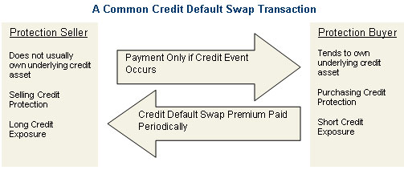
Credit Default Swap

Slide 14
Efficiency
Innovation and Deregulation enhance efficiency
But efficiency is not the same thing as stability
An efficient system may reduce flexibility
An inefficient system may be more adaptable
  Cockroach
    Responds to puffs of air, can survive nuclear holocaust
  Simple system may survive shocks
Efficient systems may not respond to environmental change

Slide 15
Agency
Financial system based on agency relationships
  Incentive system encourages risk taking
  Made worse by belief that markets are not efficient
    Yield trades were carry trades.
      Why would tranches of CDO’s rated AAA have higher yields than other AAA securities?
  Search for above risk-adjusted return
    Former Citigroup Chair, Charles Prince: “When the music stops, in terms of liquidity, things will be complicated. But as long as the music is playing, you've got to get up and dance. We're still dancing.”
      Not Anymore!!!

Slide 16
Incomplete Information, Agency, and Efficiency
Allows for hiding of risk
  Selling put options
  Earn bonuses now, risks show up later
Carry Trade is a bet on market not being efficient
  Costly when wound down

Slide 17
Leverage
Useful to enhance returns and lending
April 2004 SEC allows doubling of max leverage
Leverage works in both directions
  Shock led to de-leveraging as investors unwound positions
    Asset price deflation

Slide 18
Lesson
Financial development has raised fragility
  by increasing complexity,
  and by forging tighter links between various markets and securities, making them dangerously interdependent.
  Lack of redundancy
  Small error can cause chain reaction
    Chernobyl

Slide 19
Housing Bubble
Core is collapse of housing bubble
Made possible by low interest rates
  Fed or world savings glut
Innovation led to new types of mortgages
  Panic is due to the loss of information associated with these vehicles
  Toxicity
    Assets are toxic because of uncertainty over what is the value in the CDO.
    Because of uncertainty over the value banks are afraid to lend.
  Cannot unbundle what is bundled
How does it happen?

Slide 20
Conflict of Interest
Ratings Agencies had conflict of interest
  They are paid by the banks, fees are huge
    3 times higher than for corporate debt
  Ratings is a profitable activity
Used flawed models
  Assumed default risks were independent
  Assumed historical default rates were relevant
    Ignores effect of innovation

Slide 21
Credit Crisis
Result was a credit crisis
  Banks that held toxic waste faced difficulty in rolling over short-term debt
  Funding problems lead to fire sales and liquidity crisis
  Internationally things are even worse
    Greater leverage
    Dollar rally and unwinding of carry trade
End of the World avoided, recession imminent

Slide 22
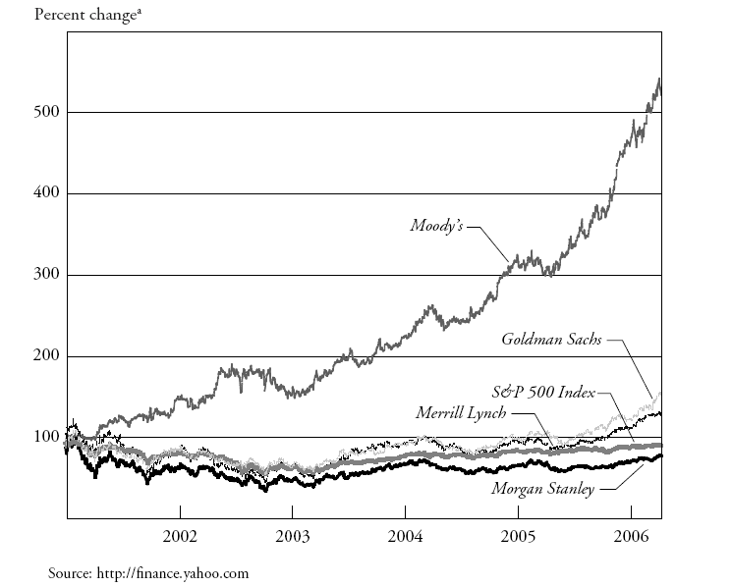
Change in Moody’s Share Price versus Major Investment Banks

Slide 23
Ratings Agencies
A conversation between two ratings analysts at S&P:
  Rahul Dilip Shah: btw: that deal is ridiculous Shannon Mooney: I know right ... model def does not capture half of the risk
  Rahul Dilip Shah: we should not be rating it Shannon Mooney: we rate every deal
  Shannon Mooney: it could be structured by cows and we would rate it

Slide 24
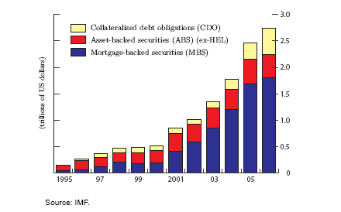
Securitization of Bank Credit Risk

Slide 25
Securitization
Securitization of mortgages (ABS)
  Bank issues a mortgage, then resells the loan to investors.
  more funds for mortgage loans
  worse quality control of borrower
Solution (US): the mortgages of “prime” borrowers are bought and securitized by Fannie Mae and Freddie Mac.
  Prime borrowers: Household debt less than 45% of annual income, 10% down-payment, good credit score.
Result: Prime borrowers have easier access to credit and investors have more investment opportunities. Subprime borrowers are out of the market.

Slide 26

Securitization II
Suppose the probability a mortgage defaults = 10%
  Large investors will not accept risk above 5% (assumption)
Bank combines 2 mortgages and sells 2 separate parts (tranches).
  The “bad” tranche defaults if either(or both) of the borrowers defaults
  The “good” tranche defaults only if both of the borrowers default.
The “good” tranche is more valuable. Probability of two defaults = 10%*10%= 1%
The default probability is (1%, 19%) for the “good” and the “bad” tranche.
If mortgages are sold separately (no “structuring”) the default probability is (10%, 10%).

Slide 27
Implications
Securitization leads to better allocation of risk: Pension funds get safe part, hedge funds get risky part.
In addition, a market developed to insure the CDOs.
  These are the Credit Default Swaps
This is a potentially revolutionary innovation! Expands possibilities of credit.
Approx. $1.5 trillion subprime mortgages were issued in the last 15 years.

Slide 28
Why?
Benefit
  Diversification and a reduction in the costs of raising external capital for loan intermediation
    Increase leverage to lend more
    Economize on capital
  Focus on intermediation
Costs
  Lemons premium
  Moral hazard cost
    Due to inefficient monitoring

Slide 29
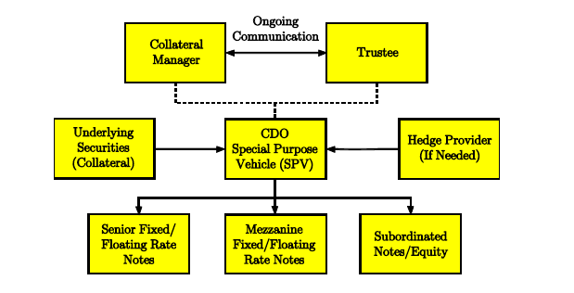
A Typical CDO

Slide 30
CDO’s
Moral Hazard plus lemons => retention of some debt by lender
  Explains some of the “trash held” by RSG Bank
    This demonstrates to investors a degree of confidence in, or commitment of effort for, low default losses.
Tranches may also satisfy demand for different risk classes
  Create high quality debt instruments for sovereign wealth funds
CDO’s reduce entry barriers to finance and thus lower cost of financing
  Efficiency effect
But they also raise the fragility of the system as we see
Biggest problem is modeling of default correlation

Slide 31
Problems with Structuring
Determining the risk of a structured product is inherently difficult.
  All depends on correlation. If correlation of default = 1(rather than 0) then instead of (1%, 19%) we have (10%, 10%).
Reliance on historical data to calculate ρ
The rating agencies (S&P, Moody’s, Fitch) have conflict of interest
The insurance that was purchased turned out to be unhelpful: too much correlation
Banks held too much on their balance sheets to earn yield

Slide 32
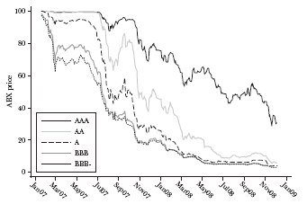
Result: Collapse of CDS Prices

Slide 33
Fundamental Points about Crisis
Why were banks so vulnerable to problems in the mortgage market?
  substantial amounts of mortgage-backed securities with exposure to subprime risk were kept on bank balance sheets
  Problematic because banks are financed with short-term borrowing that needs to always be rolled over
As the housing market deteriorated, the perceived risk of mortgage-backed securities increased, and it became difficult to roll over short-term loans against these securities.
  When banks tried to sell assets the values plummeted, perhaps even below fundamental values
    => funding problems led to fire sales and depressed prices

Slide 34
Repo
Repo is essentially depository banking, built around informationally-insensitive debt.
  one side wants to borrow money and the other side wants to save money by “depositing” it somewhere safe.
    borrowers are like as a “bank” and the lender as a “depositor,” although the lender is another firm, such as a bank, insurance company, pension fund, institutional investor, or hedge fund.
  Depositor receives bond as collateral for deposit.
    Deposits may involve haircuts
      The haircut is the percentage difference between the market value of the pledged collateral and the amount of funds lent.
        E.G., haircut of 5% means that a “bank” can borrow $95 for each $100 in pledged collateral.

Slide 35
Shadow Banking
Repo market → development of shadow banking system
Requires collateral, which is informationally insensitive
  Securitization involves the issuance of bonds (“tranches”) that came to be used extensively as collateral in repo transactions
  Efficient
As housing declined, haircuts increased as collateral became informationally sensitive

Slide 36
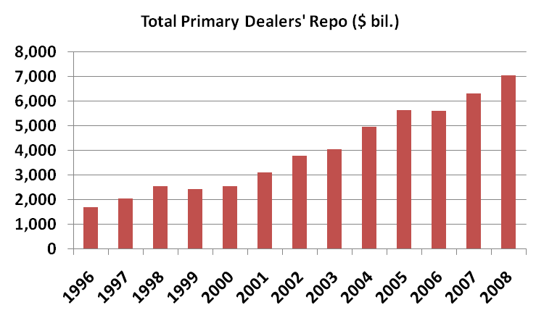
Repo Market

Slide 37
Impact of Rising Haircuts
Because of leverage, ↑ haircut => asset sales
  Example:
    Suppose bank has $100 in capital and leverage ratio = 30
      Bank holds assets = $3,000 by borrowing in repo market
    Haircut rises from 0 to 1%
      Bank needs to post $30 in margin, so has $70 left
      Bank can now hold only $2100 = 30*(100-30)
      Dumps $900 worth of securities
    Haircut rises from 1% to 2%
      Bank needs to post $60 => another $900 must be dumped
Asset sales drive down prices, which increases demand for collateral

Slide 38
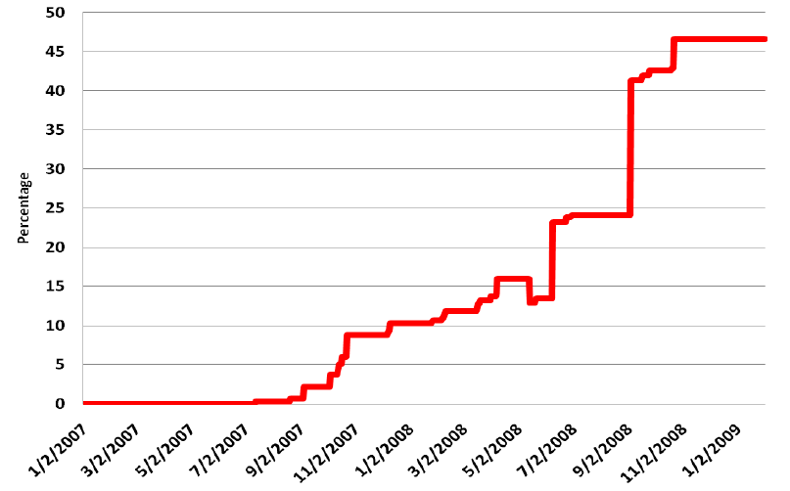
Average Repo Haircut on Structured Debt

Slide 39
Leverage and Liquidity
Banks are leveraged and require short-term financing
  Not the best place to hold tranches of CDO’s
    But agency problems required it
    Bad incentives encouraged it
Housing problems led to valuation problems
  Informationally insensitive assets became informationally sensitive
Led to difficulty in rolling over financing
  Leads to general credit crisis

Slide 40
Current Crisis
Panic centered on the repo market, which suffered a run when “depositors” required increasing haircuts, due to concerns about the value and liquidity of the collateral should the counterparty ‘bank” fail
Housing crisis made shadow banking system vulnerable
Investment banks came under pressure
  Bear Stearns, Lehman failed, AIG failed
  Spread to money markets

Slide 41
Feedback Loops
Liquidity crises arise when we get positive feedback loop
  Shock requires more liquidity, sell assets
  This depresses asset prices and leads to more selling
  Positive feedback from asset prices to balance sheet is what causes crisis
Spread across assets and to commercial paper

Slide 42
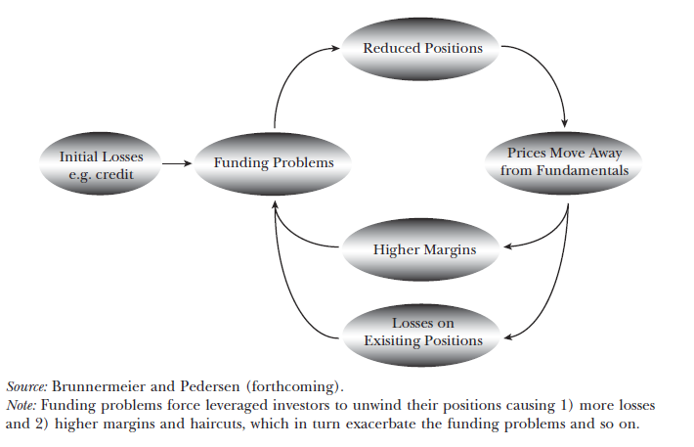
Two Liquidity Spirals

Slide 43
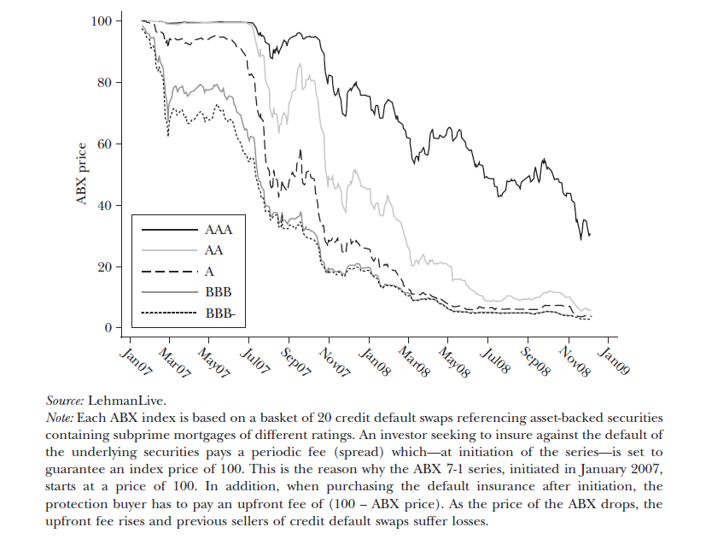
Decline in Mortgage Credit Default Swap ABX Indices

Slide 44
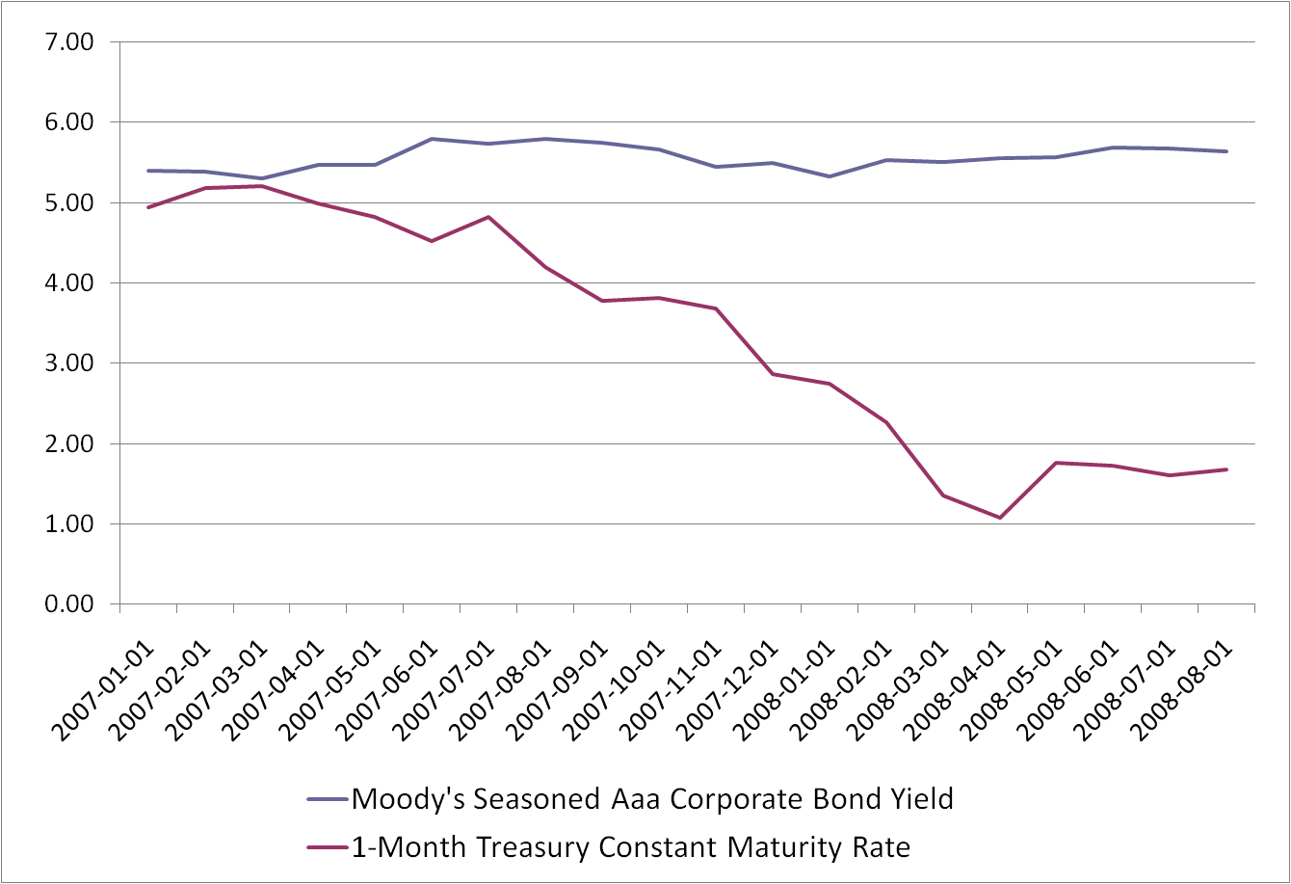
Corporate Bond Yields and Treasury Bonds

Slide 45
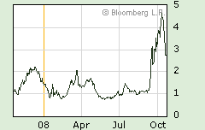
The TED Spread

Slide 46
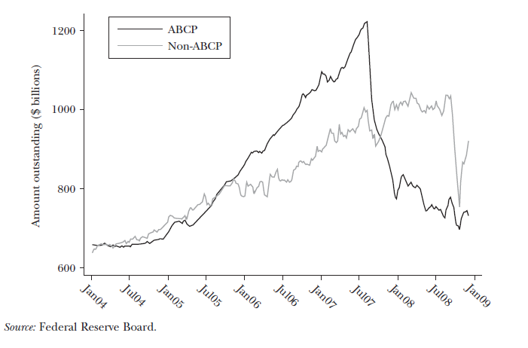
Asset Backed vs Non-Asset Backed Commercial Paper

Slide 47
Why Can’t the Market Do it?
Why the need a bailout? Why won’t private investors buy up the cheap assets?
  Failure of arbitrage
  Suppose you buy and hold today
    You profit if you can hold since P^{F} > P_{today}
    But price at next margin call may be lower
    If leveraged this could be too risky
    Hedge funds borrow to invest, investors may pull out if short-term returns tank
    Only sufficiently rich investor can hold
      In this case, US Government

Slide 48
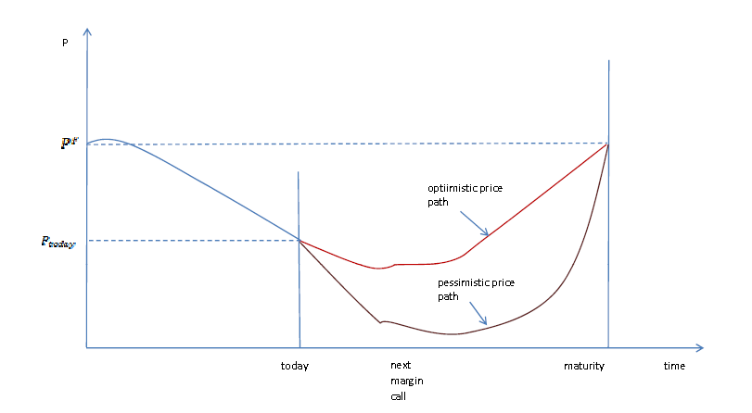
Potential Price Paths

Slide 49
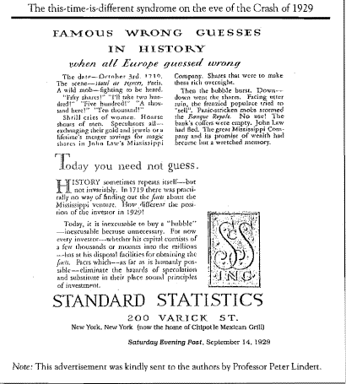
Famous Wrong Guesses

Slide 50
Macro Aspects
Low real interest rates and global surpluses
Led to asset bubble
As crisis spread to money markets it became global
  World trade collapsed
  Countries without link to subprime suffered too
Was TARP the problem?

Slide 51
Implications
Fire started in housing, but the problem became severe because of leverage
  Liquidity Black Holes
    Short-horizon traders sell because others sell – it is just like a bank run
Incentives for risk-taking
Lack of belief in efficient markets
  Belief that AAA tranches could earn higher return and be safe
  Belief that asset prices always rise

Slide 52
Example, Lehman and Bear
Equity Prices increased dramatically, then wiped out
Top executives gained lots more than they lost
Incentives encouraged excessive focus on short-term share price, and led to excessive risk-taking
  Would they have ever listened to a risk-officer?

Slide 53
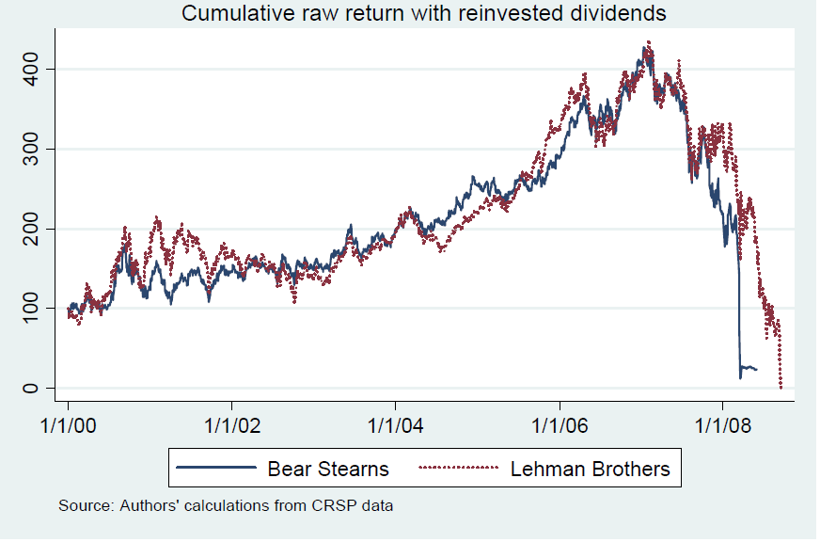
Bear and Lehman’s Performance, 2000-2008
Jan 2000=100

Slide 54
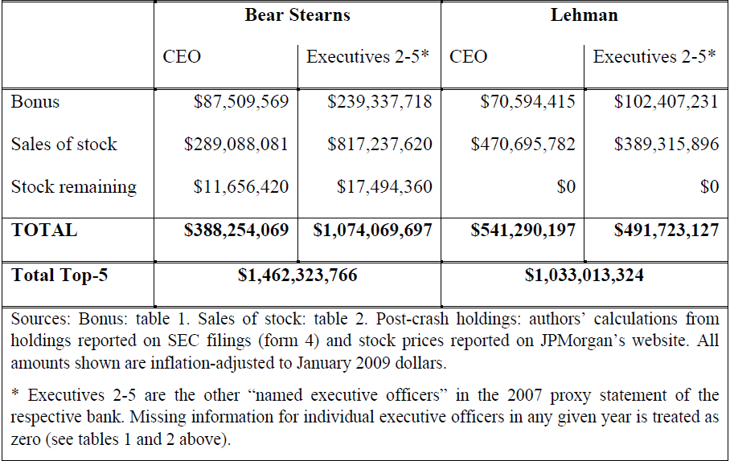
Total Cash Flows from Bonuses and Equity Sales,
2000-2008

Slide 55
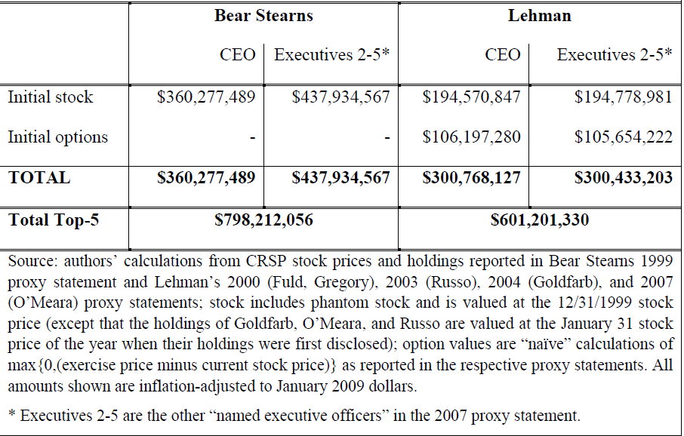
Estimated Value of Initial Holdings

Slide 56
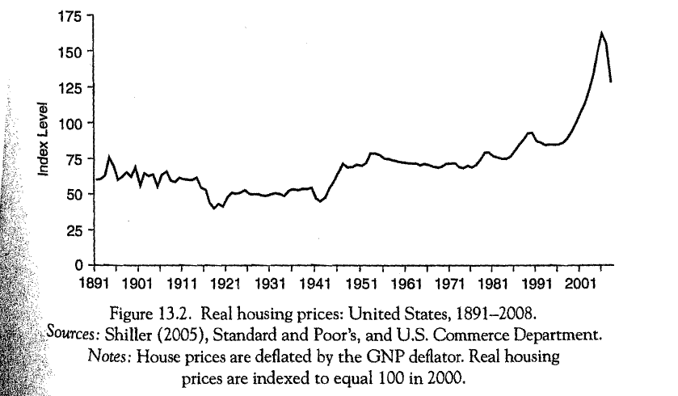
Real Housing Prices 1891-2008

Slide 57
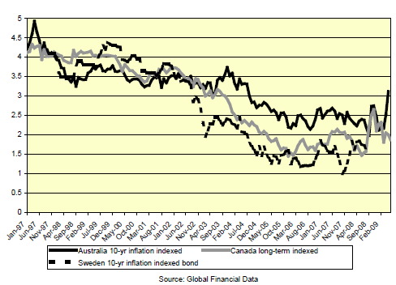
US Long-Term Real Interest Rates

Slide 58
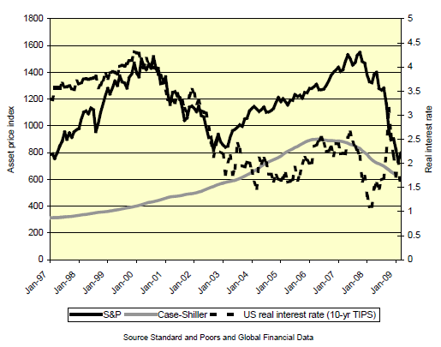
Real Interest Rates and Asset Prices

Slide 59
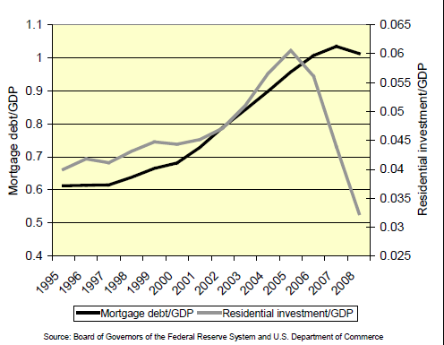
Mortgage Debt and Residential Investment

Slide 60
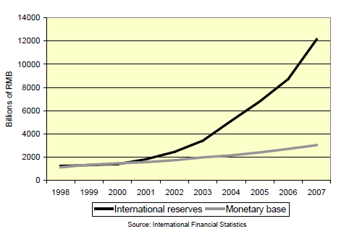
China’s MB and IR

Slide 61
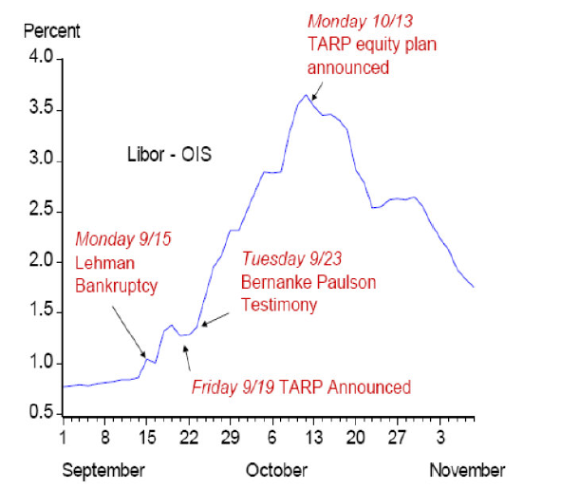
John Taylor’s Exercise

Slide 62
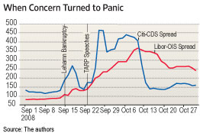
Cochrane and Zingales

Slide 63
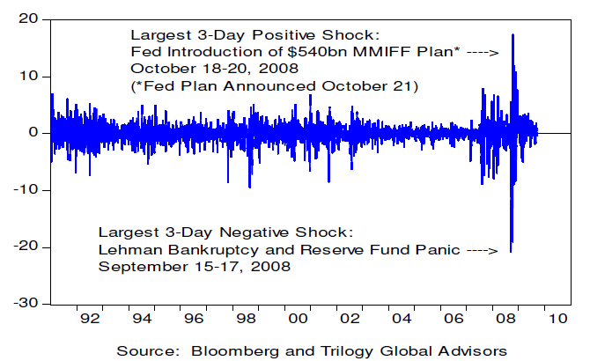
Shocks to the Bloomberg Distress Index

Slide 64
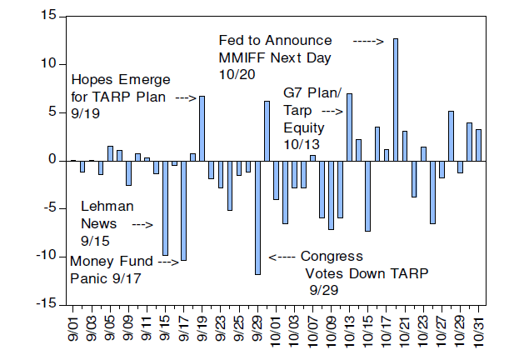
Daily Changes in Bloomberg Index

Slide 65
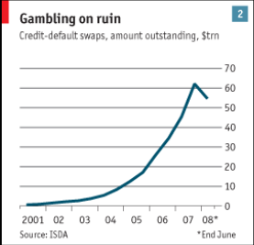
Credit Default Swaps Outstanding

Slide 66
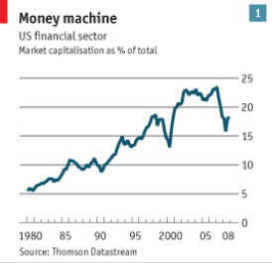
Overcapitalization

Slide 67
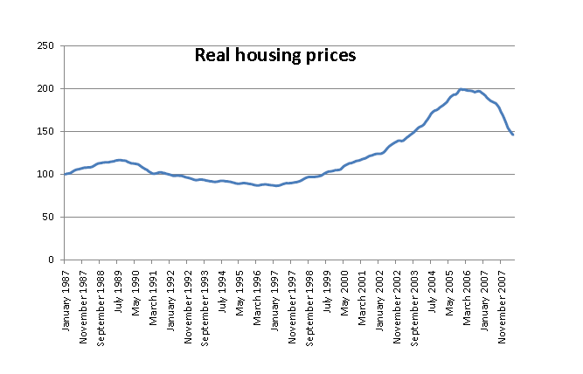
Housing Bubble

Slide 68
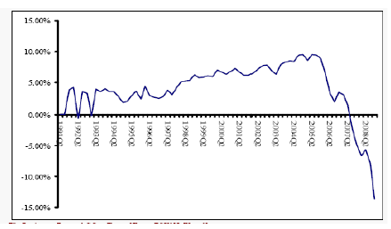
Rate of Change of US Housing Prices

Slide 69
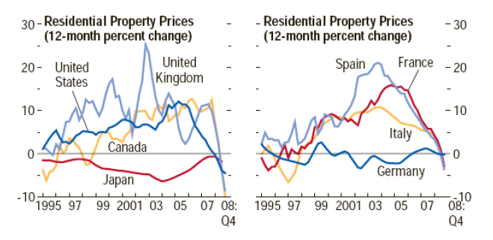
Home Prices Falling Everywhere Now

Slide 70
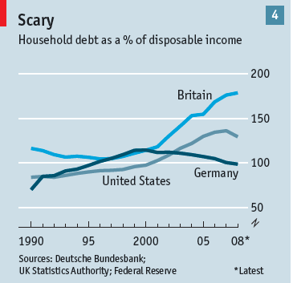
Household Debt as Share of Disposable Income

Slide 71
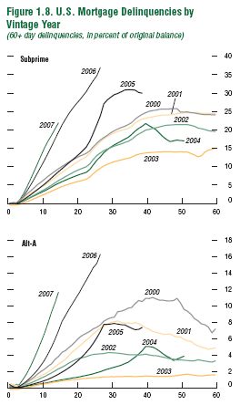
Mortgage Delinquencies by Vintage year

Slide 72
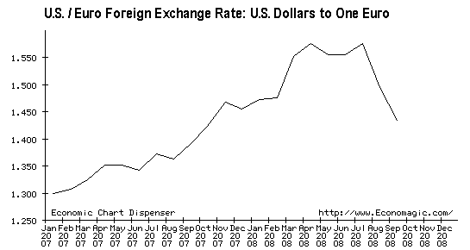
Dollar Rally vs Euro

Slide 73
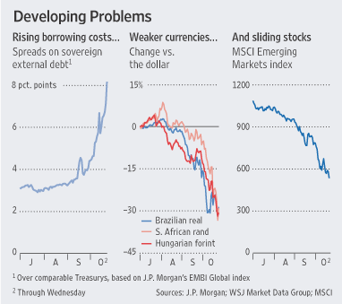

Slide 74
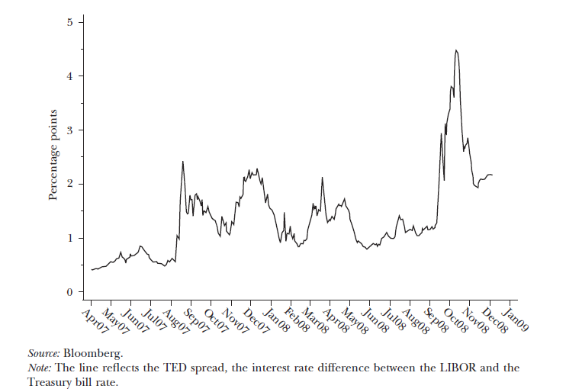
TED Spread

Slide 75
US Long-Term Real Interest Rates

Slide 76
Real Interest Rates and Asset Prices

