Slide 1
Tasks
Stabilize
  Force majeure
Liberalize
  Internal and external
Privatize
But in what order?
  Complements versus substitutes
Dilemma
  Harden budget constraints to stabilize
  Liberalize prices to make budget constraints meaningful
  Privatize so that restructuring can make HBC’s feasible

Slide 2
Two Characterizations of Transition
Neoclassical view
  Removing constraints
Alternative view
  Loss of social capital
  Coordination system collapse
  Cost of old system
Ignoring the costs of command makes transition seem easier
  Also makes failures seem more puzzling

Slide 3
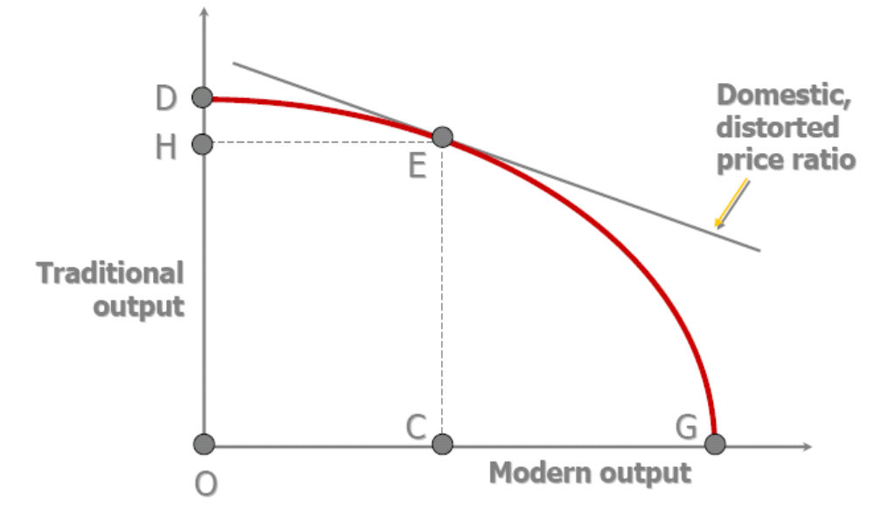
Initial Distortions

Slide 4
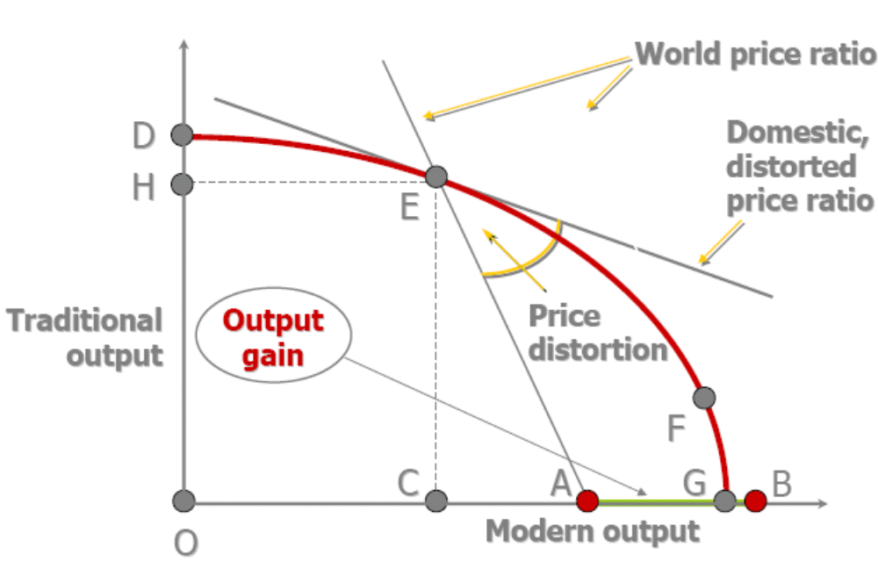
Output Gain

Slide 5
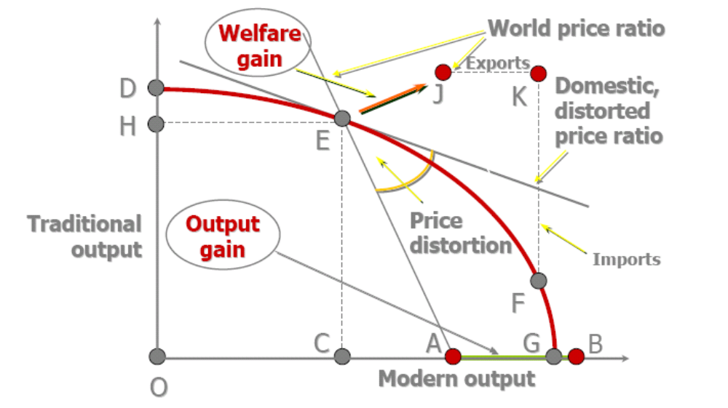
External Liberalization

Slide 6
Static Analysis
Static analysis ignores transition
How do you move from E to F?
Transition is about the adjustment path

Slide 7
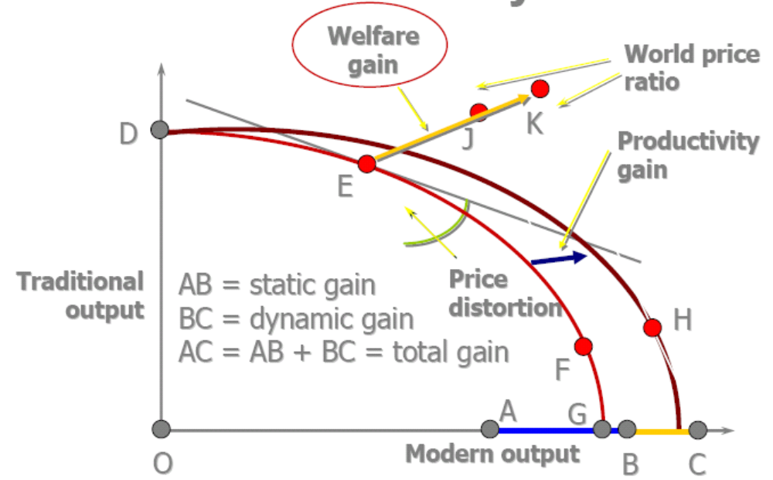
Dynamic Adjustment

Slide 8
Shortcomings
Analysis so far misses
  Output gains from reducing disorder
  Mechanism of productivity growth
Because we have ignored the adjustment process
  Transition takes time
    But that is not all
  Disorganization

Slide 9
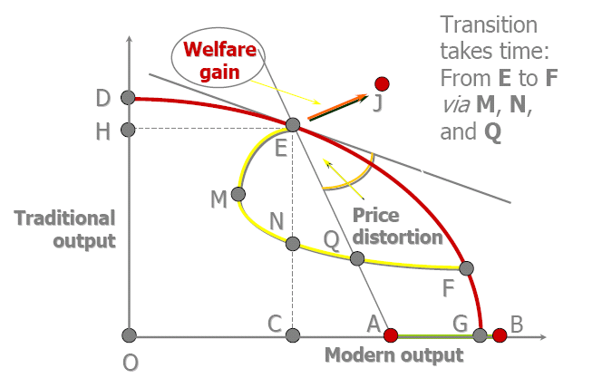
Adjustment and Inefficiency

Slide 10
Alternative View
Still more to transition problem
Adding social capital
  Trust required to operate a market economy
Adding disorder

Slide 11
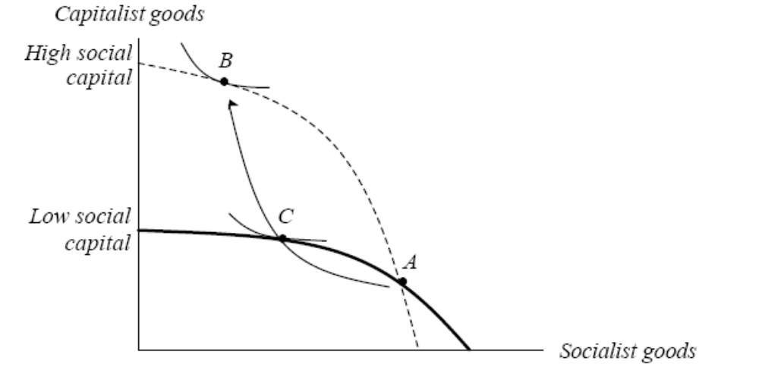
High and Low Social Capital

Slide 12
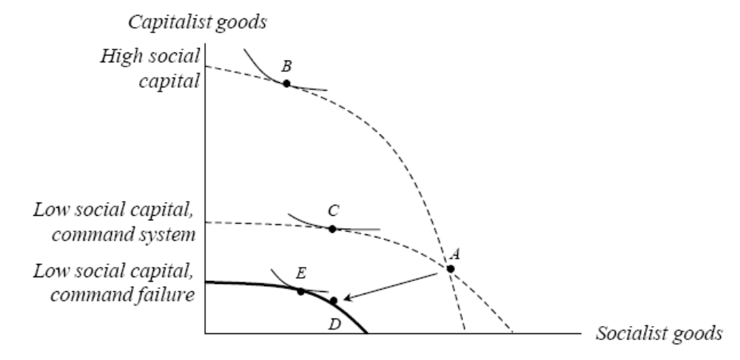
Transition After Command Failure

Slide 13
Sequencing
Big Bang versus Gradualism
Window of opportunity
  Crisis promotes change
    Recovery growth
  Irreversibility
  complementarities
Poland, shock therapy January 1990
Gradual reform
  Build constituencies
    China
    Ukraine, Uzbekistan, Belarus

Slide 14
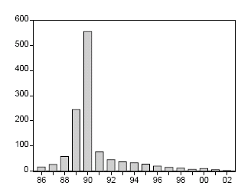
Polish Inflation

Slide 15
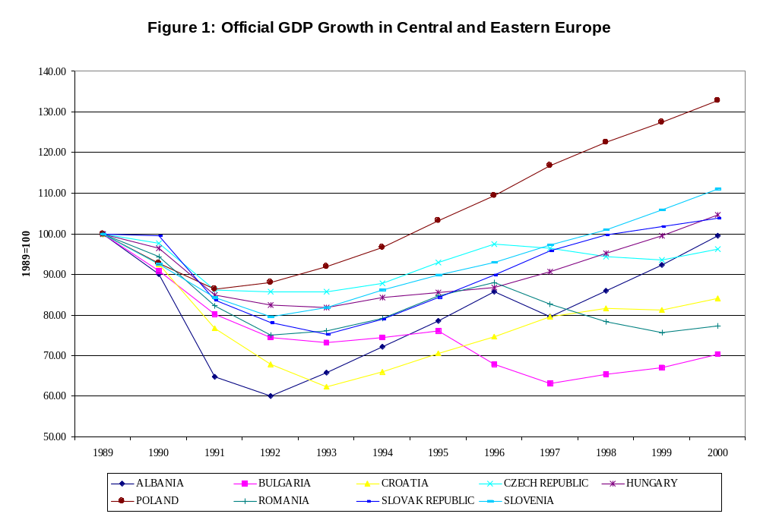
GDP in CEE’s

Slide 16
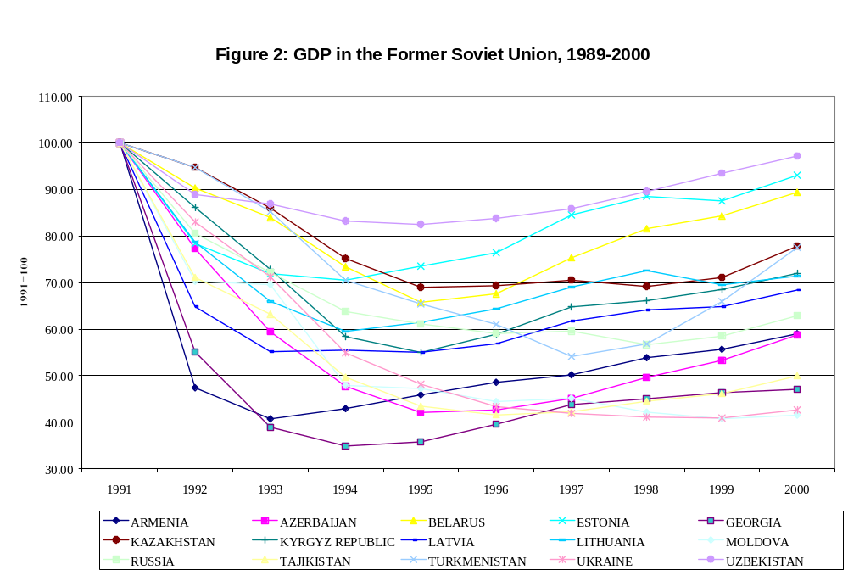
GDP in FSU

Slide 17
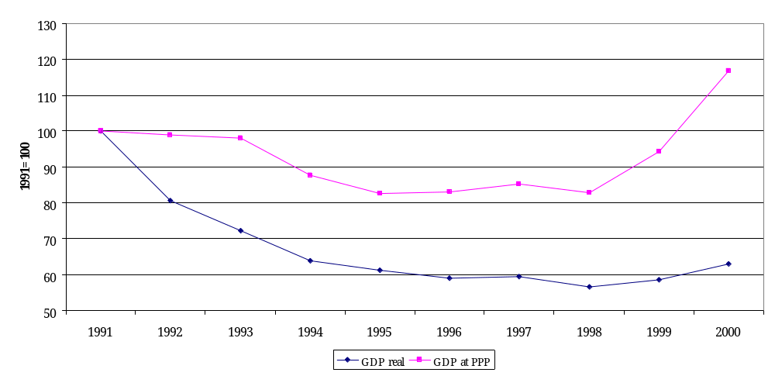
Russian Real GDP vs GDP at PPP

Slide 18
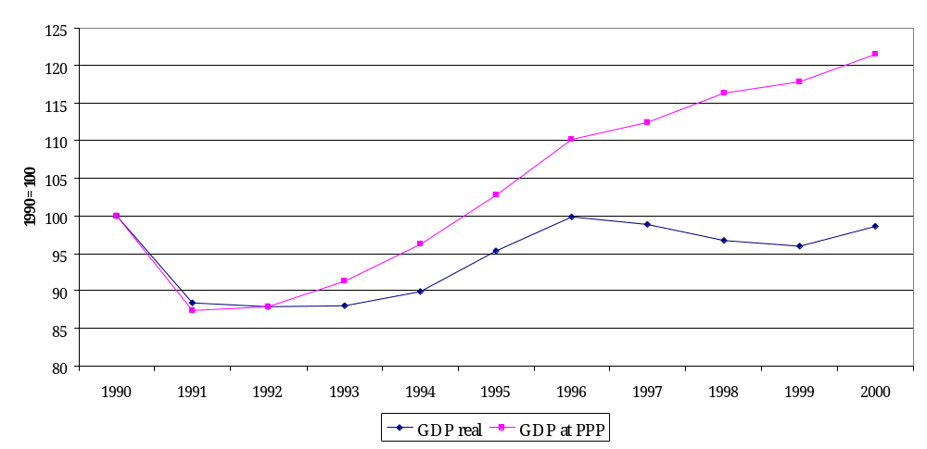
Czech Republic, GDP vs GDP at PPP

Slide 19
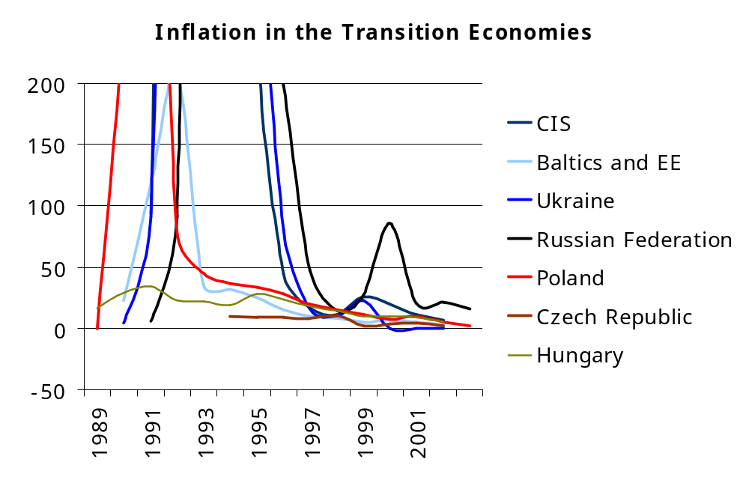

Slide 20
Political Economy of Reform
Ex ante versus ex post political constraints
  Identical without uncertainty and/or reversal costs
Uncertainty
  Let p be the probability of gaining g
  Let 1- p be the probability of losing l
  If p > 0.5 a majority wins ex post
    But ex ante we do not know if we benefit
    What if ?
      Then reform never passes, even though a majority favor it

Slide 21


Status Quo Bias
With risk neutrality, clearly if there is no reversal the reform is not implemented when , even though a majority benefits.
  Reforms that are beneficial ex post are rejected ex ante.
What if p < .5? Then a majority always wants reversal ex post.
  So even if pg + (1 − p)l > 0, as soon as the reversal cost is such that
the reform will not be adopted either.
  This is clearly the case as δ → 1.
  People know the reforms will be reversed (since p < 0.5), the net payoff from reform is
  For reforms to be implemented they must satisfy both ex ante and ex post political constraints

Slide 22
Status Quo Bias
Thus there is a status quo bias against reform
  The key point is that uncertainty resolution shifts majorities in favor of and against reform over time.
Reversal costs mean that reforms may be irreversible
  Could prevent their implementation
  Option value of waiting

Slide 23
Bundling
Reforms may not pass unless bundled
Two reforms
  Public sector
  Trade liberalization
Suppose reforms better implemented separately
  But politically that is unfeasible
  Still may be possible to implement them together

Slide 24


Three Groups, Two Reforms
If voted separately, reform two loses, 2 to 1
If bundled, however, they win, despite disruption cost (-10)
Notice that net gain is smaller
  81 < 100
But Big Bang is the only way to implement both

Slide 25
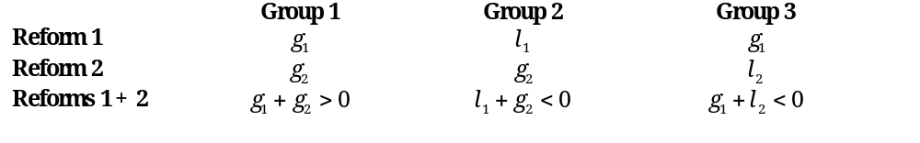



Divide and Rule
Bundling does not always work
  Suppose Big Bang is efficient, but payoffs are:
  Net efficiency gains are positive
  And wlog
  Clearly Big Bang loses majority vote

Slide 26
Divide and Rule
Propose Reform 1 first
  It wins
  Next period reform 2 will win majority
Will group 3 vote for reform in period 1?
  Yes, because they know reform 2 will win next period
  So they are better off supporting reform in period 1
So even though groups 2 and 3 oppose reform, a clever agenda works
  Group 2 would like to commit to oppose reform in period 2, but this is not credible

Slide 27
Compensation
What if losers can be compensated?
  Efficiency gains provide room
  But distortionary taxes
  Asymmetric information problems
    Government does not know who loses
      100 lose 20, 100 lose 50
      Under perfect information cost = 7,000
      Under asymmetric information cost = 10,000
  Commitment
  Credibility problems
    The Tsar’s problem
    Present value of payments paid today

Slide 28
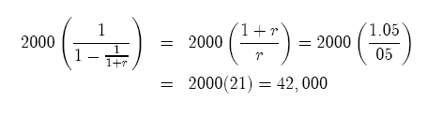
Commitment
Suppose 2000 per year, and r = .05
Then the upfront compensation could be huge

Slide 29
Gradualist Strategy
Costs
  Less efficiency gains today
  Less learning
  Current system may be hemorrhaging
    Asset stripping
Benefits
  Less transfers in PV terms
  Lower reversal costs
  Building constituencies
  Experimenting with reforms

Slide 30
Experimenting
Unbundling allows learning about reforms
What about complementarities?
  Increases the return to unbundling
    If no complementarities you can always reverse one of the reforms
  Implement the riskiest reform first
    Greater option value for the riskier reform
But how much time is there for learning?

Slide 31
Gradualism
But when is it feasible?
Political power to control agenda
  Depends on type of country
    Latin America vs EEFSU
    In LA distributional conflict and market economy
      Favors big bang: few complentarities
    In EEFSU new democracy but no market economy
      Complementarities favor partial reform
Economic crisis

Slide 32
Stabilization
Irony of transition
  Inflationary pressure and fiscal crisis
  Price liberalization means inflationary pressure
Policy mix makes adjustment difficult
  Tight credit
  But more pressure to reform
Lack of external finance
Cannot postpone price liberalization

