Slide 1
NBA Win Rate and Betting Predictions ECE 143 Project Fall 2018 Professor José Unpingco
Jiachen Li
Weixin Li
Jeffrey Yeung
Yidi Zhu

Slide 2
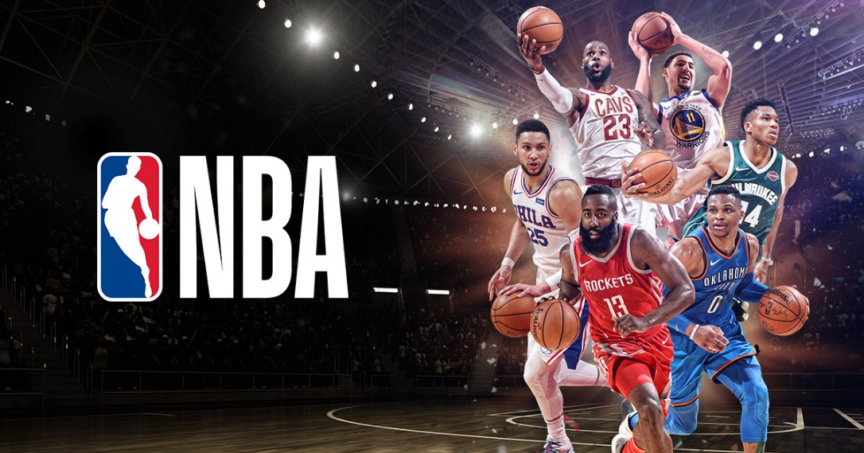
Background
The NBA is one of the most popular sports in the world
Teams with overall better players do not always win
NBA betting is a multibillion dollar industry
Every single NBA match has different betting odds

Slide 3
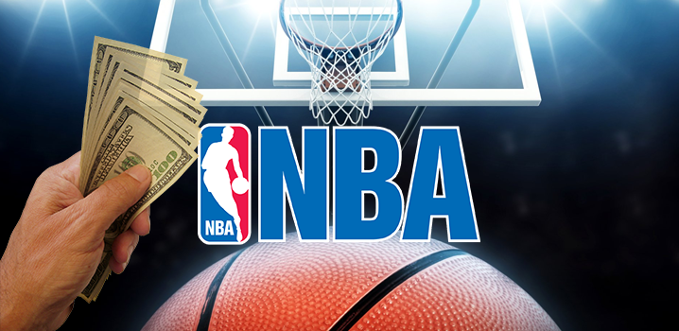
Motivation
Correctly predicting match outcomes provides more information for betting decisions
Betting on the appropriate team improves earnings
Real world application of winning or losing money
Not necessarily optimal to always bet on the better winning team

Slide 4
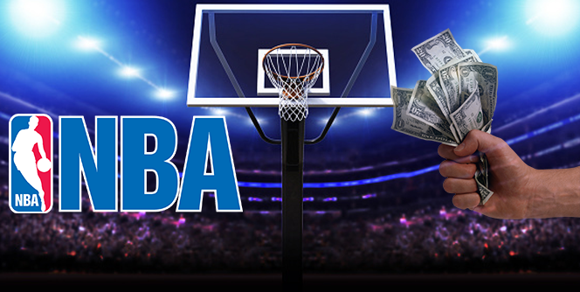
Objective
Our objective is to predict each NBA team’s overall yearly win rate, and predict, for any given match, each team’s likelihood of winning based on the team rosters
We will also calculate the optimal team to bet on for each match based on actual betting odds given by betting sites and our predicted win probabilities

Slide 5
Methodology
Scrape NBA players’ stats, each match’s outcome, and each NBA team’s overall win rate for each of the last 30 years and split
Scrape actual historical betting odds for the last 10 years
Calculate the most impactful advanced player metrics
Predict team’s overall yearly win rate based on each player’s contributions to the team
Calculate each team’s win probability for every match
Recommend the optimal team to bet on win probability and actual betting odds

Slide 6
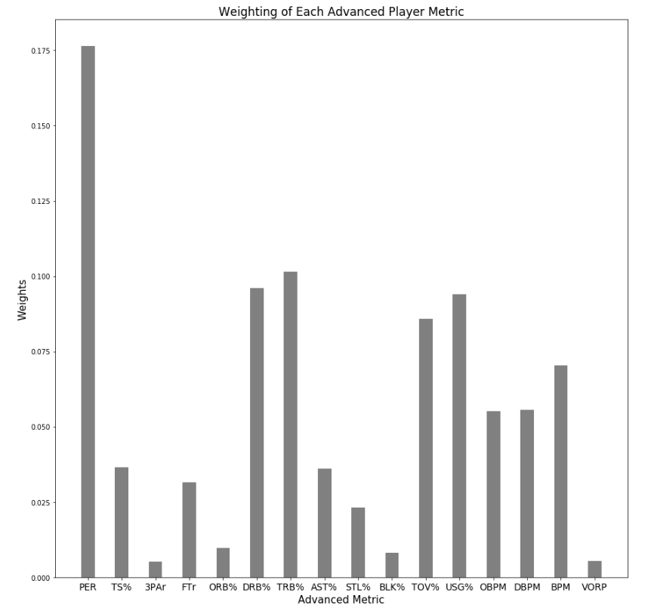
Advanced Player Stats
Most important metrics:
PER (Player Efficiency Rating)
TRB%/DRB% (Total/Defensive Rebounds Percentage)
USG% (Usage Rate)
TOV% (Turnover Rate)
Incorporated all metrics for our model because even the relatively low-weighted stats affect a team’s performance

Slide 7
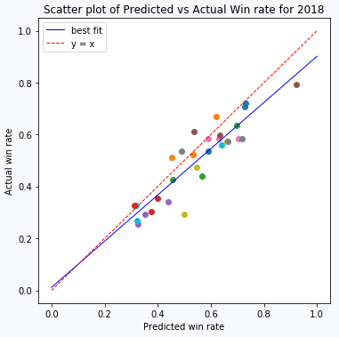
Predicted Teams Win Rates
Each colored dot represents a different team
Compared our predicted win rate for every team to the actual win rate (2018)
Mean squared error 0.1893

Slide 8
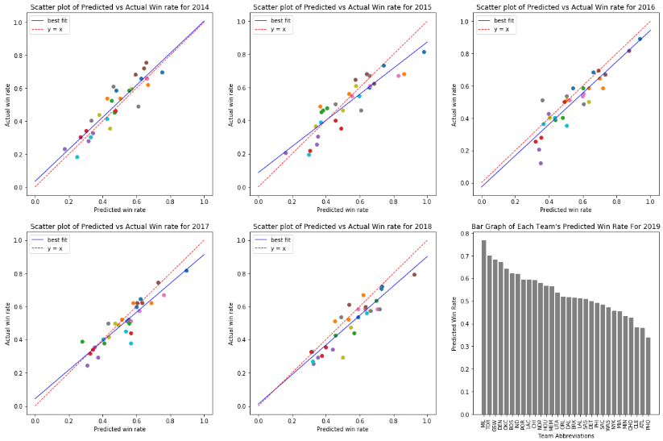
Predicted Teams Win Rates

Slide 9
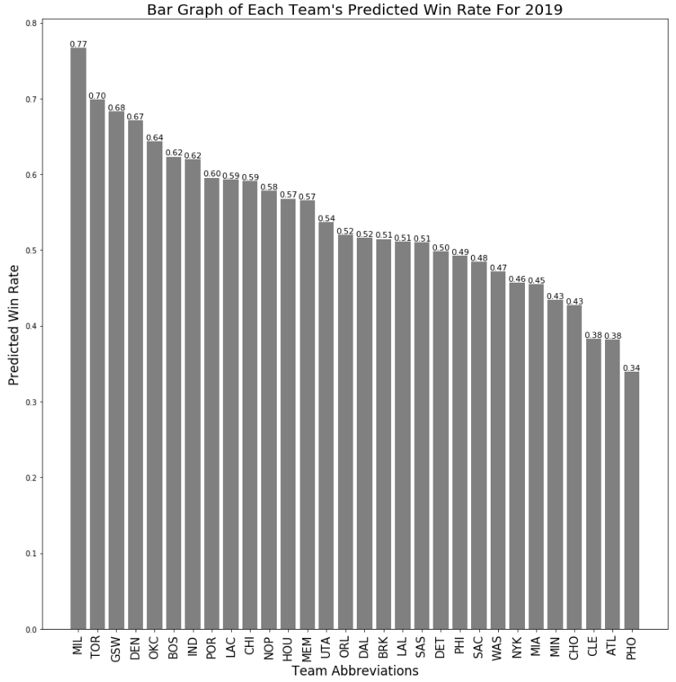
Predicted 2019 Win Rates
Overall reasonable predictions based on how well these teams usually perform
MIL had a strong season start despite being historically average
GSW has many key players injured

Slide 10
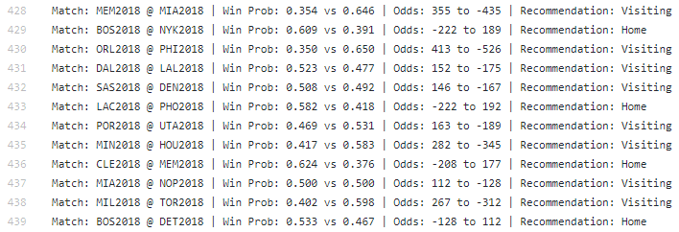
Betting Recommendations
For every match in a year, we recommend the optimal team to bet on based on their predicted win rates and the actual betting odds
We can see that although in general it is better to bet on the predicted winning team, sometimes it is optimal to bet on the predicted losing team if the odds are skewed

Slide 11
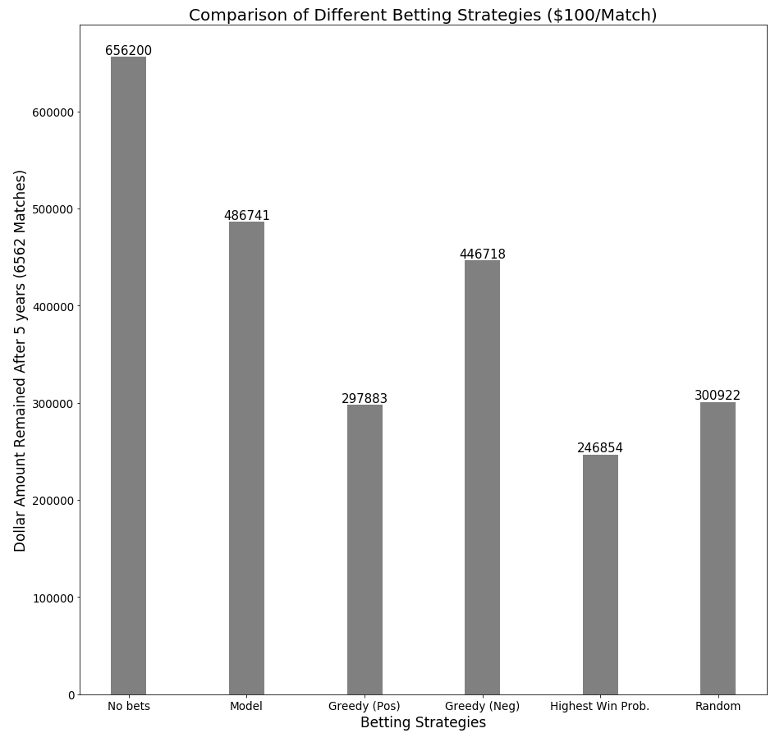
Recommendation Evaluation
5 Methods:
Our model
Greedy (Choose most positive)
Greedy (Choose most negative)
Highest Win % (Choose predicted winner)
Random selection
Baseline $656200
Amount remaining if zero bets are made in last 5 years)

Slide 12
Thank you for listening Questions?

