Slide 1

NBA Win Rate and Betting Predictions ECE 143 Project Fall 2018 Professor José Unpingco
Names here

Slide 2

Background
The NBA is one of the most popular sports in the world
Teams with overall better players do not always win
NBA betting is a multibillion dollar industry
Every single NBA match has different betting odds

Slide 3

Motivation
Correctly predicting match outcomes improves earnings
Betting appropriate amounts based on betting odds also improves earnings
Not necessarily optimal to always bet on the predicted winning team

Slide 4
Objective
Our objective is to calculate each NBA team’s overall win rate for each year, and predict, for any given match, each team’s likelihood of winning based on the team rosters
We will also calculate betting odds based on the above likelihood and compare with the betting odds given by actual betting sites to determine the better team to bet

Slide 5
Methodology
Scrape NBA players’ statistics, each match’s outcome, and each NBA team’s overall win rate for each of the last 30 years
Scrape historical betting odds for the last 10 years
Calculate the most impactful advanced player metric
Predict team’s overall yearly win rate based on players’ contributions
Predict each team’s win probability for every match in a given year
Calculate betting odds and compare with actual betting odds to recommend the optimal team to bet on

Slide 6
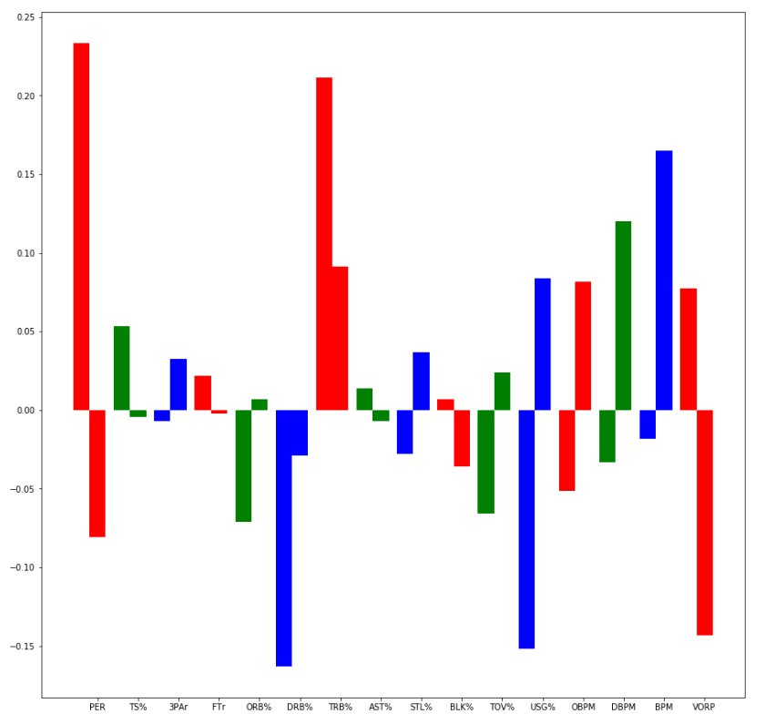
Advanced Player Stats
Highest weighted: PER (Player Efficiency Rating), TRB% (Total Rebounds %)
2 graphs?

Slide 7
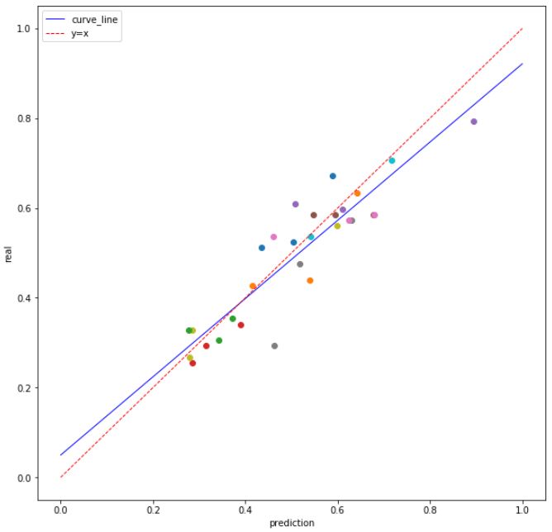
Predicted Teams Win Rates

