Slide 1

Asynchronous Ignition

Slide 2
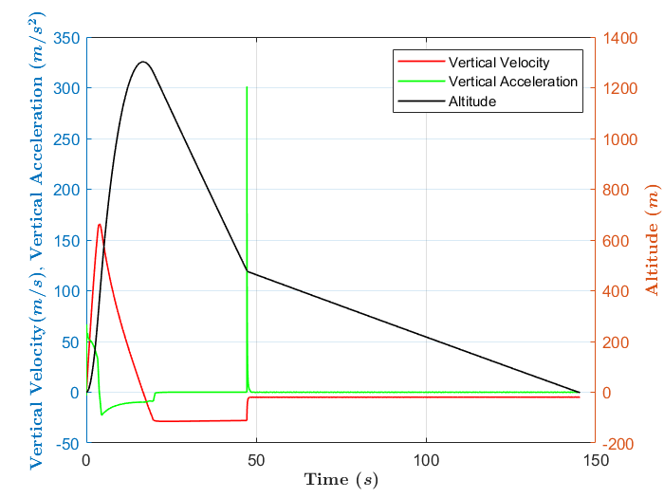
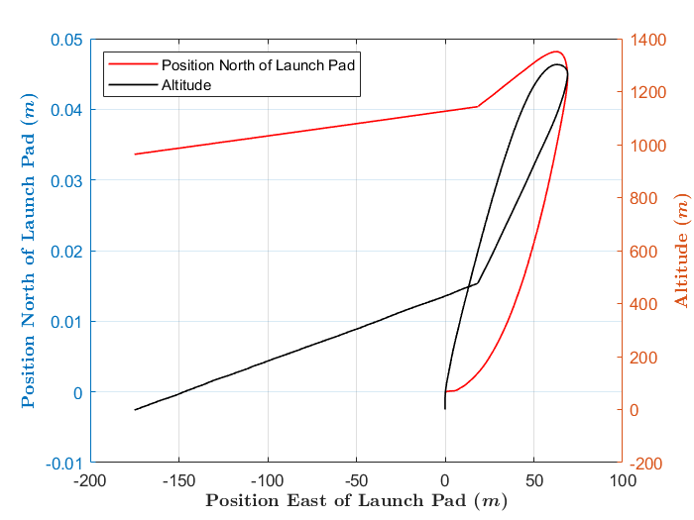
Main Engine Running Only

Slide 3
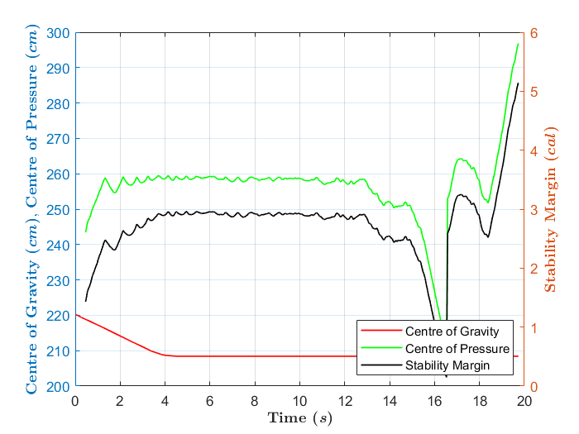
Main Engine Running Only

Slide 4
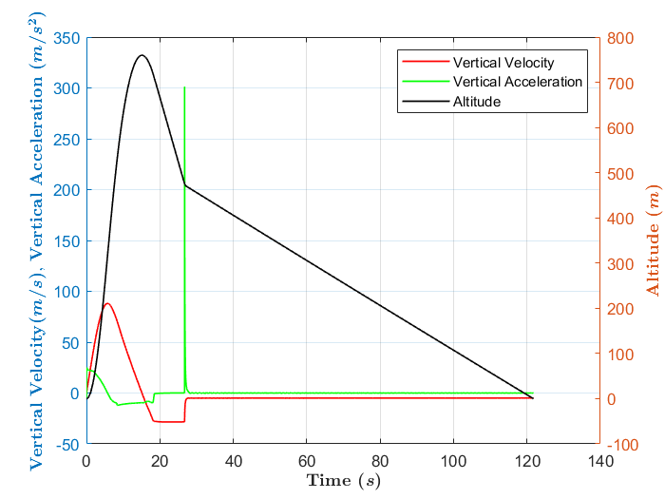
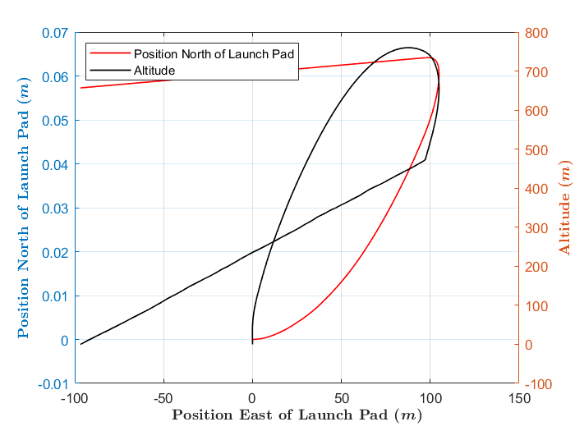
Both Boosters Running Only

Slide 5
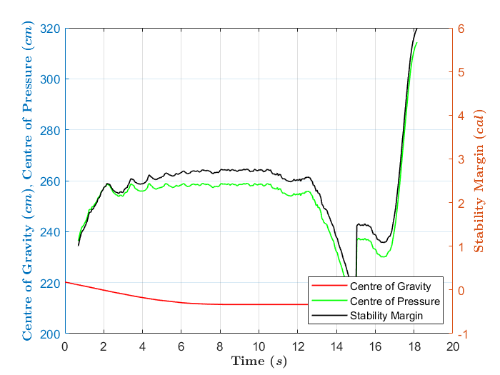
Both Boosters Running Only

Slide 6
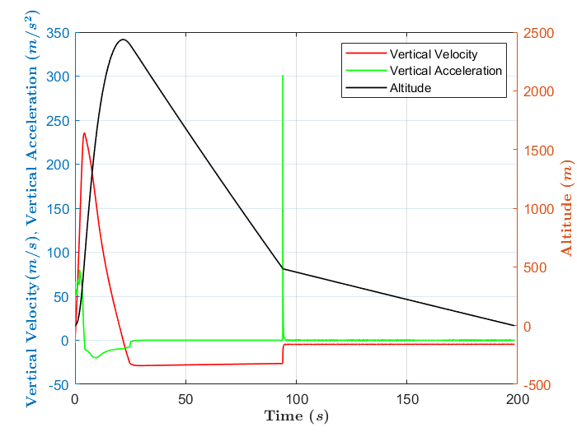
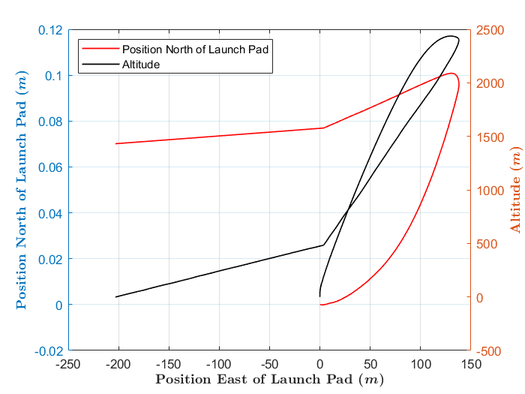
1 s delay on booster one 2 s delay on booster two
No delay on main engine

Slide 7
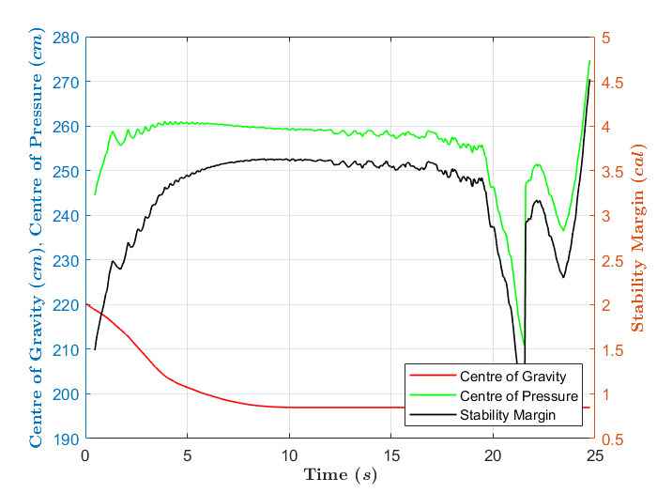
1 s delay on booster one 2 s delay on booster two
No delay on main engine

